Slide 1
Lesson 26
Hypocrites
Matthew 23
But they refused to hearken, and pulled away the shoulder, and stopped their ears, that they should not hear.
Therefore it is come to pass, that as he cried, and they would not hear; so they cried, and I would not hear, saith the Lord of hosts:
Zechariah 7:11, 13

Slide 2
Are those with the largest scriptures the most righteous?
Can we determine others’ righteousness by their outward appearance?
Hypocrisy
The word generally denotes one who pretends to be religious when he is not”.
It could also refer to someone who pretends not to be religious when he or she really is.

Slide 3
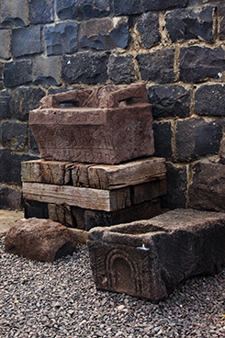
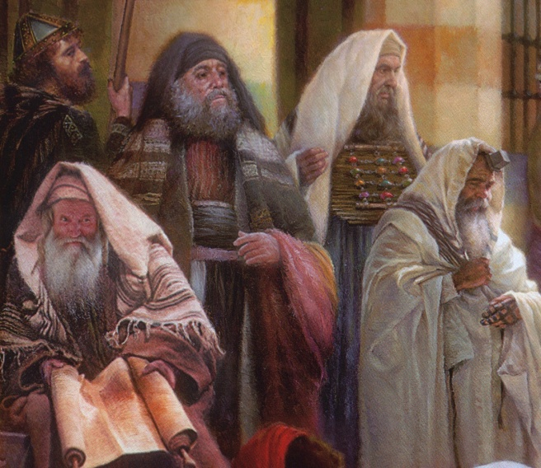
Moses Seat
This stone seat was found in the excavation of a synagogue at Chorazin, and similar stone seats have been discovered in other ancient synagogues. They may have been used by scribes and other teachers of the law of Moses.
To sit in someone’s seat meant to succeed that person, to serve in his place. As teachers of the law, the scribes were the successors of Moses. (1)
"[The traditions of the Pharisees] provided for every possible and impossible case [scenario], entered into every detail of private, family, and public life; and with iron logic, unbending rigour, and most minute analysis pursued and dominated man, turn whither he might, laying on him a yoke which was truly unbearable." (2)
Matthew 23:2-3

Slide 4
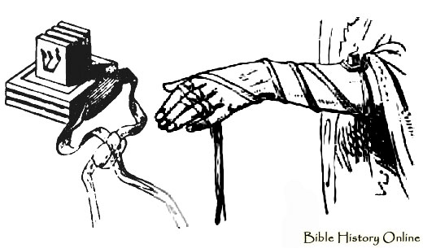
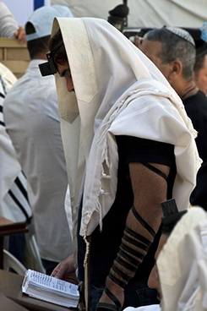
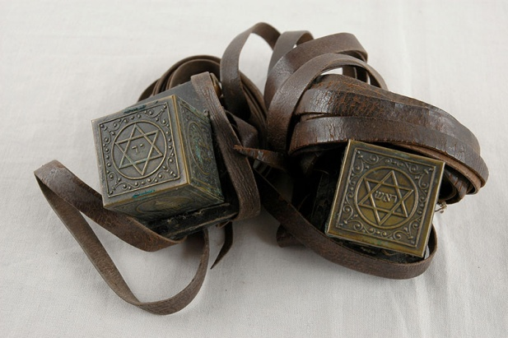
Phylacteries--also called tefillin
It was customary for the Jews to wear phylacteries, which were small leather boxes strapped onto the forehead and arm. Inside the phylacteries were small rolls of parchment that contained excerpts from the Hebrew scriptures. The Jews wore phylacteries to help them remember to follow God’s commandments.
Modern phylacteries around forearm and forehead by James Jeffrey
The Lord did not condemn those who wore phylacteries, but He did condemn those who used them hypocritically or enlarged them to cause others to notice them or to appear more important.
Deuteronomy 6:4–9; 11:13–21; Exodus 13:5–10, 14–16)

Slide 5
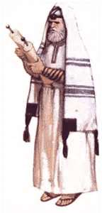
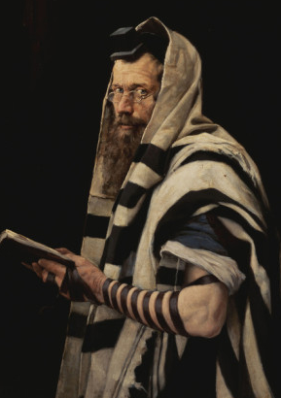
Pretending To Be Righteous
Zechariah 7 records that the Lord condemned the people of Jerusalem in Zechariah’s day for pretending to be righteous by fasting and doing other outward ordinances without being kind, fair, or charitable to others.
The Savior also warned His disciples not to follow the example of the scribes, who wore “long robes” to draw attention to themselves.
Most Jews wore phylacteries only at prayer time, but the Pharisees sometimes displayed them throughout the day. The Pharisees also made “broad their phylacteries,” or wore enlarged boxes, thus drawing attention to their supposed piety. (1)
We can choose to obey God’s laws even if we see others acting hypocritically
Matthew 23:1-7

Slide 6
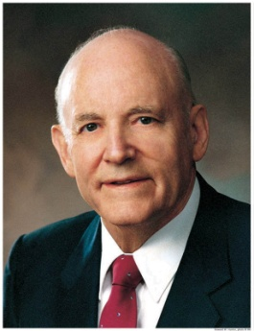
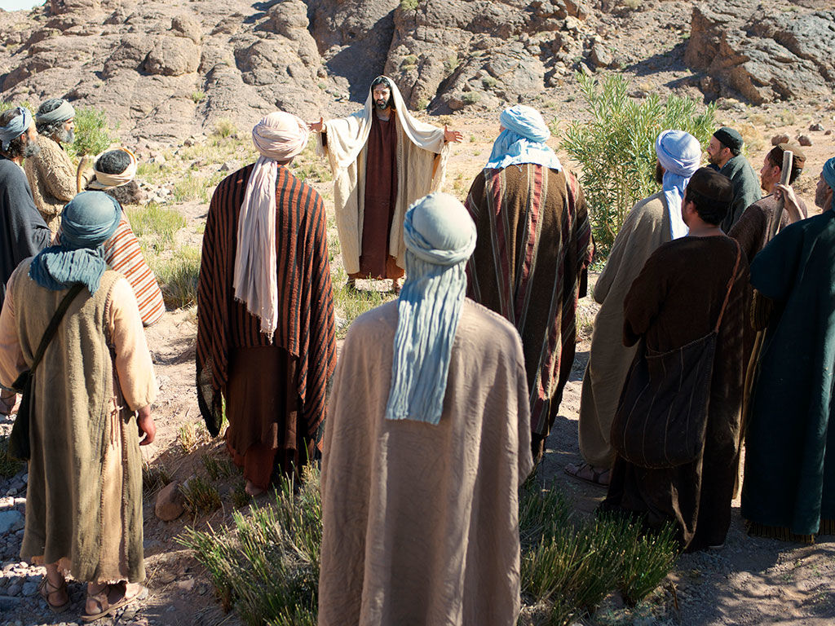
Equal in His Sight
The Savior taught the people not to consider themselves better than others, because they were all God’s children, equal in His sight.
“It is important to be appreciated.
But our focus should be on righteousness, not recognition; on service, not status.
The faithful visiting teacher, who quietly goes about her work month after month, is just as important to the work of the Lord as those who occupy what some see as more prominent positions in the Church.
Visibility does not equate to value.” (3)
Matthew 23:5-6, 11-12

Slide 7
Woe, Woe, Woe
Matthew 23:13
Matthew 23:16-22
Matthew 23:14
Matthew 23:15
Through their oaths, they gave more reverence to the gold and furnishings of the temple than to the Lord, whom the temple honors.
They not only rejected Christ, His Church, and His offer of salvation, but they also sought to prevent others from accepting Christ and salvation.
They were greedy and materialistic, and they preyed upon the misfortunes of others.
They were recruiting souls to false beliefs.
Matthew 23:25-28
Matthew 23:23
Matthew 23:29-30
They hid internal greed and self-indulgence beneath an exterior show of righteousness. They looked clean and good on the outside, but on the inside they were full of corruption and spiritual decay.
They obeyed rules but ignored the more important doctrines and principles the rules were based on.
They rejected living prophets while claiming allegiance to dead prophets.

Slide 8
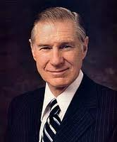
Weightier Matters of the Law
Judgment, mercy, and faith
“The Ten Commandments are still a vital thread in the fabric of the gospel of Christ, but with His coming came new light and life which brings a fuller measure of joy and happiness.
Jesus introduced a higher and more difficult standard of human conduct.
It is simpler as well as more difficult because it focuses on internal rather than external requirements:
Do unto others as you would have them do unto you. Love your neighbor as yourself. When smitten, turn the other cheek. When asked for a coat, give your cloak also. Forgive, not just once but seventy times seven.
This was the essence of the new gospel. There was more emphasis on do than do not. More moral agency was given to each of us.” (4)
As we strive to become spiritually clean on the inside, it will be reflected in our outward choices
Matthew 23:23-24

Slide 9
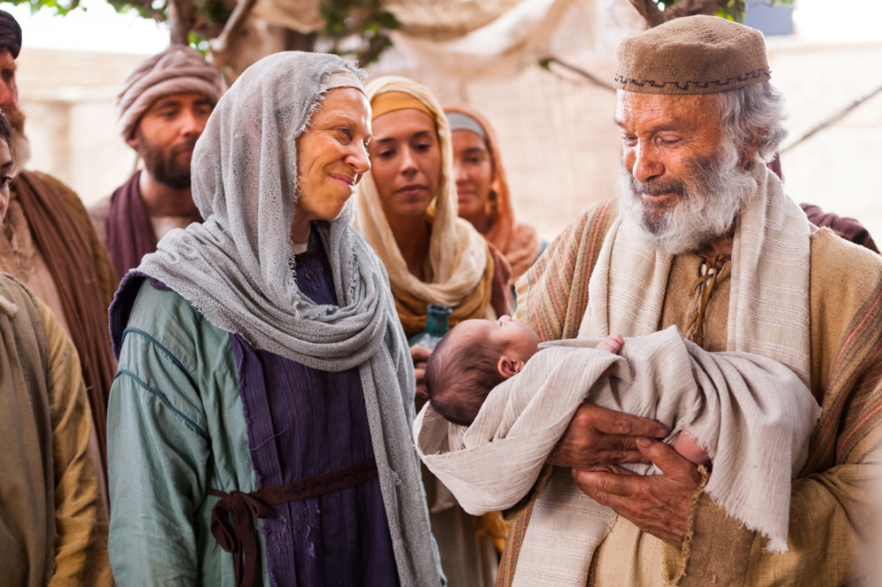
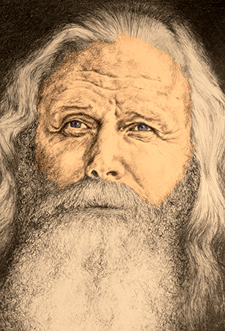
Zacharias Son of Barachias
Father of John the Baptist
“When Herod’s edict went forth to destroy the young children, John was about six months older than Jesus, and came under this hellish edict, and Zacharias caused his mother to take him into the mountains, where he was raised on locusts and wild honey.
When his father refused to disclose his hiding place, and being the officiating high priest at the Temple that year, [he] was slain by Herod’s order, between the porch and the altar, as Jesus said” (6)
Matthew 23:35

Slide 10
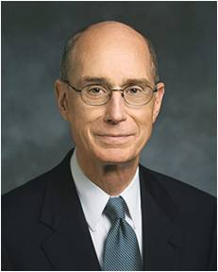
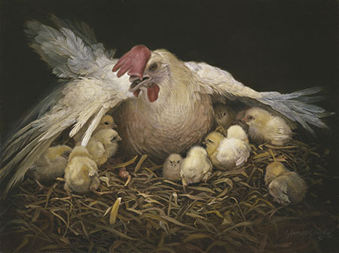
Gathered By The Savior
Why do hens gather their chicks under their wings?
“More than once [the Savior] has said that He would gather us to Him as a hen would gather her chickens under her wings. He says that we must choose to come to Him. …
“One way to do that is to gather with the Saints in His Church. Go to your meetings, even when it seems hard. If you are determined, He will help you find the strength to do it.” (7)
To protect them from danger. Point out that a hen would sacrifice her life to protect her chicks.
If we are willing to be gathered by the Savior, then we will receive His care and protection
Matthew 23:37-39

Slide 11
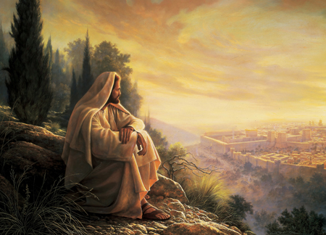
Oh, Jerusalem-- The Holy City
“Jerusalem—city of depravity, ‘which spiritually is called Sodom and Egypt’! (Rev. 11:8.)
“Jerusalem—doomed spiritually and soon to be desolated temporally. (Luke 19:41–44.)
“Jerusalem—site of the temple; home of the prophets; city of our Lord’s ministry.
“Jerusalem—city where the Son of God was crucified, crucified by ‘the more wicked part of the world,’ for ‘there is none other nation on earth that would crucify their God.’ (2 Ne. 10:3.)
“Jerusalem—future world capital and center from which ‘the word of the Lord’ shall go unto all people. (Isa. 2:3.)
Greg K. Olsen
“Truly Jerusalem’s history is like that of no other place; and truly Jesus with cause, wept because of the rebellion of her children”
Matthew 23:37-39
(5)

Slide 12
Sources:
Suggested Hymn: #132 God Is in His Holy Temple
New Testament Institute Student Manual Chapter 7
Edersheim, Jesus the Messiah, p. 69
President Howard W. Hunter (“To the Women of the Church,” Ensign, Nov. 1992, 96–97).
James E. Faust (“The Weightier Matters of the Law: Judgment, Mercy, and Faith,” Ensign, Nov. 1997, 53).
Elder Bruce R. McConkie (Doctrinal New Testament Commentary, 1:626).
Joseph Smith (“Persecution of the Prophets,” Times and Seasons, Sept. 1, 1842, 902).
President Henry B. Eyring (“In the Strength of the Lord,” Ensign or Liahona, May 2004, 18).
Presentation by ©http://fashionsbylynda.com/blog/

Slide 13
Event | Matthew | Mark | Luke | John
Jesus’ Warning; Against Scribes and Pharisees | 23:1-39 | 12:38-40 | 20:45-47
Phylacteries Matthew 23:1-7
"Through a traditional interpretation of Ex. 13:9 and Deut. 6:8, the Hebrews adopted the custom of wearing phylacteries, which consisted essentially of strips of parchment on which were inscribed in whole or in part the following texts: Ex. 13:2-10 and 11-17; Deut. 6:4-9, and 11:13-21. Phylacteries were worn on the head and arm. The parchment strips for the head were four, on each of which one of the texts cited above was written. These were placed in a cubical box of leather measuring from 1/2 inch to 1 1/2 inches along the edge; the box was divided into four compartments and one of the little parchment rolls was placed in each. Thongs held the box in place on the forehead between the eyes of the wearer. The arm phylactery comprised but a single roll of parchment on which the four prescribed texts were written; this was placed in a little box which was bound by thongs to the inside of the left arm so as to be brought close to the heart when the hands were placed together in the attitude of devotion. The Pharisees wore the arm phylactery above the elbow, while their rivals, the Sadducees, fastened it to the palm of the hand (see Ex. 13:9). The common people wore phylacteries only at prayer time; but the Pharisees were said to display them throughout the day. Our Lord's reference to the Pharisees' custom of making broad their phylacteries had reference to the enlarging of the containing box, particularly the frontlet. The size of the parchment strips was fixed by rigid rule.
"The Lord had required of Israel through Moses (Num. 15:38) that the people attach to the border of their garment a fringe with a ribbon of blue. In ostentatious display of assumed piety, the scribes and Pharisees delighted to wear enlarged borders to attract public attention. It was another manifestation of hypocritical sanctimoniousness." James E. Talmage (Jesus the Christ, 526.)
Weightier Matters Matthew 23:23-24
“weightier matters of the law,” he told them they were “blind guides, which strain at a gnat, and swallow a camel”.
This was a reference to the practice of some Jewish leaders who carefully strained their drinking water to avoid mistakenly swallowing the smallest of unclean animals. Yet they would symbolically swallow a camel—the largest of unclean animals Leviticus 11:4 (1)
The Pharisaic Jews who prided themselves in their knowledge of law and tradition were fervent in their rejection of Jesus.
What did he mean, they wondered, when he said he had tried to gather the children of Israel in the past? They didn’t understand that the God at Sinai, the Holy One of Israel, was Jesus Christ, that observance of the law of Moses was to prepare them and point them to Christ. (See Matt. 5:17–18; John 5:46–47.) They were expecting a mighty king-Messiah to come and release them from political bondage under the Romans; not understanding the freedom the Lord offered, they rejected him as the true Messiah.
Judah through the Centuries
By Ann N. Madsen and Barnard N. Madsen January 1982 Ensign
Two Kinds of Hypocrisy: Matthew 23:1-7
“Harry Emerson Fosdick observed that there are two kinds of hypocrisy: when we try to appear better than we are, and when we let ourselves appear worse than we are. We have been speaking of the kind of hypocrisy where people pretend to be more or better than they are. Too often, however, we see members of the Church who in their hearts know and believe, but through fear of public opinion fail to stand up and be counted. This kind of hypocrisy is as serious as the other” President N. Eldon Tanner (“Woe unto You … Hypocrites,” Improvement Era, Dec. 1970, 33).

Slide 14
Several similarities still exist between the modern families of Judah and Joseph:
1. Conversion: A new convert is adopted into the house of Israel by immersion and receives a new name after conversion. Jews receive a Hebrew name; Latter-day Saints take upon themselves the name of Jesus Christ.
2. Covenant people: We claim to be a renewal of the covenant made with Abraham—the “new and everlasting covenant.”
3. Heritage of persecution: We have both been mobbed, hated, and persecuted.
4. Family worship: Sabbath services held Friday evenings in Jewish families for two thousand years can be seen as similar to the LDS family home evening.
5. Dietary laws: Kosher, Word of Wisdom.
6. Emphasis on doing: Observant Jew, active Latter-day Saint.
7. First-last, last-first: “Wherefore they both shall be established in one; for there is one God and one Shepherd over all the earth.
Judah through the Centuries
By Ann N. Madsen and Barnard N. Madsen January 1982 Ensign

Slide 15
Come Unto Christ Liberty
Depths of Humility
Seek help from God
Blessings
Prosperity
Humility Cycle
Misery/Endless Wo
We come to ourselves
Selfishness
Self-Indulgence
Become “Lifted Up”
Inequality
Class divisions
Hatred
War
Pride Cycle
Persecution of Others
Seek Control over others
Use others
Insensitivity
Past Feeling
Personal Apostasy
Sin and Bondage

Slide 16
Come Unto Christ Liberty
Depths of Humility
Seek help from God
Blessings
Prosperity
Humility Cycle
Misery/Endless Wo
We come to ourselves
Selfishness
Self-Indulgence
Become “Lifted Up”
Inequality
Class divisions
Hatred
War
Pride Cycle
Persecution of Others
Seek Control over others
Use others
Insensitivity
Past Feeling
Personal Apostasy
Sin and Bondage

