Slide 1
Lesson 28
Parable of the 10 Virgins
Matthew 25:1-13

Slide 2
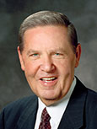
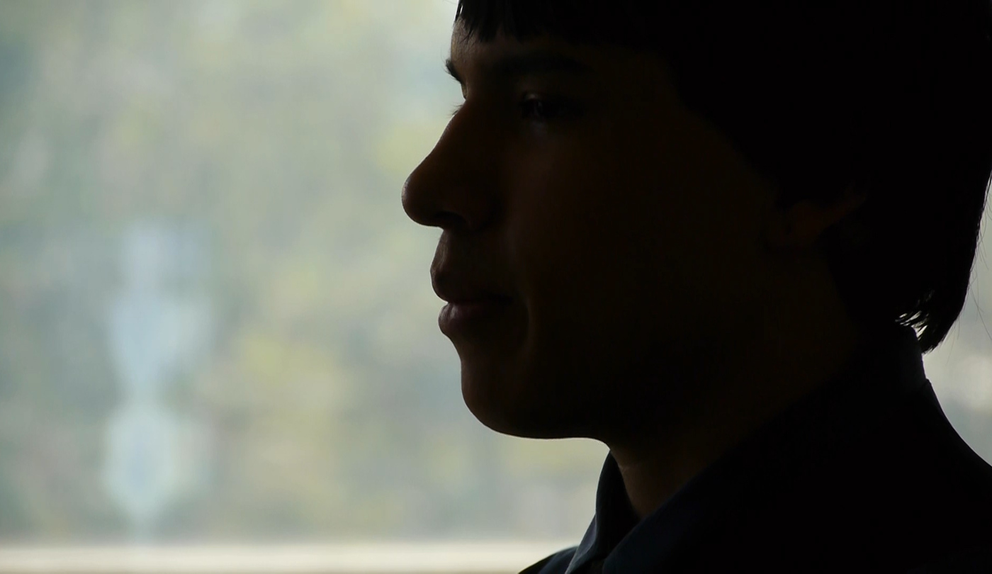
“He … told of coming home from a date shortly after he had been ordained an elder at age 18.
Something had happened on this date of which he was not proud.
He did not go into any details, nor should he have done so in a public setting.
To this day I do not know the nature of the incident,
but it was significant enough to him to have
affected his spirit and his self-esteem.
(1)

Slide 3
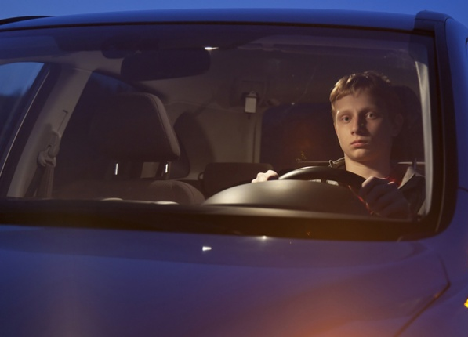
“As he sat in his car for a while in the driveway of his own home, thinking things through and feeling genuine sorrow for whatever had happened, his nonmember mother came running frantically from the house straight to his car.
“In an instant she conveyed that this boy’s younger brother had just fallen in the home, had hit his head sharply and was having some kind of seizure or convulsion.
The nonmember father had immediately called for an ambulance, but it would take some time at best for help to come.
(1)

Slide 4
“‘Come and do something,’ she cried. ‘Isn’t there something you do in your Church at times like this?
You have their priesthood. Come and do something.’ …
“… On this night when someone he loved dearly needed his faith and his strength, this young man could not respond.
Given the feelings he had just been wrestling with and the compromise he felt he had just made—whatever that was—he could not bring himself to go before the Lord and ask for the blessing that was needed.”
Is it important to always be prepared?
(1)

Slide 5
The Bridegroom Cometh
Parable of the 10 Virgins
Matthew 25:1
vb

Slide 6
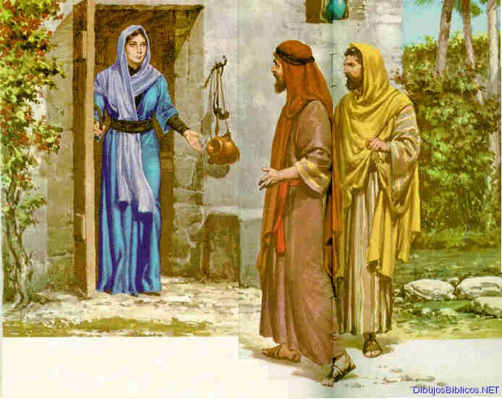
Anxiously Waiting---to hear the shouts of the wedding procession.
Father of bridegroom gives permission and the
“friend of the bridegroom” keeps her informed of progress.
Matthew 25: 1
(3)

Slide 7
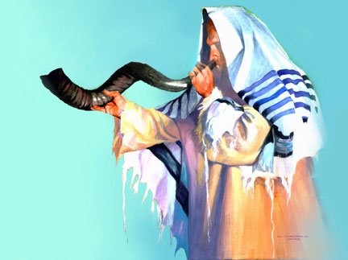
2 Invitations
The First Invitation or calling of the wedding was sent out at the time of the betrothal
Matthew 25: 1
(3)
(3)

Slide 8
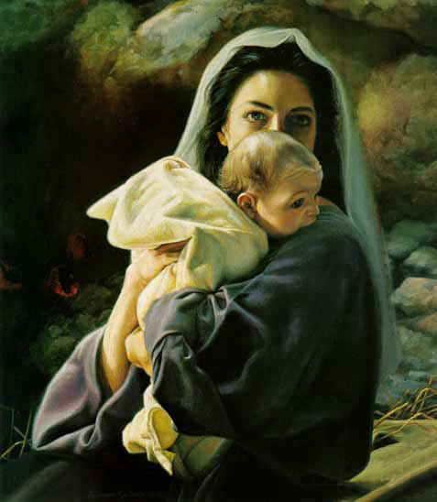
Establishing the “Call” to God’s Children
Jesus comes to earth to set up his kingdom.
Matthew 25: 1
(3)

Slide 9
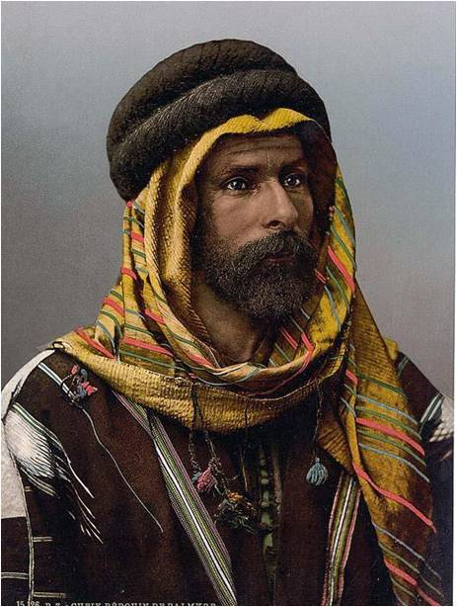
The Second announcement comes when the Bridegroom comes.
Matthew 25: 1
(3)

Slide 10
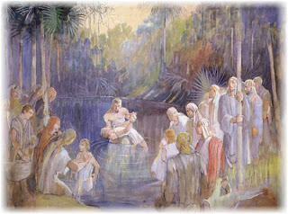
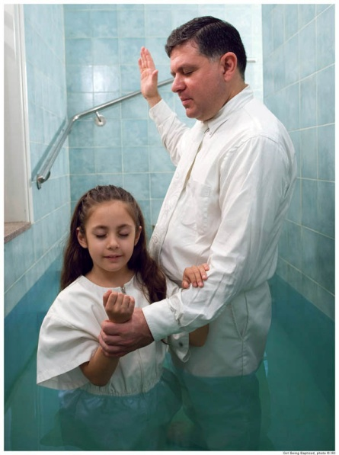
Hearing the “Call”
Showing that he had been invited
Matthew 25: 1
(3)

Slide 11
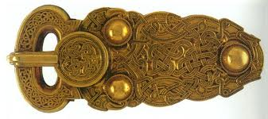
Moving the Buckle
“No citizen of Jerusalem would attend a
banquet without changing his buckle from
(one shoulder to the other shoulder.)
For what reason?
So that another person should not extend to him an invitation that would be wasted.
(6)

Slide 12
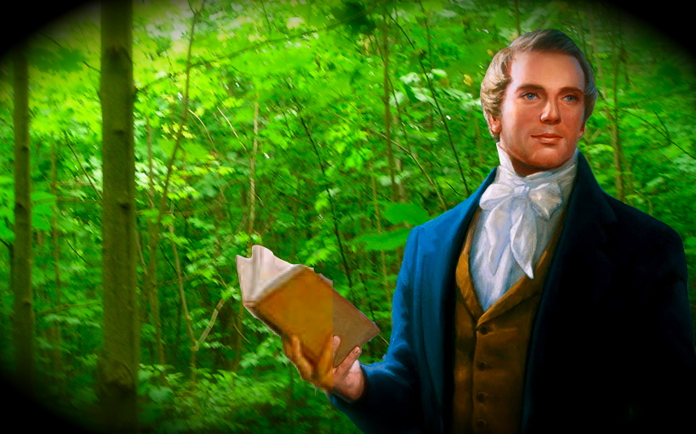
The Second Announcement came with the Restoration which is in effect today.
Matthew 25: 1
(3)

Slide 13
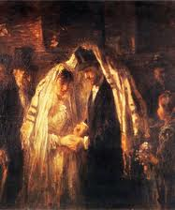
Bridegroom Dress:
Richest garments.
Sometimes wearing a crown.
Even though the Bride would be beautifully adorned, the groom would be the center of attention.
Matthew 25: 1
(3)

Slide 14
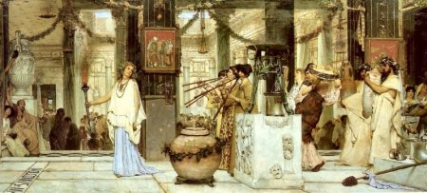
Going to the Bride’s home
Others shout followed by the groom
Matthew 25: 1
(3)

Slide 15
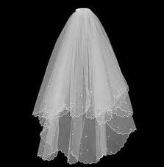
The Right Bride
The bride’s father would check to make sure this was the right young man and would let him take the bride.
The groom was able to check under the veil to make sure it was the right bride.
(mix up Jacob and Rachel)
Matthew 25: 1
(3)

Slide 16
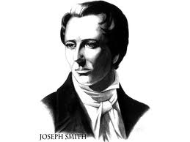
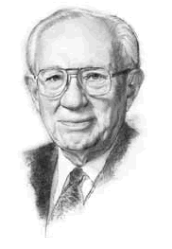
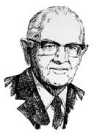
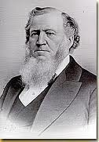
A Prophet is the one who makes the announcements for final preparations.
Read Family Proclamation for our final preparations.
Matthew 25: 1
(3)

Slide 17
One half hour of silence in the heavens before the Savior comes. (Revelation 8:1)
The Lord will come again in a dark “midnight” hour…
Matthew 24:22
(3)

Slide 18
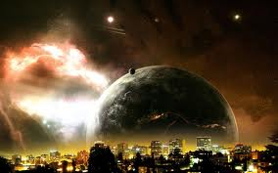
When the world is ripe in iniquity…
“And except those days should be shortened, there should no flesh be saved; but for the elect’s sake those days shall be shortened.”
Matthew 24:22
(3)

Slide 19
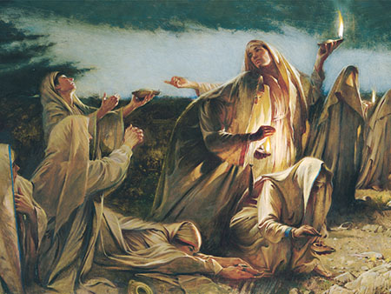
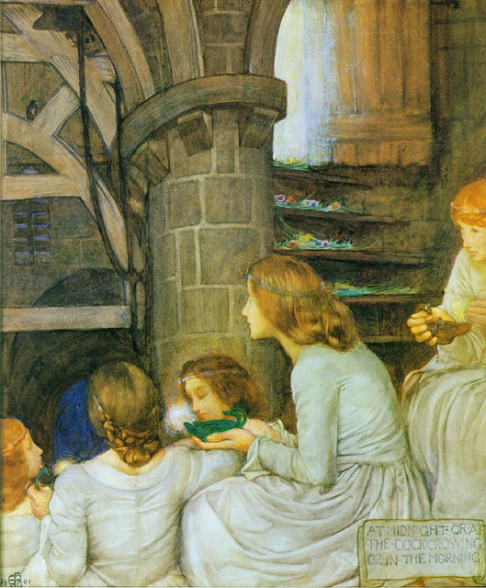
Is the Bride Ready?
“Not good and bad, not righteous and wicked, but wise and foolish.
That is, all of them have accepted the invitation to meet the Bridegroom, all are members of the Church…but only five are valiant therein.”
(5)

Slide 20
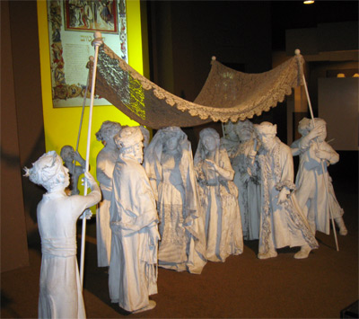
Are We Ready?
They all thought they were ready.
Outwardly , they all appeared prepared.
Matthew 25: 1
(4)

Slide 21
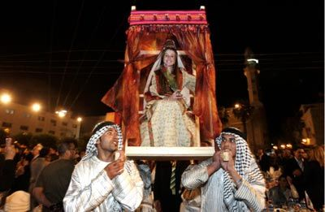
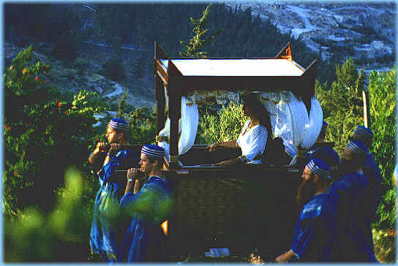
“Lifting up” the bride
“aperion”
Carried to her new house
4 strong honorary men “heroes of Israel” carry chair
Matthew 25: 1
(3)

Slide 22
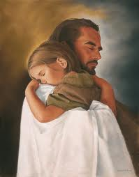
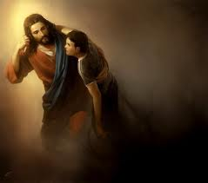
Christ was lifted up on the cross so that he could lift us through the ordinances of the Gospel as administered by the Priesthood. We are carried in comfort because we bear the name of our Lord.

Slide 23
The Marriage Supper
Parable of the 10 Virgins
Matthew 25:1-13

Slide 24
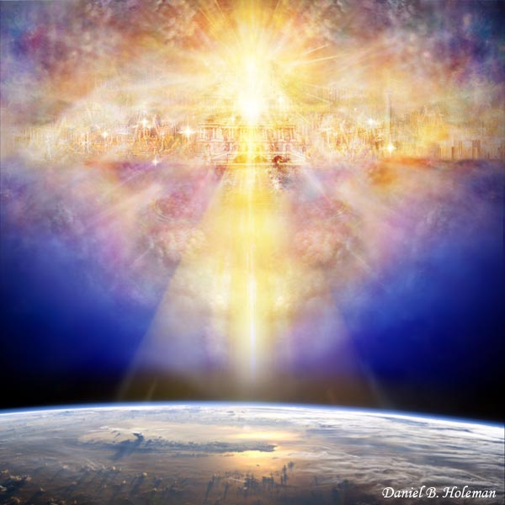
The marriage feast---The Second Coming of the Savior to receive his Church unto Himself.
(3)

Slide 25
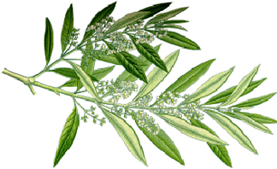
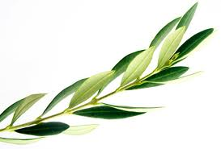
At the newly prepared home the bride and groom are crowned with garlands of olive leaves---symbol of great joy.
(3)

Slide 26
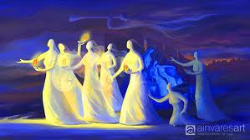
10 Virgins
The Number 10 symbolizes:
Long standing tradition---testing and trials.
Meaning:
Worthiness, consecration, and holiness
Matthew 25:2-4
(3)

Slide 27
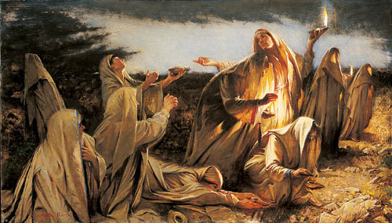
The 10 Virgins represent the Church, they are symbolic of the actual brides…not bridesmaids or guests
Matthew 25:2-4
(3)

Slide 28
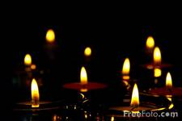
10 was the minimum number of lamps that were required at a wedding while the traditional blessings were recited.
Matthew 25:2-4
(3)

Slide 29
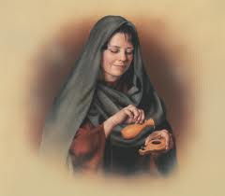
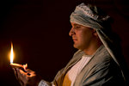
It was a religious duty to bring a light when attending a wedding.
(3)

Slide 30
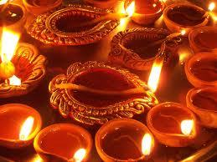
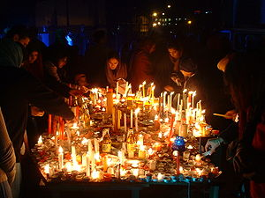
During the weeklong celebration the father’s
house was continually lit.
(3)

Slide 31
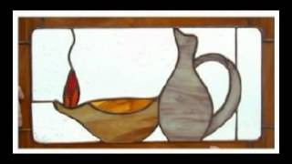
Visitors usually bought oil in the town
where the wedding was to take place. Some
people brought their own with them.
Since the wedding was a surprise and at
night everyone knew they had to have
stores of oil on hand.
(3)

Slide 32
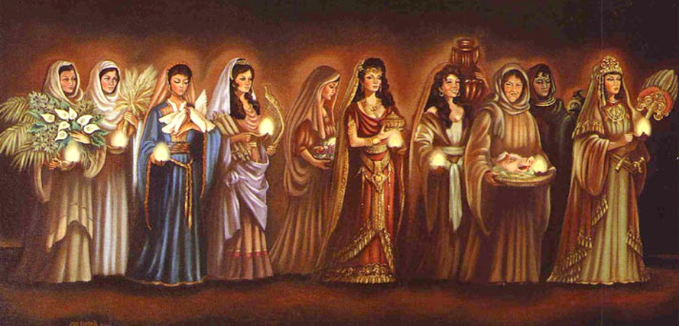
Level of obedience with all ten:
All 10 had lamps with oil in them.
All 10 took lamps with them.
All 10 were invited to the wedding.
(they were all His brides)
All 10 slept, or slumbered woke up, and went to the wedding.
Matthew 25:2-4
(3)

Slide 33
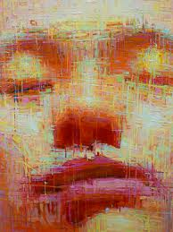
Greek---not all the brides slept
Slumbered---means to nod in signaling or beckoning for what one desires to be done.
Matthew 25:5
(3)

Slide 34
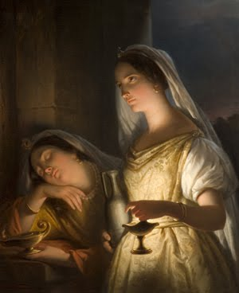
Slumbering--- 5 wise virgins are beckoning for Jesus to return
5 foolish virgins have fallen asleep.
Matthew 25:5
(3)

Slide 35
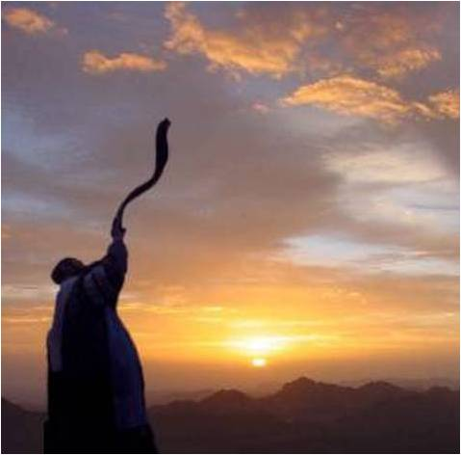
Noisy Procession:
Gathering people as they go
Blowing trumpets (shofars)
Most always in the middle of
the night waking everyone on
their way carrying torches to
light their way
Matthew 25:6
(3)

Slide 36
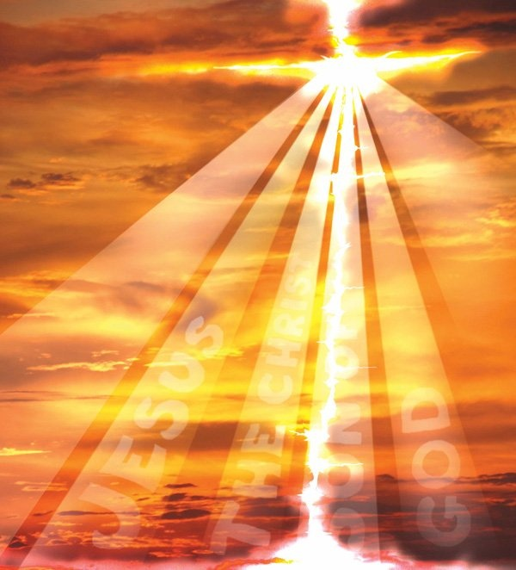
Companions of the Savior are those with
light who can see their way and are calling
out to gather others to Come unto Christ.
(3)

Slide 37
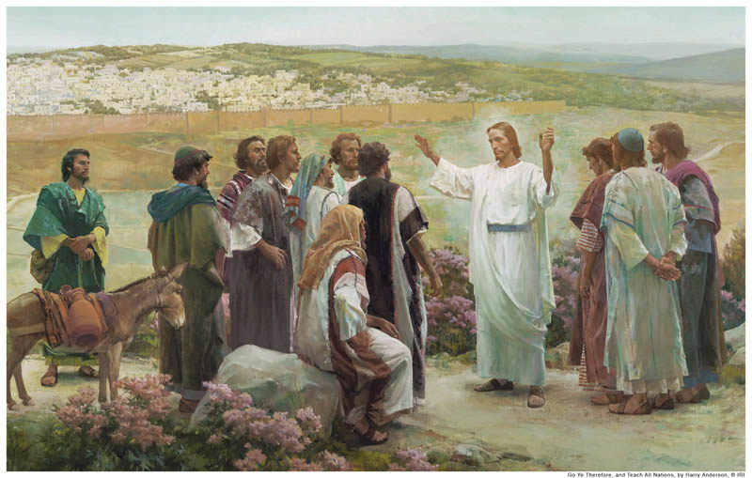
Messenger
“The Bridegroom Cometh”
30 minutes final preparations for the Bride.
Matthew 25:6
(3)

Slide 38
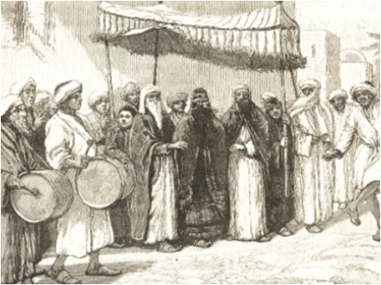
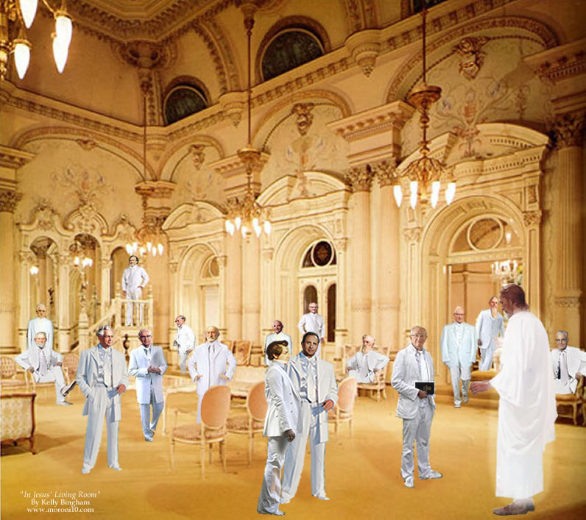
Then they would call out again:
“The Bridegroom cometh!”
The phrase “trimmed their lamps” = that the virgins cut the wicks of their lamps in a way that would allow for a bright flame.
Matthew 25:6-7
(3)

Slide 39
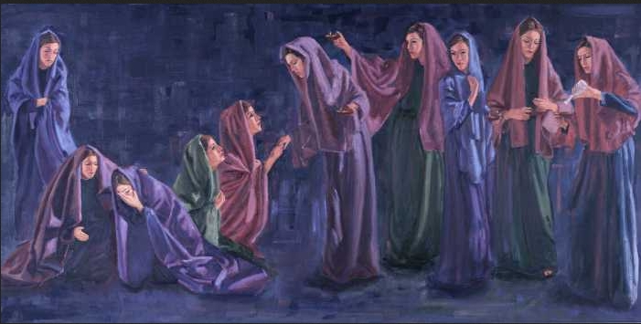
5 foolish virgins knocked, expecting to enter the marriage supper:
They thought they could prepare themselves after the Bridegroom came
Or knowing that they at first had not been prepared to enter, they were hoping for mercy.
Matthew 25:7
(3)

Slide 40
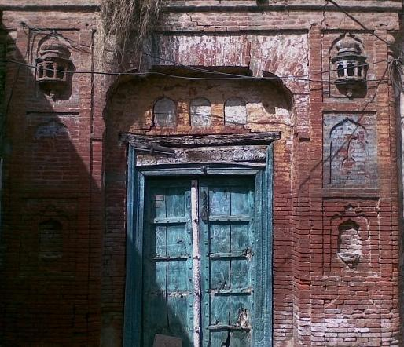
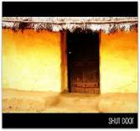
Either way the door was shut
Matthew 25:10
(3)
(3)

Slide 41
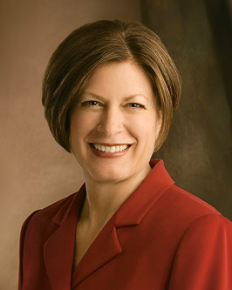
“Learning to recognize and follow the promptings of the Holy Ghost is the most important work we can do personally.” (7)

Slide 42
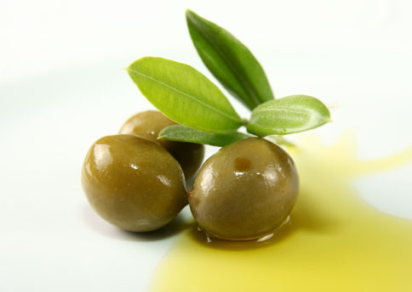
Oil
Olive oil is a symbol of purity and the presence and influence of the Holy Ghost.
(3)

Slide 43
In biblical times
adequate amount of oil was maintained in lamps
Today—we must exert constant effort to remain temple worthy.
(3)

Slide 44
They were not able to enter the door without oil
Neither can we enter the door of the temple without a recommend.
(3)

Slide 45
Extra oil is exceedingly important. This extra resource was quite separate from the oil that was in their lamps.
The oil the wise carried in their lamps was no greater in supply than the oil in the lamps of the foolish.
All 10 of them saw their lamps began to burn out as the midnight hour approached. The wise virgins certainly had extra oil with them.
(3)

Slide 46
Extra Oil
Their glory and their esteem was not in themselves. The extra oil came from an external source.
Can we save ourselves?
Drop by drop—a process of change that only comes through our submission to Christ.
(3)

Slide 47
The Door
5 Foolish try to find oil while…
… the 5 Wise are invited in.
A servant is left to guard the door.
Matthew 25:8
(3)

Slide 48
The Guard---The Bridegroom
“for He employeth no servant there.”
Matthew 25:
(3)

Slide 49
Knock on the Door
“Lord, Lord, open to us.”
“I know you not.” JST “You knew me not”
Matthew 25:11-12
(3)

Slide 50
Could the 5 wise virgins share their oil?
We cannot borrow spiritual preparation from others.
Matthew 25:8
(3)

Slide 51
“Not so; lest there be not enough for us and you”
Saints are taught to be compassionate with one another
The wise virgins were not being rude or self-righteous disposition.
Matthew 25:9
(3)

Slide 52
2 thoughts:
Giving their oil would have reduced the evidence of their love and respect for their bridegroom by putting another bride first before Him.
You can not give your testimony to another they must receive their own.

Slide 53
“Go to them that sell and buy for yourselves.”
Buying and “selling” are simply symbolic of getting the oil or character in the only legitimate way---through God and Jesus Christ.
Matthew 25:9
(3)

Slide 54
Who “Sells” the oil?
Only Heavenly Father can distribute the oil that brings light. He does it through his Son as we approach the Father in prayer

Slide 55
What price do we pay to become like Christ? We give up all - all the world has to offer and all our sins.
The foolish brides also have to give up all - which they had not done or they would have had oil.

Slide 56
It is too late for the foolish virgins.
Do we get all the time we need?
We don't know when our 2nd Coming will be - it will be either at our death, whenever that occurs or at the 2nd Coming.

Slide 57
The message of the parable does not teach that they can just go get some oil - or Godlike excellent character - when it is too late.
It is merely the Savior's friendly way of reminding those whom He was teaching to use their agency to pay the price to be ready.

Slide 58
The extra measure of oil requires work.
It requires studying the Scriptures, following the promptings of the Holy Ghost and submitting ourselves to the transforming power of the Savior.

Slide 59
Entrance to the Feast
Washing of hands and feet and anointing, followed by embraced and kissed.
Each guest was individually greeted by the Bridegroom. All ordinances are done individually.

Slide 60
The Wedding
Everyone comes dressed in most beautiful wedding garments.
For Jews white was not a symbol of virginity, but purity and victory over sin.

Slide 61
Garment represents:
The marriage of the Lamb is come, and his wife hath made herself ready…arrayed in fine linen, clean and white for the fine linen is the righteousness of saints.”
(Revelation 19:7-8)

Slide 62
Wedding Canopy
As the bridegroom approaches the canopy (Temple) the guests chant, “Blessed is He who comes.”
“For I say unto you, Ye shall not see me henceforth, till ye shall say, Blessed is he that cometh in the name of the Lord.” (Matthew 23:39)

Slide 63
Covenant hands and swaddling bands
“Tying the Knot”
A covenant together that they will live the same high character on the inside and out, especially in their relationship with one another.

Slide 64
Two cups of wine---
Cup of Joy and Cup of Salvation
Christ drank the bitter cup, we are saved.

Slide 65
Bridal Chamber
Know one another--Hebrew “Yada” meaning to have intimate experience with.
Bride removes her veil and is seen as she really is.

Slide 66
Our Relationship with the Savior
Hebrew word for “one” is “echad” meaning not one single unit but the coming together of more than one into a unity.
The purpose in Biblical understanding was to ”become one” so that together they could “bring forth.”

Slide 67
To “Know” Christ is to have intimate spiritual experiences with him.
As we are willing to keep his commandments He will reveal himself to us---removing the veil.

Slide 68
The removal of veil gives one more intimate access. The bride in ancient days wore a veil over her hair…
…but today we sometimes have other veils that keep us from knowing Christ.

Slide 69
“Behold, when ye shall rend the veil of unbelief which doth cause you to remain in your awful state of wickedness and hardness of heart, and blindness of mind, then shall the great and marvelous things…you shall know…” (Ether 4:15)

Slide 70
What would happen when we unveil ourselves to Him and we have not been completely faithful to Him while we waited?

Slide 71
“…and he gave himself up for her, that he might sanctify and cleanse her…that it should be holy and without blemish.” Ephesians 5:25-27

Slide 72
Sources:
Suggested Hymn: #217 Come, Let Us Anew verse 3
Video: “They That Are Wise”
Elder Jeffrey R. Holland (“The Confidence of Worthiness,” Liahona, Apr. 2014, 58–59).
Spencer W. Kimball, Faith Precedes the Miracle. P. 253
Lesley Meacham and Becky Davies Poway Institute
Lynn G. Robbins Oil in Our Lamps
Bruce R. McConkie Doctrinal New Testament 1:685
Beloved Bridegroom Donna B. Nielson P. 40
Julie B. Beck
Presentation by ©http://fashionsbylynda.com/blog/

Slide 73
Not to Share the Oil: Matthew 25:8
“This was not selfishness or unkindness. The kind of oil that is needed to illuminate the way and light up the darkness is not shareable. How can one share obedience to the principle of tithing; a mind at peace from righteous living; an accumulation of knowledge? How can one share faith or testimony? How can one share attitudes or chastity, or the experience of a mission? How can one share temple privileges? Each must obtain that kind of oil for himself. …
“In the parable, oil can be purchased at the market. In our lives the oil of preparedness is accumulated drop by drop in righteous living. … Each act of dedication and obedience is a drop added to our store” President Spencer W. Kimball (Faith Precedes the Miracle[1972], 255–56).
The Parable and our Testimonies:
“I now want to use one of many possible interpretations of the parable of the ten virgins to highlight the relationship between testimony and conversion. Ten virgins, five who were wise and five who were foolish, took their lamps and went to meet the bridegroom. Please think of the lamps used by the virgins as the lamps of testimony. The foolish virgins took their lamps of testimony but took no oil with them. Consider the oil to be the oil of conversion. …
“Were the five wise virgins selfish and unwilling to share, or were they indicating correctly that the oil of conversion cannot be borrowed? Can the spiritual strength that results from consistent obedience to the commandments be given to another person? Can the knowledge obtained through diligent study and pondering of the scriptures be conveyed to one who is in need? Can the peace the gospel brings to a faithful Latter-day Saint be transferred to an individual experiencing adversity or great challenge? The clear answer to each of these questions is no.
“As the wise virgins emphasized properly, each of us must ‘buy for ourselves.’ These inspired women were not describing a business transaction; rather, they were emphasizing our individual responsibility to keep our lamp of testimony burning and to obtain an ample supply of the oil of conversion. This precious oil is acquired one drop at a time—‘line upon line [and] precept upon precept’ (2 Nephi 28:30), patiently and persistently. No shortcut is available; no last-minute flurry of preparation is possible. “‘Wherefore, be faithful, praying always, having your lamps trimmed and burning, and oil with you, that you may be ready at the coming of the Bridegroom’ (D&C 33:17)” (“Converted unto the Lord,” Elder David A. Bednar Ensign or Liahona, Nov. 2012, 109).
Being Worthy: oil in the lamp
“‘No one who has not faced what I faced that night will ever know the shame I felt and the sorrow I bore for not feeling worthy to use the priesthood I held. It is an even more painful memory for me because it was my own little brother who needed me and my beloved nonmember parents who were so fearful and who had a right to expect more of me. But as I stand before you today, I can promise you this,’ he said. ‘I am not perfect, but from that night onward I have never done anything that would keep me from going before the Lord with confidence and asking for His help when it is needed. Personal worthiness is a battle in this world in which we live,’ he acknowledged, ‘but it is a battle I am winning. I have felt the finger of condemnation pointing at me once in my life, and I don’t intend to feel it ever again if I can do anything about it. And, of course,’ he concluded, ‘I can do everything about it’” Elder Jeffrey R. Holland (“The Confidence of Worthiness,” 59).
The Ten Virgins: Members
“The ten virgins obviously represent members of Christ’s Church, for all were invited to the wedding feast and all knew what was required to be admitted when the bridegroom came. But only half were ready when he came” Elder Dallin H. Oaks (“Preparation for the Second Coming,” Ensign or Liahona, May 2004, 8).
Midnight: Matthew 25:6
“The foolish virgins were not averse to buying oil. They knew they should have oil. They merely procrastinated, not knowing when the bridegroom would come. …
“Midnight is so late for those who have procrastinated” President Spencer W. Kimball (Faith Precedes the Miracle [1972], 256).
Five and Five:
“Five are zealous and devoted, while five are inactive and lukewarm; ten have the testimony of Jesus, but only five are valiant therein” Elder Bruce R. McConkie (Doctrinal New Testament Commentary, 3 vols. [1965–73], 1:685).

