Slide 2
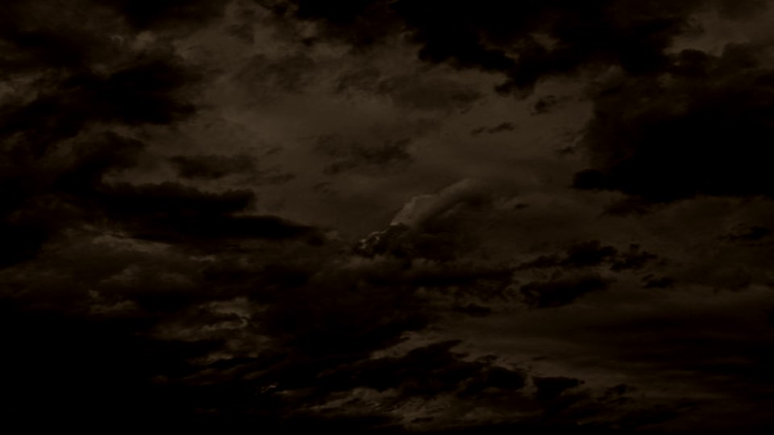
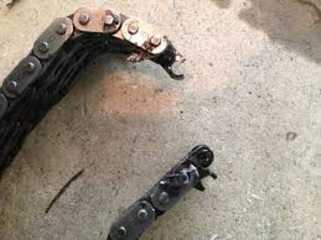
The Missing Part
What happens when the chain of a bike is missing or broken?

Slide 3
Essential Elements of Jesus Christ's church
Those of the household of God:
And are built upon the foundation of the apostles and prophets, Jesus Christ himself being the chief corner stone;
In whom all the building fitly framed together groweth unto an holy temple in the Lord:
In whom ye also are builded together for an habitation of God through the Spirit.
Apostles and prophets form the foundation of the Church of Jesus Christ.
Apostles and Prophets
Jesus Christ
Ephesians 2:19-22

Slide 4
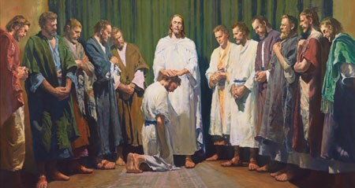
Apostles and prophets
“And he goeth up into a mountain, and calleth unto him whom he would: and they came unto him.
And he ordained twelve, that they should be with him, and that he might send them forth to preach,”
Priesthood authority is necessary to receive the ordinances and covenants of salvation.
Jesus Christ gave His Apostles the authority to direct the Church and act in God’s name for the salvation of His children.
Mark 3:13-14

Slide 5
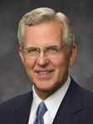
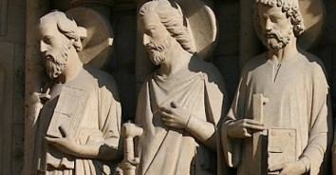
“The truths and doctrine we have received have come and will continue to come by divine revelation.
In some faith traditions … doctrinal matters may become a contest of opinions. …
But in the Church today, just as anciently, establishing the doctrine of Christ or correcting doctrinal deviations is a matter of divine revelation to those the Lord endows with apostolic authority”
Elder D. Todd Christofferson
The apostles and prophets establish correct doctrine through divine revelation.

Slide 6
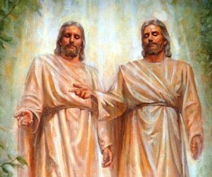
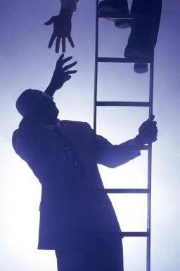
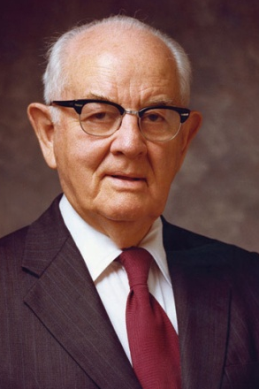
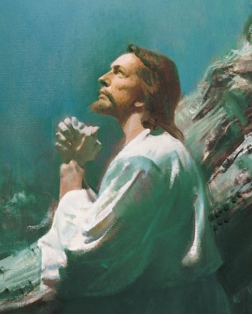
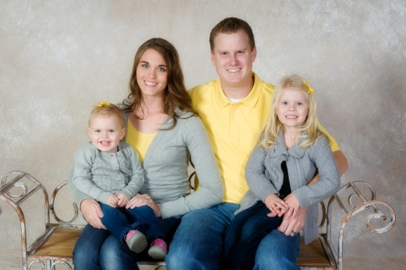
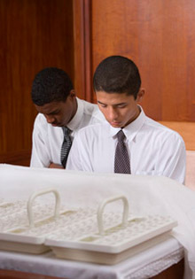
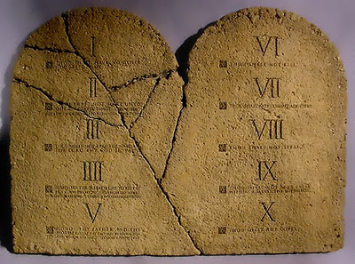
Basic Doctrine
Godhead
Plan of Salvation
Dispensation, Apostasy, and Restoration
Atonement
Prophets and Revelations
Priesthood and Priesthood Keys
Marriage and Family
Ordinances and Covenant
Commandments

Slide 7
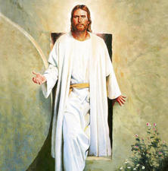
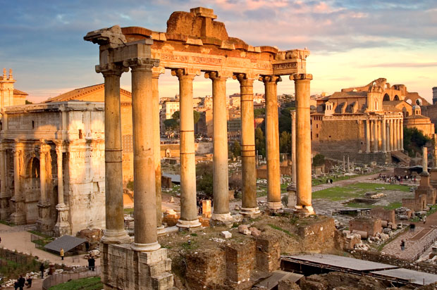
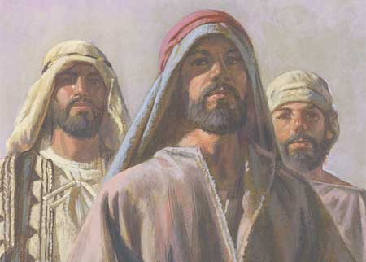
After Christ's Death
After Jesus Christ died, He was resurrected, and He ascended into heaven.
He was no longer physically present to lead the Church on the earth.
Even though He is not physically on the earth, Jesus Christ leads and guides His Apostles through revelation.
Under the leadership of His Apostles, the ancient Church spread quickly and thousands were baptized.
Congregations of Saints were formed throughout much of the Roman Empire.
Elders, bishops, deacons, priests, teachers, and evangelists (patriarchs) were called and given priesthood authority by the Apostles.

Slide 8
A Falling Away--Apostasy
Apostasy occurs when people turn away from the true doctrine of the gospel and reject the Lord’s authorized servants.
Following the deaths of the Savior’s Apostles, the principles of the gospel were corrupted and unauthorized changes were made in Church organization and to priesthood ordinances.
James was killed in Jerusalem by Herod. Peter and Paul died in Rome. Tradition holds that Philip went to the East. Much more than this we do not know.
“They scattered; they taught, testified, and established the Church. And they died for their beliefs, and with their deaths came the dark centuries of apostasy…
“The most precious thing lost in the Apostasy was the authority held by the Twelve—the priesthood keys. For the Church to be His Church, there must be a Quorum of the Twelve who hold the keys and confer them on others.”
Boyd K. Packer

Slide 9
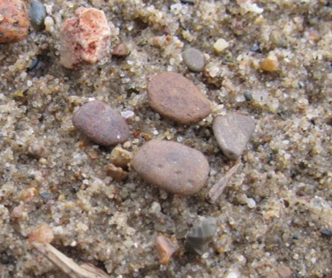
The Loss of the Priesthood
“As the centuries passed, the flame flickered and dimmed. Ordinances were changed or abandoned. The line was broken, and the authority to confer the Holy Ghost as a gift was gone. The Dark Ages of apostasy settled over the world”
Boyd K. Packer

Slide 10
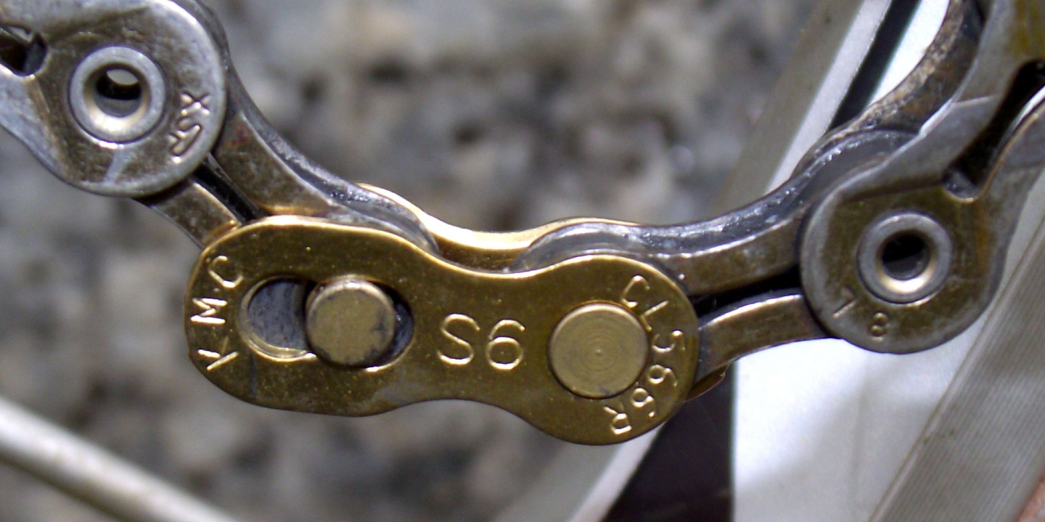
Restoration
The restoration of Jesus Christ’s doctrine and authority was necessary to overcome the effects of the Great Apostasy
Why are apostles and prophets essential?
Why is priesthood authority needed in the Church?
How can we receive and maintain correct doctrine?
What role does revelation play in the Church?

Slide 11
Before the 2nd Coming of Christ
A warning
“Now we beseech you, brethren, by the coming of our Lord Jesus Christ, and by our gathering together unto him,
That ye be not soon shaken in mind, or be troubled, neither by spirit, nor by word, nor by letter as from us, as that the day of Christ is at hand.
Let no man deceive you by any means: for that day shall not come, except there come a falling away first, and that man of sin be revealed, the son of perdition;”
Although there will not be another general apostasy from the truth, we must each guard against personal apostasy by keeping covenants, obeying the commandments, following Church leaders, partaking of the sacrament, and constantly strengthening our testimonies through daily scripture study, prayer, and service.
2 Thessalonians 2:1–3

Slide 12
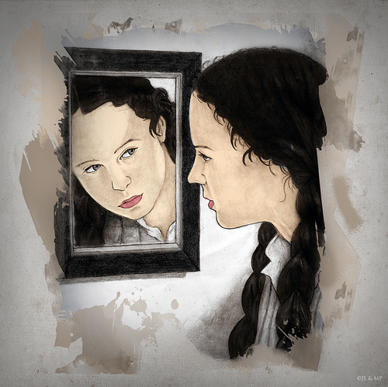
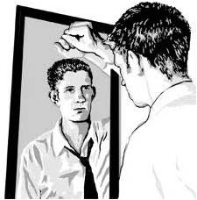
“God’s people have not always been worthy of the marvelous experience we have shared today. The Apostles, after the Ascension of Christ, continued to exercise the keys He left with them. But because of disobedience and loss of faith by the members, the Apostles died without the keys being passed on to successors.
We call that tragic episode ‘the Apostasy.’ Had the members of the Church in those days had the opportunity and the will to exercise faith as you have today, the Lord would not have taken the keys of the priesthood from the earth. So this is a day of historical significance and of eternal importance in the history of the world and to the children of our Heavenly Father.
“Now our obligation is to remain worthy of the faith necessary for us to fulfill our promise to sustain those who have been called. The Lord was well pleased with the Church at the beginning of the Restoration, as He is today. But He cautioned the members then, as He does now, that He cannot look upon sin with the least degree of allowance. For us to sustain those who have been called today, we must examine our lives, repent as necessary, pledge to keep the Lord’s commandments, and follow His servants.
The Lord warns us that if we do not do those things, the Holy Ghost will be withdrawn, we will lose the light which we have received, and we will not be able to keep the pledge we have made today to sustain the Lord’s servants in His true Church”
President Henry B. Eyring

Slide 13
Sources:
Related Videos:
The Great Apostasy (Wilford Woodruff’s search for truth)
Foundation (1:45)
Elder D. Todd Christofferson (“The Doctrine of Christ,” Ensign or Liahona, May 2012, 86).
President Boyd K. Packer [“Little Children,” Ensign, Nov. 1986, 17].)
(“The Twelve,” Ensign or Liahona, May 2008, 84).
(“The Cloven Tongues of Fire,” Ensign, May 2000, 8).
President Henry B. Eyring (“The True and Living Church,” Ensign or Liahona, May 2008, 21).
Presentation by ©http://fashionsbylynda.com/blog/

Slide 14
Elder M. Russell Ballard of the Quorum of the Twelve Apostles taught that even during times of darkness and apostasy, Heavenly Father does not turn His back on His children:
“In the relatively short span of years covered by the New Testament … the people turned against Christ and His Apostles. The collapse was so great we have come to know it as the Great Apostasy, which led to the centuries of spiritual stagnation and ignorance called the Dark Ages.
“Now, I need to be very clear about these historically reoccurring periods of apostasy and spiritual darkness. Our Heavenly Father loves all of His children, and He wants them all to have the blessings of the gospel in their lives. Spiritual light is not lost because God turns His back on His children. Rather, spiritual darkness results when His children turn their collective backs on Him. It is a natural consequence of bad choices made by individuals, communities, countries, and entire civilizations. This has been proven again and again throughout the course of time. One of the great lessons of this historical pattern is that our choices, both individually and collectively, do result in spiritual consequences for ourselves and for our posterity” (“Learning the Lessons of the Past,” Ensign or Liahona, May 2009, 32).

Slide 15
The following slides were gathered through internet sources and Bible Dictionary King James Version
Some are traditional---what the world believes, opinions, or speculation
“James, the brother of John, we know was cut down in martyrdom after a very brief ministry. Our knowledge of the activities of others of the original twelve is clouded in mystery; that they were faithful is true, and indications point to the fact that all of the original twelve and also Paul, laid down their lives in martyrdom, except John the Revelator, and he was spared to continue his ministry until the second coming of our Lord, according to the revelation given to Nephi six hundred years before John’s birth.” Joseph Fielding Smith—Questions and Answers Vol. 4 pg. 100

Slide 16
Apostles of Christ Peter
Apostle | Other known names | Family Facts | Unique characteristics | Death
Peter | Simon Cephus or Petros (stone or rock) given by Jesus Bar-jona | He was the son of a man named Jonah. His brother was Andrew | He was a fisherman by trade He was married He healed his mother-in-law Baptized by John the Baptist and one of his disciples. | According to tradition He was crucified upside down by his own request because he did not consider himself worthy to meet death in the same manner as the Lord. Tradition says: that they made Peter watch his wife be crucified.

Slide 17
Apostles of Christ Andrew
Apostle | Other known names | Family Facts | Unique characteristics | Death
Andrew | Name means: “manly” | Son of Jonah Brother of Simon Peter | Baptized by John the Baptist and one of his disciples. As a disciple of John the Baptist he met Jesus and then brought Peter to meet Jesus. He was one of the earliest called to be a disciple of Jesus Christ. He was a fisherman. Preached in the North (Ukraine) | Tradition says Andrew was crucified in Patras, Achaia (current day Greece) A.D. 70 The cross was positioned like an X and they bound him to it and he suffered for 2 days and preaching while he hung on the cross.

Slide 18
Apostles of Christ James
Apostle | Other known names | Family Facts | Unique characteristics | Death
James | Hebrew name: Jacob He was given the name Boanerges | His brother was John Son of Zebedee | He and his brother were called Boanerges, meaning “sons of thunder” Baptized by John the Baptist and one of his disciples. He was one of three chosen to be with our Lord on certain special occasions. He was the writer of the Epistle of James | Beheaded by King Herod Aggripa (Act 12:2) in Judea First apostle martyred in early church times.

Slide 19
Apostles of Christ John
Apostle | Other known names | Family Facts | Unique characteristics | Death
John | Hebrew: Johanan Meaning “Jehovah’s Gift” Also called: “John the Beloved” He calls himself “the disciple whom Jesus loved” or “that other disciple” From Jesus he received the name “Boanerges, “a son of thunder” . Writer of John, 1,2,3 John and Revelations | Son of Zebedee Brother of James | Baptized by John the Baptist and one of his disciples. He was a fisherman. He was boiled in oil and escaped miraculously,. He was sentenced to work in mines of Patmos, an island, while he wrote Revelations. He is mentioned frequently in latter-day revelation. | John did not die, but has been allowed to remain on the earth as a ministering servant until the Lord’s second coming. however tradition says he moved to Turkey and died of old age

Slide 20
Apostles of Christ Philip
Apostle | Other known names | Family Facts | Unique characteristics | Death
Philip | Name comes from Greek: “Lover of horses” | He had 4 unmarried daughters who had the gift of prophecy (Acts 21:9) | He may have been a Jewish-Greek as he was approached by the Greeks in John 12:21 He preached in Samaria. Then an angel told him to go to Gaza from Jerusalem where he taught a eunuch of great importance. He lived in Caesarea during Paul’s 3rd mission. He preached in Turkey. | Tradition says: He was martyred in Hieropolis, Turkey

Slide 21
Apostles of Christ Nathanael--Bartholomew
Apostle | Other known names | Family Facts | Unique characteristics | Death
Nathanael | Bartholomew From Hebrew meaning: “Gift of God” or “God Has Given” | He was likely the son of a man named Tholomew Friendship with Philip and he belonged to Cana in Galilee. | Nathanael is always mentioned along with apostles, but his associates mention him as Bartholomew. Preached in Armenia and India, Ethiopia, Arabia, Egypt, and Persia. | Tradition says: Nathanael was skinned alive and beheaded in Northern Armenia, in a town called Derbent

Slide 22
Apostles of Christ Thomas
Apostle | Other known names | Family Facts | Unique characteristics | Death
Thomas | Didymus From the Greek meaning: “Twin” | Didymus may have been his surname |  | Tradition says: Thomas was stabbed with a spear near Madras south eastern coast of India

Slide 23
Apostles of Christ Matthew
Apostle | Other known names | Family Facts | Unique characteristics | Death
Matthew | Levi a word meaning: “gift of Jehovah He was also called the Publican | He was the son of Alphaeus, brother of James the less making him the nephew of James the less. | Author of Matthew | Traditions says: He was either killed in Ethiopia or Persia. Most people think he was killed by a sword in Ethiopia

Slide 24
Apostles of Christ James
Apostle | Other known names | Family Facts | Unique characteristics | Death
James | Called “the less” to distinguish him from James who was the brother of John. English form of the Hebrew name Jacob. Known as “James the Just” | He was the son of Alphaeus, and Lebbaeus, whose srname was Thaddaeus | Probably the writer of Epistle of James. He spent most of his time in Israel. And went on a mission to Egypt Nothing further is know of him, unless he is, as some think, the same as Son of Alphaeus. See bible dictionary | Tradition says: he was killed in Egypt.

Slide 25
Apostles of Christ Jude
Apostle | Other known names | Family Facts | Unique characteristics | Death
Jude | Hebrew form meaning: Judas. He is also called “not Iscariot” to distinguish him from the traitor Judas Arabic root (Lebbaeus) Arabic root (Thaddaeus) Hebrew root (Heart) | Is often times confused with the brother of our Lord. | Writer of the epistle of Jude He preached in Assyria and Persia (which is Iraq and Iran) | Tradition says: He was killed in Persia

Slide 26
Apostles of Christ Simon
Apostle | Other known names | Family Facts | Unique characteristics | Death
Simon | Called “The Canaanite” Called Simon Zelotes And “The Zealot” Hebrew word for Zealot was Kananim, this would explain the title, “Canaanite” Matthew and Mark call him “the Cananaean” (not Canaanite as in the King James Version. |  | He probably had been a member of the Hebrew group which advocated fierce allegiance to Israel and violent overthrow of Roman domination. He preached in Egypt and traveled to Persia (Iran) | Tradition says: He was hacked to death in Persia.

Slide 27
Apostles of Christ Judas Iscariot
Apostle | Other known names | Family Facts | Unique characteristics | Death
Judas | Called Iscariot, probably because he was from the village of Kerioth in the tribe of Judah. | He was the son of Simon | He was the only one who was not a Galilean. Betrayer of Jesus | Hung himself in Jerusalem

Slide 28
Apostles After Christ---Matthias
Apostle | Other known names | Interesting fact | Unique characteristics | Death
Matthias | Name means: Gift of Jehovah | Because of the transgression of Judas the 11 needed to appoint another apostle. The leaders appointed two, Joseph called Barsabas, who was surnamed Justus, and Matthias. When they prayed, they knew in their hearts and the lot fell upon Matthias. | He was the person to fill the place of Judas. All that is known of him is that he was a disciple throughout the whole of our Lord’s ministry. Tradition states that he preached the gospel and suffered martyrdom in Ethiopia* | Stoned and beheaded (in Ethiopia)*

Slide 29
Apostles After Christ---Paul
Apostle | Other known names | Family Facts | Unique characteristics | Death
Paul | Saul…a Pharisee Paul’s Latin name is first mentioned in the beginning of his gentile ministry. | He belonged to Tarsus, in Cilicia. He was a pupil of Gamaliel. | Early life: He was active in the persecution of Christians and took part in the martyrdom of Stephen. Saw a vision on the Road for Damascus which changed his current life. Baptized by Ananias, and retired to Arabia for 3 years. After returning to Jerusalem he was introduced to Peter and James. He retired to Tarsus and remained 6-7 years preaching in Syria and Cilicia. He took 3 missionary journeys and spent time in prison writing letters to the saints. | Tortured and beheaded in Rome by Nero in probably in the spring of A.D. 65

