Slide 1
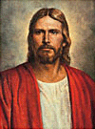
Lesson 3
The Role of the Learner
Suggested Hymn:
#304
Teach Me to Walk in the Light
New Testament
Presentation by ©http://fashionsbylynda.com/blog/

Slide 2
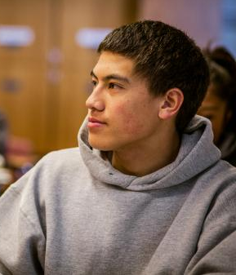
A young man is inspired and edified as he attends seminary. He feels the influence of the Holy Ghost there and is grateful for the things he learns.
Another young man is in the same seminary class. However, he is often bored and feels that he doesn’t get much out of the class.
What are some possible reasons why these two young men have such different experiences?
He may be participating more actively in the lesson.
He may have had more previous spiritual learning experiences on which his present learning can build.
He may be distracted by other concerns.

Slide 3
Role of the Holy Ghost
But the Comforter, which is the Holy Ghost, whom the Father will send in my name, he shall teach you all things, and bring all things to your remembrance, whatsoever I have said unto you.
John 14:26
Howbeit when he, the Spirit of truth, is come, he will guide you into all truth: for he shall not speak of himself; but whatsoever he shall hear, that shall he speak: and he will shew you things to come.
John 16:13
Holy Ghost
Teacher
Student
The Holy Ghost teaches truth

Slide 4
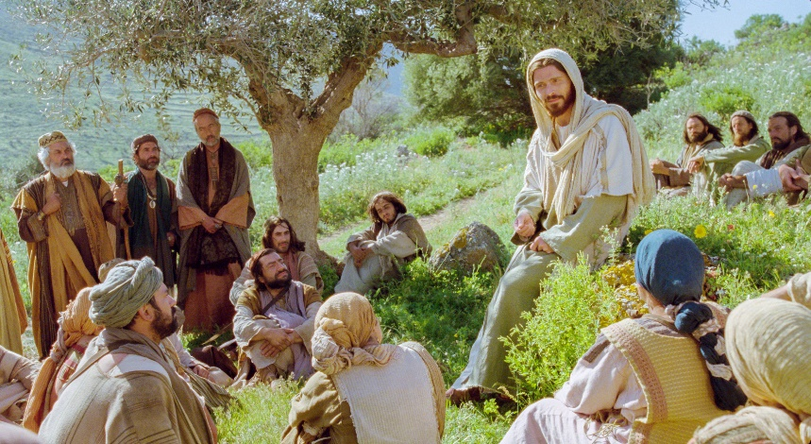
The Role of the Teacher
Wherefore, I the Lord ask you this question—unto what were ye ordained?
To preach my gospel by the Spirit, even the Comforter which was sent forth to teach the truth.
D&C 50:13-14
And the Spirit shall be given unto you by the prayer of faith; and if ye receive not the Spirit ye shall not teach.
D&C 42:14
Teacher

Slide 5
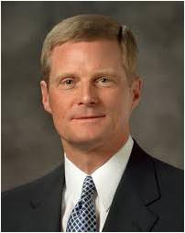
“A teacher can explain, demonstrate, persuade, and testify, and do so with great spiritual power and effectiveness.
Ultimately, however, the content of a message and the witness of the Holy Ghost penetrate into the heart only if a receiver allows them to enter.
Learning by faith opens the pathway into the heart” (1)

Slide 6
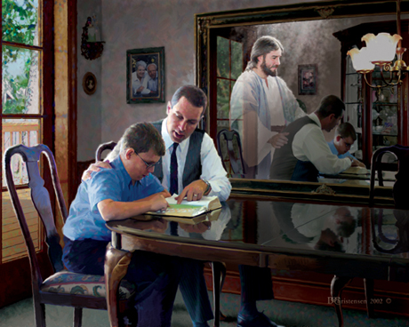
Learning By Faith
“A learner exercising agency by acting in accordance with correct principles opens his or her heart to the Holy Ghost and invites His teaching, testifying power, and confirming witness.
Learning by faith requires spiritual, mental, and physical exertion and not just passive reception. …
If we seek to learn by faith, then we invite the Holy Ghost into our hearts to teach and testify of truth.
(1)

Slide 7
Role of the Student
Appoint among yourselves a teacher, and let not all be spokesmen at once; but let one speak at a time and let all listen unto his sayings, that when all have spoken that all may be edified of all, and that every man may have an equal privilege.
D&C 88:122
What are some spiritual, mental, or physical efforts we can make to invite the Spirit to teach and testify to us of truth?
Student

Slide 8
Obtaining spiritual knowledge requires effort on our part.
When we make an effort to fulfill our role as learners, we open our hearts to the Holy Ghost’s teaching power.

Slide 9
And Jesus, walking by the sea of Galilee, saw two brethren, Simon called Peter, and Andrew his brother, casting a net into the sea: for they were fishers.
Follow Me and I will make you fishers of men
And they straightway left their nets, and followed him.
Matthew 4:18-20

Slide 10
By heeding the Savior’s call to follow Him, Peter had the privilege of hearing the Savior teach on a regular basis and of witnessing many miracles.
Lord, if it be thou, bid me come unto thee on the water
Come
And when Peter was come down out of the ship, he walked on the water, to go to Jesus.
Matthew 14:28-29

Slide 11
But whom say ye that I am?
Whom do men say that I the Son of man am?
Thou art the Christ, the Son of the living God.
Some say that thou art John the Baptist: some, Elias; and others, Jeremias, or one of the prophets.
How did Peter receive his knowledge?
…for flesh and blood hath not revealed it unto thee, but my Father which is in heaven.
Matthew 16:13-17

Slide 12
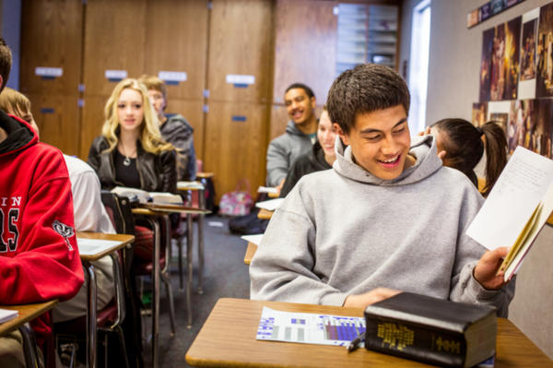
“To help youth and young adults understand and rely on the teachings and Atonement of Jesus Christ, qualify for the blessings of the temple, and prepare themselves, their families, and others for eternal life with their Father in Heaven”
As a member of our seminary class, what do you think your role is in accomplishing this purpose?
What is the purpose of Seminary?

Slide 13
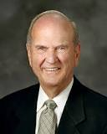
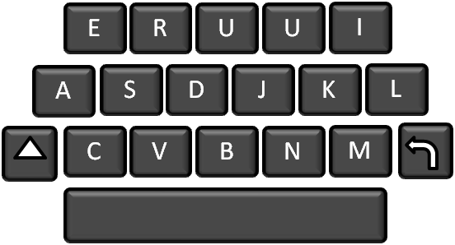
Message from the Prophet
X
zZ
“My dear brothers and sisters, the “veil o’er the earth”¹ is continuing to burst, and one of the deep desires of my heart is for you to receive all that the Lord is ready to reveal to you. Seminary and institute will help you.
Graduating from seminary and institute will increase your ability to excel in the most important things you will ever do in life. True joy will be yours! I so testify, with my expression of love for each of you, in the sacred name of Jesus Christ, amen.”

Slide 14
Sources:
Suggested Hymn: #304 Teach Me To Walk
1.
David A. Bednar (“Seek Learning by Faith,” Ensign, Sept. 2007, 61, 64).
2
February 4, 2019A Personal Invitation to Participate in Seminary and Institute
President Russell M. Nelson
Presentation by ©http://fashionsbylynda.com/blog/

Slide 15
How the Holy Ghost’s Power relates to the roles of the teacher and the student: Elder David A. Bednar :
“Nephi teaches us, ‘When a man speaketh by the power of the Holy Ghost the power of the Holy Ghost carrieth [the message] unto the hearts of the children of men’ (2 Nephi 33:1). Please notice how the power of the Spirit carries the message unto but not necessarily into the heart. A teacher can explain, demonstrate, persuade, and testify, and do so with great spiritual power and effectiveness. Ultimately, however, the content of a message and the witness of the Holy Ghost penetrate into the heart only if a receiver allows them to enter” (“Seek Learning by Faith,” Ensign, Sept. 2007, 61).
“[A learner’s] decision to participate is an exercise in agency that permits the Holy Ghost to communicate a personalized message suited to [his or her] individual needs. Creating an atmosphere of participation enhances the probability that the Spirit will teach more important lessons than [the teacher] can communicate”
Elder Richard G. Scott (“To Learn and to Teach More Effectively” [BYU Campus Education Week devotional, Aug. 21, 2007], 4–5, speeches.byu.edu ).
Reverence in Class:
“For the past several years we have watched patterns of reverence and irreverence in the Church. While many are to be highly commended, we are drifting. We have reason to be deeply concerned.
“The world grows increasingly noisy. …
“This trend to more noise, more excitement, more contention, less restraint, less dignity, less formality is not coincidental nor innocent nor harmless.
“The first order issued by a commander mounting a military invasion is the jamming of the channels of communication of those he intends to conquer.
“Irreverence suits the purposes of the adversary by obstructing the delicate channels of revelation in both mind and spirit. …
“… Leaders should teach that reverence invites revelation” President Boyd K. Packer (“Reverence Invites Revelation,” Ensign, Nov. 1991, 22).
This is a glorious time to be a youth in the Church. Remember that no matter how inspired parents, youth leaders, and seminary teachers may be, each student has responsibility for his or her own conversion. “You have [the] primary responsibility for your own conversion. No one can be converted for you, and no one can force you to be converted. However, others can help you in the process of conversion. Learn from the righteous examples of family members, Church leaders and teachers, and men and women in the scriptures” (True to the Faith: A Gospel Reference [2004], 43).
Conversion takes place when we are diligent about saying prayers, studying the scriptures, attending church, and being worthy to participate in church and temple ordinances. Conversion comes as we act on the righteous principles we learn in our homes and in the classroom. Conversion comes as we live pure and virtuous lives and enjoy the companionship of the Holy Ghost.
Reverence: “Only in an attitude of reverence can the Spirit confirm the truths of the gospel through the word of God, music, testimony, and prayer. …
“… Texting or reading e-mails in a Church meeting is not only irreverent, it is distracting and signals a lack of respect for those around us. So we exemplify reverence by participating in the meeting, listening to the speakers, and singing the hymns of Zion together” (“Respect and Reverence,” Sister Margaret S. Lifferth Ensign or Liahona, May 2009, 13).
To the Teachers:
“Our students cannot know of God, and so love as they must love, unless they are taught by the Holy Spirit. Only by the Spirit can they know that God loved us enough to send His Son to be the [mediator] for our sins and that Jesus is the Son of God and that Christ paid the price of their sins. Only by the Spirit can they know that Heavenly Father and His resurrected and glorified Son appeared to Joseph Smith. Only by the Spirit can they know that the Book of Mormon is the true word of God. And only by inspiration can they feel the love of the Father and the Son for them in giving us the ordinances necessary to receive eternal life. Only by obtaining those witnesses, placed deep into their hearts by the Holy Ghost, will they be rooted on a sure foundation to stand steady through the temptations and trials of their lives” President Henry B. Eyring (“To Know and to Love God” [address to Church Educational System religious educators, Feb. 26, 2010], 2;si.lds.org).
Participating in Class:
President Thomas S. Monson gave the following message about participating in seminary:
“Seminary has blessed the lives of hundreds of thousands of Latter-day Saint youth. I remember my own seminary experience. Seminary for me was held at an early hour in a little house across the street from my high school. I thought, if my teacher can get up that early, I can get up that early.
“Seminary will help you to understand and rely on the teachings and Atonement of Jesus Christ. You will feel the Spirit of the Lord as you learn to love the scriptures. You will prepare yourselves for the temple and for missionary service.
“Young people, I ask you to participate in seminary. Study your scriptures daily. Listen to your teachers carefully. Apply what you learn prayerfully” (“Participate in Seminary,” Aug. 12, 2011,seminary.lds.org).

Slide 16
Setting Goals and Living By Them
Study the scriptures daily.
Develop scripture study skills, such as marking, cross-referencing, and using the scripture study aids.
Actively participate in the devotional.
Reverently and attentively engage in learning activities and avoid distractions.
Ask questions and seek for answers that help them better understand the gospel and how it applies in their lives.
Record impressions, thoughts, and notes in a scripture study journal or notebook.
Identify and express doctrines and principles taught in the scriptures.
Explain gospel doctrines and principles to others, share insights and experiences related to gospel doctrines and principles, and testify of the truthfulness of gospel doctrines and principles.
Apply gospel doctrines and principles in their lives.
Setting Goals and Living By Them
Study the scriptures daily.
Develop scripture study skills, such as marking, cross-referencing, and using the scripture study aids.
Actively participate in the devotional.
Reverently and attentively engage in learning activities and avoid distractions.
Ask questions and seek for answers that help them better understand the gospel and how it applies in their lives.
Record impressions, thoughts, and notes in a scripture study journal or notebook.
Identify and express doctrines and principles taught in the scriptures.
Explain gospel doctrines and principles to others, share insights and experiences related to gospel doctrines and principles, and testify of the truthfulness of gospel doctrines and principles.
Apply gospel doctrines and principles in their lives.
Handout

