Slide 1
Lesson 30
Instituting the Sacrament
Matthew 26:1-30

Slide 2
Traditional Locations in Jerusalem
The Savior suffered in Gethsemane
Jesus Christ ate the Last Supper with His disciples
Jesus Christ instituted the sacrament
Jesus Christ was betrayed, arrested, and tried before Caiaphas

Slide 3
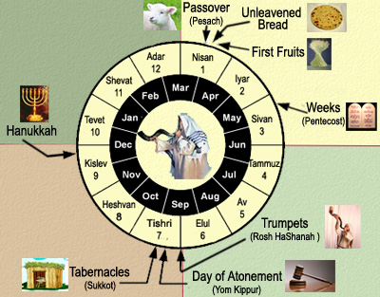
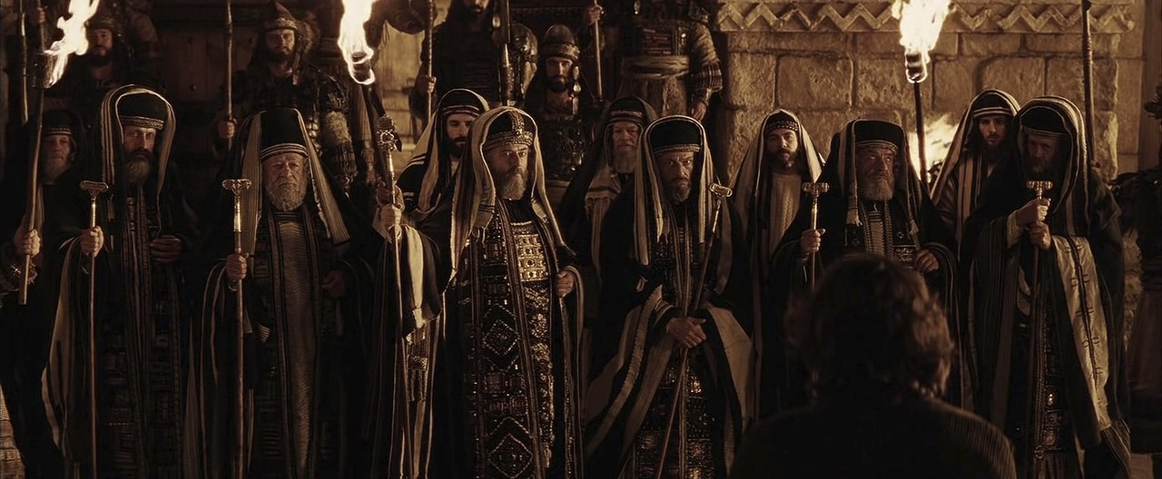
After 2 Days Is the Feast
As the Feast of the Passover approached, the Savior knew that His betrayal and Crucifixion were near, and He prophesied to His disciples that these things would occur during the feast time.
The chief priests and scribes gathered together at the palace of Caiaphas, the high priest, to consult about how they could take Jesus and kill Him without creating an uproar among the people.
The chief priests and elders represented the religious and lay leadership of the great Jerusalem Sanhedrin. They knew that many people admired Jesus Christ, and they were concerned that if they tried to take Jesus when there were so many pilgrims in Jerusalem for the holidays, there would be riots.
Matthew 26:1-5
(1)

Slide 4
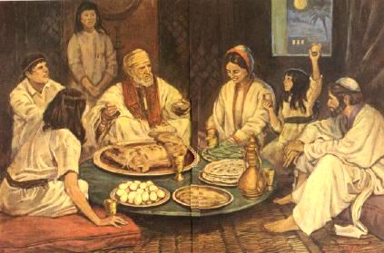
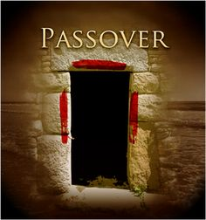
Passover
The Passover was instituted in Moses’s time to remind the children of Israel that the destroying angel passed over their houses and slew the firstborn children in Egypt.
As part of the Passover, the Israelites sacrificed a lamb and sprinkled its blood over their doorposts. This lamb symbolized the coming Messiah, whose atoning sacrifice would save mankind from death and sin.
Exodus 12:21–28; 13:14–15

Slide 5
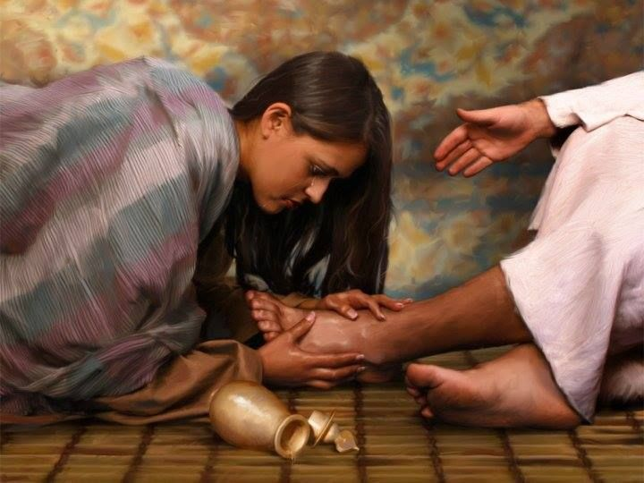
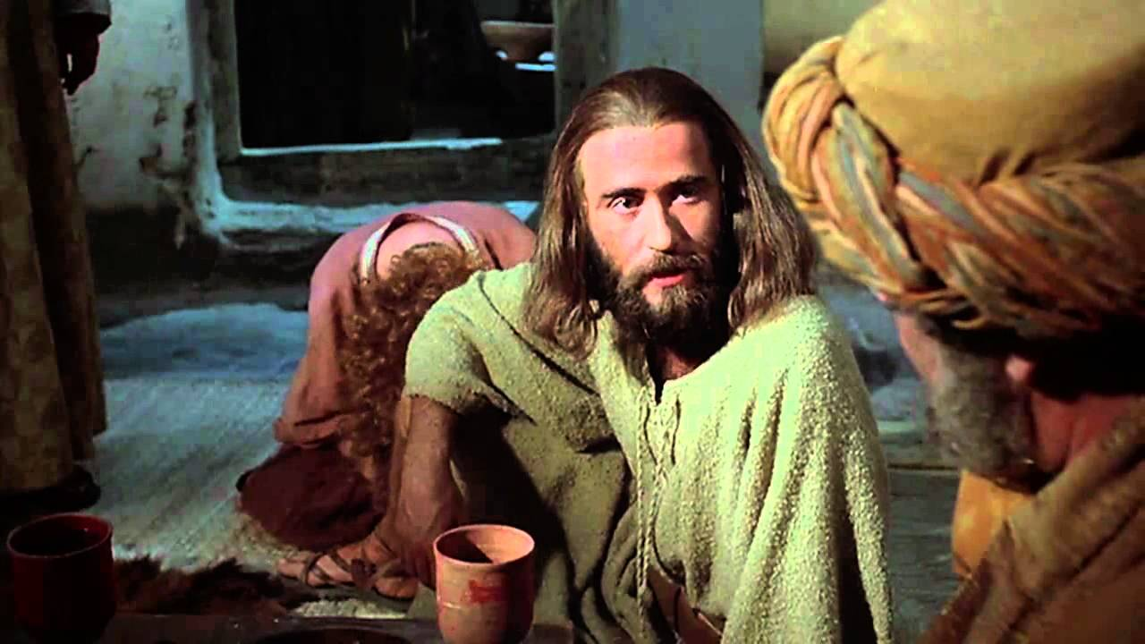
The Anointing
While Jesus was in Bethany, a woman came to Him and anointed Him with very expensive ointment to acknowledge His impending death and burial.
Some of His disciples, including Judas, one of the Twelve Apostles and the group’s treasurer, complained that the ointment should have been sold to help the poor.
However, Judas was not truly concerned for the poor but was a thief who wanted the money for himself.
Matthew 26:6-13; Mark 11-13; John12:4-6

Slide 6
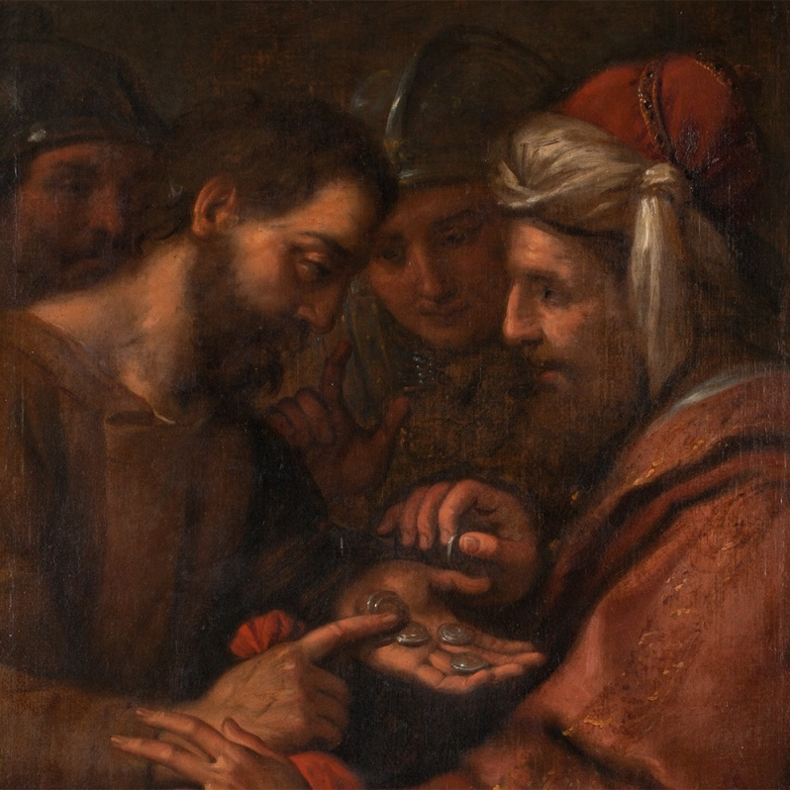
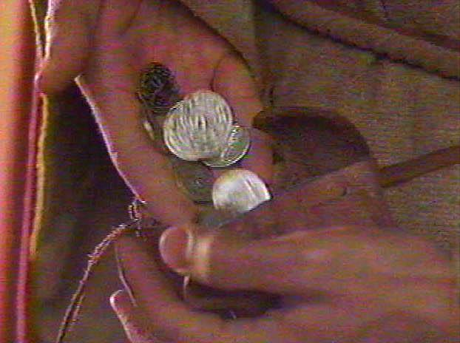
Conspiring/Low Regard
Judas conspired with the chief priests to help them locate and arrest Jesus.
How much money did the chief priests give Judas?
And I said unto them, If ye think good, give me my price; and if not, forbear. So they weighed for my price thirty pieces of silver.
And the Lord said unto me, Cast it unto the potter: a goodly price that I was prised at of them. And I took the thirty pieces of silver, and cast them to the potter in the house of the Lord. Zechariah 11:12-13
30 pieces (shekels) of silver = about $17.00
This was a fixed price for the death of a slave, also a forseen sum of the blood-money to be paid for the Lord’s betrayal. (2)
Matthew 26:14-16; Exodus 21:32

Slide 7
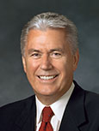
Passover Meal
“Often we try to avoid looking deeply into our souls and confronting our weaknesses, limitations, and fears. …
“But being able to see ourselves clearly is essential to our spiritual growth and well-being. …
“May I suggest that the holy scriptures and the talks given at general conference are an effective mirror we can hold up for self-examination.” (3)
Matthew 26:17-25

Slide 8
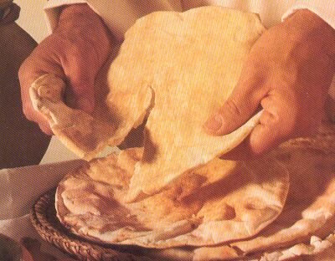
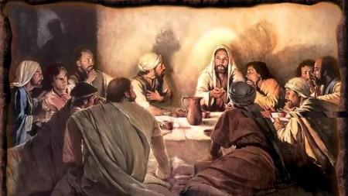
The Sacrament—Our Passover
“Do we see [the sacrament] as our Passover, remembrance of our safety and deliverance and redemption?” (4)
At the Last Supper, the Savior instituted the sacrament, a new symbolic “meal” of commemoration. Just as partaking of the emblems of the Passover pointed to the future sacrifice of Jesus Christ and helped ancient Israel remember their release from Egyptian bondage, partaking of the sacrament helps us remember Jesus Christ’s atoning sacrifice, which can release us from the bondage of sin. (1)
Matthew 26:17-25; Mark 14:12–25; Luke 22:7–30; John 13:1–2

Slide 9
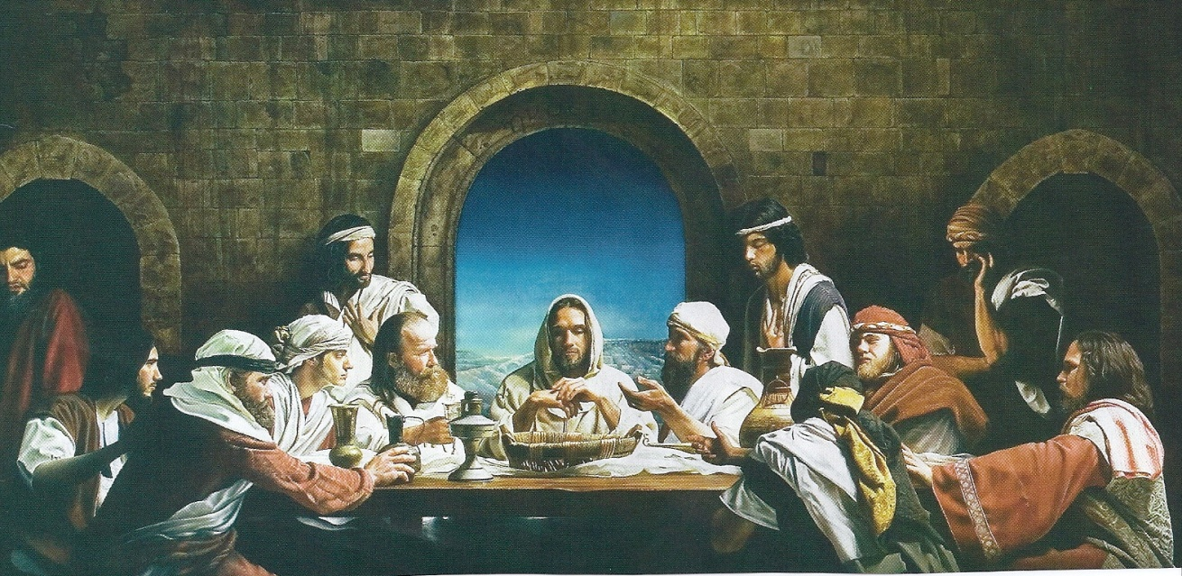
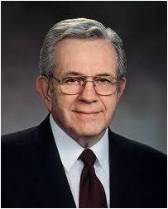
Lord, Is It I?
The Apostles had traveled with the Savior throughout Galilee and Judea. In the course of their travels and interactions with Him, they had become His trusted friends. Surely they were shocked by His announcement during the Passover meal, “One of you shall betray me.”
“I remind you that these men were apostles. They were of apostolic stature. …
It reflects something of their stature. Rather it is recorded that:
“‘They were exceeding sorrowful, and began every one of them to say unto him, Lord, is it I?’
“Would you, I plead, overrule the tendency to disregard counsel and assume for just a moment something apostolic in attitude at least and ask yourself these questions: Do I need to improve myself? Should I take this counsel to heart and act upon it? If there is one weak or failing, unwilling to follow the Brethren, Lord, is it I?” (5)
Matthew 26:22

Slide 10
When disciples of Jesus Christ hear the word of the Lord, they examine their own lives to see how it applies to them.
“The disciples didn’t question the truth of what [Jesus] said. Nor did they look around, point to someone else, and ask, ‘Is it him?’
“Instead, ‘they were exceeding sorrowful, and began every one of them to say unto him, Lord, is it I?’
“I wonder what each of us would do. … Would we look at those around us and say in our hearts, ‘He’s probably talking about Brother Johnson. I’ve always wondered about him,’ or ‘I’m glad Brother Brown is here. He really needs to hear this message’? Or would we, like those disciples of old, look inward and ask that penetrating question: “Lord is it I?” (3)
Matthew 26:22

Slide 11
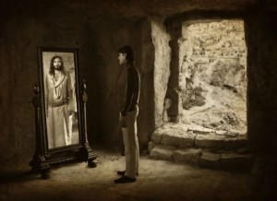
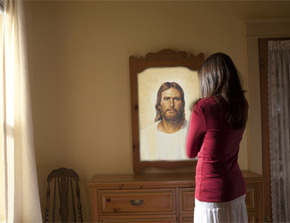
“In these simple words, ‘Lord, is it I?’ lies the beginning of wisdom and the pathway to personal conversion and lasting change. …
“We must put aside our pride, see beyond our vanity, and in humility ask, ‘Lord, is it I?’
“And if the Lord’s answer happens to be ‘Yes, my son [or daughter], there are things you must improve, things I can help you to overcome,’ I pray that we will accept this answer, humbly acknowledge our sins and shortcomings, and then change our ways by becoming better.” (3)
Matthew 26:22

Slide 12
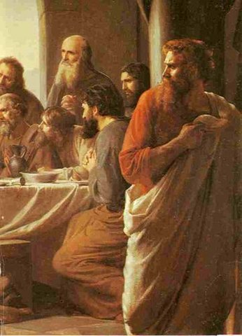
Judas is Identified
Immediately after Jesus identified Judas as the one who would betray Him, Judas left
He then having received the sop went immediately out: and it was night. John 13:30
Matthew 26:23-25

Slide 13
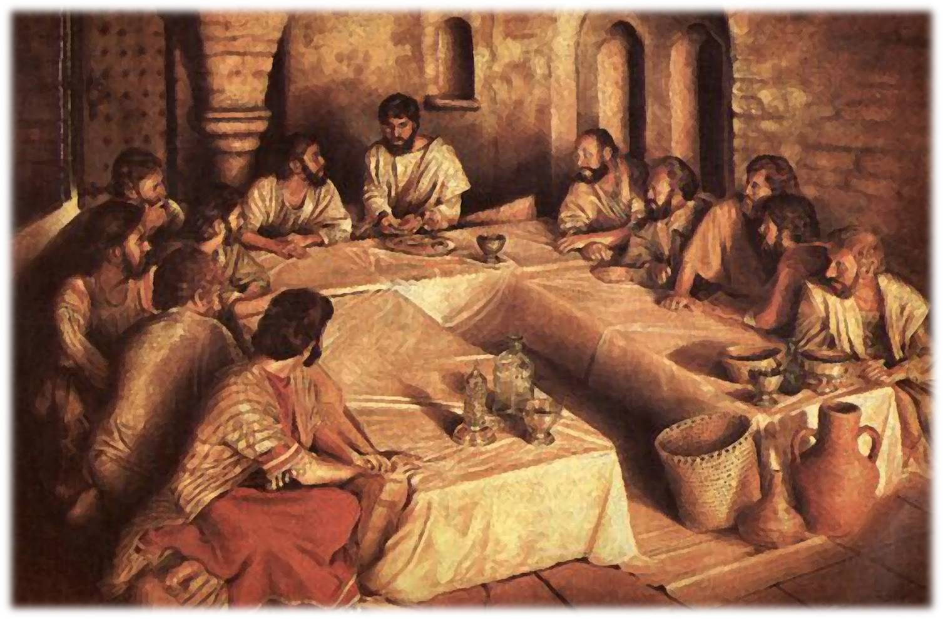
The Emblems of the Sacrament
When Jesus instituted the sacrament during the Last Supper, He taught His Apostles that the emblems of the sacrament represented His body and His blood. (1)
With a crust of bread, always broken, blessed, and offered first, we remember his bruised body and broken heart, his physical suffering on the cross where he cried, ‘I thirst,’ and finally, ‘My God, my God, why hast thou forsaken me?’
“The Savior’s physical suffering guarantees that through his mercy and grace (see 2 Ne. 2:8) every member of the human family shall be freed from the bonds of death and be resurrected triumphantly from the grave. …
“With a small cup of water we remember the shedding of Christ’s blood and the depth of his spiritual suffering, anguish which began in the Garden of Gethsemane…(4)
Matthew 26:26-28, 38; John 19:28; Luke 22:44

Slide 14
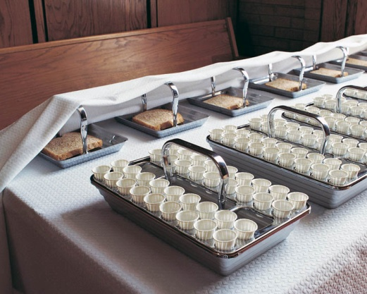
Instituting the Sacrament
Merely eating the bread and drinking the water during the sacrament does not automatically qualify us to receive a remission, or forgiveness, of our sins.
We must exercise faith in Jesus Christ, repent, and partake of the sacrament with real intent by always remembering Him and striving to keep His commandments.
Jesus Christ instituted the sacrament for us to remember Him and His Atonement for our sins
When we repent and partake of the sacrament with real intent, we can receive a remission of our sins
By worthily partaking of the sacrament, we renew our baptismal covenants
Matthew 26:26-28

Slide 15
What was one result of the Fall of Adam?
Moses 5:4
Moroni 10:30, 32
What is the mission of the Church?
What is the scriptural term for this condition?
Understanding the
Atonement
Alma 42:9
1 John 1:8
How many of us are unclean?
In what spiritual condition must we be to dwell with God?
“The sacrament not only symbolizes the Savior’s Atonement but also looks forward in anticipation to the time when He will return to the earth in glory.
Moses 6:57
Matthew 26:26-29

Slide 16
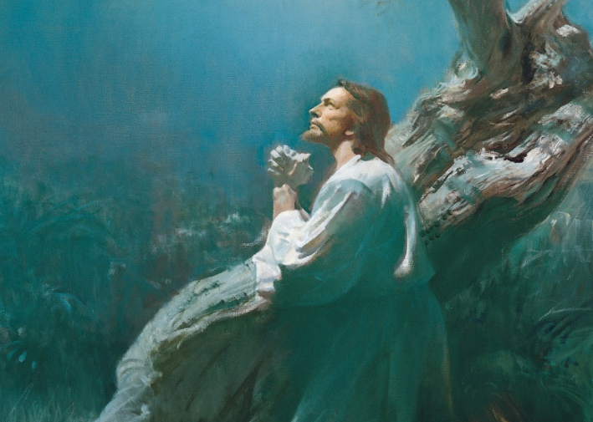
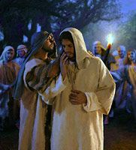
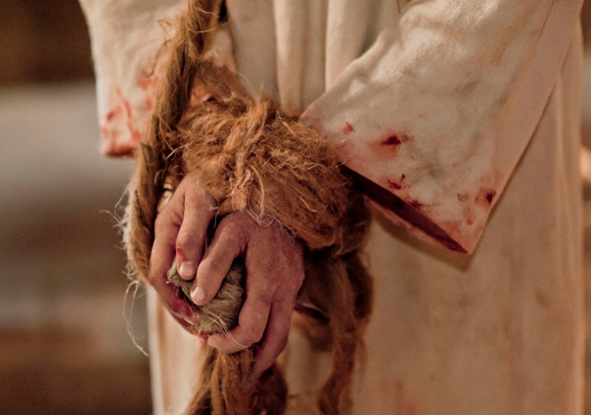
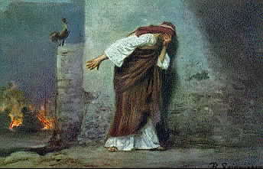
Next …
Jesus Christ begins taking upon Himself the sins of all people as part of His Atonement.
Judas betrays Jesus to the Jewish leaders.
Meanwhile, three times Peter denied knowing the Savior to those who identified him as one of Jesus Christ’s disciples.
Jesus is illegally tried before Caiaphas, the high priest, where false charges are brought against Him.
Matthew 26:31-75

Slide 17
Sources:
Suggested Hymn: #181 Jesus of Nazareth, Savior and King
Video:
Always Remember Him (5:28)
New Testament Institute Student Manual Chapter 9
James E. Talmage Jesus the Christ p. 592
President Dieter F. Uchtdorf (“Lord, Is It I?” Ensign or Liahona, Nov. 2014, 58).
Elder Jeffrey R. Holland “This Do in Remembrance of Me,” Ensign, Nov. 1995, 68).
5. President Boyd K. Packer (“That All May Be Edified” [1982], 237).
Presentation by ©http://fashionsbylynda.com/blog/

Slide 18
Event | Matthew | Mark | Luke | John
Jesus Foretells His Betrayal and Crucifixion | 26:1, 2 | 14:1 | 22:1
Rulers consult How They Can Kill Jesus | 26:3-5 | 14:1, 2 | 22:2
Judas Iscariot promises to Betray Jesus | 26:14-16 | 14:10, 11 | 22:3-6
Preparation for the Passover | 26:17-19 | 14:12-16 | 22:7-13
Jesus and the Apostles Begin Last Supper | 26:20 | 14:17 | 22:14-18
Jesus Announces His Betrayal | 26:21-25 | 14:18-21 | 22:21-23 | 13:18-22
The Sacrament | 26:26-29 | 14:22-25 | 22:19-20
Departing to Mount of Olives | 26:30 | 14:26 | 22:39
Betrayal:
No one is foreordained to do evil—Judas chose to betray the Savior. The Joseph Smith Translation explains that one reason for Judas’s betrayal was the doctrine the Savior taught: “Nevertheless, Judas Iscariot, even one of the twelve, went unto the chief priests to betray Jesus unto them; for he turned away from him, and was offended because of his words” (Joseph Smith Translation, Mark 14:31; compare Mark 14:10, footnote a). (1)
Sacrament Emblems Matthew 26:26-28
… There he said, ‘My soul is exceeding sorrowful, even unto death’. He was in agony and ‘prayed more earnestly: and his sweat was as it were great drops of blood falling down to the ground’.
“The Savior’s spiritual suffering and the shedding of his innocent blood, so lovingly and freely given, paid the debt for what the scriptures call the ‘original guilt’ of Adam’s transgression (Moses 6:54). Furthermore, Christ suffered for the sins and sorrows and pains of all the rest of the human family, providing remission for all of our sins as well, upon conditions of obedience to the principles and ordinances of the gospel he taught (see 2 Ne. 9:21–23). As the Apostle Paul wrote, we were ‘bought with a price’ (1 Cor. 6:20). What an expensive price and what a merciful purchase!
“That is why every ordinance of the gospel focuses in one way or another on the atonement of the Lord Jesus Christ, and surely that is why this particular ordinance with all its symbolism and imagery comes to us more readily and more repeatedly than any other in our life” Elder Jeffrey R. Holland (“This Do in Remembrance of Me,” 67).
Dipped His Hand With Me: Matthew 26:23
The “sop” described in John 13:26 was a small piece of bread that those dining would use to scoop broth and meat from a bowl. Since it was a gesture of kindness and respect for a host to dip a sop and give it to a dinner guest, the Savior by this act presented Judas with an offer of friendship, perhaps one final opportunity for him to abandon his planned betrayal. The Savior gave a sop to Judas, after which “Satan entered into him” (John 13:27). By saying to Judas, “That thou doest, do quickly” (John 13:27), the Lord showed that He already knew what Judas had determined to do and that the time had come for him to act upon his final decision. (1)

