Slide 1
Lesson 32
To Be Condemned
Matthew 27:1-50
Jerusalem News
34th year of the Lord

Slide 2
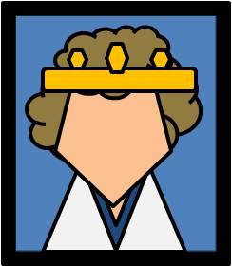
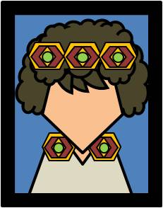
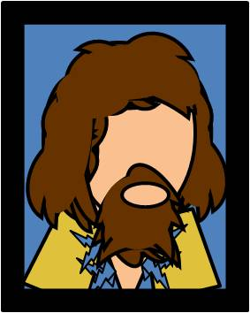
Matthew 27:1-23
34th year of the Lord
Page 1
Thirty Pieces of Silver
Because the silver pieces were “the price of blood” and therefore not lawful to add to the treasury, the Jewish leaders used the money to purchase the potter’s field, where strangers (or foreigners) were to be buried.
A quote by Zechariah an Old Testament Prophet said: And I said unto them, If ye think good, give me my price; and if not, forbear. So they weighed for my price thirty pieces of silver.
And the Lord said unto me, Cast it unto the potter: a goodly price that I was prised at of them. And I took the thirty pieces of silver, and cast them to the potter in the house of the Lord.
Jesus of Nazareth Arrested
Recently the high priest, Caiaphas and the Sanhedrin charged Jesus with blasphemy—a crime that was punishable by death under Jewish law; however, under Roman rule, the Jews had no power to put someone to death for blasphemy. Therefore, the Jewish leaders sought to find an offense under Roman law by which Jesus would be punished by death.
Jewish leaders delivered Jesus to Pontius Pilate, the Roman governor of Judea.
Treason
Jewish leaders accused Jesus of treason, or trying to overthrow the Roman government, and claimed that Jesus declared Himself a king and sought to establish His own kingdom.
Barabbas
Each year during the Feast of the Passover, it was the custom of the Roman governor to pardon a convicted criminal. The people were permitted to select one prisoner to be released. One notable prisoner at the time of Jesus’s sentencing was a man named Barabbas, who had been convicted as a thief, a rebel against Roman authority, and a murderer. However, the people chose to free Barabbas and have Jesus condemned to death.
Judas Iscariot of Kerioth
Judas served as treasurer or agent of the apostolic company, receiving and disbursing such offerings made by disciples and friends, and purchasing supplies as required.
He complained against Jesus what he called “a waste of costly spikenard” while Mary was anointing the feet of the Lord. He suggested that the precious ointment could have been sold and the proceeds given to the poor. Later he spoke to officials and received 30 pieces of silver for his betrayal of where Jesus was. Judas was present at the arrest of Jesus in the Garden of Gethsemane and kissed him as a symbol of respect but
also to inform the guards as to who Jesus was. Jesus response was, “Judas, betrayest thou the
Son of man with a kiss?”
When Judas saw what happened between Caiaphas and Pilot, he regretted his choice to betray
Jesus and sought to return the money he had received from the Jewish leaders.
He brought his guilty life to a close by a revolting suicide and his spirit went to the awful fate
reserved for the sons of perdition.
-Article by James E. Talmage Jesus The Christ, Chapter 16 The Chosen Twelve

Slide 3
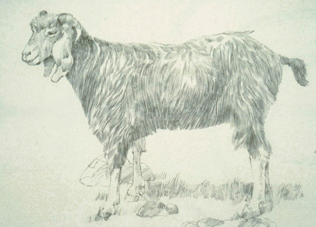
Matthew 27:24-25
Page 2
Pontius Pilate
Pontius Pilate served as a very unpopular Roman prefect (governor) over Judea from A.D. 26 to 36. Shortly after assuming office, he angered many of the Jews by marching troops into Jerusalem bearing standards with a representation of the Roman emperor on them. The Jews viewed these standards as idolatry. He later appropriated temple treasures to build an aqueduct, which led to a public riot. Pilate also ordered the slaughter of certain Galileans (see Luke 13:1–2). When the chief priests took Jesus to Pilate, they apparently had changed their charges against Him from blasphemy—a religious charge that the Romans did not consider a crime—to sedition, a political charge recognized by the Romans.
Mosaic Law
One provision of the Mosaic law stated that if a person was found to have been killed, the elders of the city could wash their hands to signify that they were not responsible.
Deut. 21:6-7
The Day of Atonement
The law of Moses taught that once a year, on the Day of Atonement, the high priest selected two goats. One goat became the scapegoat and was released alive into the wilderness, while the other was “for the Lord” and was killed as an offering for the sins of the people.
The high priest then took blood from the slain goat into the Holy of Holies of the tabernacle. He sprinkled it on the lid of the ark of the covenant (called the mercy seat), symbolically making atonement for the sins of Israel.
Who’s to Blame?
Over the past 2,000 years, people have sometimes used the statement “His blood be on us, and on our children” to blame all the Jews of Jesus’s time, or even Jews of later generations, for the death of Jesus Christ. Such accusations ignore scriptural accounts stating that a great many Jews of Jesus’s time believed in Him and that His Crucifixion was brought about by Roman authorities in cooperation with a relatively small group of Jewish leaders.
--New Testament Institute Student Manual Chapter 10
“Christ, as the lamb of Jehovah as well as High Priest, shed his own blood to enter the heavenly Holy of Holies where that blood ransomed from their sins those who would believe in him and obey his commandments.”
-quote by Gerald N. Lund Jesus Christ, Key to the Plan of Salvation[1991], 67).
Pilate recognized that Jesus was innocent of the accusations made against Him; even his wife had warned him of Jesus Christ’s innocence. Pilate washes his hands.
The Scapegoat, by Ted Henninger
Scourging of Jesus
Quote by Elder Bruce R. McConkie: “This brutal practice, a preliminary to crucifixion, consisted of stripping the victim of clothes, strapping him to a pillar or frame, and beating him with a scourge made of leather straps weighted with sharp pieces of lead and bone. It left the tortured sufferer bleeding, weak, and sometimes dead”
(Doctrinal New Testament Commentary, 1:807).
The torture and mistreatment the Savior received at the hands of the Romans were part of the Atonement, along with His suffering in Gethsemane and His death on the cross. As Isaiah testified: “He was wounded for our transgressions, he was bruised for our iniquities: the chastisement of our peace was upon him; and with his stripes we are healed”
Christ said, “Yea, and ye need not any longer hiss, nor spurn, nor make game of the Jews, nor any of the remnant of the house of Israel; for behold, the Lord remembereth his covenant unto them, and he will do unto them according to that which he hath sworn” (3 Nephi 29:8)

Slide 4
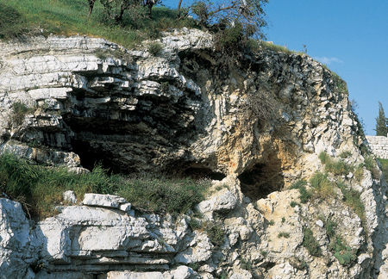
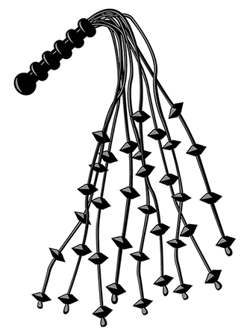
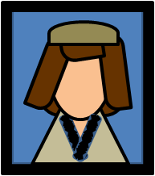
Matthew 27:27-34
Page 3
Roman Cruelty
After the Savior was scourged, the Roman soldiers put a robe on Him, made a crown of thorns (plaited means “woven”) and put it on his head, and put a reed in His right hand. Then they mockingly bowed before Him and called Him King of the Jews. The robe was purple, a color known to be used by royalty
Golgotha
The scriptures say that the Crucifixion took place at Golgotha (Aramaic) or Calvary (Latin). The traditional and oldest proposed site of the Crucifixion, burial, and Resurrection of Jesus Christ is the current site of the Church of the Holy Sepulchre. Gordon’s Calvary, sometimes referred to as the Garden Tomb, is adjacent to Golgotha, and in the 19th century it was proposed as an alternate site for the Savior’s burial and Resurrection. Many Latter-day Saints think that Gordon’s Calvary is the actual site of these events because of statements made by Church leaders. If Gordon’s Calvary is the site, then its location is symbolically significant. Gordon’s Calvary is on the mount called Moriah in the Old Testament. It was on this mount that Abraham was commanded to offer up his son Isaac as a sacrifice a sacrifice that was a similitude of the atoning sacrifice of the Savior.
It is also noteworthy that this traditional site is north of the Jerusalem temple and outside the city walls. In Old Testament times, the law of Moses required that the sin offering, which was offered for an atonement or expiation, be offered at a location north of the altar and outside the camp of Israel.
–Bible Dictionary
Golgotha Today
"the place of a skull"
Vinegar
The Old Testament alludes to a Jewish custom of using wine as an anesthetic to ease the suffering of a person who was dying. Mark recorded that just before the Savior was nailed to the cross, He was offered “wine mingled with myrrh” (Mark 15:23). Jesus refused it, deliberately choosing not to dull His senses or decrease the pain of the Crucifixion; He was determined to remain conscious and experience all that would be involved in the remainder of His atoning sufferings.
Scourging Tool
Give strong drink unto him that is ready to perish, and wine unto those that be of heavy hearts. Proverbs 31:6

Slide 5
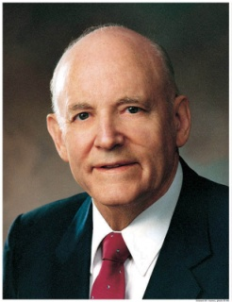
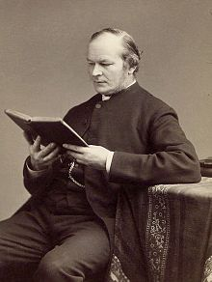
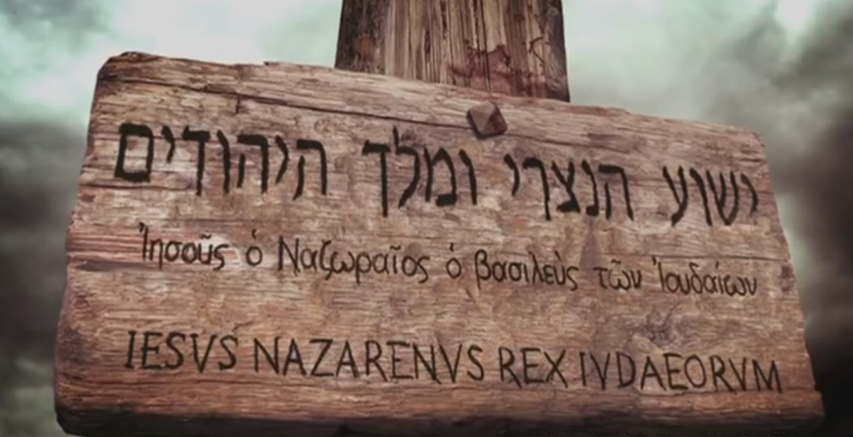
Matthew 27:35-43
Page 4
Death By Crucifixion
“The feet were but a little raised above the earth. The victim was in full reach of every hand that might choose to strike, in close proximity to every gesture of insult and hatred. He might hang for hours to be abused, outraged, even tortured by the ever-moving multitude. …
“For indeed a death by crucifixion seems to include all that pain and death can have of horrible and ghastly—dizziness, cramp, thirst, starvation, sleeplessness, traumatic fever, tetanus, publicity of shame, long continuance of torment, horror of anticipation, mortification of untended wounds—all intensified just up to the point at which they can be endured at all, but all stopping just short of the point which would give to the sufferer the relief of unconsciousness. The unnatural position made every movement painful; the lacerated veins and crushed tendons throbbed with incessant anguish; the wounds, inflamed by exposure, gradually gangrened; the arteries—especially of the head and stomach—became swollen and oppressed with surcharged blood; and while each variety of misery went on gradually increasing, there was added to them the intolerable pang of a
burning and raging thirst; and all these
physical complications caused an internal
excitement and anxiety, which made the
prospect of death itself—of death, the
awful unknown enemy, at whose approach
man usually shudders most—bear the
aspect of a delicious and exquisite release.
Such was the death to which Christ was
doomed”
-- Bible scholar Frederic W. Farrar (The Life of Christ [1874], 640–41).
Come Down From the Cross
Quote by President Howard W. Hunter:
“It is not necessary then, or ever, for Jesus to satisfy the curiosity of men, least of all unholy men.
As victory in every encounter came to Jesus, so the pathos and tragedy of
Lucifer's life is even more obvious: first, bold and taunting and tempting; then
pleading and weak and desperate; and finally-ultimately-simply banished…
Satan may have lost Jesus, but he does not believe he has lost us. He continues
to tempt, taunt, and plead for our loyalty. We should take strength for this
battle from the fact that Christ was victorious not as a God but as a man.
That We Might Have Joy, 35-36
Pilate’s Inscription—King of the Jews
“And Pilate wrote a title, and put it on the cross, and the writing was, Jesus of Nazareth, the King of the Jews, in letters of Greek, and Latin, and Hebrew” JST Matthew 27:37
Pilate had the truth printed and placed on the cross over Jesus' head for all to see.

Slide 6
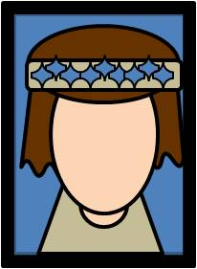
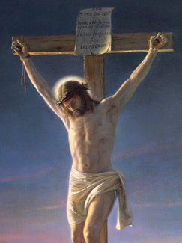
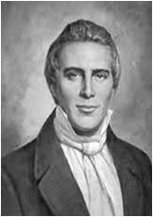
Matthew 27:45-51
Page 5
The Hour of Crucifixion
At 9:00 AM Jesus Christ was nailed to the cross—the 3rd hour of the day
Matthew recorded hew recorded that “there was darkness over all the land” from the sixth hour (about 12:00 noon) until the ninth hour (about 3:00 p.m.), which was when the Savior died.
IWhen the Light of the World died, darkness prevailed upon the land for three hours in Jerusalem and for three days in the ancient Americas.
And it came to pass that there was thick
darkness upon all the face of the land,…
And there could be no light, because of t
he darkness, neither candles, neither torches;
neither could there be fire kindled with their
fine and exceedingly dry wood, so that
there could not be any light at all;
And it came to pass that it did last for the
space of three days that there was no light seen
3 Nephi 8:20-23
Withdrawal of Heavenly Father’s Spirit
Quote by Elder Jeffrey R. Holland:
“With all the conviction of my soul I testify that … a perfect Father did not forsake His Son in that
hour. Indeed, it is my personal belief that in all of Christ’s mortal ministry the Father may never
have been closer to His Son than in these agonizing final moments of suffering. Nevertheless, …
the Father briefly withdrew from Jesus the comfort of His Spirit, the support of His personal presence.”
Elder Holland Further states:
“It was required, indeed it was central to the significance of the Atonement, that this perfect Son who had never spoken ill nor done wrong nor touched an unclean thing had to know how the rest of humankind—us, all of us—would feel when we did commit such sins. For His Atonement to be infinite and eternal, He had to feel what it was like to die not only physically but spiritually, to sense what it was like to have the divine Spirit withdraw, leaving one feeling totally, abjectly, hopelessly alone.”
(“None Were with Him,” Ensign or Liahona, May 2009, 87–88).
The Veil of the Temple Was Rent
The Holy of Holies was the most sacred room in the ancient temple; it symbolized the presence of God. Once a year, on the Day of Atonement, the high priest passed through the veil of the temple and entered into the Holy of Holies, where he sprinkled the blood of a sin offering to atone for the sins of all the congregation of Israel.
When the veil of the temple was “rent in twain” (torn in two) at the death
of Jesus Christ, it was a dramatic symbol that the Savior,
the Great High Priest, had passed through the veil of death and would
shortly enter into the presence of God.
“It is Finished”
The Joseph Smith Translation reads: “Jesus when he had cried again with a loud voice,
saying, Father, it is finished, t
hy will is done, yielded up the
ghost”
(Joseph Smith Translation, Matthew 27:54)
Elder Bruce R. McConkie quote:
“the Holy of Holies is now open to all, and all, through the atoning blood of the Lamb, can now enter into the highest and holiest of all places, that kingdom where eternal life is found.

Slide 7
Sources:
Suggested Hymn: #192 He Died! The Great Redeemer Died
Video: None Were With Him (4:25)
New Testament Institute Student Manual Chapter 10 (most of the sources come from the teacher’s manual and the Institute Student Manual)
Presentation by ©http://fashionsbylynda.com/blog/

Slide 8
Event | Matthew | Mark | Luke | John
Scourging and Mocking of Jesus | 27:27-30 | 15:16-19 |  | 19:1-3
Pilate Pleads for Jesus | 27:23 | 15:14 | 23:23 | 19:4-15
Pilate Preleases Barabbas and Delivers Jesus to Be Crucified | 27:24-26 | 15:5 | 23:24, 25 | 19:16
Jesus Mocked and led to Golgotha and Crucified | 27:31-34, 38 | 15:20-23, 25, 27, 28 | 23;26-33 | 19:16-18
Superscription: “This Is Jesus The King of the Jews” | 27:37 | 15:26 | 23:38 | 19:19-22
“Father, Forgive Them” |  |  | 23:34a
Soldiers Cast lots for His Garments | 27:35, 36 | 15:24 | 23:34b | 19:23, 24
Further Mocking by the People | 27:39-43 | 15:29-32 | 23:35-37
Words to the Thief | 27:44 | 15:32 | 23:39-43
Jesus Speaks to His Mother |  |  |  | 19:25-27
Darkness from the 6th to the 9th Hour | 27:45 | 15:33 | 23:4-45
Final Words and Death of Jesus | 27:46-50 | 15:34-37 | 23:47 | 19:28-30
Veil of the Temple Torn from Top to Bottom | 27:51 | 15:38 | 23:45
Testimony of Witnesses | 27:54-56 | 15:39-41 | 23:47-49
The Burial of Jesus | 27:57-61 | 15:42-47 | 23:50-56 | 19:38-42
Guards Placed at the Tomb | 27:62-66

Slide 9
Barabbas Matthew 27:15-21:
The name Barabbas ironically means “son of the father.” The crowd, most of whom were stirred up by the chief priests and elders, called for the release of Barabbas while rejecting the true Son of the Father. In one sense, we are all like Barabbas—we are the sinful sons set free because the true Son of the Father was condemned to death. According to the Greek text of Matthew 27:26, Barabbas’s first name was Jesus. Jesus Barabbas was a thief, murderer, and traitor, while Jesus the Christ was perfect. Those who condemned the Savior to death were presented with a clear choice, and they chose evil.
The law of Moses provided a foreshadowing of Barabbas’s release centuries before it happened. The law of Moses taught that once a year, on the Day of Atonement, the high priest selected two goats. One goat became the scapegoat and was released alive into the wilderness, while the other was “for the Lord” and was killed as an offering for the sins of the people (see Leviticus 16:8–10). The high priest then took blood from the slain goat into the Holy of Holies of the tabernacle. He sprinkled it on the lid of the ark of the covenant (called the mercy seat), symbolically making atonement for the sins of Israel. (1)
Something of Interest
Casting lots Matthew 27:35-36
Interestingly, though not commanded in the Bible, lots were cast to determine which of the priests at Jerusalem’s temple carried out a certain function like cleansing the altar or offering incense to God (The Temple at the Time of Christ, Chapter 7). They were common in games and gambling. Some of the things thrown were, depending upon the time and location, polished sticks, coins, cards, dice, bones, stones, etc.
When they were done mocking Him, they took the cloak off Him; and they put His own garments on Him and led Him away to crucify Him. (Matthew 27:31)
It was after they hung him on the cross that four Roman soldiers sought to divide the quality clothes Christ wore. Though they almost certainly were not aware of it, they were fulfilling the prophecy found in Psalm 22:18 where David wrote they would part his clothes and cast something to see who won which piece.
(the Roman soldiers) took His garments and made four parts, a part for each soldier, and the coat also. But the coat was seamless . . . For this reason, they said to one another, 'Let us not tear it . . . ' They divided My garments among them, and they cast lots for My vesture (John 19:23 - 24)
When the soldiers wanted to divide Jesus' coat or tunic, they saw it was not a patchwork of pieces sewn together. Rather, it had no seams, a quality garment that took some time to make. It was the same quality of clothing, woven from top to bottom in one piece, worn by the high priest in Jerusalem's temple. The first century Jewish historian Josephus stated in his book "Antiquities (History) of the Jews" that the temple's high priest had to wear a vestment colored blue.
This clothing was not made by pieces of clothe sewn together, or even two large pieces. It was one long vestment that was parted along the breast and back.
Unlike clothing made from pieces and thus easier to tear up, Jesus' coat would have been harder to separate into pieces. Additionally, the act of trying to divide such a seamless coat would likely make any pieces frayed and useless. The soldiers knew these facts and therefore decided to cast lots to leave it to time and chance to determine who got the entire garment.
Bible Study.org
Washing of Hands Matthew 27:19-24:
There are also examples in Greek and Roman literature of washing oneself as a symbolic gesture of absolving oneself of responsibility for shedding another’s blood. Thus, when Pilate washed his hands, he may have been claiming innocence in a way the Jewish leaders would have understood. Washing his hands, however, did not allow Pilate to evade responsibility.
On the Cross Matthew 27:45:
"Christ hung upon the cross for a period of about six hours, from approximately 9:00 A.M. until 3:00 p.m. It was during the last three hours that darkness covered the land, as apparently the agonies of Gethsemane returned (see Jesus the Christ, p. 661; Mortal Messiah 4:224-26). Of this period Elder Bruce R. McConkie writes: 'He will continue to suffer the curses of crucifixion for another three hours, until around 3:00 P.M. when he voluntarily gives up the ghost. Of these coming hours, Matthew and Mark say only that it was a period when there was darkness over all the land; Luke extends this turning of day into night over a greater area. 'There was a darkness over all the earth,' he says, 'and the sun was darkened.'...That this darkness did cover the whole earth we surmise from the Book of Mormon account. The Nephite prophets had spoken, Messianically, of three days of darkness that would be a sign unto them of the crucifixion of Christ. At that time the rocks would rend and there would be such upheavals in nature that those on the isles of the sea would say, 'The God of nature suffers.' (1 Nephi 19:10-12; Helaman 14:20-24.)" (Mortal Messiah4:224-25)" (Joseph Fielding McConkie and Robert L. Millet, Doctrinal Commentary on the Book of Mormon, 4: 38.)

Slide 10
ANCIENT PROPHECIES FULFILLED
Isaiah 53:7 “He was oppressed, and he was afflicted, yet he opened not his mouth.” | Matthew 27:14 . “He answered him to never a word.”
Isaiah 53:5 . “The chastisement of our peace was upon him; and with his stripes we are healed.” 1 Nephi 19:9 “Wherefore they scourge him, and he suffereth it.” | Matthew 27:26 Roman soldiers “scourged Jesus.”
Isaiah 50:6 . “I hid not my face from shame and spitting.” 1 Nephi 19:9 “They spit upon him, and he suffereth it.” | Matthew 27:30 They spit upon him.”
Psalm 69:21 “They gave me also gall for my meat; and in my thirst they gave me vinegar to drink.” | Matthew 27:34“They gave him vinegar to drink mingled with gall.”
Psalm 22:16 “They pierced my hands and my feet.” 1 Nephi 19:10 He “yieldeth himself … to be lifted up, … and to be crucified.” | Matthew 27:35 “They crucified him.”
Psalm 22:18 They part my garments among them, and cast lots upon my vesture.” | Matthew 27:35 The Roman soldiers “parted his garments, casting lots.”
Isaiah 53:9, 12 “He made his grave with the wicked. … He was numbered with the transgressors.” | Matthew 27:38, 44 “Then were there two thieves crucified with him.”
Psalm 22:7-8 “All they that see me laugh me to scorn: they shoot out the lip, they shake the head, saying, he trusted on the Lord that he would deliver him: let him deliver him.” | Matthew 27:41-43 “The chief priests mocking him, with the scribes and elders, said, he saved others; himself he cannot save. If he be the King of Israel, let him now come down from the cross, and we will believe him. He trusted in God; let him deliver him now.”
Psalm 22:1 “My God, my God, why hast thou forsaken me?” | Matthew 27:46 “About the ninth hour Jesus cried with a loud voice, saying, … My God, my God, why hast thou forsaken me?”
Isaiah 53:9 “He made his grave with … the rich in his death.” | Matthew 27:57-60 “A rich man of Arimathea, named Joseph, who also himself was Jesus’ disciple … wrapped [the body of Jesus] in a clean linen cloth, and laid it in his own new tomb.”
New Testament Institute Student Manual Chapter 10

Slide 11
