Slide 1
Lesson 33
Resurrection of Jesus
Matthew 27:51-66 and Matthew 28
And righteousness will I send down out of heaven; and truth will I send forth out of the earth, to bear testimony of mine Only Begotten; his resurrection from the dead; yea, and also the resurrection of all men;..
Moses 7:62

Slide 2
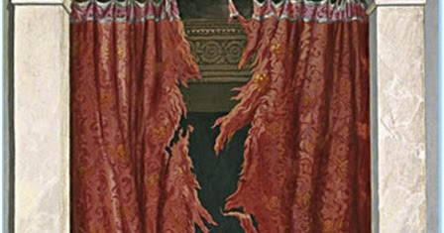
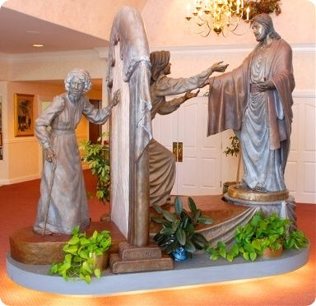
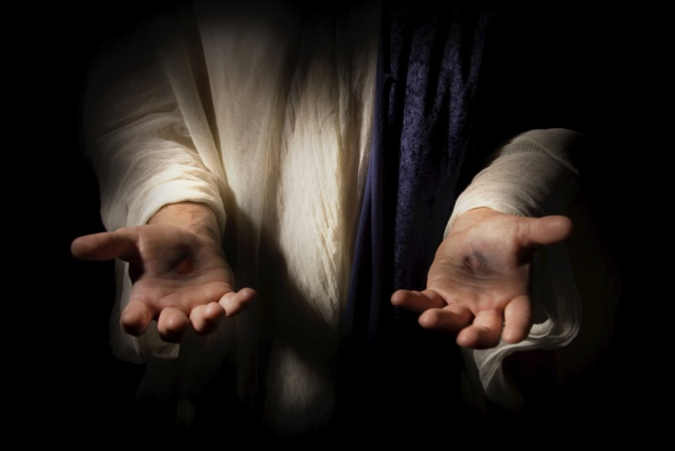
Previously…
The Veil of the Temple Was Rent in twain = torn into two pieces
For Christ is not entered into the holy places made with hands, which are the figures of the true; but into heaven itself, now to appear in the presence of God for us: Hebrew 9:24
“…the ordinances performed through the veil of the ancient temple were in similitude of what Christ was to do, which he now having done, all men become eligible to pass through the veil into the presence of the Lord to inherit full exaltation.” (2)
The Apostle Paul taught that just as the torn veil of the temple allowed symbolic entrance into the Holy of Holies, it is the torn flesh of Jesus Christ that opens the way for us into the presence of the Father. (1)
Matthew 27:51

Slide 3
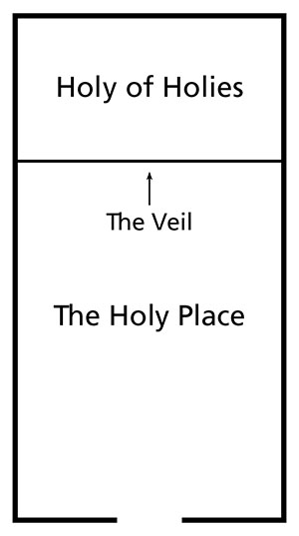
Holy of Holies
When the veil of the temple was torn in two at the death of Jesus Christ, it was a dramatic symbol that Jesus Christ, the Great High Priest, had passed through the veil of death and would shortly enter into the presence of God the Father.
During the time of Jesus, the temple had two rooms: the Holy Place and the Holy of Holies. The Holy of Holies represented the presence of God. These two rooms were separated by a veil, or curtain.
Once a year, on the Day of Atonement, the high priest passed from the Holy Place through the veil of the temple and entered into the Holy of Holies, where he sprinkled the blood of a sin offering to atone for the sins of all the congregation of Israel.
Because of the Atonement of Jesus Christ, we can all enter the presence of God if we repent and keep our covenants
Matthew 27:51

Slide 4
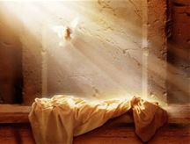
Resurrection of Many
And came out of the graves after his resurrection, and went into the holy city, and appeared unto many.
And there were gathered together in one place an innumerable company of the spirits of the just, who had been faithful in the testimony of Jesus while they lived in mortality;
They were assembled awaiting the advent of the Son of God into the spirit world, to declare their redemption from the bands of death.
While this vast multitude waited and conversed, rejoicing in the hour of their deliverance from the chains of death, the Son of God appeared, declaring liberty to the captives who had been faithful;
D&C 138:12,16,18
Many righteous people who had died were also resurrected and appeared to many people in Jerusalem.
Read D&C 138:12-18
Matthew 27:52-53

Slide 5
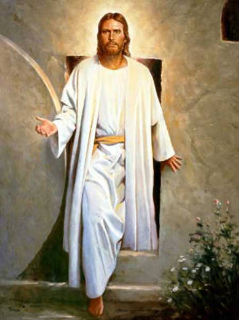
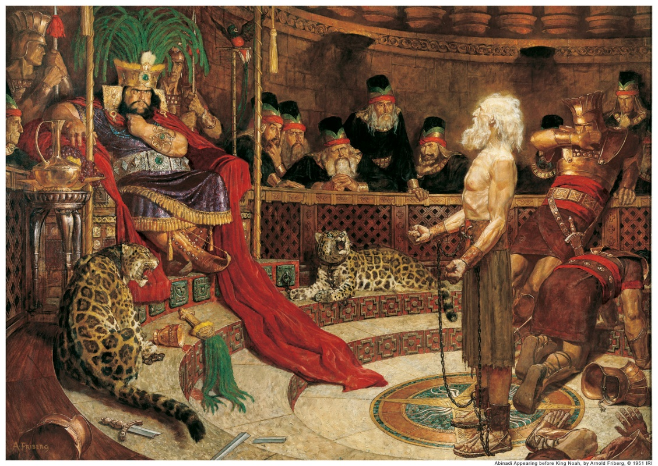
Jesus’ Resurrection
That Christ should suffer, and that he should be the first that should rise from the dead, and should shew light unto the people, and to the Gentiles. Acts 26:23
Jesus Christ was the first person resurrected
The Book of Mormon prophet Abinadi taught that those who were resurrected at the time of the Savior’s Resurrection were all the prophets and those who had kept God’s commandments
And there cometh a resurrection, even a first resurrection; yea, even a resurrection of those that have been, and who are, and who shall be, even until the resurrection of Christ—for so shall he be called.
And now, the resurrection of all the prophets, and all those that have believed in their words, or all those that have kept the commandments of God, shall come forth in the first resurrection; therefore, they are the first resurrection.
Mosiah 15:21-22
Matthew 27:52-53

Slide 6
Everyone Will Be Resurrected
Marvel not at this: for the hour is coming, in the which all that are in the graves shall hear his voice,
And shall come forth; they that have done good, unto the resurrection of life; and they that have done evil, unto the resurrection of damnation.
John 5:28-29
The spirit and the body shall be reunited again in its perfect form; both limb and joint shall be restored to its proper frame, even as we now are at this time; and we shall be brought to stand before God, knowing even as we know now, and have a bright recollection of all our guilt.
Now, this restoration shall come to all, both old and young, both bond and free, both male and female, both the wicked and the righteous; and even there shall not so much as a hair of their heads be lost; but every thing shall be restored to its perfect frame, as it is now, or in the body, and shall be brought and be arraigned before the bar of Christ the Son, and God the Father, and the Holy Spirit, which is one Eternal God, to be judged according to their works, whether they be good or whether they be evil.
Alma 11:43-44
For as in Adam all die, even so in Christ shall all be made alive.
1 Corinthians 15:22

Slide 7
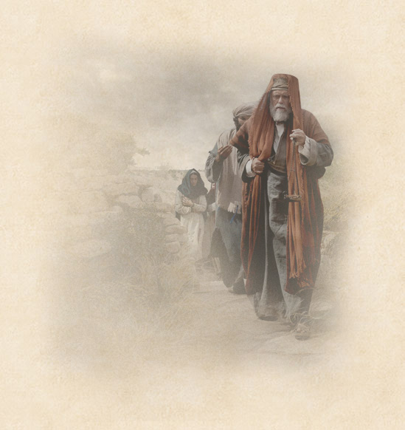
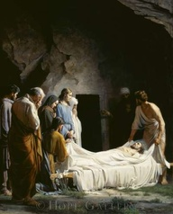
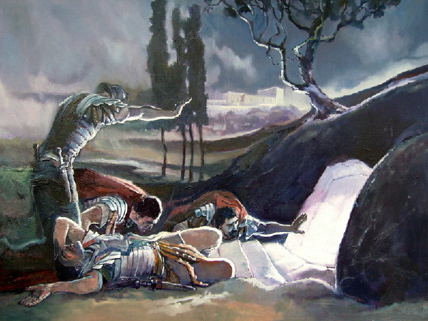
Witnesses of Empty Tomb
A rich disciple named Joseph of Arimathea “begged for the body of Jesus.”
The body of Jesus was prepared by Joseph of Arimathea, Nicodemus, another member of the Sanhedrin, who brought a costly “mixture of myrrh and aloes, about an hundred pound weight” to anoint the body. Mary Magdalene, and the other Mary sat by the sepulchre.
John 19:39
Soldiers were sent by Pilate to seal the tomb.
Those who witnessed Jesus’s death were a Roman centurion and many women.
Matthew 27:54-61

Slide 8
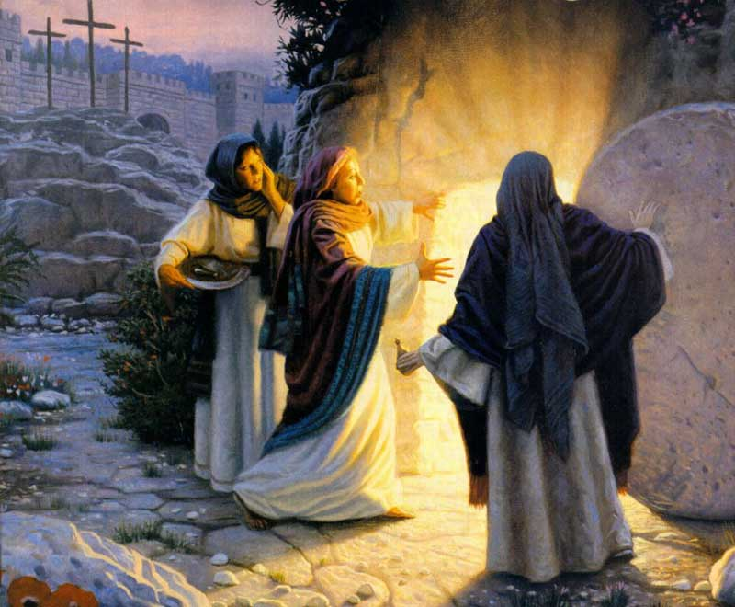
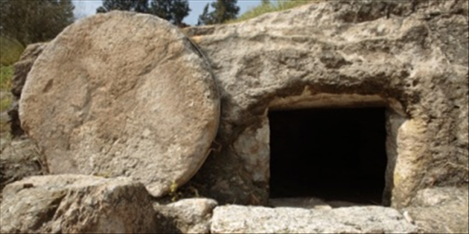
He Is Not Here
Mary Magdalene and another woman named Mary came to the tomb to anoint Jesus’s body as an expression of their love and adoration.
Among which was Mary Magdalene, and Mary the mother of James and Joses, and the mother of Zebedee’s children.
Matthew 27:54-56

Slide 9
Resurrection VS Brought Back From the Dead
What is the difference between being brought back from the dead and being resurrected?
What will happen to all humankind as a result of the Resurrection of Jesus Christ?
How can understanding the doctrine of the Resurrection provide comfort for those who have lost loved ones?
Matthew 28:6

Slide 10
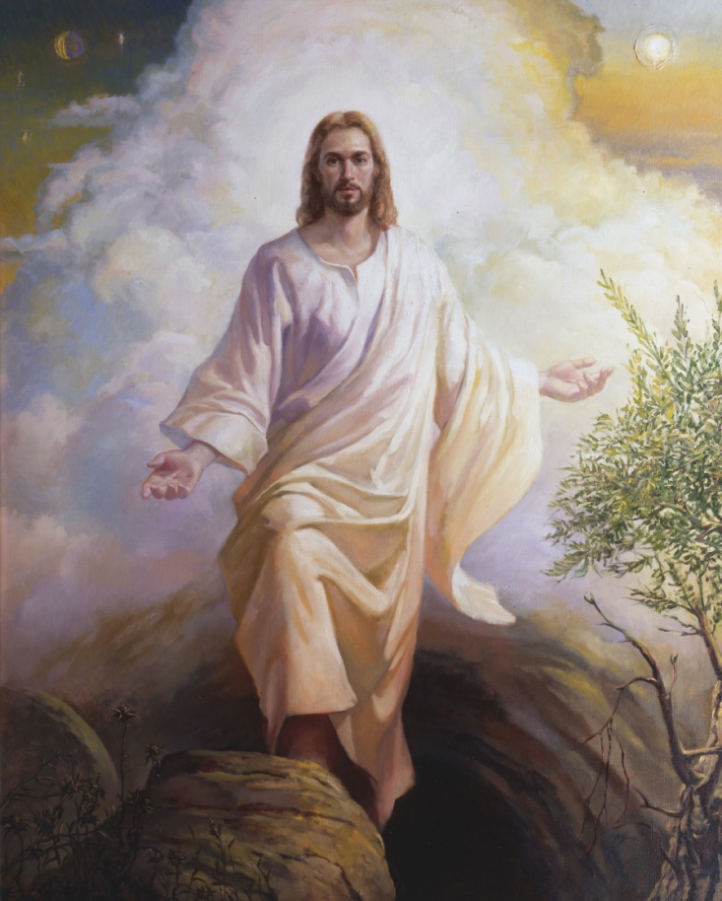
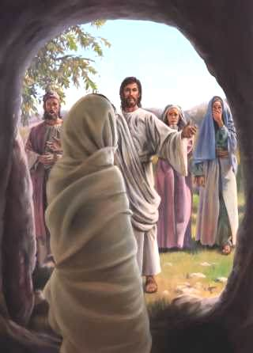
The Resurrection consists in the uniting of a spirit body with a body of flesh and bones, never again to be divided. The Resurrection shall come to all, because of Christ’s victory over death. Jesus Christ was the first to be resurrected on this earth.
Others had been brought back from death but were restored to mortality whereas a resurrection means to become immortal, with a body of flesh and bone.
All will not be raised to the same glory in the Resurrection nor will all come forth at the same time. Christ was first; the righteous have precedence over the wicked and come forth in the First Resurrection, whereas the unrepentant sinners come forth in the last resurrection.
Matthew 28:6
(3)

Slide 11
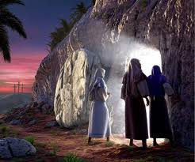
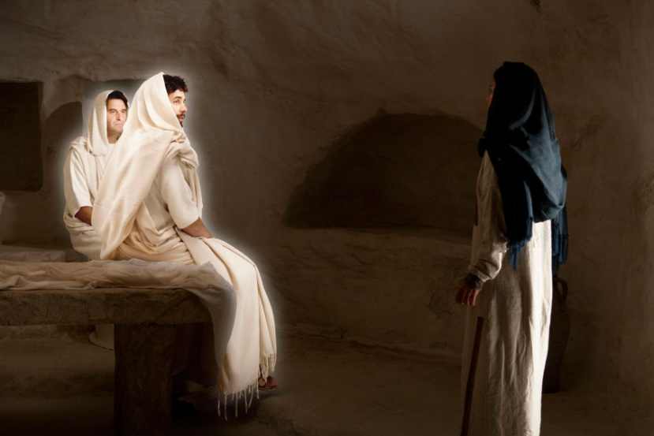
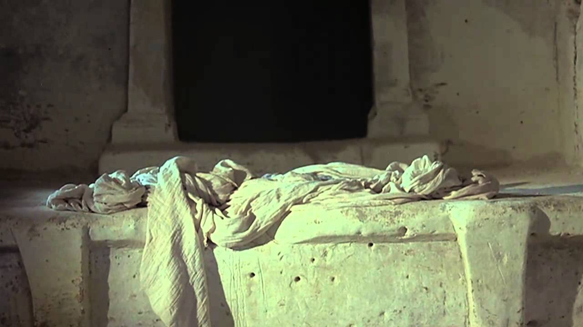
“He is Risen”
The New Testament gives ample evidence that Jesus rose with His physical body: He ate fish and honey
He said He had flesh and bones the people touched Him. the tomb was empty and the angels said He had risen.
One of the most fundamental doctrines taught by the Twelve was that Jesus was risen from the tomb, with His glorified, resurrected body, as in. To obtain a resurrection with a celestial, exalted body is the center point of hope in the gospel of Jesus Christ. The Resurrection of Jesus is the most glorious of all messages to mankind.
Matthew 28:6
(3)

Slide 12
What day of the week was it? (Matthew 28:1)

Slide 13
Who went to the sepulcher?
(Matthew 28:1)

Slide 14
Who appeared?
(Matthew 28:2)

Slide 15
How was the stone rolled away from the sepulcher?
(Matthew 28:2)

Slide 16
What happened to the soldiers?
(Matthew 28:4)

Slide 17
What did the angel say?
(Matthew 28:5-7)
He is not here: for he is risen, as he said. Come, see the place where the Lord lay.

Slide 18
Where did the women go?
(Matthew 28:8)

Slide 19
What happened to them on the way?
(Matthew 28:9-10)
Be not afraid: go tell my brethren that they go into Galilee, and there shall they see me.

Slide 20
What happened to some of the dead in Jerusalem after Christ was resurrected?
(Matthew 28:52-53)

Slide 21
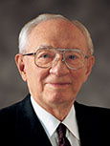
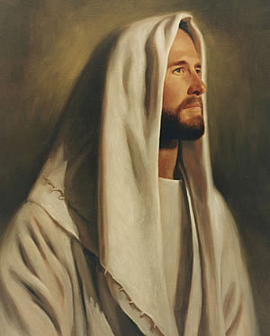
“The miracle of that resurrection morning, that first Easter Sunday, is a miracle for all mankind. It is the miracle of the power of God, whose Beloved Son gave His life to atone for the sins of all, a sacrifice of love for every son and daughter of God. In so doing He broke the seals of death. …
“And just as He took up His body and came forth from the tomb, even so shall all of us enjoy a reunion of body and spirit to become living souls in the day of our own resurrection.
“We rejoice, therefore, as do many, and as should all mankind, when we remember the most glorious, the most comforting, the most reassuring of all events of human history—the victory over death.”
As we gain a testimony of Jesus Christ, we have a responsibility to testify of Him to others
(4)

Slide 22
Sources:
Suggested Hymn: #136 I Know That My Redeemer Lives
Video:
Jesus Is Laid in a Tomb (3:29)
He Is Not Here: For He Is Risen (2:24)
Sweep the Earth as with a Flood—Highlight (2:57)
New Testament Institute Student Manual Chapter 9
Elder Bruce R. McConkie Doctrinal New Testament Commentary, 1:830
Bible Dictionary
President Gordon B. Hinckley (“The Victory over Death,” Ensign, Apr. 1997, 4).
Presentation by ©http://fashionsbylynda.com/blog/

Slide 23
Event | Matthew | Mark | Luke | John
Veil of the Temple Torn from Top to Bottom | 27:51 | 15:38 | 23:45
Testimony of Witnesses | 27:54-56 | 15:39-41 | 23:47-49
The Burial of Jesus | 27:57-61 | 15:42-47 | 23:50-56 | 19:38-42
Guards Placed at the Tomb | 27:62-66
Angel Rolls Back the Stone | 28:2-4
Women Find the Tomb Opened | 28:1 | 16:2-4 | 24:1, 2 | 20:1
Women Enter Tomb and See Angels Who Proclaim, “He is Not Here; for He is Risen” | 28:5-7 | 16:5-7 | 24:3-8
Women Hurry to Tell the Apostles | 28:8 | 16:8 | 24:9-11
Jesus Appears to Other Women | 28:9-10
Others Resurrected After Jesus | 27:52, 53
Guards Are Bribed by Chief Priests | 28:11-15
Jesus Appears to Other Women | 28:9-10
Others Resurrected After Jesus | 27:52, 53
Guards Are Bribed by Chief Priests | 28:11-15
Jesus Appears to the 11 in Galilee | 28:16-20 | 16:15-18

Slide 24
The Resurrected Matthew 27:53
How grateful are we to Matthew for including this important detail? Mark makes no mention of the resurrection of the saints. Luke says nothing. John is silent. Nephi is chastised for forgetting to record it (see 3 Ne. 23:7-13). Matthew's careful attention to detail underscores the importance of the resurrection, not just of the Master, but of all the saints. But who were these saints?
While Christ's earthly disciples mourned his crucifixion, his heavenly disciples anxiously awaited his visit to Spirit Paradise. On the cross, Christ was enclosed by 'the assembly of the wicked' (Ps. 22:16). Meanwhile, another great gathering commenced. It included Adam, Eve, with many of her faithful daughters, Abel, Seth, Noah, Shem, Abraham, Isaac, Jacob, Moses, Isaiah, Ezekiel, Daniel, Elias, Malachi, Elijah, the Nephite prophets-'All these and many more' (DC 138:38-49). What was the cause of such an important conference? They were all awaiting their glorious resurrection. gospeldoctrine.com
Myrrh and Aloes:
The amount of myrrh and aloes purchased by Nicodemus was similar to that used in royal burials, indicating that the Savior’s followers acknowledged His status as a king. (1)
Christ Resurrected on a Sunday:
As a result of Jesus Christ resurrecting early in the morning of Sunday, the observance of the Sabbath was changed from Saturday to Sunday:
“In Old Testament times, God’s covenant people observed the Sabbath on the seventh day of the week because God rested on the seventh day when He had created the earth. …
“After the Resurrection of Jesus Christ, which occurred on the first day of the week, the Lord’s disciples began observing the Sabbath on the first day of the week, Sunday (see Acts 20:7)” (True to the Faith: A Gospel Reference [2004], 145–46). See also the commentary for John 20:1–10.
Rewards of Resurrection
"What is the reward and status of those who were with Christ in his resurrection? 'They are raised to dwell with God who has redeemed them; thus they have eternal life through Christ, who has broken the bands of death.' (Mosiah 15:20-23.) Theirs is a state of glory and exaltation. Three of them-Abraham, Isaac, and Jacob-are singled out by name and made patterns for all the rest. Of these three the Lord says: 'They have entered into their exaltation, according to the promises, and sit upon thrones, and are not angels but are gods.' (D&C 132:29, 37.) These are they who were with Christ in his resurrection, who, as Matthew says, 'came out of the graves after his resurrection, and went into the holy city, and appeared unto many.' (Matt. 27:53.) These are they whom the Lord Jesus will bring with him in the clouds of glory when he comes to rule and reign among men for a thousand years." Elder Bruce R. McConkie (The Millennial Messiah: The Second Coming of the Son of Man, 632.)
He is Not Here (Special Witnesses of Christ’s Resurrection Matthew 28:6
“‘He is not here: for he is risen, as he said. Come, see the place where the Lord lay’
“These are the most reassuring words in all of human history. Death—universal and final—had now been conquered. …
“Never had this occurred before. There had been only death without hope. Now there was life eternal. Only a God could have done this. The Resurrection of Jesus Christ was the great crowning event of His life and mission. It was the capstone of the Atonement. The sacrifice of His life for all mankind was not complete without His coming forth from the grave, with the certainty of the Resurrection for all who have walked the earth.
“Of all the victories in the chronicles of humanity, none is so great, none so universal in its effects, none so everlasting in its consequences as the victory of the crucified Lord, who came forth from the tomb that first Easter morning.
“Those who were witnesses of that event, all who saw and heard and spoke with the Risen Lord, testified of the reality of this greatest of all miracles. His followers through the centuries lived and died in proclamation of the truth of this supernal act.
“To all of these we add our testimony that He who died on Calvary’s cross arose again in wondrous splendor as the Son of God, the Master of life and death” Pres. Gordon B. Hinckley (“Special Witnesses of Christ,” Ensign, Apr. 2001, 15).
.
The Empty Tomb Matthew 27:52-53:
“The empty tomb that first Easter morning brought comforting assurance, an affirmative answer to Job’s question, ‘If a man die, shall he live again?’ [Job 14:14].
“To all who have lost loved ones, we would turn Job’s question to an answer: If a man die, he shall live again. …
“Through tears and trials, through fears and sorrows, through the heartache and loneliness of losing loved ones, there is assurance that life is everlasting. Our Lord and Savior is the living witness that such is so.
“With all my heart and the fervency of my soul, I lift up my voice in testimony as a special witness and declare that God does live. Jesus is His Son, the Only Begotten of the Father in the flesh. … He became the firstfruits of the Resurrection. Because He died, all shall live again.” President Thomas S. Monson (“I Know That My Redeemer Lives!” Ensign or Liahona, May 2007, 25).

