Slide 1
Lesson 34
Preaching, Casting Out Devils, and Healing Lepers
Mark 1
Submit yourselves therefore to God. Resist the devil, and he will flee from you.
James 4:7

Slide 2
Mark
He was also called John Mark, son of Mary from Jerusalem and a cousin or nephew of Barnabas from Jerusalem
After the death of James the Apostle, at the hands of Herod Agrippa I, Peter found his way to the house of Mary the mother of John…whose surname was Mark
Mark journeyed with Paul and Barnabas on their first mission, but at Perga he declined to continue with them and later went with Barnabas to Cyprus. He was also with Paul in Rome at a later time
He was with Peter for a time and also spent time with Timothy at Ephesus
He was too young to be associated with Jesus and His ministry, but thought to be mentored by Peter. Peter referred to him as “Marcus my son”
Mark likely wrote his Gospel in Rome between A.D. 64 and A.D. 70, perhaps shortly after the Apostle Peter suffered martyrdom in about A.D. 64
Tradition states after Peter’s death, Mark visited Egypt, founded the Church of Alexandria, and died a martyrdom
He provided cultural and geographical explanations that appealed to the gentiles (non-Jewish) audience and one-third of Mark’s Gospel recounts the Savior’s teachings and experiences during the last week of His life
(2,3)

Slide 3
Gospel of Mark
Mark’s account of the Savior’s life is different from Matthew’s.
It begins suddenly and is fast-paced, emphasizing the Savior’s divinity by focusing on His works and miracles.
Mark likely wrote his account based on what he learned from the Apostle Peter.

Slide 4
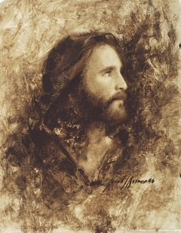
Special Attention to Jesus Christ’s Identity
“The beginning of the gospel of Jesus Christ, the Son of God.”
Mark emphasizes the importance that Jesus is the Son of God
And there came a voice from heaven, saying, Thou art my beloved Son, in whom I am well pleased.
Mark 1:11
And he healed many that were sick of divers diseases, and cast out many devils; and suffered not the devils to speak, because they knew him.
Mark 1:34
And they were astonished at his doctrine: for he taught them as one that had authority,.
Mark 1:22
I know thee who thou art, the Holy One of God.
Mark 1:24
…for with authority commandeth he even the unclean spirits, and they do obey him
Mark 1:27
Mark 1:1

Slide 5
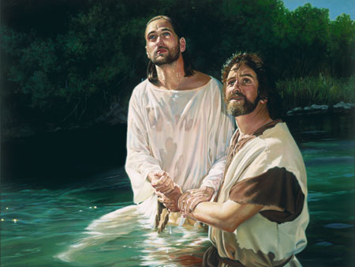
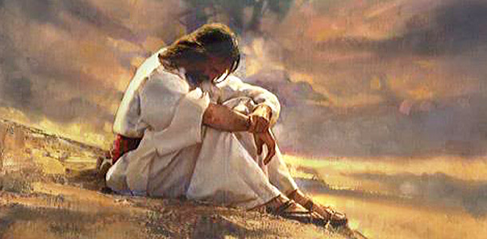
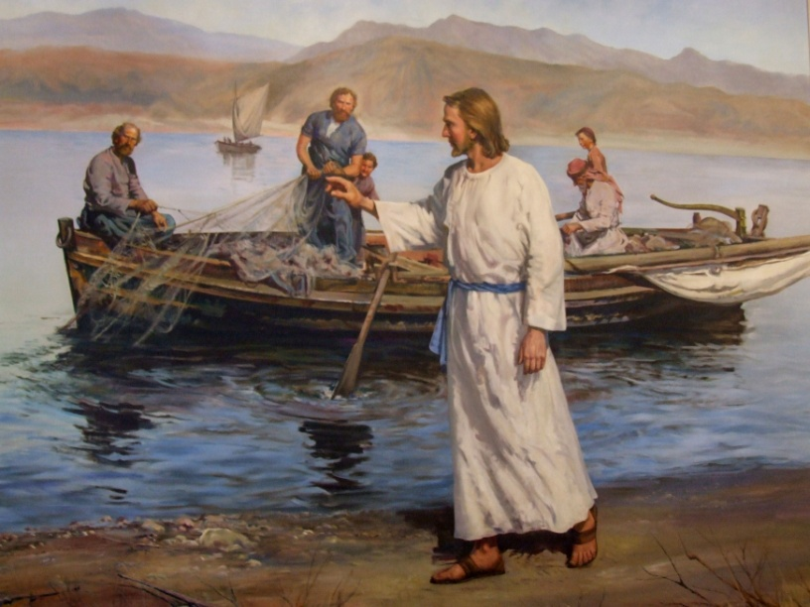
More Insight From Mark
Jesus is baptized by John and Jesus preached the baptism of repentance and the remission of sins
After Jesus fasted for 40 days, He was tempted by the devil.
He also preached repentance in Galilee and called disciples to follow Him.
Mark 1:12-20; Matthew 4

Slide 6
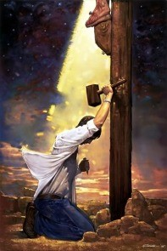
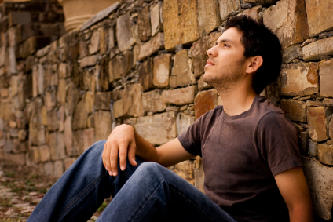
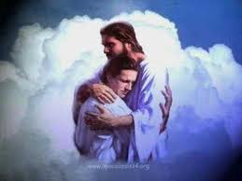
Invitation to Repent
“Repentance is one of the first principles of the gospel.
It is essential to your happiness in this life and throughout eternity. Repentance is much more than just acknowledging wrongdoings.
It is a change of mind and heart that gives you a fresh view about God, about yourself, and about the world.
It includes turning away from sin and turning to God for forgiveness” (4)
Mark 1:4-5, 15; Article of Faith 1:4

Slide 7
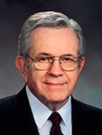
Enemy Territory
“You young people are being raised in enemy territory.
“We know from the scriptures that there was a war in heaven and that Lucifer rebelled and, with his followers, ‘was cast out into the earth’ [Revelation 12:9].
He is determined to disrupt our Heavenly Father’s plan and seeks to control the minds and actions of all.” (5)
In what ways is our life here on earth like being in enemy territory?
(1)

Slide 8
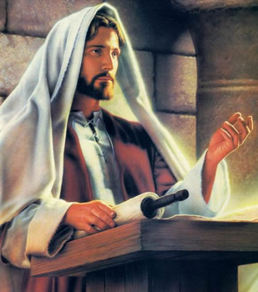
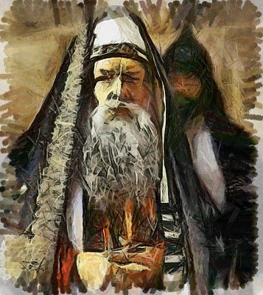
Teaching With Authority
Jesus went to Capernaum and taught in the synagogue
Scribes were considered experts in the legal aspects of the law of Moses.
When preaching and interpreting the law, they typically added greater weight and authority to their teaching by appealing to former authorities and experts. In contrast, Jesus spoke with the authority of the Lawgiver, for He was the giver of the law of Moses.
Mark 1:21-22
(1)

Slide 9
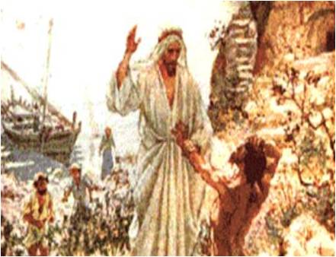
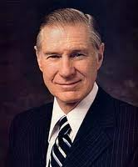
Unclean Spirits
The evil spirits that seek to possess physical bodies are Lucifer’s followers. They dwelt in the presence of Heavenly Father and Jesus Christ before being cast out of heaven
And he shall cast out devils, or the evil spirits which dwell in the hearts of the children of men. Mosiah 3:6
And because of the righteousness of his people, Satan has no power; wherefore, he cannot be loosed for the space of many years; for he hath no power over the hearts of the people, for they dwell in righteousness, and the Holy One of Israel reigneth.
1 Nephi 22:26
“We need not become paralyzed with fear of Satan’s power. He can have no power over us unless we permit it. He is really a coward, and if we stand firm, he will retreat. The Apostle James counseled: ‘Submit yourselves therefore to God.
Resist the devil, and he will flee from you’.
He cannot know our thoughts unless we speak them.
And Nephi states that ‘he hath no power over the hearts’
of people who are righteous.”
Mark 1:23-26
(6)

Slide 10
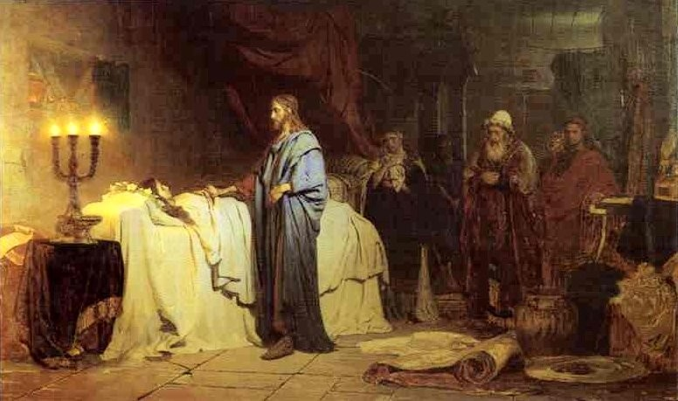
Healing Peter’s Mother-in-law
The Savior healed Simon Peter’s mother-in-law of a fever, healed many others who were sick, and cast out many devils. Jesus continued to preach in Galilee.
And in the morning, rising up a great while before day, he went out, and departed into a solitary place, and there prayed.
Mark 1:29-39
(6)

Slide 11
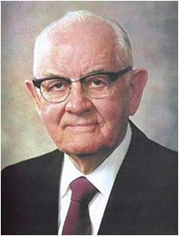
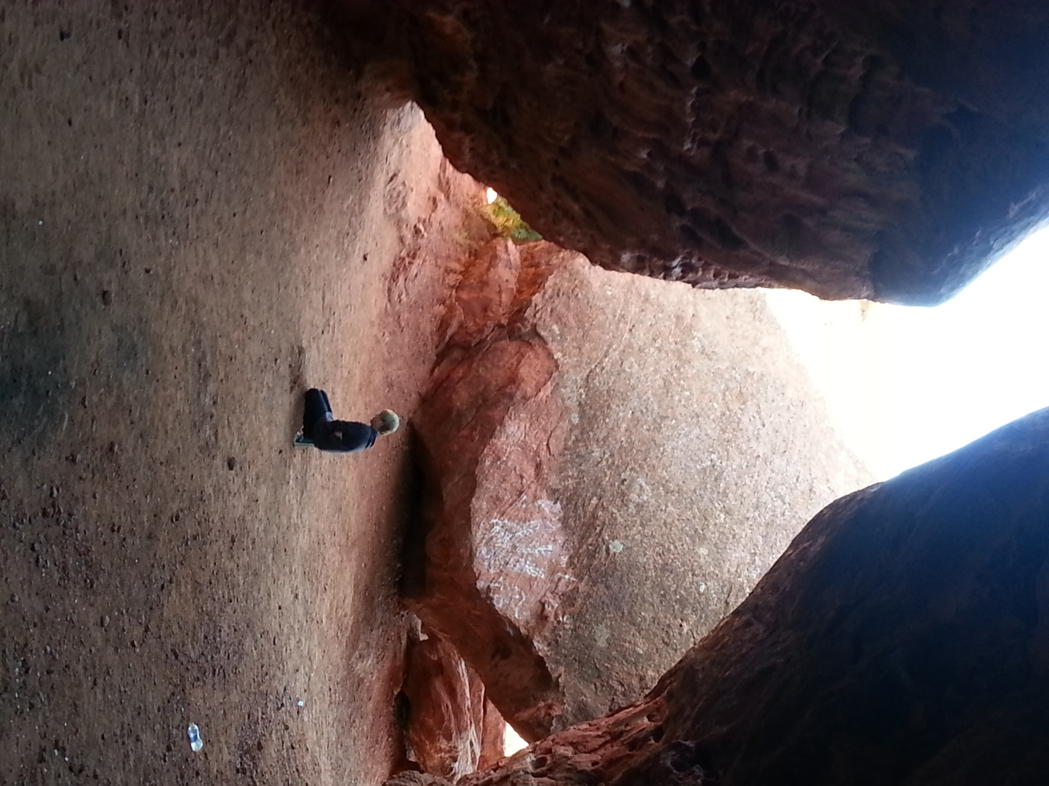
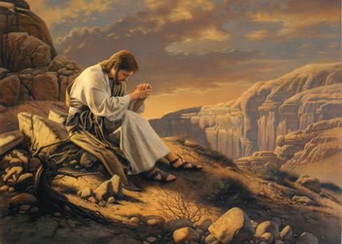
Seeking Solitude
“Solitude is rich and profitable. When we Pray alone with God, we shed all sham and pretense, all hypocrisy and arrogance…
Mark 1:35
(7)

Slide 12
The Savior found His mountains and slipped away to pray.
Mark 1:35
(7)

Slide 13
Apostle Paul found cleansing solitude down in Arabia
Galatians 1:17
(7)

Slide 14
Enos found his solitary place in the forest
Enos 1:1-11
(7)

Slide 15
Mahonri Moriancumer (Brother of Jared) went to the mountain top to ask the Lord to make the stones shine for their vessels.
Ether 3:1-6
(7)

Slide 16
Nephi learned to build a ship through communication with the Lord on a mountain far from human ears.
(7)

Slide 17
Joseph Smith found his solitude in the woods where he wanted to know ‘which of all the sects was right, that I might know which to join.’
Joseph Smith 1:14-18
(7)

Slide 18
….In solitude we, too, may pray with greater depth and fervor.”
(7)

Slide 19
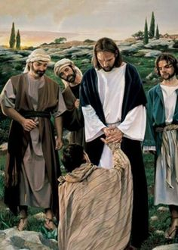
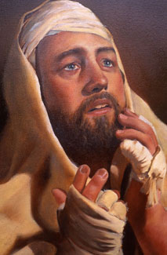
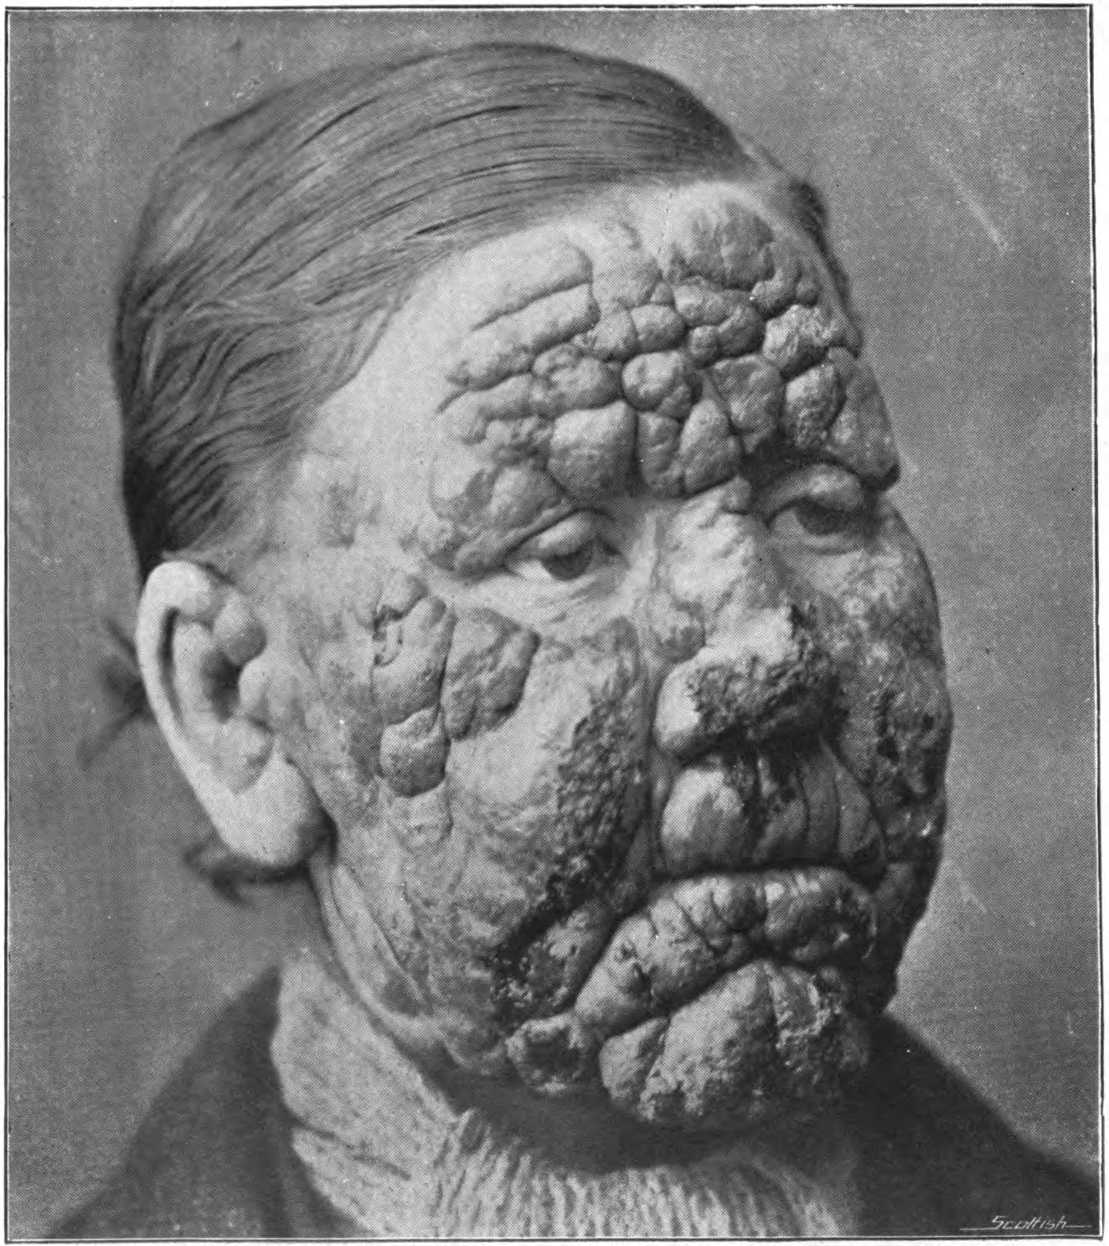
Healing a Leper
Leprosy is a chronic disease that attacks skin, nerves, eyes, bones, and limbs. Left untreated, it leads to a painful death. In ancient times, it was believed that anyone who came in contact with lepers would contract the disease.
Beseeching = begging
It is remarkable that Jesus touched this leper while healing him. (1)
After healing the man, the Savior commanded him to obey the Mosaic commandment that healed lepers present themselves to a priest, offer sacrifice, and undergo a purification ritual.
He also told him to tell no one, but word spread anyway and Jesus had to leave the city.
People still came to Him in the desert.
To protect a community’s health and well-being, lepers were forced to live outside the town. The law required them to call out “Unclean!” to warn anyone approaching them
Kyle Vincent
Mark 1:40-45; Leviticus 13:44–46
(3)

Slide 20
Sources:
Suggested Hymn: #263 Go Forth With Faith
Video:
We Believe in Christ: Personal Testimony (2:54)
“Jesus Heals a Possessed Man”(1:48)
Leprosy (0:56)
New Testament Institute Student Manual Chapter 11
Who’s Who in the New Testament by Richard J. Allen p. 107
Bible Dictionary
True to the Faith: A Gospel Reference [2004], 132
Elder Boyd K. Packer (“Counsel to Youth,” Ensign or Liahona, Nov. 2011, 16).
James E. Faust (“The Great Imitator,” Ensign, Nov. 1987, 35).
President Spencer W. Kimball Faith Precedes the Miracle
Presentation by ©http://fashionsbylynda.com/blog/

Slide 21
Event | Matthew | Mark | Luke | John
John and His Message | 3:1-12 | 1:2-8 | 3:3-18
Jesus is Baptized by John | 3:13-17 | 1:9-11 | 3:21-23
Fast and Temptation of Jesus | 4:1-11 | 1:12, 13 | 4:1-13
Jesus Leaves Judea for Galilee | 4:12 | 1:14 | 4:14 | 4:1-3
Goes to Capernaum | 4:13-17 | 1:15
Fishers of Men: Peter, Andrew, James, and John | 4:18-22 | 1:16-20 | 5:1-11
Jesus Teaches with Power and Authority |  | 1:21,22 | 4:31,32
Jesus Casts Out Unclean Spirit |  | 1:23-28 | 4:33-37
Jesus Heals Peter’s Mother-in-Law and Others | 8:14-17 | 1:29-34 | 4:38-41
Jesus Preaches and Heals in Galilee | 4:23-25 | 1:35-39 | 4:42-44
Jesus Cleanses a Leper | 8:2-4 | 1:40-45 | 5:12-16
Joseph Smith on Mark 1:4
"It was the baptism of repentance unto the remission of sins for the receiving of the Holy Ghost, and it was the gospel baptism.
"John preached the gospel and must have preached the first principles. If so he must have preached the doctrine of baptism for the remission of sins, for that is the first principle of the gospel and was ordained before the foundation of the world.
"John came preaching the gospel for the remission of sins. He had his authority from God, and the oracles of God were with him. The kingdom of [God] for a season seemed to be with John alone. . . . He preached the same gospel and baptism that Jesus and the apostles preached after him." (Kent P. Jackson, comp. and ed., Joseph Smith's Commentary on the Bible [Salt Lake City: Deseret Book Co., 1994], 116.)
Baptism JST John 4:3-4:
The other interesting doctrinal addition by the Prophet is that Jesus did in fact personally perform the ordinance of baptism. This little known fact is preserved in this rendition of Mark and in JST John 4:3-4, 'Now the Lord...himself baptized not so many as his disciples; For he suffered them for an example preferring one another.' See also JST John 1:28 and commentary for John 3:22.
Ordinance of Baptism:
"Those who seek to follow the Savior will understand the importance of the ordinance of baptism. The Lamb without Blemish saw fit to submit himself to baptism by one holding the authority of the priesthood in order to 'fulfil all righteousness.' How much more each of us has need of the cleansing and saving power of this ordinance and the other ordinances of the gospel." Elder Dallin H. Oaks ("Always Remember Him," Ensign, May 1988, 31)

Slide 22
Sign of the Dove Mark 1:10:
"The sign of the dove was instituted before the creation of the world, a witness for the Holy Ghost, and the devil cannot come in the sign of a dove. The Holy Ghost is a personage, and is in the form of a personage. It does not confine itself to the form of the dove; but in sign of the dove. The Holy Ghost cannot be transformed into a dove; but the sign of a dove was given to John to signify the truth of the deed, as the dove is an emblem or token of truth and innocence." Joseph Smith (Teachings, pp. 275-276.)
John and James Mark 1:19-20:
To be a ship-owner with hired servants suggests that James and John were men of some means. Interestingly, John also had political connections. John's personal relationship with the high priest allowed him to gain access to the council of the Sanhedrin at the time of Christ's trial-eventually allowing Peter access as well (John 18:15-16). How a Galilean fisherman like John became an acquaintance of the high priest is unknown. gospeldoctrine.com
Repent Origin :
“When Jesus said ‘repent,’ His disciples recorded that command in the Greek language with the verb metanoeo. This powerful word has great significance. In this word, the prefix meta means ‘change.’ The suffix relates to four important Greek terms: nous, meaning ‘the mind’; gnosis, meaning ‘knowledge’; pneuma, meaning ‘spirit’; and pnoe, meaning ‘breath.’
“Thus, when Jesus said ‘repent,’ He asked us to change—to change our mind, knowledge, and spirit” Elder Russell M. Nelson(“Repentance and Conversion,” Ensign or Liahona, May 2007, 103).
My Beloved Son. Hear Him Mark 1:11:
"Each time the Father has introduced the Son, he has declared the Sonship of the Only Begotten. As John the Baptist baptized Jesus while others stood on the river bank, the Father declared to Jesus: 'Thou art my beloved Son, in whom I am well pleased.' At the transfiguration, the Father said to Peter, James, and John: 'This is my beloved Son, in whom I am well pleased; hear ye him.' And to the people on this hemisphere, the Father proclaimed: 'Behold my Beloved Son, in whom I am well pleased, in whom I have glorified my name-hear ye him.'
"[And again to Joseph Smith], praying in the woods on that bright spring morning, the Father, calling the youth by name, pointed to the Son, and said: 'This is My Beloved Son. Hear Him!'" J. Rueben Clark Jr. (On the Way to Immortality and Eternal Life [Salt Lake City: Deseret Book Co., 1949], 115.)
Unclean Spirits Mark 1:23
“[Joseph Smith] stated, ‘Wicked spirits have their bounds, limits, and laws by which they are governed’ [in History of the Church,4:576]. So Satan and his angels are not all-powerful. …
“… Satan’s efforts can be thwarted by all who come unto Christ by obedience to the covenants and ordinances of the gospel.” President James E. Faust (“Serving the Lord and Resisting the Devil,” Ensign, Sept. 1995, 6, 7).
With Wild Beasts and Angels Mark 1:13:
"Meditation is one of the most secret, most sacred doors through which we pass into the presence of the Lord. Jesus set the example for us. As soon as he was baptized...Jesus repaired to what is now known as the mount of temptation. I like to think of it as the mount of meditation where, during the forty days of fasting, he communed with himself and his Father, and contemplated upon the responsibility of his great mission.“David O. McKay (Conference Report, April 1946, p. 113.)
Solitary Place Mark 1:35:
"[Jesus] communed constantly with his Father through prayer. This he did not only to learn the will of his Father but also to obtain the strength to do his Father's will. He fasted and prayed forty days and forty nights at the beginning of his ministry. (Matthew 4:2; Mark 1:13; Luke 4:2.) He prayed all night just before choosing his twelve apostles. (Luke 6:12-13.) He prayed in the Garden of Gethsemane. (Matthew 26:39.) It would seem that during his earthly ministry he never made a major decision or met a crisis without praying." (Come unto Christ [Salt Lake City: Deseret Book Co., 1983], 44.)
Kingdom of God Mark 1:15:
"Some say the kingdom of God was not set up on the earth until the day of Pentecost, and that John did not preach the baptism of repentance for the remission of sins. But I say, in the name of the Lord, that the kingdom of God was set up on the earth from the days of Adam to the present time, whenever there has been a righteous man on earth unto whom God revealed His word and gave power and authority to administer in His name. And where there is a priest of God-a minister who has power and authority from God to administer in the ordinances of the gospel and officiate in the priesthood of God-there is the kingdom of God." (Teachings of the Prophet Joseph Smith, 271)

Slide 23
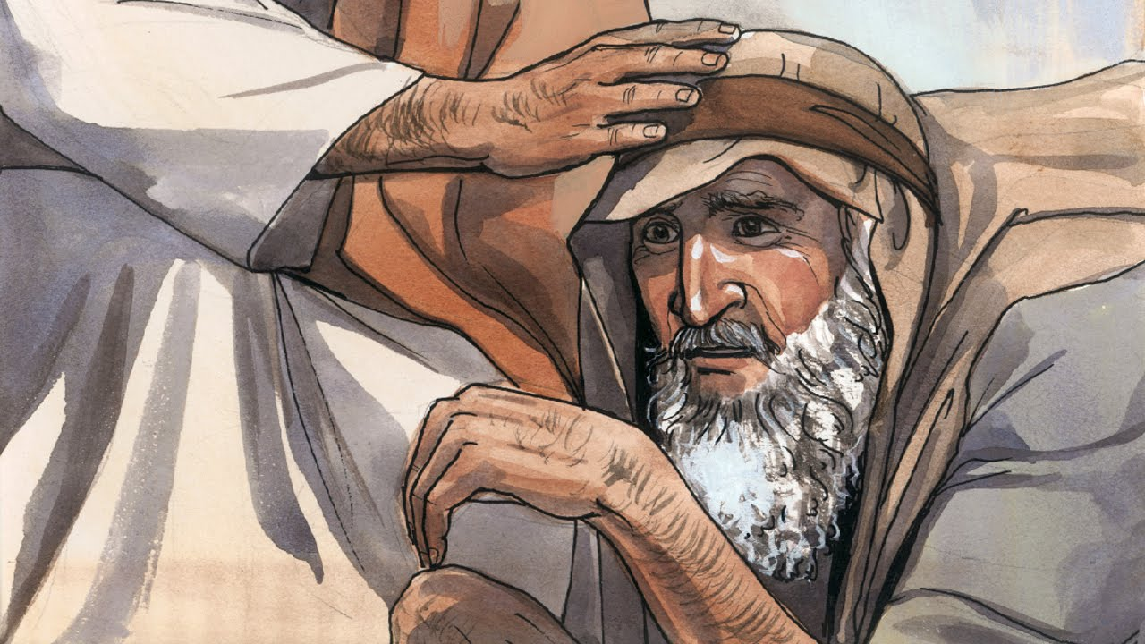
In ancient times the cry “Unclean!”
Would warn of lepers near.
“Unclean! Unclean!” the words rang out;
Then all drew back in fear,
Lest by the touch of lepers’ hands
They, too, would lepers be.
There was no cure in ancient times,
Just hopeless agony.
· · · · · · · · · · · · · · · · · · ·
But there was One, the record shows,
Whose touch could make them pure;
Could ease their awful suffering,
Their rotting flesh restore.
· · · · · · · · · · · · · · · · · · ·
The day He made ten lepers whole,
The day He made them clean,
Well symbolized His ministry
And what His life would mean.
However great that miracle,
This was not why He came.
He came to rescue every soul
From death, from sin, from shame.
· · · · · · · · · · · · · · · · · · ·
What must be done to make us clean
We cannot do alone.
The law, to be a law, requires
A pure one must atone.
He taught that justice will be stayed
Till mercy’s claim be heard
If we repent and are baptized
And live by every word.
· · · · · · · · · · · · · · · · · · ·
If we could only understand
All we have heard and seen,
We’d know there is no greater gift
Than those two words—“Washed clean!”
President Boyd K. Packer wrote a poem likening the Savior’s healing of lepers to the forgiveness that is available through repentance and the Atonement of Jesus Christ:
“Washed Clean,” Ensign, May 1997, 10–11

