Slide 1
Lesson 35
Healing and Teaching the Sabbath
Mark 2-3
He ordained twelve, that they should be with him
Mark 3:14

Slide 2
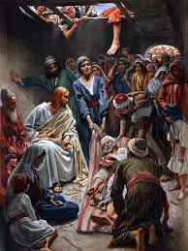
Palsy
In the village of Capernaum in Galilee, there was a man “sick of the palsy” which means he was paralyzed.
Four other men carried this man to the house where Jesus was.
When they found that the house was so crowded that they could not enter it, they disassembled part of the roof of the house and lowered the paralytic man into the Savior’s presence.
Mark 2:1-4

Slide 3
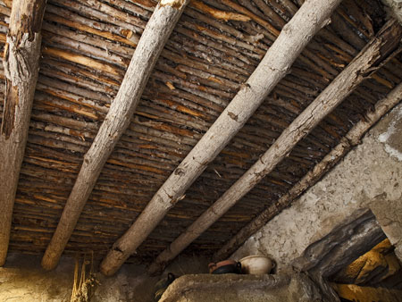
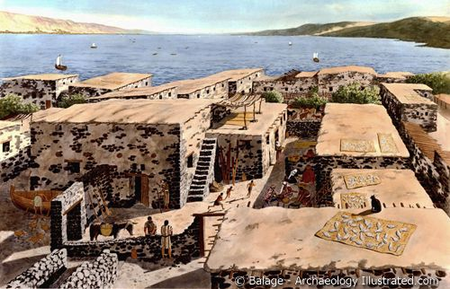
Houses in Capernaum
First-century houses in Capernaum were constructed of stone walls that were topped by a flat roof made from wooden beams, thatch, and packed earth. (1)
Underside of the roof of a reconstructed ancient house in Israel by James Jeffrey
It would not have been difficult to raise the ceiling by the courtyard stairs and to remove a part to allow the bed to be brought down to where Jesus stood. (2)
Mark 2:1-4

Slide 4
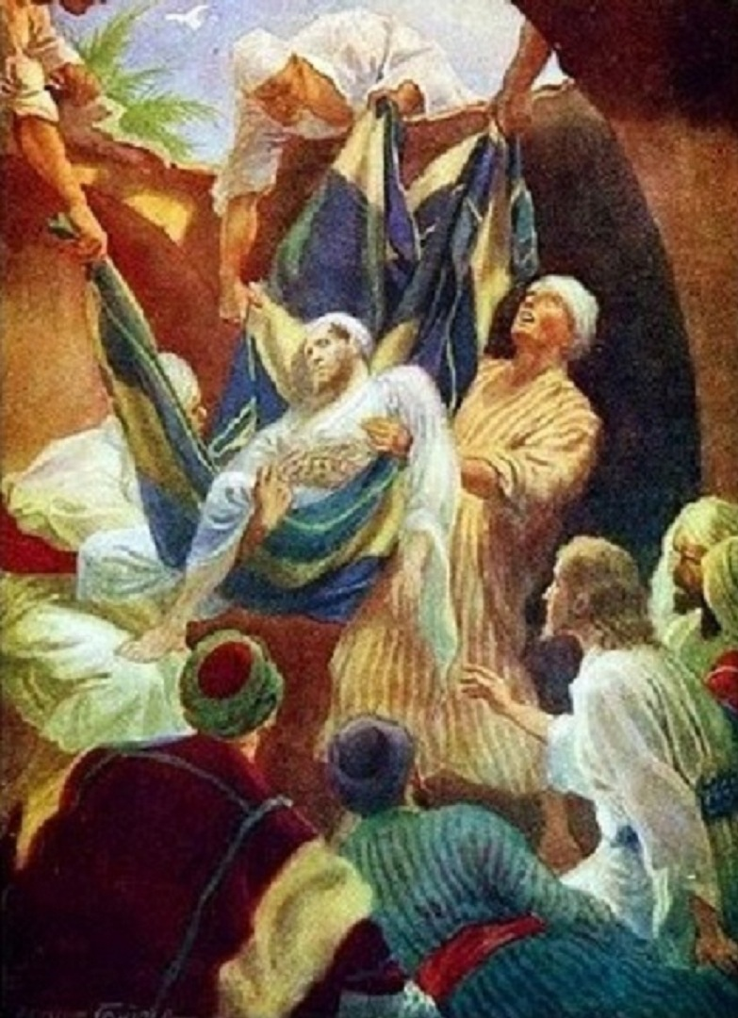
Jesus Saw Their Faith
Faith is the power to see things which are unseen
This was the combined faith of all five, as demonstrated by their unusual persistence and united effort in striving to reach the Savior. (1)
Jesus Christ has the power to heal us spiritually and physically
Mark 2:5

Slide 5
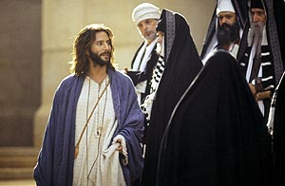
Opposing and Plotting
The Savior healed and forgave the man with palsy, called Matthew to the ministry, ate with sinners, and healed a man with a withered hand on the Sabbath.
The scribes and Pharisees opposed each event, increasing their opposition from skeptical thoughts to plotting to destroy Jesus. (1)
They were angered by His claim to grant forgiveness for sins.
Mark 2:6-7

Slide 6
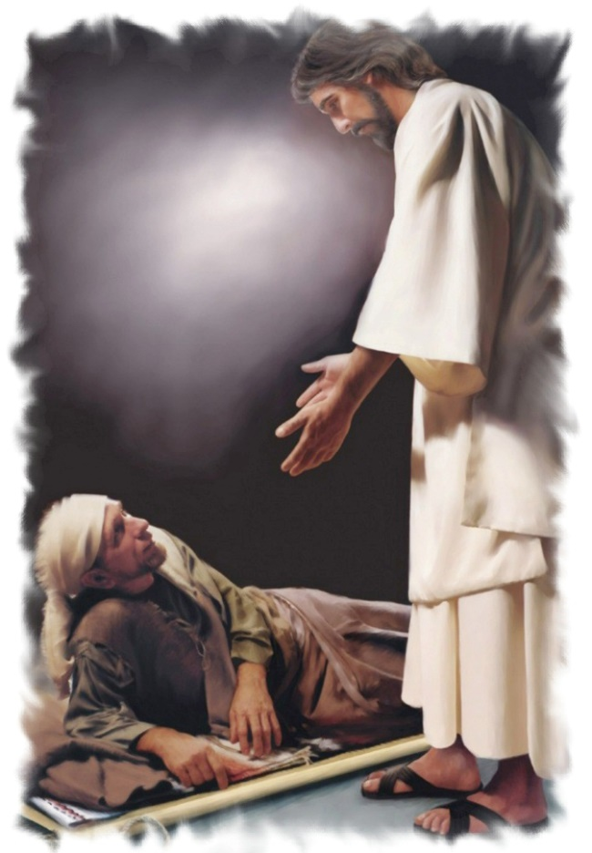
“Take Thy Bed”
"Jesus could have told the palsied man that his sins were forgiven, and no observer would have been able to prove or disprove whether it actually was so.
But when he commanded a sick man to rise and walk, the validity of his power was immediately able to be tested.
Hence in a hostile situation it is easier to say that sins are forgiven. But so that those present would know that he had power to do both, Jesus used the healing of the body as evidence of his power to forgive sins." (3)
And immediately he arose, took up the bed, and went forth before them all; insomuch that they were all amazed, and many glorified God, saying, We never saw the power of God after this manner” JST Mark 2:9
Mark 2:9-12

Slide 7
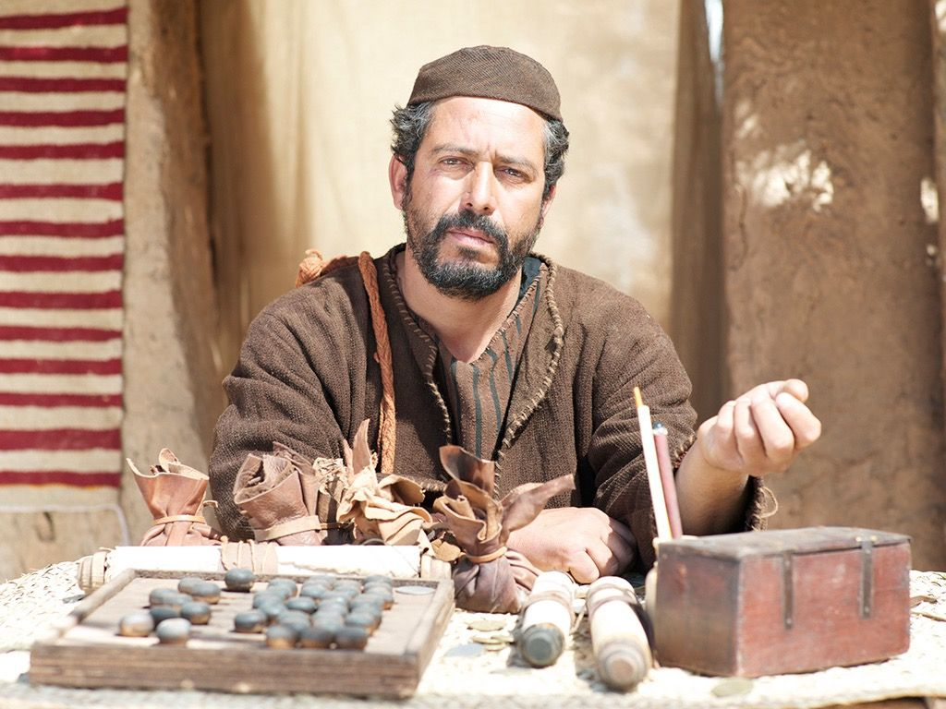
The Tax Collector
"Publicans are tax collectors; they represent Rome and are a symbol of the tyranny and oppression of the Gentile yoke. Partiality, avarice, greed, exacting more than is lawful, and petty oppression are deemed, in the public mind, to be a way of life with them. 'The rabbis ranked them as cutthroats and robbers, as social outcasts, as religiously half-excommunicated.'
It is assumed their wealth comes from rapine and their business is the business of extortioners.
"It is to this class of people that Matthew belongs. Manifestly the claims made against them are exaggerated and do not apply to all individual tax collectors."
Mark 2:13-32
(4)

Slide 8
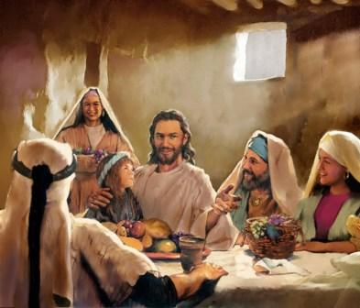
Eating and Drinking with Publicans
In the ancient Near East, sharing a meal with others meant much more than simply eating and drinking together. It was a sign of fellowship; it indicated that a bond of friendship and peace existed or was at least being offered.
The Savior often used the occasion of sharing a meal to extend the invitation to repent and obtain forgiveness.
On a number of these occasions, pious Jews criticized Jesus for dining in fellowship with people they regarded as sinners.
Mark 2:15-17
(1)

Slide 9
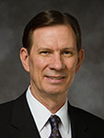
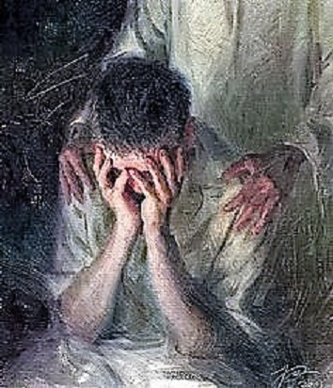
The Physician
The Savior reaffirmed His power to heal both spiritually and physically.
The Lord loves us and wants us to understand His willingness to forgive. …
“… All of us, including those struggling to overcome addictive behaviors such as substance abuse or pornography and those close to them, can know that the Lord will recognize our righteous efforts and will lovingly forgive when repentance is complete” (5)
The Savior desires to help us repent of our sins and be healed
The Pharisees and the Scribes did not come to Him to be healed
Mark 2:17

Slide 10
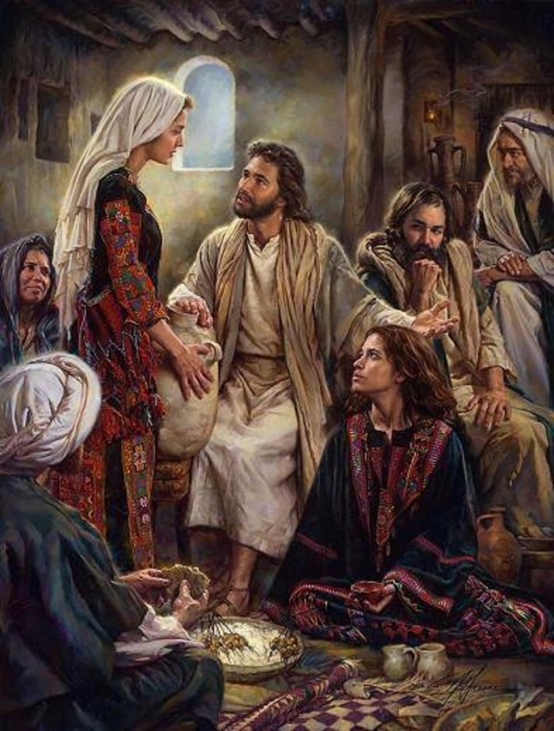
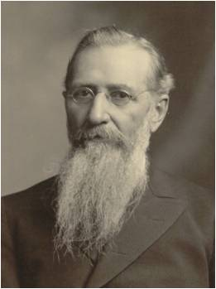
Fasting In the Presence of God?
“As Long as They Have the Bridegroom With Them, They Cannot Fast
Christ's answer teaches us something fundamental about fasting. He indicates that since his disciples were in the presence of God already, they did not need to fast. Fasting, then, is intended to bring us closer to God. The disciples had already come as close as you can get, walking and talking with Jesus Christ.
"As fasting should always be accompanied by prayer, this law would bring the people nearer to God, and divert their minds once a month at least, from the mad rush of worldly affairs and cause them to be brought into immediate contact with practical, pure, and undefiled religion - to visit the fatherless and the widow, and keep themselves unspotted from the sins of the world." (6)
Mark 2:18-20

Slide 11
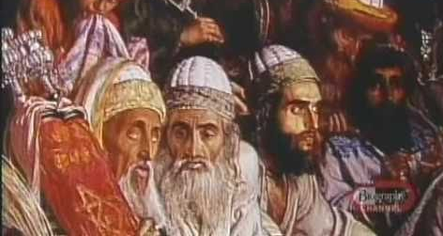
New VS Old
'Then said the Pharisees unto him, Why will ye not receive us with our baptism, seeing we keep the whole law?
But Jesus said unto them, Ye keep not the law, If ye had kept the law, ye would have received me, for I am he who gave the law.
I receive not you with your baptism, because it profiteth you nothing.
For when that which is new is come, the old is ready to be put away.' (JST Matt 9:18-21)
The baptism of the Pharisees and their hypocritical application of the law were not to be mixed with the teachings of the Lawgiver and his baptism by fire. (7)
See JST Matthew 9:18
Mark 2:21-22

Slide 12
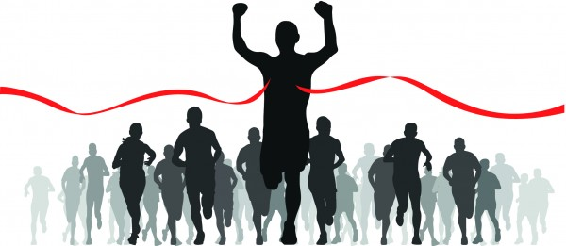
The Sabbath
How do you know whether an activity is appropriate to do on the Sabbath?
Mark 2:23

Slide 13
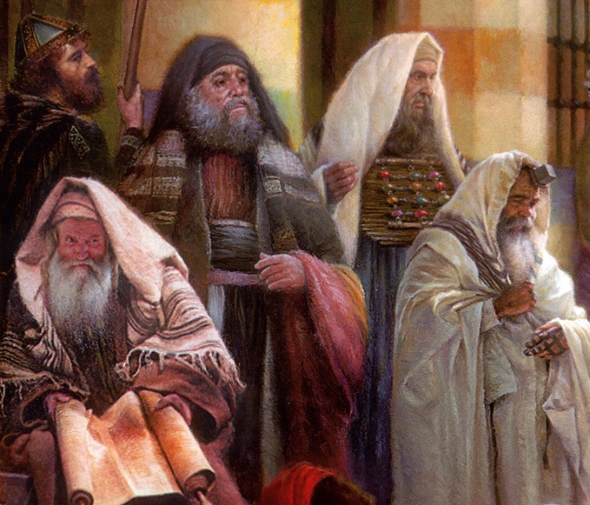
The Sabbath
Many of the objections Jewish leaders brought against the Savior during His mortal ministry concerned what activities were appropriate on the Sabbath day.
In ancient Israel the Sabbath was regarded as something that set Israel apart from all other people.
Other cultures had holy sites, sacrificial laws, and various religious customs, but only Israel had the Sabbath
To safeguard their holy day, Jewish rabbis developed many rules about what activities were or were not permissible on the Sabbath.
Such traditions of the “oral law” were intended to prevent violations of the written law.
By New Testament times, these traditions of forbidding certain activities on the Sabbath day had become points of contention among many Jews.
Mark 2:23
(1)

Slide 14
The Sabbath Was Made For Man
“Wherefore the Sabbath was given unto man for a day of rest; and also that man should glorify God, and not that man should not eat; for the Son of man made the Sabbath day, therefore the Son of man is Lord also of the Sabbath”
JST Mark 2:26-27
Mark 2:27-28
(1)

Slide 15
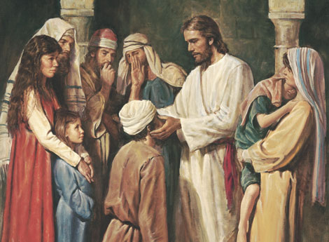
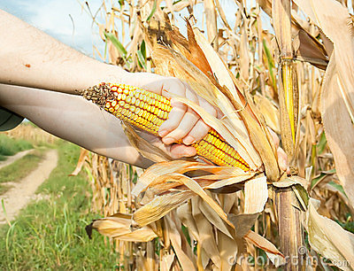
Good Vs Evil
“Is it lawful to do good on the sabbath days, or to do evil? to save life, or to kill?”
What did the Pharisees believe was unlawful for the Savior and His disciples to do on the Sabbath?
Jewish teachers added their own rules and interpretations, called the oral law or tradition, to the law of Moses.
These added rules were intended to prevent violation of God’s law, but they also prevented some people from understanding the true purpose of certain commandments, including the command to keep the Sabbath day holy.
Mark 3:1-6

Slide 16
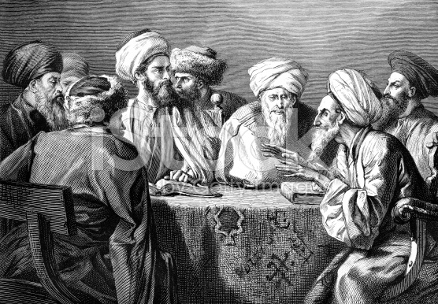
Herodians
The Herodians were a political group with religious objectives. They supported the Herodian family and its leadership—in particular Herod Antipas during Jesus’s ministry.
They appear to have been in league with the Pharisees in opposing the Savior and attempting to entrap Him. To what extent they were influenced by the Pharisees is not known.
Mark 3:6; Matthew 22:15-16

Slide 17
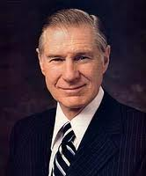
We can keep the Sabbath day holy by glorifying God and doing good works
“Where is the line as to what is acceptable and unacceptable on the Sabbath? Within the guidelines, each of us must answer this question for ourselves. While these guidelines are contained in the scriptures and in the words of the modern prophets, they must also be written in our hearts and governed by our conscience. …
It is quite unlikely that there will be any serious violation of Sabbath worship if we come humbly before the Lord and offer him all our heart, our soul, and our mind.
“What is worthy or unworthy on the Sabbath day will have to be judged by each of us by trying to be honest with the Lord. On the Sabbath day we should do what we have to do and what we ought to do in an attitude of worshipfulness and then limit our other activities.”
Mark 3:2-6
(8)

Slide 18
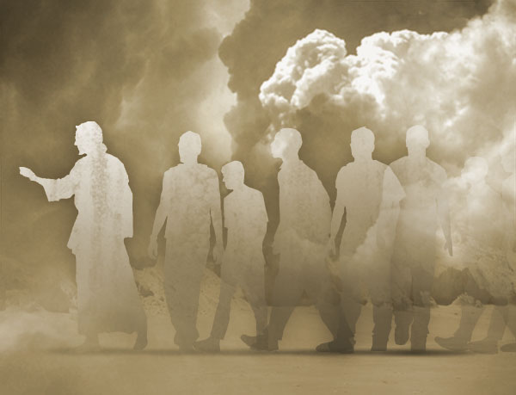
Those Who Followed Jesus
People came from all around Galilee to see Jesus. Some even came from Idumea, a region south of Judea, which was almost 120 miles from Galilee.
They came when they heard of what great things he did.
They didn't come because of the great things he said or because of the great principles he taught, but because he could work mighty miracles.
Least of all, did they come because of who he was. Yet, the marvelous miracles,… were not as important as the timeless doctrines or the significance of who he was-the Great God of Israel, the long-awaited Messiah. (7)
What Would Make You Follow Jesus?
Mark 3:7-8

Slide 19
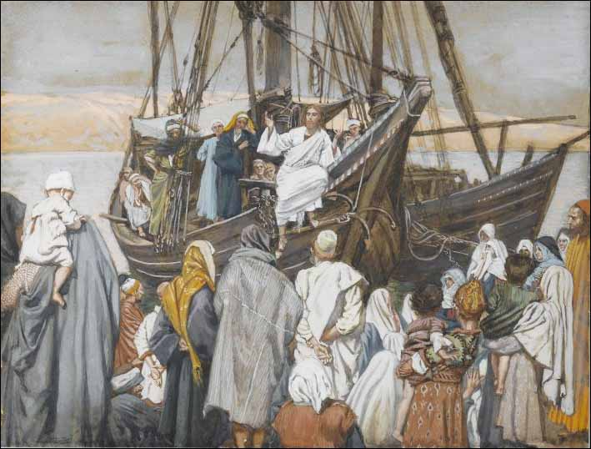
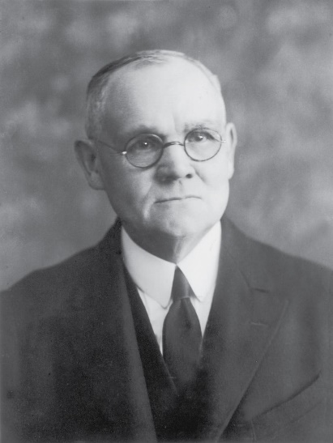
Teaching From a Ship
"One effect of the people's eagerness, which led them to press and crowd around Him, was to render difficult if not impossible at times the effective delivery of any discourse. His usual place for open-air teaching while He tarried in the vicinity of the sea, or lake, of Galilee was the shore; and thither flocked the crowds to hear Him.
James J. Tissot
At His request the disciples had provided a 'small ship,' which was kept in readiness on the beach; and it was usual with Him to sit in the boat a short distance off shore, and preach to the people, as He had done when in the earlier days He called the chosen fishermen to leave their nets and follow Him.“ (9)
Mark 3:9

Slide 20
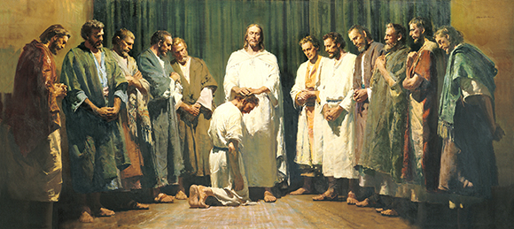
Sending Forth to Preach
And he ordained twelve, that they should be with him, and that he might send them forth to preach,
They had been given power to heal the sick and cast out devils
Mark 3:14-15

Slide 21
A Strong Man’s House
A Strong Man = Satan
Spoil his goods = cast out his servants
First bind a strong man = power and control over Satan
Spoil his house = The Savior had power to enter Satan's dominion and cast out his servants-not because he was a devil but because He was a God. (7)
DELETE
Mark 3:27

Slide 22
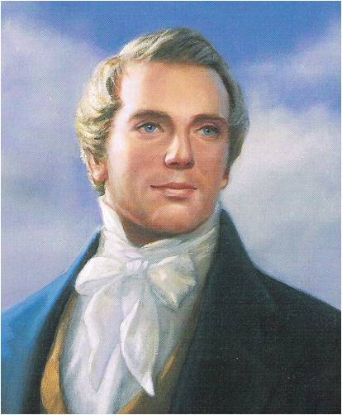
All sin, and all blasphemies, and every transgression, except one, that man can be guilty of, may be forgiven; and there is a salvation for all men, either in this world or the world to come, who have not committed the unpardonable sin, there being a provision either in this world or the world of spirits.
Hence God hath made a provision that every spirit in the eternal world can be ferreted out and saved (at least in the telestial kingdom) unless he has committed that unpardonable sin which cannot be remitted to him either in this world or the world of spirits.
God has wrought out a salvation for all men, unless they have committed a certain sin; and every man who has a friend in the eternal world can save him, unless he has committed the unpardonable sin. And so you can see how far you can be a savior."
READ
DC 76:31-39
Mark 3:28
(10)

Slide 23
Sources:
Suggested Hymn:#116 Come, Follow Me
Videos:
Jesus Forgives Sins and Heals a Man Stricken with Palsy (2:57)
The Savior Wants to Forgive (5:50).
New Testament Institute Student Manual Chapter 11
Wikipedia
Robert J. Matthews, Behold the Messiah [Salt Lake City: Bookcraft, 1994], 137.
Elder Bruce R. McConkie New Testament Commentary 1:181.
The Mortal Messiah: From Bethlehem to Calvary, 4 vols. [Salt Lake City: Deseret Book Co., 1979-1981], 2: 56
Elder Craig A. Cardon (“The Savior Wants to Forgive,” Ensign or Liahona, May 2013, 16).
Joseph F. Smith (Gospel Doctrine, 5th ed., pp. 237-238.)
Gospeldoctrine.com
President James E. Faust (“The Lord’s Day,” Ensign, Nov. 1991, 35).
James E. Talmage (Jesus the Christ, [Salt Lake City: Deseret Book Co., 1983], 262.)
(Teachings of the Prophet Joseph Smith, selected and arranged by Joseph Fielding Smith [Salt Lake City: Deseret Book Co., 1976], 356-357.)
Presentation by ©http://fashionsbylynda.com/blog/

Slide 24
Event | Matthew | Mark | Luke | John
Jesus Heals a Man with Palsy | 9:2-8 | 2:1-12 | 5:17-26
Matthew Follows Jesus | 9:9 | 2:13-14 | 5:27, 28
Jesus Came to Call Sinners to Repentance | 9:10-13 | 2:15-17 | 5:29-32
Jesus is the New law | 9:14-17 | 2:18-22 | 5:33-39
Jesus is Lord of the Sabbath | 12:1-8 | 2:23-28 | 6:1-5
Jesus Heals Man With Withered Hand on the Sabbath | 12:9-14 | 3:1-6 | 6:6-11
Multitudes Throng Jesus | 12:15-21 | 3:7-12
Call and Ordination of the Twelve Apostles | 10:2-4 | 3:13-19 | 6:12-16
Jesus Accused of Working with Beelzebub | 12:22-30 | 3:19-27
No Forgiveness for Blasphemy Against Holy Ghost | 12:31-37 | 3:28-20
Jesus’ Mother and Brother Seek Him | 12:46-50 | 3:31-35 | 8:19-21
Jesus’ Followers: Mark 3:7-8:
"The multitudes flocked to him in Palestine, not for the spiritual truths he proclaimed, nor to follow the pattern of life he declared and led. They cared little for either of these. They came to him because he healed their sick, made whole their crippled, cast out from them their evil spirits." J. Reuben Clark (Behold the Lamb of God [Salt Lake City: Deseret Book Co., 1991], 299.)

Slide 25
Capernaum: was a fishing village established during the time of the Hasmoneans, located on the northern shore of the Sea of Galilee. It had a population of about 1,500. Archaeological excavations have revealed two ancient synagogues built one over the other. A house turned into a church by the Byzantines is said to be the home of Saint Peter. The village was inhabited continuously from the 2nd century BCE to the 11th century CE, when it was abandoned sometime before the Crusader conquest.
Kfar Nahum, the original name of the small town, means "Nahum's village" in Hebrew, but apparently there is no connection with the prophet named Nahum.
The town is cited in all four gospels (where it was reported to have been near the hometown of the apostles Simon Peter, Andrew, James, and John, as well as the tax collector Matthew.
Given the coarse construction of the walls, there was no second story to a typical home, and the roof would have been constructed of light wooden beams and thatch mixed with mud. This, along with the discovery of the stairs to the roof, recalls the biblical story of the Healing of the Paralytic: "And when they could not come nigh unto him for the press, they uncovered the roof where he was: and when they had broken it up, let down the bed wherein the sick of the palsy lay." (Mark 2:4) With the type of construction seen in Capernaum, it would not have been difficult to raise the ceiling by the courtyard stairs and to remove a part to allow the bed to be brought down to where Jesus stood.
Wikipedia
Tax Collector Mark 2:14:
A tax collector or a taxman is a person who collects unpaid taxes from other people or corporations. Tax collectors are often portrayed in fiction as being evil, and in the modern world share a similar stereotype to that of lawyers.
Tax collectors, also known as publicans, are mentioned many times in the Bible (mainly in the New Testament). They were reviled by the Jews of Jesus' day because of their perceived greed and collaboration with the Roman occupiers. Tax collectors amassed personal wealth by demanding tax payments in excess of what Rome levied and keeping the difference. They worked for tax farmers. In the Gospel of Luke, Jesus sympathizes with the tax collector Zacchaeus, causing outrage from the crowds that Jesus would rather be the guest of a sinner than of a more respectable or "righteous" person. Saint Matthew in the New Testament was a tax collector. Wikipedia
The Sabbath Mark 2:26-27
“The Mosaic injunctions of Sabbath day observance contained many detailed do’s and don’ts. This may have been necessary to teach obedience to those who had been in captivity and had long been denied individual freedom of choice. Thereafter, these Mosaic instructions were carried to many unwarranted extremes which the Savior condemned. In that day the technicalities of Sabbath day observance outweighed the ‘weightier matters of the law’ (Matt. 23:23) such as faith, charity, and the gifts of the Spirit.
“In our time God has recognized our intelligence by not requiring endless restrictions. Perhaps this was done with a hope that we would catch more of the spirit of Sabbath worship rather than the letter thereof. In our day, however, this pendulum of Sabbath day desecration has swung very far indeed. We stand in jeopardy of losing great blessings promised. After all, it is a test by which the Lord seeks to ‘prove you in all things’ (D&C 98:14) to see if your devotion is complete.
“Where is the line as to what is acceptable and unacceptable on the Sabbath? Within the guidelines, each of us must answer this question for ourselves. While these guidelines are contained in the scriptures and in the words of the modern prophets, they must also be written in our hearts and governed by our conscience. … It is quite unlikely that there will be any serious violation of Sabbath worship if we come humbly before the Lord and offer him all our heart, our soul, and our mind. (See Matt. 22:37)
“What is worthy or unworthy on the Sabbath day will have to be judged by each of us by trying to be honest with the Lord. On the Sabbath day we should do what we have to do and what we ought to do in an attitude of worshipfulness and then limit our other activities. I wish to testify unequivocally concerning the blessings of Sabbath day worship” President James E. Faust (“The Lord’s Day,” Ensign, Nov. 1991, 35).
Who Can Forgive Others: Mark 2:7
“This event in the life of our Lord was visible and irrefutable proof that he was the Messiah; and it was so recognized by those among whom he ministered. He had borne frequent verbal testimony that God was his Father and had supported that personal witness with an unparalleled ministry of preaching and healing. Now it was his purpose to announce that he had done what no one but God could do and to prove that he had done it by a further manifestation of his Father’s power.
“Both Jesus and the ‘doctors of the law’ who were then present knew that none but God can forgive sins. Accordingly, as a pointed and dramatic witness that the power of God was resident in him, Jesus took (perhaps sought) this appropriate occasion to forgive sins. Being then called in question by the scripturalists who knew (and that rightly) that the false assumption of the power to forgive sins was blasphemy, Jesus did what no imposter could have done—he proved his divine power by healing the forgiven man. To his query, ‘Does it require more power to forgive sins than to make the sick rise up and walk?’ there could be only one answer! They are as one; he that can do the one, can do the other” Elder Bruce R. McConkie (Doctrinal New Testament Commentary, 3 vols. [1965–73], 1:177–78).

Slide 26
The 12 Apostles Are Ordained
Simon | Given a special name by Jesus: Cephas (Syriac) or Petros (Greek) which means "stone or rock." He is Andrew's brother.
James | James is the Greek form of the Hebrew Jacob. The Hebrew James means "supplanter." He is John's brother.
John | The name means "Jehovah's Gift," from the Hebrew Johanan. He is James' brother.
Andrew | The name means "manly." He is Simon Peter's brother.
Philip | The name comes from the Greek and means "lover of horses."
Bartholomew (Nathanael) | The name means "gift of God," and is from the Hebrew.
Thomas | He is also called Didymus, from the Greek, meaning "twin." See John 11:16; 20:24.
Matthew | He was also called Levi, a Hebrew word meaning "gift of Jehovah." Also called the Publican. He is James the Less' brother.
James | Called "the less" to distinguish him from James, son of Zebedee. He is Matthew's brother.
Thaddeus (Judas, not Iscariot) | Thaddeus is the Hebrew root for "heart." He is also called Lebbaeus which is Arabic for "root."
Simon | Called "the Canaanite" (Matthew 10:4) and "the Zealot" (Lu. 6:15). The Hebrew word for zealots wasKananim. This would explain the title "Canaanite."
Judas | Called Iscariot, probably because he was from the village of Kerioth (Joshua 15:24).
Adapted from Institute Manual, The Life and Teachings of Jesus & his Apostles, 2nd ed., p. 55

