Slide 1
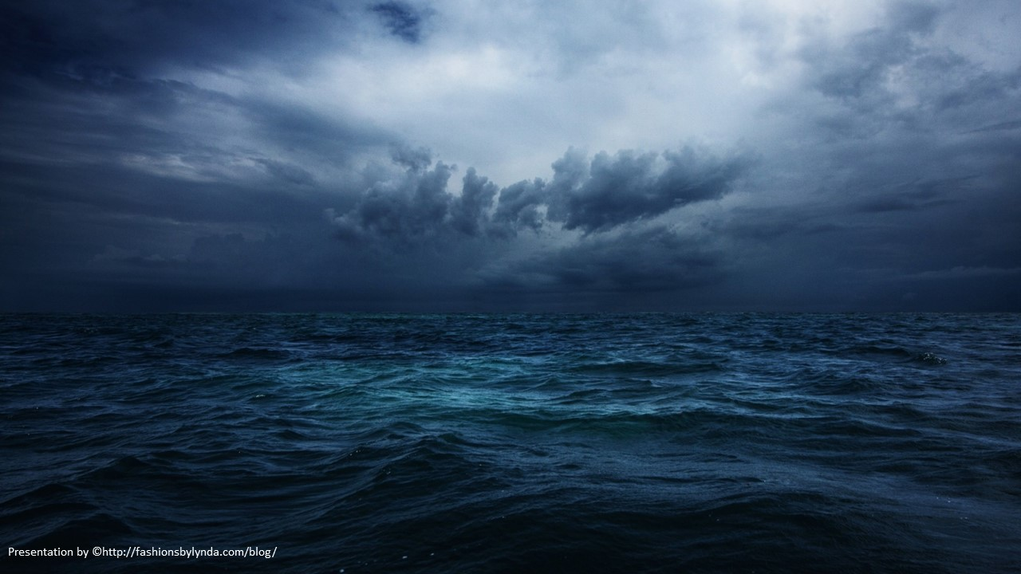
Lesson 36
Peace Be Still
Mark 4-5

Slide 2
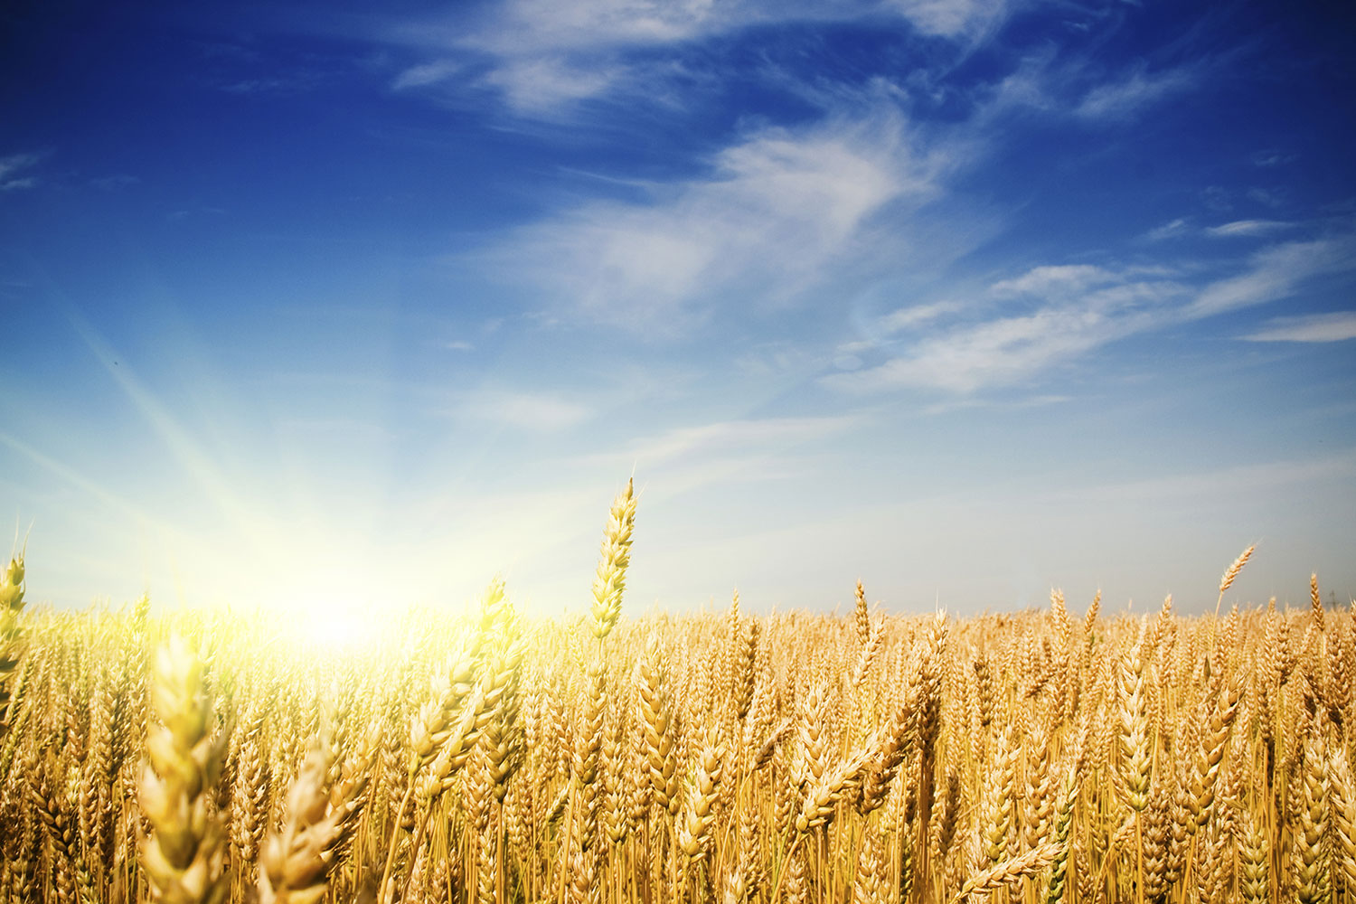
Parable of the Sower
God must be the primary force behind our harvest
This parable of the seed growing by itself, found only in the Gospel of Mark, teaches about the partnership between God and man. The man plants seeds in an environment where growth can occur, but then he must wait for that growth to happen
As time passes, the earth that God created gradually brings “forth fruit of herself”
Only God can make things grow. This principle applies to spiritual growth in individuals and to the growth of the Church throughout the world. (1)
I have planted, Apollos watered; but God gave the increase.
So then neither is he that planteth any thing, neither he that watereth; but God that giveth the increase.
1 Corinthians 3:6-7
Mark 4:26-29

Slide 3
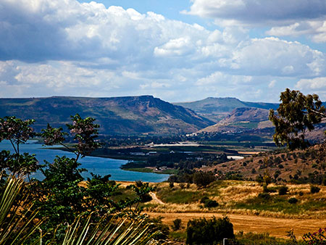
The Sea of Galilee is 700 feet below sea level and is surrounded on three sides by mountains. At times, cool, dry winds rush down the mountains and collide with warm, moist air over the Sea of Galilee, creating sudden, intense storms—sometimes in a matter of minutes—with large waves on this relatively small body of water.

Slide 4
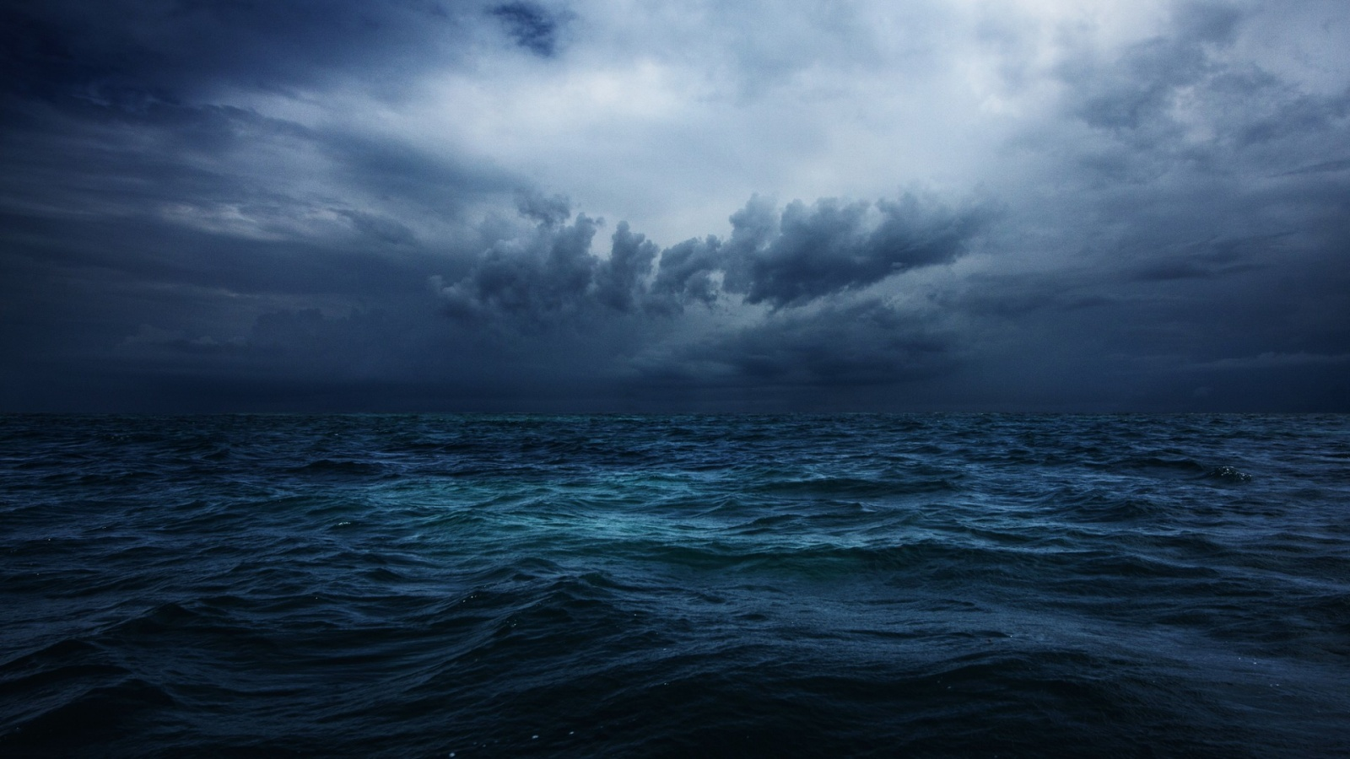
Why Are Challenges Like A Storm?
Physical
Spiritual
Mental
Social

Slide 5
In times of peril He is aroused by the pleas of His servants
He delivers those who have faith in His name
He rebukes the winds and the waters
Faithful passengers never drown
Christ sails His own ship
He may seem to be asleep , but He is there.
“Peace
Be Still”
He speaks peace to troubled souls
Mark 4:35-41

Slide 6
Why Are Ye So Fearful?
If we do not have faith, we limit our ability to experience miracles in our lives
Mark 4:40

Slide 7
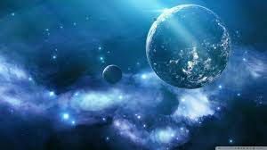
Miracles
The Savior’s miracles reveal the Savior’s great compassion and teach eternal truths about the plan of salvation.
Miracles were “an important element in the work of Jesus Christ, being not only divine acts, but forming also a part of the divine teaching. …
They were intended to be a proof to the Jews that Jesus was the Christ
Each miracle points to something larger than the event itself, and to look for specific truths about God and His work that the miracle affirms
Mark 5
(1)

Slide 8
Legion—Many Evil Spirits
A word that in New Testament times referred to a division of the Roman army usually composed of 3,000 to 6,000 soldiers.
“(1) Evil spirits, actual beings from Lucifer’s realm, gain literal entrance into mortal bodies;
“(5) The desire to gain bodies is so great among Lucifer’s minions as to cause them, not only to steal the mortal tabernacles of men, but to enter the bodies of animals;
“(2) They then have such power over those bodies as to control the physical acts performed … ;
“(6) The devils know their eventual destiny is to be cast out into an eternal hell from whence there is no return;
“(3) Persons possessed by evil spirits are subjected to the severest mental and physical sufferings and to the basest sort of degradation—all symbolical of the eternal torment to be imposed upon those who fall under Satan’s control in the world to come;
“(7) Rebellious and worldly people are not converted to the truth by observing miracles; and
“(8) Those cleansed from evil spirits can then be used on the Lord’s errand to testify of his grace and goodness so that receptive persons may be led to believe in him.”
“(4) Devils remember Jesus from pre-existence … ;
Mark 5:1-20
(3)

Slide 9
Power Over Satan
Jesus Christ has power over the devil.
Through the power of Jesus Christ we can overcome Satan’s influence in our life.
The devil does not care about our well-being but rather seeks to make us miserable and to destroy us.
The devil and the spirits who follow him have a knowledge of Jesus Christ’s divinity and power.
Mark 5:2-15

Slide 10
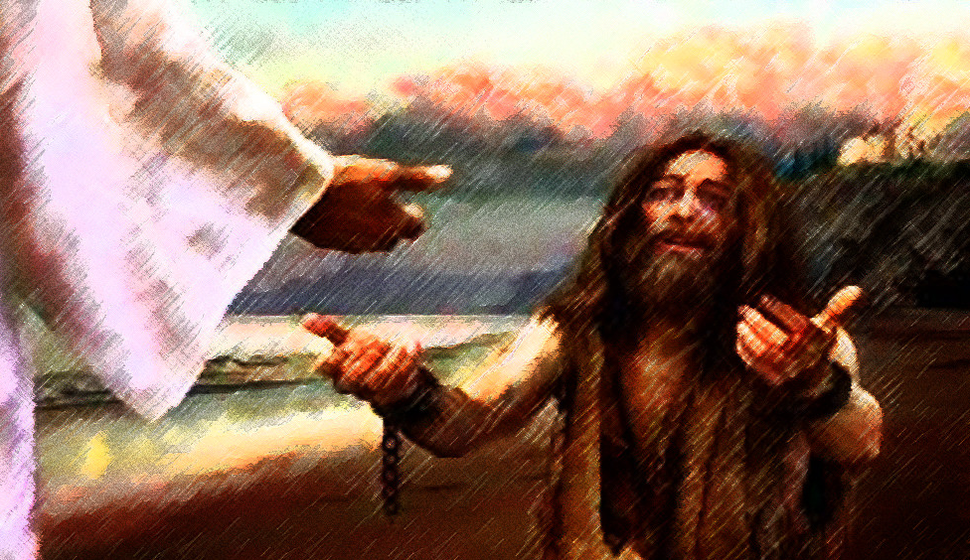
Tell Your Friends
Jesus healed a man full of “unclean,” or evil, spirits. After these unclean spirits had been cast out of the man, they entered a herd of swine, which then violently ran off a cliff into the sea. The man then sought to enter the ship where Jesus was.
The miracle occurred in the Gentile region of Decapolis, away from the influence of Jewish leaders. (1)
When we experience the Savior’s power in our lives, we can testify to others of His blessings and compassion

Slide 11
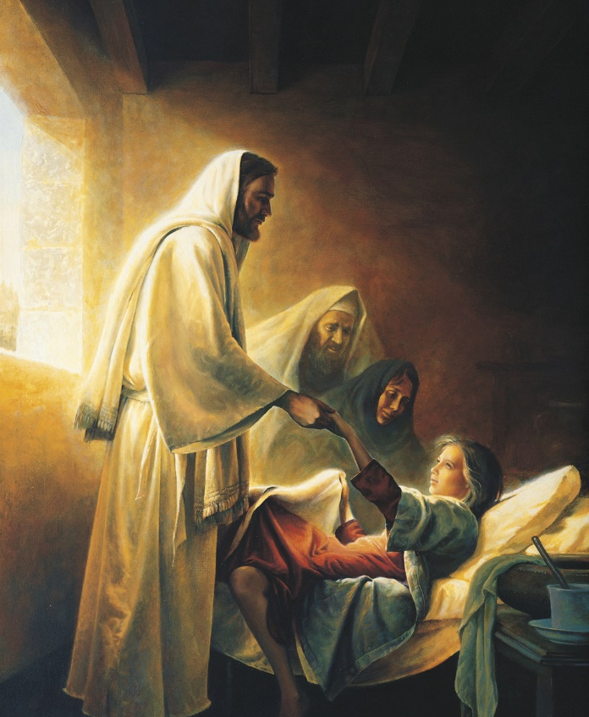
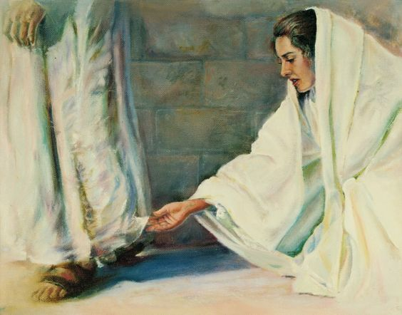
Only Believe
I pray thee, come and lay thy hands on her, that she may be healed; and she shall live.
If I may touch but his clothes, I shall be whole.
If we demonstrate our faith in Jesus Christ through our efforts to come to Him, He can make us whole
And he took the damsel by the hand, and said unto her, Talitha cumi; which is, being interpreted, Damsel, I say unto thee, arise.
Daughter, thy faith hath made thee whole; go in peace, and be whole of thy plague.
Mark 5:1-27-43

Slide 12
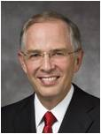
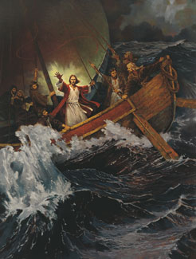
Fear Overcome By Faith
“Challenges, difficulties, questions, doubts—these are part of our mortality. But we are not alone. As disciples of the Lord Jesus Christ, we have enormous spiritual reservoirs of light and truth available to us.
Fear and faith cannot coexist in our hearts at the same time. In our days of difficulty, we choose the road of faith. Jesus said, ‘Be not afraid, only believe’.
Stilling the Storm, by Ted Henninger

Slide 13
Sources:
Suggested Hymn: #105 Master, the Tempest is Raging
Video:
Always Remember Him (5:28)
Jesus Raises the Daughter of Jairus (3:26)
Calming the Tempest (2:17)
New Testament Institute Student Manual Chapter 11 and 12
Picture of Sea of Galilee and Mt. Arbel
Elder Bruce R. McConkie (Doctrinal New Testament Commentary, 3 vols. [1965–73], 1:311).
Elder Neil L. Andersen “You Know Enough,” Ensign or Liahona, Nov. 2008, 14).
Greg K. Olsen ‘Jairus Daughter’ artwork
Presentation by ©http://fashionsbylynda.com/blog/

Slide 14
Event | Matthew | Mark | Luke | John
Parable of the Sower, or Different Kinds of Soil | 13:1-23 | 4:1-25 | 8:4-18
Parable of Mustard Seed and Leaven | 13:31-35 | 4:30-34
Jesus Calms the Storm at the Sea | 8:18, 23-27 | 4:35-41 | 8:22-25
Jesus Casts Legion of Devils into Swine | 8:28-34 | 5:1-20 | 8:26-39
Return to Capernaum | 9:1 | 5:21 | 8:40
Jairus Seeks Jesus to Heal His Dying Daughter | 9:18, 19 | 5:22-24 | 8:41, 42
Woman Touches Jesus and is Healed | 9:20-22 | 5:25-34 | 8:43-48
Jairus’ Daughter Raised from Death | 9:23-26 | 5:35-43 | 8:49-56
Parable of the Sower Mark 4:26-29: Compare Matthew 13:1-23
“An important lesson of this parable is for those of us who are teachers, whether in the home or Church classroom, or who are involved in missionary work. The germination and full flowering of living gospel seeds in the hearts and minds of those we teach depend on factors over which we may have little control. The choice of whether a person will ponder and accept the truths of the gospel belongs, as a matter of personal agency, with those we teach. If a person’s testimony is to grow until it bears mature fruit, or conversion, God must be the primary force behind our harvest. Under the influence of the Holy Spirit, we may participate in the education of those who are growing and becoming fruitful. We, as authorized sowers, need to understand and trust that the restored gospel of Jesus Christ is a living seed and that if we will teach it, the grace of God will attend those we teach, as they grow to spiritual maturity and bring forth good works. Our joy will then be full in the day of the harvest.” Elder Wilfredo R. López (“The Parable of the Seed Growing Secretly,” Ensign, Feb. 2003, 58).
Talitha and Cumi: Mark 5:41
Aramaic was the language commonly spoken by the Jewish people in the first century A.D., and it is the language the Savior spoke. Mark recorded the actual Aramaic words the Savior spoke to the young girl (see Mark 5:41). Talitha is an Aramaic word meaning “young girl” or “damsel” (and may have been a nickname applied to a young girl in a moment of tenderness), while cumi is an Aramaic word of command meaning to “stand” or “arise.” After the Savior’s words, the young girl immediately arose.(1)

Slide 15
Storms in our lives Mark 4:35-41:
“All of us have seen some sudden storms in our lives. A few of them, though temporary like these on the Sea of Galilee, can be violent and frightening and potentially destructive. As individuals, as families, as communities, as nations, even as a church, we have had sudden squalls arise which have made us ask one way or another, ‘Master, carest thou not that we perish?’ And one way or another we always hear in the stillness after the storm, ‘Why are ye so fearful? how is it that ye have no faith?’
“None of us would like to think we have no faith, but I suppose the Lord’s gentle rebuke here is largely deserved. This great Jehovah, in whom we say we trust and whose name we have taken upon us, is he who said, ‘Let there be a firmament in the midst of the waters, and let it divide the waters from the waters.’ (Gen. 1:6.) And he is also the one who said, ‘Let the waters under the heaven be gathered together unto one place, and let the dry land appear.’ (Gen. 1:9.) Furthermore, it was he who parted the Red Sea, allowing the Israelites to pass through on dry ground. (See Ex. 14:21–22.) Certainly it should be no surprise that he could command a few elements acting up on the Sea of Galilee. And our faith should remind us that he can calm the troubled waters of our lives. …
“But Jesus was not spared grief and pain and anguish and buffeting. … His ship was tossed most of his life, and, at least to mortal eyes, it crashed fatally on the rocky coast of Calvary. We are asked not to look on life with mortal eyes; with spiritual vision we know something quite different was happening upon the cross.
“Peace was on the lips and in the heart of the Savior no matter how fiercely the tempest was raging. May it so be with us—in our own hearts, in our own homes, in our nations of the world, and even in the buffetings faced from time to time by the Church. We should not expect to get through life individually or collectively without some opposition.” President Howard W. Hunter (“Master, the Tempest Is Raging,” Ensign, Nov. 1984, 33, 35).
Jairus, Chief Ruler: Mark 5:23:
In Jesus’s day, synagogues were presided over by a council of elders under the direction of a chief ruler, such as Jairus. Though he was held in high esteem by the Jews, Jairus showed great reverence to the Savior. The laying on of hands is the same ordinance of healing used today in The Church of Jesus Christ of Latter-day Saints., such as Jairus. (1)
Bringing Back From the Dead
“Nowhere else in the scriptures does this man [Jairus] or his name appear except on this occasion, yet his memory lives in history because of a brief contact with Jesus. Many, many lives have become memorable that otherwise would have been lost in obscurity had it not been for the touch of the Master’s hand that made a significant change of thought and action and a new and better life. …
“… The tremor we hear in Jairus’s voice as he speaks of ‘My little daughter’ stirs our souls with sympathy as we think of this man of high position in the synagogue on his knees before the Savior.
“Then comes a great acknowledgement of faith: ‘I pray thee, come and lay thy hands on her, that she may be healed; and she shall live’ [Mark 5:23]. These are not only the words of faith of a father torn with grief but are also a reminder to us that whatever Jesus lays his hands upon lives. If Jesus lays his hands upon a marriage, it lives. If he is allowed to lay his hands on the family, it lives. …
“… When they got to the home of the ruler of the synagogue, Jesus took the little girl by the hand and raised her from the dead. In like manner, he will lift and raise every man to a new and better life who will permit the Savior to take him by the hand” President Howard W. Hunter (“Reading the Scriptures,” Ensign, Nov. 1979, 65).
Among the Crowd a Woman Mark 5:25-34
Outwardly, there was little to distinguish her from any other person in the crowd. No one tried to stop her from moving toward Jesus. Certainly, the Apostles neither noticed her nor made any attempt to stop her. But there was something that set her apart from all others in the crowd that day. Though buried among the thronging mass, she resolutely and quietly pressed forward with a single purpose in mind: to come to the Savior, having faith that He had the power to heal her, that He cared about her and would respond to her need. In this one thing she set herself apart from the crowd. The crowd came to see, but the woman came to be healed. …
“… All of us are among the crowds of this world. Almost all of us are like the woman who, despite the crowd, comes to the Savior. We all have faith that just a touch will bring healing to our aching souls and relief to our innermost needs.
“… In all of life’s circumstances let us quietly and resolutely press forward to the Savior, having faith that He cares about us and has the power to heal and save us” Elder Dennis B. Neuenschwander (“One among the Crowd,” Ensign or Liahona, May 2008, 101–3).
Swine: Mark 5:1-5:
Though Mark and Luke identified the location of this miracle as Gadara and Matthew identified it as Gergesa, it is clear that the miracle took place on the eastern shore of the Sea of Galilee, which was inhabited by Gentiles. This explains the presence of swine herding in the area—Gentiles could eat pork, but Jews could not, for eating pork was forbidden by the law of Moses (see Leviticus 11:1–8). New Testament Institute Student Institute Manual Chapter 12

