Slide 1
Lesson 37
Rejection in Nazareth
Mark 6
Including Anointing With Oil
And now behold, I say unto you that the right way is to believe in Christ, and deny him not; and Christ is the Holy One of Israel; wherefore ye must bow down before him, and worship him with all your might, mind, and strength, and your whole soul; and if ye do this ye shall in nowise be cast out. 2 Nephi 25:29

Slide 2
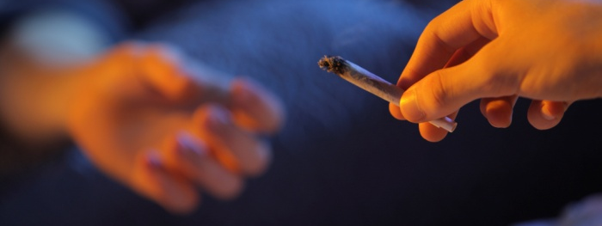
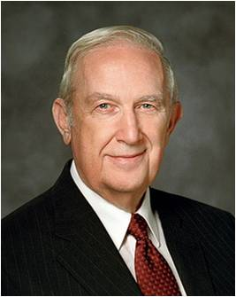
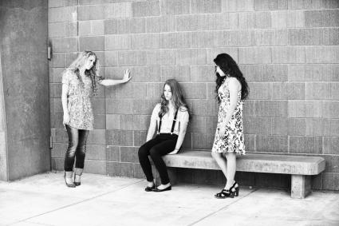
Joining Along With Others
“Individuals who do wrong want you to join them because they feel more comfortable in what they are doing when others do it also.” (2)
Do others try to pressure you into something you know is wrong?

Slide 3
Hometown--Nazareth
Jesus preached in His hometown of Nazareth.
However, because of the people’s unbelief He did not perform many miracles among them.
While there, Jesus sent the Twelve Apostles out two by two to preach the gospel.
While preaching the gospel, they also cast out devils and healed the sick.
When Herod heard about the many miracles that Jesus performed, he feared that John the Baptist had risen from the dead and was performing these miracles.
Bethsaida
Nazareth
Mt. Tabor
Jerusalem
Mt. Nebo
Bethlehem

Slide 4
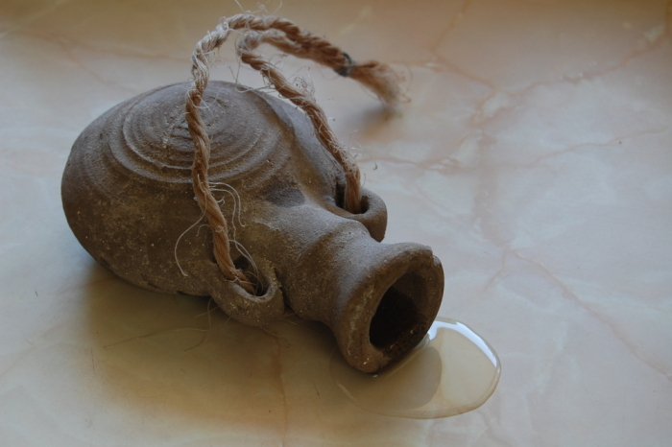
Anointed With Oil
"Although Jesus healed many people without anointing them with oil-sometimes even healed a person without touching him or her-it was a general practice for priesthood holders in the Church to anoint the sick with oil.
While performing their first missionary labors, the Twelve Apostles 'anointed with oil many that were sick, and healed them.' (3)
Olive oil, which is exuded from crushed olives, can also be seen as a symbol of the atoning blood of Jesus Christ. (1)
Mark 6:13

Slide 5
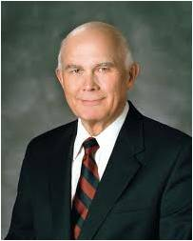
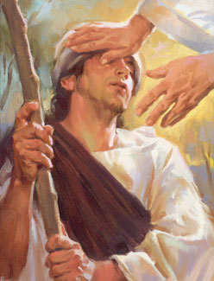
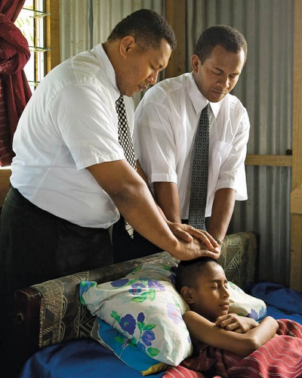
Miracles and Oil
“Miracles happen when the authority of the priesthood is used to bless the sick.
“The Old Testament frequently mentions anointing with oil as part of a blessing conferred by priesthood authority.
Anointings were declared to be for sanctification and perhaps can also be seen as symbolic of the blessings to be poured out from heaven as a result of this sacred act.
Sam Lawlor
“… When elders anoint a sick person and seal the anointing, they open the windows of heaven for the Lord to pour forth the blessing He wills for the person afflicted.”
Mark 6:5, 13
(6)

Slide 6
Herod and John the Baptist
Herod Antipas, who governed the regions of Galilee and Perea following the death of his father, Herod the Great.
Herod Antipas had divorced his wife and married Herodias, the wife of his brother Philip.
Thou shalt not uncover the nakedness of thy brother’s wife: it is thy brother’s nakedness.
Leviticus 18:16
This act was a blatant violation of Jewish law, and John the Baptist had vocally condemned it.
John’s opposition to this marriage angered Herodias, so Herod imprisoned John to appease her.
Mark 6:17-29

Slide 7
Herodias’ Doing
Herodias quarreled that John be killed, but Herod feared John knowing he was a just man—a man of God
Why did Herod have John beheaded if he knew it was wrong and did not want to do it?
“for their sakes which sat with him,” =
Herod was concerned about the opinion of those who sat with him.
Seeking to please others instead of doing what we know is right can lead to wrong choices, sorrow, and regret
Mark 6:17-29

Slide 8
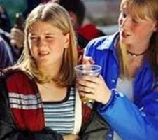
Joining Along With Others
Does giving in to pressures from other bring sorrow and regret?
Do you know someone who chose to do right instead of seeking to please others?
What can help us choose to do what we know is right instead of seeking to please others?

Slide 9
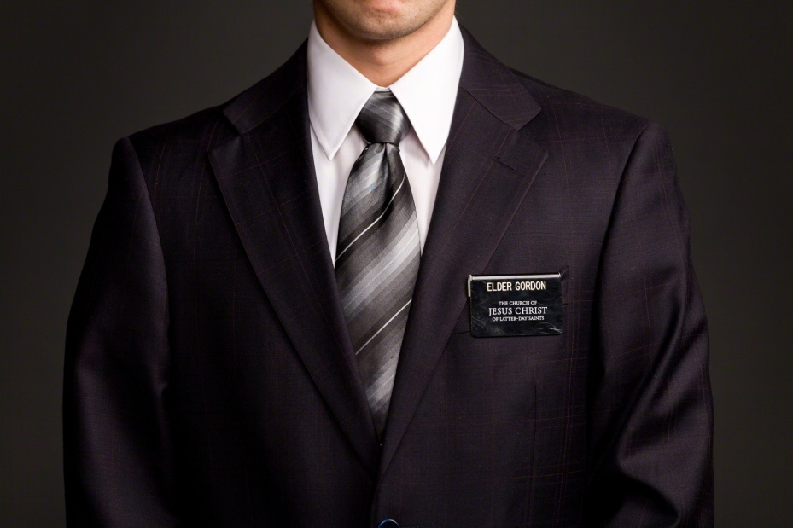
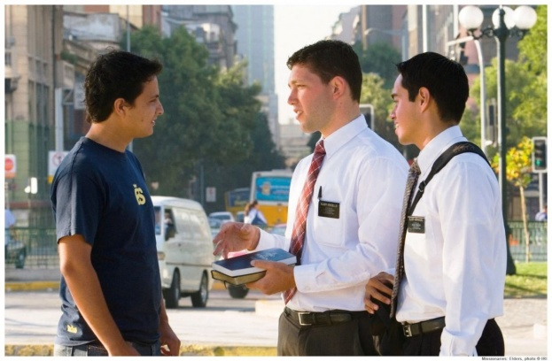
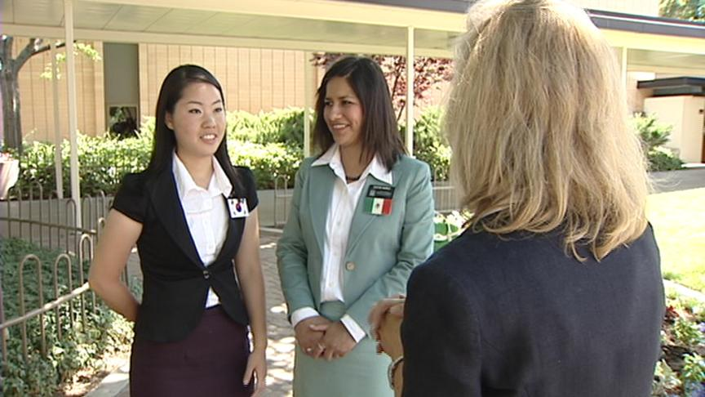
Feeling Inadequate
A newly called missionary is very nervous to depart on his or her mission. This person is not a good speaker and struggles in social settings.
Whether you come into the mission with many successes under your belt or few, if you are humble, teachable, and willing to keep trying and working, the Lord can work with you. But your missionary skills will only improve as you practice, ask questions, get help, and keep trying.
If you are convinced that people are just naturally good (or naturally bad) at missionary work, languages, testimony, or relationships, you’ll have a harder time. (4)
Mark 6:30-44

Slide 10
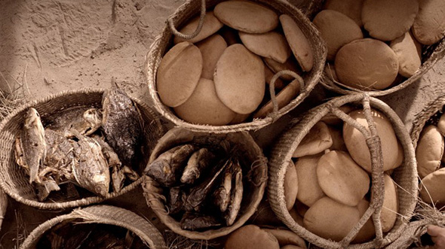
Feeding 5,000
What Happened First?
7
The Twelve Apostles returned from preaching the gospel and reported to Jesus what they had done and taught. Jesus and the Twelve Apostles boarded a ship to travel to a place where they could be alone and rest.
However, people from several nearby towns went to where Jesus would land and were awaiting Him when He arrived.
____ The Savior multiplied what the disciples brought, meeting and surpassing what was needed.
____ The disciples said they had five loaves and two fishes.
____ The disciples proposed sending the people away to buy food.
____ The Savior asked what the disciples could provide.
____ The Savior told the disciples to give the people food.
____ The multitude had nothing to eat.
____ The Savior asked the disciples to give Him what they had.
5
2
4
3
1
6
“five thousand men” = five thousand adult males.
Thus, the number fed was likely greater, considering that women and children were also present
Mark 6:30-44

Slide 11
Offer All We Have
The Savior first asked His disciples to offer the five loaves and two fishes—which was all that they had—to Him.
When we offer the Savior all that we have, He can magnify our offering to accomplish His purposes
The Savior invites all who seek to accomplish His purposes to give Him all of their desires, abilities, talents, skills, strengths, gifts, and efforts
… come unto him, and offer your whole souls as an offering unto him, and continue in fasting and praying, and endure to the end; and as the Lord liveth ye will be saved. Omni 1:26
Mark 6:30-44

Slide 12
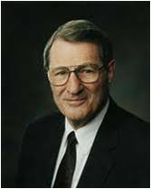
After the Miracle
Capernaum
Besaida
Gennesaret
"Only by persisting in His questioning did Jesus succeed in getting His disciples to remember that there were actually twelve baskets of 'leftovers' after the miracle of the loaves.
The Bread of Life always gives 'enough and to spare', but we're so forgetful." (5)
Tiberias
In the region of Gennesaret
"This region-a rich, fertile, and productive plain-extended southward along the western shore of the Sea of Galilee from Capernaum on the north to the region around Magdala and Tiberias.
Though having set out for Capernaum, apparently because of the storm, Jesus and the apostles landed somewhat south of that city. It was while traveling northward to Capernaum that the sick and diseased from the cities, villages, and whole region of Gennesaret were brought to him to be healed." (7)
Mark 6:30-44; Matthew 14:15-21; 16:9-10; D&C 104:17

Slide 13
Sources:
Suggested Hymn: #239 Choose the Right
Video:
Leave the Party (6:26)
New Testament Institute Student Manual Chapter 12
Elder Richard G. Scott “Making the Right Choices,” Ensign, Nov. 1994, 37)
"I Have a Question," Ensign, Oct. 1991, 61
The Hardest Part of Being a Missionary By Wendy Ulrich, PhD June 2016 New Era
Elder Neal A. Maxwell (That Ye May Believe, 199.)
Elder Dallin H. Oaks (“Healing the Sick,” Ensign or Liahona, May 2010, 48
Bruce R. McConkie (Doctrinal New Testament Commentary, 3 vols. [Salt Lake City: Bookcraft, 1965-1973], 1: 350.)
Presentation by ©http://fashionsbylynda.com/blog/

Slide 14
Event | Matthew | Mark | Luke | John
Jesus is Rejected at Nazareth Once Again | 13:54-58 | 6:1-6
Jesus Again Tours Galilee | 9:35-38 | 6:6
Apostles Are Sent on Missions | 10:1, 5-42 | 6:7-13 | 9:1-6
Herod Antipas Has John the Baptist Beheaded | 14:6-12 | 6:21-29
The Twelve Apostles Return and Depart—Jesus is to Rest | 14:13 | 6:30-33 | 9:10 | 6:1, 2
Jesus Feeds 5,000 | 14:14-21 | 6:34-44 | 9:11-17 | 6:3-14
Jesus Departs to the Mountain to Avoid Being Made King | 14:22, 23 | 6:45, 46 |  | 6:15
Jesus Walks on Water | 14:24-33 | 6:47-52 |  | 6:16-21
Jesus Heals People of Gennesaret | 14:34-36 | 6:53-56

Slide 15
Taking Nothing For Their Journey Mark 6:8:
Some people are really upset if they can't take everything with them. You can imagine the natural response to this commandment: "well, what am I going to eat? How will I buy provisions without any money? What if I get cold and only have one coat to wear?" These are all good questions. But Jesus is going to give them a crash course in relying on the Lord. It's one thing to follow the Savior around and let him make the major decisions and do all the teaching. It's quite another to rely completely on the Lord for your every temporal need. What a test of faith! It's a test of faith that most of us would fail. But the mentoring Lord was careful to reinforce the important lesson, asking them after their missions, 'When I sent you without purse, and scrip, and shoes, lacked ye any thing? And they said, Nothing' (Luke 22:35).
If we could only learn to rely on the Lord as they did! How silly we are to always rely on ourselves instead of the Lord. Of course we believe in self-reliance, but in so many ways-especially in our spiritual endeavors-we make the mistake of relying on the puny arm of our own flesh rather than the unfailing strength of the arm of the Lord. Indeed, the spiritual journey must be done, as it were, without purse or scrip. gospeldoctrine.com
Teaching the Apostles and the Order of the Priesthood Mark 6:37:
"In addition to showing his miraculous power over the elements, Jesus also demonstrated an important gospel principle on this occasion. When he gave food to his apostles and then commanded them to give it to others, he was teaching the order of priesthood government. (See Matt. 14:19) The Lord's pattern is to call and instruct individuals to whom he gives responsibility and through whom he then works for the benefit of all. So it is with priesthood, with temple ordinances, with church administration, and with parenthood. Jesus blessed and divided the food, but perhaps the miraculous proliferation of it took place while it was in the hands of the apostles. Their distributing of the food, blessed and prepared as it was by divine power, typified their service in the church in other ways, as the Master gave into the hands of these mortals a portion of his mission and a portion of his authority, and sanctified their labors of righteousness." (Kent P. Jackson and Robert L. Millet, eds., Studies in Scripture, Vol. 5: The Gospels [Salt Lake City: Deseret Book Co., 1986], 290.)
Symbols of oil:
“We find through all the prophetic writings that olive trees and olive oil are emblems of sacredness and purity” (Answers to Gospel Questions, 5 vols. [1957–66], 1:152). In ancient times, anointing with oil was a symbol of sanctification. As described in Leviticus 8:12, Moses “poured of the anointing oil upon Aaron’s head, and anointed him, to sanctify him.” And sanctification leads to receiving the Holy Ghost (see Alma 13:12; 3 Nephi 27:20 Institute Student Manual New Testament
Overcoming the Feeling of Inadequacy:
Try doing new and hard things. Then you’ll learn not to take feelings of inadequacy too seriously. For example:
• Try things that take you a little out of your comfort zone, like new jobs, extracurricular activities, or unfamiliar classes. Ask questions, get help, analyze mistakes, and keep trying. Take on things you must practice and work at so you learn to trust that you will improve with effort.
• Talk back to voices in your head that tell you people are either born with talent, intelligence, or social skills or they aren’t. The world’s greatest athletes, musicians, scholars—and missionaries—experience many failures and practice many hours on their way to success.
Rejection and disappointment are daily experiences on a mission. Practice taking risks and facing rejection so you get better at taking them in stride.
• Apply for a job, do job interviews, and work part-time or full-time.
• Try out for a team or a play.
• Ask people on dates or to activities.
• When things don’t go well, notice thoughts and actions that help you cope and feel better.
• Learn from setbacks and try again. (4)
Herod’s Decision Mark 6:22:
"It is interesting that Herod, the king, should be outmaneuvered by his wife and by a dancing girl. His appetite and lust for the girl's bodily charms snared him into a compromising situation for which he afterward was very sorry. The whole caper was brought about in the first place because of his libidinous desire for Herodias, whom he had spirited away from Philip, and whom it was not lawful for him to have. It was bodily lust and passion that had caused him to forsake his wife, the daughter of Aretas, for Herodias, and now it was more of the same that made him vulnerable to the scheming of Herodias in her plan to make him destroy the very man he had previously protected. Herodias, above all others, knew what kind of a man Herod was. She knew his weakness for the flesh.
"Since Herodias wished to kill John but could not because Herod protected him, she set about to devise a method not only to get John killed, but to get Herod to do it. Herod had shown himself to be a man of much passion, with fleeting moments of good intention but with little self-control and even less manly discipline. Herodias herself had beguiled him in their days at Rome, and now she again played upon his weaknesses. But this time she would use a younger woman: Salome would be the bait." (Robert J. Matthews, Behold the Messiah [Salt Lake City: Bookcraft, 1994], 69.)

Slide 16
The Miracle of Feeding 5,000 Mark 6:30-40:
"In our time, we seem to have forgotten the miracle of the five loaves and the two fishes in favor of the miracles wrought by the mind and hand of men. I refer to the marvels of modern transportation and the increasing sophistication of all scientific knowledge, including the new electronic highway. We have forgotten that this amazing knowledge comes to mankind only as God chooses to reveal it, and it should be used for purposes nobler and wiser than mere entertainment....A miracle even greater than that of the loaves and the fishes was the vision of the Prophet Joseph Smith, who saw the Father and the Son in the Sacred Grove near Palmyra, New York. Subsequently the keys, the priesthood, and the saving ordinances were restored in their fulness, and Christ's church was reestablished in our time. Thus God has again 'fed' us and filled our 'baskets' to overflowing." President James E. Faust ("Five Loaves and Two Fishes," Ensign, May 1994, 4-5)
Jesus Walks on the Water Mark 6:45-56 and Matthew 14:27-31:
“In [the disciples’] moment of greatest extremity they looked and saw in the darkness an image in a fluttering robe, walking toward them on the ridges of the sea. They cried out in terror at the sight, thinking that it was a phantom that walked upon the waves. And through the storm and darkness to them—as so often to us, when, amid the darknesses of life, the ocean seems so great and our little boats so small—there came the ultimate and reassuring voice of peace with this simple declaration, ‘It is I; be not afraid.’ Peter exclaimed, ‘Lord, if it be thou, bid me come unto thee on the water.’ And Christ’s answer to him was the same as to all of us: ‘Come.’
“Peter sprang over the vessel’s side and into the troubled waves, and while his eyes were fixed upon the Lord, the wind might toss his hair and the spray might drench his robes, but all was well. Only when with wavering faith he removed his glance from the Master to look at the furious waves and the black gulf beneath him, only then did he begin to sink. Again, like most of us, he cried, ‘Lord, save me.’ Nor did Jesus fail him. He stretched out his hand and grasped the drowning disciple with the gentle rebuke, ‘O thou of little faith, wherefore didst thou doubt?’ … (Adapted from [Frederic W.] Farrar, The Life of Christ, pp. 310–13; see Matt. 14:22–33.)
“It is my firm belief that if as individual people, as families, communities, and nations, we could, like Peter, fix our eyes on Jesus, we too might walk triumphantly over ‘the swelling waves of disbelief’ and remain ‘unterrified amid the rising winds of doubt.’ But if we turn away our eyes from him in whom we must believe, as it is so easy to do and the world is so much tempted to do, if we look to the power and fury of those terrible and destructive elements around us rather than to him who can help and save us, then we shall inevitably sink in a sea of conflict and sorrow and despair.
“At such times when we feel the floods are threatening to drown us and the deep is going to swallow up the tossed vessel of our faith, I pray we may always hear amid the storm and the darkness that sweet utterance of the Savior of the world: ‘Be of good cheer; it is I; be not afraid.’ (Matt. 14:27.)” (“The Beacon in the Harbor of Peace,” Pres. Howard W. Hunter Ensign, Nov. 1992, 19).
Those Who Give All:
Many nameless people with gifts equal only to five loaves and two small fishes magnify their callings [in the Church] and serve without attention or recognition, feeding literally thousands. … These are the hundreds of thousands of leaders and teachers in all of the auxiliaries and priesthood quorums, the home teachers, the Relief Society visiting teachers. These are the many humble bishops in the Church, some without formal training, but greatly magnified, always learning, with a humble desire to serve the Lord and the people of their wards. …
“A major reason this church has grown from its humble beginnings to its current strength is the faithfulness and devotion of millions of humble and devoted people who have only five loaves and two small fishes to offer in the service of the Master.” President James E. Faust (“Five Loaves and Two Fishes”Ensign, May 1994, 5–6).

Slide 17
NEW TESTAMENT SEMINARY TEACHER MANUAL—LESSON 37

