Slide 1
Lesson 38
Opportunities to Serve
Mark 7-8
Including:
Unwashed Hands
Jesus Heals
Jesus Feeds 4,000

Slide 2
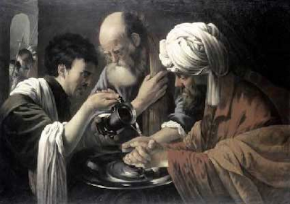
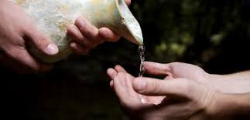
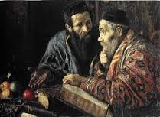
Unwashed Hands
Under the law of Moses, many aspects of daily life were divided into categories of “clean” and “unclean.” Uncleanness referred to being ceremonially or ritually unclean and did not mean that the person was either unsanitary or morally unclean, though ritually “unclean” persons were excluded from certain religious and social activities until they were purified.
The washing of hands = a ceremonial washing for the sake of ritual purity.
By New Testament times, Jewish concern for ritual purity had given rise to many traditions, including the ritual washings. These traditions in Jesus' day were oral (not written) and were passed down from rabbi to rabbi and to their followers or students. They later became incorporated in written form in the Talmud.
When the Pharisees found fault with the Savior’s disciples for not observing these traditional rituals, the Savior reproved the Pharisees for professing devotion to God while placing a higher priority on man-made traditions than on God’s commandments.
Mark 7:1-13
(1)

Slide 3
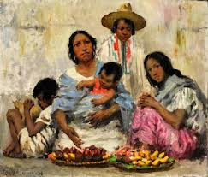
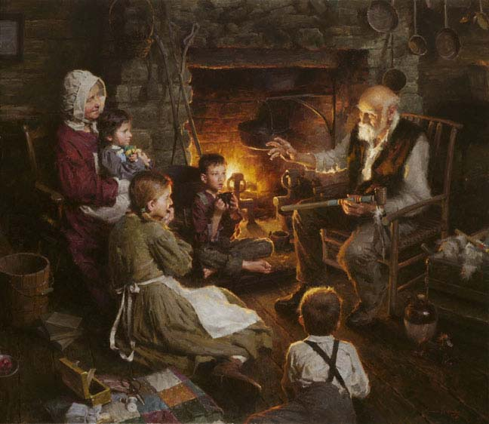
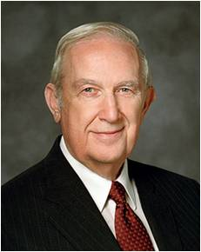
“I testify that you will remove barriers to happiness and find greater peace as you make your first allegiance your membership in the Church of Jesus Christ, and His teachings the foundation of your life.
Where family or national traditions or customs conflict with the teachings of God, set them aside.
Where traditions and customs are in harmony with His teachings, they should be cherished and followed to preserve your culture and heritage.
There is one heritage that you need never change. It is that heritage that comes from your being a daughter or son of Father in Heaven. For happiness, control your life by that heritage.”
Morgan Weistling
(3)

Slide 4
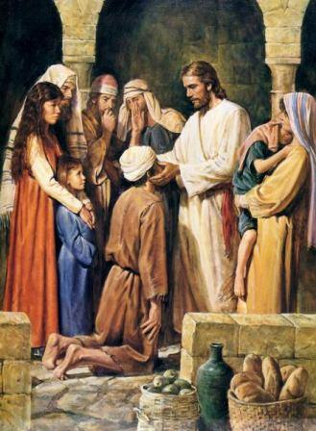
The Man in Decapolis
After the Savior left Tyre and Sidon, He traveled to the east side of the Sea of Galilee, to the region of Decapolis.
Sidon
Tyre
“The Lord is dealing with a believing soul who cannot hear his words or give fluent answer to them. And so what is more natural than to make use of common signs, known to and understood by the deaf and speech inhibited man, to indicate what the Master could and would do … ?” (2)
Region of Decapolis
Jerusalem
Despite the Savior’s warning to those He healed to not publish His miracles, people in the Decapolis region still heard about the wonderful things the Savior had done, and great multitudes gathered to Him
The Savior’s healing enabled this man to speak immediately and plainly.
Mark 7:31-37

Slide 5
How often do we have opportunities to help others in need?
How often do we act upon it?

Slide 6
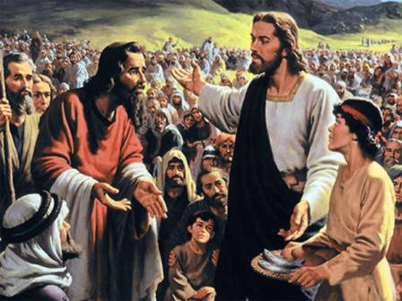
“First Observe, Then Serve”
(4)
I have compassion on the multitude
Despite the Savior’s warning to those He healed to not publish His miracles, people in the Decapolis region still heard about the wonderful things the Savior had done, and great multitudes gathered to Him
Many people followed Jesus and for three days they were without food.
We can follow the Savior’s example by perceiving the needs of others and then helping to fulfill those needs
Mark 8:1-9

Slide 7
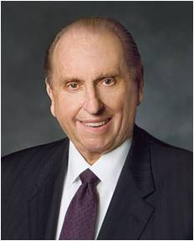
“How many times has your heart been touched as you have witnessed the need of another? How often have you intended to be the one to help? And yet how often has day-to-day living interfered and you’ve left it for others to help, feeling that ‘oh, surely someone will take care of that need.’
“We become so caught up in the busyness of our lives. Were we to step back, however, and take a good look at what we’re doing, we may find that we have immersed ourselves in the ‘thick of thin things.’ In other words, too often we spend most of our time taking care of the things which do not really matter much at all in the grand scheme of things, neglecting those more important causes.”
Mark 8
(5)

Slide 8
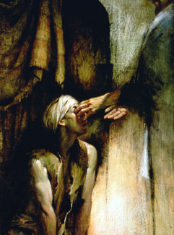
Gradual Healing
Jesus personally:
(1) led the blind man by the hand out of the town,
(2) applied his own saliva to the eyes of the sightless one,
(3) performed the ordinance of laying on of hands, and
(4) put his hands a second time upon the man’s eyes.
Walter Rane
“I see men as trees, walking” [verse 24] indicates that the blind man could see, but not clearly.)
Mark 8:22-26
(5)

Slide 9
“Certainly the manner in which this healing took place teaches that men should seek the Lord’s healing grace with all their strength and faith, though such is sufficient for a partial cure only.”
Following the receipt of this partial cure, “they may then gain the added assurance and faith to be made whole and well every whit.
Men also are often healed of their spiritual maladies by degrees, step by step as they get their lives in harmony with the plans and purposes of Deity.”
Mark 8:22-26
(5)

Slide 10
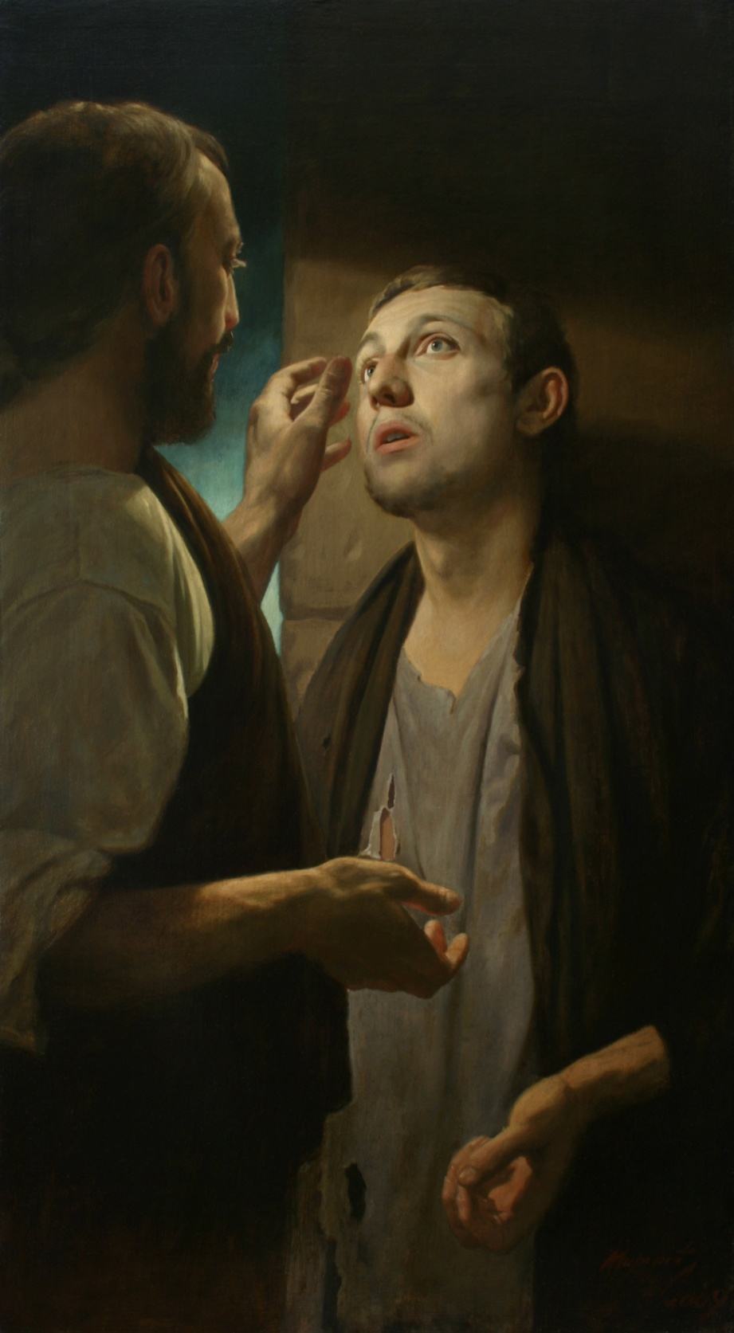
Our Gradual Healing
”It must be remembered that whether the Lord sees fit to heal instantaneously or gradually, whether it be through surgery and treatment or without it, the healing is still the Lord’s miracle.”
Mark 8:22-26
(6)

Slide 11
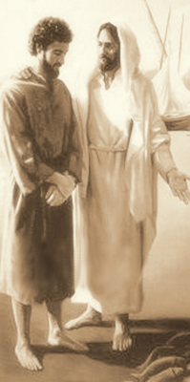
Peter’s Testimony
Jesus prophesied that the Son of Man would suffer and be killed.
Because of the popular Jewish expectations of a conquering Messiah, it was difficult for Peter, as well as for many Jews of that time, to understand and accept the idea of a Messiah who would suffer and die.
Mark 8:27-32

Slide 12
Sources:
Suggested Hymn: #223 Have I Done Any Good?
Video:
“For Madison” (4:08)
New Testament Institute Student Manual Chapter 12, 13
Elder Bruce R. McConkie (Doctrinal New Testament Commentary, 3 vols. [1965–73], 1:373, 1:379–80).
Elder Richard G. Scott “Removing Barriers to Happiness,” Ensign, May 1998, 87
Linda K. Burton (“First Observe, Then Serve,” Ensign or Liahona, Nov. 2012, 78
President Thomas S. Monson “What Have I Done for Someone Today?” Ensign or Liahona, Nov. 2009, 85
President Spencer W. Kimball President Kimball Speaks Out on Administration to the Sick August 1982 Ensign
Presentation by ©http://fashionsbylynda.com/blog/

Slide 13
Event | Matthew | Mark | Luke | John
Conflict with Scribes and Pharisees over Cleanliness | 15:1-20 | 7:1-23
Jesus Heals a Gentile’s Daughter | 15:21-28 | 7:24-30
Jesus Returns to the Sea of Galilee and Heals Many | 15:29-31 | 7:31-37
Jesus Feeds 4,000 | 15:32-38 | 8:1-9
Jesus Goes to Magdala | 15:39 | 8:10
Another Discourse on Signs | 16:1-4 | 8:11-13
Conflict with Scribes and Pharisees over Cleanliness | 15:1-20 | 7:1-23
Jesus Heals a Gentile’s Daughter | 15:21-28 | 7:24-30
Jesus Returns to the Sea of Galilee and Heals Many | 15:29-31 | 7:31-37

Slide 14
Hypocrisy—tradition of Corban Mark 7:10-13
An example of this hypocrisy was the Pharisees’ observance of the tradition of “corban”. Corban meant “given to God.” A tradition of the elders held that if a man had money or other resources he intended to give to God or the temple, those resources could be declared “corban” and need not be used to care for his aging parents, even though God had commanded, “Honour thy father and thy mother” (Exodus 20:12). Placing man-made tradition above the word of God in ways like this showed that traditions had taken precedence over the word of God (see Mark 7:6, 13). New Testament Student Institute Manual Chapter 12
Feeding of the 4,000 Mark 7:31
According to Mark 7:31, the feeding of the four thousand occurred in the largely Gentile Decapolis region, which was on the southeastern shore of the Sea of Galilee. There had been people in this area who believed in Jesus Christ from at least the time of the healing of the man out of whom the Savior cast a legion of devils (see Mark 5:19–20; Matthew 4:25), and the number of believers had grown to a “very great” multitude (Mark 8:1).
“This miraculous feeding of the four thousand is not a mere duplication or repetition of the feeding of the five thousand which took place a short time before near Bethsaida. Then our Lord was mingling with his own kindred of Israel; now he is teaching other hosts who in substantial part, being inhabitants of Decapolis, are presumed to be Gentile. Then he was laying the foundation for his incomparable sermon on the Bread of Life; now he is prefiguring the future presentation of the living bread to the Gentile nations. And significantly, this mixed multitude from the east of the Jordan were more receptive, and took a more sane and sound view of the matchless miracle of feeding thousands by use of the creative powers resident in him, than did the members of the chosen seed” elder Bruce R. McConkie (Doctrinal New Testament Commentary, 3 vols. [1965–73], 1:375).
The Divine Gift of Gratitude:
“‘[The Savior] took the seven loaves and the fishes, andgave thanks, and brake them, and gave to his disciples, and the disciples to the multitude.’
“Notice that the Savior gave thanks for what they had—and a miracle followed: ‘And they did all eat, and were filled: and they took up of the broken meat that was left seven baskets full’ [see Matthew 15:32–38; italics added; see also Mark 8:1–8]. …
“Regardless of our circumstances, each of us has much for which to be grateful if we will but pause and contemplate our blessings. … To live with gratitude ever in our hearts is to touch heaven” President Thomas S. Monson (“The Divine Gift of Gratitude,” Ensign or Liahona, Nov. 2010, 88, 90).
Hypocrites:
“The teachings of Jesus also challenged the traditions of different groups. … ‘Hypocrites’ is what He called those whose adherence to their traditions kept them from keeping the commandments of God [see Mark 7:6;Matthew 15:7]. …
“The traditions or culture or way of life of a people inevitably include some practices that must be changed by those who wish to qualify for God’s choicest blessings.
“Chastity is an example. … Always the prophets of God have condemned whoredoms. Yet these eternal commands have frequently been ignored, opposed, or mocked by powerful traditions in many lands. … Sexual relations out of wedlock are tolerated or advocated by many. So is the rapidly expanding culture of pornography. All who have belonged to these cultures of sin must repent and change if they are to become the people of God, for He has warned that ‘no unclean thing can enter into his kingdom’ (3 Nephi 27:19). …
“Another example is honesty. Some cultures allow lying, stealing, and other dishonest practices. But dishonesty in any form—whether to appease, to save face, or to get gain—is in direct conflict with gospel commandments and culture. God is a God of truth, and God does not change. We are the ones who must change.” Elder Dallin H. Oaks (“Repentance and Change,” Ensign or Liahona, Nov. 2003, 38).
Healing Mark 7:31-37
“The Lord is dealing with a believing soul who cannot hear his words or give fluent answer to them. And so what is more natural than to make use of common signs, known to and understood by the deaf and speech inhibited man, to indicate what the Master could and would do in accordance with the law of faith?” Elder Bruce R. McConkie (Doctrinal New Testament Commentary, 1:373).

Slide 15
Why Did Jesus Instruct His Apostles Not to Tell People He Was the Messiah?
Mark 8:30:
1. Mark relates that Jesus’s fame grew so great that it created difficulties. At times Jesus could not enter certain villages, people who wanted to see Him could not get through the crowds, and He and His disciples were so beset by throngs of people that they could not even find time or space to eat (see Mark 1:45; 2:2;3:20). Instructing people not to tell others about His miracles may have been one way the Savior carefully managed such difficulties so as not to hinder His overall mission.
2. The Savior may also have asked for silence in order to forestall the opposition that would lead to His Crucifixion—until the time was right (see Mark 9:30–31; compare John 7:1–10 with Matthew 26:18). The more people learned about Jesus, the more the chief priests increased their opposition to Him, for they did not want Him to undermine their place in society. After Jesus entered Jerusalem in a way that clearly and publicly proclaimed Him as the Messiah, less than a week passed before He was arrested and put to death (see Mark 11:8–11; 14:1–2; 15:22–25;2 Nephi 10:5).
3. Some of the Savior’s commandments for silence were directed at devils, who vocally acknowledged Jesus as the Son of God (see Mark 1:24, 34; 3:11–12; compare Acts 16:16–18).
Elder Bruce R. McConkie taught that Jesus “consistently refused to permit [devils] to bear record of his divinity. Converting testimony comes from God, not from Lucifer. Had Jesus let unclean spirits go unrebuked, or had he acquiesced in their testimony of him (though in fact it was true), the Jews would have claimed greater justification for their false charge against him, ‘He hath a devil, and is mad; why hear ye him?’ (John 10:20)” (Doctrinal New Testament Commentary, 1:168).
4. The Savior knew that most Jews of His day were expecting the Messiah to put an end to Israel’s political enemies and reign as a Jewish king. It is clear that Jesus wanted to avoid presenting Himself as the Messiah of popular expectation. Therefore, one likely reason the Savior instructed His disciples not to tell people He was the Christ (see Matthew 16:20; Mark 8:29–30) was that He wanted to teach people a new understanding of what kind of salvation He had come to bring. He had come not to overthrow Rome but to conquer the eternal enemies of mankind—death, sin, and suffering.
New Testament Institute Student Manual Chapter 13

