Slide 1
Lesson 39
That I May Heal You
Mark 9:1-29
O all ye that are spared because ye were more righteous than they, will ye not now return unto me, and repent of your sins, and be converted, that I may heal you?
3 Nephi 9:13

Slide 2
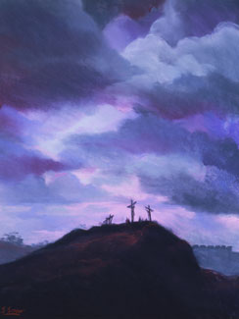
Foretelling of the Savior’s Suffering, Death, and Resurrection
“He began to teach them, that the Son of man must suffer many things, … and be killed, and after three days rise again”
…that the Son of man must suffer many things, and be rejected of the elders, and of the chief priests, and scribes, and be killed, and after three days rise again.
For he taught his disciples, and said unto them, The Son of man is delivered into the hands of men, and they shall kill him; and after that he is killed, he shall rise the third day.
…Saying, Behold, we go up to Jerusalem; and the Son of man shall be delivered unto the chief priests, and unto the scribes; and they shall condemn him to death, and shall deliver him to the Gentiles:
And they shall mock him, and shall scourge him, and shall spit upon him, and shall kill him: and the third day he shall rise again.
Scott M. Snow
Mark 8:31: Mark 9:31: Mark 10:33-34

Slide 3
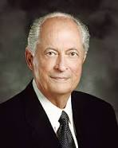
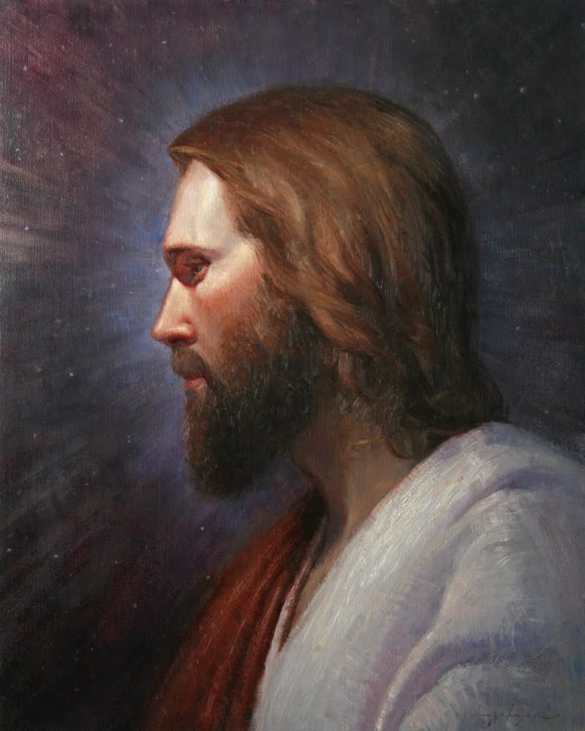
“Jesus knew who He was—the Son of God. He knew His purpose—to carry out the will of the Father through the Atonement.
His vision was eternal—‘to bring to pass the immortality and eternal life of man’
(2)

Slide 4
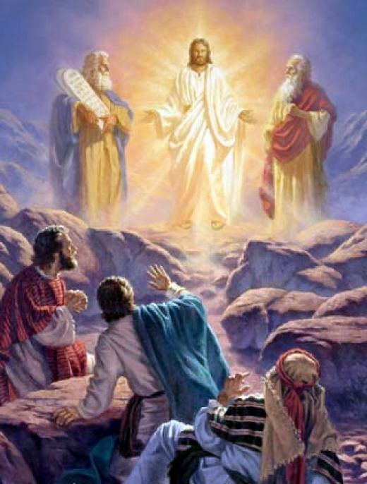
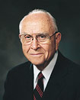
Elias—John the Baptist—One Who Prepares The Way
The Joseph Smith Translation indicates that John the Baptist also appeared on the Mount of Transfiguration
JST Mark 9:4
John’s appearance to Jesus, Peter, James, and John foreshadowed his role in the latter days when he would come to restore the Aaronic Priesthood.
Many things happened on the Mount of Transfiguration that are not recorded in our scriptures.
When the earth shall be transfigured, even according to the pattern which was shown unto mine apostles upon the mount; of which account the fulness ye have not yet received. D&C 63:21
During this heavenly event Moses and Elias also appeared, and the three Apostles heard the voice of the Father bearing witness that Jesus is his Beloved Son and the command that they were to hear and obey. (3)
Mark 9:1-13

Slide 5
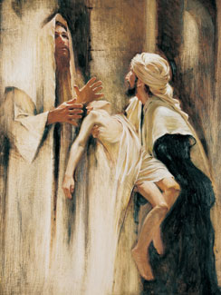
“Help Thou Mine Unbelief”
The challenge of faith
“In moments of fear or doubt or troubling times, hold the ground you have already won, even if that ground is limited. In the growth we all have to experience in mortality, the spiritual equivalent of this boy’s affliction or this parent’s desperation is going to come to all of us.”
“…the father asserts his strength first and only then acknowledges his limitation. His initial declaration is affirmative and without hesitation: ‘Lord, I believe.’ I would say to all who wish for more faith, remember this man!
If we believe in Jesus Christ, all things will be possible to us
Walter Rane
“…hold fast to what you already know and stand strong until additional knowledge comes. …”
Mark 9:14-29

Slide 6
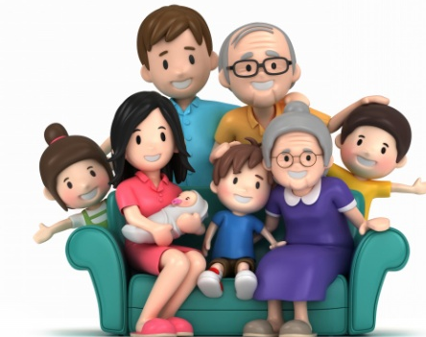
When problems come and questions arise, do not start your quest for faith by saying how much you do not have, leading as it were with your ‘unbelief.’ …
I am not asking you to pretend to faith you do not have.
I am asking you to be true to the faith you do have.
Sometimes we act as if an honest declaration of doubt is a higher manifestation of moral courage than is an honest declaration of faith.
It is not! So let us all remember the clear message of this scriptural account:
Be as candid about your questions as you need to be; life is full of them on one subject or another.
But if you and your family want to be healed, don’t let those questions stand in the way of faith working its miracle. …
Mark 9:14-29

Slide 7
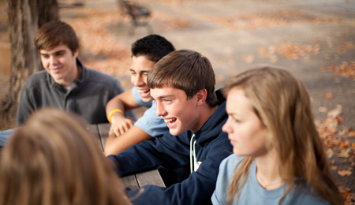
Facing Challenges
If we hold on to what we believe and seek the Lord’s assistance, He will help us strengthen our faith
What did the Savior do in response to the father’s pleas?
Mark 9:14-29

Slide 8
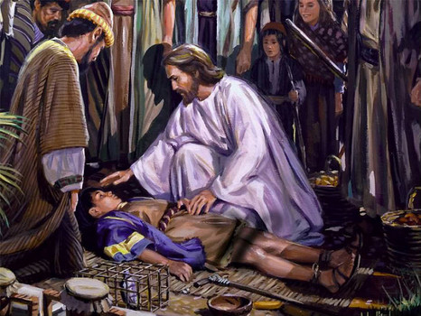
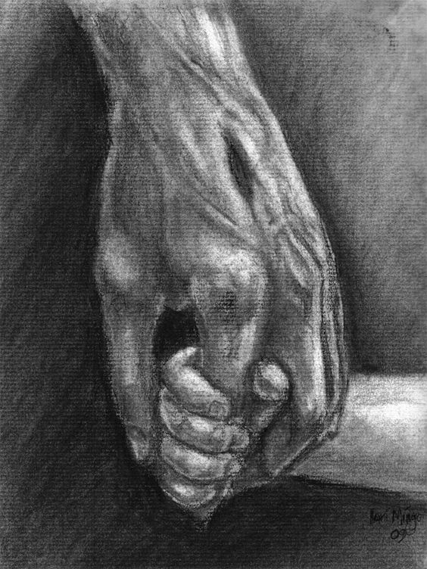
Why Couldn’t the Disciples Cast Out the Evil Spirit?
When the Savior cast a devil out of a deaf and dumb child, he used the occasion to teach His disciples about the power of fasting and prayer.
"How beautiful in the eyes of the Lord are the spiritually well, those who have been taken by the hand and lifted up and made spiritually whole. How beautiful in the eyes of the Lord are those who take the time to lift the needy hand. Peace of mind only comes to us when we are spiritually healed. True joy comes from within. Freedom from a troubled soul is a worthy goal of all.
"Frequently the Savior admonished the physically healed to boast not of their new strength, but rather to go their ways, walking in truth and using their new powers to lift others.
Evidence teaches us many were healed physically but remained undisciplined and spiritually ill. '... return unto me, and repent of your sins, and be converted, that I may heal you'
Mark 9:28-29
(5)

Slide 9
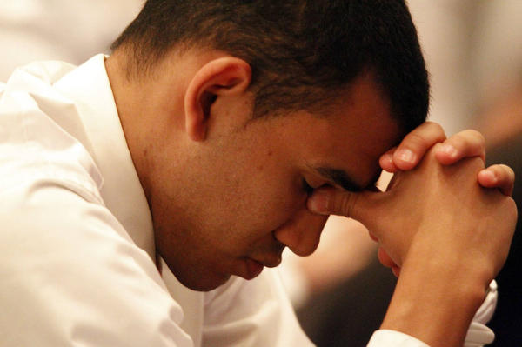
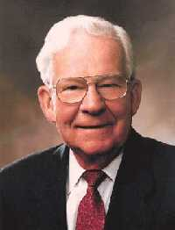
Fasting and Prayer
We can increase our faith in Jesus Christ through prayer and fasting
“This account [of Jesus casting out an evil spirit from a man’s son] teaches that prayer and fasting can give added strength to those giving and receiving priesthood blessings.
The account can also be applied to your personal efforts to live the gospel.
If you have a weakness or sin that you have struggled to overcome, you may need to fast and pray in order to receive the help or forgiveness you desire.
Like the demon that Christ cast out, your difficulty may be the kind that will go out only through prayer and fasting.”
Mark 9:29
(6)

Slide 10
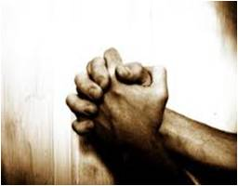
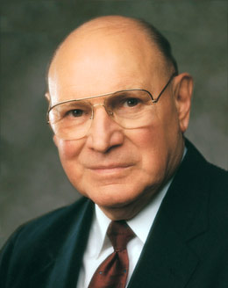
“We observe that in the scriptures, fasting almost always is linked with prayer.
Without prayer, fasting is not complete fasting; it’s simply going hungry.
If we want our fasting to be more than just going without eating, we must lift our hearts, our minds, and our voices in communion with our Heavenly Father.
Fasting, coupled with mighty prayer, is powerful.”
Mark 9:29
(7)

Slide 11
Sources:
Suggested Hymn: #128 When Faith Endures
Video:
“Lord, I Believe” (3:00)
New Testament Institute Student Manual Chapter 13
Elder Robert D. Hales (“Behold, We Count Them Happy Which Endure,” Ensign, May 1998, 75).
Elder David B. Haight “The Keys of the Kingdom” Nov. 1982 Ensign
Elder Jeffrey R. Holland (“Lord, I Believe,” Ensign or Liahona, May 2013, 93–94).
Elder Marvin J. Ashton ("He Took Him by the Hand," Ensign, Jan. 1974, 102-104)
(True to the Faith: A Gospel Reference [2004], 67)
Elder Joseph B. Wirthlin (“The Law of the Fast,” Ensign, May 2001, 73).
Presentation by ©http://fashionsbylynda.com/blog/

Slide 12
Event | Matthew | Mark | Luke | John
The Transfiguration | 17:1-13 | 9:2-13 | 9:28-36
Demonic Boy Healed | 17:14-21 | 9:14-29 | 9:37-43
Jesus Again Foretells His Death and Resurrection | 17:22, 23 | 9:30-32 | 9:43-45
Tribute Money | 17:24-27 | 9:33
Discourse on Humility, Service, and Forgiveness | 18:1-35 | 9:33-50 | 9:46-50
The Transfiguration | 17:1-13 | 9:2-13 | 9:28-36
Demonic Boy Healed | 17:14-21 | 9:14-29 | 9:37-43
Jesus Again Foretells His Death and Resurrection | 17:22, 23 | 9:30-32 | 9:43-45
Tribute Money | 17:24-27 | 9:33
Discourse on Humility, Service, and Forgiveness | 18:1-35 | 9:33-50 | 9:46-50

Slide 13
Master, I have brought unto Thee my son Mark 9:17-18:
he son was possessed by an evil spirit, which caused speech loss, deafness and other maladies. Whenever the evil spirit seized hold of the son, the son would convulse, foam at the mouth, grind his teeth, and become rigid. Teacher Manual
Trusting In the Lord:
"Has someone convinced you that you are no good at music or mathematics, or that you'll always be overweight? Re-evaluate your attitudes. Each of us has great gifts, but many of us severely limit ourselves with negative attitudes about our potential.
"The Lord said, 'As [a man] thinketh in his heart, so is he.' (Prov. 23:7.) And again, 'If thou canst believe, all things are possible to him that believeth.' (Mark 9:23.) You cannot rise higher than your own beliefs and thoughts about yourself.
"Trust the Lord to help you unlock the door to the gifts you have just begun to recognize and use. There is literally genius locked inside each of us. Don't let anyone convince you otherwise!" Gene R. Cook ("Trust in the Lord," Ensign, Mar. 1986, 78-79)
Lord, I Believe Mark 9:17-22:
“With no other hope remaining, this father asserts what faith he has and pleads with the Savior of the world, ‘If thou canst do any thing, have compassion on us, and help us’ [Mark 9:22; italics added]. I can hardly read those words without weeping. The plural pronoun us is obviously used intentionally. This man is saying, in effect, ‘Our whole family is pleading. Our struggle never ceases. We are exhausted. Our son falls into the water. He falls into the fire. He is continually in danger, and we are continually afraid. We don’t know where else to turn. Can you help us? We will be grateful for anything—a partial blessing, a glimmer of hope, some small lifting of the burden carried by this boy’s mother every day of her life.’”
“When facing the challenge of faith, the father asserts his strength first and only then acknowledges his limitation. His initial declaration is affirmative and without hesitation: ‘Lord, I believe.’ I would say to all who wish for more faith, remember this man! In moments of fear or doubt or troubling times, hold the ground you have already won, even if that ground is limited. In the growth we all have to experience in mortality, the spiritual equivalent of this boy’s affliction or this parent’s desperation is going to come to all of us. When those moments come and issues surface, the resolution of which is not immediately forthcoming, hold fast to what you already know and stand strong until additional knowledge comes”. Elder Jeffrey R. Holland “Lord, I Believe,” Ensign or Liahona, May 2013, 93)
Having Enough Faith:
"We do not need to wait for perfect faith to have enough faith to begin building Christ-centered families. When the apostles could not cast an evil spirit out of a boy, the father carried him to Jesus, who gave him a piercing challenge: 'If thou canst believe, all things are possible.' The father, knowing the imperfect state of his faith but also his desire for more, cried out, weeping, 'Lord, I believe; help thou mine unbelief.' (Mark 9:23-24.) Jesus did not rebuke him or say, 'Come back when you have more faith.' He healed the child.
"The scriptures show us examples of families with whom Jesus interacted during his premortal and mortal ministries. They had hearts willing to receive him even if their circumstances were not ideal. They had faith and yearned for more. They sacrificed, served others, prayed, fasted, and pondered the promises of the prophets.
"What is our Heavenly Father's work and glory? It is 'to bring to pass [our] immortality and eternal life.' (Moses 1:39.) The work of salvation goes on despite imperfect circumstances and imperfect faith. 'I am come that they might have life,' the Savior explained, 'and that they might have it more abundantly.' (John 10:10.) His task was not only to give life to the dead, miraculous though that was, but to give increased life to those living with less than flourishing faith, less than vibrant hope, less than burning charity.
"He accepts our imperfections even as he challenges us to rise above them. He loves us even when we are not very lovable. He rewards even a struggling faith with miracles.“Chieko N. Okazaki (Aloha! [Salt Lake City: Deseret Book Co., 1995], 9-10.)
Healing Mark 7:31-37
“The Lord is dealing with a believing soul who cannot hear his words or give fluent answer to them. And so what is more natural than to make use of common signs, known to and understood by the deaf and speech inhibited man, to indicate what the Master could and would do in accordance with the law of faith?” Elder Bruce R. McConkie (Doctrinal New Testament Commentary, 1:373).

