Slide 2
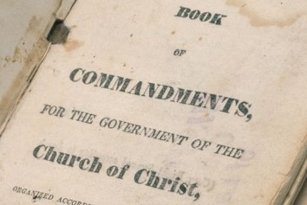
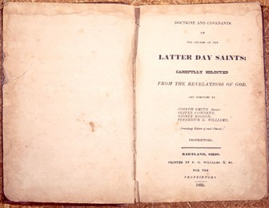
Book of Commandments—Preface by Revelation
By November 1831, Joseph Smith had received more than 60 revelations.
However, most Church members did not have access to copies of the revelations.
The Prophet convened a conference in Hiram, Ohio, to discuss publishing them as a book that would be called the Book of Commandments.
A committee of elders drafted a preface to the book. Unsatisfied with this draft, those who attended the conference requested that Joseph Smith ask the Lord for a preface.
After petitioning the Lord in prayer, Joseph received a preface by revelation. The Lord’s preface to the Book of Commandments became section 1 of the Doctrine and Covenants.
November 1831

Slide 3
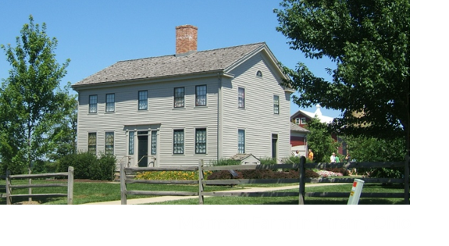
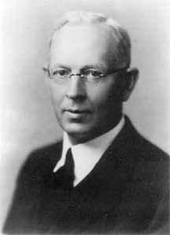
Given in This Dispensation
Revelation given through Joseph Smith the Prophet, on November 1, 1831, during a special conference of elders of the Church, held at Hiram, Ohio.
A Voice of Warning…unto all
“The Doctrine and Covenants is not a book just for the Latter-day Saints; it is more that that, it belongs to all the world…it is his book if he will accept it, if he will receive it.”
Joseph Fielding Smith
D&C 1:1-4

Slide 4
None Can Hide
“…their iniquities shall be spoken upon the housetops, and their secret acts shall be revealed.”
For everyone who rejects the gospel—When the light comes they (those who rebel) can no longer hide their errors, their iniquities, their secrets.
D&C Commentary
D&C 1:3

Slide 5
Through the Prophets
Given the divine authority to preach the gospel and warn the world
The Lord speaks His warnings to all people through His chosen disciples.
The Preface is given by the Lord Himself—it was not written by Joseph Smith but dictated by Jesus Christ
D&C 1:4-7

Slide 6
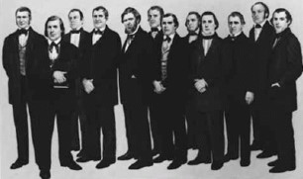
Power to Seal
Tav—to seal on their foreheads…a mark “T” for those who would not partake in the practice of abominations in Jerusalem—sealing the servants to God
That sealing was done on the eve of the Exodus on marking the door with blood in order to save those who were marked for destruction
Latter-days—they have the power to discuss between truth and error, right and wrong, and to declare, authoritatively, that such conduct is in accordance with the mind and will of God
D&C 1:8-10 D&C Commentary

Slide 7
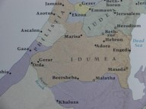
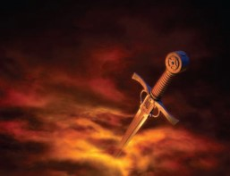
Prepare Ye
Anger of the Lord--God is long suffering, and infinitely patient
Arm—God’s arm is of action—His strength
“For my sword shall be bathed in heaven: behold, it shall come down upon Idumea, and upon the people of my curse, to judgment.”
Isaiah 34:5
An expressive term indicating the Lord’s fury upon the armies. Delivering them to destruction and slaughter. –the prediction of Isaiah in the last days.
D&C 1:11-14 D&C Commentary

Slide 8
Walk In Your Own Way
The image of their own God
Idolatry—the worship of other gods
Developed of man to give comfort and enjoyment
To satisfy wants, passions and desires
Modern idols:
Bodily appetites—food, drink, physical prowess
Clothes –Homes- Careers- Electronics -Automobile
“I would soon see a man worshiping a little god made of brass or of wood as to see him worshipping his property” Brigham Young
“Degrees, letters, and titles can become idols
There is a difference between providing for oneself and family and worshipping “things”
D&C 1:15-16 Spencer W. Kimball

Slide 9
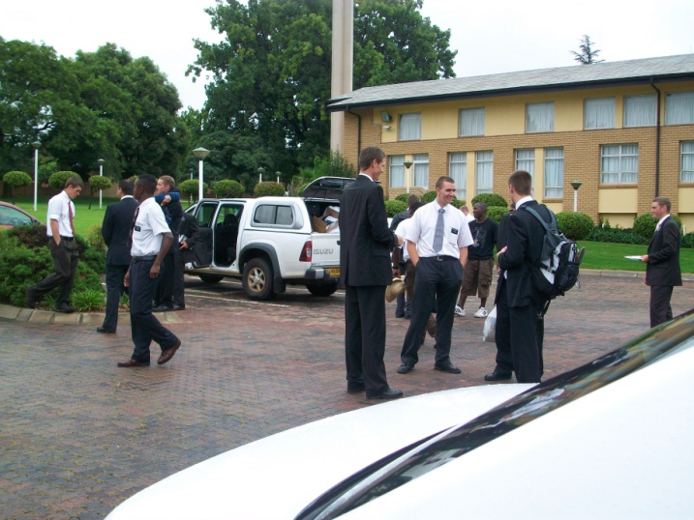
“…Many young men decide to attend college when they should be on missions first. The degree, and the wealth and the security which come through it, appear so desirable that the mission takes second place.
Some neglect Church service through their college years, feeling to give preference to the secular training and ignoring the spiritual covenants they have made.
Many people build and furnish a home and buy an automobile first—and then find they “cannot afford’ to pay tithing. Whom do they worship?
Certainly not the Lord of heaven and earth, for we serve whom we love and give first consideration to the object of our affection and desires.”
D&C 1:15-16 Spencer W. Kimball

Slide 10
 | What Solution did the Lord Give for the calamity that would come upon the Earth? | How can this solution help us face the calamity of the last days?
D&C 1:17
D&C 1:18-23
D&C 1:29
D&C 1:30

Slide 11
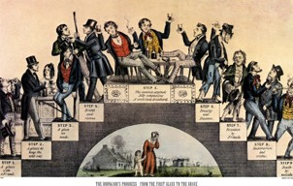
The Condition of the World
“…The Lord commissioned Joseph Smith and others to sound a voice of warning and find a place of refuge for those who would accept their message. They were weak in the estimation of the worlds.”
Paul:
“And I was with you in weakness, and in fear, and in much trembling.”
1 Corinthians 2:3
The Lord knew the condition of the world, what was in 1830, and what it would be today…Knowing the calamities that were coming to his children, unless they changed their course,…he called upon his servant, Joseph Smith, to warn men, to call repentance, and others to join in this great proclamation to all me”
Elder Melvin J. Ballard
D&C 1:17-18

Slide 12
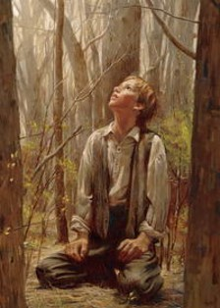
Week Things of the World
Why does God Choose the “Weak Things of the World” to do His work?
“The Lord called Joseph Smith and others from among the weak things of the world, because he and his associates were contrite and humble. The great and mighty ones in the nations the Lord could not use because of their pride and self-righteousness…
The Lord’s ways are not man’s ways, and he cannot choose those who in their own judgment are too wise to be taught. Therefore he chooses those who are willing to be taught and he make them mighty even to the breaking down of the great and might.”
Joseph Fielding Smith
D&C 1:19-24

Slide 13
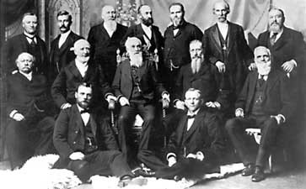
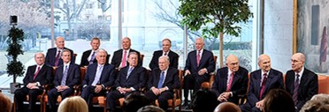
Inasmuch:
“And inasmuch as they erred it might be made known;
And inasmuch as they sought wisdom they might be instructed;
And inasmuch as they sinned they might be chastened, that they might repent;
And inasmuch as they were humble they might be made strong, and blessed from on high, and receive knowledge from time to time.”
D&C 1:25-28

Slide 14
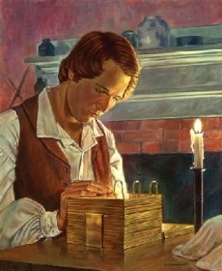
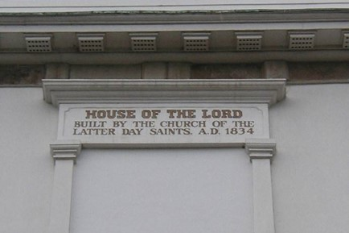
Power To Translate and Establish This Church
Joseph Smith was given the power to translate the Records of the Nephites by the mercy of God…called “The Book of Mormon”
Those who accepted the restoration of the gospel and the revelation of Joseph Smith, would have the power to lay down the foundation of this church
D&C 1:29-30

Slide 15
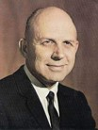
The Living Church—Modern Revelation
“There is much difference between a dead and living church. While one may have the form and shape, the ritual and dimensions, the living church has life. A living prophet leads the Church today. There is a vibrant, living movement to it, a captivating spirit about it, a glory to it that lifts and builds and helps and blesses the lives of all it touches. The Church will move forward to its divine destiny.”
A. Theodore Tuttle
D&C 1:30

Slide 16
Repentance and Forgiveness
“The truth is that we all need repentance. If we are capable of reason and past the age of eight, we all need the cleansing that comes through applying the full effects of the Atonement of Jesus Christ. When that is clear, we cannot be tricked into delay by the subtle question: “Have I crossed the line of serious sin, or can I put off even thinking about repentance?” The question that really matters is this: “How can I learn to sense even the beginning of sin and so repent early?...
The Lord cannot save us in our sins, but can save us from our sins
Alma 11:37
…the world might be willing to excuse our bad behavior because those around us behave badly. It is not true that the behavior of others removes our responsibility for our own. God’s standards for our behavior are unchanged whether or not others choose to rise to them.”
The very faith we need to repent is weakened by delay. The choice to continue in sin diminishes our faith and lessens our right to claim the Holy Ghost as our companion and comforter.
D&C 1:31-33 Henry B. Eyring

Slide 17
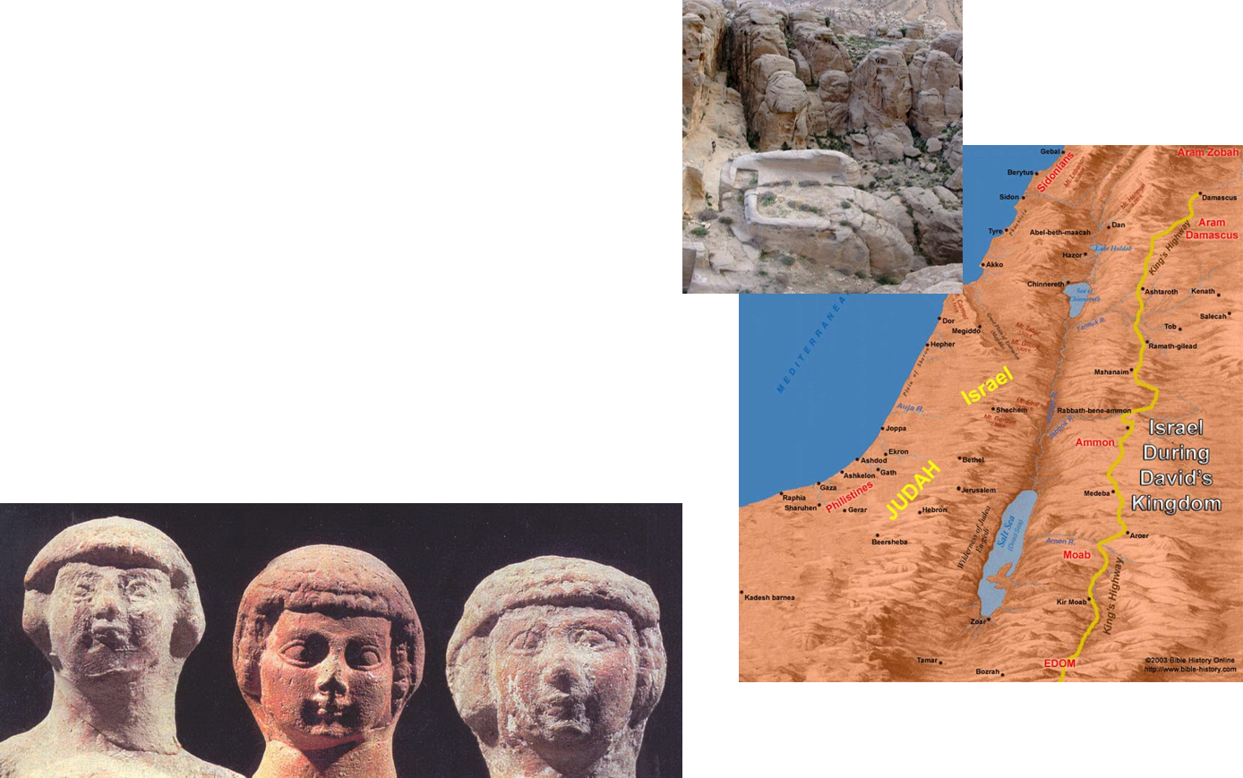
Idumea
Idumea or Edom, of which Bozrah was the principal city, was a nation to the south of the Salt Sea, through which the trade route (called the King’s Highway) ran between Egypt and Arabia. The Idumeans or Edomites were a wicked non-Israelitish people; hence, traveling through their country symbolized to the prophetic mind the pilgrimage of men through a wicked world; and so, Idumea meant the world.”
Bruce R. McConkie

Slide 18
Doctrinal Mastery
And also those to whom these commandments were given, might have power to lay the foundation of this church, and to bring it forth out of obscurity and out of darkness, the only true and living church upon the face of the whole earth, with which I, the Lord, am well pleased, speaking unto the church collectively and not individually—
D&C 1:30

Slide 19
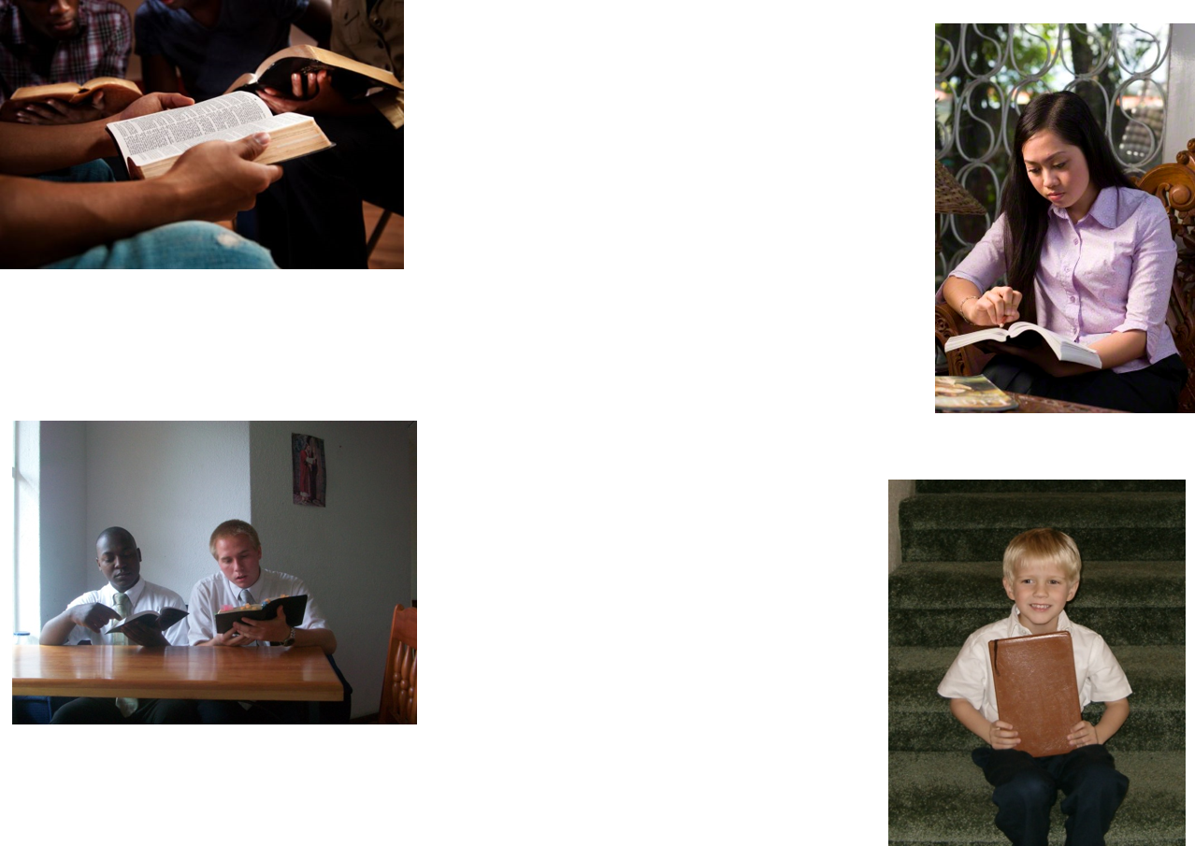
Search These Truths
We are to search the commandments the Lord has given. The Lord’s words will all be fulfilled. The Lord’s words are true whether they are stated by Him or by His servants
D&C 1:37-38

Slide 20
Doctrinal Mastery
Search these commandments, for they are true and faithful, and the prophecies and promises which are in them shall all be fulfilled.
What I the Lord have spoken, I have spoken, and I excuse not myself; and though the heavens and the earth pass away, my word shall not pass away, but shall all be fulfilled, whether by mine own voice or by the voice of my servants, it is the same.
D&C 1:37-38

Slide 21
Sources:
Related Video:
Prophets Warning (1:24)
Seek the Lord (6:18)
The True and Living Church (1:24)
The John Johnson Sr. Farm in Hiram, OH. Located at: 6203 Pioneer Trail Hiram, Ohio
Joseph Fielding Smith Conference Report Oct 1919 pg. 146
Weak things: Church History and Modern Revelation 1:255
Doctrine and Covenants Commentary –containing revelation given to Joseph Smith Jr. Historical and Exegetical Notes by Hyrum M. Smith (of the Council of the Twelve Apostles) and Janne M. Sjodahl Deseret Book Company pg. 3,6-7
Spencer W. Kimball—excerpts from Miracle of Forgiveness pg. 40-41
Elder Melvin J. Ballard Conf. Report Oct 1923 pp. 30-31
A. Theodore Tuttle Conf. Report April 1975 or May 1975 Ensign
Henry B. Eyring Do Not Delay Oct. 1999 Conf. Report
Bruce R. McConkie Mormon Doctrine p. 374

Slide 22
D&C 1:17-30 | What Solution did the Lord Give for the calamity that would come upon the Earth? | How can this solution help us face the calamity of the last days?
D&C 1:17
D&C 1:18-23
D&C 1:29
D&C 1:30

Slide 23
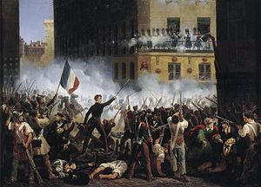
Doctrine and Covenants 1:14.
“Give heed to the words of the prophets”
Elder M. Russell Ballard taught:
“It is no small thing, my brothers and sisters, to have a prophet of God in our midst. Great and wonderful are the blessings that come into our lives as we listen to the word of the Lord given to us through him. At the same time, knowing that [the President of the Church] is God’s prophet also endows us with responsibility. When we hear the counsel of the Lord expressed through the words of the President of the Church, our response should be positive and prompt. History has shown that there is safety, peace, prosperity, and happiness in responding to prophetic counsel as did Nephi of old: ‘I will go and do the things which the Lord hath commanded’ (1 Ne. 3:7)” (“His Word Ye Shall Receive,”Ensign, May 2001, 65).
Idumea
Sacred Harp Music
Charles Wesley 1763
Ananias Davisson 1816
And am I born to die?
To lay this body down!
And must my trembling spirit fly
Into a world unknown?
A land of deepest shade,
Unpierced by human thought;
The dreary regions of the dead,
Where all things are forgot!
Soon as from earth I go,
What will become of me?
Eternal happiness or woe
Must then my portion be!
Waked by the trumpet sound,
I from my grave shall rise;
And see the Judge with glory crowned,
And see the flaming skies!
Ecc. 3:2
http://www.sacredharpbremen.org/lieder/026-bis-099/047b-idumea
Idolatry
“Sadly, however, we find that to be shown the way is not necessarily to walk in it, and many have not been able to continue in faith. These have submitted themselves in one degree or another to the enticings of Satan and his servants and joined with those of “the world” in lives of ever-deepening idolatry…
…Whatever thing a man sets his heart and his trust in most is his god; and if his god doesn’t also happen to be the true and living God of Israel, that man is laboring in idolatry.
June 1976 Ensign “The False Gods We Worship”
Other Interesting Topics
The Condition of Paris and United States in 1830’s
1784-1861
In the late eighteenth and early nineteenth century, various factors contributed to an epidemic of alcoholism that went hand-in-hand with spousal abuse, family neglect, and chronic unemployment. Americans used to drinking lightly alcoholic beverages like cider "from the crack of dawn to the crack of dawn" began ingesting far more alcohol as they drank more of strong, cheap beverages like rum (in the colonial period) and whiskey (in the post-Revolutionary period). Popular pressure for cheap and plentiful alcohol led to relaxed ordinances on alcohol sales.
http://en.wikipedia.org/wiki/Temperance_movement_in_the_United_States
July Revolution in 1830 in Paris

