Slide 1
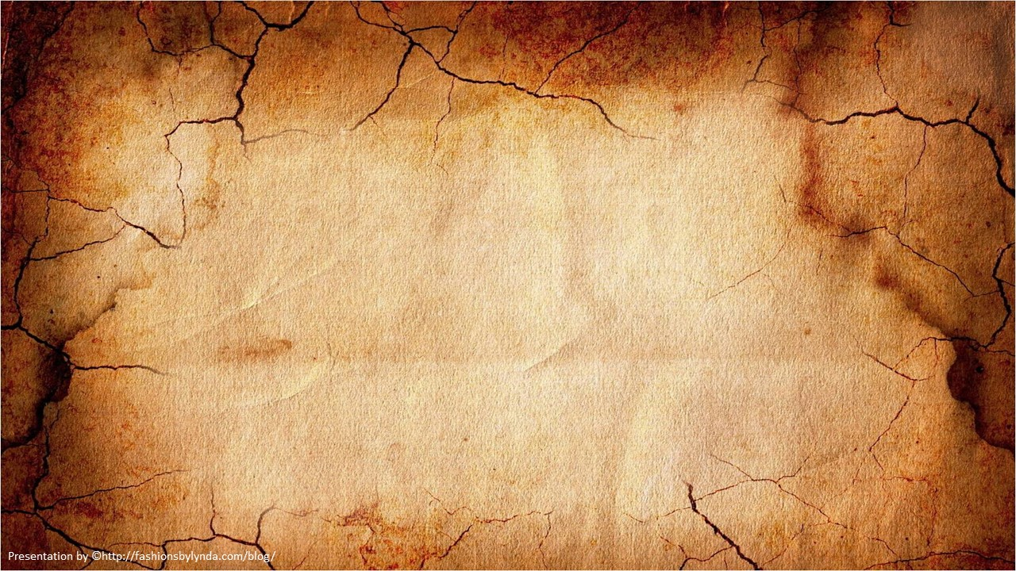
Lesson 4
Studying the Scriptures
All scripture is given by inspiration of God
2 Timothy 3:16

Slide 2
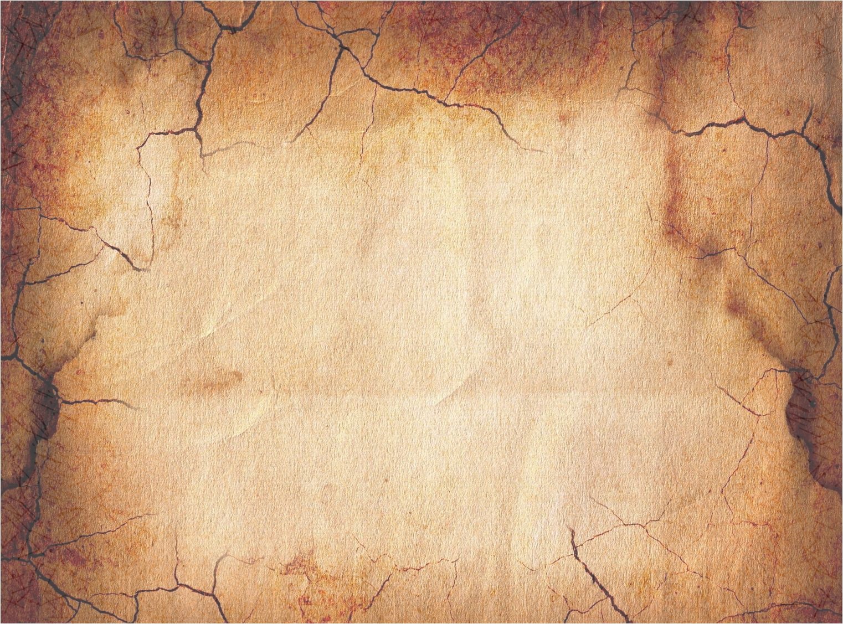
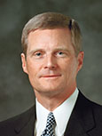
“The scriptures contain the words of Christ and are a reservoir of living water to which we have ready access and from which we can drink deeply and long. …
“Through normal activity each day, you and I lose a substantial amount of the water that constitutes so much of our physical bodies. Thirst is a demand by the cells of the body for water, and the water in our bodies must be replenished daily. It frankly does not make sense to occasionally ‘fill up’ with water, with long periods of dehydration in between.
The same thing is true spiritually. Spiritual thirst is a need for living water. A constant flow of living water is far superior to sporadic sipping.” (1)

Slide 3
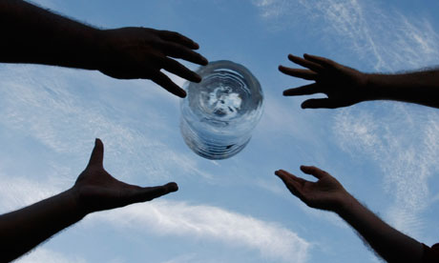
As we study the scriptures daily, we receive the “living water” we need.

Slide 4
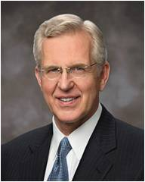
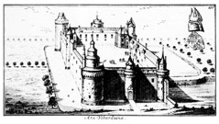
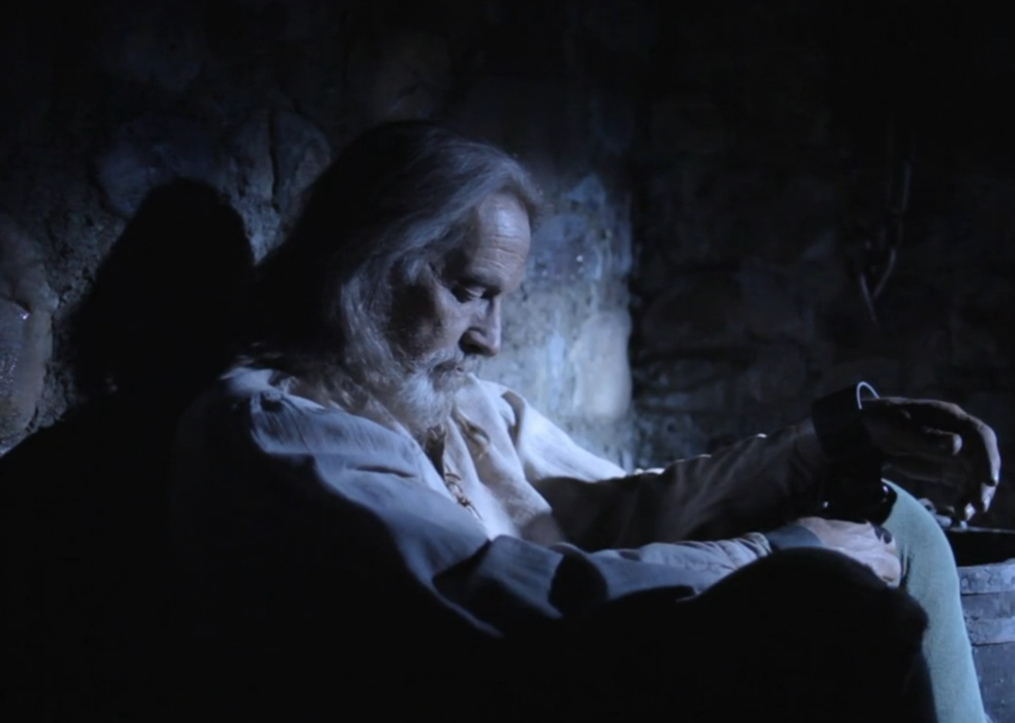
“On October 6, in the year 1536, a pitiful figure was led from a dungeon in Vilvorde Castle near Brussels, Belgium.
Engraving of Vilvorde Castle
For nearly a year and a half, the man had suffered isolation in a dark, damp cell.
(2)

Slide 5
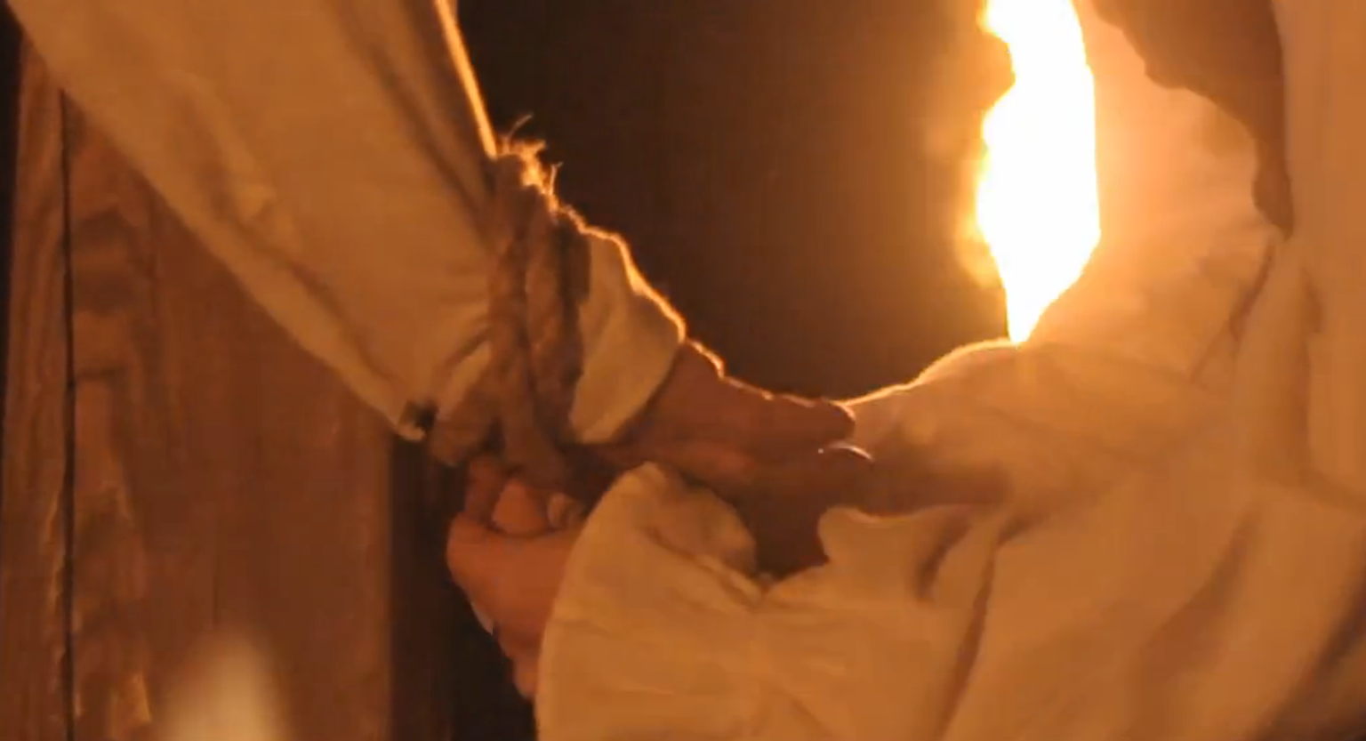
Now outside the castle wall, the prisoner was fastened to a post. He had time to utter aloud his final prayer, ‘Lord! open the king of England’s eyes,’ and then he was strangled.
Immediately, his body was burned at the stake. Who was this man, and what was the offense … ?”
(2)

Slide 6
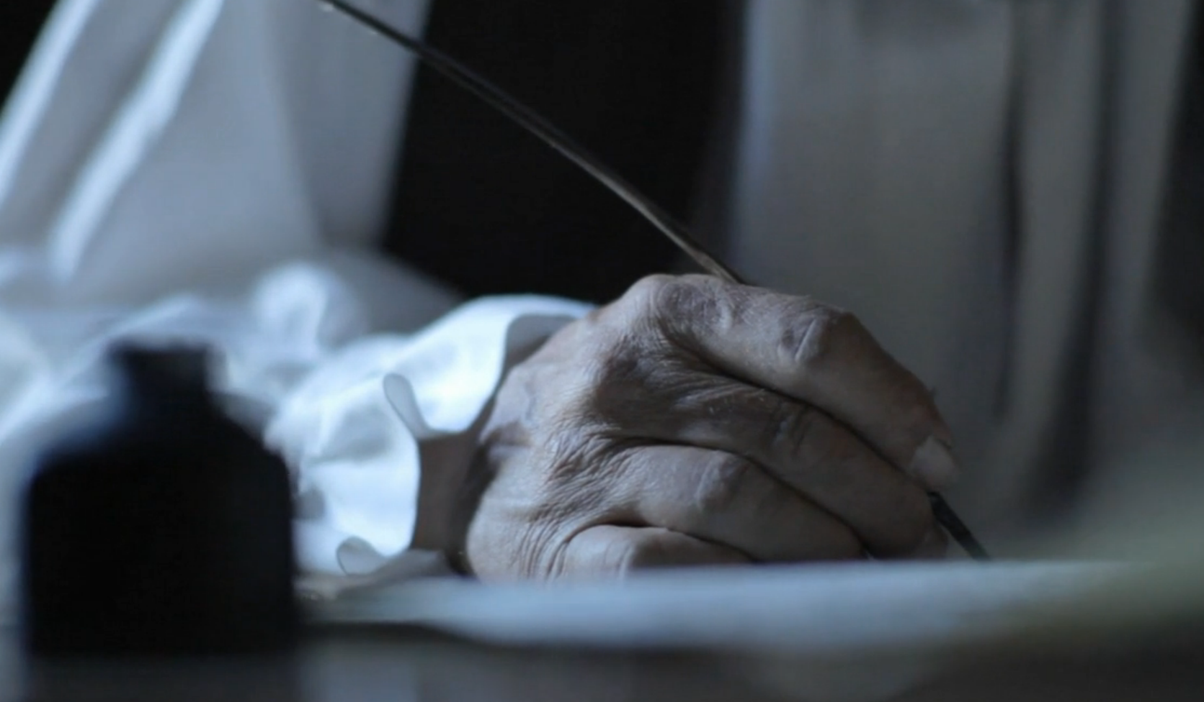
“His name was William Tyndale, and his crime was to have translated and published the Bible in English.
“… In a heated exchange with a cleric who argued against putting scripture in the hands of the common man, Tyndale vowed, ‘If God spare my life, ere many years I will cause a boy that driveth the plough, shall know more of the Scripture than thou dost!’ …
(2)

Slide 7
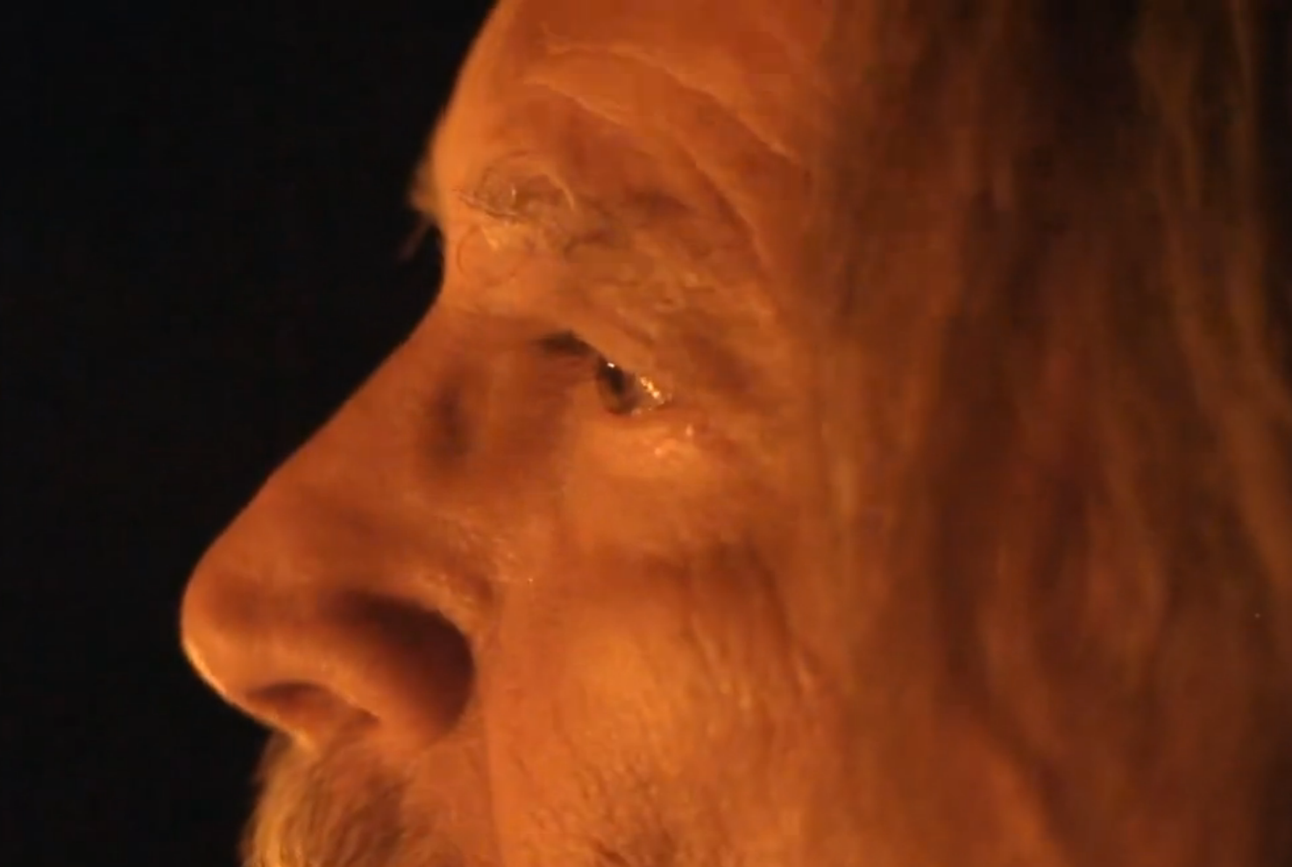
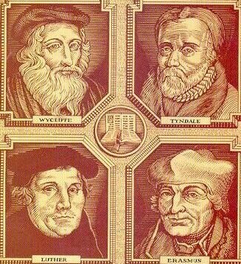
“William Tyndale was not the first, nor the last, of those who in many countries and languages have sacrificed, even to the point of death, to bring the word of God out of obscurity. …
What did they know about the importance of scriptures that we also need to know?
What did people in 16th-century England, who paid enormous sums and ran grave personal risks for access to a Bible, understand that we should also understand?”
(2)

Slide 8
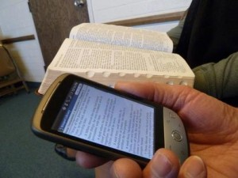
“In Tyndale’s day, scriptural ignorance abounded because people lacked access to the Bible, especially in a language they could understand.
Today the Bible and other scripture are readily at hand, yet there is a growing scriptural illiteracy because people will not open the books. Consequently they have forgotten things their grandparents knew”
(2)

Slide 9
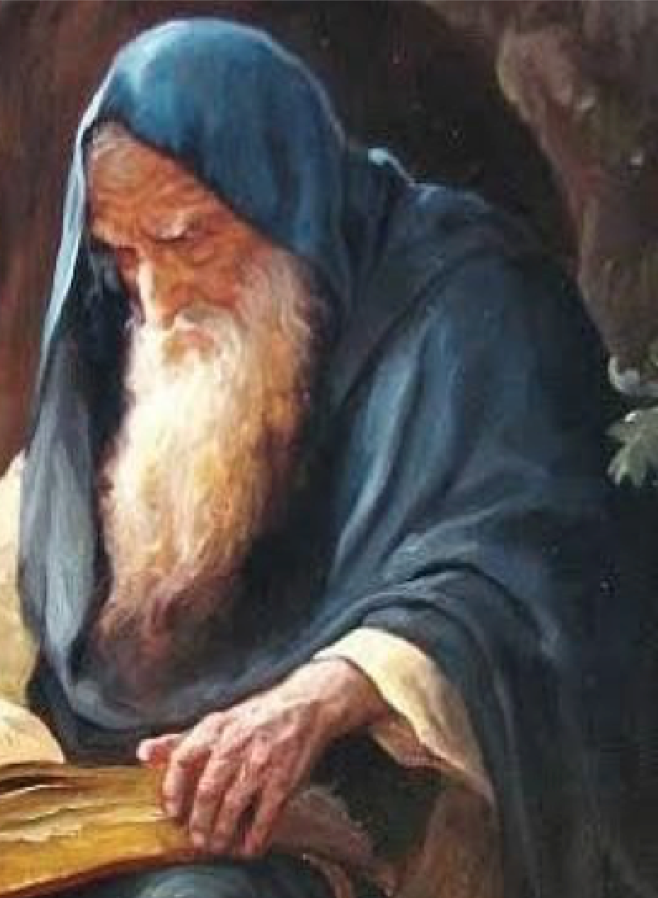
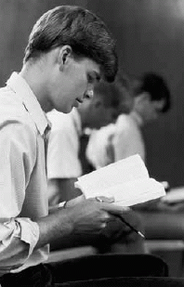
“Consider the magnitude of our blessing to have the Holy Bible and some 900 additional pages of scripture, including the Book of Mormon, the Doctrine and Covenants, and the Pearl of Great Price. … Surely with this blessing the Lord is telling us that our need for constant recourse to the scriptures is greater than in any previous time.”
(2)

Slide 10
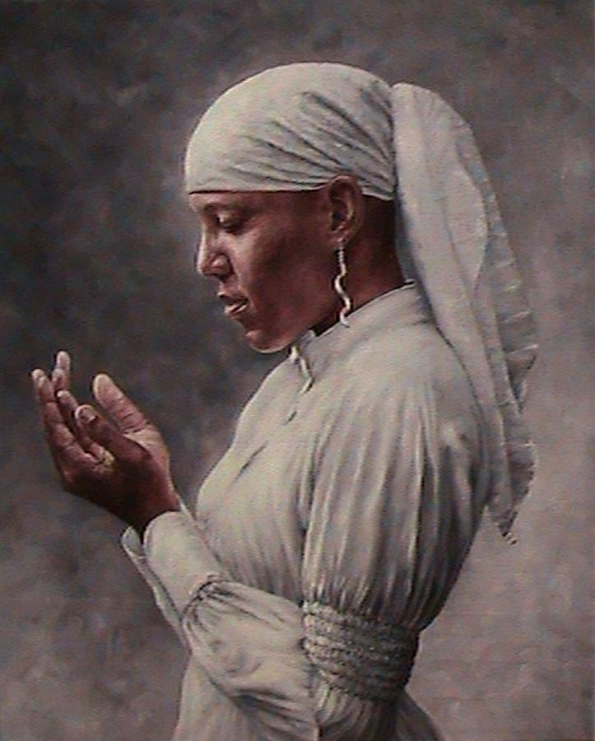
Our need for the scriptures is greater today than in any previous time

Slide 11
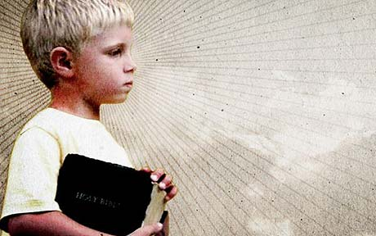
In Times of Peril
But continue thou in the things which thou hast learned and hast been assured of, knowing of whom thou hast learned them;
And that from a child thou hast known the holy scriptures, which are able to make thee wise unto salvation through faith which is in Christ Jesus.
All scripture is given by inspiration of God, and is profitable for doctrine, for reproof, for correction, for instruction in righteousness:
That the man of God may be perfect, throughly furnished unto all good works.
2 Timothy 3:14-17

Slide 12
As we study the scriptures, we can receive wisdom, correction, and instruction that will lead us to salvation

Slide 13
Name Substitution
To help you relate doctrines and principles from the scriptures to your life, substitute your name for a name in the scriptures. Try using this scripture study skill with Peter’s name in Matthew 16:15–17.
15 He saith unto them, But whom say ye that I am?
16 And __________answered and said, Thou art the Christ, the Son of the living God.
17 And Jesus answered and said unto him, Blessed art thou, ____________: for flesh and blood hath not revealed it unto thee, but my Father which is in heaven.

Slide 14
Cause and Effect
To help you identify gospel principles in the scriptures, look for “if–then” and “because–therefore” relationships. Try using this skill with Matthew 6:14–15.
For if ye forgive men their trespasses
.
your heavenly Father will also forgive you
neither will your Father forgive your trespasses.
.
But if ye forgive not men their trespasses

Slide 15
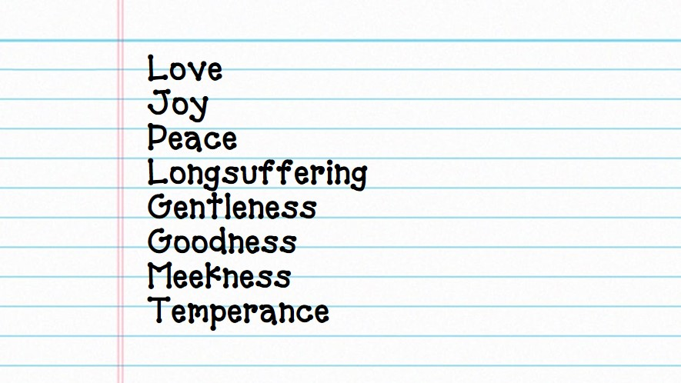
Scripture Lists
The scriptures often contain lists of things such as instructions or warnings. When you find lists, consider numbering each element. Try using this skill with Galatians 5:22–23.

Slide 16
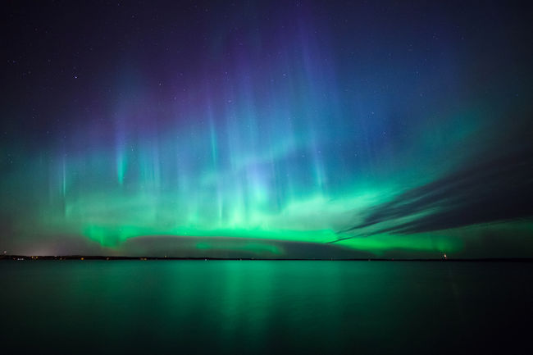
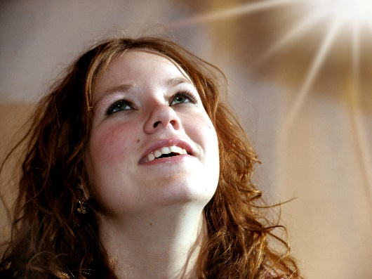
Contrasts
The scriptures often contrast ideas, events, and people. These contrasts emphasize gospel principles. Look for contrasts in single verses, in chapters, and across chapters and books. Try this skill with Matthew 5:14–16.
.
14 Ye are the light of the world. A city that is set on an hill cannot be hid.
15 Neither do men light a candle, and put it under a bushel, but on a candlestick; and it giveth light unto all that are in the house.
16 Let your light so shine before men, that they may see your good works, and glorify your Father which is in heaven.

Slide 17
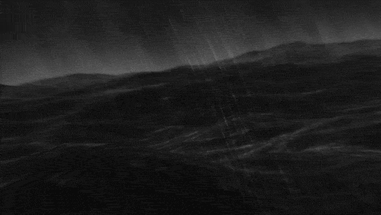
Visualization
Look for descriptive details that can help you create a mental picture as you read. Imagine being present at certain events. This can strengthen your testimony of the reality of what you read in the scriptures. Try this skill with Matthew 8:23–27
23 And when he was entered into a ship, his disciples followed him.
24 And, behold, there arose a great tempest in the sea, insomuch that the ship was covered with the waves: but he was asleep.
25 And his disciples came to him, and awoke him, saying, Lord, save us: we perish.
26 And he saith unto them, Why are ye fearful, O ye of little faith? Then he arose, and rebuked the winds and the sea; and there was a great calm.
27 But the men marvelled, saying, What manner of man is this, that even the winds and the sea obey him!

Slide 18
Cross-references
Often, one scripture passage can explain or clarify a phrase or concept found in a different passage. Link scripture passages to each other by using the footnotes, the index, or the Topical Guide or Guide to the Scriptures to help unlock the meaning of a scripture passage. Practice this skill by reading John 10:16 and then following the cross-reference in footnote a to 3 Nephi 15:21. How does reading 3 Nephi 15:21 help you better understand the meaning of John 10:16?
OTHER
3 Ne. 15:21 (11–24); 16:1 (1–3); D&C 10:59.
TG Israel, Scattering of..
16 And ªother ^{b}sheep I have, which are not of this fold: them also I must bring, and they shall hear my voice; and there shall be ^{c}one fold, and one shepherd.
SHEEP
TG Book of Mormon; Israel, Joseph, People of; Israel, Ten Lost Tribes of;Sheep.
ONE
Ezek. 37:22.
SHEPERD
TG Jesus Christ, Good Shepherd.
21. And verily I say unto you, that ye are they of whom I said: ªOther sheep I have which are not of this fold; them also I must bring, and they shall hear my voice; and there shall be one fold, and one ^{b}shepherd.

Slide 19
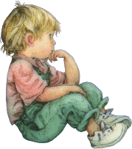
Pondering
Pondering includes thinking, meditating, asking questions, and evaluating what you know and what you have learned. Pondering often helps us understand what we need to do to apply gospel principles. Ponder how you might apply the truths in Hebrews 12:9.
.
9 Furthermore we have had fathers of our flesh which corrected us, and we gave them reverence: shall we not much rather be in subjection unto the Father of spirits, and live?

Slide 20
Applying
As you identify and understand doctrines and principles found in the scriptures, you can gain deeper knowledge by acting on the truths you have discovered.
Jesus Christ said
17 If any man will do his will, he shall know of the doctrine, whether it be of God, or whether I speak of myself.
John 7:17
Look for opportunities to apply what you learn as you study the scriptures on your own.

Slide 21
Sources:
Suggested Hymn: #277 As I Search the Holy Scriptures
Video: “The Blessings of Scripture” (3:04)
Can use story in power pt. or show the video
Elder David A. Bednar (“A Reservoir of Living Water” [Church Educational System fireside, Feb. 4, 2007], 1, 7,broadcast.lds.org).
Elder D. Todd Christofferson (“The Blessing of Scripture,” Ensign or Liahona, May 2010, 32).
Presentation by ©http://fashionsbylynda.com/blog/

Slide 22
Handout

