Slide 1
Lesson 40
Separating From Unrighteous Influences
Mark 9:30-50
'When men are called unto mine everlasting gospel, and covenant with an everlasting covenant, they are accounted as the salt of the earth and the savor of men;
They are called to be the savor of men; therefore, if that salt of the earth lose its savor, behold, it is thenceforth good for nothing only to be cast out and trodden under the feet of men.‘ D&C 101:39-40

Slide 2
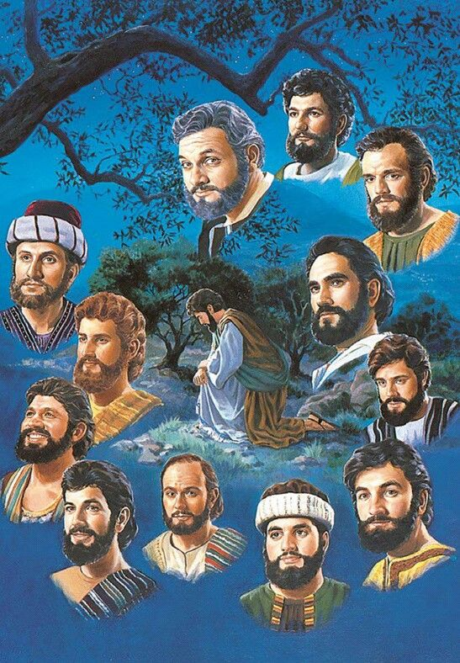
Lack of Understanding
The Apostles revealed a lack of understanding about leadership in the kingdom of God. In each instance, the Savior patiently taught them that their callings were not about receiving glory and honor, but about humbly serving others.
If any man desire to be first, the same shall be last of all, and servant of all.
Mark 9:33-39

Slide 3
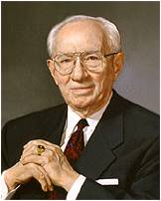
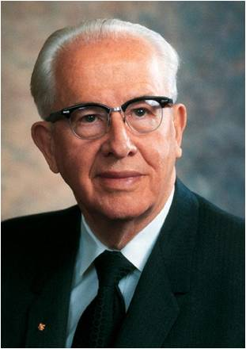
Who is Greatest?
“It matters not where we serve in this great cause, but how we serve. We each make our own contribution, and that contribution adds up to the building of the cause.” (2)
Missionaries should be taught that it doesn't matter where they serve, but how. Position doesn't save anyone, but faithfulness does. Aspiring to positions of responsibility can destroy the spirit of the mission as well as the spirit of a missionary." (3)
Mark 9:34

Slide 4
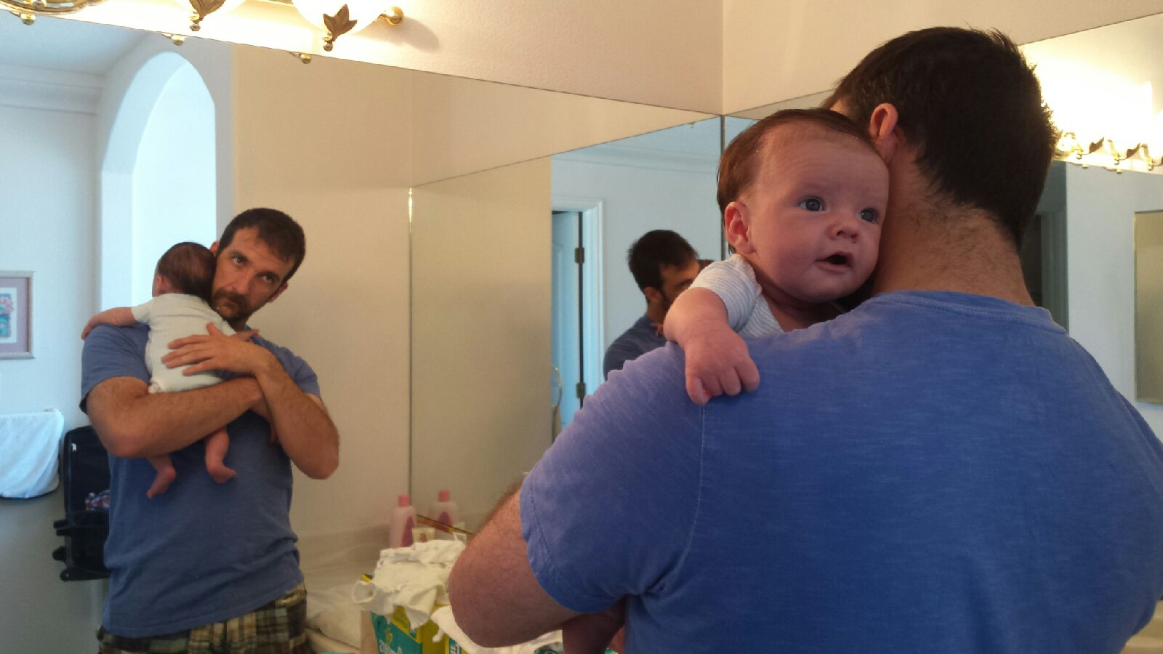
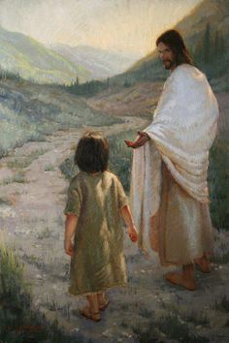
Receive One
"Parents are to nourish, tend, and teach their children so they will grow to their full stature and potential.
True teachers and leaders see children as they may become.
"To see our children grow, succeed, and take their places in society and in the Lord's kingdom is an eternal reward worth any inconvenience or sacrifice.” (4)
Whosoever shall humble himself like one of these children, and receiveth me, ye shall receive in my name. (1)
“And whosoever shall receive me, receiveth not me only, but him that sent me, even the Father”
JST Mark 9:37

Slide 5
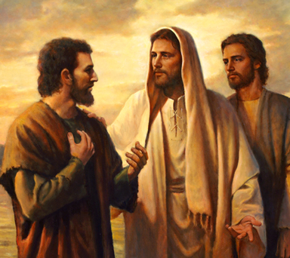
Casting Out Devils
“He that is not against us is on our part” (Mark 9:40)
“He that is not with me is against me” (Matthew 12:30)
The Pharisees said that the Savior cast out devils by the power of the devil.
The Savior declared that He cast out devils by the power of God and that the Pharisees could not take a neutral position concerning Him
The Apostles forbade this man from casting out devils because he was not a traveling companion of the Twelve Apostles.
However, the Savior told them not to forbid the man (indicating he was a righteous man who had authority) and taught that people who help His representatives will be rewarded.
Wherefore, all things which are good cometh of God;
Moroni 7:12
Mark 9:38-40

Slide 6
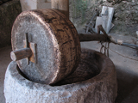
Milestone Around Neck
“Few crimes are as gross and wicked as that of teaching false doctrine and leading souls away from God and salvation. … If eternal joy is the reward given those who teach the truth and bring souls to salvation, shall not those who teach false doctrines and lead souls to damnation receive as their reward eternal remorse?
Read: D&C 18:10–16
“… It is better to die and be denied the blessings of continued mortal existence than to live and lead souls from the truth, thereby gaining eternal damnation for oneself.”
Mark 9:42
(6)

Slide 7
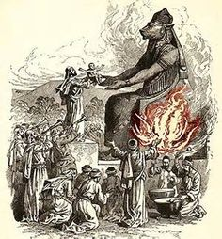
Hell—Valley of Hinnom
The word hell is a translation of the word gehenna, which is the Greek form of the Hebrew words ge hinnom, meaning “valley of Hinnom.”
In this deep valley on the south side of Jerusalem, “idolatrous Jews offered their children [as sacrifices] to [the pagan god] Moloch.
After King Josiah ended this practice, the valley was “used as a place for burning the refuse of the city (2 Kgs. 23:10) and in that way became symbolic of the place of torment.
Expressions about ‘hell-fire’ are probably due to the impression produced on men’s minds by the sight of this ceaseless burning and are figurative of the torment of those who willfully disobey God.”
Mark 9:43, 45, 47
(7)

Slide 8
Worms
The rebellious having a worm that “dieth not.”
Some types of worms gnaw through refuse.
Parasitic worms infest living bodies, causing various ailments and intense pain.
Thus, the worm that “dieth not” represents the memories and remorse of conscience of the rebellious that will continually gnaw at and torment them in the next life.
Mark 9:44,46

Slide 9
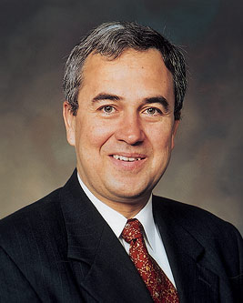
If Thy Hand Offend Thee, Cut It Off
“offend” comes from the Greek word skandalizō, meaning “to put a stumbling block or impediment in the way; to cause to sin.”
We must eliminate from our lives any association or influence, no matter how dear, that would keep us from entering the kingdom of God.
“Fortunately, the Savior Himself taught the meaning of cutting off our hand. It’s not about self-mutilation but rather about removing from our lives today those influences that keep us from preparing for tomorrow’s [times of adversity].
If I have friends who are bad influences for me, the advice is clear: ‘It is better for thee to enter into life without thy brother, than for thee and thy brother to be cast into hell’
It follows that such cutting off refers not only to friends but to every bad influence, such as inappropriate television shows, Internet sites, movies, literature, games, or music.
Engraving in our souls this principle will help us to
resist the temptation to yield to any bad influence.” (5)
Mark 9:42-48
(1)

Slide 10
It is better to separate ourselves from unrighteous influences than to end up being separated from God
Even though separating ourselves from influences that lead us to sin can sometimes be difficult, what can we gain through this sacrifice?
Mark 9:42-48
(1)

Slide 11
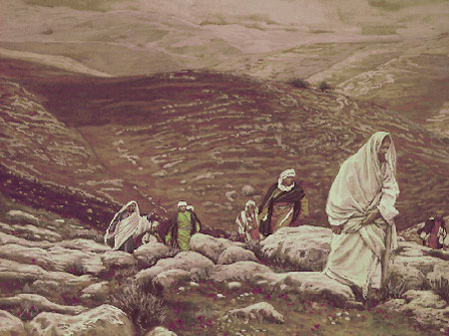
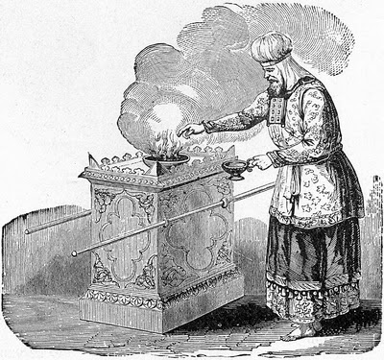
Salted With Fire
The Savior emphasized that followers of Jesus Christ must be willing to sacrifice unworthy aspects of their lives (represented by their hands, feet, or eyes) in order to enter the kingdom.
The Savior then spoke of the entire person as a sacrifice to God
James Tissot
I beseech you therefore, brethren, by the mercies of God, that ye present your bodies a living sacrifice, holy, acceptable unto God, which is your reasonable service. Romans 12:1
Sacrifices in ancient Israel were made with salt and with fire. Salt was an important symbol of the covenant between the Lord and Israel (see Leviticus 2:13),
and fire was often a symbol of spiritual preservation, purification, trials, and complete dedication to God.
Mark 9:49
(1)

Slide 12
“Every member of the Church shall be tested and tried in all things, to see whether he will abide in the covenant ‘even unto death.’”
Mark 9:49
(6)

Slide 13
Sources:
Suggested Hymn: #237 Do What is Right
Video:
Jesus Teaches That We Must Become as Little Children (3:06)
New Testament Institute Student Manual Chapter 13
President Gordon B. Hinckley "Our Testimony to the World," Ensign, May 1997, 84)
President Ezra Taft Benson (The Teachings of Ezra Taft Benson [Salt Lake City: Bookcraft, 1988], 202.)
Elder M. Russell Ballard Teach the Children, Ensign, May 1991, 78-79
Elder Walter F. González (“Today Is the Time,” Ensign or Liahona, Nov. 2007, 54–55)
Elder Bruce R. McConkie (Doctrinal New Testament Commentary, 1:421; 3 vols. 1:420).
Bible Dictionary “Hell”
Presentation by ©http://fashionsbylynda.com/blog/

Slide 14
Event | Matthew | Mark | Luke | John
The Transfiguration | 17:1-13 | 9:2-13 | 9:28-36
Demonic Boy Healed | 17:14-21 | 9:14-29 | 9:37-43
Jesus Again Foretells His Death and Resurrection | 17:22, 23 | 9:30-32 | 9:43-45
Tribute Money | 17:24-27 | 9:33
Discourse on Humility, Service, and Forgiveness | 18:1-35 | 9:33-50 | 9:46-50
The Transfiguration | 17:1-13 | 9:2-13 | 9:28-36
Demonic Boy Healed | 17:14-21 | 9:14-29 | 9:37-43
Jesus Again Foretells His Death and Resurrection | 17:22, 23 | 9:30-32 | 9:43-45
Tribute Money | 17:24-27 | 9:33
Discourse on Humility, Service, and Forgiveness | 18:1-35 | 9:33-50 | 9:46-50

Slide 15
Who is the Greatest Mark 9:34
“Position in the Church does not exalt anyone, but faithfulness does. On the other hand, aspiring to a visible position—striving to become a master rather than a servant—can destroy the spirit of the worker and the work.
“Occasionally confusion exists regarding servants and masters. The Bible reports that a group of men ‘had disputed among themselves, who should be the greatest’ among them. Jesus said, ‘If any man desire to be first, the same shall be last of all, and servant of all’’. Elder Russell M. Nelson (“Thou Shalt Have No Other Gods,” Ensign, May 1996, 15–16).
Separating Ourselves from sin Mark 9:43-48
“With whom will you choose to associate?
“You will mingle with many good people who also believe in God. Whether they be Jewish, Catholic, Protestant, or Muslim, believers know that there actually is absolute truth. …
“As you move along life’s journey, you will also become acquainted with people who do not believe in God. Many of them have not yet found divine truth and don’t know where to look for it. But you youth of the noble birthright are coming to their rescue. …
“As you mingle with nonbelievers, be aware that there may be a few who do not have your best interest at heart (see D&C 1:16;89:4). As soon as you discern that, flee from them quickly and permanently (see 1 Timothy 6:5–6, 11)” (“What Will You Choose?”Ensign, Jan. 2015, 33, or Liahona, Jan. 2015, 21).
He Followed Us Not Mark 9:38-40
John’s concern by explaining that the man “was not one of the inner circle of disciples who traveled, ate, slept, and communed continually with the Master. Luke has it: ‘He followeth not with us’ [Luke 9:49; italics added]; that is, he is not one of our traveling companions. But from our Lord’s reply it is evident that he was a member of the kingdom, a legal administrator who was acting in the authority of the priesthood and the power of faith. Either he was unknown to John who therefore erroneously supposed him to be without authority or else John falsely supposed that the power to cast out devils was limited to the Twelve and did not extend to all faithful priesthood holders. It is quite possible that the one casting out devils was a seventy. [see Luke 10:1, 17]
The Savior’s answer to John, recorded in Mark 9:40, reassured John and the Twelve that the man was a disciple with authority, though not an Apostle” Elder Bruce R. McConkie (Doctrinal New Testament Commentary, 1:417).
Elder Walter F. González
General Authority Seventy Elder Walter F. González was sustained a member of the First Quorum of the Seventy of The Church of Jesus Christ of Latter-day Saints on March 31, 2001. He had previously served in the Fourth Quorum of the Seventy, beginning in April 1997, and as an Area Authority in the South America North Area since August 15, 1995.
He is currently serving as president of the South America South Area. Elder González previously served in the Presidency of the Seventy with supervisory responsibility for the North America Southeast Area, as president of the South America West Area, president of the Brazil North Area, first counselor in the Brazil North Area Presidency, and first counselor in the South America North Area Presidency.
He earned a bachelor of general studies degree at Indiana University and a technician’s certificate in business administration at CEMLAD Institute. His professional career led him to be director of the Church Educational System for the South America North Area. Prior to taking that position, he was a CES employee in several South American countries.

