Slide 1
Lesson 41
Rich Young Man
Mark 10
Jesus said unto him, If thou wilt be perfect, go and sell that thou hast, and give to the poor, and thou shalt have treasure in heaven; and come and follow me. Matthew 19:21

Slide 2
Pharisees Tempt Jesus Again
Near the end of the Savior’s ministry, He left Galilee and went to an area called Perea.
There He taught the importance of marriage.
Galilee
Perea
Jerusalem
Is it lawful for a man to put away his wife?
Mark 10:2-5

Slide 3
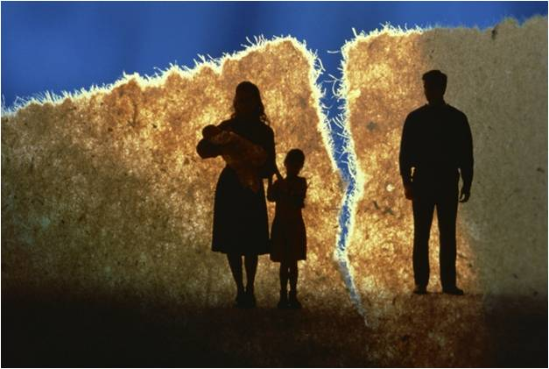
Divorce
But from the beginning of the creation God made them male and female.
For this cause shall a man leave his father and mother, and cleave to his wife;
And they twain shall be one flesh: so then they are no more twain, but one flesh.
What therefore God hath joined together, let not man put asunder.
'Divorce is not part of the gospel plan no matter what kind of marriage is involved. But because men [and women] in practice do not always live in harmony with gospel standards, the Lord permits divorce [as in Moses' time] for one reason or another, depending upon the spiritual stability of the people involved. ...
Mark 10:6-9
(2)

Slide 4
Allowing Divorce
"If our societies were on a higher plane, then, marriage covenants would be held in great, sacred trust; essentially, divorce would not exist or be considered except for truly serious reasons such as adultery. I would also suggest that in a higher system, with individuals living in harmony with all the Lord's teachings, there would be no such serious problems and thus no divorce.
"Unfortunately, our societies are less than ideal. Some persons do live in unbearably difficult marital circumstances, suffering as victims of spouse abuse, substance abuse, promiscuity, and other evils that are sometimes addressed through divorce as a last resort. In such cases, the Lord in his mercy 'permits his agents to exercise the power to loose [to authorize divorce] as well as the power to bind.‘”
Mark 10:6-9
(2)

Slide 5
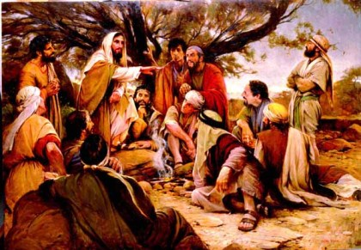
Teaching the Disciples
Once the group had gathered together in the house, this subject resurfaced.
It was to his disciples that He taught the celestial standard. Out of earshot of the wicked, the Master taught the consequences of divorce for one who understands the celestial standard.
The difficult doctrine was given not to the world but to the elect. Their response was incredulous, "If the case of the man be so with his wife, it is not good to marry" (Matt. 19:10).
The Savior's response again was meant for his disciples, "All men cannot receive this saying, save they to whom it is given" (Matt. 19:11)
That statement is as true today as it was when the Master taught it. To whom was the saying given? It was to the elect whom the Lord expects can keep such a difficult standard
Mark 10:10
(3)

Slide 6
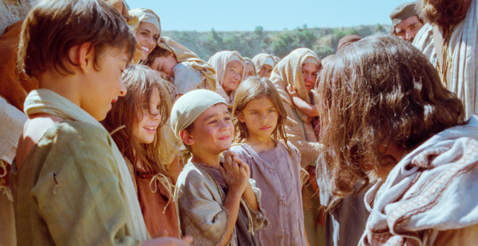
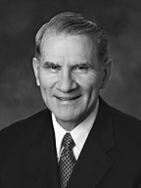
Suffer the Little Children
forbid them not: for of such is the kingdom of God.
Rebuked = the disciples told the people they were wrong to bring their children to the Savior
As we receive the gospel like little children, we will be prepared to enter God’s kingdom
Only in Mark's account is found this tender experience: "And he took them up in his arms, put his hands upon them,
and blessed them. We do not know how many
children were so blessed to have Him take them
into His arms, put His hands on them, and bless them.”
Mark 10:13-16
(4)

Slide 7
The rich young man
Mark 10:17-22
What lack I yet?
Because He loves us, the Lord will help us know what we lack in our efforts to follow Him. If we ask the Lord, He will teach us what we need to do to inherit eternal life
We may not be asked to give up great riches to follow the Lord, He has asked us to make other sacrifices to serve Him and obey His commandments.

Slide 8
Eye of a Needle
“…in ancient times there was a small gate cut inside the larger gate of the city through which one might enter after nightfall, when the city was closed.
Although this small gate—termed the “eye of the needle”—could readily admit a man, a camel could enter only by first being relieved of its burden and then by walking through on its knees.
“…there is absolutely no evidence whatsoever of the use of such small inset gates in the time of Christ.
“The imagery here is that of the sinner casting away his faults (or the rich man his worldly possessions) and kneeling in prayer.”
See rest of Article by John A. Tvedtnes
Mark 10:25

Slide 9
Riches and Desires
Why do you think it is so hard for those who trust in riches or other worldly things to enter the kingdom of God?
What do you think it means that all things are possible for those who trust in God?
And Jesus looking upon them saith, With men it is impossible, but not with God: for with God all things are possible.
Mark 10:27 JST
(5)

Slide 10
Peter
Mark 10: 28-30
We have left all, and have followed thee.
Eternal life includes living forever in God’s presence with our righteous family members
To receive eternal life, we must be willing to give up whatever the Lord requires of us.

Slide 11
James and John
Mark 10:35-37
Grant unto us that we may sit, one on thy right hand, and the other on thy left hand, in thy glory.
This blessing would be given to those who were prepared to receive it.
To be truly great, we must follow the Savior’s example by serving others
To minister means to provide care, comfort, aid, and support for others.

Slide 12
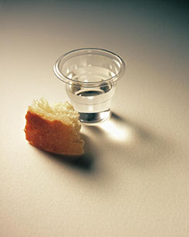
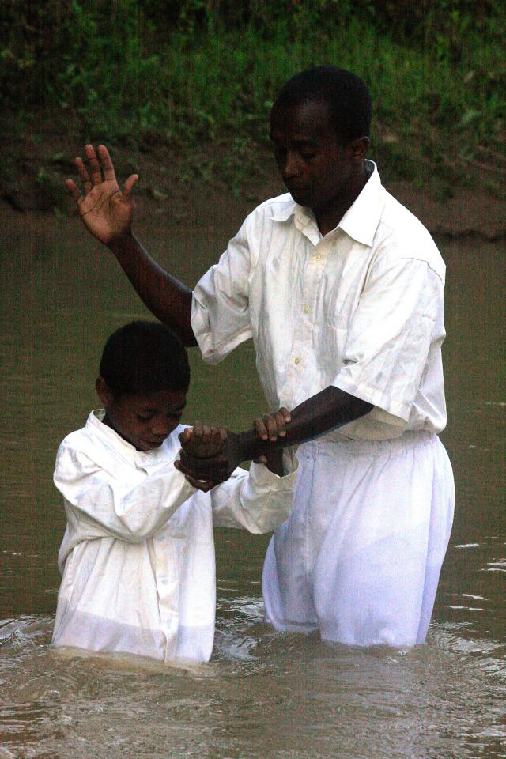
Drink of This Cup
“To do the things which my lot in life requires of me.”’
Be baptized with the baptism that I am baptized with’ =
‘to follow my course, suffer persecution, be rejected of men, and finally be slain for the truth’s sake’
Mark 10:38-39
(2)

Slide 13
Bartimaeus
Mark 10:46-52
Have mercy on me.
"How joyous it would be if we too could have the faith to call without ceasing, to arise, to see, to be whole again, and, by the power of our faith, take the way with our Master.
“Through the words of Mark this joy comes nearer to realization. Simplicity is power, in words and in faith."
Bartimeus “received his sight after his persistent, faithful efforts to reach the Lord”
(5)

Slide 14
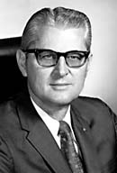
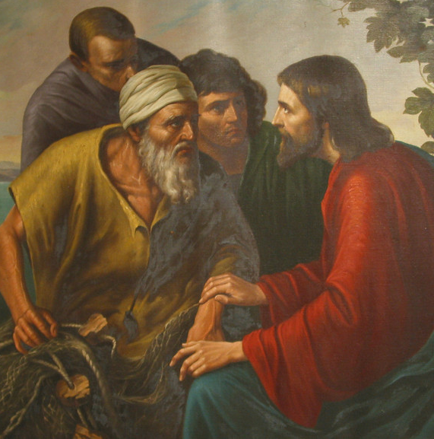
A selfless person is one who is more concerned about the happiness and well-being of another than about his or her own convenience or comfort, one who is willing to serve another when it is neither sought for nor appreciated, or one who is willing to serve even those whom he or she dislikes.
A selfless person displays a willingness to sacrifice, a willingness to purge from his or her mind and heart personal wants, and needs, and feelings.
Instead of reaching for and requiring praise and recognition for himself, or gratification of his or her own wants, the selfless person will meet these very human needs for others.
Remember the words of the Savior as he taught his disciples on an occasion when personal recognition was being sought: "But Jesus called them to him, and saith unto them, ... whosoever will be great among you, shall be your minister: And whosoever of you will be the chiefest, shall be servant of all. For even the son of man came not to be ministered unto, but to minister, and to give his life a ransom for many.”
Mark 10:42-45
(6)

Slide 15
Sources:
Suggested Hymn: #116 Come Follow Me
Video:
“Your Day for a Mission” (3:32)
New Testament Institute Student Manual Chapter 13
Elder Bruce R. McConkie Doctrinal New Testament Commentary, 3 vols., Salt Lake City: Bookcraft, 1973, 1:547, 1:566.) Mormon Doctrine, 2d ed., Salt Lake City: Bookcraft, 1966, p. 204.)
Gospeldoctrine.com (Mark 10:10)
Elder James E. Jensen "Little Children and the Gospel," Ensign, Jan. 1999, 34.
Neal E. Lambert and Richard H. Cracroft, "The Powerful Voices of the Gospels," New Era, Jan. 1973, 39-40
H. Burke Peterson ("Selflessness: A Pattern for Happiness," Ensign, May 1985, 66)
Presentation by ©http://fashionsbylynda.com/blog/

Slide 16
Event | Matthew | Mark | Luke | John
Jesus Sends Forth the Seventy | 11:20-24 | 10:1:1-16
Jesus Travels from Galilee to Judea | 19:1, 2 | 10:1
Jesus Teaches About Marriage and Divorce | 19:3-12 | 10:2-12
Jesus Blesses the Little Children | 19:13-15 | 10:13-16 | 18:15-17
Jesus Teaches a Rich Young Ruler | 19:16-26 | 10:17-27 | 18:18-27
Results of Following Jesus | 19:27-30 | 10:28-31 | 18:28-30
Parable of Laborers in the Vineyard | 20:1-16
Jesus Foretells his Death and Resurrection in Jerusalem | 20:17-19 | 10:32-34 | 18:31-34
Seeking Greatness in the Kingdom | 20:20-28 | 10:35-45
Blind Bartimaeus and Another Healed Near Jericho | 20:29-34 | 10:46-52 | 18:35-43

Slide 17
The unbroken Home Mark 10:6-9
"In the light of scripture, ancient and modern, we are justified in concluding that Christ's ideal pertaining to marriage is the unbroken home, and conditions that cause divorce are violations of his divine teachings. ... There may be circumstances which make the continuance of the marriage state a greater evil than divorce. But these are extreme cases-they are the mistakes, the calamities in the realm of marriage. If we could remove them I would say there never should be a divorce. It is Christ's ideal that home and marriage should be perpetual-eternal." President David O. McKay (Treasures of Life, Salt Lake City: Deseret Book Co., 1965, p. 66.)" (Jonathan M. Chamberlain, "I Have a Question," Ensign, Jan. 1993, 59-60)
Rich Man’s Falling Mark 10:17-28:
This man's failing was not his possession of riches but his attitude toward them. As was demonstrated by his apparent failure to follow the Savior's challenge, he still lacked the attitude toward the things of this world that is required to 'inherit eternal life.' As the Prophet Joseph Smith taught in our own day, 'A religion that does not require the sacrifice of all things never has power sufficient to produce the faith necessary unto life and salvation' (Lectures on Faith 6:7)." Elder Dallin H. Oaks (Pure in Heart [Salt Lake City: Bookcraft, 1988], 76.)
Marriage and Gospel Standards Mark 10:6-9:
It is sad, indeed, to see how lightly some take their marriage vows. There is great concern among the Brethren as to the increasing number of divorces in the Church today.
Even though the divorce rate among members of the Church is considerably less than the national rate, and the rate of divorce among those married in the temple is less than with those married civilly, yet the rate is alarmingly high.
Divorce is usually the result of one or both not living the gospel. I suppose this is the same reason divorce was finally permitted in the time of Moses, as referred to by the Savior as he answered the Pharisees, when he said: "Moses because of the hardness of your hearts suffered you to put away your wives: but from the beginning it was not so." (Matt. 19:8.) And so in our day members do not abide by the law of the gospel in its fullness, and, as in the day of Moses, divorce is permitted, when deemed necessary, although it was never intended to be.
If, in marriage, both parties would make gospel standards and principles the basis of their marriage, few problems would arise they could not handle. When one or the other or both begin to compromise gospel standards, problems follow. Marriage is a sacred relationship, and good members of the Church would know that it is entered into primarily for the rearing of a family. James A. Cullimore ("Marriage Is Intended to Be Forever," Ensign, June 1971, 93)
Camel through an Eye of a Needle Mark 10:25:
"A hyperbole is a statement exaggerated for effect. It is a way of verbally underscoring an idea or principle. Hyperbole or overstatement is a figure of speech common to peoples of all ages, and it is natural that the scriptures would abound with it. It can be used in flattery, as in the song of the dancing women: 'Saul hath slain his thousands, and David his ten thousands' (1 Samuel 18:7). It is also used in lament: 'They were swifter than eagles, they were stronger than lions' (2 Samuel 1:23). It was a device frequently used by Jesus. To the Pharisees he said, you 'strain at a gnat, and swallow a camel' (Matthew 23:24). To those who trusted in their wealth he said, 'It is easier for a camel to go through the eye of a needle, than for a rich man to enter into the kingdom of God' (Mark 10:25). Literalists suggest to us that the needle's eye was the name for a low gate, like the door into the Church of the Nativity at Bethlehem, but since we find him using exaggerated statements so effectively and frequently one is left to wonder why the fuss in this instance." (Joseph Fielding McConkie, Gospel Symbolism [Salt Lake City: Bookcraft, 1999], 22.)
On the Right Hand of God Mark 10:40
The prophets who are on Christ's right and left hand will likely be the greatest prophets in the history of the earth. Michael and Gabriel would certainly be candidates.
However, there is an irony in the Master's response. He appropriately puts down the brothers' lofty aspirations, but in reality, they will both be on his right side, clothed in glory, when He comes again.
And again, verily, verily, I say unto you, and it hath gone forth in a firm decree, by the will of the Father, that mine apostles, the Twelve which were with me in my ministry at Jerusalem, shall stand at my right hand at the day of my coming in a pillar of fire, being clothed with robes of righteousness, with crowns upon their heads, in glory even as I am, to judge the whole house of Israel... (D&C 29:12) gospeldoctrine.com
One thing thou lackest Mark 10:17-28:
"We may say quite sincerely and even somewhat accurately that we are doing reasonably well at commandment keeping. Let us ponder, however, the episode with the young man who told the Savior that he too had kept the commandments from his youth. Jesus then gave him an added and very customized challenge: to go and sell all that he had and give the proceeds to the poor and then 'take up the cross, and follow me.' Doing this, said the Savior to the young man, would take care of the 'one thing thou lackest.' (Mark 10:21.) For some of us, would that it were just one thing! But having a healthy consciousness of that which we yet lack can become an additional test and spur. Though we may have already proved we can play checkers, are we now ready to play chess? Are we willing to let the Lord lead us into further developmental experiences? Or do we shrink back? The things that 'greatly enlarge the soul' have no part with shrinking!" Elder Neal A. Maxwell (Notwithstanding My Weakness [Salt Lake City: Deseret Book Co., 1981], 115.)

Slide 18
The Eye of a Needle:
John A. Tvedtnes, specialist in ancient Near Eastern studies and instructor at the Brigham Young University–Salt Lake Center.
Over the years, biblical commentators have taken three approaches in exploring the meaning of this scripture. The first of these has found wide acceptance among Christians because of the beauty of its teachings. It holds that in ancient times there was a small gate cut inside the larger gate of the city through which one might enter after nightfall, when the city was closed. Although this small gate—termed the “eye of the needle”—could readily admit a man, a camel could enter only by first being relieved of its burden and then by walking through on its knees. The imagery here is that of the sinner casting away his faults (or the rich man his worldly possessions) and kneeling in prayer.
Unfortunately, there are problems with this beautiful explanation. One is that the camel’s anatomy does not permit it to crawl on its knees. More serious, however, is the fact that there is absolutely no evidence whatsoever of the use of such small inset gates in the time of Christ. One may see them today in Jerusalem and Damascus, where the local tour guides will call them by the term “eye of the needle,” but there are no such gates dating prior to the twelfth century A.D. Moreover, the guides have taken the term “eye of the needle” from modern commentators of the Matthew passage and not from an authentic ancient tradition.
A second possibility is that Jesus actually used the word “rope,” the Greek form of which (kamilos) is similar to the word used for “camel” in Matthew 19:24 (kamelos) [Matt. 19:24]. The rope, after all, is just a larger version of string or thread, which one would expect to use with a needle.
A third possibility is that Jesus really meant to say “camel” and that his speech was deliberate hyperbole—exaggeration for the purpose of emphasis—common in that part of the world. Dummelow, for example, cites the Greek saying, “It is easier to hide five elephants under one’s arm,” and the Latin, “More easily would a locust bring forth an elephant.” Alongside these, he notes the tradition in which one rabbi said to another, “Perhaps thou art one of those of Pombeditha, who can make an elephant pass through a needle’s eye.” The parallel with Jesus’ statement is remarkable, suggesting a lingering use in Judaism of this particular kind of hyperbole. (J. R. Dummelow, A Commentary on the Holy Bible, New York: MacMillan, 1973, pp. 689–90.)
Evidence suggesting that hyperbole may have been intended when Jesus spoke of the camel and the needle’s eye comes from the fact that his hearers understood the impossibility of the statement and “were exceedingly amazed, saying, Who then can be saved?” To this, Jesus replied, “With men this is impossible; but with God all things are possible.” (Matt. 19:25–26; italics added.)
Jesus’ use of hyperbole is found in another of his sayings: “Ye blind guides, which strain at a gnat, and swallow a camel.” (Matt. 23:24.) Obviously, those to whom he addressed these words did not really swallow camels!
The prophet Joseph Smith knew that the Savior’s words about straining at a gnat and swallowing a camel were not to be taken literally. In his translation (JST, Matt. 23:21), he deleted reference to swallowing the camel and wrote, “Ye blind guides, who make yourselves appear unto men that ye would not commit the least sin, and yet ye yourselves, transgress the whole law.” The real intent of Jesus’ hyperbolic teaching is to be found in this translation, though the wording is not literal.
Hyperbole, exaggeration for the sake of emphasis, found in the Old as well as the New Testament, remains even today a part of everyday speech in the Middle East. It is a linguistic and cultural trait common to that area. Its usage in the Bible does not diminish the importance or the truthfulness of that sacred volume. Rather, it places it geographically and adds to its authenticity.
All three possible explanations of Matthew 19:24—the gate, the rope, and the Jewish figure of speech—have been mentioned by prominent Latter-day Saint leaders. (See James E. Talmage, Jesus the Christ, Salt Lake City: Deseret Book, 1973, pp. 485–6; Bruce R. McConkie, Doctrinal New Testament Commentary, 3 vols., Salt Lake City: Bookcraft, 1965–73, 1:556.)
In any event, the idea is clear—riches can become a serious stumbling block to a person seeking eternal life.
March 1985 Ensign “I Have a Question”

Slide 19
The Eye of the Needle: From Seminary Teacher Manual
“Some have asserted that the eye of the needle was a small door in the Jerusalem city wall, requiring a camel to be stripped of its load in order to enter. There is no evidence that such a door ever existed. Others have proposed that altering one letter in the Greek text would change the scripture to mean that a rope, not a camel, would have to pass through the eye of a needle.
However, when Jesus Christ referred to a camel passing through the eye of a needle, it was likely an example of hyperbole, an intentional exaggeration to teach ‘that a rich man shall hardly [with difficulty] enter into the kingdom of heaven’ (Matthew 19:23).
The Joseph Smith Translation adds, ‘With men that trust in riches, it is impossible; but not impossible with men who trust in God and leave all for my sake, for with such all these things are possible’ (Joseph Smith Translation, Mark 10:26 [in Mark 10:27, footnote a])” (New Testament Student Manual [Church Educational System manual, 2014], 63).

