Slide 1
Lesson 43
The Annunciation
Luke 1
The Holy Ghost shall come upon thee, and the power of the Highest shall overshadow thee: therefore also that holy thing which shall be born of thee shall be called the Son of God.
Luke 1:35

Slide 2
Luke
He was a Gentile by birth
He was a physician
He was called to be a “messenger of Jesus Christ”
He was well educated in Greek, culture and language
He did not witness the events of the Savior’s life, but became acquainted with them through others
He was one of Paul’s missionary companions at various times, during Paul's 2nd and 3rd journeys
He was the author of Acts
His audience included the Gentiles
His gospel contains the traditional Christmas narrative

Slide 3
The Book of Luke
Luke was written before Acts, probably between A.D. 57-79
*As a writer: He wanted the Gentiles to come to the same knowledge of the truth he had.
(Luke writes this testimony so his friend Theophilus, probably also a Greek convert, would know the truth about Jesus Christ).
It is the longest Book in the New Testament.
He was as not a Jew, but gives meanings to Hebrew
words
He presented Jesus as the Son of God.
He narrated events of the humanity of Christ.
He added the genealogy back to Adam.
He added a detailed account of the life of Jesus’ mother, Mary and His childhood.
Much of the material focused on women, the poor, and the lower class.
He provided a hope through the life and atoning sacrifice of Jesus Christ to all the people.
He was especially concerned with the mission to the Gentiles.
Book
Of
Luke

Slide 4
Zacharias and Elisabeth
He was a Judean priest, from the family of Aaron, in the days of king Herod and husband to Elizabeth
He and his wife were both righteous
They had no children and both were ‘stricken in years’
He was visited by the angel Gabriel (Noah) and was told that his wife would have a son
Not convinced, Zacharias was struck dumb (not able to speak) until after the birth of their son, John (the Baptist)
________________________________________________________________
She was the wife of Zacharias, the priest, and mother to John the Baptist
She belonged to the priestly family of Aaron
She was a kinswoman to Mary, mother of Jesus

Slide 5
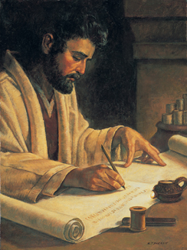
Theophilus—Friend of God
The name or honorary title of the person to whom the Gospel of Luke and the Acts.
The person to whom Luke addressed his Gospel and the Acts. The use of the title “most excellent” seems to show that he was a real personage.
One possibility…
"...This Theophilus was probably a native of Italy and perhaps an inhabitant of Rome, in tracing St. Paul's journey to Rome, places which an Italian might be supposed not to know are described minutely, Acts 27:8, 12, 16; but when he comes to Sicily and Italy this is neglected.
Hence it would appear that the person for whom Luke wrote in the first instance was a Gentile reader; and accordingly we find traces in the Gospel of a leaning toward Gentile rather than Jewish converts." (2)
Luke 1:3

Slide 6
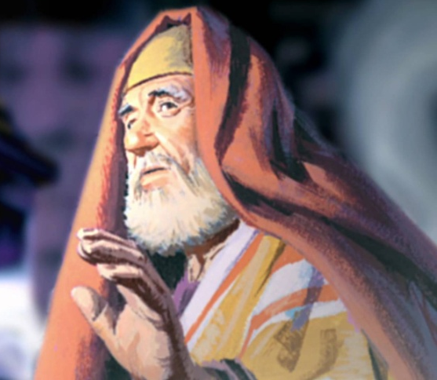
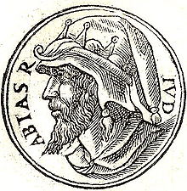
The Course of Abia
Zacharias belonged to the course of priests named after Abijah, and known in later time as the course of Abia.
This was the eighth in the order of the twenty-four courses established by David the king, each course being appointed to serve in turn a week at the sanctuary.
Centuries before the birth of Jesus, King David had divided the priests of Israel into 24 families (called “courses”), each of which was called to serve in the temple twice a year for one week each time. Zacharias belonged to the priestly family of Abia (also called Abijah;).
Joseph Smith Translation, Luke 1:8 replaces the word course with priesthood.
The priests drew lots to determine who among them would receive the high honor of offering incense within the temple.
Because of the large number of priests, the opportunity to burn incense was a rare privilege, one that would have been a high point in Zacharias’s life of service as a priest. (1)
According to the Hebrew Bible, the fourth king of the House of David and the second of the Kingdom of Judah. He was the son of Rehoboam, the grandson of Solomon and the great-grandson of David. The Chronicler refers to him as Abijah. Wikipedia
Luke 1:5; 1 Chronicles 23:1-6; 24:1-19

Slide 7
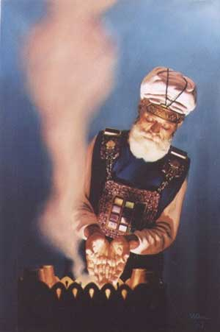
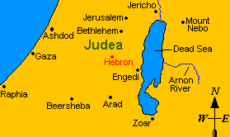
Zacharias Priestly Duty
Appointed to burn incense in the Jerusalem temple
"Twice each year, in April and October, the priests of the course of Abia, named for Abijah, traveled from their village homes to the House of the Lord in Jerusalem, there to take their week-long turns at performing those sacred rites and ordinances which for fifteen hundred years had been the center of Israel's worship.” (3)
Zacharias and Elisabeth dwelt in a village in the hill country of Judea, believed to be Hebron.
Luke 1:9

Slide 8
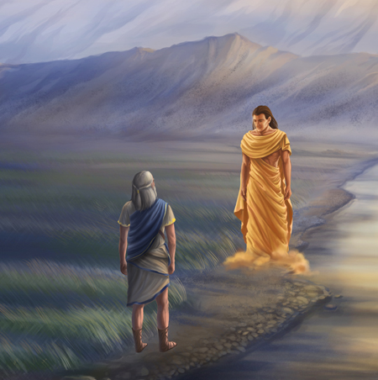
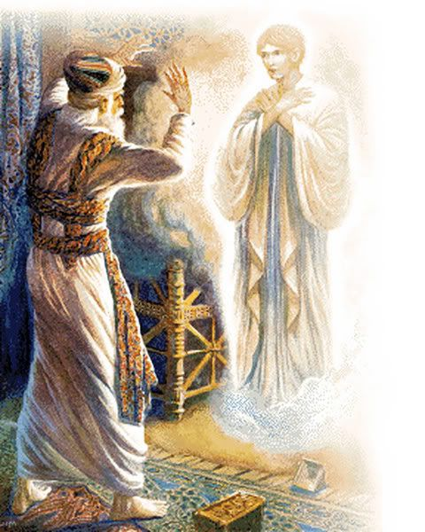
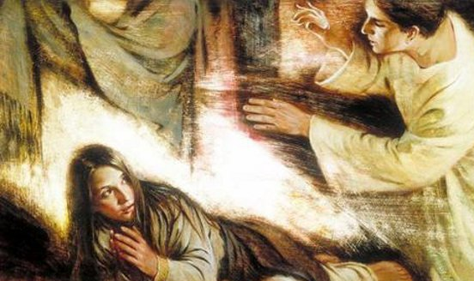
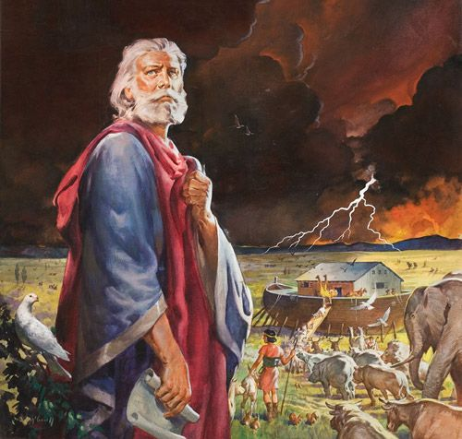
Angel Gabriel—Man of God
The name of an angel sent:
To Daniel
To Zacharias
To Mary
“Noah … is Gabriel; he stands next in authority to Adam in the Priesthood; he was called of God to this office, and was the father of all living in his day, and to him was given the dominion” (5)
Luke 1:11-19; 26-38 ; Daniel 8:16; 9:21 HC3:386
(4)

Slide 9
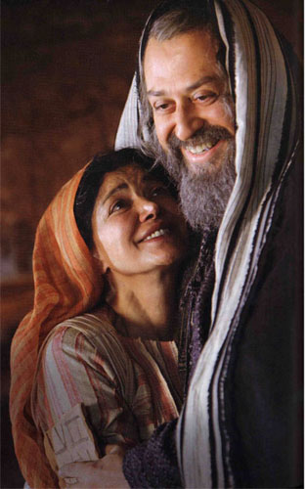
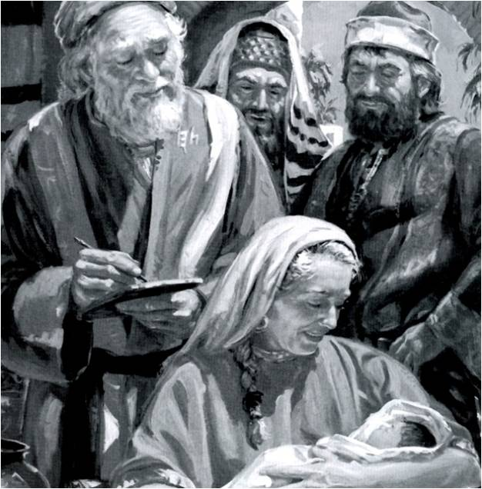
Joy and Gladness
Zacharias and Elisabeth had prayed for the opportunity to become parents.
Zacharias had no posterity through whom his priesthood line could continue, and Elisabeth later remarked that her barrenness had been viewed with “reproach among men”
Prophecy of John, the forerunner, the Elias, of the Son of God
The Lord’s words spoken through His servants will be fulfilled in their season
Fear not, Zacharias: for thy prayer is heard; and thy wife Elisabeth shall bear thee a son, and thou shalt call his name John.
Luke 1:14-17, 25
(4)

Slide 10
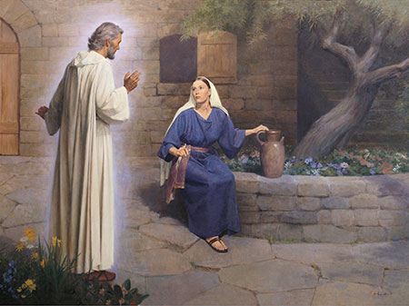
Gabriel and Mary
In the sixth month of Elisabeth’s pregnancy, the angel Gabriel was sent to Mary, a young woman in Nazareth.
Hail, thou that art highly favoured, the Lord is with thee: blessed art thou among women.
Fear not, Mary: for thou hast found favour with God.
Luke 1:26-38
(4)

Slide 11
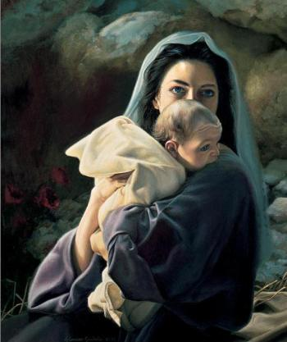
The Name
And he shall be called Jesus Christ, the Son of God, the Father of heaven and earth, the Creator of all things from the beginning; and his mother shall be called Mary. Mosiah 3:8
“Son of the Highest” = Jesus Christ is the Son of God
“That Child to be born of Mary … was of right to be called the ‘Son of the Highest.’ In His nature would be combined the powers of Godhood with the capacity and possibilities of mortality. … The Child Jesus was to inherit the physical, mental, and spiritual traits, tendencies, and powers that characterized His parents—one immortal and glorified—God, the other human—woman.” (6)
'The Lord himself shall give you a sign; Behold, a virgin shall conceive, and bear a son, and shall call his name Immanuel.' (Isaiah 7:14)
Liz Lemon
Luke 1:32
(4)

Slide 12
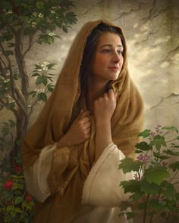
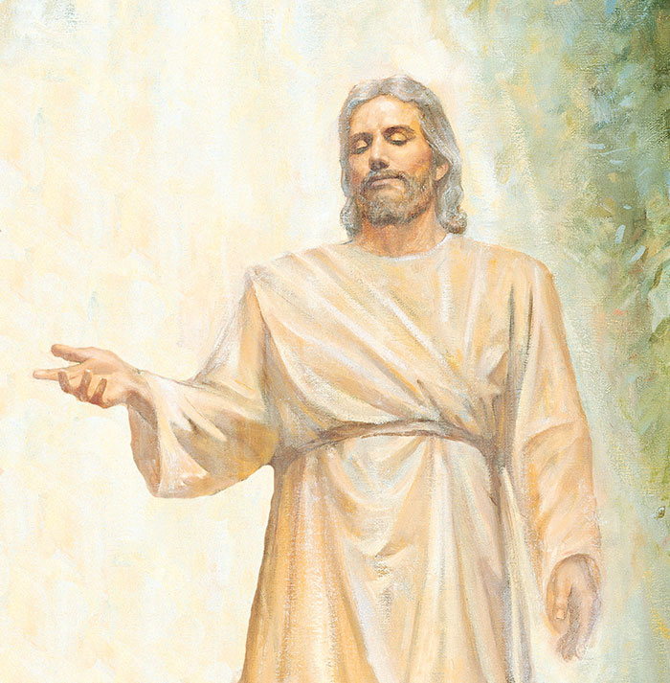
Inherited
Through Jesus’s mortal mother, Mary, He inherited the ability to “lay down His life voluntarily.”
Howard Lyon
From His Heavenly Father, Jesus inherited the ability to endure suffering during His atoning sacrifice “such as no other being who has lived on earth might even conceive as possible.”
Because of Jesus’s parentage, He had both immortal and mortal qualities, which He needed to perform the Atonement
Luke 1:32-33
(6)

Slide 13
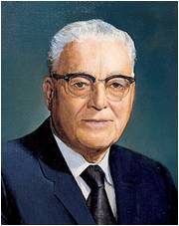
“I Know Not A Man”
The Holy Ghost shall come upon thee, and the power of the Highest shall overshadow thee: therefore also that holy thing which shall be born of thee shall be called the Son of God.
Luke 1:35
Now the birth of Jesus Christ was on this wise: When as his mother Mary was espoused to Joseph, before they came together, she was found with child of the Holy Ghost.
Matthew 1:18
And behold, he shall be born of Mary, at Jerusalem which is the land of our forefathers, she being a virgin, a precious and chosen vessel, who shall be overshadowed and conceive by the power of the Holy Ghost, and bring forth a son, yea, even the Son of God.
Alma 7:10
And it came to pass that I beheld that she was carried away in the Spirit;
1 Nephi 11:19
For my thoughts are not your thoughts, neither are your ways my ways, saith the Lord. For as the heavens are higher than the earth, so are my ways higher than your ways, and my thoughts than your thoughts.
Isaiah 55:8-9
“Let the Lord rest His case with this declaration and wait until He sees fit to tell us more” (7)

Slide 14
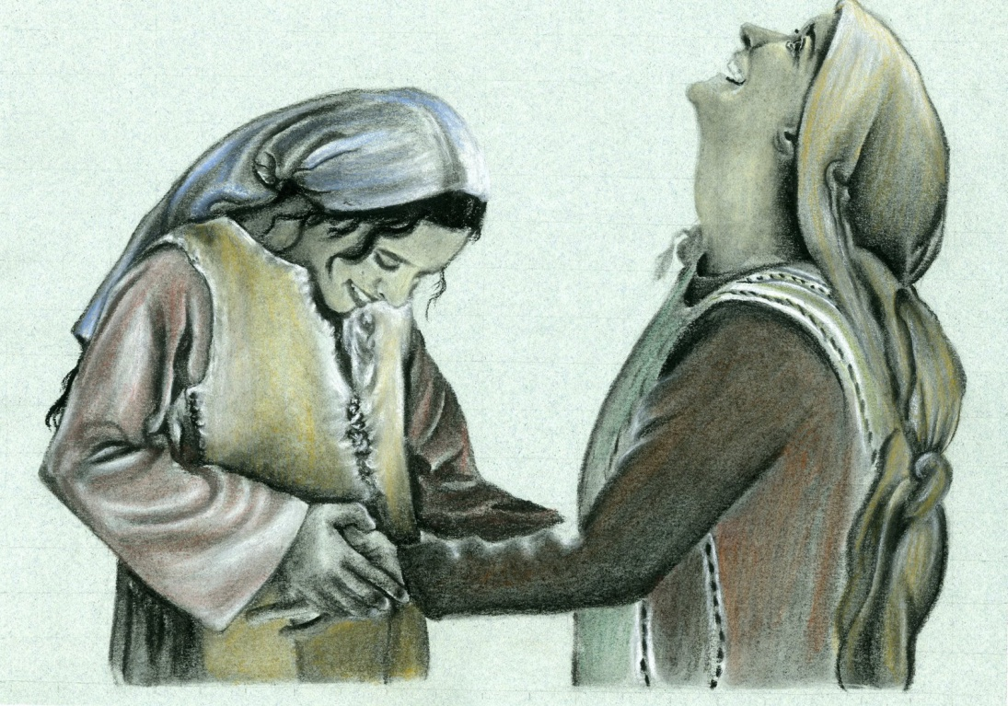
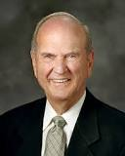
With God Nothing Shall Be Impossible
The angel Gabriel testified that Mary’s cousin Elisabeth, who was an aged and barren woman, was six months pregnant .
This was a witness to Mary that she could also have a child in a miraculous manner.
"How is it possible to achieve the 'impossible'?
Learn and obey the teachings of God.
From the holy scriptures, heaven-sent lift will be found for heaven-sent duties.“
Luke 1:36-37
(8)

Slide 15
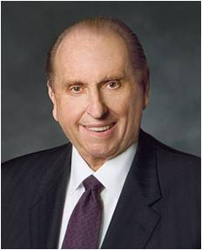
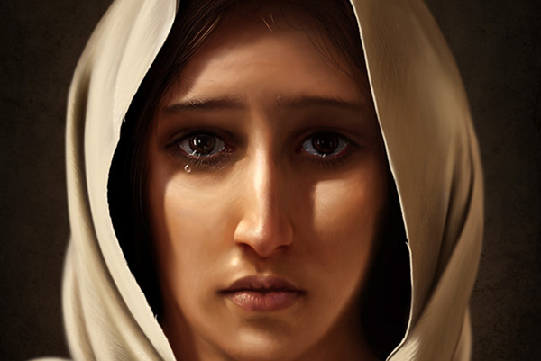
Mary of Nazareth—Handmaid of the Lord
"In our selection of heroes, let us nominate also heroines...I speak of Mary of Nazareth, espoused to Joseph, destined to become the mother of the only truly perfect man to walk the earth. Her acceptance of this sacred and historic role is a hallmark of humility.
"Could we ask, What makes of these men heroes and these women heroines?
I answer: Unwavering trust in an all-wise Heavenly Father and an abiding testimony concerning the mission of a divine Savior. This knowledge is like a golden thread woven through the tapestry of their lives.“
Dean Packwood
Luke 1:38
(9)

Slide 16
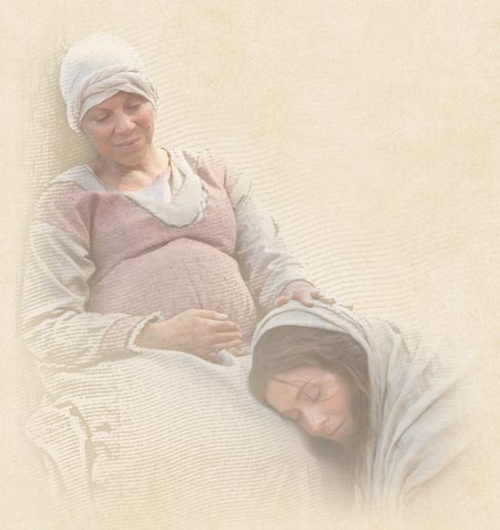
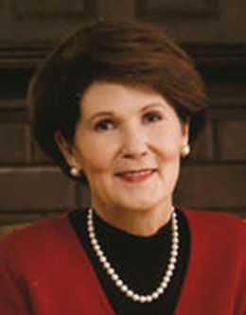
Mary and Elisabeth
“… her singular time of confusion and wonder and awe, Mary went to another woman. She knew she could go to Elisabeth.
Mary was very young-probably in her mid-teens at most-and Elisabeth was well beyond her childbearing years.
The scripture says she was 'well stricken' in years. Yet these two women came together, greeting one another in a bond that only women can know.
…And in the special roles they were destined to play, these two beloved women-representing both personally and dispensationally the old and the new-sang to each other even as the babe in the womb of one leapt in recognition of the divinity of the other.”
Luke 1:38-41
(10)

Slide 17
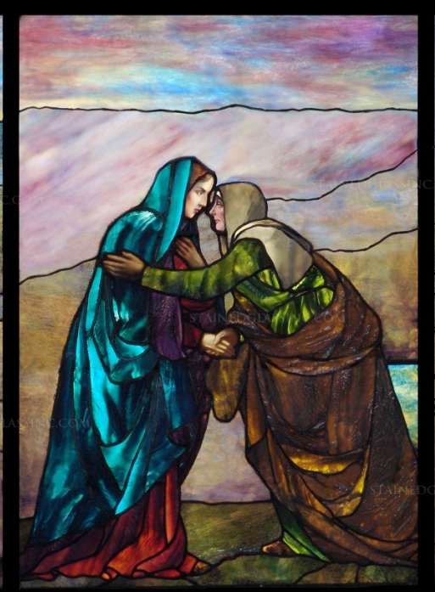
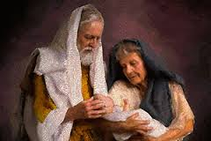
Song of Mary
Magnificat = which in Latin means “magnifies”
Elisabeth recognized Mary’s remarkable mission and, filled with the Holy Ghost, spoke words of praise and testimony
If we faithfully try to fulfill the roles the Lord has for us, He can do great things in our lives
When Zacharias’s tongue was loosed at the time his son, John, was circumcised and named, Zacharias, also filled with the Holy Ghost, spoke beautiful words of praise, testifying of the mission of the Savior.
Zacharias’s hymn of praise is known as the Benedictus (which in Latin means “blessed”).
Luke 1:41-55, 67-80
(1)

Slide 18
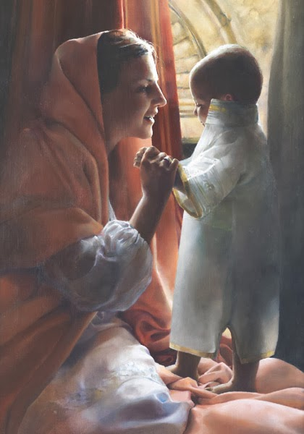
Hymns of Praise in the Bible
Old Testament
Exodus 15:1-21
1 Samuel 1:11, 28
Judges 5:1-31
1 Samuel 2:1-10
1 Chronicles 16:7-36
Mary’s song closely resembles the song of Hannah. Hannah was a handmaid of the Lord who, through faith, miraculously conceived Samuel and dedicated him to God’s service .
The Song of Mary associates the birth of Jesus Christ with Israel’s sacred past and celebrates the Lord’s mercy in once again reaching out to bless and honor His people—particularly those of “low degree”.
Luke 1:46-55
(1)

Slide 19
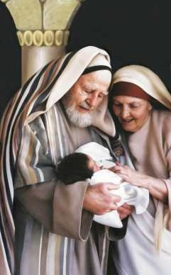
The Eighth Day
John is born of Zacharias and Elisabeth
“Naming of children and circumcision of male members of the house of Israel took place on [the eighth] day. In the case of John, he ‘was ordained by the angel of God at the time he was eight days old’—not to the Aaronic Priesthood, for such would come later, after his baptism and other preparation.
That is, at this solemn eighth day ceremony, an angel … gave the Lord’s Elias [John] the divine commission to serve as the greatest forerunner of all the ages”
For he was baptized while he was yet in his childhood, and was ordained by the angel of God at the time he was eight days old unto this power, to overthrow the kingdom of the Jews, and to make straight the way of the Lord before the face of his people, to prepare them for the coming of the Lord, in whose hand is given all power. D&C 84:28
Luke 1:52
(3)

Slide 20
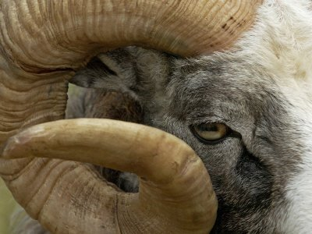
Horn of Salvation
The God of my rock; in him will I trust: he is my shield, and the horn of my salvation, my high tower, and my refuge, my saviour; thou savest me from violence. 2 Samuel 22:3
When John’s father, Zacharias, was released by God from his inability to speak, he praised God and prophesied of John’s mission.
He mentioned that God had raised up a “horn of salvation,” which is a messianic title that refers to Jesus Christ.
The Lord is my rock, and my fortress, and my deliverer; my God, my strength, in whom I will trust; my buckler, and the horn of my salvation, and my high tower. Psalm 18:2
The horn was a symbol of power—an allusion to the strength of horned animals indigenous to the Near.
Luke 1:69
(3)

Slide 21
Sources:
Suggested Hymn: #195 How Great the Wisdom and the Love
New Testament Institute Student Manual Chapter 15
William Smith, Dictionary of the Bible, "Luke, Gospel of“ found in gospeldoctrine.com
Elder Bruce R. McConkie (The Mortal Messiah: From Bethlehem to Calvary, 4 vols. [Salt Lake City: Deseret Book Co., 1979-1981], 1: 306-307.) and (Doctrinal New Testament Commentary, 1:89).
Bible Dictionary
Teachings of Presidents of the Church: Joseph Smith[2007], 104).
James E. Talmage Jesus the Christ, 81, 613
The Teachings of Harold B. Lee, ed. Clyde J. Williams [1996], 14).
Elder Russell M. Nelson (Perfection Pending, and Other Favorite Discourses [Salt Lake City: Deseret Book Co., 1998], 105-108.)
President Thomas S. Monson (Be Your Best Self [Salt Lake City: Deseret Book Co., 1979], 40.)
Jeffrey R. Holland and Patricia T. Holland, On Earth As It Is in Heaven [Salt Lake City: Deseret Book Co., 1989], 33.)
Presentation by ©http://fashionsbylynda.com/blog/

Slide 22
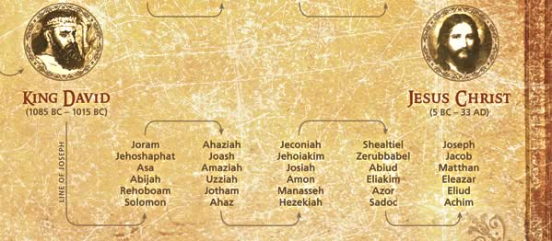
The Lineage of Jesus Christ

Slide 23
Event | Matthew | Mark | Luke | John
Annunciation to Zacharias |  |  | 1:5-25
Annunciation to Mary |  |  | 1:26-38
Mary Visits Elizabeth |  |  | 1:39-55
Birth of John the Baptist |  |  | 1:57-64
Prophecy of Zacharias |  |  | 1:67-79, 65,66
Mary Returns to Nazareth |  |  | 1:56

Slide 24
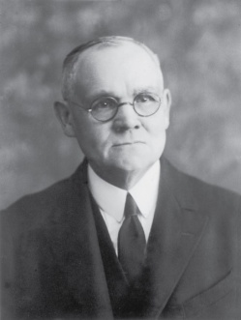
Zacharias:
About fifteen months prior to the Savior’s birth, Zacharias, a priest of the Aaronic order, was officiating in the functions of his office in the temple at Jerusalem. His wife, Elisabeth, was also of a priestly family; being numbered among the descendants of Aaron. The couple had never been blessed with children; and at the time of which we speak they were both well stricken in years and had sorrowfully given up hope of posterity. Zacharias belonged to the course of priests named after Abijah, and known in later time as the course of Abia. This was the eighth in the order of the twenty-four courses established by David the king, each course being appointed to serve in turn a week at the sanctuary. It will be remembered that on the return of the people from Babylon only four of the courses were represented; but of these four each averaged over fourteen hundred men.
During his week of service each priest was required to maintain scrupulously a state of ceremonial cleanliness of person; he had to abstain from wine, and from food except that specifically prescribed; he had to bathe frequently; he lived within the temple precincts and thus was cut off from family association; he was not allowed to come near the dead, nor to mourn in the formal manner if death should rob him of even his nearest and dearest of kin. We learn that the daily selection of the priest who should enter the Holy Place, and there burn incense on the golden altar, was determined by lot; and furthermore we gather, from non-scriptural history, that because of the great number of priests the honor of so officiating seldom fell twice to the same person.
On this day the lot had fallen to Zacharias. It was a very solemn occasion in the life of the humble Judean priest—this one day in his life on which the special and particularly sacred service was required of him. Within the Holy Place he was separated by the veil of the temple only from the Oracle or Holy of Holies—the inner sanctuary into which none but the high priest might enter, and he only on the Day of Atonement, after long ceremonial preparation. The place and the time were conducive to the highest and most reverential feelings. As Zacharias ministered within the Holy Place, the people without bowed themselves in prayer, watching for the clouds of incense smoke to appear above the great partition which formed the barrier between the place of general assembly and the Holy Place, and awaiting the reappearance of the priest and his pronouncement of the benediction.
Before the astonished gaze of Zacharias, at this supreme moment of his priestly service, there appeared, standing on the right of the golden altar of incense, an angel of the Lord. Many generations had passed in Jewry since any visible presence other than mortal had been manifest within the temple, either in the Holy Place or the Holy of Holies; the people regarded personal visitations of heavenly beings as occurrences of the past; they had come almost to believe that there were no longer prophets in Israel. Nevertheless, there was always a feeling of anxiety, akin to that of troubled expectancy, whenever a priest approached the inner sanctuary, which was regarded as the particular abode of Jehovah should He ever again condescend to visit His people. In view of these conditions we read without surprise that this angelic presence troubled Zacharias and caused fear to fall upon him. The words of the heavenly visitant, however, were comforting though of startling import, embodying as they did the unqualified assurance that the man’s prayers had been heard, and that his wife should bear him a son, who must be named John. The promise went even further, specifying that the child to be born of Elisabeth would be a blessing to the people; many would rejoice at his birth; he would be great in the sight of the Lord, and must be guarded against wine and strong drink; he would be filled with the Holy Ghost, would be the means of turning many souls to God, and would go before to make ready a people prepared to receive the Messiah.
…In due time the child was born, there in the hill country of Judea^{i} where Zacharias and Elisabeth had their home; and, on the eighth day following the birth the family assembled in accordance with custom and Mosaic requirement, to name the babe in connection with the rite of circumcision.^{j} All suggestions that he be called after his father were overruled by Zacharias, who wrote with decisive finality: “His name is John.” Thereupon the dumb priest’s tongue was loosed, and being filled with the Holy Ghost he burst forth in prophecy, praise and song;
Elisabeth must have known that the approaching birth of her son would soon be followed by that of the Messiah, and that therefore the day for which Israel had waited and prayed through the long dark centuries was about to dawn. When Mary’s salutation fell upon her ears, the Holy Ghost bore witness that the chosen mother of the Lord stood before her in the person of her cousin; and as she experienced the physical thrill incident to the quickening spirit of her own blessed conception, she returned the greeting of her visitor with reverence: “Blessed art thou among women, and blessed is the fruit of thy womb. And whence is this to me, that the mother of my Lord should come to me?”
Jesus the Christ by James E. Talmage
Chapter 7 pgs. 75-78

Slide 25
‘Why were angels so prominent at the Savior’s birth? And why were they such an important part of His life and ministry?’
The answers are twofold. The first pertains to the nature and mission of the personage whom they were heralding—a divine Being, the Son of God, the Only Begotten in the flesh who came to earth to save all of God’s children. The second concerns the ushering in of a new dispensation, a period of time when the gospel would be restored in its fulness. The ministry of angels is to assist in the ushering in of dispensations.
“The last prophet of the Old Testament was Malachi, who lived 400 years before the birth of Christ. At that time Israel in large part had turned away from the covenants made with Jehovah. Consequently, they were in apostasy. Although the Aaronic Priesthood was on earth when Jesus was born, the Melchizedek Priesthood had been taken from the earth. Therefore, there was a need for the priesthood and the gospel to be restored in their fulness. …
“At the beginning of a new dispensation following a period of apostasy, there is no one with priesthood authority to administer the covenants in their fulness. Consequently, the Lord sends messengers from the other side of the veil to return priesthood keys and the gospel plan to the earth.
“It is not surprising then that an angel visited Zacharias and instructed him with regard to the mission of his son” Elder Merrill J. Bateman(“A Season for Angels,” Ensign, Dec. 2007, 10, 14).
Abijam (Abia) from Guillaume Rouillé's Promptuarii Iconum Insigniorum, 1553
Reign | 913 to 911 BC
Predecessor | Rehoboam, his father
Successor | Asa, his son
Died | 911 BC possibly Jerusalem
Burial | Jerusalem
Spouse | 14 wives
Issue | 22 sons and 16 daughters
Hebrew name | אבים בן-רחבעם ’Aviyam ben Rehav’am
House | House of David
Father | Rehoboam
Mother | Maacah, or Micaiah, daughter of Uriel of Gibeah, and granddaughter of Absalom (Abishalom)
Forerunner: Luke 1:17
“Being the forerunner was neither a simple task nor an honorary title. Difficult and dangerous work needed to be done. … John, a mere mortal—armed with the Aaronic Priesthood, a divine commission, personal righteousness, the truth of God, and a huge amount of courage—was launched on his ministry to prepare the way for the Son of God. What John was called to do placed his life in jeopardy.
“The term forerunner is descriptive. Forerunners anciently would run before the chariot of the king and clear the path of rocks or other obstacles, and loudly proclaim the coming of the ruler. … John was both a forerunner and a proclaimer of Jesus. He was the divinely appointed herald” (Robert J. Matthews, Behold the Messiah [1994], 46).
Inherited Luke 1:32-33:
“From His immortal Father, Jesus inherited the power to live forever. From His mortal mother He inherited the fate of physical death. Those unique attributes were essential for His mission to atone for the sins of all mankind. Thus Jesus the Christ was born to die (see 3 Nephi 27:13–15). He died that we might live. He was born that all humankind could live beyond the grave.” Elder Russell M. Nelson (“Christ the Savior Is Born,” New Era, Dec. 2006, 5).
Jesus is the Son of God Luke 1:35
President Ezra Taft Benson taught: “the testimonies of appointed witnesses leave no question as to the paternity of Jesus Christ. God was the Father of His fleshly tabernacle, and Mary, a mortal woman, was His mother. … He was not the son of Joseph, nor was He begotten by the Holy Ghost. He is the Son of the Eternal Father!” (“Five Marks of the Divinity of Jesus Christ,” Ensign, Dec. 2001, 10–11).
“[Jesus Christ] was the Only Begotten Son of our Heavenly Father in the flesh—the only child whose mortal body was begotten by our Heavenly Father. His mortal mother, Mary, was called a virgin, both before and after she gave birth. (See 1 Ne. 11:20.)” (“Joy in Christ,” Ensign, Mar. 1986, 3–4).
Wikipedia

Slide 26
Mary’s Faith, The Angel Departed From Her Luke 1:38:
"Mary's example teaches us much about giving the answer of faith when things happen that we don't understand, about trusting in the Lord when things happen that try us and challenge our faith, about having confidence in his goodness at seasons of loss and sorrow.
"We are so used to thinking of the annunciation as the beginning of the joyous celebration of Christmas that we focus on Mary's joy, which I'm sure she felt, and on the great gladness of the Savior's birth. We are not used to thinking of this season as a time of loss for Mary. But it was a loss. She was a righteous young woman, but she was bound to lose her reputation among her family and friends and those who knew her in Nazareth. What else could they think, when they saw her pregnant, but that she had been unchaste? The last line in the annunciation is, 'And the angel departed from her' (v. 38). In other words, the angel didn't take the rabbi aside for a quiet chat about this very special young woman he had in town. He didn't whisper to the chief merchants that Mary was going to be remembered till the end of time, while their names would barely survive their own generation. The angel was not there at the well when Mary went for water, after she came back from visiting Elisabeth, her body already rounded with a sixth-month pregnancy. He didn't explain to the other women, shocked and scandalized and whispering to each other behind their hands, that Mary was the chosen vessel of the Lord. Nobody explained to the girls younger than Mary that she was the living embodiment of faith.
"Furthermore, Mary didn't explain it either. She obviously didn't explain it even to Joseph, because Joseph was the one person to whom the angel did come, to tell him that his faith in Mary was not misplaced. So, yes, I think we have to admit that despite the joy this was also a season of loss and mourning." Chieko N. Okazaki (Disciples [Salt Lake City: Deseret Book Co., 1998], 165 - 166.)
Jesus Born of Mortal and Immortal Luke 1:31-35
if Jesus Christ had been born of two mortal parents, He could not have endured the infinite pain and suffering of the Atonement or overcome death. If He had been born of two immortal parents, He would not have been subject to physical suffering and death. Because Jesus was born of one divine parent and one mortal parent, He had the ability to suffer infinitely, to allow Himself to die, and then to overcome death through His Resurrection.)
John as a child Luke 1:80:
"As John grew to maturity, the Holy Ghost prepared the young man's mind for his ministry. John received the Holy Ghost while he was in his mother's womb (see D&C 84:27; Luke 1:15), and no one can receive the Holy Ghost without receiving revelation (see Teachings of the Prophet Joseph Smith, p. 328). John was 'baptized while yet in his childhood,' was set apart for his mission by an angel when he was only eight days old (see D&C 84:28), and later received the full keys of the Aaronic Priesthood, including the keys of the ministering of angels. (See D&C 13.) It follows that he would have received the visitation of angels during these preparatory years. (gospeldoctrine.com)
"Elder James E. Talmage wrote that John 'had been a student under the tutelage of divine teachers; and there in the wilderness of Judea the word of the Lord reached him; as in similar environment it had reached Moses and Elijah of old.' (Jesus the Christ, 3d ed., Salt Lake City: The Church of Jesus Christ of Latter-day Saints, 1916, p. 122.)
"The training of this great Elias required the finest spiritual education possible and included study of the scriptures, lessons in Israel's history, the workings and revelations of the Holy Ghost, and the ministry of angels. When John came forth preaching at the age of thirty, he was ready. He knew what his mission was and what he was to do, and he had the authority to go about it." (Robert J. Matthews, " 'There Is Not a Greater Prophet': The Ministry of John the Baptist," Ensign, Jan. 1991, 15)
Mary and Elisabeth Luke 1:39-40:
"For the next three months, Mary remained with Elizabeth. From Mary, in her youth and with a special mission few others could comprehend, there was surely understanding and support. And from Elizabeth, there surely came wisdom shared from the experiences of a long life. Women the world over appreciate the closeness Mary and Elizabeth felt and the strength they each gained together.
"This account allows us to see clearly that sisterhood may be both individual and shared. As the Savior would later say, 'My mother and my brethren [and we may add sisters], are these which hear the word of God, and do it.' (Luke 8:21.) In that sense, Mary, as well as Elizabeth, enjoyed a sisterhood that had to do with personally qualifying through faithfulness to be counted among the followers of righteousness-the sons and daughters of God." Barbara B. Smith ("The Bonds of Sisterhood," Ensign, Mar. 1983, 22)
The power pt on the next slides are from Nephi’s Tree of Life.
This is also a separate slide put on the web under 600 years before Jesus’ birth

Slide 27
What was happening in the New World 600 years before Jesus’ birth….

Slide 28
The Tree of Life
1 Nephi Chapter 11
Nephi asks the Lord to explain his father’s dream.

Slide 29
1 Nephi 11:8
Nephi saw a tree. The same tree his father had seen. It was beautiful and as white as the snow.

Slide 30
1 Nephi 11:13
Nephi saw the great city of Jerusalem, and other cities, and the city of Nazareth.

Slide 31
1 Nephi 11:14
Nephi saw an angel coming from the heavens.

Slide 32
1 Nephi 11:15 and 20
Nephi saw a virgin (Mary) and she was beautiful and was carrying the Lamb of God, the Son of the Eternal Father.

Slide 33
1 Nephi 11:24
Nephi saw Jesus with many people who bowed down and worshipped him.

Slide 34
Word Of God
1 Nephi 11:25
Nephi saw the iron rod which was the Word of God that led to the living waters, which is the Love of God.

Slide 35
1 Nephi 11:27
Nephi saw a prophet (John the Baptist) who prepared a way for Jesus and baptized him.

Slide 36
1 Nephi 11:28
Nephi saw the Savior among the people preaching. Some listened to his word and some did not.

Slide 37
1 Nephi 11:29
Nephi saw twelve others following Jesus.

Slide 38
1 Nephi 11:30
Nephi saw the heavens open again and angels came and administered to the children of men.

Slide 39
1 Nephi 11:31
Nephi saw the Savior administering to the sick and healing them.

Slide 40
1 Nephi 11:32-33
Nephi saw that some men had taken Jesus and put him on the cross and Jesus was slain for the sins of the world

Slide 41
1 Nephi 11:34-35
Nephi saw a great and spacious building and many people ready to fight the apostles of Jesus and against all righteousness.

Slide 42
1 Nephi 11:36
Nephi saw that the people in the building (pride of the world) was destroyed and fell down.

Slide 43
The
Book
Of
Mormon
1 Nephi 11:36
Nephi saw and wrote all these things down so we could read them today in the Book of Mormon.

Slide 44
Helaman 14:17
“But behold, the resurrection of Christ redeemeth mankind, yea, even all mankind, and bringeth them back into the presence of the Lord.”

