Slide 1
Lesson 45 part 2
Jesus Teaches in the Synagogue
Luke 4

Slide 2
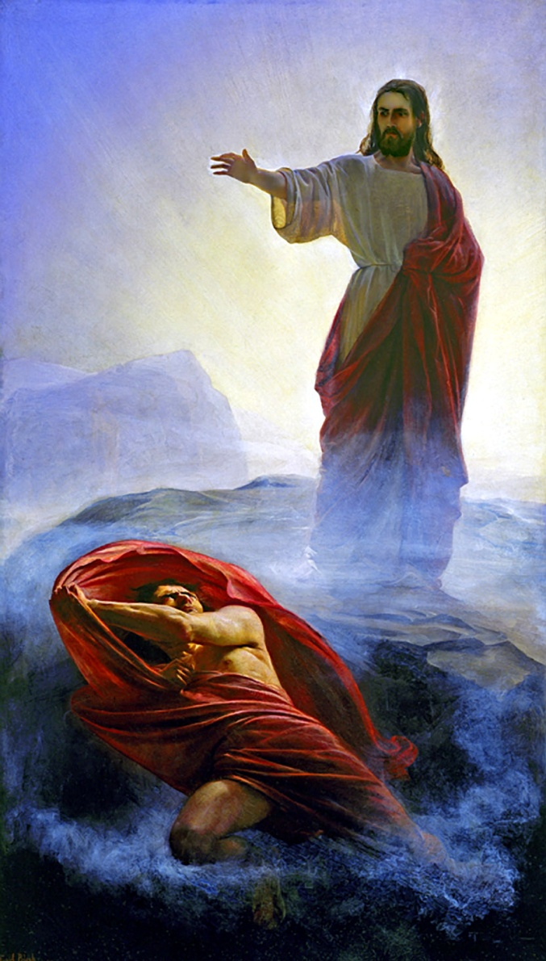
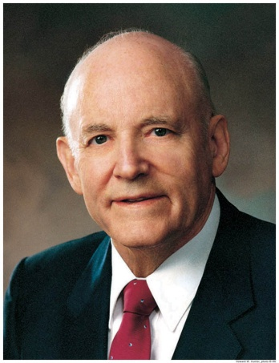
Fasting 40 Days
Satan tempted Jesus to use His power for selfish reasons—to save Himself, not all mankind. Satan continued to tempt the Savior in this way even at the end of His life.
Satan also offered the Savior all the kingdoms, power, and glory of the world if He would worship him. However, these were not Satan’s to give. Jesus Christ, as the Creator, already held dominion over this earth, under the direction of His Father.
“The surest way to lose the blessings of time or eternity is to accept them on Satan’s terms” (2)
Luke 4:1-13
(1)

Slide 3
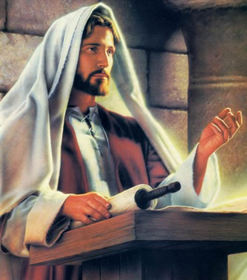
Jesus is the Messiah
He began to preach in the synagogues in Galilee. Soon, He returned to His hometown of Nazareth. While there, He stood in a synagogue and read from the book of Isaiah.
Jesus is the Messiah who was sent to heal the brokenhearted and deliver those who are spiritually captive
Luke 4:14-21
(1)

Slide 4
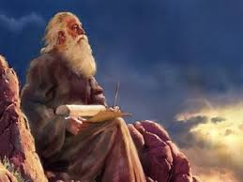
Quoting Isaiah
The Spirit of the Lord is upon me because he hath anointed me
To preach the gospel to the poor in spirit;
He hath sent me to heal those with a broken heart and contrite spirit
To preach deliverance to the captives in spirit prison
And recovering of sight to the spiritually blind,
To set at liberty them that are bruised and battered in spiritual bondage.
Luke 4:14-21; Isaiah 61:1-2

Slide 5
Summary of His Earthly Mission and Atoning Sacrifice
Anointed = The Messiah
His atoning sacrifice would save those who offer the sacrifice of a broken heart and contrite spirit.
“heal the brokenhearted”
And ye shall offer for a sacrifice unto me a broken heart and a contrite spirit. And whoso cometh unto me with a broken heart and a contrite spirit, him will I baptize with fire and with the Holy Ghost…
3 Nephi 9:20
Thou shalt offer a sacrifice unto the Lord thy God in righteousness, even that of a broken heart and a contrite spirit.
D&C 59:8
Luke 4:14-21; Isaiah 61:1-2
(1)

Slide 6
Summary of His Earthly Mission and Atoning Sacrifice
His gospel would deliver those in spirit prison as well as those in spiritual bondage.
“preach deliverance to the captives”
For Christ also hath once suffered for sins, the just for the unjust,…By which also he went and preached unto the spirits in prison; 1 Peter 3:18-19
…the Son of God appeared, declaring liberty to the captives who had been faithful;
Those who rejected = Where these were, darkness reigned, but among the righteous there was peace; D&C 138:18-22
Luke 4:14-21; Isaiah 61:1-2
(1)

Slide 7
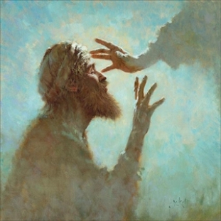
Summary of His Earthly Mission and Atoning Sacrifice
He would miraculously restore physical and spiritual sight. had!
Provide “sight to the blind”
Then was brought unto him one possessed with a devil, blind, and dumb: and he healed him, insomuch that theblind and dumb both spake and saw. Matthew 12:22
Luke 4:14-21; Isaiah 61:1-2
(1)

Slide 8
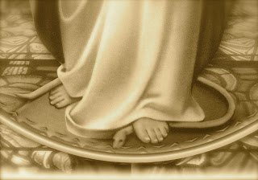
Summary of His Earthly Mission and Atoning Sacrifice
Fulfilling the promise to Mother Eve that her posterity, whose heels were bruised by the serpent, would have power to crush the serpent’s head
“set at liberty them that are bruised”
And I will put enmity between thee and the woman, and between thy seed and her seed; it shall bruise thy head, and thou shalt bruise his heel.
Luke 4:14-21; Isaiah 61:1-2
(1)

Slide 9
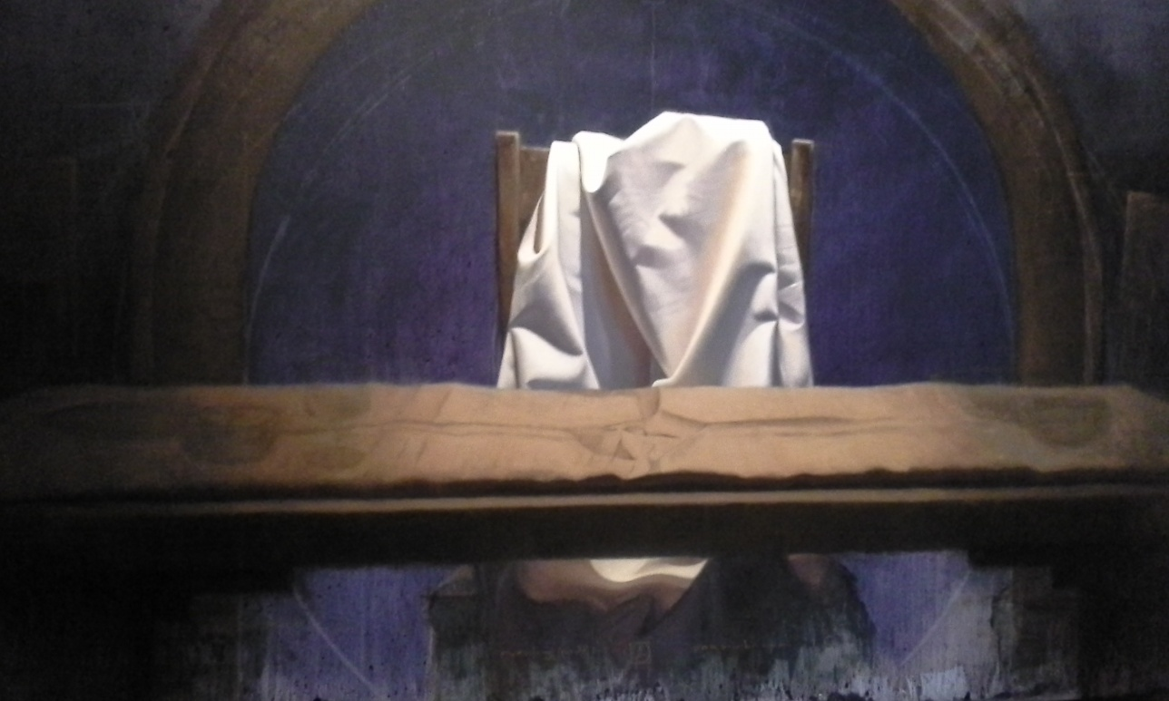
Summary of His Earthly Mission and Atoning Sacrifice
To preach that the Lord had begun His ministry, which He had!
“preach the acceptable year of the Lord”
An "acceptable year," or "year of acceptance," is a space of time during which God would be pleased to accept such as repented and turned to him. (BibleHub)
To proclaim the acceptable year of the Lord, and the day of vengeance of our God; Isaiah 61:2
Luke 4:14-21; Isaiah 61:1-2
(1)

Slide 10
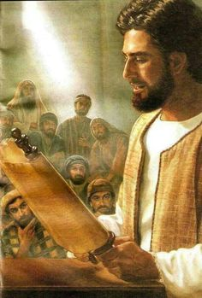
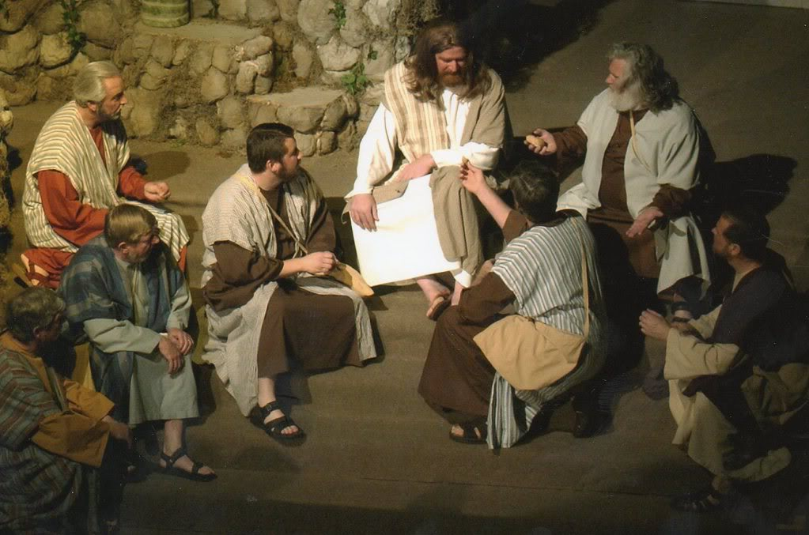
Teaching
After reading the scripture, Jesus Christ sat down to comment.
In Jesus' era, it was customary to stand while reading but to sit while teaching
Luke 4:14-21; Isaiah 61:1-2
(1)

Slide 11
Do We Need Proof?
Require not miracles, except I shall command you, except casting out devils, healing the sick, and against poisonous serpents, and against deadly poisons;
D&C 24:13
Jesus knew that the people in Nazareth would challenge Him to prove He was the Messiah by repeating the miracles He had performed in Capernaum.
And he that seeketh signs shall see signs, but not unto salvation.
Verily, I say unto you, there are those among you who seek signs, and there have been such even from the beginning;
But, behold, faith cometh not by signs, but signs follow those that believe. D&C 63:7-9
When we demonstrate our faith in Jesus Christ, we can see miracles occur
Wherefore, I, the Lord, am not pleased with those among you who have sought after signs and wonders for faith, and not for the good of men unto my glory. D&C 63:12
Miracles occur to bless the faithful, not to convert skeptics.
Luke 4:22
(1)

Slide 12
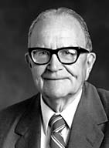
"Thus Jesus Christ was rejected by the people because he told them what saving work he would do for the captives then confined to a spiritual prison and for those who had been bruised in their souls through iniquity.
Instead of rejoicing in this liberation, the people hated Jesus for being so presumptuous as to tell them that he had been anointed to open the prison doors.
Even his very life was threatened. Nevertheless, he continued to preach this doctrine even more clearly, in the hopes that people would understand him and the importance of the work he had been called to do.“
Luke 4:22-30
(4)

Slide 13
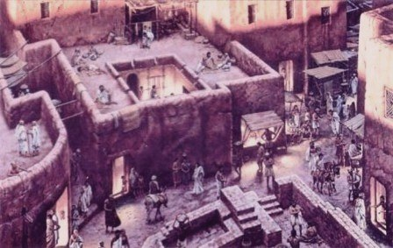
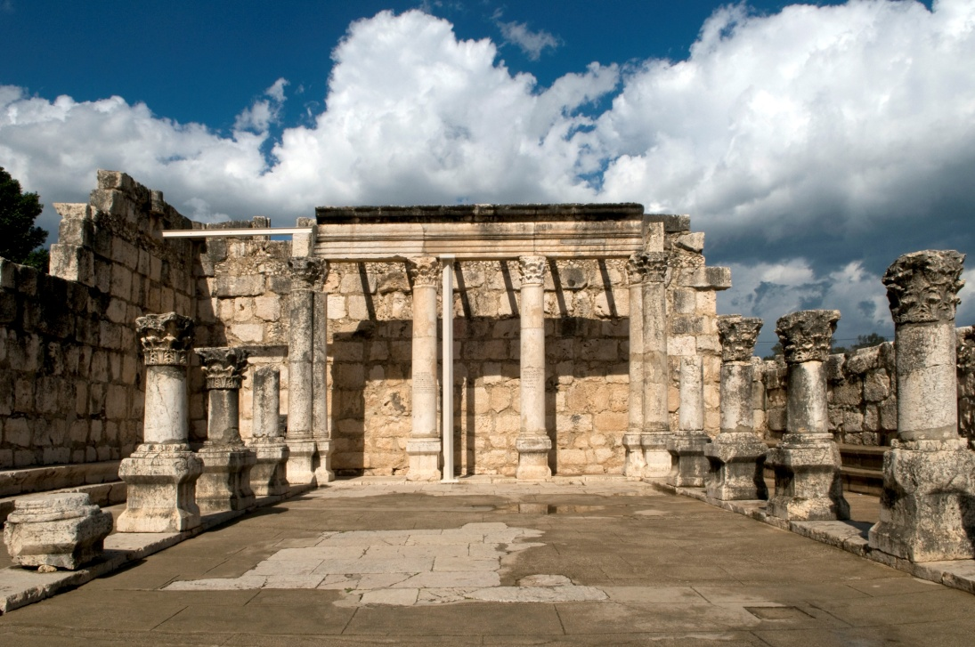
Those Who Sought Him
In contrast to the people of Nazareth who rejected the Savior, many in Capernaum sought Him out and pleaded
Nazareth
This may have been one of the reasons why Capernaum came to be known as Jesus' “own city” and as Church headquarters for His ministry.
Ancient Capernaum
Luke 4:31-44; Matthew 9:1
(1)

Slide 14
“Where there is faith, there is the miracle; where there is no faith, no miracle is wrought. And if the prophets of old went outside the fold of Israel to find those worthy of their ministry, so Jesus would go outside Nazareth to find receptive souls who would believe in him and receive the blessings that he came to bestow.
Should the people of Nazareth desire to see the wondrous works done elsewhere, then let them accept Him who now preached in their synagogue, and they too would receive the blessings of heaven.”
Luke 4:31-44
(5)

Slide 15
"We are amazed that everywhere he went the forces of evil went before him and that they knew him from the beginning, even if mortals did not.
"We stand all amazed as these forces of evil were cast out and defeated, even as the lame were made to walk, the blind to see, the deaf to hear, the infirm to stand.
Indeed we are all amazed at every movement and moment-as every generation from Adam to the end of the world must be.“
Luke 4:31-44
(6)

Slide 16
Sources:
Suggested Hymn: #141 Jesus, the Very Thought of Thee verse 3
New Testament Institute Student Manual Chapter 16
President Howard W. Hunter (“The Temptations of Christ,” Ensign, Nov. 1976, 18
Gospeldoctrine.com
Elder Theodore M. Burton (Conference Report, October 1970, Afternoon Meeting 34.)
Elder Bruce R. McConkie (The Mortal Messiah, 4 vols. [1979–81], 2:26).
Elder Jeffrey R. Holland ("I Stand All Amazed," Ensign, Aug. 1986, 68)
Presentation by ©http://fashionsbylynda.com/blog/

Slide 17
Event | Matthew | Mark | Luke | John
Fast and Temptation of Jesus | 4:1-11 | 1:12, 13 | 4:1-13
Jesus Leaves Judea for Galilee | 4:12 | 1:14 | 4:14 | 4:1-3
Jesus Enters Galilee |  |  | 4:15 | 4:43-45
Jesus is Rejected at Nazareth |  |  | 4:16-30
Jesus Teaches with Power and Authority |  | 1:21,22 | 4:31,32
Jesus Teaches with Power and Authority |  | 1:21,22 | 4:31,32
Jesus Casts Out Unclean Spirit |  | 1:23-28 | 4:33-37
Jesus Heals Peter’s Mother-in-Law and Others | 8:14-17 | 1:29-34 | 4:38-41
Jesus Preaches and Heals in Galilee | 4:23-25 | 1:35-39 | 4:42-44

Slide 18
To the High Mountain Luke 4:5,9:
Joseph Smith’s inspired translation of Luke 4:5, 9 makes clear that it was the Spirit, not the devil, who took Jesus Christ to a high mountain and brought Him to Jerusalem, and then afterward Satan came to tempt Him (see Joseph Smith Translation, Luke 4:5 [in Luke 4:5, footnote a]
He Hath Appointed Me Luke 4:18:
The title of Christ literally means "the anointed one." We might ask, "what was Jesus anointed with?" Or, "who performed this anointing?" The answer comes from Peter, 'God anointed Jesus of Nazareth with the Holy Ghost and with power' (Acts 10:38). Therefore, when Isaiah declares, 'the spirit of the Lord is upon me, because he hath anointed me,' it means just what it says: Jesus was filled with the Spirit because he was anointed by the Father. Our own anointings symbolize this same outpouring of the Spirit. The pure olive oil is anointed in priesthood administrations to symbolize the sanctification of the Spirit. The Holy Ghost is the Sanctifier.'" (Joseph Fielding McConkie, Gospel Symbolism [Salt Lake City: Bookcraft, 1999], 115.)
Teaching in the Synagogue Luke 18-19:
“Many times as boy and man He had sat in that house of worship [the synagogue], listening to the reading of the law and the prophets and to the commentaries … , as delivered by appointed readers; but now, as a recognized teacher of legal age He was eligible to take the reader’s place. On this occasion He stood up to read, when the service had reached the stage at which extracts from the prophetical books were to be read to the congregation. The minister in charge handed Him the roll, or book, of Isaiah; He turned to the part known to us as the beginning of the sixty-first chapter, and read: [Luke 4:18–19]. … The scripture He had quoted was one recognized by all classes as specifically referring to the Messiah, for whose coming the nation waited” James E. Talmage (Jesus the Christ, 3rd ed. [1916], 179).
People of Nazareth Reject Jesus’ Words Luke 4:22-30:
“In their hearts the people were eager for a sign, a wonder, a miracle. They knew that Jesus had wrought such in Cana, and a boy in Capernaum had been healed by His word; at Jerusalem too He had astonished the people with mighty works. Were they, His townsmen, to be slighted? Why would He not treat them to some entertaining exhibition of His powers?
He continued His address, reminding them that in the days of Elijah, when for three years and a half no rain had fallen, and famine had reigned, the prophet had been sent to but one of the many widows, and she a woman of Sarepta in Sidon, a Gentile, not a daughter of Israel. And again, though there had been many lepers in Israel in the days of Elisha, [only] one leper, and he a Syrian, not an Israelite, had been cleansed through the prophet’s ministration, for Naaman alone had manifested the requisite faith.
“Then great was their wrath. Did He dare to class them with Gentiles and lepers? Were they to be likened unto despised unbelievers, and that too by the son of the village carpenter, who had grown from childhood in their community? Victims of diabolical rage, they seized the Lord and took Him to the brow of the hill on the slopes of which the town was built, determined to avenge their wounded feelings by hurling Him from the rocky cliffs” James E. Talmage (Jesus the Christ, 180).

