Slide 1
Lesson 46
Trust in the Lord
Luke 5
Trust in the Lord with all thine heart; and lean not unto thine own understanding.
In all thy ways acknowledge him, and he shall direct thy paths.
Be not wise in thine own eyes: fear the Lord, and depart from evil.
Proverbs 3:5-7

Slide 2
When have you been asked to do something without knowing all the reasons for doing it?
Why Follow the Lord?

Slide 3
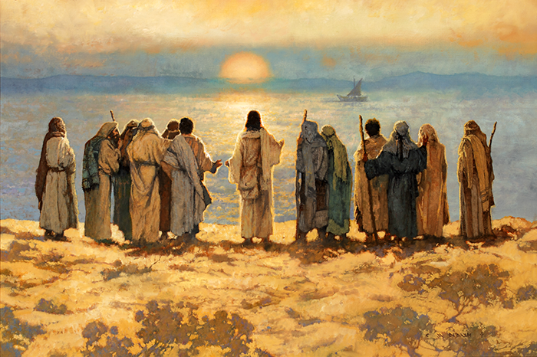
Lake of Gennesaret
let down your nets for a draught = a catch or haul of fish
Capernaum
Besaida
Gennesaret
Sea of Galilee
Tiberias
Michael Dudash
Luke 5:1-4

Slide 4
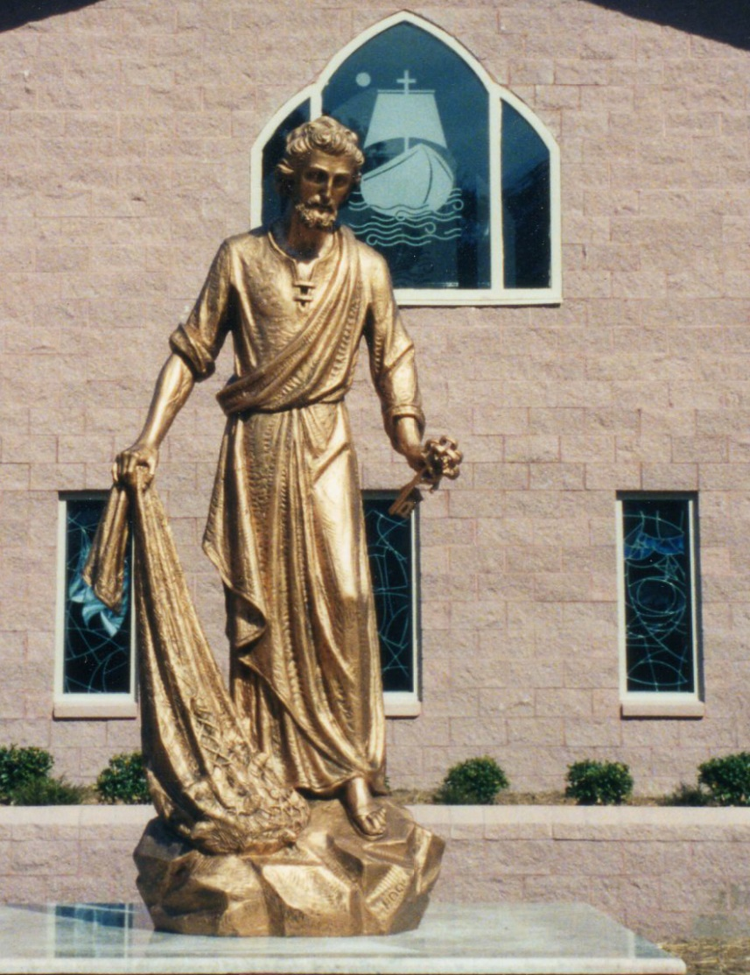
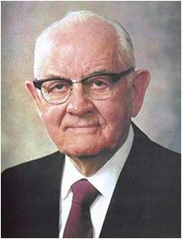
Diamond in the Rough
Simon Peter was working as a successful fisherman who, with his partners, owned at least two ships. Yet Peter was willing to forsake everything to follow Jesus Christ.
“Peter was, in President [Spencer W.] Kimball’s words, ‘a diamond in the rough—a diamond that would need to be cut, trimmed, and polished by correction, chastisement, and trials—but nevertheless a diamond of real quality.”
(3)
Luke 5:1-4
(2)

Slide 5
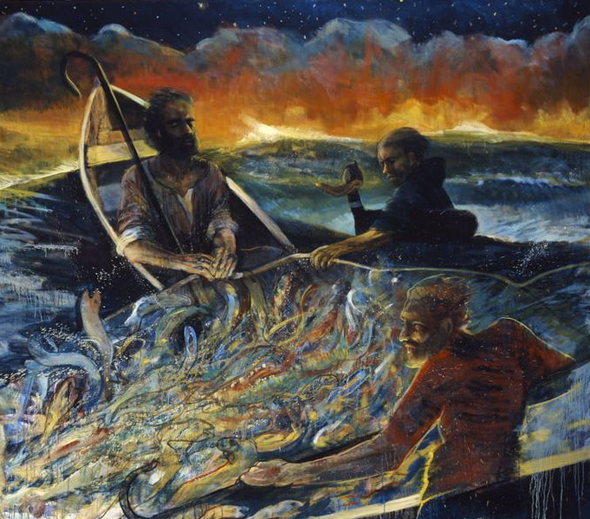
Deep In the Heart of the Sea
After an unsuccessful night of effort, Peter’s expert judgment told him a final effort was useless. But this was a man of genuinely childlike faith, and he lowered the net.
The number of fish taken in that single attempt strained the strings until they began to break and filled two boats until they began to sink.
In that small ship Peter kneeled, stunned, at the feet of the Master. Jesus said lovingly, ‘Henceforth thou shalt catch men.’ (1)
Luke 5:1-11
(2)

Slide 6
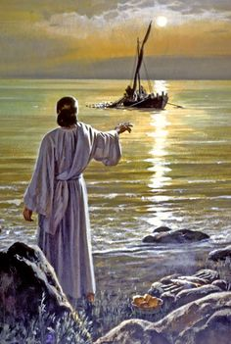
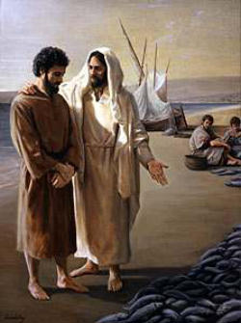
Giving It Up to Follow Jesus
Peter could not have known the ever-widening circles that single command would make in the stream of his plain and simple life. He was launching out into the expanse of godliness, into the eternal possibilities of redeemed and celestial life. He would be learning the mysteries of the kingdom.
He would be hearing unspeakable things. To launch out into that limitless sea of the gospel of Jesus Christ, Peter brought his craft to shore, turned his back on the most spectacular single catch ever taken from Galilee, ‘forsook all, and followed him.’
Luke 5:1-11
(2)

Slide 7
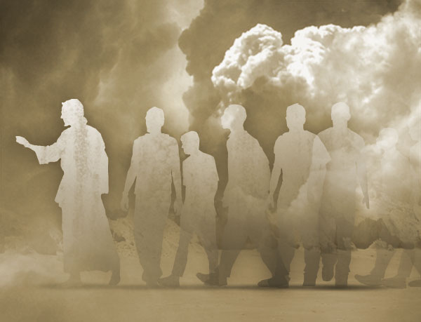
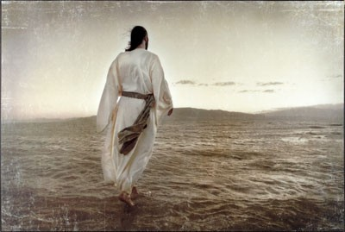
Disciple = Followers of Jesus
The word for disciple and the word for discipline both come from the same Latin root—discipulus, which means pupil.
It emphasizes practice or exercise. Self-discipline and self-control are consistent and permanent characteristics of the followers of Jesus, as exemplified by Peter, James, and John, who indeed ‘forsook all, and followed him.’
If we do what the Lord asks even when we do not understand why, He can provide greater blessings than we could have anticipated
Luke 5:1-11
(4)

Slide 8
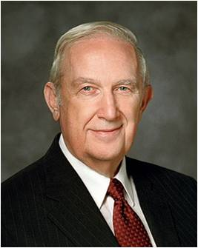
To Trust and Obey
“This life is an experience in profound trust—trust in Jesus Christ, trust in His teachings, trust in our capacity as led by the Holy Spirit to obey those teachings for happiness now and for a purposeful, supremely happy eternal existence.
To trust means to obey willingly without knowing the end from the beginning.
To produce fruit, your trust in the Lord must be more powerful and enduring than your confidence in your own personal feelings and experience.”
Luke 5:1-11
(5)

Slide 9
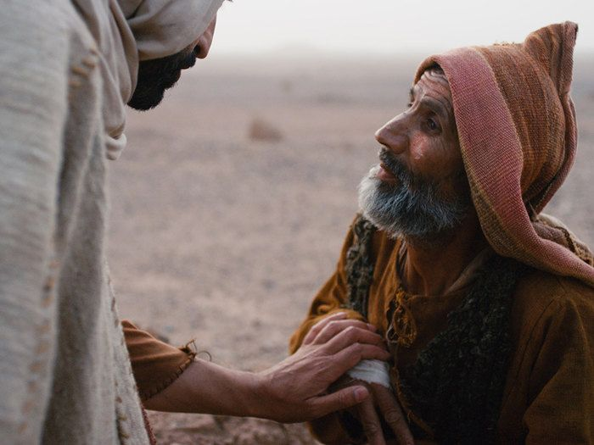
Faithful Personal Healing
Luke 5
12-15
Leprosy
The man seeks for Jesus
Jesus touches him
Jesus asks him to tell no one
Jesus asks him to present himself to the priest
A Personal Faith
The one who seeks for Jesus Christ was healed because of his faith.
His healing was immediate and his sins removed through obedience.
As we exercise faith and come to the Savior, He can heal us.
Luke 5:12-25

Slide 10
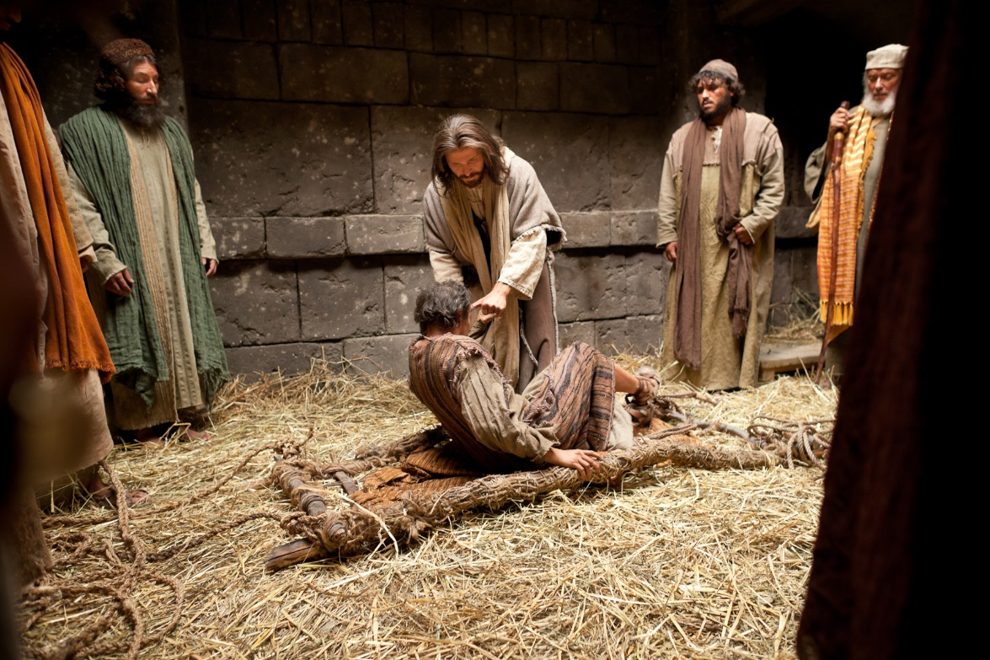
Faithful Public Healing
Luke 5
18-25
Palsy = paralyzed
Others brought him to see Jesus
Jesus see their faith and forgives the man
Jesus performs the miracle in front of many
The man is immediately healed
Faith of Others
Those who seek Jesus and those who are forgiven of their sins will be forgiven.
His healing was immediate with others to witness the miracle.
We can help others come to the Savior so they can be healed.
Luke 5:12-25

Slide 11
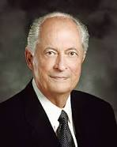
Lifting Burdens
…and now, as ye are desirous to come into the fold of God, and to be called his people, and are willing to bear one another’s burdens, that they may be light;
Mosiah 18:8
Once we receive a witness of the Spirit, our testimony is strengthened through study, prayer, and living the gospel.
Our growing testimony brings us increased faith in Jesus Christ and His plan of happiness.
We are motivated to repent and obey the commandments, which, with a mighty change of heart, leads to our conversion. And our conversion brings divine forgiveness, healing, joy, and the desire to bear our witness to others. (6)
Luke 5:12-25

Slide 12
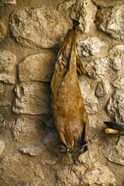
New Wine in Old Bottles
Have you ever tried jam that was canned in an old pickle jar?
How does it taste?
As new wine fermented in leather bags, gases would build up inside and stretch the leather. Once a wineskin had already been stretched in this way, attempting to ferment new wine in it again would risk bursting it.
The new wine = the Savior’s teachings and the fulness of the everlasting gospel.
The old wine = the practices, traditions, and beliefs of the Pharisees under the law of Moses.
Luke 5:36-39

Slide 13
Willing to Change
Just as old bottles are too inflexible to hold new wine, the scribes and Pharisees were hard-hearted and unwilling to change to accept the Savior and His teachings.
New Bottles
Those people who are humble and willing to change to accept the Savior and His teachings
To accept the Savior and His gospel, we must be humble and willing to change
Luke 5:36-39

Slide 14
Sources:
Suggested Hymn: #281 Help Me Teach with Inspiration Verses 2 and 4
Video: Jesus forgives sins and heals.
Lifting Burdens (3:35)
New Testament Institute Student Manual Chapter 16
President Spencer W. Kimball and Elder Jeffrey R. Holland ‘Peter, My Brother,’ Brigham Young University Speeches of the Year (July 13, 1971), 2 (“The Lengthening Shadow of Peter,” Ensign, Sept. 1975, 32).
Peter the fisherman statue located Catholic Church of Oriental, North Carolina.
President James E. Faust (“Discipleship,” Ensign or Liahona, Nov. 2006, 20, 22).
Elder Richard G. Scott (“Trust in the Lord,” Ensign, Nov. 1995, 17).
Elder Robert D. Hales Receiving a Testimony of the Restored Gospel of Jesus Christ Liahona November 2003
Presentation by ©http://fashionsbylynda.com/blog/

Slide 15
Event | Matthew | Mark | Luke | John
Jesus Cleanses a Leper | 8:2-4 | 1:40-45 | 5:12-16
Jesus Heals a Man with Palsy | 9:2-8 | 2:1-12 | 5:17-26
Matthew Follows Jesus | 9:9 | 2:13-14 | 5:27, 28
Jesus Came to Call Sinners to Repentance | 9:10-13 | 2:15-17 | 5:29-32
Jesus is the New law | 9:14-17 | 2:18-22 | 5:33-39
Miracles:
“The greatest miracles I see today are not necessarily the healing of sick bodies, but the greatest miracles I see are the healing of sick souls, those who are sick in soul and spirit and are downhearted and distraught, on the verge of nervous breakdowns. We are reaching out to all such, because they are precious in the sight of the Lord, and we want no one to feel that they are forgotten” President Harold B. Lee (“Stand Ye in Holy Places” Ensign, July 1973, 123).
New wine in Old bottles Luke 5:36-39
"In such wise did our Lord proclaim the newness and completeness of His gospel. It was in no sense a patching up of Judaism. He had not come to mend old and torn garments; the cloth He provided was new, and to sew it on the old would be but to tear afresh the threadbare fabric and leave a more unsightly rent than at first. Or to change the figure, new wine could not safely be entrusted to old bottles. The bottles here referred to were really bags, made of the skins of animals, and of course they deteriorated with age. Just as old leather splits or tears under even slight strain, so the old bottle-skins would burst from the pressure of fermenting juice, and the good wine would be lost.
The gospel taught by Christ was a new revelation, superseding the past, and marking the fulfillment of the law; it was no mere addendum, nor was it a reenactment of past requirements; it embodied a new and an everlasting covenant. Attempts to patch the Judaistic robe of traditionalism with the new fabric of the covenant could result in nothing more sightly than a rending of the fabric. The new wine of the gospel could not be held in the old time-worn containers of Mosaic libations. Judaism would be belittled and Christianity perverted by any such incongruous association." James E. Talmage (Jesus the Christ, 184)
Four Men of Faith: Luke 5:18-25:
“Who were those people that Jesus mentioned? They could well include the four who carried the man with palsy, the man himself, the people who had prayed for him, and all those who were there listening to the preaching of Jesus and cheering quietly in their hearts for the soon-to-come miracle. They could also include a spouse, a parent, a son or a daughter, a missionary, a quorum president, a Relief Society president, a bishop, and a faraway friend. We can all help one another. We should always be anxiously engaged in seeking to rescue those in need” (“Rescue in Unity,” Ensign or Liahona, Nov. 2014, 16).perverted by any such incongruous association." James E. Talmage (Jesus the Christ, 184)

