Slide 1
Lesson 47 Part 1
Sermon on the Plain
Luke 6
Presentation by ©http://fashionsbylynda.com/blog/

Slide 2
Who Will Serve?
Announcement during Church meeting on Sunday:
A service project for a family that lives nearby.
“That family has been through a lot lately. I am happy to help in any way that I can
“I don’t really want to go, but I could use some help next week with a project that I’m organizing, so I should probably help out now.”
There had better be refreshments afterward, because if there aren’t, I’m not going.
If my friend is going, I will go

Slide 3
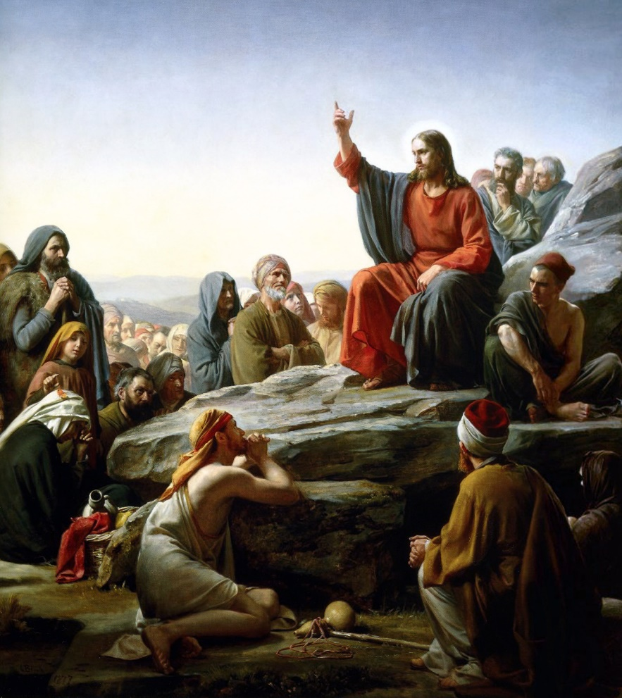
Jesus in Galilee
Capernaum
Besaida
Gennesaret
While Jesus was in Galilee early in His ministry, He healed a man’s withered hand on the Sabbath, spent a night in prayer, and called the Twelve Apostles. Jesus then began to teach them and “a great multitude of people” how to receive heavenly rewards.
Galilee
Sea of Galilee
Luke 6:17

Slide 4
Matthew 5-7
“Came down from the mountain”
Luke 6-7
Stood on the plain
It is unclear whether “the plain” refers to a low place apart from the mountain or a plateau within the mount.
Because of this uncertainty, there are varying views regarding whether the Sermon on the Mount recorded by Matthew and the Sermon on the Plain recorded by Luke were the same or different events. However, the chronological placement and the context of Luke’s record seem to indicate that the same sermon is being recorded in Luke 6 and Matthew 5–7.
(1)

Slide 5
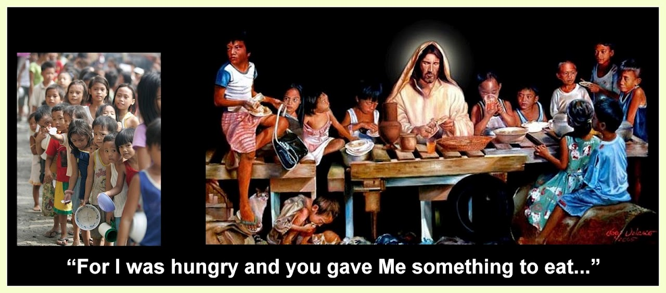
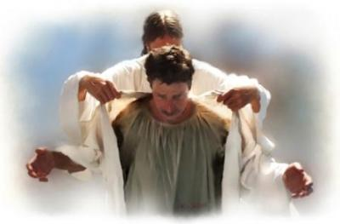
Blessings—Luke 6:20-23
Blessed be ye the poor
Blessed are ye that hunger now
Blessed are ye that weep now
Blessed are ye, when men shall hate you…
For yours is the Kingdom of God
For ye shall be filled
For ye shall laugh
Your reward is great in heaven
Greg Olsen

Slide 6
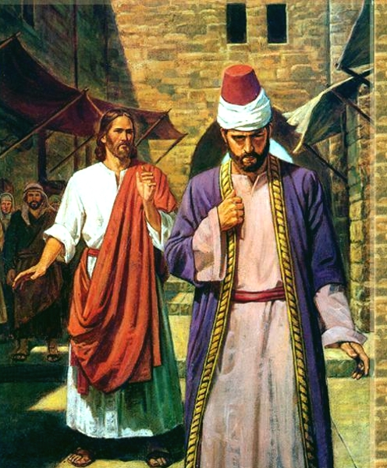
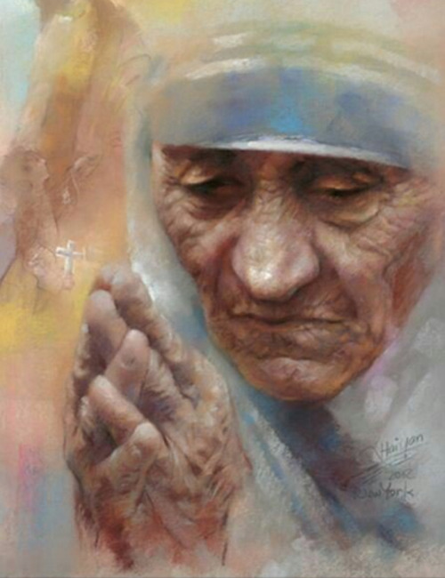
Woes—Luke 6:24-26
Woe unto you that are rich
Woe unto you that are full
Woe unto you that laugh now
Woe unto you, when men shall speak ill of you
For ye have received your consolation
For ye shall hunger
For ye shall mourn and weep
For so did their fathers to the false prophet

Slide 7
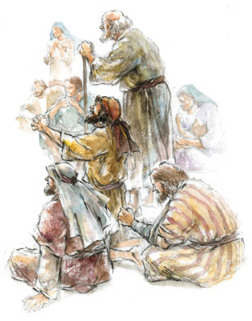
The Higher Law—Luke 6:31-35
Love your enemies
Him that taketh away thy cloak forbid not to take thy coat also
Pray for them which despitefully use you
Do good to them which hate you
Unto him that smiteth thee on the one cheek offer also the other
Give to every man that asketh of thee
As ye would that men should do to you, do ye also to them likewise.
If we do good to others without expecting anything in return, our reward will be great and we will be the children of the Highest

Slide 8
The Harvest Bucket
“Pressed Down, and Shaken Together, and Running Over”
A harvest basket that has been filled with produce beyond the specified amount.
Then the contents of the basket have been “pressed down” and “shaken together” so that even more produce can be added—until the basket is “running over.”
Those give in abundance will in turn receive from others the same measure of generosity.
(1)

Slide 9
Sources:
New Testament Institute Student Manual Chapter 16
Presentation by ©http://fashionsbylynda.com/blog/

Slide 10
Event | Matthew | Mark | Luke | John
Jesus is Lord of the Sabbath | 12:1-8 | 2:23-28 | 6:1-5
Jesus Heals Man With Withered Hand on the Sabbath | 12:9-14 | 3:1-6 | 6:6-11
Call and Ordination of the Twelve Apostles | 10:2-4 | 3:13-19 | 6:12-16
The Sermon on the Mount | 5, 6, 7 |  | 6:17-49
Sermon on the Plain: Luke 6
"In his sixth chapter Luke records an event similar to the 'Sermon on the Mount' but places it on the plain after Jesus had come down from the mountain, having just ordained the Twelve (Luke 6:10-17). There is a question whether these are two different sermons or two accounts of one sermon. It has been noted that Matthew's account is to disciples only, whereas Luke's account seems to include a multitude as well as the disciples (see Luke 6:17-20). It is possible that Jesus gave instructions on the mount to the Twelve and then came down with the Twelve and delivered portions to the multitude on the plain. The specific instruction that was given only to the disciples about not having a preoccupation with food and clothing (as in Matt. 6:25, 34, noted earlier), and the references to the 'salt of the earth' and the 'light of the world' are not found in Luke's account, which would be proper if the Sermon on the Plain was directed to the multitude generally and not to the Twelve specifically. Although the Twelve were present, there would be no need to repeat that which he had spoken specifically to them on the mount a few hours before." (Robert J. Matthews, Behold the Messiah [Salt Lake City: Bookcraft, 1994], 122.)
List of Woes: Luke 6: 24-26:
Absent from the Matthew account of the beatitudes, is this short list of "woes for the wicked." They contain the universal truth that those who have been blessed temporally while ignoring the things of the spirit will suffer the inevitable consequences. Hence, "there is a law, irrevocably decreed in heaven before the foundations of this world, upon which all cursings are predicated-And when we obtain any cursing from God, it is by disobedience to that law upon which it is predicated" (see DC 130:20-21). Thus, the man who was rich as to temporal things will find himself the poorest of all on judgment day. Those whose stomachs were always full will finally feel hunger-only to realize that spiritual hunger pangs are even more acute than physical ones. Those whose mortal lives were filled with fun and laughter will mourn and weep when they realize they have wasted away 'the days of [their] probation' (2 Ne. 9:27). Gospel doctrine.com

