Slide 1
Lesson 47 Part 2 and Lesson 48
“…Go In Peace”
Luke 7
“…And never, until I did cry out unto the Lord Jesus Christ for mercy, did I receive a remission of my sins. But behold, I did cry unto him and I did find peace to my soul.”
Alma 38:8

Slide 2
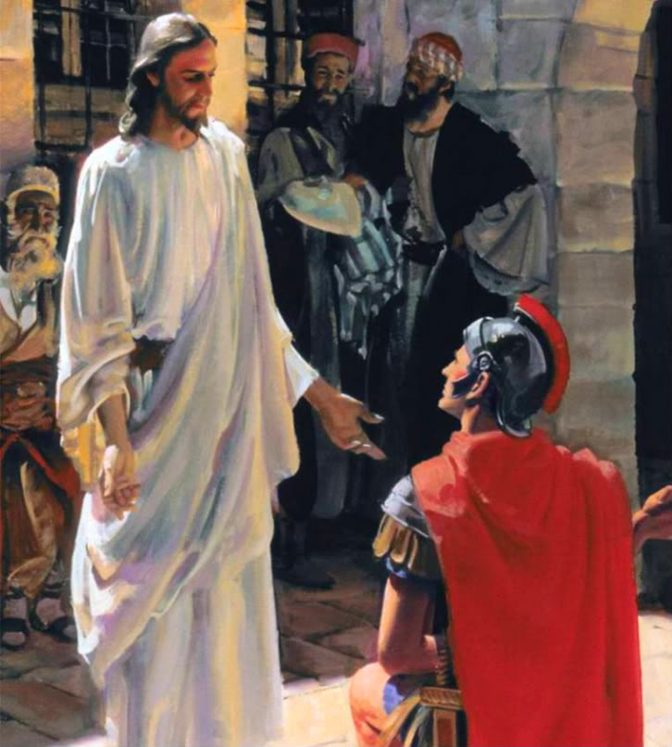
The Compassion of Jesus Christ
Jesus heals the centurion’s servant
A centurion was a Roman army officer in command of a company of 50 to 100 men.
Jews generally disliked centurions because they represented the Romans’ political and military power over the Jews and their land. (1)
By exercising faith in Jesus Christ, we can help bring blessings into others’ lives
Luke 7:1-10

Slide 3
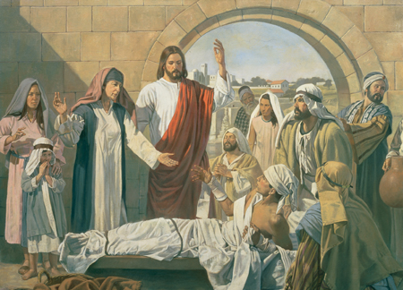
The Compassion of Jesus Christ
Jesus Christ Restored to Life the Son of a Widow of Nain
A bier is a coffin or the stand on which a coffin is placed.)
The young man was “the only son of his mother, and she was a widow”.
The loss of her only son meant that the widow was left without means of temporal support.
We can follow Jesus Christ’s example by demonstrating compassion for others and ministering to their unspoken needs
Robert T. Barrett
Luke 7:11-18

Slide 4
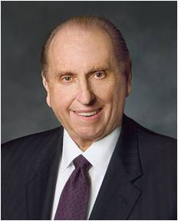
“Few accounts of the Master’s ministry touch me more than His example of compassion shown to the grieving widow at Nain. …
“What power, what tenderness, what compassion did our Master thus demonstrate! We, too, can bless if we will but follow His noble example. Opportunities are everywhere.
Needed are eyes to see the pitiable plight and ears to hear the silent pleadings of a broken heart.
Yes, and a soul filled with compassion, that we might communicate not only eye to eye or voice to ear but, in the majestic style of the Savior, even heart to heart.”
Luke 7:11-18
(3)

Slide 5
Who was John the Baptist?
Luke 7:18-35

Slide 6
John’s forthcoming birth and ministry were announced to John’s father by the angel Gabriel
Luke 1:5-25

Slide 7
John was the son of Zacharias and Elisabeth being a priestly descent through both parents.

Slide 8
John was a child of promise, with prophecies of his mission having been given by:
1 Nephi 10:7-10
Isaiah (40:3)
Malachi (3:1)

Slide 9
John was baptized at a
very early age
John was ordained to the priesthood at the time he was eight days old
D&C 84:27-28

Slide 10
John was a cousin of Jesus and born 6 months before Jesus

Slide 11
John grew up in the desert until the time arrived for his ministry to prepare the way for the Savior

Slide 12
John had preached and baptized for several months before he baptized the Savior, and continued to do so afterwards for several months.
John 3:23-24

Slide 13
John, the beloved, and Andrew, later members of the Twelve were baptized and disciples of John the Baptist. Others were probably tutored by John
Acts 1:21-22

Slide 14
At the time of Jesus’ baptism, John saw the sign and heard the voice of the Father bearing record that Jesus was the Beloved Son, in whom the Father was well pleased
(Matthew 3:13-17)

Slide 15
The sign of the dove, as an emblem for the Holy Ghost, was a pre-appointed signal by which John knew he was to recognize that he had baptized the Son of God.
John 1:29-34

Slide 16
John was shut up in prison by order of Herod, for criticizing Herod’s unlawful marriage of Herod
Mark 6:16-29

Slide 17
While in prison, John sent two of his disciples to inquire of Jesus to reassure their faith. Jesus took the occasion to bear testimony of the great work John had done, emphasizing that he was unwavering and true.
Luke 7:24-28

Slide 18
After nearly a year in prison, John was beheaded at the instigation of Herodias
John
the Baptist
Matthew 14:3
Mark 6:17

Slide 19
On May 15, 1829 John came to Joseph Smith and Oliver Cowdery on the banks of the Susquehanna River near Harmony, Pennsylvania, and ordained them to the Priesthood of Aaron
(D&C 13, 27: 7-8)
(JS-H 1:68-72)

Slide 20
John’s ministry has operated in three dispensations; He was the last of the prophets under the law of Moses, he was the first of the New Testament prophets, and he brought the Aaronic Priesthood to the dispensation of the fulness of times.

Slide 21
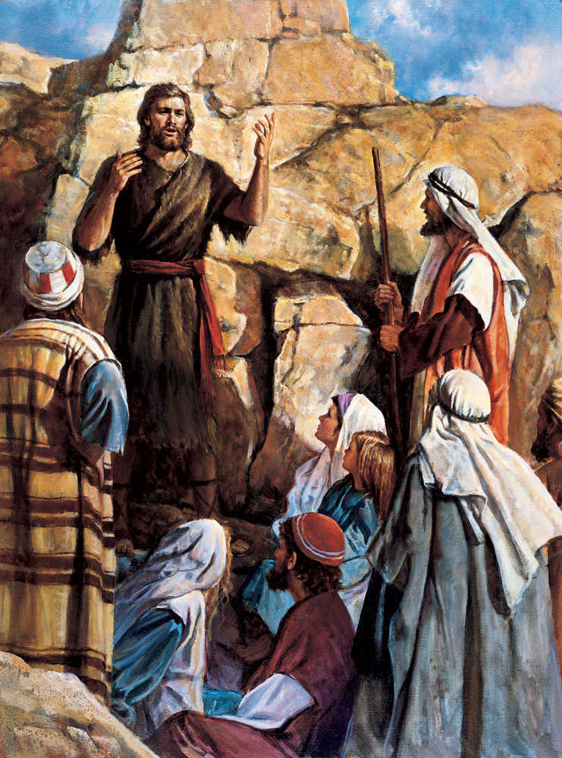

Slide 22
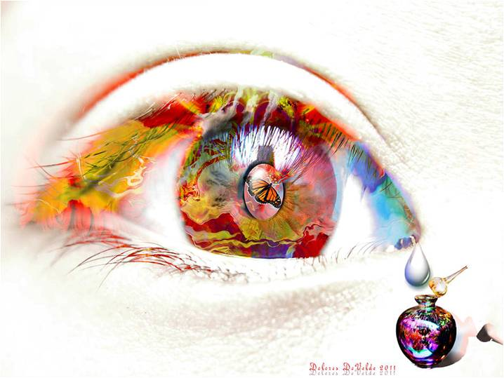
“…Go in Peace.”
Luke 7:36-50

Slide 23
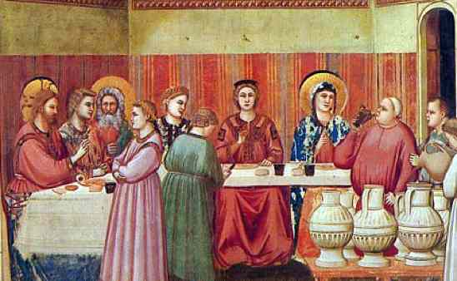
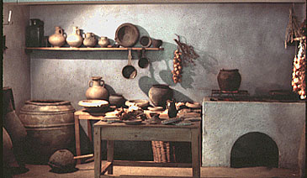
Jesus is invited to Simon the Pharisees’ house to eat
Luke 7:36

Slide 24
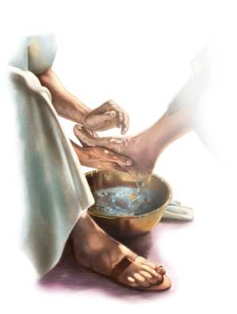
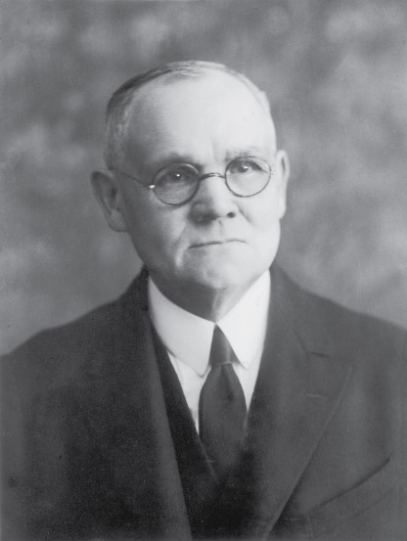
As a distinguished guest the host would be:
Received with a welcome “kiss”
Provided water for washing dusty feet
Provided with oil for anointing the hair of the head and the beard
All of these courteous attentions were omitted by Simon
(4)

Slide 25
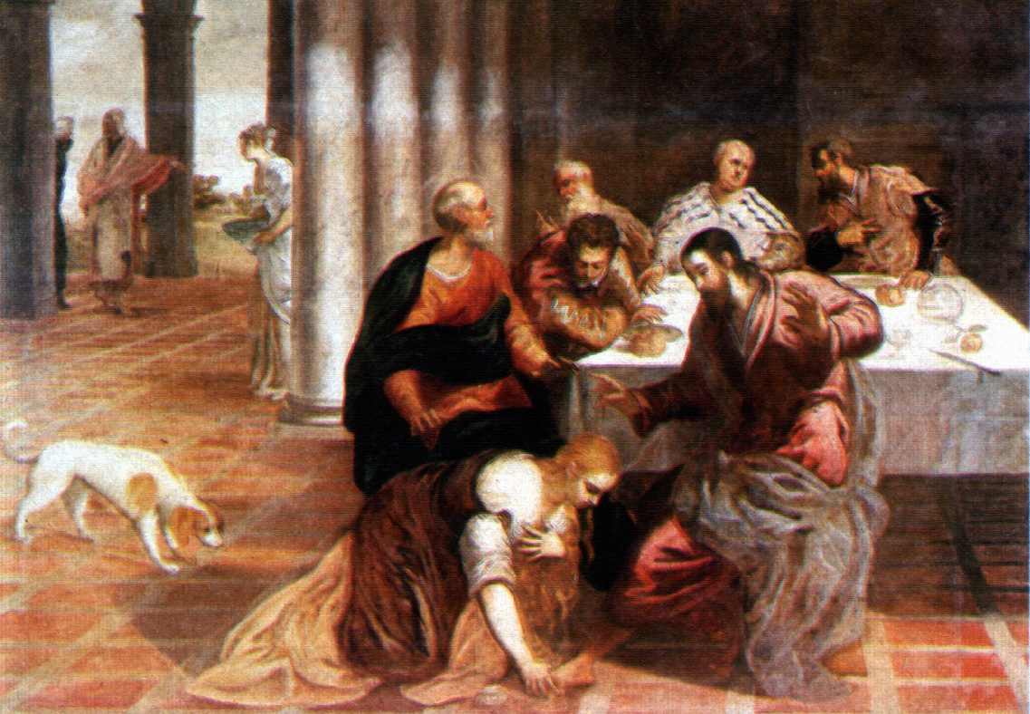
Because of the layout of the homes, it was common for people who were not invited to walk in during the supper

Slide 26
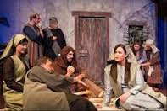
Custom was that they would lay on their side to eat

Slide 27
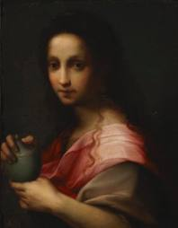
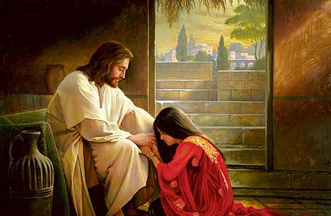
A woman, who was a sinner, knew Jesus was at Simon’s
Luke 7:37

Slide 28
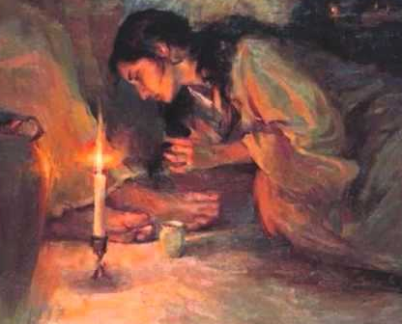
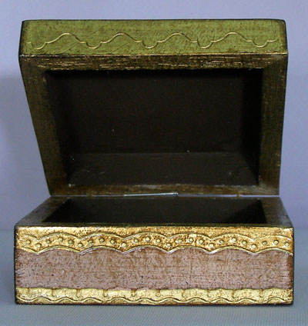
She brought an alabaster box of Ointment
Luke 7:37

Slide 29
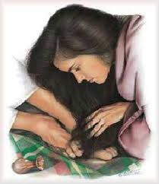
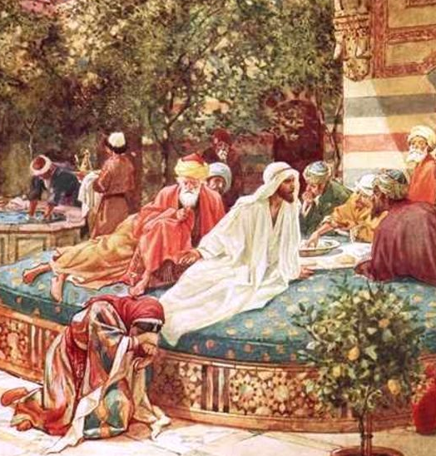
She stood at his feet and began to wash them
Luke 7:38
With her tears…
Luke 7:38

Slide 30
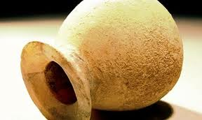
Her tears were collected and save….
They were tears of repentance

Slide 31
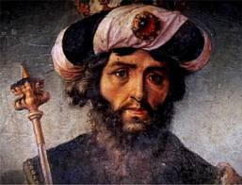
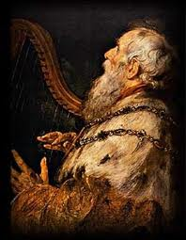
Tears in the
Old Testament
“Thou tellest my wanderings: put thou my tears into a bottle; are they not in thy book?”
Psalms 56:8
King David during a time of distress…

Slide 32
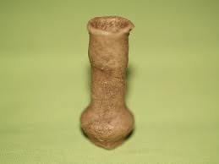
Tear Bottles in the East were made of skin…but any bottles were used to collect tears
“ lachrymatory"

Slide 33
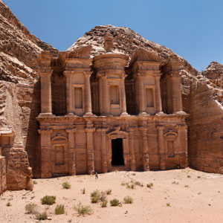
These “lachrymatory” bottles have been found in ancient tombs but the bottles only have dust in them

Slide 34
“Tears were collected as a custom during times of calamity and sorrow, and preserved in small bottles.”

Slide 35
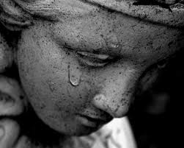
The Romans had a custom, that in a time of mourning, such as a funeral, a friend went to one in sorrow, and wiped away the tears from the eyes with a piece of cloth, and squeezed the tears into a small bottle of glass or earth made and preserved, as a memorial of friendship and sorrow.

Slide 36
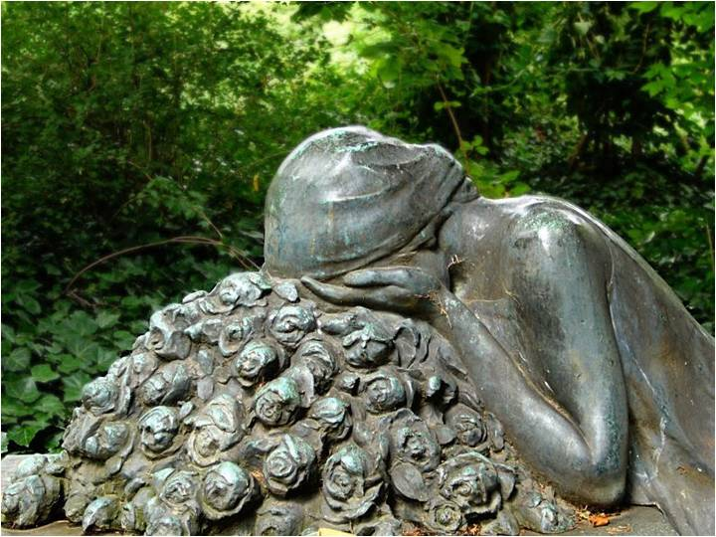
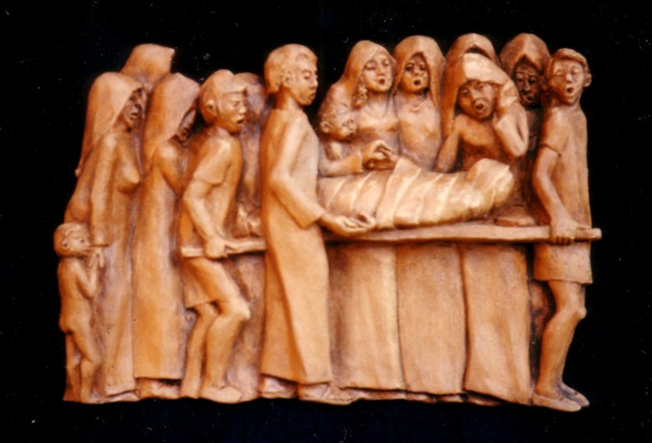
Sometimes women were even paid to cry into these vessels, as they walked along the mourning procession.
Those crying the loudest and producing the most tears received the most compensation, or so the legend goes.

Slide 37
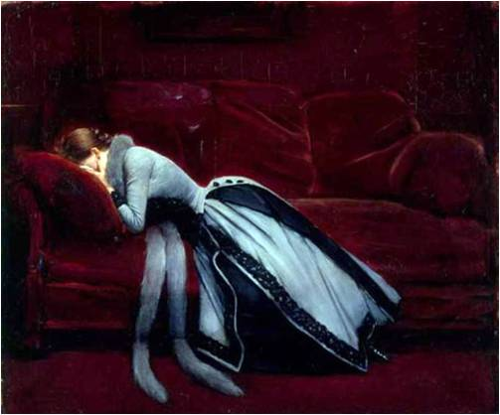
Tear bottles reappeared during the Victorian period of the 19th century, when those mourning the loss of loved ones would collect their tears in bottles with special stoppers that allowed the tears to evaporate. When the tears had evaporated, the mourning period would end.

Slide 38
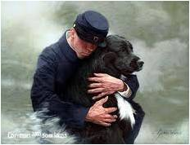
In some American Civil war stories were said to have cried into tear bottles and saved them until their husbands returned from battle. Their collected tears would show the men how much they were adored and missed.

Slide 39
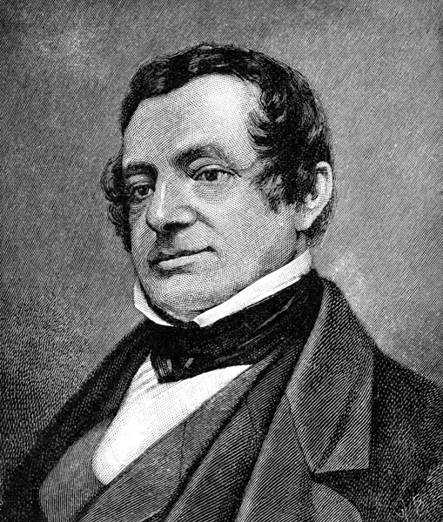
“There is a sacredness in tears. They are not a mark of weakness, but of power.
They speak more eloquently than ten thousand tongues.
They are the messengers of overwhelming grief, of deep contrition and of unspeakable love." - WASHINGTON IRVING

Slide 40
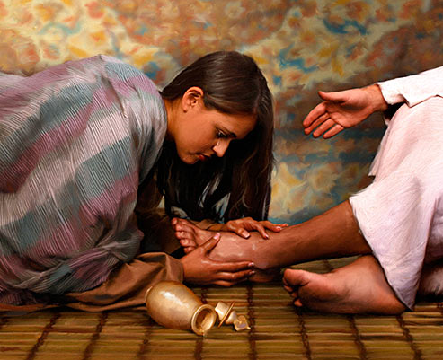
“…did wipe them with the hairs of her head, and kissed his feet, and anointed them with the ointment.”
Luke 7:38

Slide 41
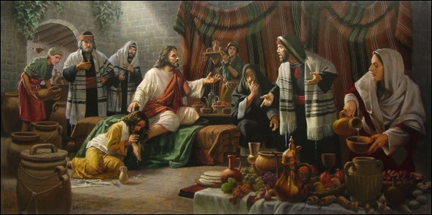
Simon questions Jesus’ letting “a sinner” touch him and Jesus replies with the parable of the two debtors.
Luke 7:39-43

Slide 42
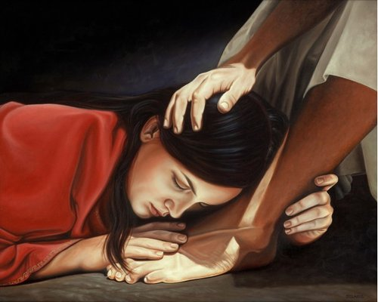
This woman had done what Simon should have done…
Luke 7:44-46

Slide 43
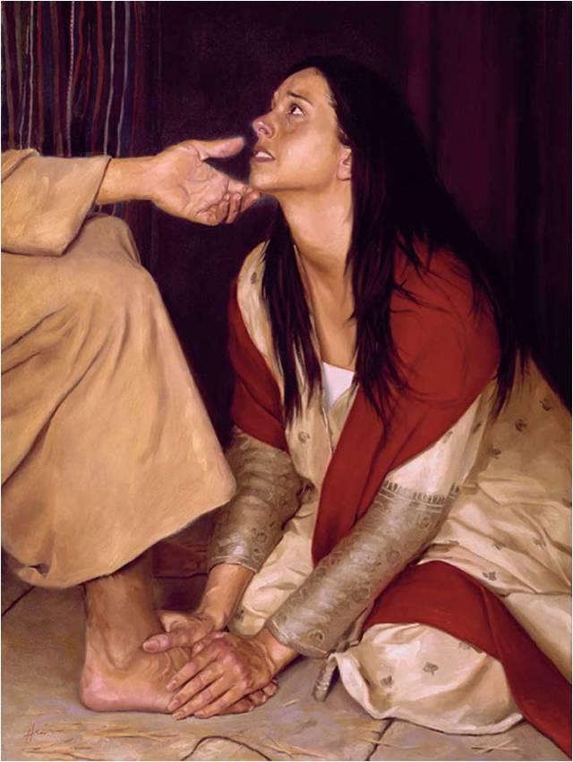
Jesus forgave her sins
Luke 7:48
Go in Peace
Luke 7:50

Slide 44
The woman is not offering her love hoping to receive forgiveness. Rather, she has already received forgiveness.

Slide 45
“It happened when she believed and was baptized in his name; it happened when she repented with full purpose of heart…
She was now free from the from the crushing burden of her many offenses; who now walked into newness of life because of him whose feet she now kissed.”
(2)

Slide 46
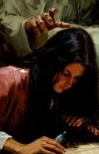
You keep track of all my sorrows.
You have collected all my tears in your bottle.
You have recorded each one in your book.

Slide 47
“…And never, until I did cry out unto the Lord Jesus Christ for mercy, did I receive a remission of my sins. But behold, I did cry unto him and I did find peace to my soul.” Alma 38:8

Slide 48
Sources:
Suggested Hymn: #129 Where Can I Turn for Peace?
Videos: “The Widow of Nain” (0:00–0:45)
Providing for the Refugees in Lebanon (4:40)
New Testament Student Manual [Church Educational System manual, 2014], 153).
Elder Bruce R. McConkie The Mortal Messiah pp. 200-201
President Thomas S. Monson (“Meeting Life’s Challenges,” Ensign, Nov. 1993, 71).
James E. Talmage Jesus the Christ p. 261
Presentation by ©http://fashionsbylynda.com/blog/

Slide 49
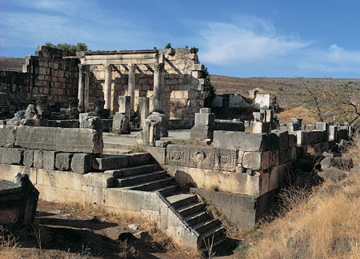
Event | Matthew | Mark | Luke | John
Jesus Goes to Capernaum and Heals Centurion’s Servant | 8:1, 5-13 |  | 7:1-10
Jesus Raises a Widow’s Son from the Dead |  |  | 7:11-17
John the Baptist Sends Messenger to Jesus | 11:2-6 |  | 7:18-23
Jesus Testifies of John’s Greatness | 11:7-19 |  | 7:24-35
Woman Anoints Jesus’ Feet with Oil |  |  | 7:36-50
Ruins of Capernaum Synagogue dating to the fourth or fifth century A.D. Beneath the remains of the white limestone synagogue, the black basalt foundation of an earlier synagogue can be seen. It has been dated to the first century A.D. and is likely the synagogue built by the centurion.
In this synagogue, the Savior taught (see Mark 1:21; John 6:59), cast evil spirits out of a man (see Mark 1:21–26), and healed a man with a withered hand (see Mark 2:1; 3:1–5). New Testament Institute Student Manual Chapter 16

