Slide 1
Lesson 49
Lesson 49
Save, Not Destroy
Luke 8-9
For the Son of man is not come to destroy men’s lives, but to save them.
Luke 9:56
SAVE

Slide 2
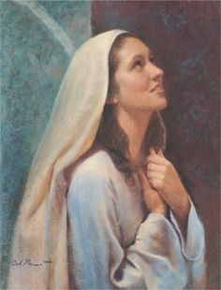
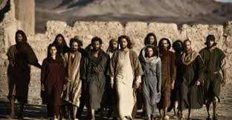
Lesson 47 Part 2
The Women Who Traveled With Jesus
Luke 7
During the Savior’s ministry in Galilee, teaching in “every city and village” of the region His Apostles traveled with Him, as did many women, some of whom had been healed of various maladies.
Others could have been wives of the Apostles. Some women followed Jesus to the time of His death and beyond Using the means they had, these women were supporting Jesus and His leaders.
Mary Magdalene, the woman to whom the resurrected Savior first appeared was one of the women who accompanied Jesus. Luke recorded that the Savior had cast seven devils out of her (see Luke 8:2).
Mary Magdalene should not be confused with the sinful woman mentioned in Luke 7:36–50 or with Mary of Bethany (see Luke 10:38–42; John 11:1).
Mary Magdalene held an honored place in the kingdom.
Luke 8:1-3; Luke 23:27; 24:10; John 20:11–18
(1)

Slide 3
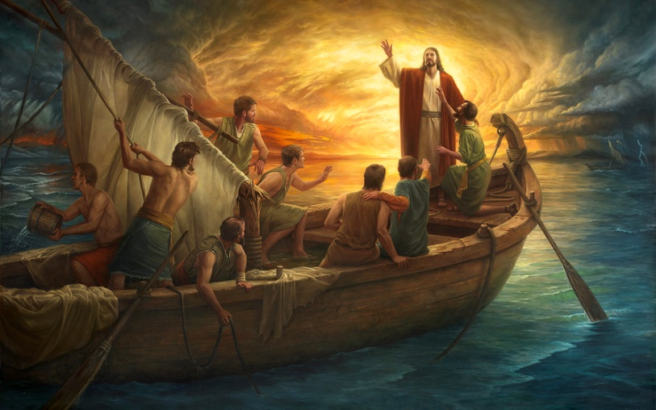
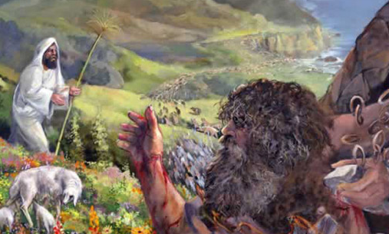
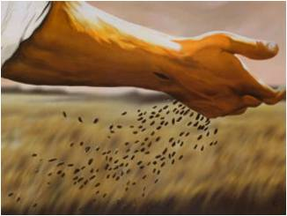
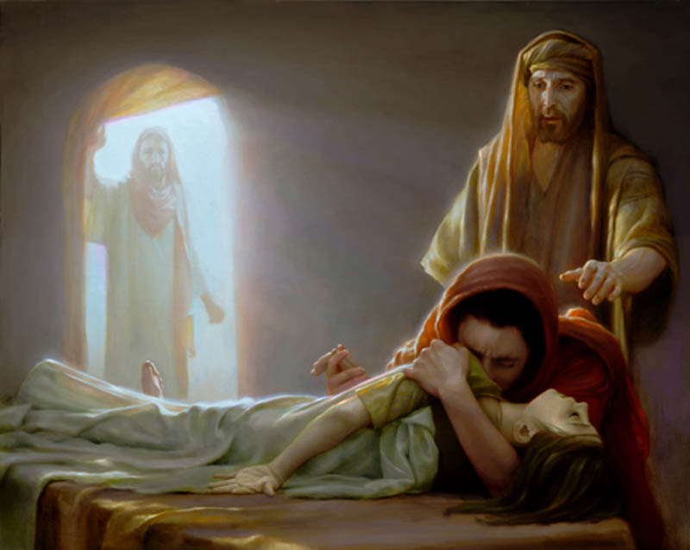
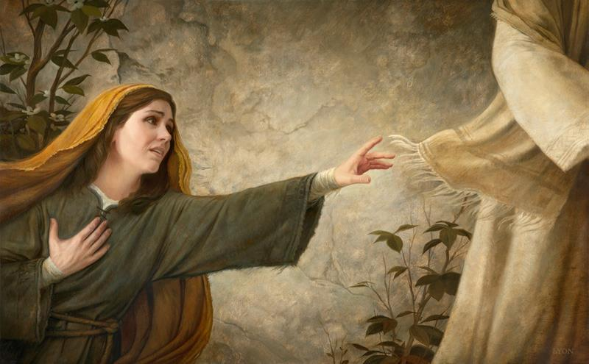
Lesson 47 Part 2
Luke’s Added Insight…
Luke 7
Christ gave the parable of the sower.
Matthew 13:4-8
Howard Lyon
The Savior cast out a legion of devils.
Mark 5:1-20
Jesus Christ calmed a storm.
Mark 4:35-41
The Savior healed a woman with an issue of blood.
Mark 5:25-34
Jesus Christ raised Jairus’s daughter from the dead.
Mark 5:22–24, 35–42
Howard Lyon
Luke 8

Slide 4
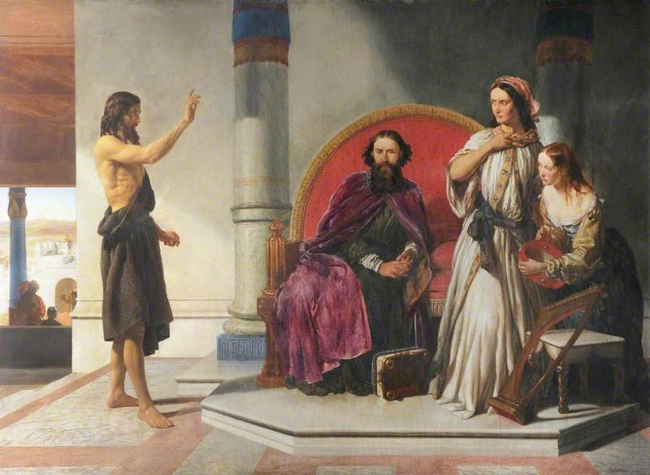
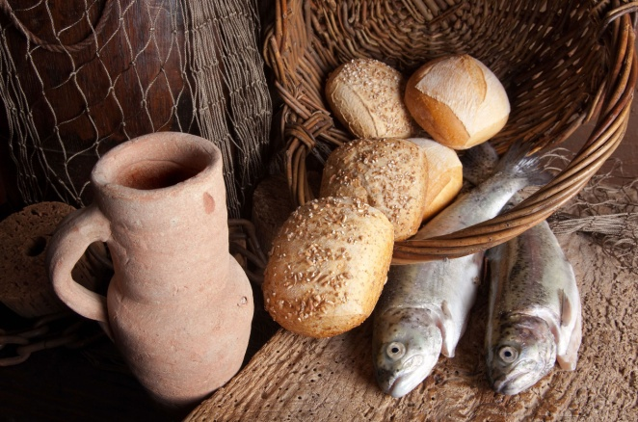
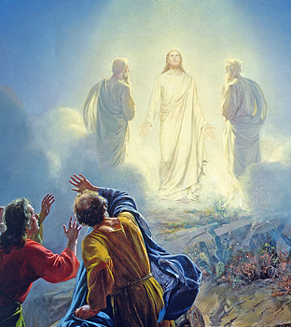
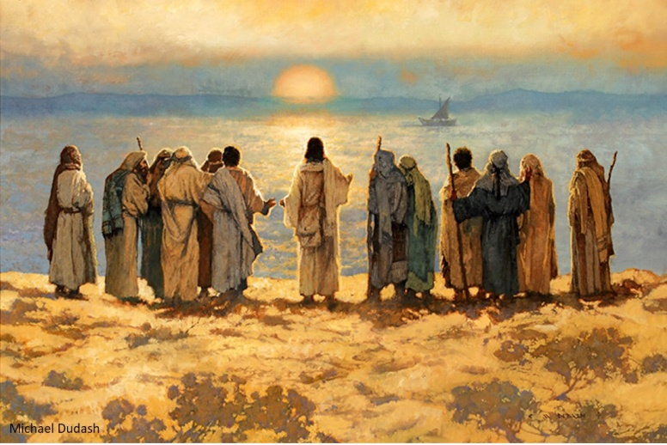
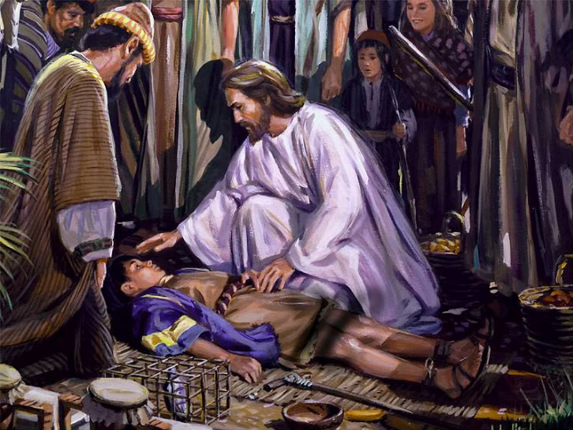
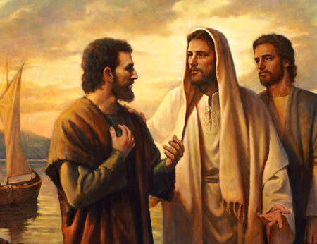
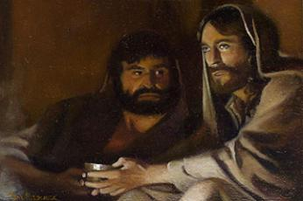
Lesson 47 Part 2
The Savior sent the Twelve out to preach and heal.
Matthew 10:1-5
Christ fed the five thousand.
Mark 6:32-44
Luke 7
Herod had John the Baptist killed and desired to see Jesus.
Mark 6:14-29
Carl Bloch
The Transfiguration took place.
Matthew 17:1-13
A man’s son, who was possessed by an unclean spirit, was healed.
Mark 9:17-29
Peter testified that Jesus is the Christ.
Mark 8:27-32
The disciples asked which should be greatest among them.
Mark 9:33–37; 10:35–45
Luke 9:1-48

Slide 5
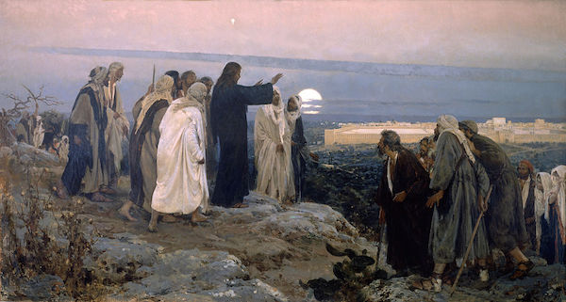
Lesson 47 Part 2
“be received up”
Luke 7
The Savior’s approaching Ascension into heaven
After Jesus completed His mission in Galilee and knew that it was time for Him to travel toward Jerusalem, He sent messengers to prepare a place for Him in a Samaritan village.
But because the Samaritans hated the Jews, the villagers would not let the Savior stay in their village.
In these circumstances, Jesus demonstrated patience and forbearance and admonished
His disciples to do the same.
He taught them that they
were not acting under the
influence of God’s Spirit.
Galilee
Jerusalem
Luke 9:51-56

Slide 6
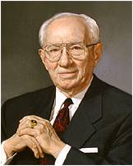
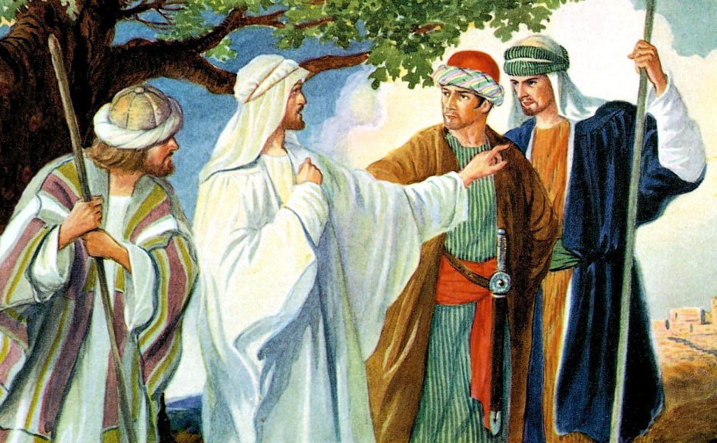
Lesson 47 Part 2
Exercising Forbearance
Luke 7
How did James and John react to the Samaritans’ inhospitality toward and rejection of the Savior?
“There is so great a need for civility and mutual respect among those of differing beliefs and philosophies.
We must not be partisans of any doctrine of ethnic superiority. We live in a world of diversity.
We can and must be respectful toward those with whose teachings we may not agree.
We must be willing to defend the rights of others who may become the victims of bigotry.” (2)
…he that hath the spirit of contention is not of me, but is of the devil, who is the father of contention, and he stirreth up the hearts of men to contend with anger, one with another.
Behold, this is not my doctrine, to stir up the hearts of men with anger, one against another; but this is my doctrine, that such things should be done away. 3 Nephi 11:29-30
Luke 9:54-56

Slide 7
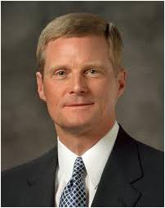
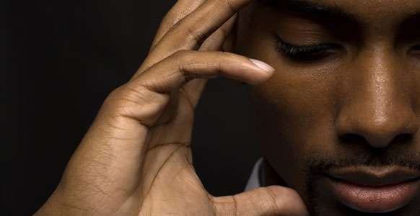
Lesson 47 Part 2
Luke 7
“To believe that someone or something can make us feel offended, angry, hurt, or bitter diminishes our moral agency and transforms us into objects to be acted upon.
As agents, however, you and I have the power to act and to choose how we will respond to an offensive or hurtful situation. …
“The Savior is the greatest example of how we should respond to potentially offensive events or situations.” (5)
Luke 9:54-56

Slide 8
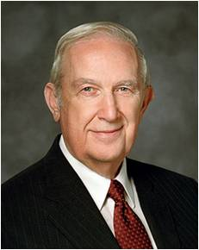
Lesson 47 Part 2
However…
Luke 7
We follow the Savior’s example when we choose to respond to offenses with patience and long-suffering
You should not allow any type of abuse to continue against you.
If you are a victim of abuse, you should immediately seek help from parents, priesthood leaders, and other authorities as appropriate.
“As a victim, do not waste effort in revenge or retribution against your aggressor. Focus on your responsibility to do what is in your power to correct. Leave the handling of the offender to civil and Church authorities.” (3)
Luke 9:54-56

Slide 9
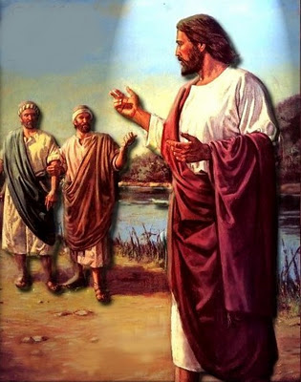
Lesson 47 Part 2
Following Jesus Christ
Luke 7
When a “certain man” said that he would follow the Savior wherever He went, the Savior answered that “the Son of man hath not where to lay his head”, indicating that He had no home of His own.
His mission was void of comforts and ease, implying that such may also be the case for those who follow Him.
"In other words, Jesus wanted it to be understood that nothing was to stand in the way of preaching the kingdom of God, not even the care of one's dead or the saying of farewell.” (4)
Luke 9:57-62

Slide 10
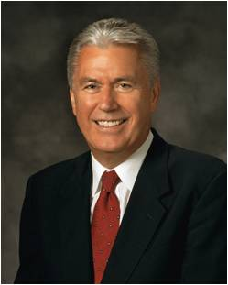
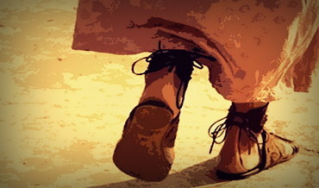
“Those who have entered the waters of baptism and received the gift of the Holy Ghost have set their feet on the path of discipleship and are charged to follow steadily and faithfully in the footsteps of our Savior.”
Luke 9:62
(6)

Slide 11
Sources:
Suggested Hymn: #228 You Can Make the Pathway Bright verses 2 and 3
Video:
Discipleship (2:34)
New Testament Institute Student Manual Chapter 16 and 17
President Gordon B. Hinckley (“This Is the Work of the Master,” Ensign, May 1995, 71).
Elder Richard G. Scott Healing the Tragic Scars of Abuse may 1992 Ensign
Elder LeGrand Richards (A Marvelous Work and a Wonder, 247.)
David A. Bednar (“And Nothing Shall Offend Them,” Ensign or Liahona, Nov. 2006, 90).
President Dieter F. Uchtdorf (“Saints for All Seasons,” Ensign or Liahona, Sept. 2013, 5).
Presentation by ©http://fashionsbylynda.com/blog/

Slide 12
Parable of the Sower
(planting the seed)
Lehi’s Dream
(reactions to the tree of life)
Some seeds fell by the way side
(Luke 8-5) (Matthew 13:4,19)
Some went directly to the great and spacious building
(1 Nephi 8:31:32)
Some seeds grew, then withered in the sun
(Matthew 13:5-6, 20-21)
Some partook of the fruit, then fell away
(1Nephi 8:25)
Some grew among thorns and choked
(Luke 8:7) (Matthew 13:7, 22)
Some started on the path, then wandered off
(1 Nephi 8:23)
Some grew in good soil and brought forth fruit
(Luke 8:8) (Matthew 13:8, 23)
Some partook of the fruit and stayed by the tree
(1 Nephi 8:30)

Slide 13
Event | Matthew | Mark | Luke | John
Preaching in Galilee with the Twelve |  |  | 8:1-3
Jesus’ Mother and Brother Seek Him | 12:46-50 | 3:31-35 | 8:19-21
Parable of the Sower, or Different Kinds of Soil | 13:1-23 | 4:1-25 | 8:4-18
Jesus Calms the Storm at the Sea | 8:18, 23-27 | 4:35-41 | 8:22-25
Jesus Casts Legion of Devils into Swine | 8:28-34 | 5:1-20 | 8:26-39
Return to Capernaum | 9:1 | 5:21 | 8:40
Jairus Seeks Jesus to Heal His Dying Daughter | 9:18, 19 | 5:22-24 | 8:41, 42
Woman Touches Jesus and is Healed | 9:20-22 | 5:25-34 | 8:43-48
Jairus’ Daughter Raised from Death | 9:23-26 | 5:35-43 | 8:49-56
Apostles Are Sent on Missions | 10:1, 5-42 | 6:7-13 | 9:1-6
The Twelve Apostles Return and Depart—Jesus is to Rest | 14:13 | 6:30-33 | 9:10 | 6:1, 2
Jesus Feeds 5,000 | 14:14-21 | 6:34-44 | 9:11-17 | 6:3-14

Slide 14
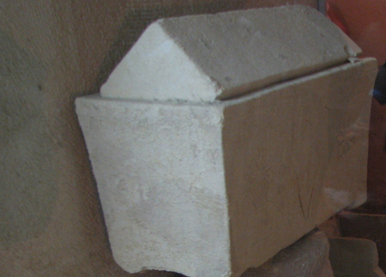
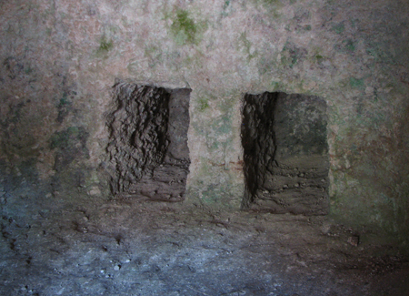
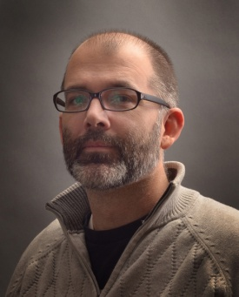
Support of the Women Luke 8:1-3:
“It must be comforting to you beloved sisters of his Church to remember that this same Jesus, our Savior through the Atonement, demonstrated his love and concern for the women of his time. He enjoyed the company of women and had close friends among them. … Is there any reason to think that he cares any less about women today? …
“As our Lord and Savior needed the women of his time for a comforting hand, a listening ear, a believing heart, a kind look, an encouraging word, loyalty—even in his hour of humiliation, agony, and death—so we, his servants all across the Church, need you, the women of the Church, to stand with us and for us in stemming the tide of evil that threatens to engulf us. Together we must stand faithful and firm in the faith against superior numbers of other-minded people. It seems to me that there is a great need to rally the women of the Church to stand with and for the Brethren in stemming the tide of evil that surrounds us and in moving forward the work of our Savior” President Howard W. Hunter (“To the Women of the Church,” Ensign, Nov. 1992, 95–96).
Let the Dead Bury Their Dead Luke 9:59-60
Respect for parents was very important in Jewish culture and included the responsibility to provide a proper burial for them when they died. After preparing a body for burial and placing it in a tomb, family members typically returned a year later to place the bones in a stone box called an ossuary, which remained in the tomb as a secondary burial. If the disciple was speaking of his father’s secondary burial, the Savior’s response would seem to communicate that now was the time for the man to serve a mission (see Luke 9:59–60). The man could be at peace about letting his deceased father remain in the tomb with other dead members of the family. It is also possible that the Savior’s response could be understood, “Let the [spiritually] dead bury their [physically] dead.”
In either case, the Savior’s words do not mean it is wrong to mourn the loss of a loved one or give proper respect at a funeral. Rather, these words emphasize devotion to the Lord as a disciple’s highest priority. (1)
Artist Howard Lyon:
Howard Lyon was born and raised in Mesa, Arizona. He is the youngest of five children. Howard had very supportive parents who, even when he was very young, made sure he had the materials and education to hone his talents. While attending high school, Howard met his wife, Shari Lunt. After they graduated, Howard served a mission and then they married and went to BYU and started their family. He began his career studying illustration at Brigham Young University working with artists such as Robert Barrett, Don Seegmiller, James Christensen, and Greg Olsen. Over the past twenty years he has worked in the video game industry as an art director, concept artist, and freelance illustrator. For much of his career he has painted dragons and trolls or scenes from science fiction. His work can be found in products from Dungeons and Dragons books, World of Warcraft cards, Magic: the Gathering and Star Wars. He has studied art in Italy, France, and most recently at the Grand Central Academy in New York. He has recently combined these experiences to switch gears and expand his subject matter to create inspirational pieces in the style of some of his favorite old masters: William Bouguereau, Lawrence Alma-Tadema, and John William Waterhouse.
An ossuary—a stone box in which bones of the deceased are respectfully placed. Below: A niche that has been chiseled out of a stone tomb, where an ossuary is placed for permanent burial.
Looking Back Luke 9:62:
“To dig a straight furrow, the plowman needs to keep his eyes on a fixed point ahead of him. That keeps him on a true course. If, however, he happens to look back to see where he has been, his chances of straying are increased. The results are crooked and irregular furrows. We invite those of you who are new members to fix your attention on your new goal and never look back on your earlier problems or transgressions except as a reminder of your growth and your worth and your blessings from God. If our energies are focused not behind us but ahead of us—on eternal life and the joy of salvation—we assuredly will obtain it.” President Howard W. Hunter (“Am I a ‘Living’ Member?” Ensign, May 1987, 17).

