Slide 1
Lesson 18
Context and Overview of the
New Testament
New Testament

Slide 2
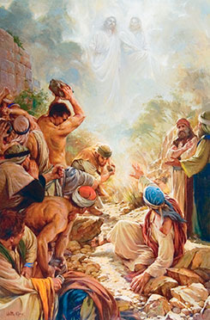
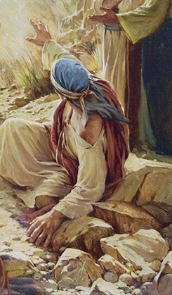
What is happening in the picture?
Why is the man on the ground and stretching forth his hand?
But he, being full of the Holy Ghost, looked up steadfastly into heaven, and saw the glory of God, and Jesus standing on the right hand of God,
And said, Behold, I see the heavens opened, and theSon of man standing on the right hand of God.
Then they cried out with a loud voice, and stopped their ears, and ran upon him with one accord,
And cast him out of the city, and stoned him
Acts 7:55-58

Slide 3
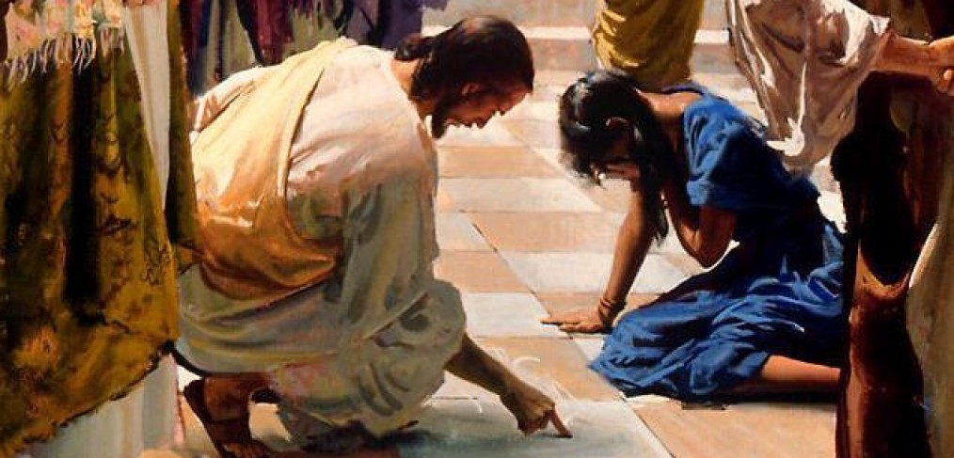
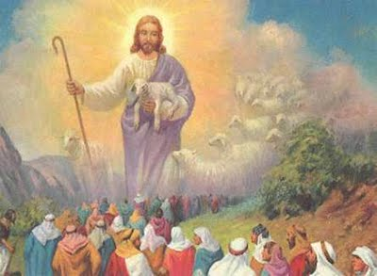
Understanding the Whole Picture
The word context refers to the circumstances that surround or give background to a scriptural passage, event, or story.
Becoming familiar with the historical and cultural context of the New Testament, we can better understand and apply its teachings.

Slide 4
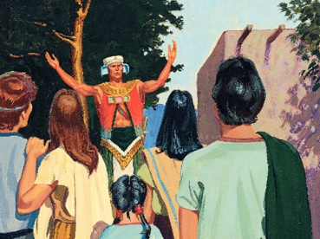
Understanding Words and Phrases
Wherefore, as I said unto you, it must needs be expedient that Christ—for in the last night the angel spake unto me that this should be his name—should come among the Jews, among those who are the more wicked part of the world; and they shall crucify him—for thus it behooveth our God, and there is none other nation on earth that would crucify their God.
For should the mighty miracles be wrought among other nations they would repent, and know that he be their God.
But because of priestcrafts and iniquities, they at Jerusalem will stiffen their necks against him, that he be crucified.
2 Nephi 10:3
Woe unto you, ye blind guides, which say, Whosoever shall swear by the temple, it is nothing; but whosoever shall swear by the gold of the temple, he is a debtor!
Ye blind guides, which strain at a gnat, and swallow a camel.
Matthew 23:16,24
Jesus described these Jewish religious leaders during His ministry = the Pharisees had missed the spirit of the law. They didn't know which was more important the gold of the temple or the temple itself. Was it the gift on the altar or the altar itself which was important? (1)
priestcrafts = “gain and praise of the world” rather than the welfare of God’s people.
Those who were guilty of priestcrafts were primarily wicked religious leaders among the Jews who were leading people astray

Slide 5
Understanding the Whole Picture
In the absence of prophets, Jewish teachers and leaders added their own rules and interpretations to the law.
Known variously as the oral law, oral tradition, or the traditions of the elders, these added rules and interpretations were intended to prevent violation of God’s law.
According to the oral law, it was forbidden to untie a knot with both hands on the Sabbath. Doing so was considered work and thus a violation of the Sabbath day.
However, untying a knot with only one hand was permitted.
Law of Moses
Oral Law

Slide 6
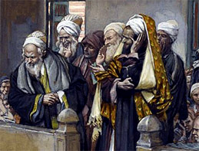
“They took the plain and simple things of pure religion and added to them a host of their own interpretations; they embellished them with added rites and performances; and they took a happy, joyous way of worship and turned it into a restrictive, curtailing, depressive system of rituals and performances.
The living spirit of the Lord’s law became in their hands the dead letter of Jewish ritualism.” (2)

Slide 7
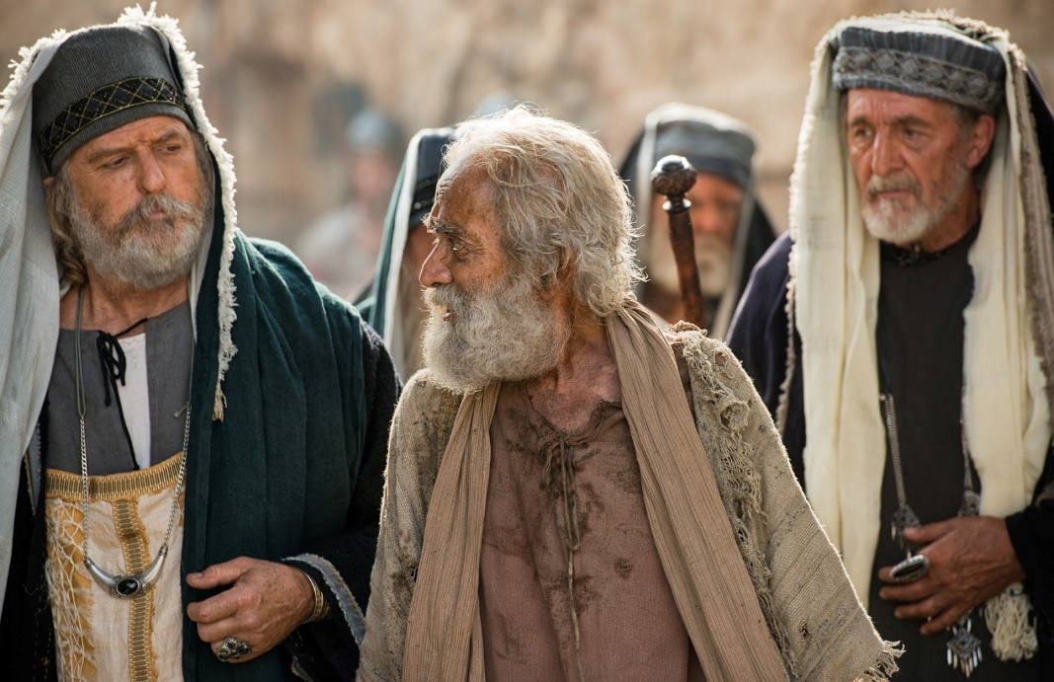
Apostasy in the Midst
The Jews in Jesus’s day were in a state of apostasy
Although the authority and ordinances of the Aaronic Priesthood continued among them, many of the Jews had fallen away from the true practice of their religion as revealed by God to Moses.
And the lesser priesthood continued, which priesthood holdeth the key of the ministering of angels and the preparatory gospel;
For he was baptized while he was yet in his childhood, and was ordained by the angel of God at the time he was eight days old unto this power, to overthrow the kingdom of the Jews, and to make straight the way of the Lord before the face of his people, to prepare them for the coming of the Lord, in whose hand is given all power.
D&C 84:26, 28
The tradition of the elders had gained priority over pure religion and the written word of God.

Slide 8
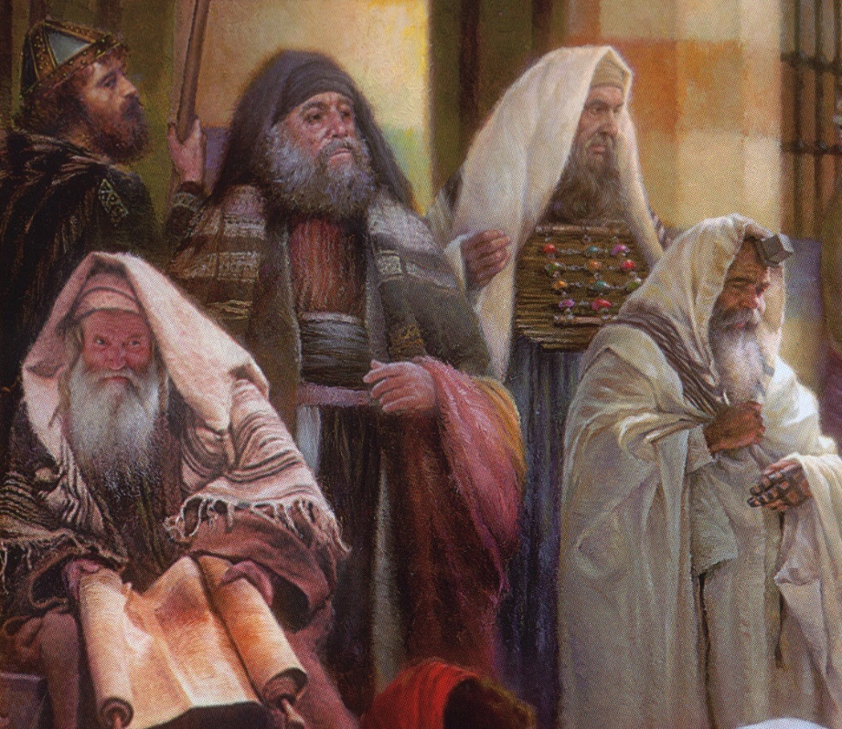
Pharisees
There was a group in Jesus’ day that Jesus focused His harshest critiques, warnings, and teachings on.
This group knew God’s Law inside and out, were the most religiously educated, adhered to strict standards and ethics and codes, and were the religious elite of the day. They liked to cast stones and condemn. (3)
Then the Pharisees went out, and held a council against him, how they might destroy him.
Matthew 12:14
In addition to apostate Jewish traditions, other false philosophies influenced people’s rejection of Jesus Christ after His Resurrection.

Slide 9
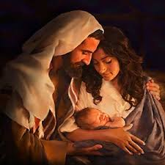
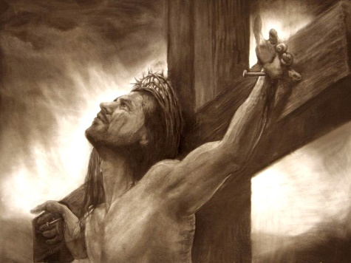
Approximate times
New Testament Times
Except for one period of independence, by New Testament times the Jews had lived as a conquered people for over 500 years.
430 B.C.
160 B.C.
63 B.C.
40 B.C.
Birth of Jesus
Malachi was the last recorded prophet to preach to the Jews.
Rome conquered Israel.
A revolt led by the Maccabees, a family of Jewish patriots, led to independence about 160 years before Christ’s birth.
King Herod (also known as Herod the Great), who had married into the Maccabee family, was appointed by Rome to rule over Israel.
The Jews resented Roman rule and eagerly looked forward to a promised Messiah who they believed would deliver them from the Romans.
Because many Jews expected a Messiah who would deliver them from foreign rule, they rejected Jesus Christ as their Savior.

Slide 10
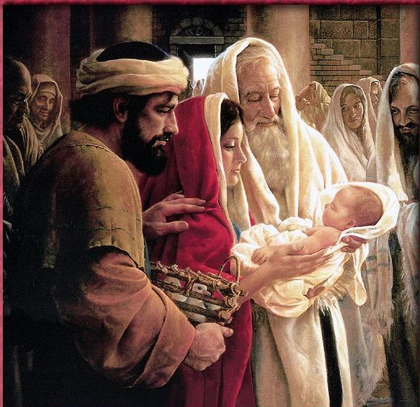
Those Who Believed…
While some Jews rejected Christ, others who were humble and spiritually sensitive recognized Him as the Messiah and Savior.
Read Luke 2:25-33
Jesus Christ was sent to bring salvation to all people

Slide 11
A Better Understanding
Remembering the cultural and historical context we will have a better understanding of the teachings of the Savior and His Apostles.

Slide 12
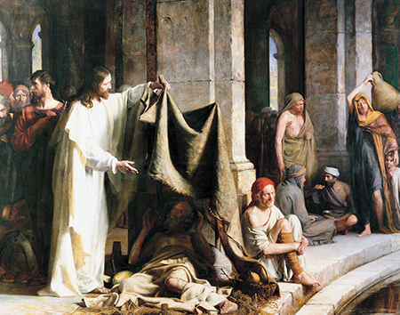
What Do You See?

Slide 13
What Did You See?
Jesus holding a tarp
Man lying under a tarp
Man sitting next to pillar
3 men talking-- 2 are sitting
Woman with child and water pitcher on
her shoulder
3 men observing what Jesus is doing
1 man looking away
The pool of water
Where was this taking place?
What does this picture represent?

Slide 14
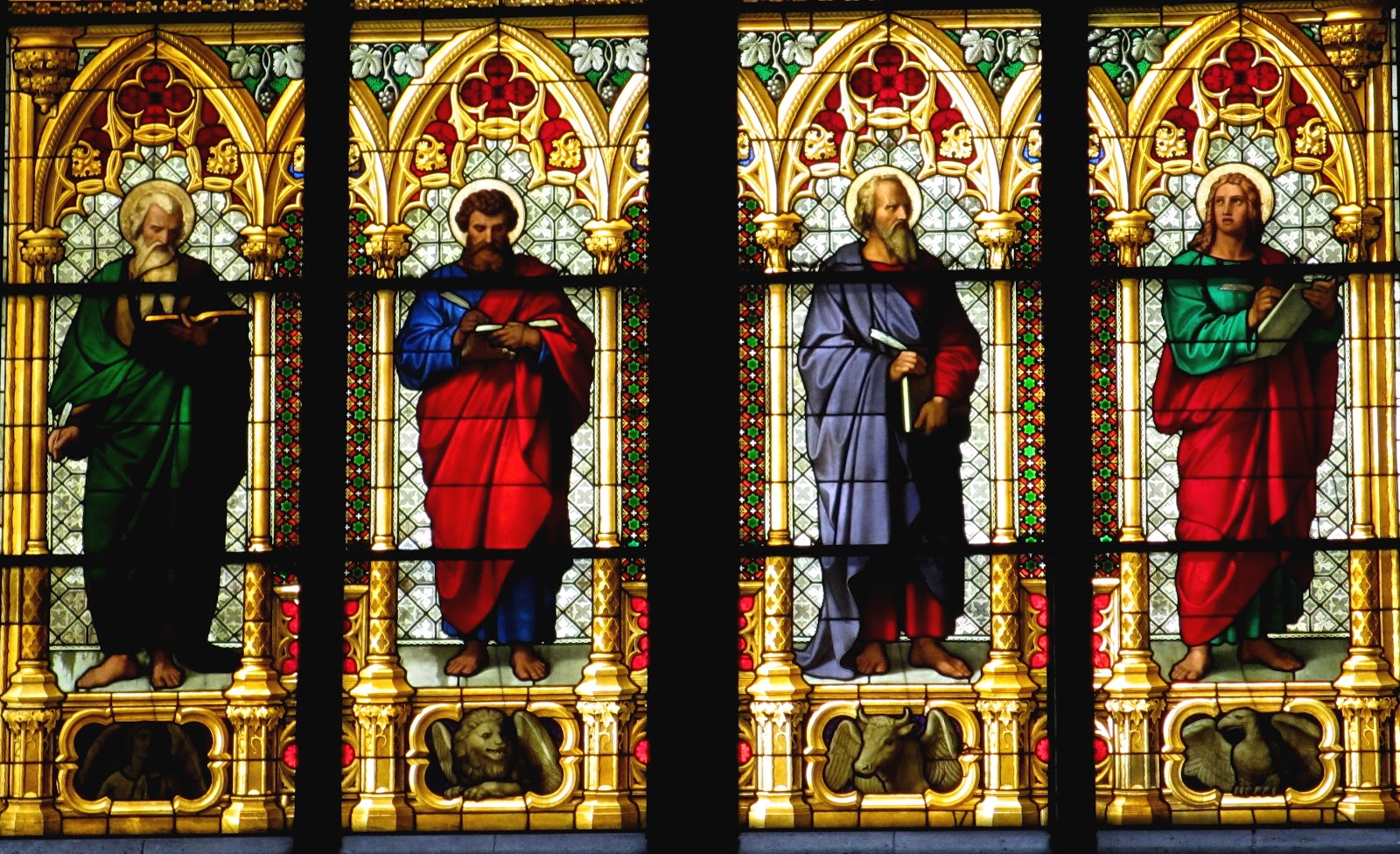
Different Perspectives
Their records are called the Gospels.
The word gospel means “good news.”
Matthew, Mark, Luke, and John.
Although the four Gospels vary in some details and perspective, they all recount the events of the Savior’s life and earthly ministry among the Jews. All four Gospels testify that Jesus Christ is the Son of God and the Savior of the world. (4)

Slide 15
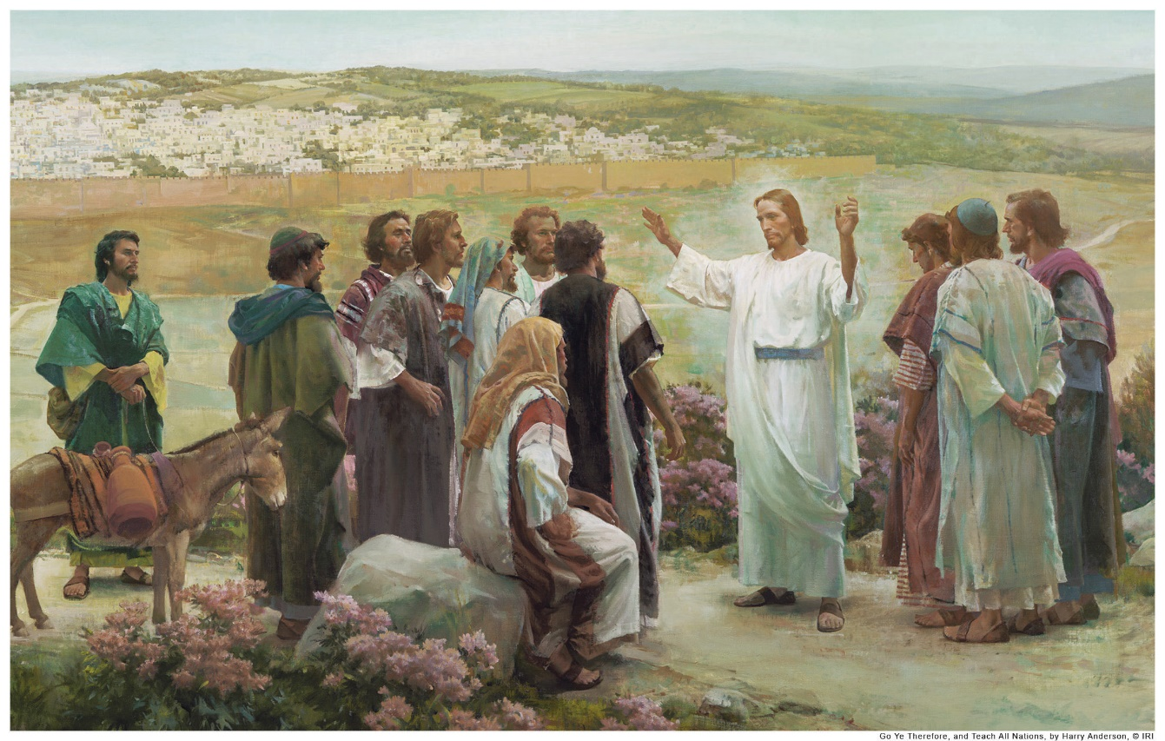
Diving Into the New Testament
The Gospels give an account of the Savior’s ministry, the books from Acts through Revelation record the ministry of Christ’s ancient Apostles after His Crucifixion, Resurrection, and Ascension.
These Apostles traveled throughout the land of Israel and the Roman Empire preaching the gospel and establishing branches of the Church. By studying these Apostles’ acts and writings, we can strengthen our faith in the Savior and learn how to receive the blessings of His Atonement.

Slide 16
Sources:
Video: News Program (7:12)
Adam Clark Bible Commentary
Bruce R. McConkie (The Mortal Messiah, 4 vols. [1979–81], 1:238).
On gentiles, women, and slaves (and Pharisees): by, Grant Walsh website
Bible Dictionary
See Also: The Lost 500 Years: From Malachi to John the Baptist By S. Kent Brown, Professor Emeritus of Ancient Scripture, and Richard Neitzel Holzapfel, Professor of Church History and Doctrine at Brigham Young University December 2014 Ensign
Looking beyond the Mark: Why Many Did Not Accept the Messiah
By Robert L. Millet July 1987 Ensign
The Reality of the Resurrection
By Richard D. Draper April 1994 Ensign
Presentation by ©http://fashionsbylynda.com/blog/

Slide 17
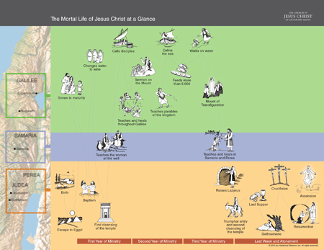
Slide 4: Ye blind guides, which strain at a gnat, and swallow a camel:
Figuratively speaking, the scribes and Pharisees could never tolerate a little gnat in their (or anybody else's) drink, but a camel could be swallowed whole. Jesus, of course, is referring to the strictness with which these legalistic Jews had interpreted the law, yet their concern for detail did not prevent them from violating the most important commandments in the law." ("Through a Glass Darkly: Trying To Understand the Scriptures" by Royal Skousen Fn, BYU Studies, vol. 26 (1986), Number 3 - Summer 1986, p. 9.)
Slide 14: The Rest of the New Testament:
The book of Acts records some of the major missionary activities of the Apostles. The books from Romans to Jude are epistles, or letters, written by Paul and other Church leaders to instruct and edify the Saints. The Pauline epistles are arranged “by length, in descending order from the longest (Romans) to the shortest (Philemon). This is the case except with the epistle to the Hebrews, which was placed last because some have questioned whether or not it was written by Paul” (Bible Dictionary, “Pauline Epistles”). The epistles of James through Jude are referred to as the General Epistles “because they are not directed to any one person or specific branch of the Church” (Bible Dictionary, “General Epistles”). The book of Revelation, also called the Apocalypse, contains John the Beloved’s specific counsel to seven branches of the Church in Asia as well as a revelation to John consisting basically of the history of the world, especially the last days.
Slide 13: The four Gospels:
are the first four books of the New Testament. Written by Matthew, Mark, Luke, and John, they contain four testimonies of Jesus’s mortal life and the events pertaining to His ministry. In many ways, the book of 3 Nephi in the Book of Mormon is similar to the Gospels and is sometimes referred to as “the Fifth Gospel.”
“The books of the New Testament were originally written in Greek. The Greek word for gospel means ‘good news.’ The good news is that Jesus Christ has made an atonement that will redeem all mankind from death and reward each individual according to his [or her] works” (Guide to the Scriptures, “Gospels” scriptures.lds.org).
Slide 13: Different Perspectives:
“It is true that the four New Testament gospels do present different aspects of our Lord’s personality and teachings. It appears that Matthew was directing his gospel to the Jews. He presents Christ as the promised Messiah and Christianity as the fulfillment of Judaism. Mark apparently wrote with the aim of appealing to the Roman or Gentile mind. Luke’s gospel presents the Master to the Greeks, to those of culture and refinement. And the gospel of John is the account for the saints; it is pre-eminently the gospel for the Church, for those who understand the scriptures and their symbolisms and who are concerned with spiritual and eternal things. Obviously such varying approaches have the great advantage of presenting the truths of salvation to people of different cultures, backgrounds, and experiences. But the simple fact is that all of the gospel authors wrote by inspiration, and all had the same purposes: 1. To testify of the divine Sonship of our Lord; and 2. To teach the truths of the plan of salvation” Elder Bruce R. McConkie (Mormon Doctrine, 2nd ed. [1966], 336).

