Slide 1

Lesson 50
Parable of the Good Samaritan
Luke 10:1-37
Thou shalt love the Lord thy God with all thy heart, and with all thy soul, and with all thy strength, and with all thy mind; and thy neighbour as thyself. Luke 10:27

Slide 2


Do you ever feel like you have too much responsibility?
Holy Bible
The
Book
of
Mormon
Doctrine
And
Covenants
ANOTHER TESTAMENT
OF JESUS CHRIST

Slide 3
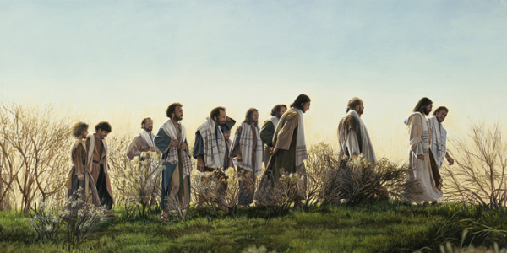
Appointing the Seventy
An office in the Melchizedek Priesthood
Luke is the only Gospel writer to record that Jesus Christ called the Seventy, in addition to the Twelve Apostles, to preach the gospel and prepare the way for Him.
The Savior’s calling of the Seventy and instructions to them were similar to the instructions He gave to His Twelve Apostles.
See Matthew 10
Luke 10:1-16
(1)

Slide 4
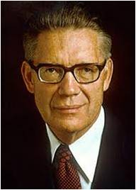
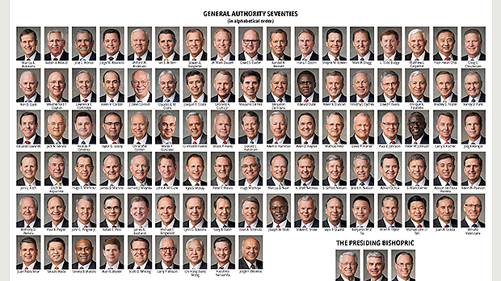
Modern Day Seventy
Because modern Apostles cannot go everywhere they are needed, they assign members of the Seventy to minister in their stead.
“Each of the Seventy has had conferred upon him the apostolic authority. … The Seventy go where the Twelve, limited by their number, cannot. Seventies are scattered across the world, as they were in the early days of the Church.”
The Lord calls laborers in addition to the Apostles to represent Him and to assist Him in His work
The Seventy today are called to be “traveling ministers”, while deacons and teachers and elders are appointed to be “standing ministers unto the church.”
Luke 10:1-16; D&C 107:97; D&C 84;111; D&C 124:137
(1,2)

Slide 5
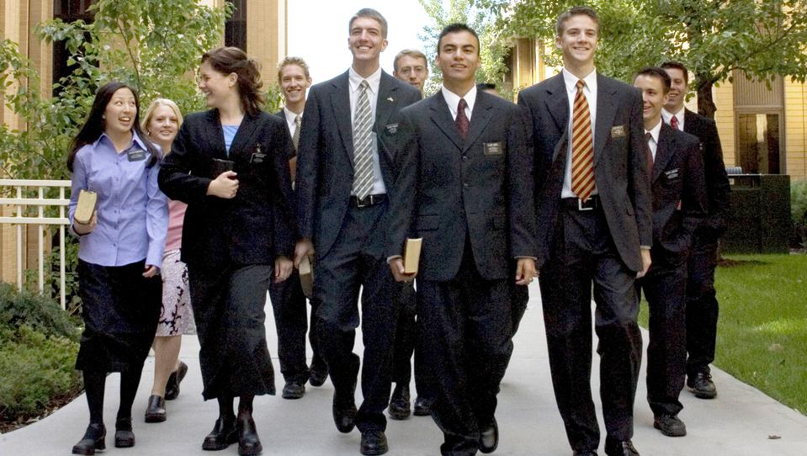
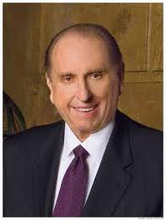
The Need For Laborers
“I repeat what prophets have long taught—that every worthy, able young man should prepare to serve a mission. Missionary service is a priesthood duty—an obligation the Lord expects of us who have been given so very much. Young men, I admonish you to prepare for service as a missionary. …
“A word to you young sisters: while you do not have the same priesthood responsibility as do the young men to serve as full-time missionaries, you also make a valuable contribution as missionaries, and we welcome your service.”
(3)

Slide 6

Worldwide Statistics
As of May 2016
Missionaries | 74,079
Missions | 418
Mission Training Centers | 15
Seminary Students Enrolled | 407,971
Just think: if all the Senior Seminary Students enrolled in last year, graduating class of 2016 went on missions in the next year or two, what would be the result?
(4)

Slide 7
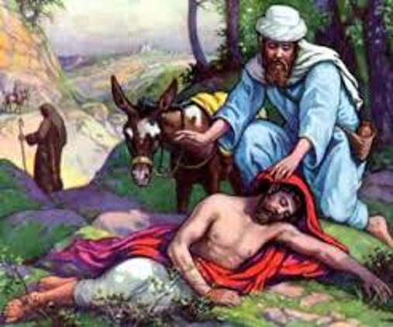
Who is My Neighbor?
To obtain eternal life we must love God and love our neighbor as ourselves
The Parable of the
Good Samaritan Luke 10:30-37

Slide 8
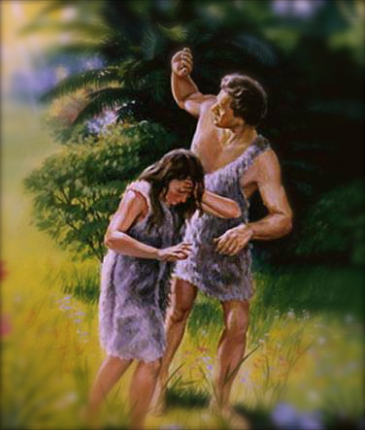
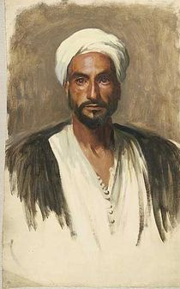
Went down…
One early Christian writer saw in this phrase the descent of Adam from the garden into this world – from immortality to mortality.
The story implies that the man went down intentionally, knowing the risks that would be involved in the journey. No one forced him to go down to Jericho.
He apparently felt that the journey was worth the well-known risks of such travel.
(5)

Slide 9
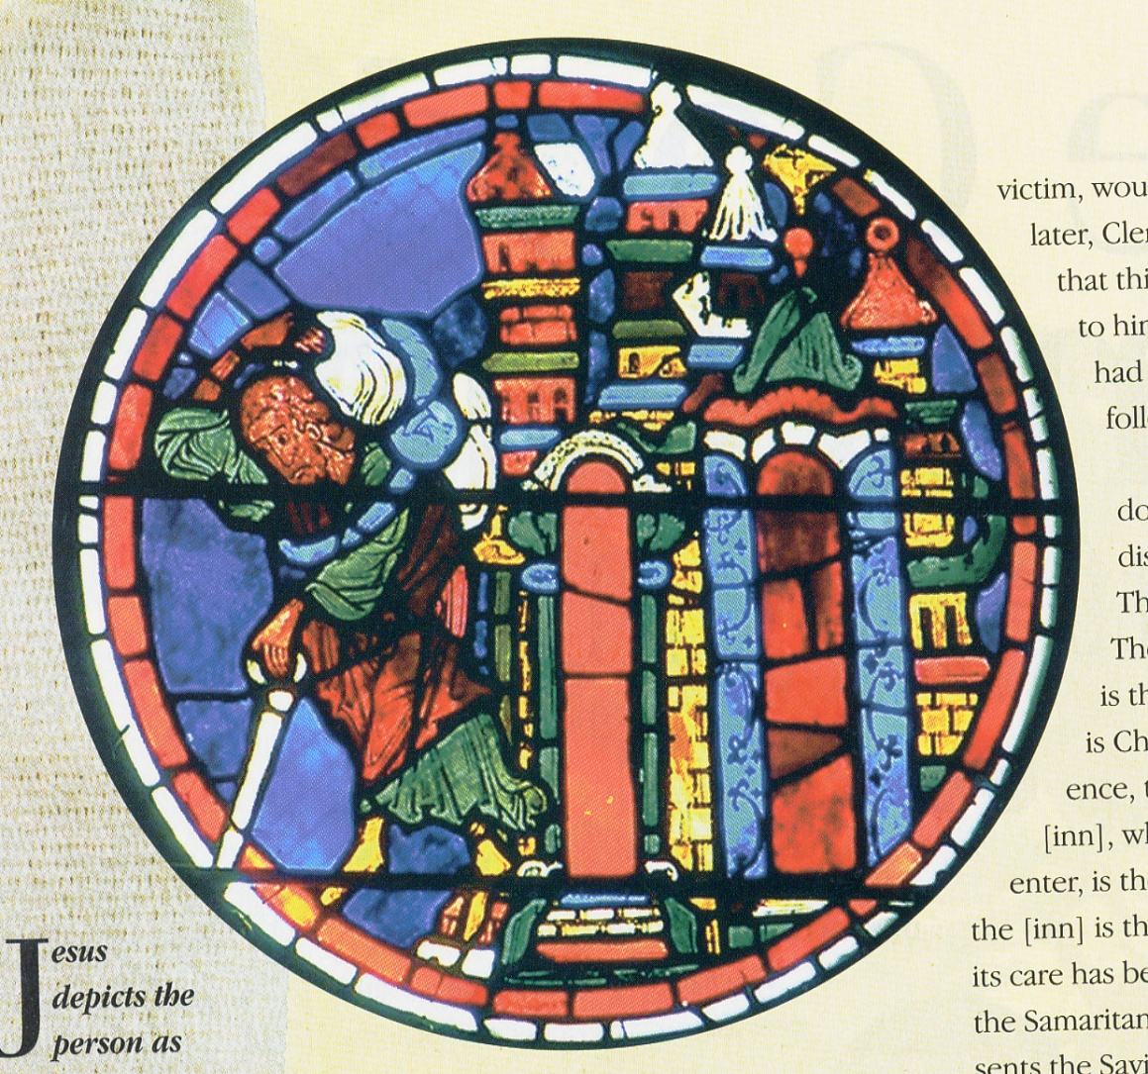
Jesus depicts the person as going down from Jerusalem.
Because of the sanctity of the holy temple-city, early Christians readily saw in this element the idea that a person had come down from the presence of God.
Bourges
(5)

Slide 10
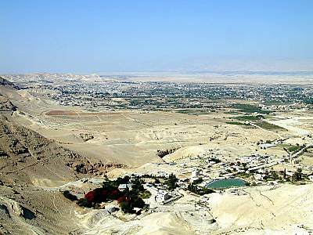
To Jericho…
Jericho was identified with this world
Jericho is the lowest city on earth
(825 feet below sea level)
(5)

Slide 11
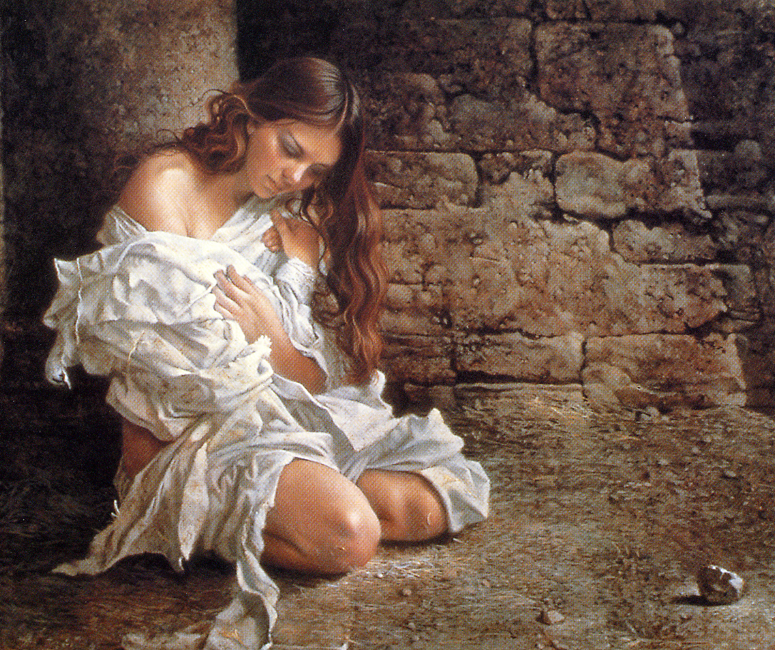
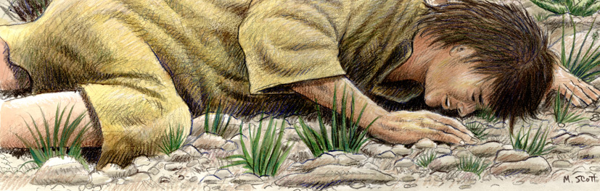
Fell…
It is easy to see here an allusion to the fallen mortal state and to the plight of individual sinfulness:
  “Yea, all are fallen and are lost.” Alma 34:9
The parable of the Woman Taken in Adultery by James C. Christensen
(5)

Slide 12
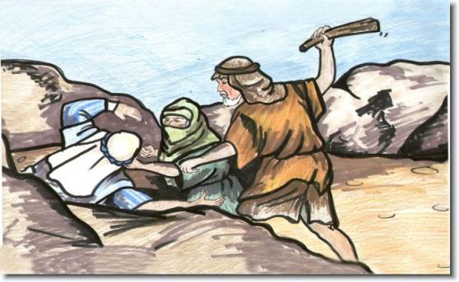

Among thieves…
The early Christian writers variously saw the thieves or robbers as the devil and his satanic forces, evil spirits, or false teachers.
These thieves were not casual operators.
The traveler was assailed by a band of pernicious highwaymen in a scheming, organized society that acted with deliberate and concerted intent.
Who are the thieves of Today?
(5)

Slide 13
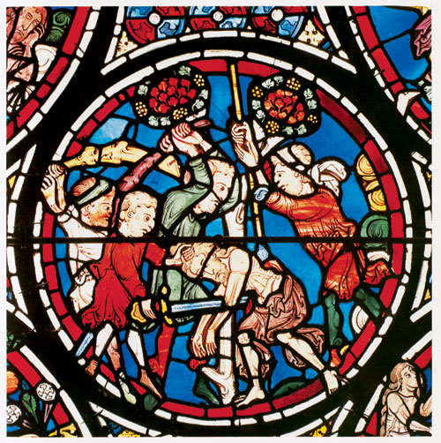
This scene from the Bourges window shows the traveler falling among robbers and appears in the context of scenes depicting the creation and fall of Adam.
(5)

Slide 14
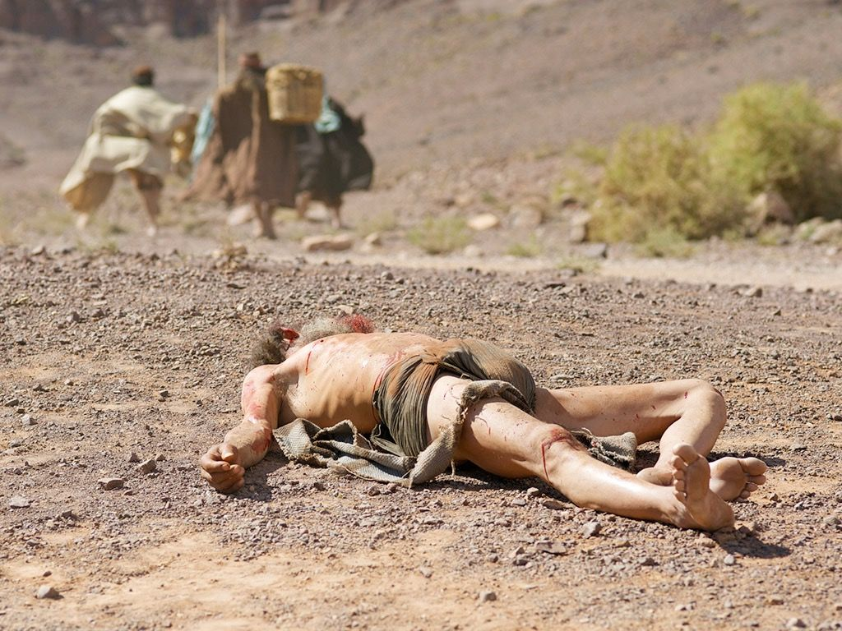
Which stripped him of his raiment…
The attackers apparently wanted the traveler’s clothing, for no mention is made of any wealth or commodities he might be carrying.
For some reason, the robbers seem interested in his garment, something brought down from the holy place and something they envy and want to take away.
What are some of the things people might want to take away from you?
(5)

Slide 15
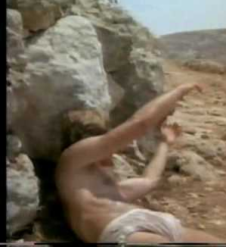
And wounded him…
This term was seen as a similitude of the pains of life, travails of the soul, and afflictions due to diverse sins and vices. Indeed, the enemies of the soul leave wounds.
Transgression has real effects.
(5)

Slide 16
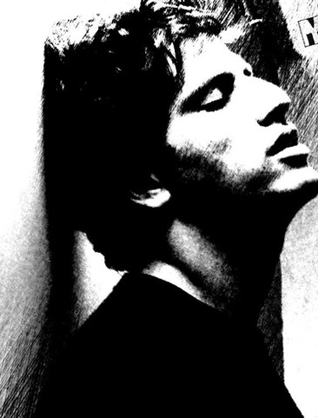
Half dead…
The robbers departed, leaving the person precisely “half dead.” We may see in this detail an allusion to the first and second deaths.
The person had fallen, had become subject to sin, and had suffered the first death, becoming mortal.
But the second death, the permanent separation from God, could still be averted.

Slide 17
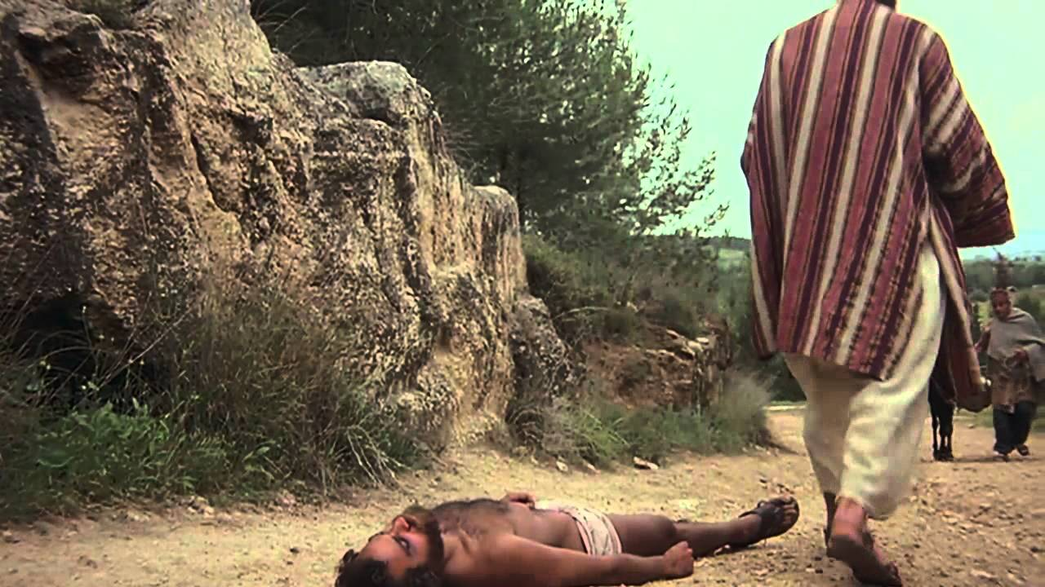
Luke 10:31-32
“And by chance there came down a certain priest (representing the law of Moses) that way: and when he saw him, he passed by on the other side.”
“And likewise a Levite” -representing the Old Testament prophets, whose word the Lord came to fulfill
The Levite came close to helping – perhaps he wanted to help, but he lacked the power to save the dying person.

Slide 18
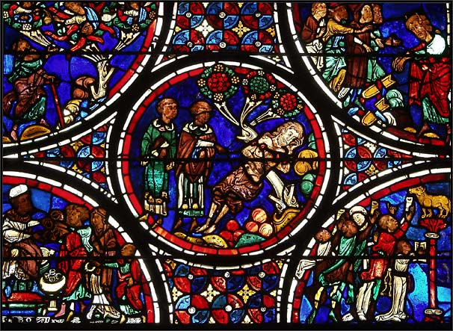
This scene in the window at Bourges with the priest and Levite is surrounded by images of Moses.
Notice the golden calf in the lower right scene.

Slide 19
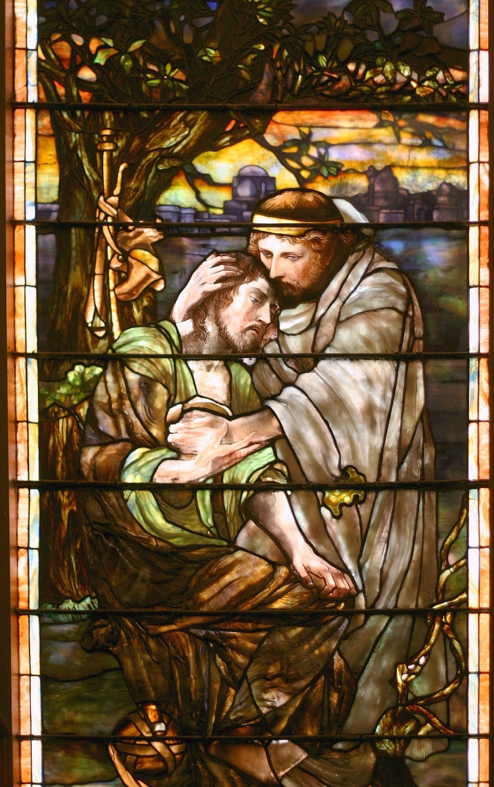
Luke 10:33-34
“But a certain Samaritan, as he journeyed, came where he was: and when he saw him, he had compassion on him, and went to him, and bound up his wounds, pouring in oil and wine…”
What do these key words symbolize?

Slide 20
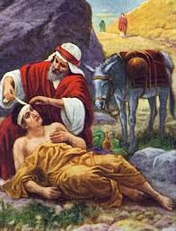
Bound his wounds…
Do the bandages represent love, faith and hope, “ligatures of salvation which cannot be undone?”
Does Christ bind us up with his teachings?
Do we understand that we are bound to the Lord through covenants?

Slide 21
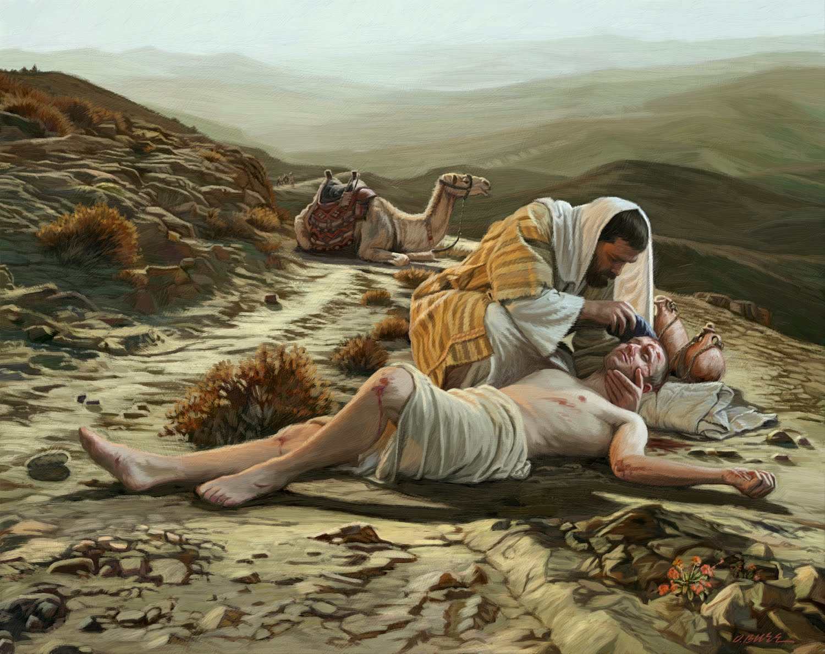
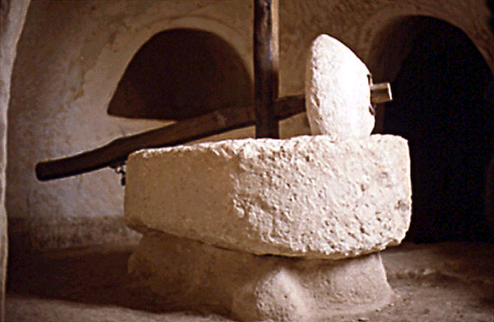
Oil…
An olive oil lotion is very soothing.
One early author, Chrysostom, saw this as a “holy anointing” – which may refer to several priesthood ordinances, the healing of the sick, the gift of the Holy Ghost (often symbolized by olive oil), or the anointing of a king or queen.

Slide 22
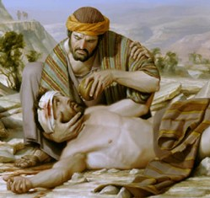
Wine…
In addition to rendering physical help, a truly good Samaritan administers the saving principles and ordinances of the gospel as well.
The wine may sting at first, but its effects soon bring healing peace.
The Repentance process is very difficult at first, but you can be forgiven and spiritually healed.
(5)

Slide 23
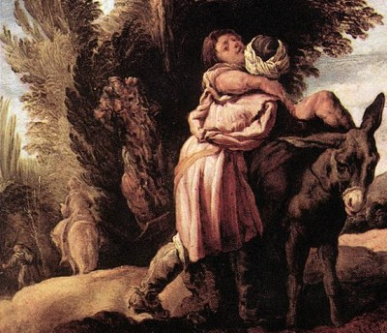
Set him on his own beast
Christ, fulfilling prophecy, bears our infirmities. The Samaritan’s beast was thought to symbolize Christ’s body.
Being placed on his beast is to believe that God became flesh, bore our sins, and suffered for us.
(5)

Slide 24
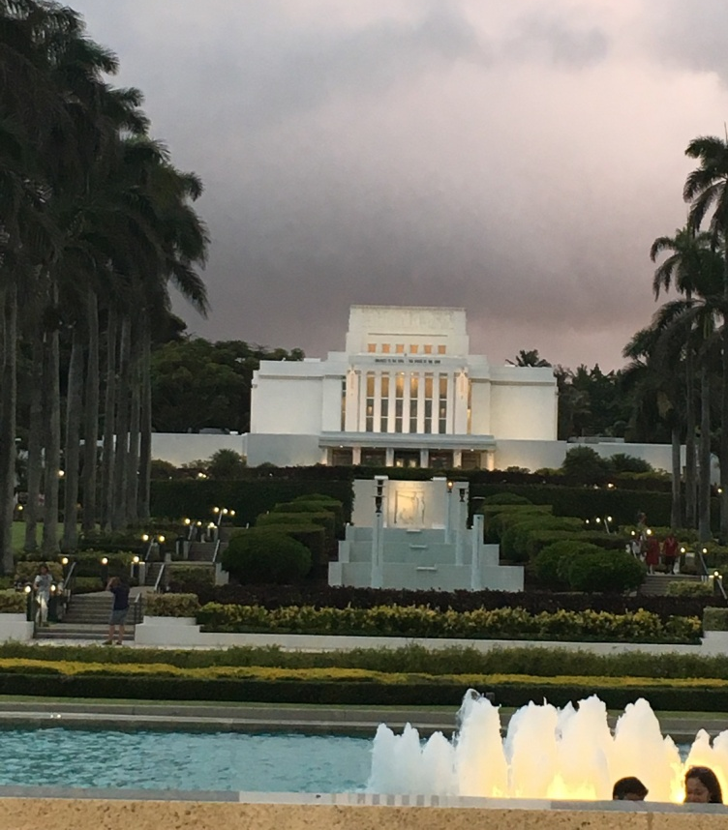
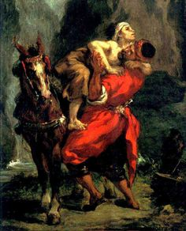
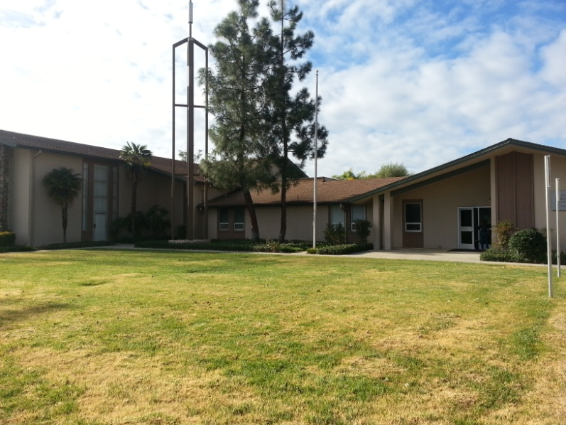
And brought him to an inn…
For the early Christians this element readily symbolized the Church. An “inn” was a “public house open to all.”
A public shelter is comparable to the Church of Christ in several ways.
A wayside inn is not the heavenly destination but a necessary aid in helping travelers reach their eternal home.
(5,6)

Slide 25
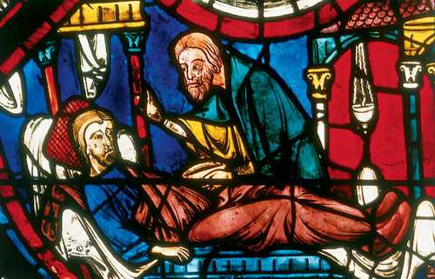
Early commentators believed the Samaritan stayed with the traveler through the night in the inn
(5)

Slide 26
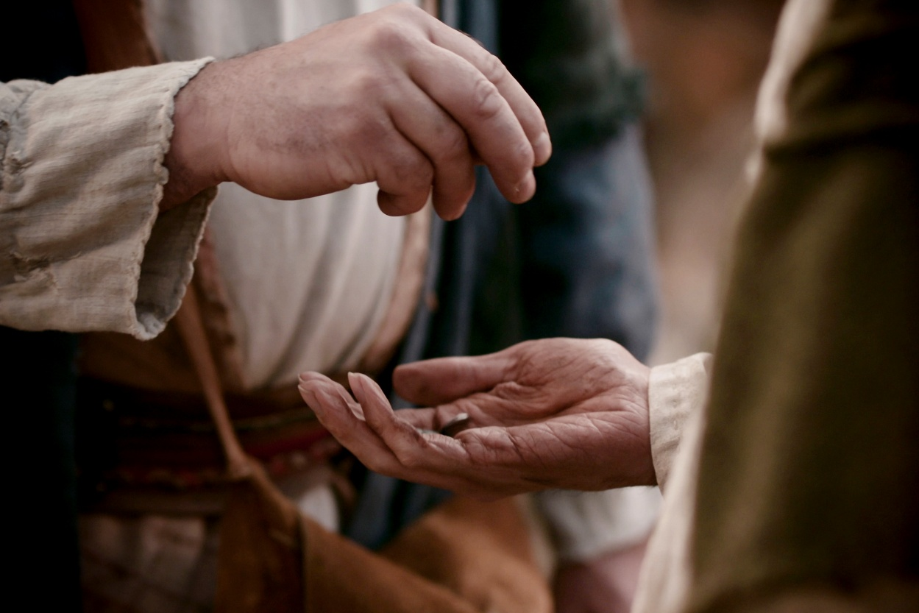
Luke 10:35
“And on the morrow when he departed, he took out two pence, and gave them to the host, and said unto him, Take care of him; and whatsoever thou spendest more, when I come again, I will repay thee.”
On the morrow – Early commentators saw here the idea that Jesus would rise on Resurrection morning. Christ ministered in person to His disciples for a short time. After His Ascension, He left the traveler to be cared for by the Church.
(5)

Slide 27
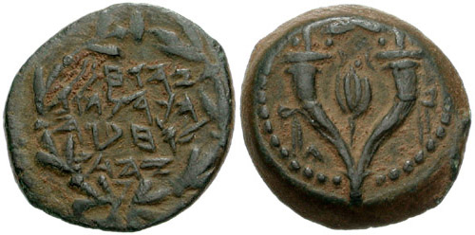
Two Pence could symbolize…
The father and the Son
Old and New Testament
Two priesthoods
Two witnesses to the truth
The two denarii represented two days’ wages. These coins could well represent making adequate provision for the needs of the person.
The temple tax for each male was two denarii (half a shekel).
(5)

Slide 28
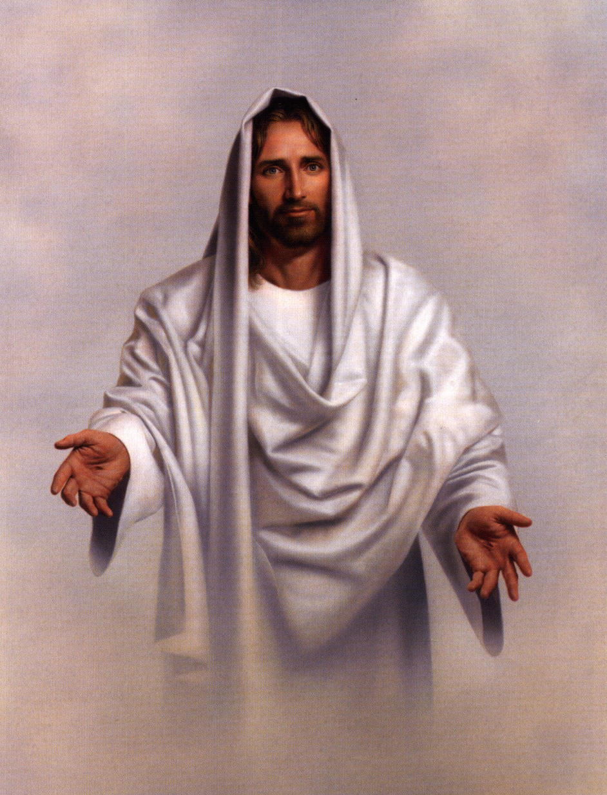
Jesus Christ is our most exemplary neighbor!
How can we be like Him?
Who is our neighbor?
Simon Dewey
(5)

Slide 29
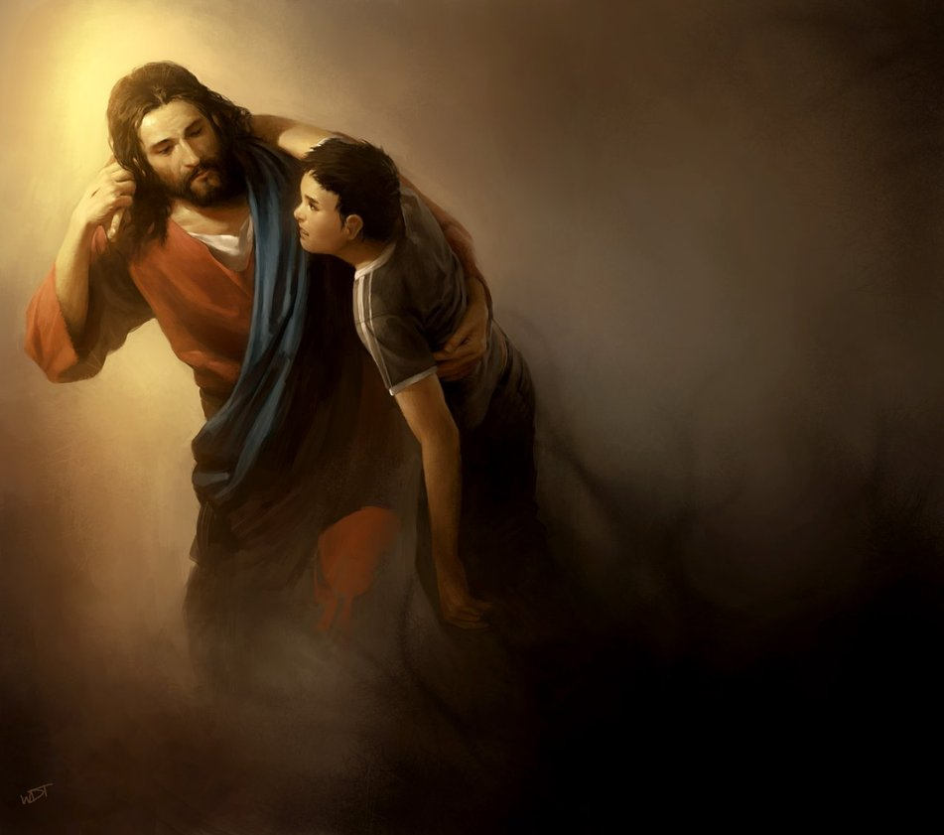
Jesus Christ our Savior will rescue us, each one of us, in sin, transgression, sickness, loneliness, all that and more
Go, and do thou likewise
wraithdt
(6)

Slide 30
Sources:
Suggested Hymn: #220 Lord, I Would Follow Thee
Video:
The Good Samaritan (12:23)
“Parable of the Good Samaritan” (5:11)
New Testament Institute Student Manual Chapter 17
Elder Bruce R. McConkie Fledgling Finches and Family Life [Brigham Young University devotional, Aug. 18, 2009], 4;speeches.byu.edu).
President Thomas S. Monson (“As We Meet Together Again,” Ensign or Liahona, Nov. 2010, 5–6).
Mormon news room facts and statistics
Various slides by Becky Davies and Lesley Meacham of Poway Institute in California
Various slides by Author of Website
Presentation by ©http://fashionsbylynda.com/blog/

Slide 31
Event | Matthew | Mark | Luke | John
Parable of the Good Samaritan |  |  | 10:25-37
Jesus Visit Mary and Martha |  |  | 10:38-42
Return of the Seventy | 11:25-27 |  | 10:17-24
Seventies Luke 10:1-2:
This same office exists in the restored Church today. (If possible, show the pages titled “General Authorities and General Officers of The Church of Jesus Christ of Latter-day Saints” in the most recent conference issue of the Ensign or Liahona.) There are now multiple quorums of the Seventy, though only members of the first two quorums are called as General Authorities. Each quorum may have up to 70 members. Their work to preach the gospel and help administer the Church is directed by the Quorum of the Twelve Apostles and the Presidency of the Seventy. Guide to the scriptures
The Harvest is Great Luke 10:2:
I repeat what prophets have long taught—that every worthy, able young man should prepare to serve a mission. Missionary service is a priesthood duty—an obligation the Lord expects of us who have been given so very much. Young men, I admonish you to prepare for service as a missionary. …
“A word to you young sisters: while you do not have the same priesthood responsibility as do the young men to serve as full-time missionaries, you also make a valuable contribution as missionaries, and we welcome your service” President Thomas S. Monson (“As We Meet Together Again,” Ensign or Liahona, Nov. 2010, 5–6).
Go, and do thou likewise Luke 10:37:
“Each of us, in the journey through mortality, will travel his own Jericho Road. What will be your experience? What will be mine? Will I fail to notice him who has fallen among thieves and requires my help? Will you? Will I be one who sees the injured and hears his plea, yet crosses to the other side? Will you? Or will I be one who sees, who hears, who pauses, and who helps? Will you?
“Jesus provided our watchword: ‘Go, and do thou likewise.’ When we obey that declaration, there opens to our view a vista of joy seldom equaled and never surpassed. …
“… When we walk in the steps of that good Samaritan, we walk the pathway that leads to perfection” President Thomas S. Monson (“Your Jericho Road,” Ensign, Feb. 1989, 2, 4).

Slide 32
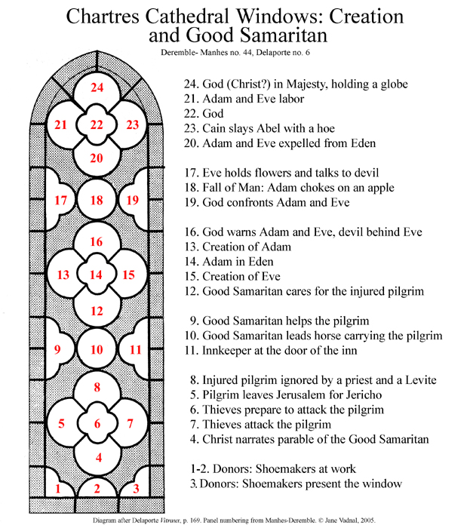
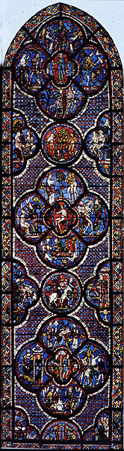

Slide 33
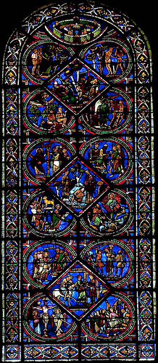
Elements from this window in Sens are organized by the themes they represent. The parable of the good Samaritan uses the three central panes of the windows, while themes from the plan of salvation, including the Fall of Adam and Eve and the Crucifixion of the Savior surround the parable to complete the window.
Ensign, The Good Samaritan Forgotten Symbols, by John W. Welch, 47

Slide 34
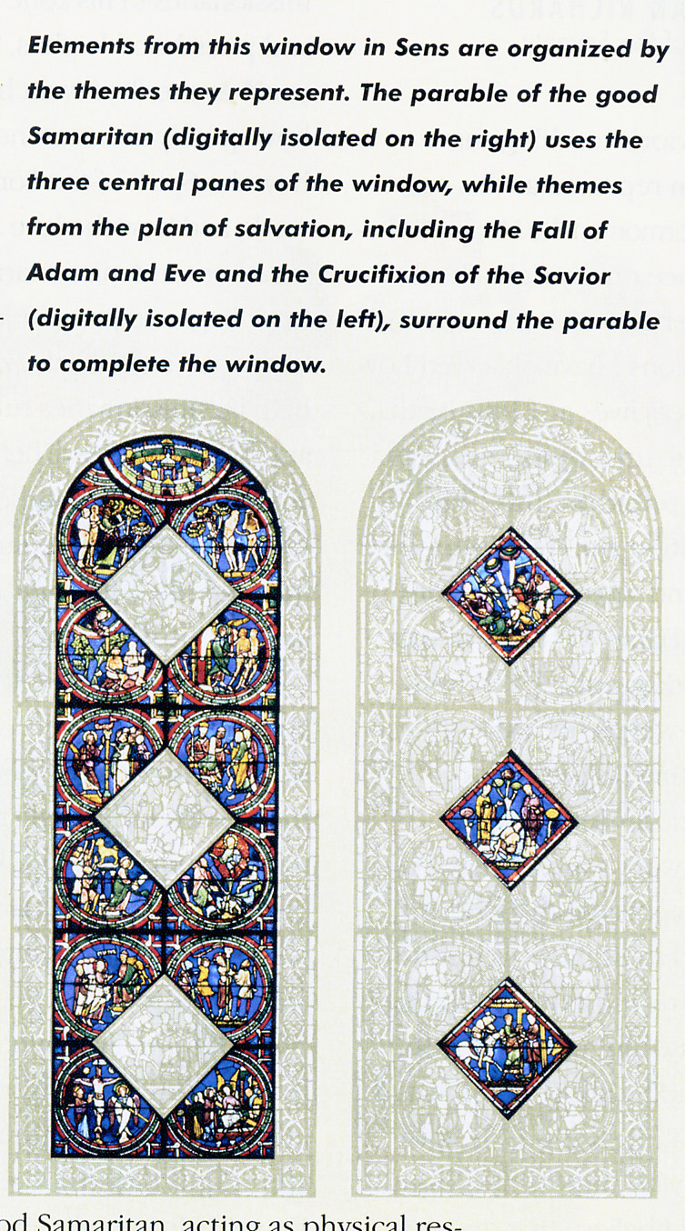
Fell among the thieves
Here the themes of the parable of the Good Samaritan are digitally isolated on the right.
Ensign, The Good Samaritan Forgotten Symbols, 47
Priest and Levite pass by
Taken to the inn

Slide 35
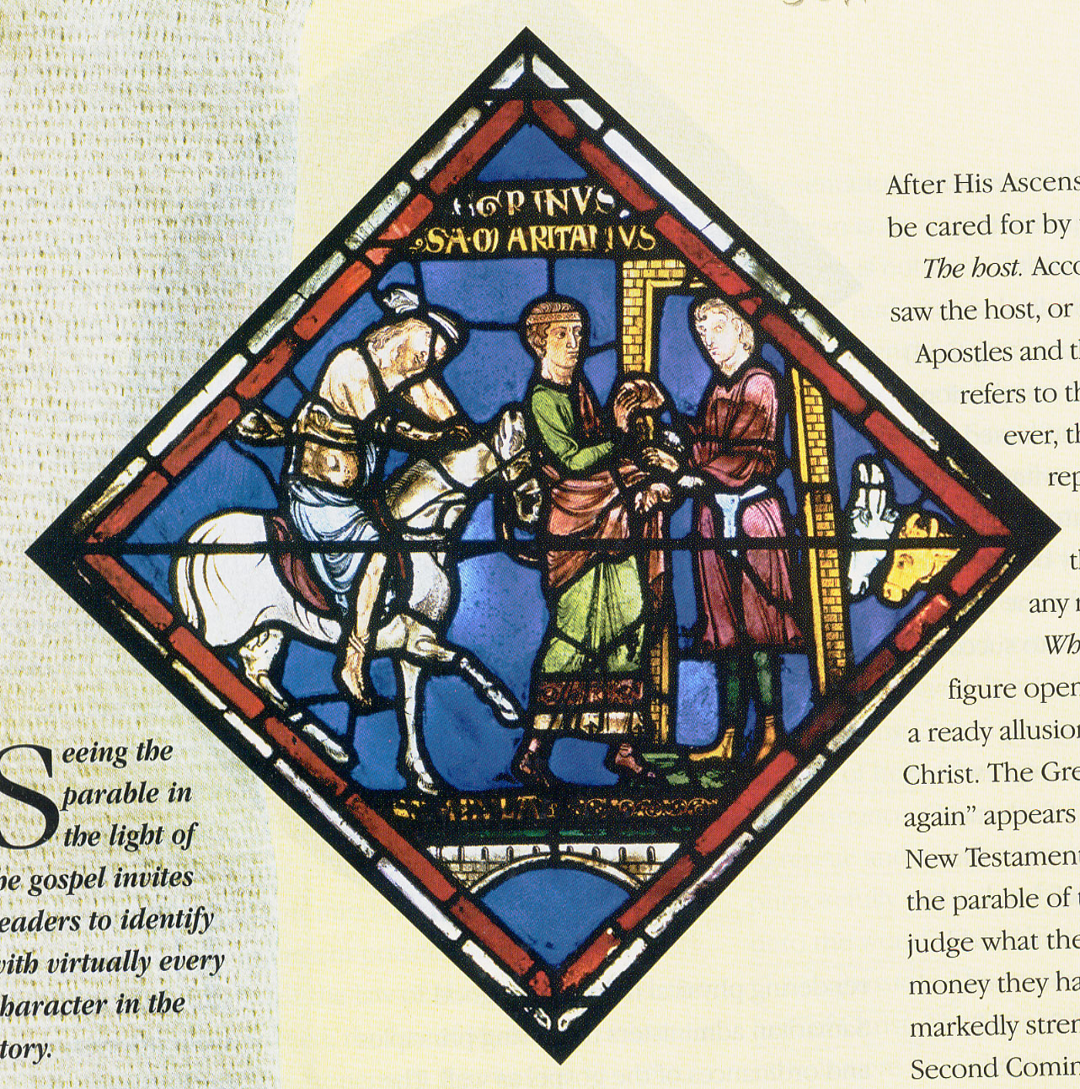
Window at Sens Cathedral
Luke 10:35

Slide 36
Parable | Symbolically | Me
Certain Man | All mankind | Me
Jerusalem (2700 ft above sea level) “Went down” to Jericho (80 ft below sea level) | Left the premortal existence From the presence of God To the world | Spiritual death
Fell among thieves | A fallen state to Satan (false teachings) | The world and its ways
Stripped of raiment | The experiences of mortality | Sin (Human)---natural man
Wounded | Subject to first death 2nd death-a permanent separation from God | Sin and Vices
Levite Priest—left him | Those with partial authority can’t save. | Priesthood

Slide 37
Parable | Symbolically | Me
Half Dead | Christ was half divine half mortal which is the symbolism of a Samaritan | Only Jesus can save
Samaritan | Jesus—purposely look for people—pure love of Christ | Service and Charity towards one another.
Had Compassion on Him | Christ is compassionate Greek word: Charis---means Grace. Pure love of Christ | The action we take towards one another.
Bind Wounds | Jesus Helps those in need. Binds him with covenants | Knowing when to ask for help. Putting a band-aid on symbolically
Pours oil | The healing of the Holy Ghost with Peace and Knowledge | Olive oil used in anointing, with worthiness
Pours wine | The Atonement, representing His Blood | It may sting at first but then it heals

Slide 38
Parable | Symbolically | Me
Set on Beast | Donkey is the symbol of “Peace” When one road in on a donkey it was in Peace, when one rode in on a horse it meant “War” | What animal do we ride in on?
Took him to the Inn | Church, where he will be taken care of. Leaving him there in Good hands | Spiritually weak we go to church and take the sacrament. Souls who are wafting to be repaired. A place to get healed. Physically weak we go to the Hospital.
The Innkeeper | Agents of Christ, one to help bring back into the fold. Church leaders. | Prophets, bishops, Priesthood holders, teachers, etc.
On the morrow. Paid what he owed | Born again. Covering all the cost, a reward , an eternal round | Repentance and the Atonement He will rescue us in our sins
When I come again | The Second Coming | Christ will come again to live on the earth. The Millennium
Repay | Christ covers all costs through the Atonement and rewards well | Repentance will bring you back to the arms of Heavenly Father, for Christ has paid that through the Atonement. All may receive forgiveness.

