Slide 1
Lesson 53
Lost
Luke 15
Including:
Parable of the Lost Sheep
Parable of the Lost Coin
Parable of the Prodigal Son

Slide 2
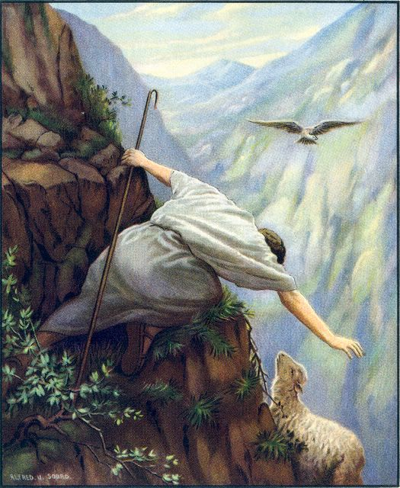
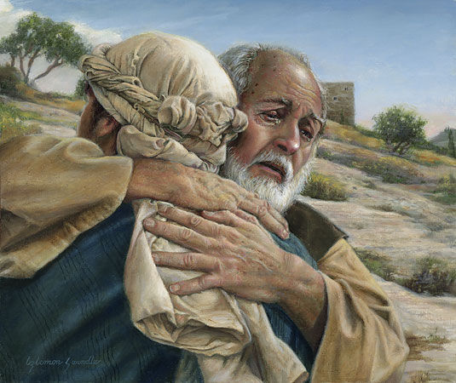
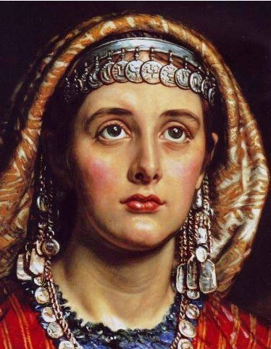
Luke 15 is a message within the message, and the gospel within the gospel.
The message is: “God loves his children, all of them, and he will do everything in his power to save them.”
Three Parables in One
Only found in Luke
All inter-related

Slide 3
“…for I have found my sheep which was lost.”
Luke 15:3-7

Slide 4
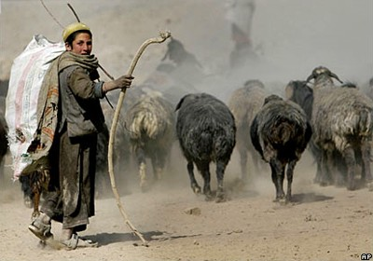
Parable of The
Lost Sheep
Luke 15:3-7

Slide 5
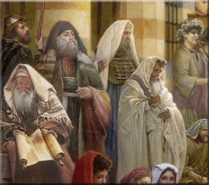
“Then drew near unto him all the publicans and sinners for to hear him.”
Jesus sits with them and teaches
Luke 15:1

Slide 6
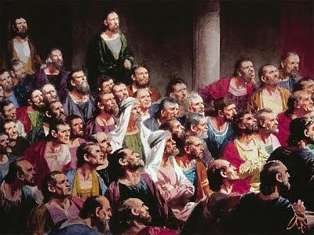
“And the Pharisees and scribes murmured, saying, This man receiveth sinners, and eateth with them”
They viewed sinners as unclean and any person touching a sinner was unclean themselves.
Luke 15:2

Slide 7
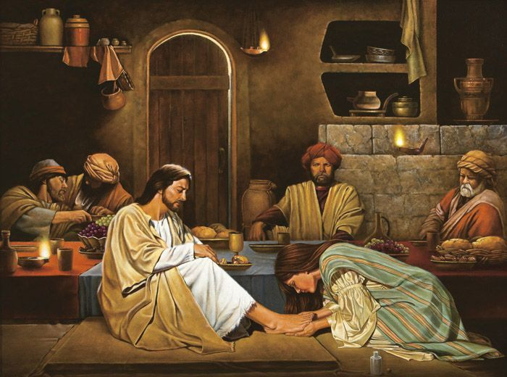
Jesus ate with sinners, he didn’t sin with them
His fellowship invites discipleship

Slide 8
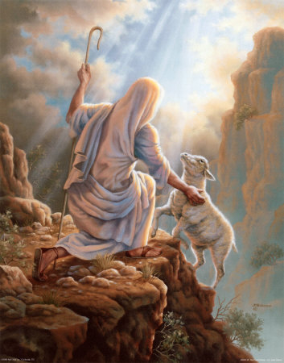
“What man of you, having an hundred sheep, if he lose one of them, doth not leave the ninety and nine in the wilderness, and go after that which is lost, until he find it?”
Luke 15:4

Slide 9
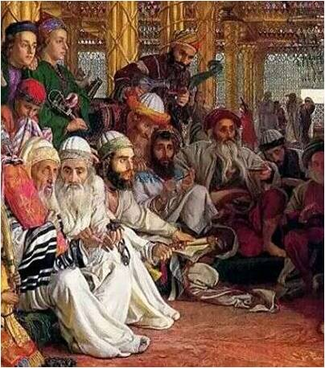
“What man of you,…”
Jesus was implicating the Pharisees and scribes.
He compare them to shepherds.
Luke 15:4

Slide 10
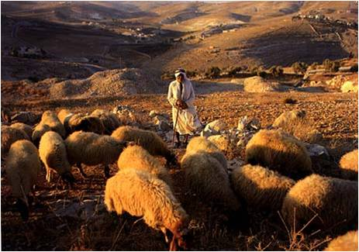
Shepherding was a job beneath the dignity and status of his audience and to compare them to shepherds was an insult.

Slide 11
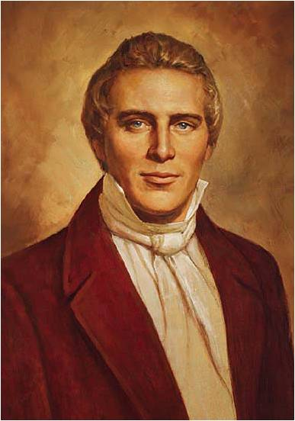
Joseph Smith explained:
“The hundred sheep represent one hundred Sadducees and Pharisees, as though Jesus had said, ‘If you Sadducees and Pharisees are in the sheepfold, I have no mission for you; I am sent to look up sheep that are lost and when I have found them, I will back them up and make joy in heaven’. This represents hunting after a few individuals or one poor publican, which the Pharisees and Sadducees despised.”

Slide 12
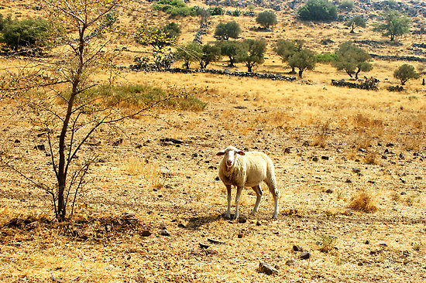
“…if he lose one of them, …”
Middle Eastern culture one would usually not take the blame for losing something. He would say, “One of my sheep is lost” but he would not say, “I lost one of my sheep”.
Luke 15:4

Slide 13
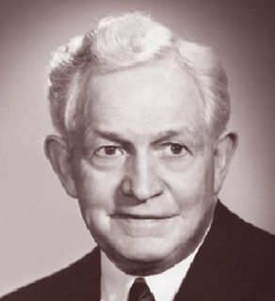
President McKay asked:
“How did that sheep get lost? He was not rebellious. If you follow the comparison, the lamb was seeking its livelihood in a perfectly legitimate manner, but either stupidly, perhaps unconsciously; it followed the enticement of the fields, the prospect of better grass until it got out beyond the fold and was lost.”

Slide 14
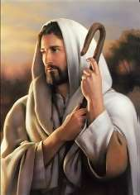
A good shepherd is one with his sheep.
A good shepherd would seek after any lost sheep.
A shepherd is held responsible for the loss of his sheep. He would be shamed and his honor and reputation would be questioned.

Slide 15
President McKay’s application?
“So we have those in the Church, young men and young women, who wander away from the fold in perfectly legitimate ways. They are seeking success, success in business, success in their professions, and before long they become disinterested in Church and finally disconnected from the fold; they have lost track of what true success is, perhaps stupidly, perhaps unconsciously, in some cases, perhaps willingly. They are blind to what constitutes true success.”

Slide 16
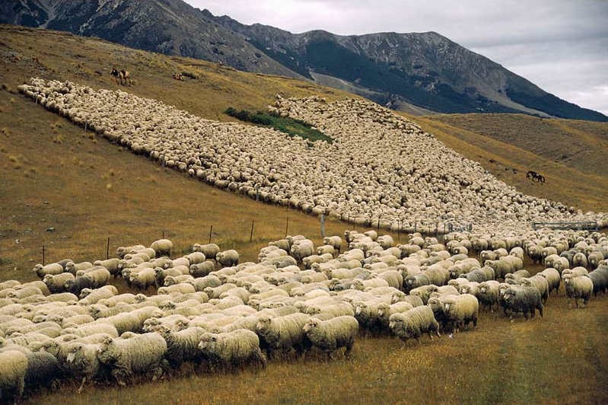
“…doth not leave the ninety and nine in the wilderness,…”
JST change: It is important to note that the King James Version says all one hundred sheep are out in the wilderness. But the JST says "....if he loseth one of them, doth not leave the ninety and nine and go into the wilderness..."
Luke 15:4

Slide 17
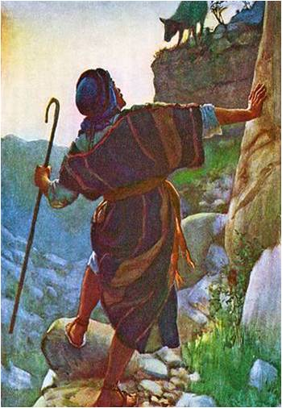
The shepherd leaves the sheep safely in the fold and he goes out into the wilderness to look for the lost sheep.
Luke 15:4

Slide 18
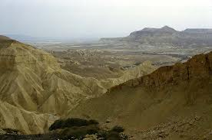
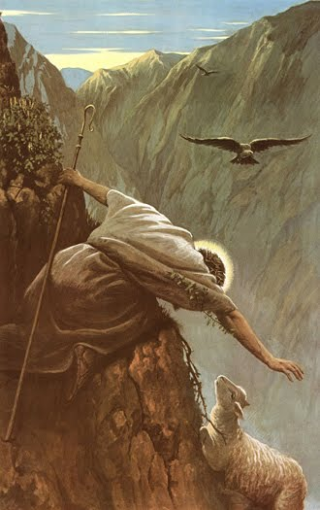
The wilderness is a dangerous place both for the shepherd and his sheep.
Many times the sheep has fallen down a crevice or has been attacked by a wild animal.

Slide 19
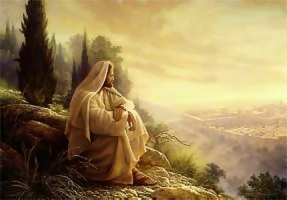
“…and go after that which is lost…”
Jesus shows compassion on His lost children.
Luke 15:4

Slide 20
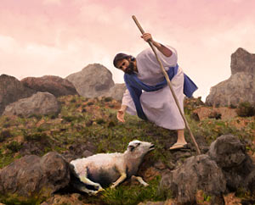
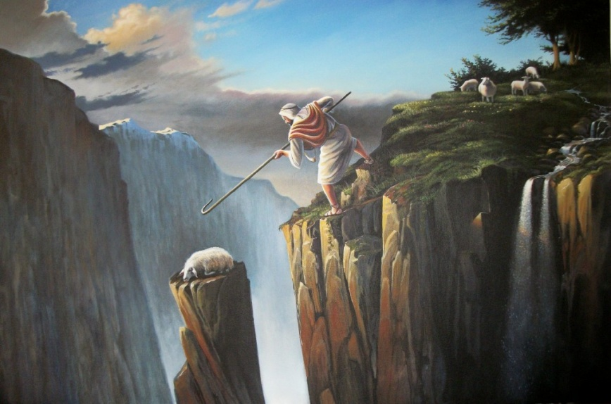
The shepherd takes his rod to fight off predators
The rod = The Word of God that leads to the Tree of Life = Atonement
The shepherd takes his staff to use as a tool for rescuing.
The staff = Mercy = only through the grace of God are we saved

Slide 21
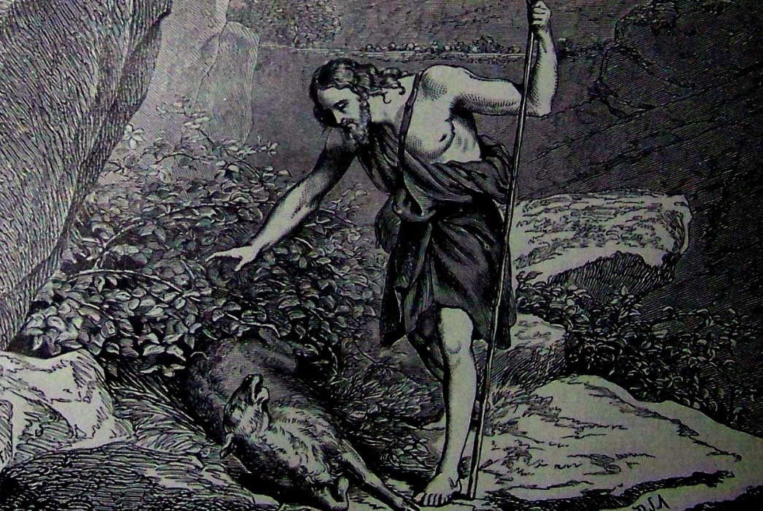
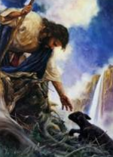
When sheep get lost they become terrified. They often collapse in a thicket and begin bleating.
When found they are too terrified to even rise to their feet. They cannot be herded or led on a rope. They must be carried.

Slide 22
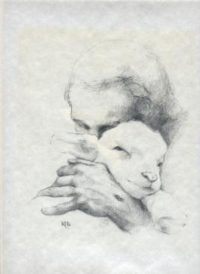
“…until he find it.”
The sheep offers no service to the shepherd and in no way earns or deserves his rescue.
Luke 15:4

Slide 23
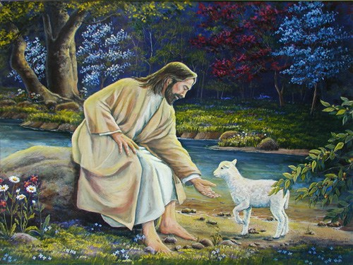
“And when he hath found it…”
It comes as a gift. Just as we who are undeserving, are rescued by Christ through His Grace
Luke 15:5

Slide 24
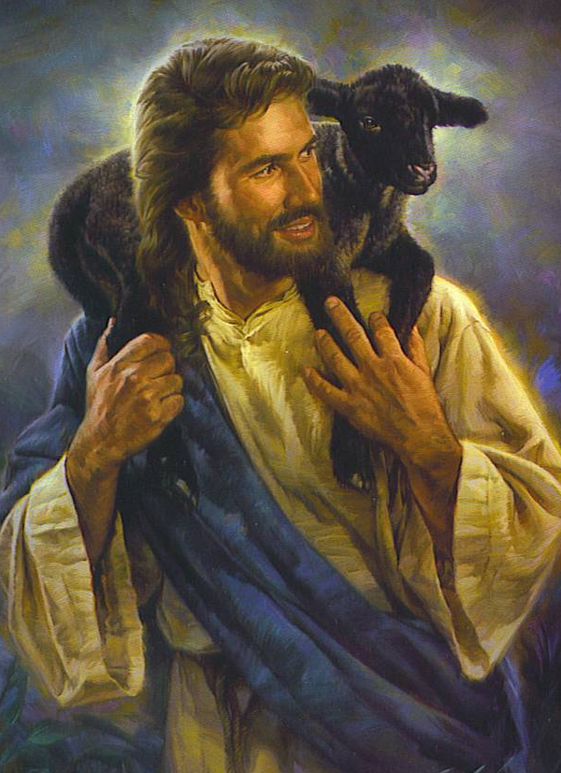
“…he layeth it on his shoulders, rejoicing”
An average sheep weighs up to 70 pounds.
Luke 15:5

Slide 25
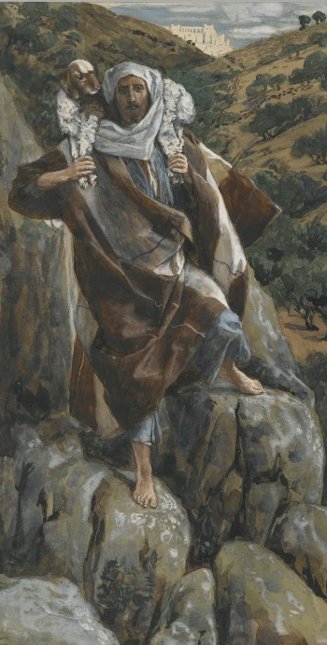
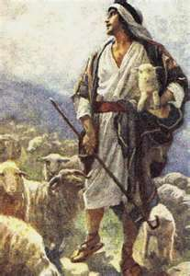
The terrain was rugged. The shepherd would place the sheep around his shoulders and grab his legs in front.
This was hard work. The Western images have Jesus carrying a little lamb under his arm…

Slide 26
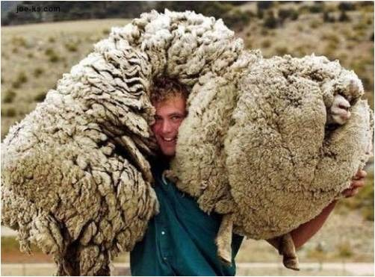
…Most Eastern images have sheep that are as big as the shepherd indicating a heavy load that is carried.

Slide 27
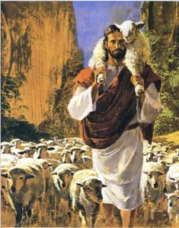
“And when he cometh home...”
The act of the shepherd in carrying the sheep back to his home in the village and the sheep’s acceptance of that act are symbolic of our acceptance of Christ’s atonement…
Luke 15:6

Slide 28
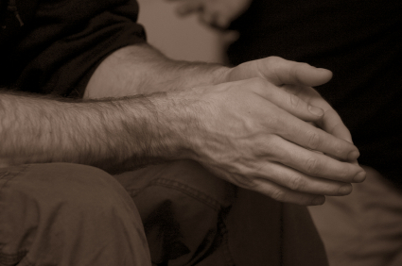
…We can believe that He can and will cleanse us.

Slide 29
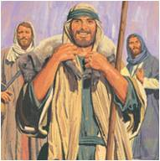
“…he calleth together his friends and neighbours, saying unto them, Rejoice with me;...”
The shepherd returns home with his lost sheep and calls for a celebration.
Why?
Luke 15:6

Slide 30
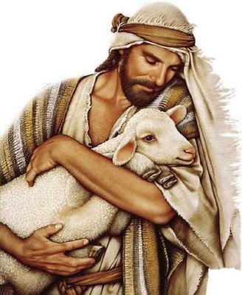
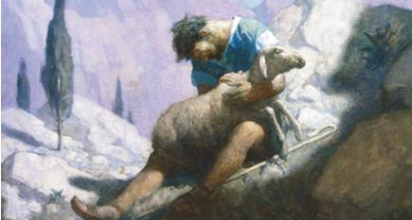
The Western tradition is that He loves the sheep and is relieved to find it.
The Eastern tradition, if the shepherd loses the sheep, he loses his character and reputation.

Slide 31
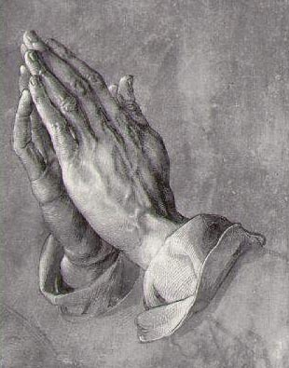
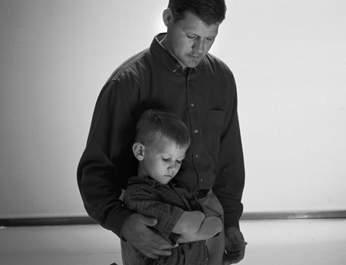
“I say unto you, that likewise joy shall be in heaven over one sinner that repenteth,…”
Through the Atonement we can be forgiven, and Heavenly Father will rejoice at our return.
Luke 15:7

Slide 32
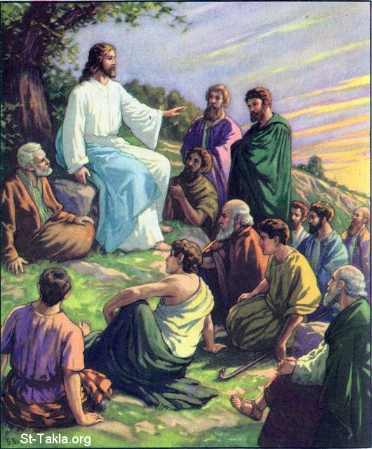
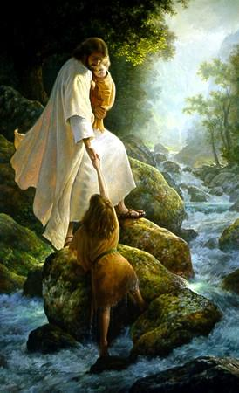
“…more than over ninety and nine just persons, which need no repentance.”
What about the ninety-nine?
They are already safe in the fold.
Luke 15:7

Slide 33
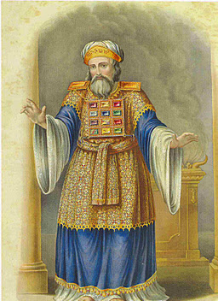
Who would those people be?
Who exactly needs no repentance?
This jab was directed to the Pharisees and Scribes who were striving to live the Law perfectly so that they would be “justified” for heaven and would need no Savior.

Slide 34
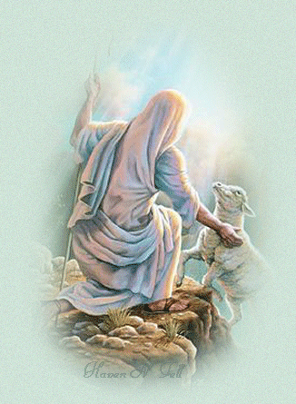
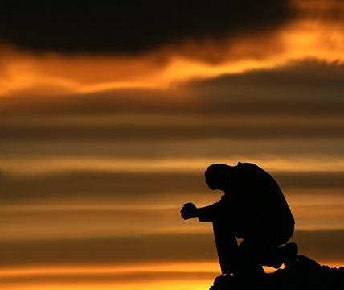
What does the lost sheep do to save himself?
Do you need a Savior?
At most, he bleats so he may be found.
Salvation comes only from the Shepherd.

Slide 35
Psalms 14:3
“There is none that doeth good, no not one.”
Romans 3:23
“All have sinned, and come short of the glory of God”

Slide 36
Chiasmus
The Lost Sheep
1. YOU 4 "Which one of you, having a hundred sheep
2. ONE and losing one of them,
3. NINETY-NINE does not leave the ninety-nine in the wilderness
A. LOST and go after the one
B. FIND that is lost until he finds it? 5 When he has found it,
C. REJOICE he places it on his shoulders, rejoicing.
D. RESTORE 6 And when he comes home, he calls together his friends and neighbors,
C. REJOICE saying to them, 'Rejoice with me,
B. FIND for I have found my sheep
A. LOST that was lost.'
4. YOU 7 Just so, I tell you, there will be more joy in heaven
5. ONE over one sinner who repents
6. NINETY-NINE than over ninety-nine righteous persons who need no repentance.

Slide 37
Joseph Smith stated:
“There is joy in the presence of the angels of God over one sinner that repenteth, more than over ninety-and-nine just person that are so righteous; they (the prideful ones) will be damned anyhow; you cannot save them.”

Slide 38
“Rejoice With Me”
The Parable of the Lost Coin
Luke 15:8-10

Slide 39
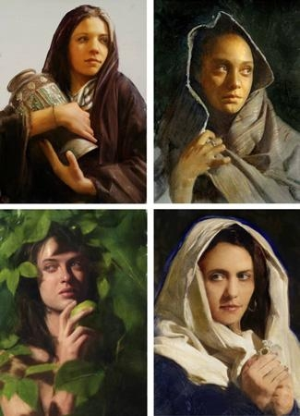
Jesus speaks of a woman in this parable.
A speaker in Middle Eastern culture cannot compare a male audience to a woman without giving offense. Jesus does it anyway with the intent of elevating the status of all women.

Slide 40
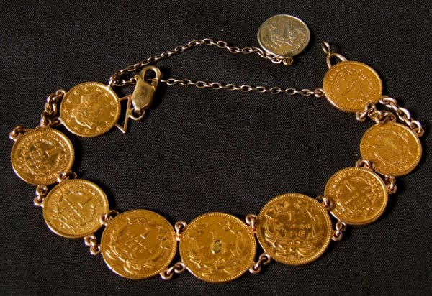
“Either what woman having ten pieces of silver,…”
Drachmas
Luke 15:8

Slide 41
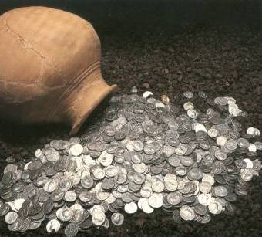
The coins were her insurance that if she ever lost her husband she would have the coins to support her

Slide 42
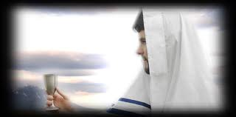
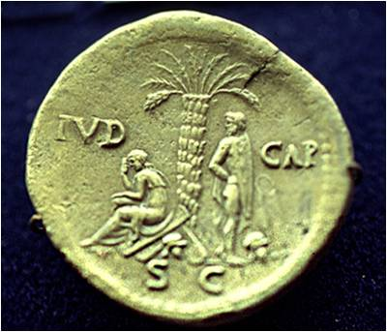
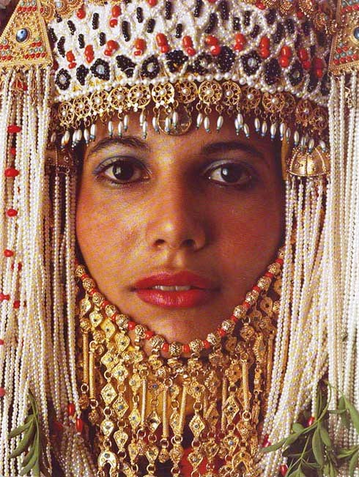
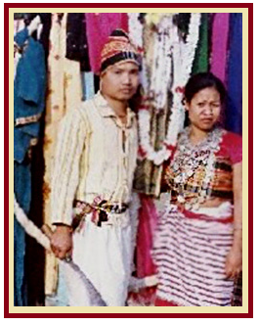
Bride Price
A drachma is about one day’s wages.
Paid by husband at the betrothal.

Slide 43
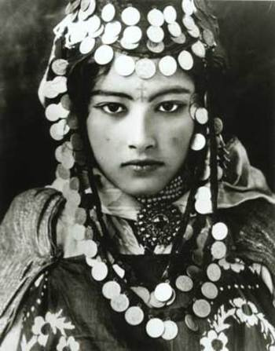
If the woman is found unfaithful her husband might take the coins away to her disgrace
If the husband discovers a coin missing he might get the wrong idea

Slide 44
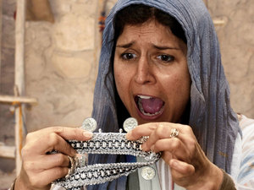
A complete set of coins represented a faithful wife.
“…if she lose one piece,…”
Luke 15:8

Slide 45
Middle Easterners do not take direct blame for such an act. They might say, “The coin is lost” but would not say “I lost the coin.”
Jesus emphasizes that this woman has indeed lost the coin and she take responsibility for having done so
Luke 15:8

Slide 46
“…doth not light a candle…”
Luke 15:8

Slide 47
The homes were made with basalt (black volcanic rock) floors. The rooms were about 7 feet high with six inch slits near the top for the only windows. The floors were stones pieced together, with numerous cracks where the stones met.
The woman must light a lamp in the dark room and painstakingly search for the coin.

Slide 48
“…and sweep the house, and seek diligently till she find it?”
Luke 15:8

Slide 49
Transgression or neglect, that which is lost, perhaps virtue or chastity, needs to be found

Slide 50
In order to get back what is lost, we need to repent by searching and praying for forgiveness.
How do you know when you have been forgiven?

Slide 51
Joy in Finding
Knowing that you had done everything possible to find that which was lost

Slide 52
“And when she hath found it, she calleth her friends and her neighbours together, saying, Rejoice with me; for I have found the piece which I had lost.”
The woman finds the coin and invites the neighbors to a celebration.
Luke 15:9

Slide 53
Having found the coin she has proven her faithfulness and it is her success that she wants to celebrate.
So it is with us, when we fully repent we rejoice to be able to return to the Savior

Slide 54
“Just so, I say unto you, there is joy in the presence of the angels of God over one sinner that repenteth.”
Luke 15:10

Slide 55
Chiasmus
INTRODUCTION "Or what woman having ten silver coins”
1. LOST if she loses one of them,
2. FOUND does not light a lamp, sweep the house, and search carefully until she finds it?
3. REJOICE When she has found it, she calls together her friends and neighbors, saying, 'Rejoice with me,
4. FOUND for I have found the coin
5. LOST that I had lost.
CONCLUSION “Just so, I tell you, there is joy in the presence of the angels of God over one sinner who repents."

Slide 56
“…he was lost, and is found”
Parable of the Prodigal Son
Luke 15:11-32

Slide 57
“And a certain man had two sons…”
Luke 15:11

Slide 58
“ And the younger of them said to his father, Father, give me the portion of that falleth to me…”
The Younger Son Requests his Inheritance
Cultural:
Betrayal
of Family and Community Values
Akin to wishing the Father was dead
He would have
been shunned
by the community
Luke 15:12

Slide 59
The prodigal asked not only for his inheritance, but the right to dispose of it as he pleased.
According to tradition, a father had claim on all his property and the income from it until his death.

Slide 60
Why did the Father give this inheritance to his son?
Land was given to each tribe of Israel as an eternal inheritance.
By complying, the father wrecked the family generational estate.
Then it was divided within each tribe into family inheritances that were passed generation to generation intact.
The father would have had to liquidate the son's portion, keep the property and give the son the money.

Slide 61
Deuteronomy 21:18-21
The Law of Moses
A Rebellious Son could be stoned to death

Slide 62
“…And he divided unto him his living.”
The father had to sell 1/3 of the family’s generational estate and convert it to cash.
Luke 15:11

Slide 63
The Father allowed his son to experience the consequences.
Tough Love
He wanted his son to learn through life’s trials.

Slide 64
“And not many days after the younger son gathered all together, …”
Luke 15:13

Slide 65
“…and took his journey into a far country…”
Gentile country—Babylon.
Luke 15:13

Slide 66
As long as you had money in Babylon you were treated well
If a Jewish boy spent his inheritance among the Gentiles, his home community would perform a “Kutzash”

Slide 67
Like the prodigal son, we too can go to “a far country” is not measured by miles but by how far our hearts and minds are from Jesus!
Fidelity, not geography, really determines the distance.
Neal A. Maxwell Conference October 2000

Slide 68
“…and there wasted his substance with riotous living…”
Luke 15:13

Slide 69
What did he want?
The 4 P’s
Popularity
Power
Possession
Passions
Luke 15:13

Slide 70
“…And when he had spent all,…”
The King James Version is incorrect in their translation of “riotous living.” We assume this speaks of his dissipated, immoral life. The Greek word, “asotozs” means “a glutton.” There is no hint of immorality from the language. He is simply living an expensive, carefree life as a spendthrift.
Luke 15:14

Slide 71
“…there arose a mighty famine in that land,…”
Luke 15:14

Slide 72
“…and he began to be in want.”
The natural thing to do would be to return home, but in the Middle East, cultural life is governed by honor and shame.
Luke 15:14

Slide 73
He loses everything…if he was with family they would of helped, but he has departed from them…he is an alien in a Gentile country and had no family to return to.

Slide 74
“…And he went and joined himself to a citizen of that country; and he sent him into his fields to feed swine.”
He goes to work for the lowest job and the lowest pay
Luke 15:15

Slide 75
“And he would fain have filled his belly with the husks that the swine did eat: and no man gave unto him.”
According to Jewish law, this makes him ritually unclean. He has sunk to the lowest a Jewish boy could get. He also was not allowed to eat the pig’s food.

Slide 76
The Son left home seeking his freedom.
Where is his freedom now?

Slide 77
“And when he came to himself, he said. How many hired servants of my father’s have bread enough and to spare, and I perish with hunger!”
During the famine the swine would have been worth more than the Prodigal who was no more than a slave.
Luke 15:17

Slide 78
“Came to Himself”
The repentance process begins when he starts being honest with himself over his situation. He is now “compelled” to be humble which prepares him to even think of submitting to a higher power.
The spirit can begin his work within the son.

Slide 79
"The returning prodigals are never numerous enough, but regularly some come back from “a far country”. Of course, it is better if we are humbled “because of the word” rather than being compelled by circumstances, yet the latter may do!
Famine can induce spiritual hunger."
(1)

Slide 80
“I will arise and go to my father, and will say unto him, Father, I have sinned against heaven and before thee,…”
Realizing he needs his father’s help and he makes his plan to return to his father.
Luke 15:18

Slide 81
“And am no more worthy to be called they son…”
He has broken the law of Moses, sinned against his father by humiliating him publicly and bringing dishonor to his family name.
Luke 15:19

Slide 82
“If you have repented form serous transgression and mistakenly believe that you will always be a second-class citizen in the kingdom of God, learn that is not true…find encouragement in the lives of Alma the Younger and the sons of Mosiah. They were tragically wicked. Yet their full repentance and service qualified them to be considered as a noble as righteous Captain Moroni.”
Luke 15:19
(2)

Slide 83
“And am no more worthy to be called they son: make me as one of the hired servants.”
He is now hoping his father will take him back as a servant
3 types of servants:
Bondsmen—a native Israelite sold for a debt or crime—freed on the 7th year.
Lower-class slaves—purchased slaves from heathen tribes.
Hired hands—day laborers—outsiders who had no job security and lived in destitution.
Luke 15:19

Slide 84
“And he arose, and came to his father…”
Joe Cavazos
Luke 15:20

Slide 85
“…But when he was yet a great way off, his father saw him,…
The Prodigal’s father has been watching and waiting for his son. The father knows the son and that he had failed in the world. He also knows his son is proud and will not come back until he falls to his lowest point.
Luke 15:20

Slide 86
When his father sees him, he knows he needs to greet him before the son gets to the village and is seen by the community and openly shamed.
The Village would expect the father to yell and berate the son when he see him.

Slide 87
Protecting the boy the father runs to greet him before he gets to the village
In the near east, for an elderly gentleman to run was disgraceful. He often has long flowing robes, and running would require him to roll up his robes, allowing people to see his legs, this would be humiliating.
‘gird up his loins’
Gird(up) your loins-- to prepare yourself mentally to do something difficult Usage notes:
This phrase comes from the Bible, where girding up your loins meant to tie up long, loose clothes so that they were more practical when you were working or travelling.
Both sides are presently girding their loins for the legal battles that lie ahead.

Slide 88
“Kutzasah”
Or
“Kezazah”
The community would throw down an earthen pot, breaking it.
It signifies that the Jewish boy is dead to them unless he brings his inheritance back.

Slide 89
“…and had compassion, and ran, and fell on his neck, and kissed him.”
The father’s kiss was a sign of reconciliation and forgiveness.
Luke 15:20

Slide 90
When a serious quarrel has taken place in the village and reconciliation is achieved, a part of the ceremony enacted as a sacrament of reconciliation is a public kiss by the leading men involved.

Slide 91
In the Law of Moses the Scribes and Pharisees would have required a ritual cleansing of the son before they would even have touched him.

Slide 92
“…And the son said unto him, Father, I have sinned against heaven, and in they sight, and am no more worthy to be called they son.”
Luke 15:21

Slide 93
“But the father said to his servants, Bring forth the best robe, and put it on him; and put a ring on his had, and shoes on his feet:”
Clothing his son is symbolic:
It is a public statement of his unconditional acceptance.
Luke 15:22

Slide 94
Best Robe….Putting on the spirit or Righteousness
Ring….access to the estates most important documents and possession authority as part of the family
Freedom…no slave would wear shoes…only freemen. Shoes were worn by the master, not the guest, who removed them when they entered the house.

Slide 95
The servants are asked to place the shoes on the son, thus suggesting his reinstatement as a member of the family.

Slide 96
“And bring hither the fatted calf, and kill it; and let us eat, and be merry:”
The father modeled for the townspeople how they should accept his son.
A fatted calf was kept only for sacred festivals…it would have fed over 100 people. This would have been no small gathering to celebrate.
Luke 15:23

Slide 97
The Fatted calf = Sacrifice of an animal Christ’s atonement

Slide 98
“For this my son was dead, and is alive again; he was lost , and is found, and they began to be merry…”
Ary Scheffer
Luke 15:24

Slide 99
“Now his elder son was in the field: and as he came and drew night to the house, he heard musick and dancing.”
The devoted son hears music and dancing and asks a servant about it.
Luke 15:25

Slide 100
“And he called one of the servants, and asked what these things meant.
And he said unto him Thy brother is come; and thy father hath killed the fatted calf, because he hath received him safe and sound.”
Luke 15:25

Slide 101
“And he was angry, and would not go in: therefore came his father out, and intreated him.”
The devoted son feels betrayed, because he has served and worked while his brother had gone and squandered his inheritance
Luke 15:28

Slide 102
“And he answering said to his father, Lo these many years do I serve thee, neither transgressed I at any time thy commandment; and yet thou never gavest me a kid, that I might make merry with my friends:”
You are always with me
Luke 15:29

Slide 103
“But as soon as this thy son was come, which hath devoured thy living with harlots, thou hast killed for him the fatted calf.”
Almost as if he were saying, “I am slaving for you, and he has done nothing, and yet you have treated him with more favor than me.”
Luke 15:30

Slide 104
“The older son forgets for a moment that he has never had known filth or despair, fear or self-loathing. He forgets for a moment that every calf on the ranch is already his and so are all the robes in the closet and every ring in the drawer. He forget for a moment that his faithfulness has been and always will be rewarded.”
Luke 15:29
(3)

Slide 105
“And he said unto him Son, thou art ever with me, and all that I have is thine.”
Keep in mind the older son is the “birthright” son which means his inheritance is a “double portion”.
Luke 15:31

Slide 106
“It was meet that we should make merry, and be glad; for this thy brother was dead, and is alive again; and was lost, and is found.”
His father reminds him that this is his brother. That he was faithful all along and that he has not lost anything. This is what Christ would do, forgive his brothers.
Luke 15:32

Slide 107
There is no limit to the number of lost souls who can be welcomed back.
We can tell how close we are to Heavenly Father
by checking how we
feel about people
who are in sin.

Slide 108
"Nothing is so much calculated to lead people to forsake sin as to take them by the hand, and watch over them with tenderness.....
….The nearer we get to our Heavenly Father, the more we are disposed to look with compassion on perishing souls; we feel that we want to take them upon our shoulders, and cast their sins behind our backs.
Joseph Smith TPJS 240-241

Slide 109
Message of Hope
“The Other Prodigal” Elder Jeffrey R Holland May 2002 Ensign
Lessons learned from the Prodigal Son

Slide 110
Lessons learned from the Prodigal Son
Coming to Christ is true freedom from bondage
It’s never over ‘til it’s over. Do we really know the final outcome in the lives of our spiritual sibling? It’s in God’s hands. Joseph Smith said, “A soul is never too old to repent.” TPJS p 191
Be careful not to condemn. Remorse is not repentance but it is a good beginning.
The lowest point (rock bottom) is someone’s life can be a switch point for turning back to God. There also is “Foxhole” religion” Repentance borne of desperation is not always lasting. Time will tell for the younger son.

Slide 111
Repentance is not a work we perform on our own. We must allow God to “find” us. The lost sheep and coin didn’t regent---they were found.
There are limits to the mercy of God. We don’t sin so that mercy can abound. We could lose something we can never reclaim.
It is always better to “prepare and prevent” than to “repair and repent.” You ALWAYS lose something during a period of rebellion.
Ask yourself: Would I have attended the banquet of the returning prodigal? Would I feel I am condoning the actions of the guilty: Remember: All of us fall short of perfection. God cheers on every runner, calling out that the race is against sin, not against each other.
In order to have faith in Jesus Christ and God the Father, we must understand their character and attributes. This parable should be “the parable of the Loving Father’ The Father of the prodigal sons is our father. He is the “hero”.

Slide 112
“When we are lost, we can ‘come to ourselves’ but we may not always be able to ‘find ourselves,’ and, worlds without end, we cannot ‘save ourselves.’ Only the Father and His only Begotten Son can do that. Salvation is in Them only.
So we pray that They will help us, that They will ‘come out’ to meet and embrace us and bring us into the feast They have prepared.”
(3)

Slide 113
Sources:
Suggested Hymn: #129 Where Can I Turn For Peace? Or #221 Dear to the Heart of the Shepherd
Video: “The Prodigal Son”(5:35)
Neal A. Maxwell, CR October 2000
Elder Richard G. Scott Conference Oct. 2000
Elder Jeffrey R. Holland The Other Prodigal May Ensign 2002
Inspired by Poway Institute:
By Becky Davies and Lesley Meacham
https://www.youtube.com/watch?v=X6Mtpk4jeVA
https://www.youtube.com/watch?v=GYMLMj-SibU
Presentation by ©http://fashionsbylynda.com/blog/

Slide 114
Event | Matthew | Mark | Luke | John
Parable of the Lost Sheep |  |  | 15:1-7
Parable of the Lost Coin |  |  | 15:8-10
Parable of the Prodigal Son |  |  | 15:11-37
“The three parables … are as one in portraying the joy that abounds in heaven over the recovery of a soul once numbered among the lost, whether that soul be best symbolized by a sheep that had wandered afar, a coin that had dropped out of sight through the custodian’s neglect, or a son who would deliberately sever himself from home and heaven. There is no justification for the inference that a repentant sinner is to be given precedence over a righteous soul who had resisted sin. … Unqualifiedly offensive as is sin, the sinner is yet precious in the Father’s eyes, because of the possibility of his repentance and return to righteousness. The loss of a soul is a very real and a very great loss to God. He is pained and grieved thereby, for it is His will that not one should perish” James E. Talmage (Jesus the Christ, 3rd ed. [1916], 461
Searching for the Lost:
“Some of our own … cry out in pain and suffering and loneliness and fear. Ours is a great and solemn duty to reach out and help them, to lift them, to feed them if they are hungry, to nurture their spirits if they thirst for truth and righteousness. …
I would hope, I would pray that each of us … would resolve to seek those who need help, who are in desperate and difficult circumstances, and lift them in the spirit of love into the embrace of the Church, where strong hands and loving hearts will warm them, comfort them, sustain them, and put them on the way of happy and productive lives” President Gordon B. Hinckley (“Reach with a Rescuing Hand,” Ensign, Nov. 1996, 86).
The Prodigal Son:
“The tender image of this boy’s anxious, faithful father running to meet him and showering him with kisses is one of the most moving and compassionate scenes in all of holy writ. It tells every child of God, wayward or otherwise, how much God wants us back in the protection of His arms”
The Other Son:
“This son is not so much angry that the other has come home as he is angry that his parents are so happy about it. Feeling unappreciated and perhaps more than a little self-pity, this dutiful son—and he is wonderfully dutiful—forgets for a moment that he has never had to know filth or despair, fear or self-loathing. He forgets for a moment that every calf on the ranch is already his and so are all the robes in the closet and every ring in the drawer. He forgets for a moment that his faithfulness has been and always will be rewarded. …
“… He has yet to come to the compassion and mercy, the charitable breadth of vision to see thatthis is not a rival returning. It is his brother. …
“Certainly this younger brother had been a prisoner—a prisoner of sin, stupidity, and a pigsty. But the older brother lives in some confinement, too. He has, as yet, been unable to break out of the prison of himself. He is haunted by the green-eyed monster of jealousy”
Elder Jeffrey R. Holland (“The Other Prodigal,” Ensign, May 2002, 62).

Slide 115
Chiasmus
The Lost Sheep
YOU 4 "Which one of you, having a hundred sheep
2. ONE and losing one of them,
3. NINETY-NINE does not leave the ninety-nine in the wilderness
A. LOST and go after the one
B. FIND that is lost until he finds it? 5 When he has found it,
C. REJOICE he places it on his shoulders, rejoicing.
D. RESTORE 6 And when he comes home, he calls together his friends and neighbors,
C. REJOICE saying to them, 'Rejoice with me,
B. FIND for I have found my sheep
A. LOST that was lost.'
4. YOU 7 Just so, I tell you, there will be more joy in heaven
5. ONE over one sinner who repents
6. NINETY-NINE than over ninety-nine righteous persons who need no repentance.

Slide 116
Chiasmus
The Lost Coin
INTRODUCTION "Or what woman having ten silver coins,
1. LOST if she loses one of them,
2. FOUND does not light a lamp, sweep the house, and search carefully until she finds it?
3. REJOICE When she has found it, she calls together her friends and neighbors, saying, 'Rejoice with me,
4. FOUND for I have found the coin
5. LOST that I had lost.
CONCLUSION Just so, I tell you, there is joy in the presence of the angels of God over one sinner who repents."

