Slide 1
Lesson 54
Eternal Riches
Luke 16
Including:
Parable of the Unjust Steward
Parable of the Rich Man and Lazarus
But lay up for yourselves treasures in heaven, where neither moth nor rust doth corrupt, and where thieves do not break through nor steal.
For where your treasure is, there will your heart be also.
3 Nephi 13:20-21

Slide 2
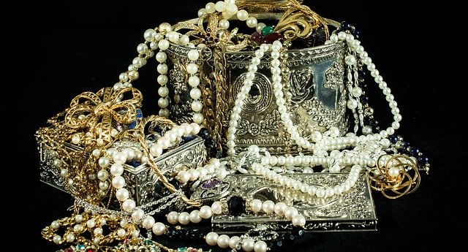
What are some items that people often set their hearts on and try to obtain?

Slide 3
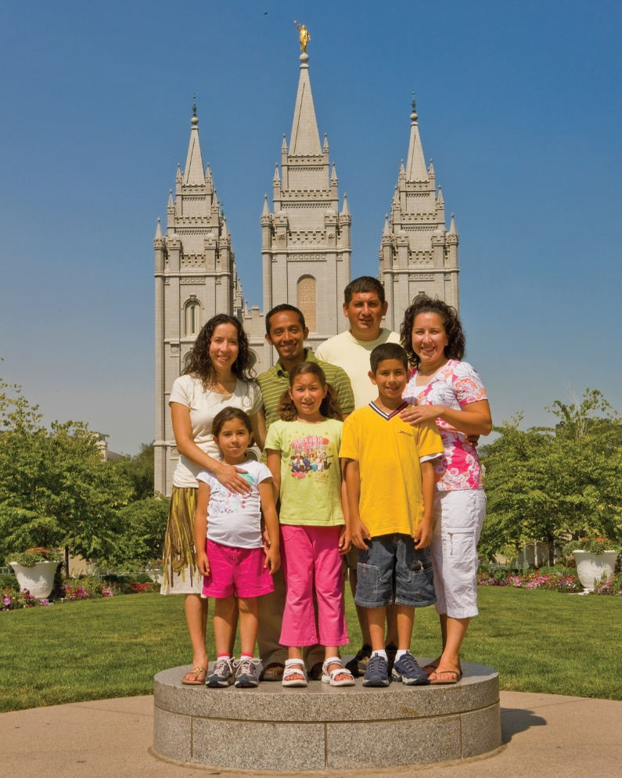
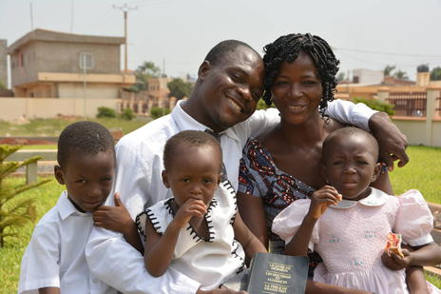
What are some riches that Heavenly Father wants us to seek?

Slide 4
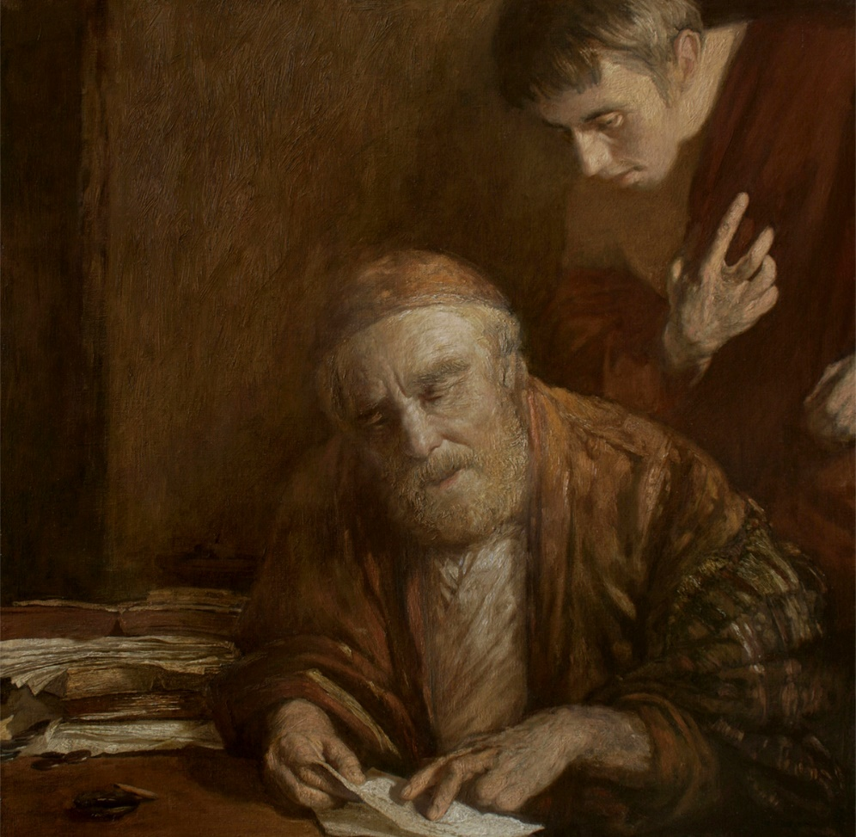
Parable of the Unjust Steward
Steward = someone who is given authority to oversee or to manage his master’s property.
What had the steward be doing with the rich man’s goods?
Was the steward about to lose his job because of his wastefulness?
The steward worried about what he would do when he lost his job because he did not feel he could do manual labor and was too ashamed to beg.
Luke 16:1-4

Slide 5
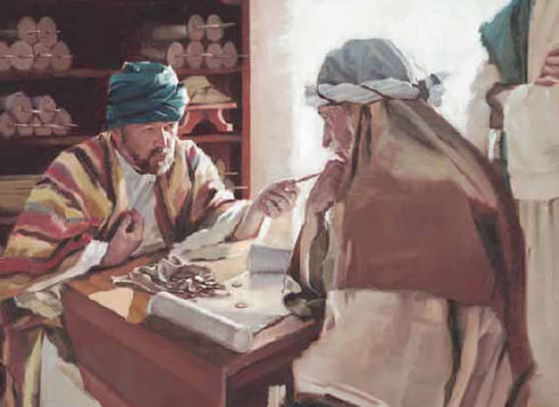
The Plan
The steward devised a plan that he thought might lead to job opportunities in other households.
He visited two of the rich man’s debtors and significantly discounted their debts, which he hoped would earn their favor.
Luke 16:3-7

Slide 6
Preparation for Temporal Future
This parable does not encourage us to be dishonest or to cheat others in any way; rather, it encourages us to prepare for our eternal future with the same energy and effort as this steward prepared for his temporal future.
If we wisely prepare for our eternal future and righteously use earthly riches, we can be blessed with eternal riches.
Luke 16:3-7
(1)

Slide 7
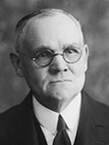
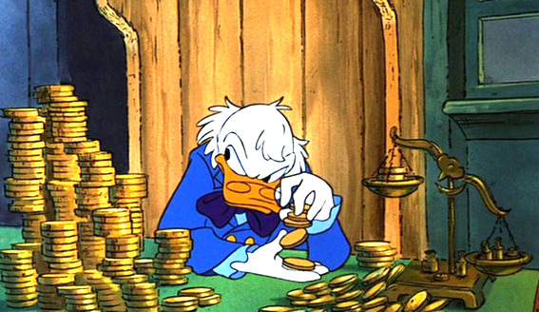
“Our Lord’s purpose was to show the contrast between the care, thoughtfulness, and devotion of men engaged in the money-making affairs of earth, and the half hearted ways of many who are professedly striving after spiritual riches. …
“… Take a lesson from even the dishonest and the evil; if they are so prudent as to provide for the only future they think of, how much more should you, who believe in an eternal future, provide therefor! …
Emulate the unjust steward and the lovers of mammon, not in their dishonesty, cupidity [selfish greed], and miserly hoarding of the wealth that is at best but transitory [temporary], but in their zeal, forethought, and provision for the future.”
Luke 16:8
(4)

Slide 8
We Cannot Serve God and Mammon
No servant can serve two masters: for either he will hate the one, and love the other; or else he will hold to the one, and despise the other. Ye cannot serve God and mammon.
Servir a Dois Senhore
"We know that 'a double minded man is unstable in all his ways' (James 1:8) and that we cannot 'serve two masters.'
President Marion G. Romney wisely observed that there are too many of us 'who try to serve the Lord without offending the devil.'"
Luke 16:13-14
(2)

Slide 9
Parable of the Rich Man and Lazarus
Luke 16:13-31

Slide 10
Folktale brought out by Jesus to teach a lesson

Slide 11
Before Jesus there was an Egyptian folktale circulating depicting a rich man dressed in fine linen and a poor man on a straw mat, whose roles were reversed after death…

Slide 12
Brought to Israel by Alexandrian Jews, the folktale was altered to a rich tax collector
by the name of
Bar Ma’jan and a poor teacher of the law…
Tax collector

Slide 13
…after death, the teacher of the law strolled along the broad streams of Paradise while the tax collector standing next to the water was unable to reach it to quench his thirst

Slide 14
A Certain rich man, clothed in purple and fine linen, did very well for himself
Luke 16:19

Slide 15
A poor man, Lazarus, begs for crumbs from the table
Luke 16:21

Slide 16
They both die and Lazarus was taken by angels into Abraham’s bosom, and the rich man was buried
R.I.P.
Lazarus

Slide 17
“Abraham’s Bosom”
This is the only phrase used in the entire Bible. It meant Paradise to the rabbis
To sit on someone’s right side during dinner was to recline in their “bosom”, which is also a position of close friendship.
Lazarus was now at Abraham’s bosom, a place where every Jew wanted to be.

Slide 18
“Paradise, the temporary abode of righteous Abraham as he awaited the day of his resurrection.”
(2)

Slide 19
The tables had been turned. Lazarus was with Abraham in Paradise and the rich man in torment
Luke 16:22-23

Slide 20
Lazarus had received evil things in life, while the rich man had received good things.
Now Lazarus is comforted, while the man is tormented
“And beside all this, between us and you there is a great gulf fixed…”
Luke 16:25-26

Slide 21
Lazarus could not bring the man water because of the “great gulf” between them
One can not move from one kingdom to another until after the resurrection.

Slide 22
I desire these things be known to my 5 brothers.
They have the prophets to hear the Word of God.
But if they see me, they will believe. (A sign)
If they haven’t already listened to the Word of God, they will not now.
Luke 16:27-31

Slide 23
Jesus gave the beggar a name, Lazarus, he may have used this name because of his good friend Lazarus (Mary and Martha’s brother) Lazarus’ name means “Helped of God”
This parable came just before the raising of Lazarus from the dead
(3)

Slide 24
Perhaps this parable condemns those who seek for a sign but also reminds the Pharisees to take care of the poor.
Food

Slide 25
“”Therefore, if any man shall take of the abundance which I have made, and impart not his portion, according to the law of my gospel, unto the poor and the needy, he shall, with the wicked, lift up his eyes in hell, being in torment”
D&C 104:18

Slide 26
Conversion comes through believing and heeding the words of prophets, not by witnessing miracles or seeing angels

Slide 27
Sources:
Suggested Hymn: #219 Because I Have Been Given Much
New Testament Institute Teacher Manual Chapter 18 and Student Manual
Elder Bruce R. McConkie New Testament Commentary 1:521
Bible Dictionary
James E. Talmage (Jesus the Christ, 3rd ed. [1916], 463, 464).
Joseph B. Wirthlin ("True to the Truth," Ensign, May 1997, 16)
Presentation by ©http://fashionsbylynda.com/blog/

Slide 28
Event | Matthew | Mark | Luke | John
Parable of the Unjust Steward |  |  | 16:1-13
Hypocrisy of the Pharisees |  |  | 16:14-18
Parable of the Rich man and Lazarus |  |  | 16:19-31
Serving God or Mammon Luke 16:13-14:
“The scriptures say to have thoughts of God always within our hearts. Many people now fill their hearts with thoughts of riches, power, and fame. They worship their possessions, loving things without life.”
• “We serve ourselves much too often when we should be serving the Lord. We must not worship our time—a graven image that takes the place of God in many cases. God asks us to sacrifice our time, making sure that he, not our own selfish interests, is first in our lives.”
• “The graven images I see people worshiping are clothing, cars, homes, hobbies, and recreation. The fact that I spend more time deciding what to wear each morning than I do in prayer is very telling.”
“Alma 1:32 says, ‘Those who did not belong to their church did indulge themselves in sorceries, and in idolatry or idleness.’ This is something that I had never contemplated before: idleness as a form of idolatry.”
• “Money is one of the most common images that people bow down to today. They bow down by giving up their integrity and honesty in dealing with others in order to obtain it. They bend their principles as they are bowing down.”
• “Too often people make man their graven image. Because we are afraid of others’ opinions, we won’t serve others or be kind to those society looks down on. We worship others’ praise and honor; we desire above all else the prestige others can give us. We want the right titles and awards. We want to wear the right clothing. We want to be popular.” By Dennis Largey Refusing to Worship Today’s Graven Images march 1998 Ensign
Exchanged Between Jesus and the Pharisees Luke 16:16-23:
The Pharisees claimed that the law of Moses and other prophetic scripture (the Old Testament) served as their law, and they therefore rejected Jesus as their judge. Jesus explained that the law of Moses and the prophets had testified of Him. He questioned the Pharisees for denying what had been written and rebuked them for “pervert[ing] the right way” (Joseph Smith Translation, Luke 16:21). To help the Pharisees, whose hearts were set on worldly riches and power, to understand their behavior and the consequences of it, the Savior likened them to the rich man in the parable recorded in Luke 16:19–31.
The parable of the rich man and Lazarus teaches us about the principle of divine justice. In the parable, the rich man found that after his death, he would have to suffer for a time because of the decisions he had made as a mortal. Lazarus found that after his death, he was blessed and comforted. This teaches us that all the inequities of this life will be made up to the righteous in the next life. Justice is the friend of those who rely on the Atonement of Jesus Christ. As Abraham said to the rich man in the parable, in the next life the injustices of mortality are made right: “Remember that thou in thy lifetime receivedst thy good things, and likewise Lazarus evil things: but now he is comforted, and thou are tormented” (1)
Lazarus:
A short time after the parable was given, the Savior’s close friend Lazarus died and the Savior restored him to life (see John 11). In literal fulfillment of Jesus’s prophecy that someone who had risen from the dead would not persuade the wicked to repent, Jewish leaders responded to the raising of Lazarus from the dead by seeking to have him killed (see John 12:10–11). Not too many months later, Jesus Himself would be slain and would rise from the dead, and the Jewish leaders would continue to refuse to be persuaded.

