Slide 1
Lesson 55
“Thy Faith Hath Made Thee Whole”
Luke 17
Including:
Forgiveness
Parable of the Unprofitable Servant
The 10 Lepers Are Cleansed

Slide 2
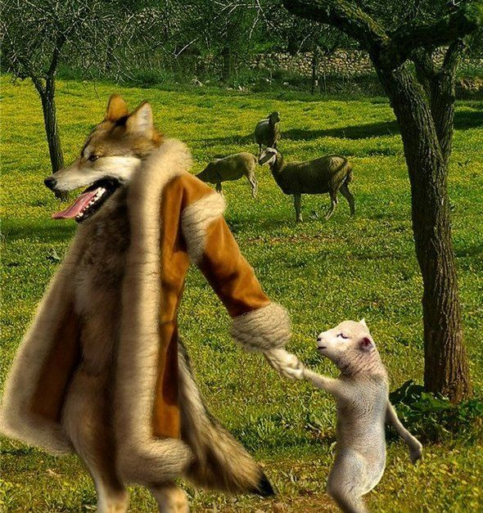
Leading Others Astray
The Savior warned that those who lead others astray or persuade them to sin will be held accountable.
The Savior’s disciples must watch themselves so they do not cause others to stumble
Luke 17:1-2

Slide 3
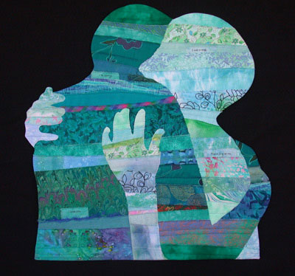
Forgive—7 Times a Day
Jesus also taught us to forgive others, even if they trespass “seven times in a day” and then repent each time.
Forgiveness is required of everyone
Wherefore, I say unto you, that ye ought to forgive one another; for he that forgiveth not his brother his trespasses standeth condemned before the Lord; for there remaineth in him the greater sin.
D&C 64:9
Luke 17:3-5
(1)

Slide 4
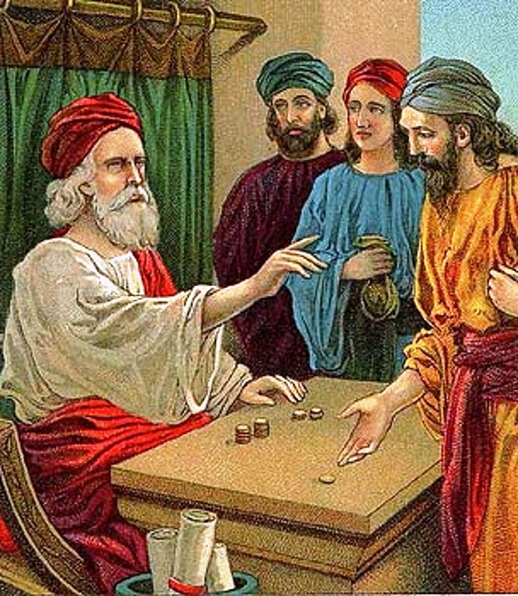
Parable of the Unprofitable Servant
A master provided all the necessities of life to his servant as the servant faithfully fulfilled his expected duties.
Because of this, there was no need for the master to give special thanks to his servant or to feel indebted to him for performing his duties…
The servant should not expect any special reward or adopt a sense of entitlement simply because he had done his duty.
No matter how well a servant performed his duties, he was still in his master’s debt for all that he had.
Luke 17:5-10
(1)

Slide 5
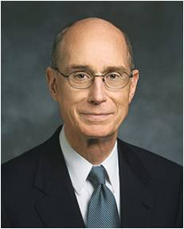
Indebted
We are eternally indebted to our Heavenly Father and can never fully pay Him back or place Him in our debt.
Thus, in answer to the Apostles’ request to strengthen their faith, the Savior taught that faith in God involves recognizing our indebtedness to Him and dependence on Him.
"You will not be surprised that the Lord responded by speaking of a seed. The first thing to know about how faith in him increases is to think of its growth like that of a tree. You remember how Alma used that illustration. The seed is the word of God. It must be planted in the heart of the person you serve and whose faith you want to see increase.”
Luke 17:5-10
(2)

Slide 6
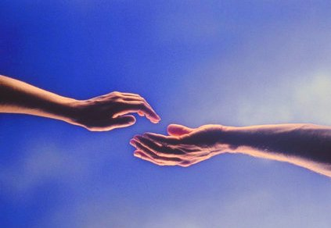
“…thy faith hath made thee whole.”
Cleansing the 10 Lepers

Slide 7
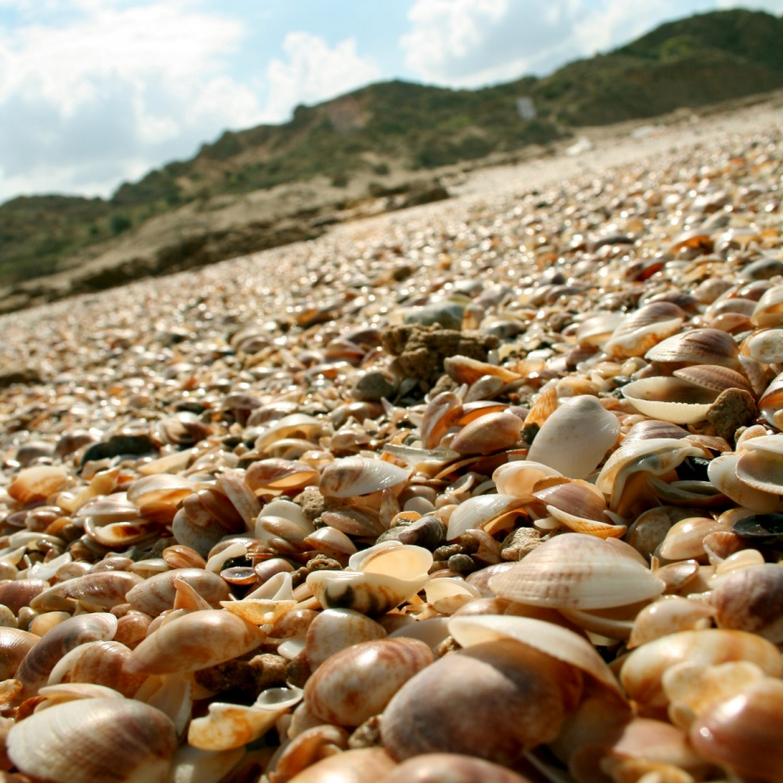
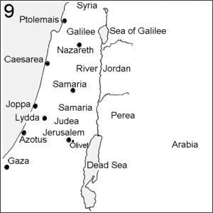
“And it came to pass, as he went to Jerusalem, that he passed through the midst of Samaria and Galilee.”
Luke 17:11

Slide 8
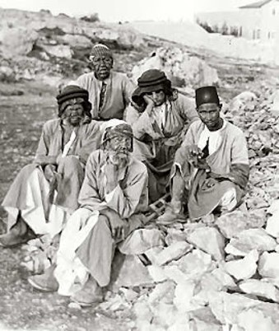
“And as he entered into a certain village…
“…there met him ten men that were lepers, which stood afar off:”
Luke 17:12

Slide 9
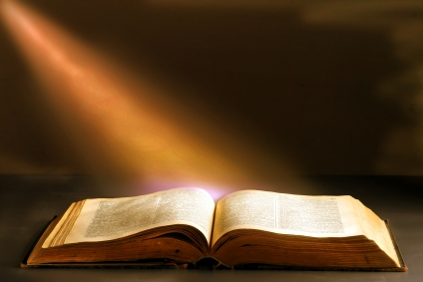
Leprosy
The term “leprosy” (including leper, lepers, leprosy, leprous) occurs:
68 times in the Bible—
55 times in the Old Testament (Hebrew = tsara’ath) and
13 times in the New Testament (Greek = lepros, lepra).
(3)

Slide 10
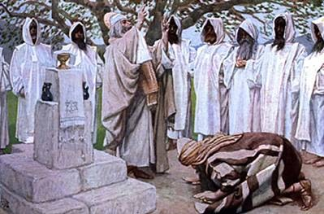
Leviticus 13
Laws of Leprosy: Those who have the appearance of a skin disorder
Brought to a Priest (Aaron)
Pronounce unclean
White, not deep…shut up for 7 days
If not cleared up then shut up for 7 more days

Slide 11
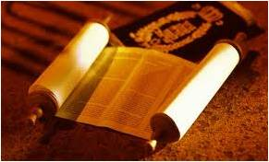
If plague does not spread, the priest pronounces clean
If plague is spread Priest
pronounces unclean.
His clothes shall be burned,
He head shall be bare
He puts a covering upon his upper lip, and cry, “unclean, unclean.”
He shall dwell alone; without the camp.

Slide 12
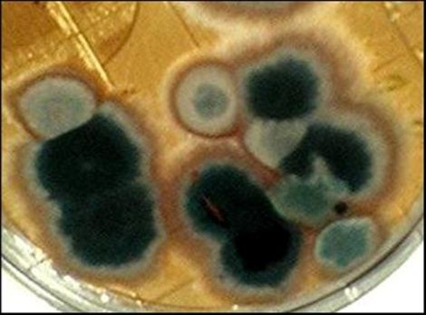
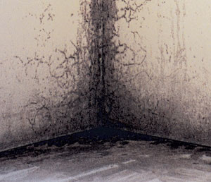
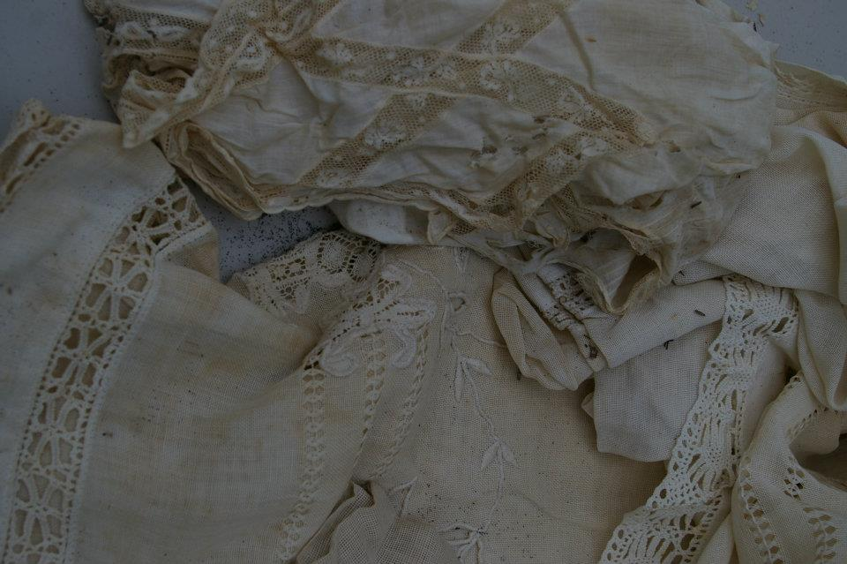
In the Old Testament, the instances of leprosy most likely meant a variety of infectious skin diseases, and even mold and mildew on clothing and walls.

Slide 13
Aaron pleads for Miriam:
Numbers 12:10-12
“…and behold, Miriam became leprous, white as snow; and Aaron looked upon Miriam, and behold, she was leprous.
“Let her (Miriam) not be as one dead, of whom the flesh is half consumed…”

Slide 14
Leviticus 14:2-57 "This shall be the law of the leper.“
God's law for lepers: Get two birds. Kill one. Dip the live bird in the blood of the dead one.
Sprinkle the blood on the leper seven times, and then let the blood-soaked bird fly away.
Next find a lamb and kill it. Wipe some of its blood on the patient's right ear, thumb, and big toe.
Sprinkle seven times with oil and wipe some of the oil on his right ear, thumb and big toe. Repeat.
Finally find another pair of birds. Kill one and dip the live bird in the dead bird's blood.
Wipe some blood on the patient's right ear, thumb, and big toe. Sprinkle the house with blood 7 times.
That's all there is to it.
(3)

Slide 15
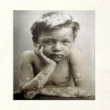
The precise meaning of the leprosy in both the Old and New Testaments is still in dispute, but it probably includes the modern Hansen’s disease (especially in the New Testament) and infectious skin diseases.
Mycobacterium leprae, the infectious bacterial agent of leprosy.
(3)

Slide 16
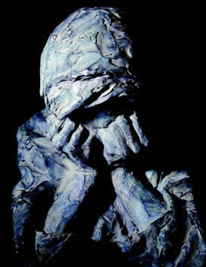
Leprosy is reported as early as 600 BC in India, China, and Egypt.
Leprosy was considered a curse of God, often associated with sin.
(3)

Slide 17
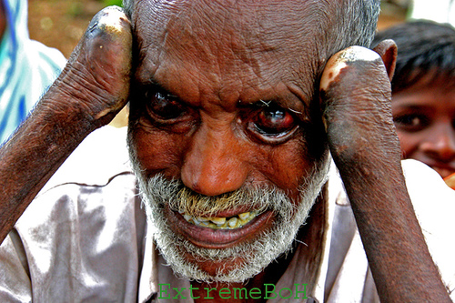
Leprosy did not kill, but neither did it seem to end.
Leprosy lingered for years, causing the tissues to degenerate and deform the body.
(3)

Slide 18
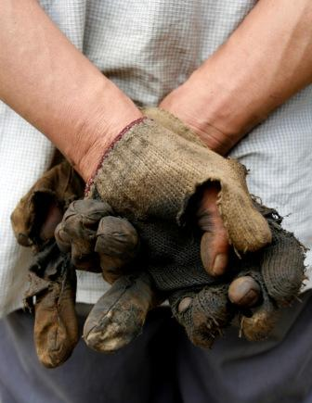
Many thought leprosy to be a disease of the skin…
It is better classified as a disease of the nervous system, because the bacterium attacks the nerves.
(3)

Slide 19
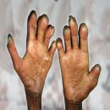
Patients with leprosy experience disfigurement of the skin and bones, twisting of the limbs, and curling of the fingers to form the characteristic claw hand. Facial changes include thickening of the outer ear and collapsing of the nose.
(3)

Slide 20
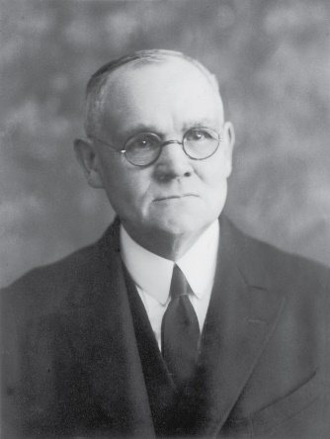
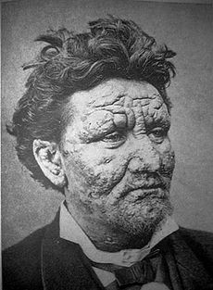
“Leprosy was nothing short of a living death, …a poisoning of the very springs of life; a dissolution, little by little, of the whole body, so that one limb after another actually decayed and fell away.
The disease was incurable
by the art and skill of
man…”
(3)

Slide 21
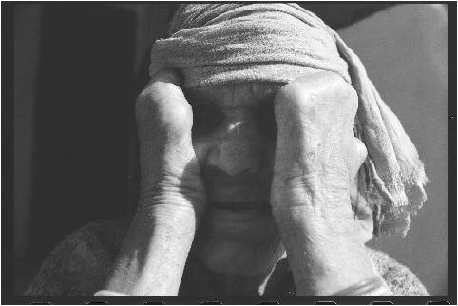
…The leper, thus fearfully bearing about the body the outward and visible token of sin in the soul, was treated throughout as a sinner.”
Considered unclean, they were shut out from society.
(3)

Slide 22
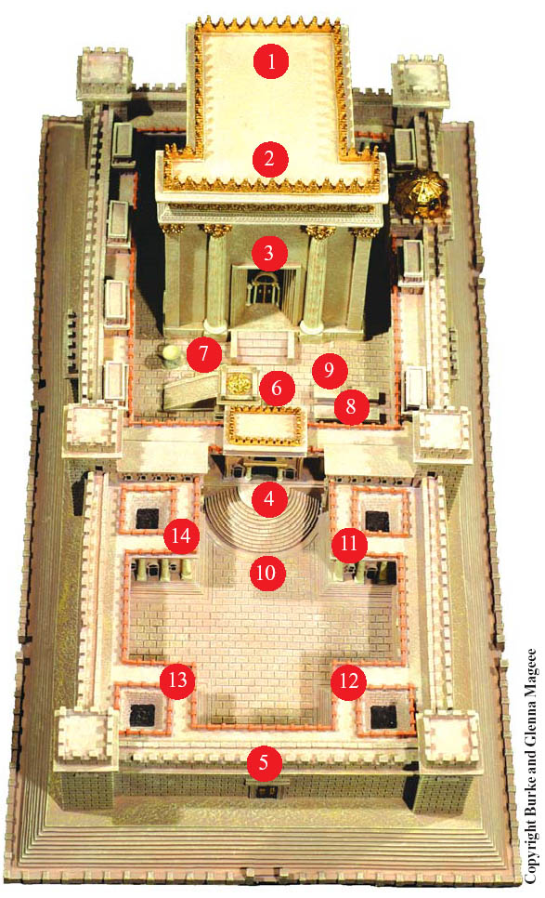
11 Chamber of Leper (Metzorah) This chamber served as a gathering place for people with a Biblical skin disease caused by speaking slander. It was only diagnosed by a qualified Priest (Kohain).
(3)

Slide 23
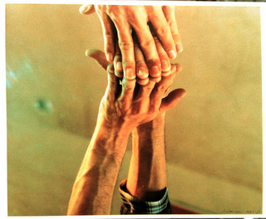
Leprosy is related to the tuberculosis bacterium…Leprosy is spread by multiple skin contacts, as well as secretions transmitted from person to person
To touch a person with Leprosy you were considered unclean.
(3)

Slide 24
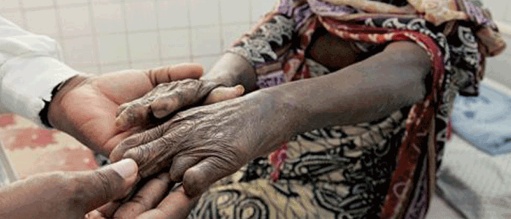
Jesus freely touched people with leprosy. While people with leprosy traditionally suffered banishment from family and neighbors…
…Jesus broke from the tradition. He treated lepers with compassion, touching and healing them.
(3)

Slide 25
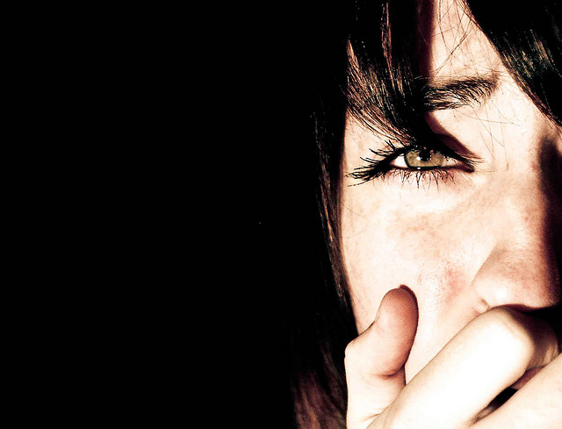
Like leprosy, sin starts out small but can then spread, leading to other sins and causing great damage to our relationship with God and others.

Slide 26
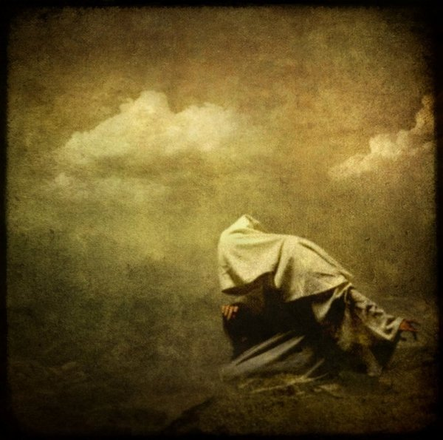
Inner Leprosy
Although we can’t know all the reasons that God allows disease into our lives, biblical leprosy is a powerful symbol reminding us of sin’s spread and its horrible consequences.

Slide 27
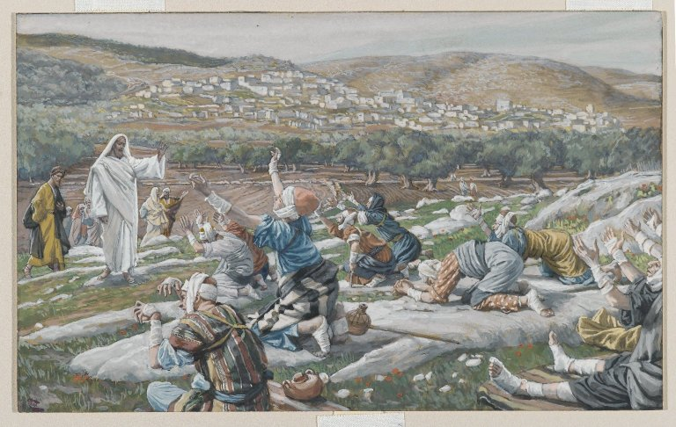
“And they lifted up their voices, and said…
“Jesus, Master, have mercy on us.”
Luke 17:13

Slide 28
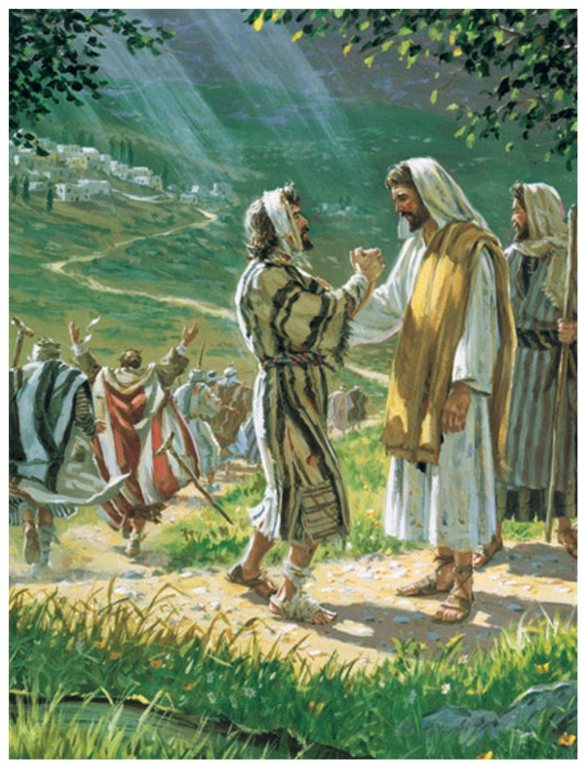
“And when he saw them, he said unto them…
…Go shew yourselves unto the priests…
Luke 17:14

Slide 29
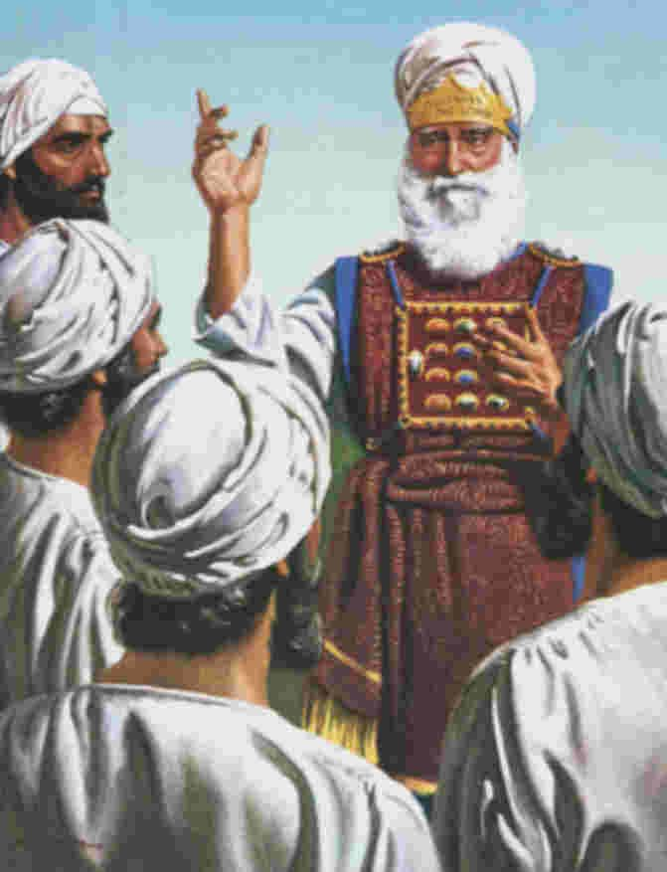
Obedience would be their test of faith
No one who had been leprous could be lawfully restored to the community until pronounced clean by a priest
(3)

Slide 30
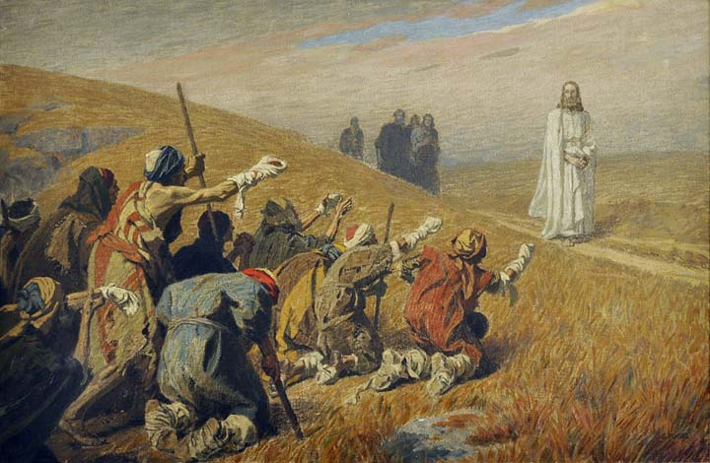
“…as they went, they were cleansed.”
We receive the Lord’s blessings as we do what He has instructed us to do
In hast they went in obedience of the Lord.
Luke 17:14

Slide 31
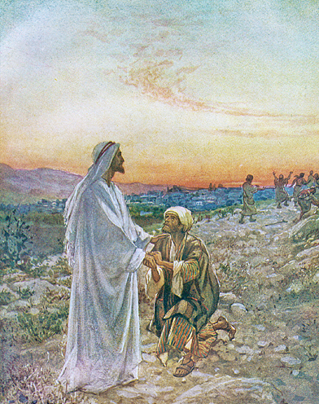
“…And one of them, when he saw that he was healed…
…turned back, and with a loud voice glorified God.”
Luke 17:15

Slide 32
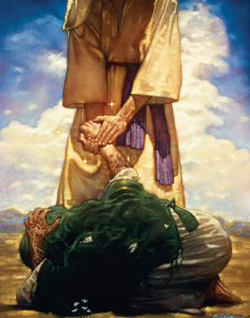
“And fell down on his face at his feet, giving him thanks…
It is important to express gratitude for the blessings we receive
…and he was a Samaritan.”
Luke 17:16

Slide 33
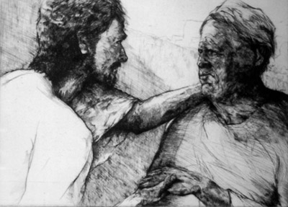
“…Were there not ten cleansed?…
Luke 17:17

Slide 34
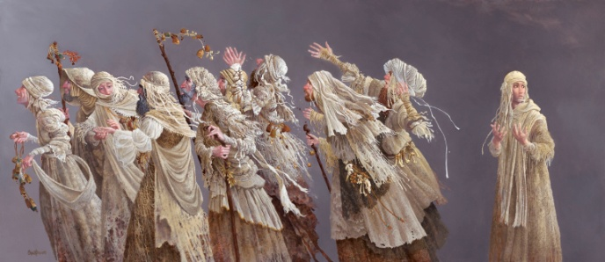
Doubtless the nine who did not come back were obedient to the strict letter of the Lord’s command…
James Christensen
…but their lack of gratitude and their failure to acknowledge the power of God was in contrast to the one filled with the spirit.
(3)

Slide 35
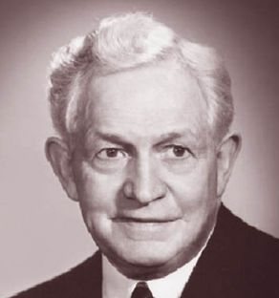
“Gratitude is deeper than thanks. Thankfulness is the beginning of gratitude. Gratitude is the completion of thankfulness. Thankfulness may consist merely of words. Gratitude is shown in acts.”
(4)

Slide 36
“There are not found that returned to give glory to God…
…save this stranger.”
Luke 17:18

Slide 37
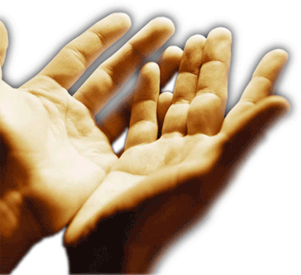
Through faith and obedience and repentance we can be made clean
(3)

Slide 38
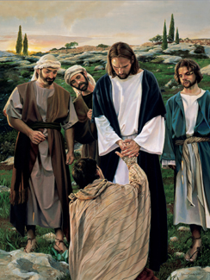
“…Arise, go thy way…
Liz lemon Swindle
…thy faith hath made thee whole.”
Luke 17:19

Slide 39
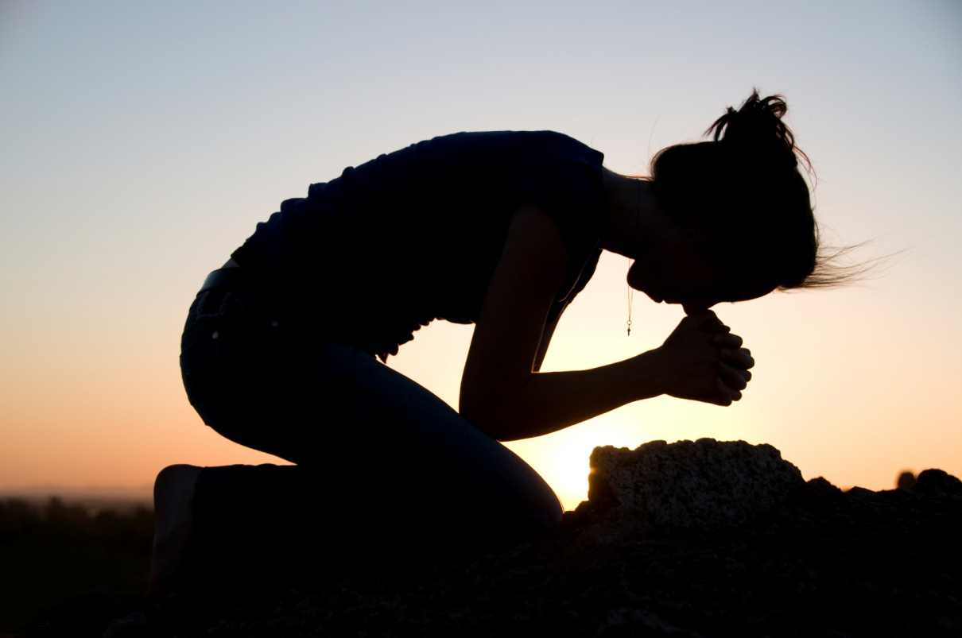
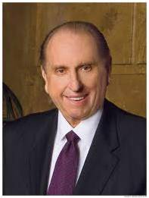
“Thou shalt thank the Lord thy God in all things.”
D&C 59:7
“My brothers and sisters, do we remember to give thanks for the blessings we receive? Sincerely giving thanks not only helps us recognize our blessings, but it also unlocks the doors of heaven and helps us feel God’s love”

Slide 40
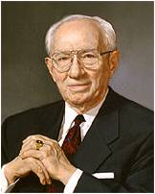
The Habit of Saying Thankyou
“The habit of saying thank you is the mark of an educated man or woman. …
“… Let a spirit of thanksgiving guide and bless your days and nights. Work at it. You will find it will yield wonderful results.”
(6)

Slide 41
Sources:
Suggested Hymn: #241 Count Your Blessings
Video: The 10th Leper (5:38)
New Testament Institute Student Manual Chapter 18
President Henry B. Eyring ("To Touch a Life with Faith,“ Ensign, Nov. 1995, 38)
Leprosy notes from: Dr. Alan Gillen, a biology professor at Liberty University and James E. Talmage “Jesus the Christ” pg. 201,470-471 and Bible Dictionary
David O. McKay (Improvement Era, Nov. 1964)
President Thomas S. Monson “The Divine Gift of Gratitude,” Ensign or Liahona, Nov. 2010, 87).
President Gordon B. Hinckley (“A Prophet’s Counsel and Prayer for Youth,” Ensign, Jan. 2001, 4, orL iahona, Apr. 2001, 32).
Presentation by ©http://fashionsbylynda.com/blog/

Slide 42
Event | Matthew | Mark | Luke | John
Sin, forgiveness, Faith, and Duty |  |  | 17:1-4
Parable of Unprofitable Servant (Faith as a Mustard Seed) | 17:20 |  | 17:5-10
Jesus Goes North into Samaria and Galilee |  |  | 17:11
Jesus Cleanses Ten lepers |  |  | 17:12-19
Signs and Times of the Kingdom of God |  |  | 17:20-37
Mustard Seed Luke 17:5-10:
Elder John K. Carmack taught: “No matter how difficult and impossible the circumstances we face, we must retain the attitude that we are still in the Lord’s debt. Just keeping the commandments, while laudable, may be enough to maintain our faith but not enough to increase it. We must continue sacrificing and serving with no thought of reward. We do it out of love and gratitude for the Lord, to whom we owe everything” (“Lord, Increase Our Faith,” Ensign, Mar. 2002, 56).
Dr. Alan Gillen, a biology professor at Liberty University, is the author of Body by Design and The Genesis of Germs. He has also written more than 30 papers on topics in microbiology, zoology, and anatomy. Dr. Gillen is a regular contributor to various creation-based magazines, journals, and books.
Healing Inside Luke 17:11-19
“In becoming a whole person, the grateful leper was healed inside as well as on the outside. That day nine lepers were healed skin deep, but only one had the faith to be made whole” Bishop Merrill J. Bateman, (“The Power to Heal from Within,” Ensign, May 1995, 14).
Kingdom of God Luke 17:21:
The Prophet Joseph Smith taught the following about the “kingdom of God”:
“Some say the kingdom of God was not set up on the earth until the day of Pentecost, and that John [the Baptist] did not preach the baptism of repentance for the remission of sins; but I say, in the name of the Lord, that the kingdom of God was set up on the earth from the days of Adam to the present time. Whenever there has been a righteous man on earth unto whom God revealed His word and gave power and authority to administer in His name, … there is the kingdom of God” (Teachings of Presidents of the Church: Joseph Smith [2007], 82).

