Slide 1
Lesson 56
Judgment, Pride,
and The Life We Lead
Luke 18-21
Including:
The Parable of the Importuning Widow
and Unjust Judge
Parable of the Pharisee and the Publican
Parable of the Pounds
Zacchaeus
Parable of the Wicked Husbandmen
…and he inviteth them all to come unto him and partake of his goodness; and he denieth none that come unto him, black and white, bond and free, male and female; and he remembereth the heathen; and all are alike unto God, both Jew and Gentile.
2 Nephi 26:33

Slide 2
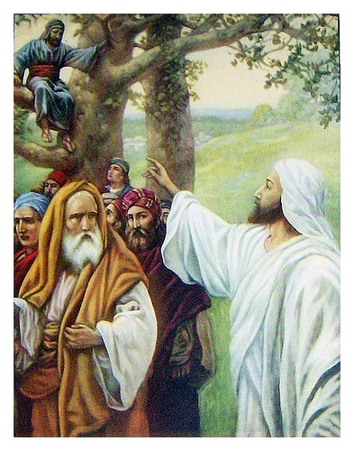
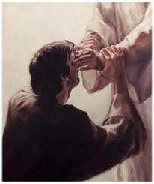
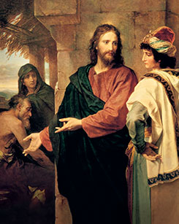
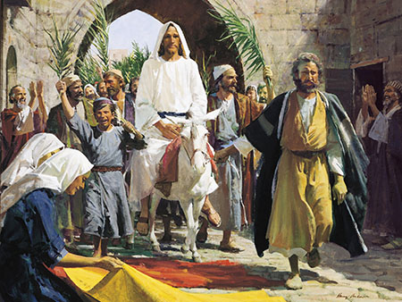
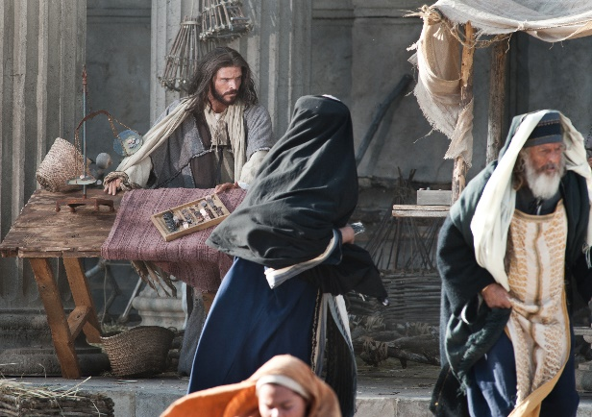
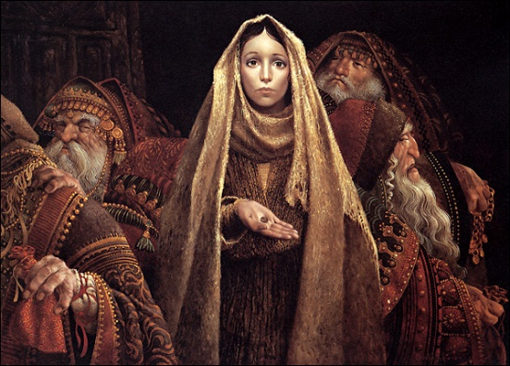
Previously Taught…
Jesus Christ traveled to Jerusalem for the last time in mortality.
He healed a blind man.
He invited the rich young ruler to give all to the poor and follow Him.
Despite ridicule, He dined with one of the chief publicans in Jericho.
He arrived in Jerusalem and, amidst shouts of praise, rode a colt as He entered the city.
He praised a widow who offered her two mites to the temple treasury
He again expelled the moneychangers from the temple,
He also taught the disciples about His Second Coming.

Slide 3
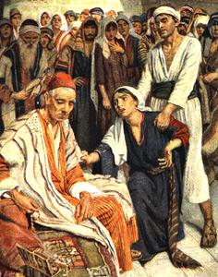
Parable of the Unjust Judge
“avenge = “give justice; see that justice is done.”
And I charged your judges at that time, saying, Hear the causes between your brethren, and judge righteously between every man and his brother, and the stranger that is with him.
Ye shall not respect persons in judgment; but ye shall hear the small as well as the great; ye shall not be afraid of the face of man; for the judgment is God’s: and the cause that is too hard for you, bring it unto me, and I will hear it.
Deuteronomy 1:16-17
If an unrighteous judge, faced with the persistent cry of a widow in whom he has no interest, responds eventually and vindicates her, how much more God in his righteousness, faced with the persistent cry of his elects, will respond and vindicate them quickly.” (2)
Luke 18:1-8

Slide 4
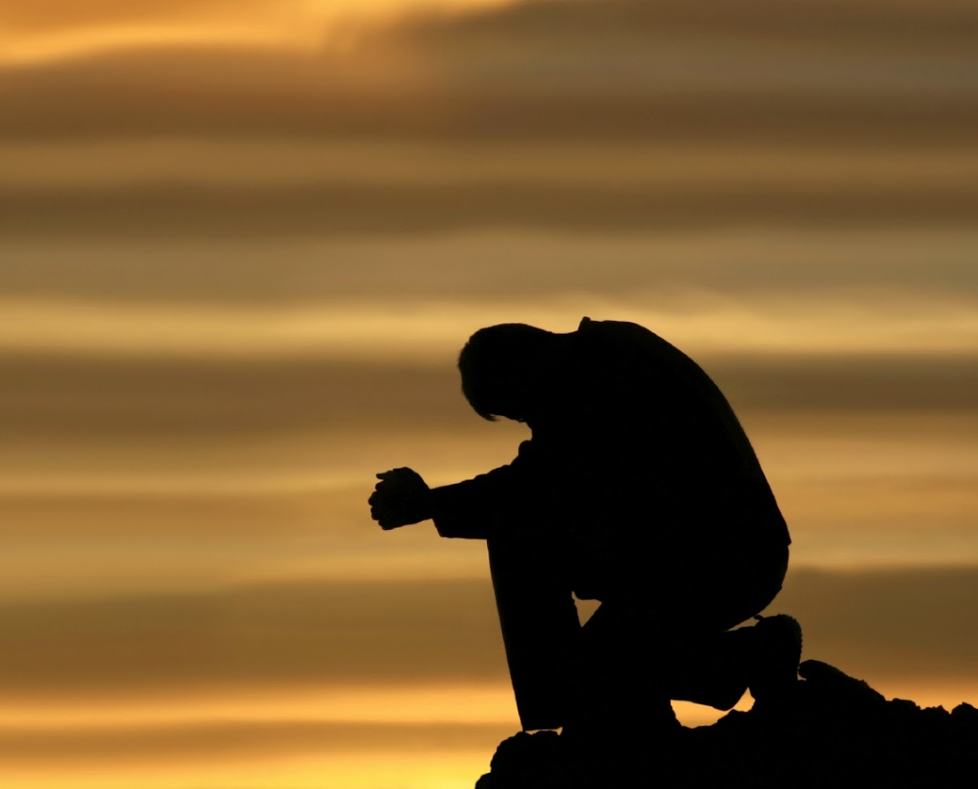
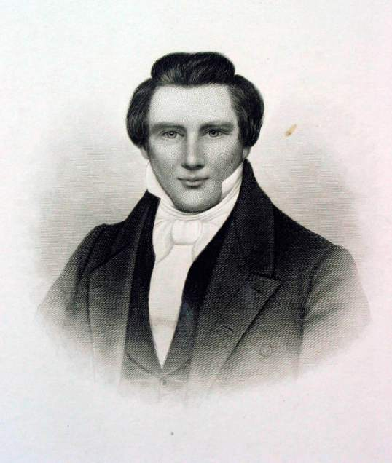
Pray Always and Not Faint
The parable teaches us to be persistent…keep praying for those in need, those whom we love, for guidance and safety, for health and strength.
However…
“This does not mean that we continually ask for something when we’ve already received an answer…” (3)
…wherefore, trouble me no more concerning this matter.
D&C 59:22
Joseph prays for when the Second Coming will be
Joseph, my son, if thou livest until thou art eighty-five years old, thou shalt see the face of the Son of Man; therefore let this suffice, and trouble me no more on this matter.
D&C 130:15
Luke 18:1-8; 2 Nephi 32:9

Slide 5
“One Proud, One Humble”
Parable of the Pharisee and The Publican
Luke 18:9-14

Slide 6
“Two men went to the temple to pray, one a Pharisee, and the other a publican”
Luke 18:10

Slide 7
Pharisee stood and prayed thus with himself, God, I thank thee, that I am not as other men are, extortioners, unjust, adulterers, or even as this publican.”
“I fast twice in the week, I give tithes of all that I posses”
Luke 18:11-12

Slide 8
“And the publican, standing afar off, would not lift up so much as his eyes unto heaven…
…But smote upon his breast, saying, God be merciful to me a sinner”
Luke 18:13

Slide 9
“I tell you, this man went down to his house justified rather than the other:
Luke 18:14

Slide 10
“For every one that exalteth himself shall be abased;
,,,And he that humbleth himself shall be exalted.”
Luke 18:14

Slide 11
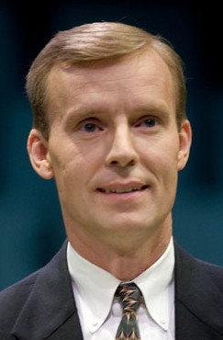
The Pharisee VS the Publican
Expresses gratitude that he is not as other men.
Expresses sorrow for his sins
Enumerates his works (fasting and tithing), as if to put God in his debt
Acknowledges his sins, his debt to God
Prays about himself with humility
Self-justified, self-sufficient, needs nothing
In need of mercy
Prays about himself
Looks down in humility
Looks up with pride
His prayer is 7 words, one which is “God” and one a personal pronoun “me”
His prayer is 34 words, 5 of which are “I”, one of which is “God”
(3)

Slide 12
Alma 31:17
“…Thou hast elected us that we shall be saved, whilst all around us are elected to be cast by thy wrath down to hell; for the which holiness, O God, we thank thee…
Prayer of the Zoramites on top of Rameumptom

Slide 13
Alma 31:17
…and we also thank thee that thou hast elected us, that we may not be led away after the foolish traditions of our brethren, which doth bind them down to a belief of Christ, which doth lead their hearts to wander far from thee, our God.”

Slide 14
Come Unto Christ
Liberty
Seek help from God
Repentance
Blessings
Prosperity
Humility Cycle
Misery
We come to ourselves
Selfishness
Selp-Indulgence
Pride Cycle
“Lifted up”
Inequality and class divsion
Hatred
War
Persecution of others
Seek control over others and use others
Insensitivity
Past feeling
Personal Apostasy
Sin and
Bondage

Slide 15
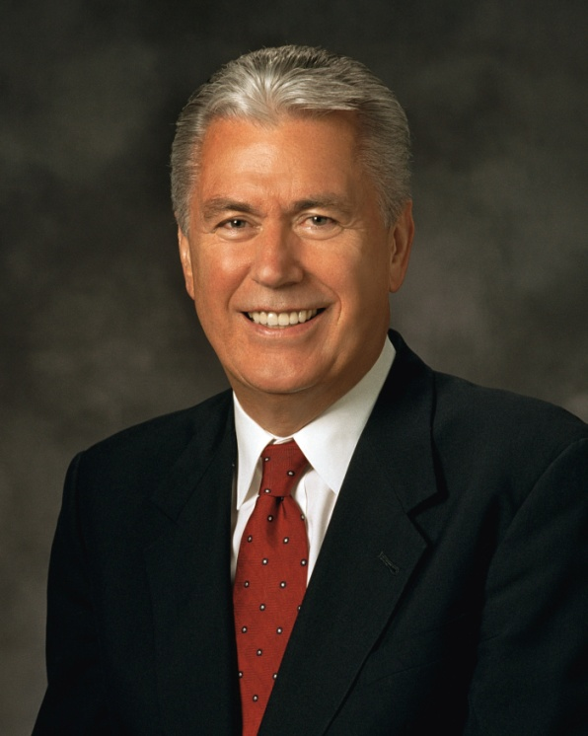
“Pride is the great sin of self-elevation.
It is for so many a personal Rameumptom, a holy stand that justifies envy, greed, and vanity. In a sense, pride is the original sin, for before the foundations of this earth, pride felled Lucifer… Some count these blessings as evidence of being “chosen,” “superior,” or “more righteous” than others.
This is a sin of “Thank God I am more
special than you.”
(4)

Slide 16
Peter warned:
“God resisteth the proud, and giveth grace to the humble”
Peter 5:5
“…for none is acceptable before God, save the meek and lowly in heart;…”
Moroni 7:44
“But God hath chosen the foolish things of the world to confound the wise; and God hath chosen the weak things of the world to confound the things which are mighty”
1 Corinthians 1:27
“The weak things of the world shall come forth and break down the might and strong ones…” D&C 1:19

Slide 17
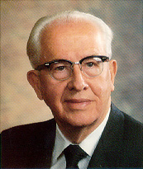
“Pride exists not only from the top looking down, but often from the bottom looking up”
(5)

Slide 18
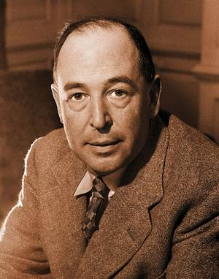
C. S. Lewis
“Pride gets no pleasure out of having something, only out of having more of it than the next man…
…it is the comparison that makes you proud; the pleasure of being above the rest.
(6)

Slide 19
Once the element of competition is gone, pride has gone.
Whenever we find that our religious life is making us feel that we are good—above all, that we are better than someone else—I think we may be sure that we are being acted on, not by God, but by the devil.”
(6)

Slide 20
“Do not say: O God, I thank thee that we are better than our brethren! but rather say; O Lord, forgive my unworthiness, and remember my brethren in mercy—yea acknowledge your unworthiness before God at all times.”
Alma to son Shilbon
Alma 38:14

Slide 21
Mosiah 3:19
“…and becometh as a child, submissive, meek, humble, patient, full of love, willing to submit to all things which the Lord seeth fit to inflict upon him, even as a child doth submit to his father.”

Slide 22
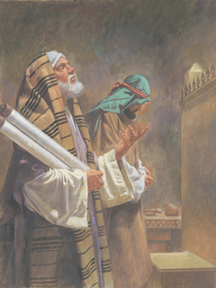
“Could there be greater contrast in the prayers of the two men? The Pharisee stood apart because he believed he was better than other men, whom he considered as common. The publican stood apart also, but it was because he felt himself unworthy.
The Pharisee thought of no one other than himself and regarded everyone else a sinner, whereas the publican thought of everyone else as righteous as compared with himself, a sinner. The Pharisee asked nothing of God, but relied upon his own self-righteousness. The publican appealed to God for mercy and forgiveness of his sins.
Robert T. Barrett
(7)

Slide 23
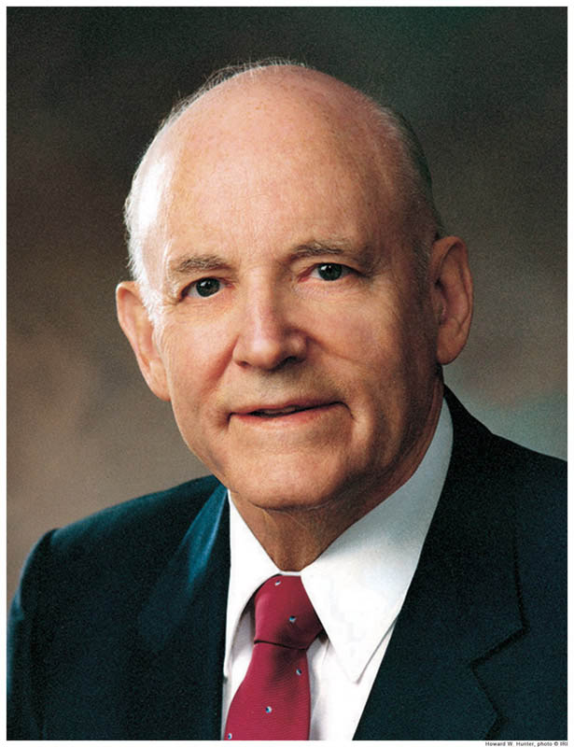
“Humility is an attribute of godliness possessed by true Saints. It is easy to understand why a proud man fails. He is content to rely upon himself only.
… The proud man shuts himself off from God, and when he does he no longer lives in the light. …
“… History bears record that those who have exalted themselves have been abased, but the humble have been exalted. On every busy street there are Pharisees and publicans. It may be that one of them bears our name.”
(7)

Slide 24
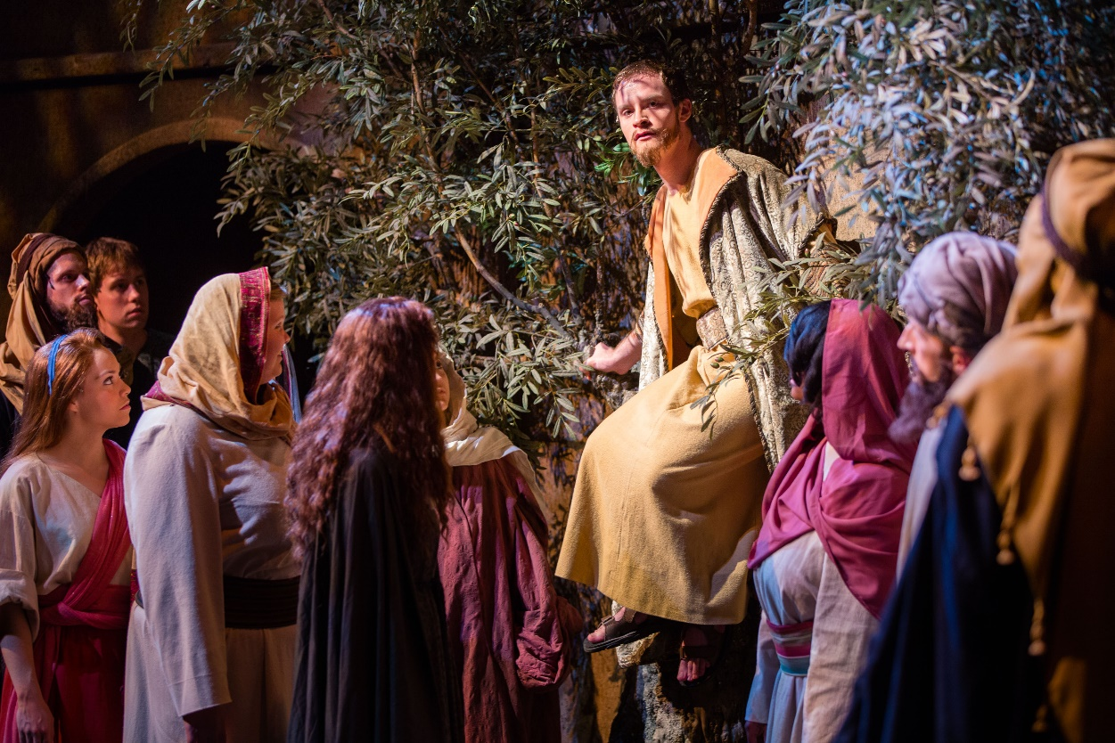
Zacchaeus
Jesus was on His way to Jerusalem for the last time. He passed through Jericho, where he encountered a man named Zacchaeus. Zacchaeus was a good man, who gave half of his goods to the poor and made “fourfold” restitution when necessary—well beyond what the law of Moses required.
Luke 19:1-10
(1)

Slide 25
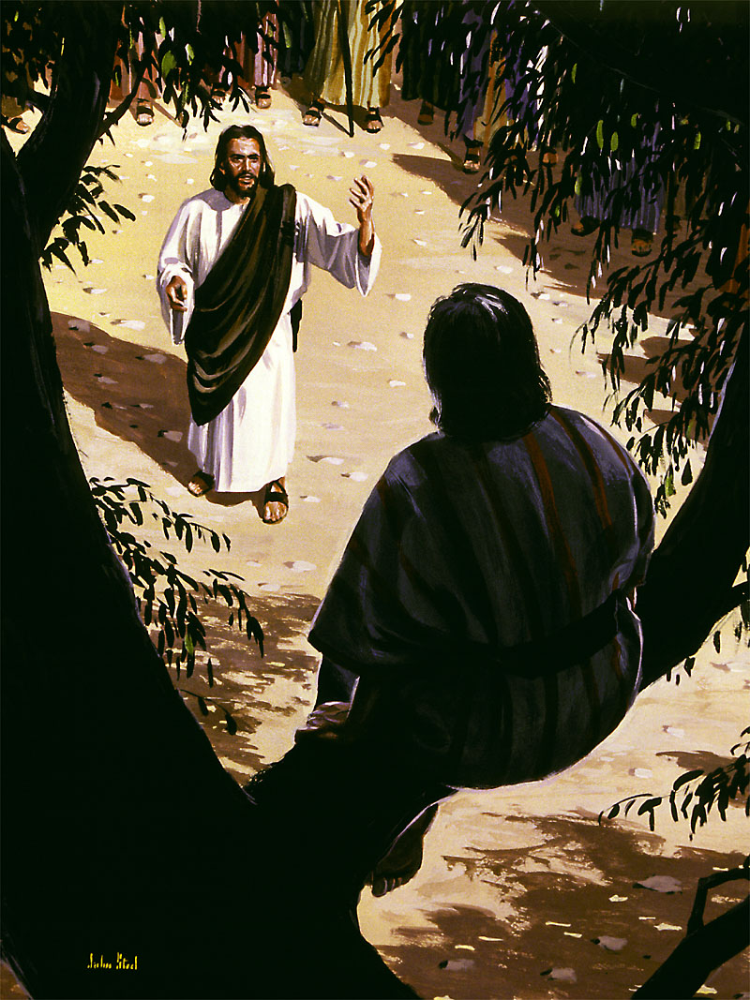
Seek and Save That Which Was Lost
He was sincere and determined to do all he could to make things right. However, before his meeting with Jesus, Zacchaeus could have been considered the epitome of the “lost.”
Not only was he a despised publican, but he was “the chief among the publicans.” Some people regarded Jewish publicans as having forfeited their claim to be among Abraham’s chosen offspring, but the Savior offered fellowship and salvation even to Zacchaeus, affirming that he “also is a son of Abraham.”
Luke 19:1-10
(1)

Slide 26
Parable of the Pounds
Luke 19:12-27
Matthew 19:16-28
Mark 10
Interpretation by
Bruce R. McConkie (8)

Slide 27
Christ is the nobleman

Slide 28
The far off country is heaven

Slide 29
The Kingdom there to be given him is “all power”…in heaven and in earth

Slide 30
And his promised return is the glorious Second Coming, when the literal and visible kingdom shall be set up on earth.

Slide 31
The ten servants are the members of the Church, to whom he has given physical, mental, and spiritual capacities (pounds) to be used in his service.

Slide 32
Those designated as “citizens” are the other people in the world, those who are subject to him because he is the God of the whole earth, but who have not accepted his gospel and come into his fold as servants.

Slide 33
The servants are commanded to labor in the vineyard on their Lord’s errand until he returns.

Slide 34
When the nobleman returns to judge the world, he will reward his servants in accordance with their works.

Slide 35
All shall not receive the same status in the mansions which are prepared; there are degrees of glory.
Some will rule ten cities, others five, and those who were slothful shall be disinherited entirely.

Slide 36
Unused faculties are lost; rightly used abilities can be increased until perfection is attained.
“Unto every servant who is diligent shall be given great reward; and from him who is slothful shall be taken away even the light, abilities, and faculties which he had.
(8)

Slide 37
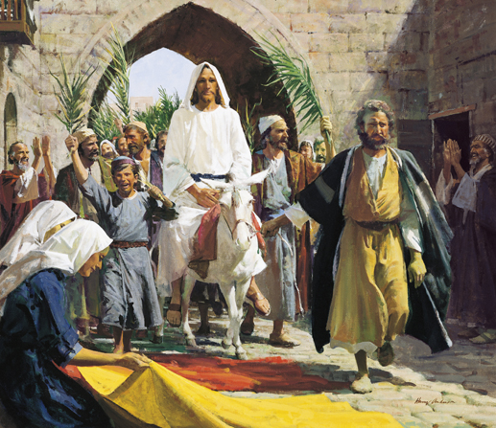
The Triumphal Entry
Luke 19:30-35

Slide 38
“A colt tied, whereon yet never man sat”
Zechariah 9:9
Matthew 21:2-7
Mark 11:2-7
John 12:14-15

Slide 39
“They spread their clothes in the way”
Luke 19:36
Matthew 21:8
Mark 1:8

Slide 40
“Took branches of palm trees, and went forth to meet him”
John 12:13
Matthew 21:8
Mark 11:8

Slide 41
Hosanna
Hosanna to the Son of David: Blessed is he that cometh in the name of the Lord”
Matthew 21:9
Mark 11:9-10
Luke 19:38
John 12:13

Slide 42
“If these should hold their peace, the stones, would immediately cry out”
Luke 19:40
John 12:19

Slide 43
The Parable of the Wicked Husbandmen
Luke 20:9-18
Also see Matthew 21:33-46
Mark 12:1-12

Slide 44
Luke 20:9

Slide 45
Luke 20:10

Slide 46
Luke 20:11

Slide 47
Luke 20:12

Slide 48
Luke 20:13

Slide 49
Luke 20:14

Slide 50
Luke 20:15

Slide 51
Luke 20:16

Slide 52
Luke 20:17
“And he beheld them, and said, What is this then that is written, The stone which the builders rejected, the same is become the head of the corner?
18. Whosoever shall fall upon that stone shall be broken; but on whomsoever it shall fall, it will grind him to powder”

Slide 53
A Certain Man
Vineyard
Far country
Husbandmen (farmers)
Servants
Beloved Son
Cast and killed
Destroy vineyard and give to others
Our Father in Heaven
The world
Heaven
People of the world
Prophets, Apostles, those who preach the gospel of Jesus Christ
Jesus Christ
Rejected Jesus and crucified him. Rejecting the Gospel
Heavenly Father will withdraw His spirit from those who reject the gospel and give it to those who will embrace it.
Symbolism

Slide 54
A Message from Preach My Gospel
People have repeatedly chosen to
reject the Gospel of Jesus Christ,
messages that have been revealed to
His servants such as Adam, Noah,
Abraham, and Moses. If we continue
to reject, (cast out) His gospel the
Lord
will withdraw His kingdom and
establish His Gospel to those who will listen.

Slide 55
Luke 21
Jesus foretells the destruction of the temple and of Jerusalem
He tells of the signs to precede his Second Coming and gives the parable of the fig tree.

Slide 56
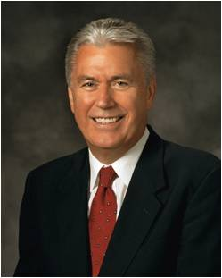
Patience—a Process of Perfection
The Savior Himself said that in your patience you possess your souls.
Or, to use another translation of the Greek text, in your patience you win mastery of your souls.
Patience means to abide in faith, knowing that sometimes it is in the waiting rather than in the receiving that we grow the most.
This was true in the time of the Savior. It is true in our time as well, for we are commanded in these latter days to ‘continue in patience until ye are perfected’”
Luke 21:19
(4)

Slide 57
Sources:
Suggested Hymn: #117 Come Unto Jesus
Video: Pure and Simple Faith (5:22)
New Testament Institute Student Manual Chapter 19
David Wenham Parable of Jesus p. 167
John Bytheway Of Pigs, Pearls, and Prodigals p. 207
Dieter F. Uchtodorf Pride and the Priesthood 2010 Oct. Conference and “Continue in Patience,” Ensign or Liahona, May 2010, 59
President Ezra Taft Benson Beware of Pride April 1989 Gen. Conf.
C. S. Lewis Mere Christianity P 109-111
President Howard W. Hunter (“The Pharisee and the Publican,” Ensign, May 1984, 65–66).
Elder Bruce R. McConkie (Doctrinal New Testament Commentary 1:572-73)
Presentation by ©http://fashionsbylynda.com/blog/

Slide 58
Perean Ministry
Event | Matthew | Mark | Luke | John
Jesus Blesses the Little Children | 19:13-15 | 10:13-16 | 18:15-17
Jesus Teaches a Rich Young Ruler | 19:16-26 | 10:17-27 | 18:18-27
Results of Following Jesus | 19:27-30 | 10:28-31 | 18:28-30
Jesus Foretells his Death and Resurrection in Jerusalem | 20:17-19 | 10:32-34 | 18:31-34
Blind Bartimaeus and Another Healed Near Jericho | 20:29-34 | 10:46-52 | 18:35-43
Zacchaeus the Sinner is Saved |  |  | 19:1-10
Parable Showing the Kingdom of God Not to appear Immediately |  |  | 19:11-27
Jesus Approaches Jerusalem for the Passover |  |  | 19:28
Triumphal Entry into Jerusalem and Return to Bethany | 21:1-11 | 11:1-11 | 19:29-44 | 12:12-19
Second Cleansing of the Temple | 21:12-16 | 11:15-18 | 19:45-48

Slide 59
Perean Ministry Continued
Event | Matthew | Mark | Luke | John
Return to Bethany | 21:17 | 11:19 | 21:37
By What Authority? | 21:23-27 | 11:27-33 | 21:38, 20:1-8
Parable of the Wicked Husbandmen | 21:33-46 | 12:1-12 | 20:9-19
Marriage and Resurrection | 22:23-33 | 12:18-27 | 20:27-39
“Which is the Great Commandment in the Law?” | 22:41-46 | 12:35-37 | 20:41-44
“What Think Ye of Christ/ Whose Son is He?” | 22:41-46 | 12:35-37 | 20:41-44
Jesus’ Warning; Against Scribes and Pharisees | 23:1-39 | 12:38-40 | 20:45-47
The Widow’s Mite |  | 12:41-44 | 21:1-4
Signs of the Destruction of the Temple and of Jesus’ Second Coming | 24:1-31 | 13:1-27 | 21:5-28
Parable of the Fig Tree | 24:32-36 | 13:28-32 | 21:29-33
Second Coming Likened to the Days of Noah | 24:37-42 | 13:33 | 21:34-36

Slide 60
Widows Luke 18:1-8
“Widows were a traditionally vulnerable group in Palestinian society. Girls were regularly married at the age of thirteen or fourteen, and so a widow could be quite young, with no grown-up children to care for her. For such a wife to lose her husband was to lose her position and status in society, and also her natural male protector. Whether your or old, widows were often easy game for the ruthless exploiter, and Jesus speaks in mark 12:40 of teachers of the law who should have been the first to car for the weak “devouring widows’ houses” –presumably a reference to economic exploitation of some kind. David Wenham Parables of Jesus , p. 185-86
Pharisees and Publicans Luke 18:9—14
Luke stated that the Savior addressed the parable of the Pharisee and the publican to people who “trusted in themselves that they were righteous, and despised others” (Luke 18:9). The parable probably surprised those who heard it, for Pharisees were generally admired and regarded as very obedient to the law, though Jesus had rebuked them for hypocrisy. Publicans, however, were tax collectors and were hated, shunned, and seen as corrupt. Though they were :often grouped with harlots and sinners, many were receptive to Jesus’s teaching
The four Gospels record no instance of Jesus being critical of those who were willing to listen, to be taught, and to change their lives for good. To the self-righteous, proud, or hypocritical, however, He was often fearless and unyielding in His denunciation of their behavior, as He was in this parable. The Savior stated the moral of the parable in terms of pride and humility: “For every one that exalteth himself shall be abased; and he that humbleth himself shall be exalted”
(1)
Keep Knocking Luke 18:1-8
“When lonely, cold, hard times come, we have to endure, we have to continue, we have to persist. That was the Savior’s message in the parable of the importuning widow. … Keep knocking on that door. Keep pleading. In the meantime, know that God hears your cries and knows your distress. He is your Father, and you are His child” Elder Jeffrey R. Holland (“Lessons from Liberty Jail,” Ensign, Sept. 2009, 30).
Perseverance is rooted in the foundational gospel principles of faith and hope. Perseverance reflects our faith that our actions will bring the Lord’s blessings into our lives.(1)
Bruce R. McConkie: “If an evil magistrate, caring nothing for a poor widow, will finally adjudge her case, how much more shall the Judge of all the earth, who loves his saints, finally, in the day of vengeance at his coming, avenge his elect upon all their enemies” (The Mortal Messiah: From Bethlehem to Calvary, 4 vols. [1979–81], 3:289).
Parable of the Pounds Luke 19:11-27:
To correct the false concept that ‘the kingdom of God’—meaning the political kingdom, the kingdom which should rule all nations with King Messiah at its head, the millennial kingdom—‘should immediately appear,’ Jesus gave the Parable of the Pounds. …
“Christ is the nobleman; the far off country is heaven; the kingdom there to be given him is ‘all power … in heaven and in earth’ (Matt. 28:18); and his promised return is the glorious Second Coming, when the literal and visible kingdom shall be set up on earth. … The servants are commanded to labor in the vineyard on their Lord’s errand until he returns” Elder Bruce R. McConkie (Doctrinal New Testament Commentary [1965–73], 1:571–72).
Faith of the Widow Luke 8:1-8:
“True faith is focused in and on the Lord Jesus Christ and always leads to righteous action” (“Ask in Faith,” Ensign or Liahona, May 2008, 95).
Mercy of the Lord:
“The Lord’s tender mercies are the very personal and individualized blessings, strength, protection, assurances, guidance, loving-kindnesses, consolation, support, and spiritual gifts which we receive from and because of and through the Lord Jesus Christ” Elder David A. Bednar (“The Tender Mercies of the Lord,” Ensign or Liahona, May 2005, 99).
To Be Fulfilled Luke 21:24:
Many of the Savior’s teachings about the destruction of Jerusalem and the Second Coming found in Luke 21 are also found in Matthew 24, Mark 13, and Joseph Smith—Matthew. However, only Luke recorded the Savior’s warning that if people were “overcharged [weighed down] with surfeiting [overindulgence of appetites], and drunkenness, and cares of this life [anxieties and stresses]” (Luke 21:34), they would not be prepared for His Second Coming. This warning about self-indulgence and drunkenness in the last days is similar to the Savior’s declaration that the last days would be “as the days of Noe [Noah],” when people “were eating and drinking, … and knew not until the flood came” (Matthew 24:37–39). To protect Saints in the latter days, the Lord revealed the Word of Wisdom, including the commandment to abstain from alcohol and harmful drugs (see D&C 89:4–7, 18–21). Obeying this commandment not only benefits our physical health but also helps us be spiritually prepared to meet the Savior. (1)

Slide 61
A Certain Man
Vineyard
Far country
Husbandmen (farmers)
Servants
Beloved Son
Cast and killed
Destroy vineyard and give to others
Our Father in Heaven
The world
Heaven
People of the world
Prophets, Apostles, those who preach the gospel of Jesus Christ
Jesus Christ
Rejected Jesus and crucified him. Rejecting the Gospel
Heavenly Father will withdraw His spirit from those who reject the gospel and give it to those who will embrace it.
Symbolism
Symbolism
The Parable of the Wicked Husbandmen

