Slide 1
Lesson 58
Trial, Crucifixion, and Burial of Jesus
Luke 23
…forgive them; for they know not what they do.
Luke 23:35

Slide 2
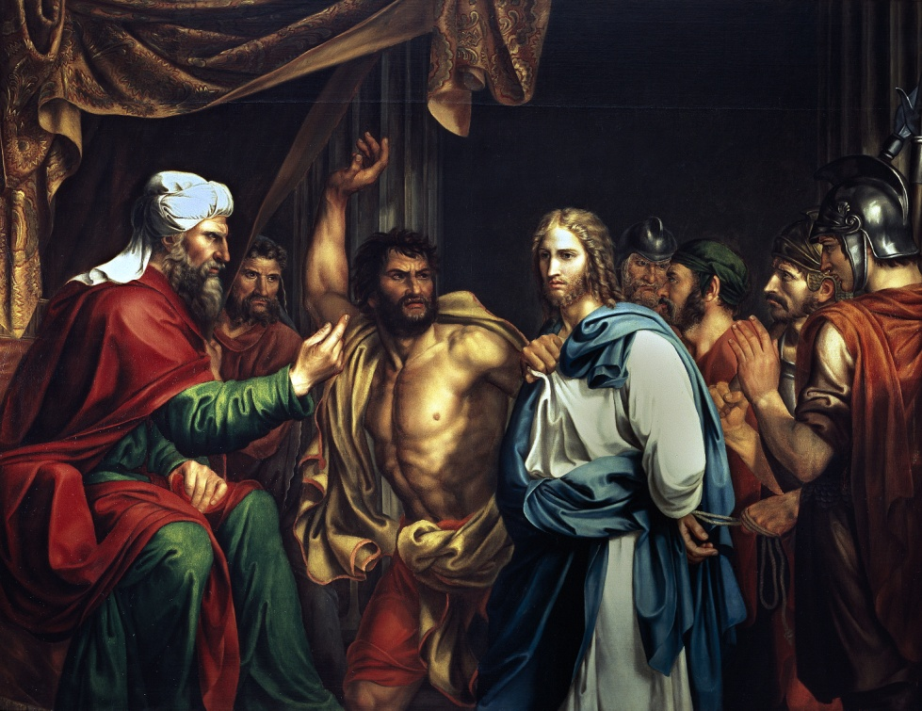
3 Charges Brought Against Jesus
After Jesus had suffered in Gethsemane, the chief priests arrested Him and condemned Him to die.
1. “perverting” or causing disruption to the nation.
2. Teaching Roman subjects not to pay tribute to Caesar.
3. Claiming to be a king of a competing earthly kingdom.
These would have been considered acts of treason, for which the penalty was death. Jesus Christ, of course, was innocent of these trumped-up charges.
Jose Madrazo, 1803.
(1)

Slide 3
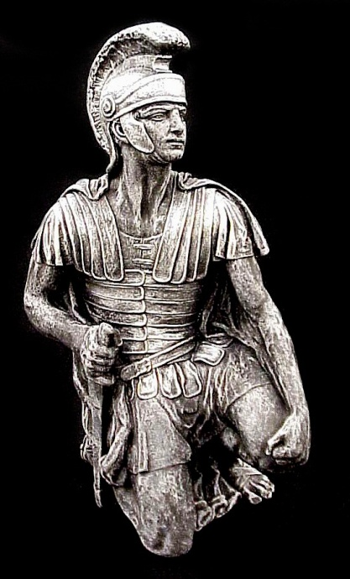
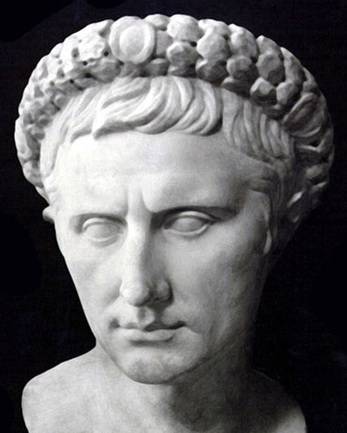
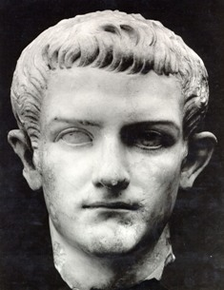
Judgment and Mistreatment
Pontius Pilate
Herod Antipas
Roman Soldiers
The presence of Roman forces in Judea was brought about by a treaty between Judas Maccabaeus (the Jewish head of state) and Rome about 160 BC.
“The soldiers of the Governor…” The term here (stratiwtai/stratiotai) is the regular term for soldier.
This is the same term used to describe the people who carried out all of the brutal and violent acts attributed to soldiers in the New Testament. (2)
A Roman ruler in the territory of Judea, which included the capital city of Jerusalem.
Ruled the territories of Galilee and Perea under Roman authority—had also put John the Baptist to death.
(1)

Slide 4
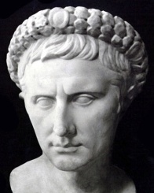
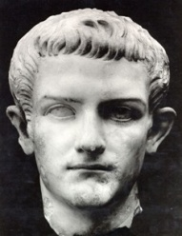
Savior’s Trial
Pontius Pilate
Herod Antipas
Roman Soldiers
Herod and his men-at-arms made sport of the suffering Christ, ‘set him at nought and mocked him’; then in travesty they ‘arrayed him in a gorgeous robe and sent him again to Pilate’
Pilate began looking for a way to dismiss the case against Him.
When Pilate learned that Jesus was a Galilean, he sent Him to Herod Antipas.
Herod was eager to see Jesus, hoping to witness a miracle of some sort.
“Herod began to question the Prisoner; but Jesus remained silent.
As far as we know, Herod is … the only being who saw Christ face to face and spoke to Him, yet never heard His voice. … For Herod the fox He had but disdainful and kingly silence.
Herod had found nothing in Jesus to warrant condemnation” (3)
Luke 23:1-12
(1)

Slide 5
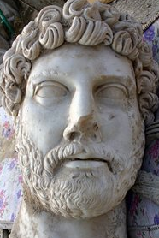
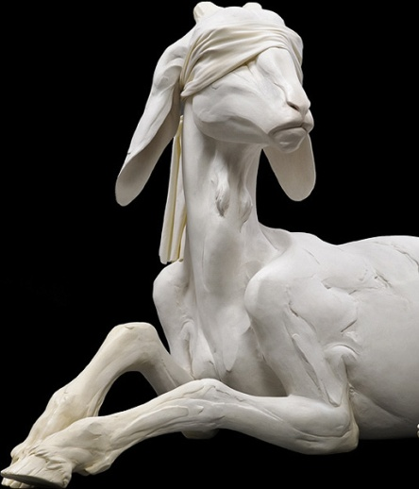
Release of a Prisoner
Pontius Pilate
The law of Moses taught that once a year, on the Day of Atonement, the high priest selected two goats. One goat became the scapegoat and was released alive into the wilderness, while the other was “for the Lord” and was killed as an offering for the sins of the people.
The high priest then took blood from the slain goat into the Holy of Holies of the tabernacle. He sprinkled it on the lid of the ark of the covenant (called the mercy seat), symbolically making atonement for the sins of Israel.
Barabbas
Neither Pilate nor Herod could find fault with Jesus, so Pilate told the multitude that he would punish Jesus and release Him.
Pilate asked the Jews in attendance three times why they wanted Jesus crucified and then, finally giving in to popular pressure, released Barabbas
According to the Greek to Matthew, Barabbas’s first name was Jesus.
Jesus Barabbas was a thief, murderer, and traitor, while Jesus the Christ was perfect.
Luke 23:12-25; Matthew 27:26; Leviticus 16:8-10
(1)

Slide 6
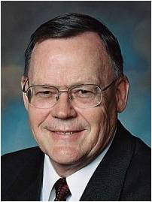
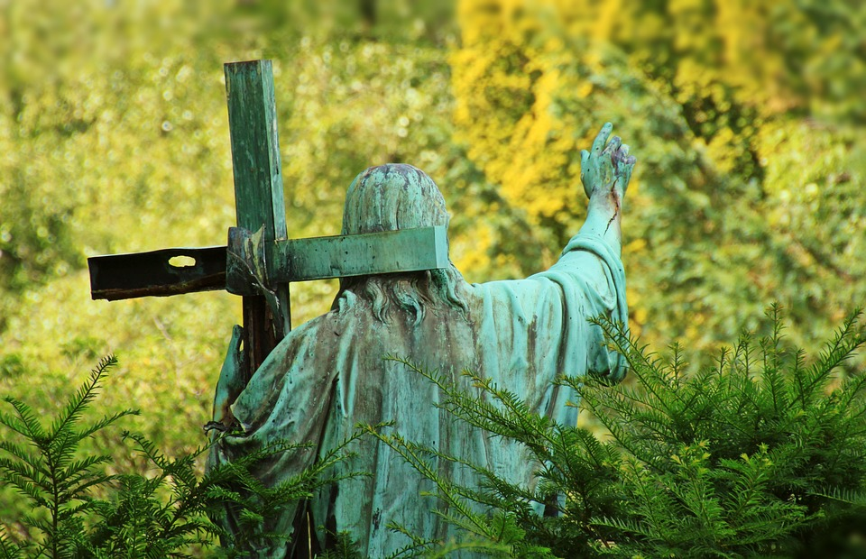
“Christ, as the lamb of Jehovah as well as High Priest, shed his own blood to enter the heavenly Holy of Holies where that blood ransomed from their sins those who would believe in him and obey his commandments.”
Heb. 9:11–14, 24–28; 10:11–22; D&C 45:3–5.
(4)

Slide 7
Pilot Washes His Hands
Pontius Pilate
One provision of the Mosaic law stated that if a person was found to have been killed, the elders of the city could wash their hands to signify that they were not responsible.
Pilate recognized that Jesus was innocent of the accusations made against Him; even his wife had warned him of Jesus Christ’s innocence.
There are also examples in Greek and Roman literature of washing oneself as a symbolic gesture of absolving oneself of responsibility for shedding another’s blood. Thus, when Pilate washed his hands, he may have been claiming innocence in a way the Jewish leaders would have understood.
“Pilate’s freshly washed hands could not have been more stained or more unclean” (5)
Luke 23:19-24; Matthew 27:19-24
(1)

Slide 8
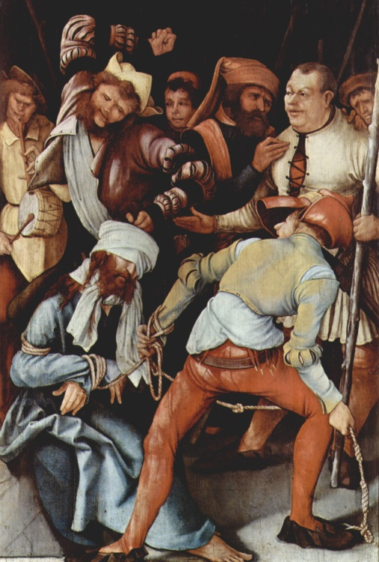
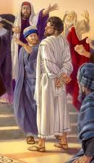
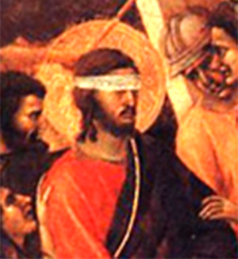
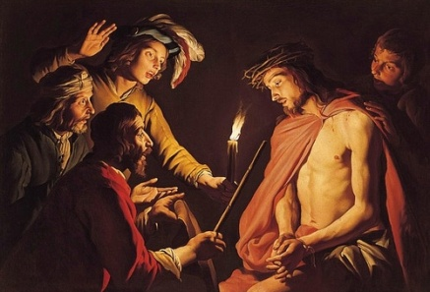
Mistreatment
Luke 23 Matthew 26-27 Mark 15 John 19
Mocked
Smote
Blindfolded
Struck on the face

Slide 9
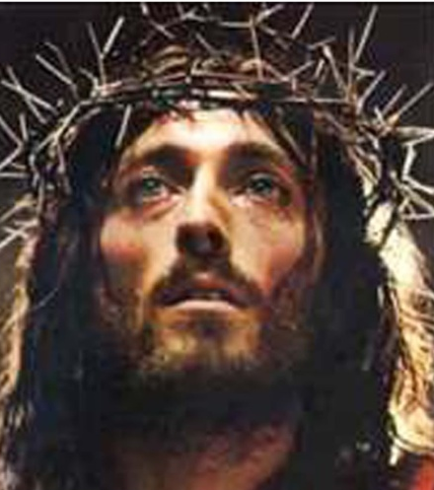
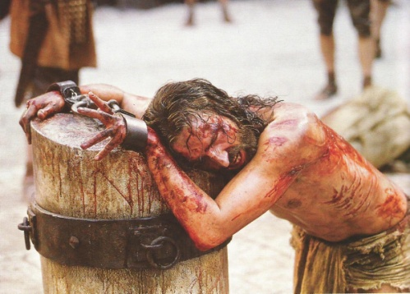
Mistreatment
Luke 23 Matthew 26-27 Mark 15 John 19
Scourged
Stripped
Scarlet robe
Crown of thorns
Mocked
Smote
Blindfolded
Struck on the face

Slide 10
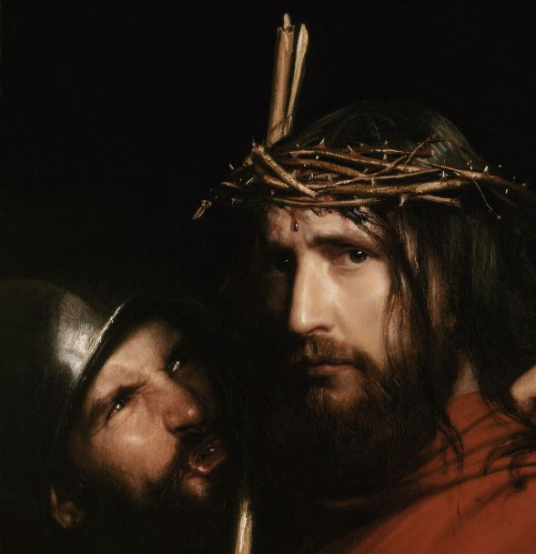
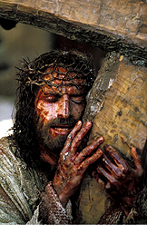
Mistreatment
Luke 23 Matthew 26-27 Mark 15 John 19
With reed smote him
Spit upon
Carried cross
Scourged
Stripped
Scarlet robe
Crown of thorns
Mocked
Smote
Blindfolded
Struck on the face

Slide 11
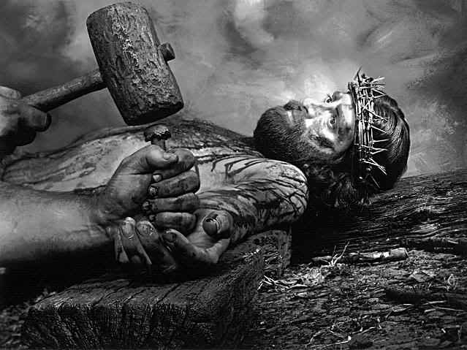
Mistreatment
Luke 23 Matthew 26-27 Mark 15 John 19
Antonio Ciseri
Took robe
Put on raiment
Nailed hands and feet
With reed smote him
Spit upon
Carried cross
Scourged
Stripped
Scarlet robe
Crown of thorns
Mocked
Smote
Blindfolded
Struck on the face

Slide 12
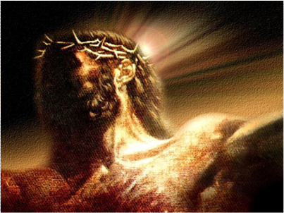
Mistreatment
Luke 23 Matthew 26-27 Mark 15 John 19
ὁ βασιλεὺς τῶν Ἰουδαίων
Crucified Him
Took robe
Put on raiment
Nailed hands and feet
With reed smote him
Spit upon
Carried cross
Scourged
Stripped
Scarlet robe
Crown of thorns
Mocked
Smote
Blindfolded
Struck on the face

Slide 13
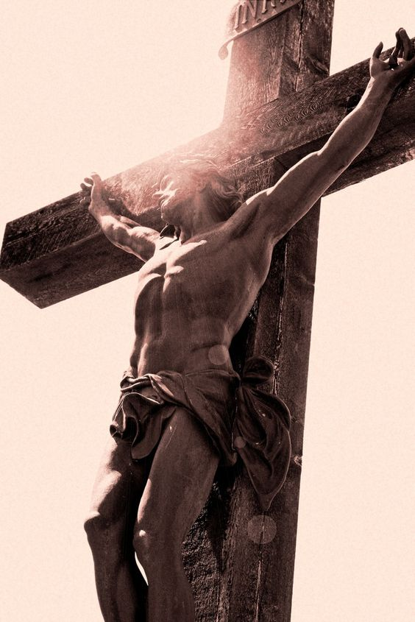
Mistreatment
Luke 23 Matthew 26-27 Mark 15 John 19
Pierced His side
ὁ βασιλεὺς τῶν Ἰουδαίων
Cast lots
Sat and watched
Vinegar to drink
Parted garments
Took robe
Put on raiment
Nailed hands and feet
With reed smote him
Spit upon
Carried cross
Scourged
Stripped
Scarlet robe
Crown of thorns
Mocked
Smote
Blindfolded
Struck on the face

Slide 14
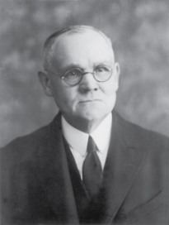
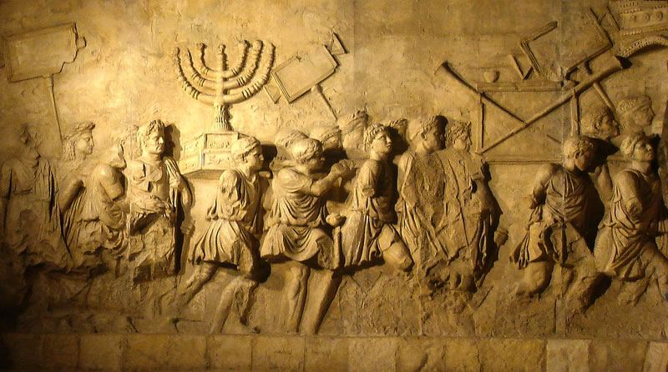
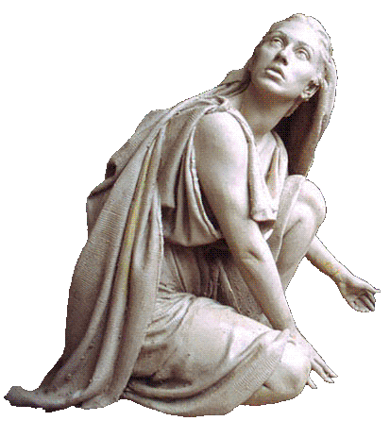
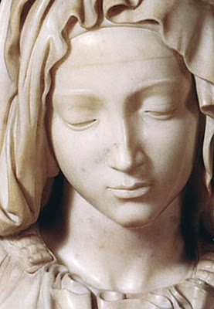
Daughters of Jerusalem
After Pilate sentenced the Savior to be crucified, many sorrowful people followed Him as He was led away. Luke particularly mentioned that women were members of this group—one of his numerous references to faithful women who revered Jesus Christ. At least some of them had followed Jesus from Galilee to Jerusalem.
The Lord’s warning to these women, whom He called “daughters of Jerusalem” referred to the future destruction of Jerusalem in A.D. 70:
“It was the Lord’s last testimony of the impending … destruction that was to follow the nation’s rejection of her King.
Although motherhood was the glory of every Jewish woman’s life, yet in the terrible scenes which many of those there weeping would live to witness, barrenness would be accounted a blessing; for the childless would have fewer to weep over, and at least would be spared the horror of seeing their offspring die of starvation or by violence” (3)
Luke 23:27-31, 49, 55
(1)

Slide 15
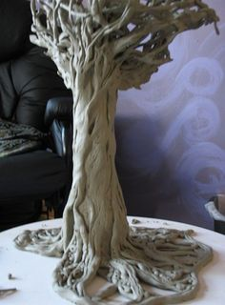
Green and Dry Tree
For if they do these things in a green tree, what shall be done in the dry?
The “green tree” = the time of Jesus Christ’s mortal ministry.
The Savior’s statement implied that if the oppressors of the Jewish people could carry out such evil acts at a time when Jesus was among them, they would do much worse things to the Jewish people after He was gone—a time represented by the “dry tree.”
The Joseph Smith Translation adds a sentence to this verse which describes the destruction that would occur after the Savior’s death.
Footnote b: This he spake, signifying the scattering of Israel, and the desolation of the heathen, or in other words, the Gentiles.
Luke 23:31 (JST)
(1)

Slide 16
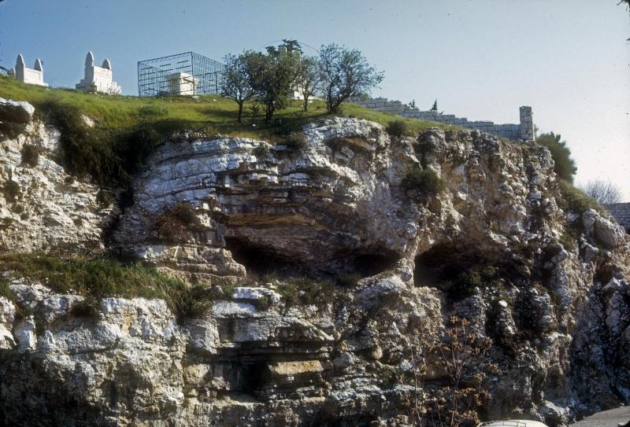
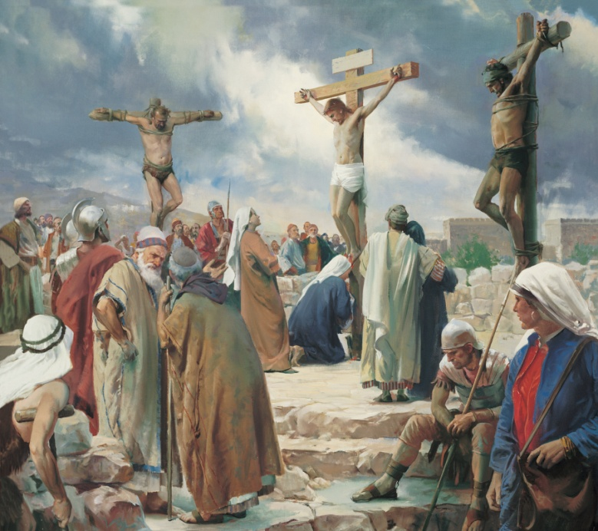
Jesus Crucified Between Two Thieves
Calvariae (in English, Calvary) is the Latin translation of the Greek word that means “skull.”
The other Gospel writers called the place of execution Golgotha, which comes from the Hebrew gulgoleth and the Aramaic gulgutha, both of which mean “skull.”
…and the malefactors, one on the right hand, and the other on the left.
Luke 23:33
(1)

Slide 17
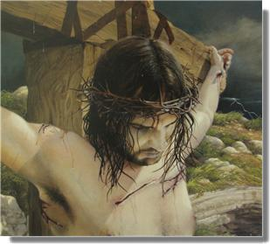
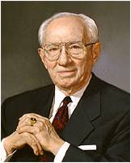
Forgiveness
The Joseph Smith Translation clarifies that the Savior spoke of the soldiers who crucified Him when He prayed, “Father, forgive them”:
“Then said Jesus, Father, forgive them; for they know not what they do (Meaning the soldiers who crucified him,)
Forgiving others does not mean that those who sin against us should not be held accountable for their actions. Nor does it mean that we should put ourselves in situations in which people can continue to mistreat us. Rather, forgiveness means to treat with love those who have mistreated us and to harbor no resentment or anger toward them. (6)
“I plead with you to ask the Lord for strength to forgive. … It may not be easy, and it may not come quickly. But if you will seek it with
sincerity and
cultivate it, it
will come” (7)
Luke 23:34
(1)

Slide 18
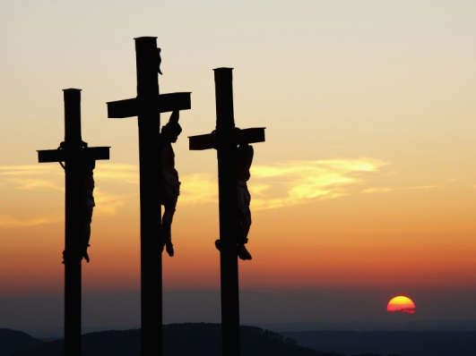
Paradise
Designates a place of peace and happiness in the postmortal spirit world, reserved for those who have been baptized and who have remained faithful.
Those in spirit prison have the opportunity to learn the gospel of Jesus Christ, repent of their sins, and receive the ordinances of baptism and confirmation through the work we do in temples. When they do, they may enter paradise.
“A second use of the word paradise is found in Luke’s account of the Savior’s Crucifixion. … The Prophet Joseph Smith explained that … the Lord actually
said that the thief would be with
Him in the world of spirits.”
The spirits of all people enter the spirit world at the time of their death
Luke 23:39-43; Alma 40:12; Moroni 10:34; D&C 138:30-35
(1,8)

Slide 19
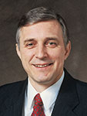
Spirit Prison
Under Jesus Christ’s direction, righteous messengers teach the gospel to those in spirit prison
“The Savior graciously answered and gave him hope. This criminal likely did not understand that the gospel would be preached to him in the spirit world or that he would be given an opportunity to live according to God in the spirit.
Truly the Savior cared for the thief who hung beside Him; surely He cares greatly for those who love Him and strive to keep His commandments!”
Luke 23:43; D&C 138:30-35; 1 Peter 4:6
(9)

Slide 20
To Be Redeemed
What would the thief, or any other spirit in spirit prison, need to do in order to be redeemed?
What will happen to those spirits who repent and accept the temple ordinances performed on their behalf?
Spirits “who repent will be redeemed, through obedience to the ordinances of the [temple],” be cleansed through the Atonement, and “receive [their] reward”
What can we do to help those spirits who, like the thief, need to be redeemed?
We can complete family history work and participate in temple ordinances for the dead.
Luke 23:43; D&C 138:58-59

Slide 21
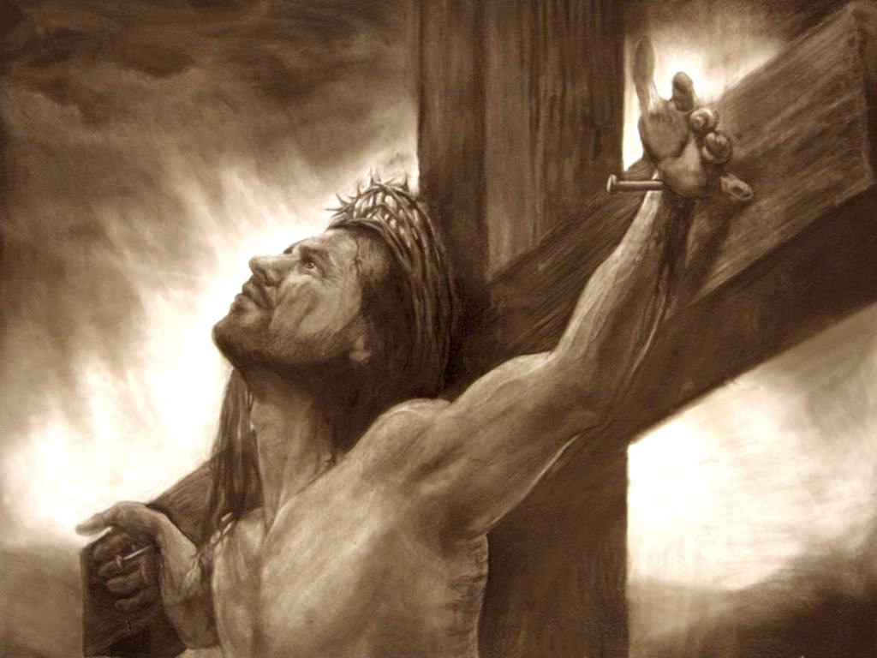
“Into Thy Hands I Commend My Spirit”
“When the uttermost farthing had then been paid, when Christ’s determination to be faithful was as obvious as it was utterly invincible, finally and mercifully, it was ‘finished’.
Against all odds and with none to help or uphold Him, Jesus of Nazareth, the living Son of the living God, restored physical life where death had held sway and brought joyful, spiritual redemption out of sin, hellish darkness, and despair.
With faith in the God He knew was there, He could say in triumph, ‘Father, into thy hands I commend my spirit.’”
Luke 23:46; John 19:30
(5)

Slide 22
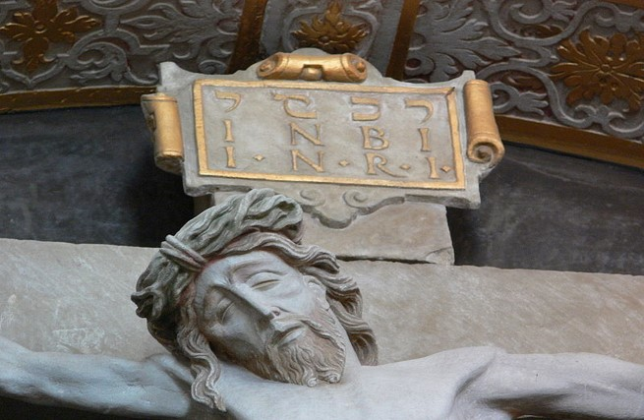

Slide 23
 | Mark | Luke | Matthew | John
Verse | 15:26 | 23:38 | 27:37 | 19:19-20
Greek Inscription | ὁ βασιλεὺς τῶν Ἰουδαίων | ὁ βασιλεὺς τῶν Ἰουδαίων οὗτος | οὗτός ἐστιν Ἰησοῦς ὁ βασιλεὺς τῶν Ἰουδαίων | Ἰησοῦς ὁ Ναζωραῖος ὁ βασιλεὺς τῶν Ἰουδαίων
English translation | The King of the Jews | This is the King of the Jews | This is Jesus, the King of the Jews | Jesus of Nazareth, the King of the Jews
Languages | [none specified] | Hebrew, Latin, Greek | [none specified] | Hebrew, Latin, Greek
Full verse in KJV | And the superscription of His accusation was written over, THE KING OF THE JEWS. | And a superscription also was written over Him in letters of Greek, and Latin, and Hebrew, THIS IS THE KING OF THE JEWS. | And set up over His head His accusation written, THIS IS JESUS THE KING OF THE JEWS | And Pilate wrote a title, and put it on the cross. And the writing was JESUS OF NAZARETH THE KING OF THE JEWS.
Name Plaque on the cross
Wikipedia

Slide 24
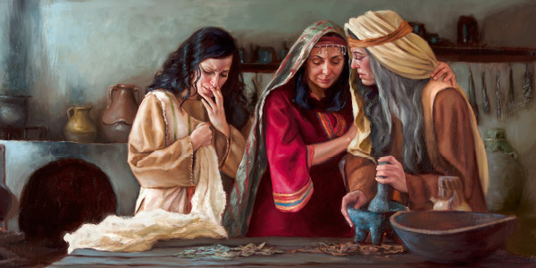
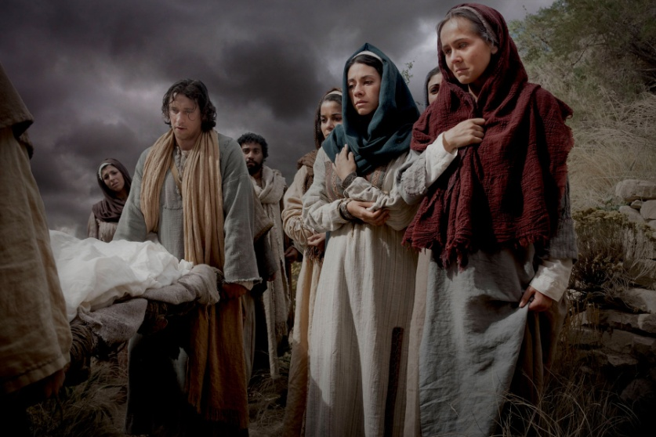
Burial of Jesus
The women had prepared spices and ointments to finish preparation of the body of Jesus because his burial had been done in haste.
Yet, the women strictly observed the Sabbath (on Saturday) “according to the commandment” before they went back to the tomb on Sunday to finish their task.
Even in the midst of their great tragedy, they kept the Sabbath commandment. The Greek word for “spice” is aroma. Spices and ointments were usually scented and were used for funerary, cosmetic, and medicinal purposes.
Luke 23:54-56; Matthew 27:57-60
(1)

Slide 25
Sources:
Suggested Hymn: #184 Upon the Cross of Calvary
New Testament Institute Student Manual Chapter 10 (Scapegoat) and 19
Bible.org article The Roman Military in the New Testament by John Hopkins
Elder James E. Talmage Jesus the Christ p. 636
Elder Gerald Lund Jesus Christ, Key to the Plan of Salvation[1991], 67
Elder Jeffrey R. Holland (“None Were with Him,” Ensign or Liahona, May 2009, 86, 88).
Forgiveness: Guide to the Scriptures
President Gordon B. Hinckley (“Of You It Is Required to Forgive,” Ensign, June 1991, 5).
(True to the Faith: A Gospel Reference [2004], 111; see also History of the Church, 5:424–25).
Brother Alain A. Petion (“Words of Jesus: On the Cross,” Ensign, June 2003, 34).
Presentation by ©http://fashionsbylynda.com/blog/

Slide 26
The Week of Atonement
Event | Matthew | Mark | Luke | John
First Appearance Before Pilate | 27:2, 11-14 | 15:1-5 | 23:1-7 | 18:28-38
Jesus Before Herod |  |  | 23:8-12
Pilate Pleads for Jesus | 27:23 | 15:14 | 23:23 | 19:4-15
Pilate Preleases Barabbas and Delivers Jesus to Be Crucified | 27:24-26 | 15:5 | 23:24, 25 | 19:16
Jesus Mocked and led to Golgotha and Crucified | 27:31-34, 38 | 15:20-23, 25, 27, 28 | 23:26-33 | 19:16-18
Superscription: “This Is Jesus The King of the Jews” | 27:37 | 15:26 | 23:38 | 19:19-22
“Father, Forgive Them” |  |  | 23:34a
Soldiers Cast lots for His Garments | 27:35, 36 | 15:24 | 23:34b | 19:23, 24
Further Mocking by the People | 27:39-43 | 15:29-32 | 23:35-37
Words to the Thief | 27:44 | 15:32 | 23:39-43
Darkness from the 6th to the 9th Hour | 27:45 | 15:33 | 23:4-45
Final Words and Death of Jesus | 27:46-50 | 15:34-37 | 23:47 | 19:28-30
Veil of the Temple Torn from Top to Bottom | 27:51 | 15:38 | 23:45
Testimony of Witnesses | 27:54-56 | 15:39-41 | 23:47-49

Slide 27
The Week of Atonement
Event | Matthew | Mark | Luke | John
Pilate Pleads for Jesus | 27:23 | 15:14 | 23:23 | 19:4-15
Pilate Preleases Barabbas and Delivers Jesus to Be Crucified | 27:24-26 | 15:5 | 23:24, 25 | 19:16
Jesus Mocked and led to Golgotha and Crucified | 27:31-34, 38 | 15:20-23, 25, 27, 28 | 23:26-33 | 19:16-18
Superscription: “This Is Jesus The King of the Jews” | 27:37 | 15:26 | 23:38 | 19:19-22
Soldiers Cast lots for His Garments | 27:35, 36 | 15:24 | 23:34b | 19:23, 24
Further Mocking by the People | 27:39-43 | 15:29-32 | 23:35-37
Words to the Thief | 27:44 | 15:32 | 23:39-43
Darkness from the 6th to the 9th Hour | 27:45 | 15:33 | 23:4-45
Final Words and Death of Jesus | 27:46-50 | 15:34-37 | 23:47 | 19:28-30
Veil of the Temple Torn from Top to Bottom | 27:51 | 15:38 | 23:45
Testimony of Witnesses | 27:54-56 | 15:39-41 | 23:47-49
The Burial of Jesus | 27:57-61 | 15:42-47 | 23:50-56 | 19:38-42
John Taylor (Mediation and Atonement 1882 149-50)
“ The suffering of the Son of God was not simply the suffering of personal death; for in assuming the position that He did in making an atonement for the sins of the world He bore the weight, the responsibility, and the burden of the sins of all men, which, to us, in incomprehensible.

Slide 28
Pontius Pilate:
Christians tend to regard Pontius Pilate negatively, but he does not seem to have been regarded that way by Rome. His ten or eleven year term as governor (AD 25-36) in Judea was relatively long by the standards of the day. He was of the equestrian class. Equestrians were the class just below the Senatorial class. They had been gaining importance for some decades before his birth. Julius Caesar had employed equestrians as his principle advisors.
The Jewish historian Josephus portrayed him as a harsh administrator who failed to understand the religious convictions and national pride of the Jews. Many Christian commentators take the same view. Commentator Frank Stagg takes it as a given based, primarily, on the Jewish writers. He cites Pilate’s recall in AD 36 as proof of Rome’s displeasure with him. Tiberius was dying when Pilate was recalled. He had, in fact, died when Pilate arrived. It had been Tiberius who had appointed Pilate. We may never know for sure why he was recalled.
Some traditions maintain that Pilate became a Christian. He is considered a martyr of the Coptic Church. His feast day is June 25
Forgiveness:
“We must forgive and bear no malice toward those who offend us. The Savior set the example from the cross: ‘Father, forgive them; for they know not what they do’ (Luke 23:34). We do not know the hearts of those who offend us” Pres. Henry B. Eyring (“That We May Be One,” Ensign, May 1998, 68).
Spices for Jesus’ Body: Luke 23:55-56
Were more spices and ointment necessary to finalize the embalming process? The historical record is vague on this point. However, we know that the women who prepared the spices felt it was necessary to apply more spices and ointment to the body, either as an additional show of honor and respect or out of necessity in order to finalize the process. See Mk.16:1‑2; Lk.24:1.
Some biblical researchers assume that there was not enough time between the time of Jesus' death and sunset for the women to purchase and prepare spices for the anointing of Jesus' body on the day after the Sabbath. Others assume that the spices were purchased before or after Jesus' death and prepared after the Sabbath. The following shows a number of problems with both assumptions:
These women had purchased the spices in preparation to anoint Jesus' body; however, this account does not say when the spices were purchased. Any assumption that the scriptures show that the spices were purchased and prepared before or after the Sabbath is not supported by the Greek text. The Greek text does not reveal a specific time of purchase or any spice preparation; it merely states the fact that the spices had been purchased and that the women brought the spices with them.
A logical assumption is that the spices were not purchased on the weekly Sabbath which was also the first day of the Festival of Unleavened Bread that year. Therefore, it seems logical that the spices were purchased on the preparation day before the Sabbath or after sunset at the end of the Sabbath, which is the first day of the week.
Many believe that it took a considerable amount of time and effort for the women to purchase and prepare the spices; however, nowhere in the biblical record are we told the quantity or type of spices purchased by the women. Therefore, any assumption as to the length of time and the effort required to prepare these materials has no basis in fact. Remember also that Jesus' body had already been prepared for burial using the extremely large quantity of embalming materials provided by Nicodemus; therefore, since his body had already been prepared, it would seem that any additional anointing of the body would have been minimal.
Bible Search.org
Herod Antipus:
Herod The death of Herod the Great did not eliminate Rome’s need for a government in Judea. Herod’s will left various parts of his territory to successors. This touched off internal squabbles which left Judea directly in the hands of Rome. This would be Pilate’s jurisdiction in A.D. 25.
Kings like Herod and their governments were considered ‘members and parts of the empire’ Rome deemed them buffers between the empire and the barbarians outside.
Roman Soldiers:
Matthew refers to Jesus being brought before the governor’s troops. He uses the termspeira/speira to refer to the size of the body of soldiers involved. The Greek speira meant literally anything round or whatever might be wrapped around a thing. It is usually used to refer to a body of soldiers. The New American Standard Bible and Net Bible translate it as “cohort”, KJV and RSV as “band”, and NIV as “company” Cohort is the Latin term (cohortes) simply brought into English largely untranslated. John describes the unit sent to arrest Jesus in John 18: 3 and 12 as a speira. The term itself is imprecise. A cohort consists six centuries of eighty men each. As the name implies, the century was originally one hundred men each. The organization of the army went through changes about 100 B.C. which included the reduction of the number of troops in a century to eighty. A cohort would then be four hundred eighty soldiers. I do not believe that the entire cohort was sent as it would represent a major portion of Pilate’s force.
A substantial number of troops, but less than a full legion was consistent with the equestrian rank that Pilate held. The above articles from: The Roman Military in the New Testament Bible.org by John Hopkins

