Slide 1
Lesson 59
Resurrection and Ascension of Jesus Christ
Luke 24
“Believe in the Son of God, that he will come to redeem his people, and that he shall suffer and die to atone for their sins; and that he shall rise again from the dead, which shall bring to pass the resurrection, that all men shall stand before him, to be judged at the last and judgment day”
(Alma 33:22).

Slide 2
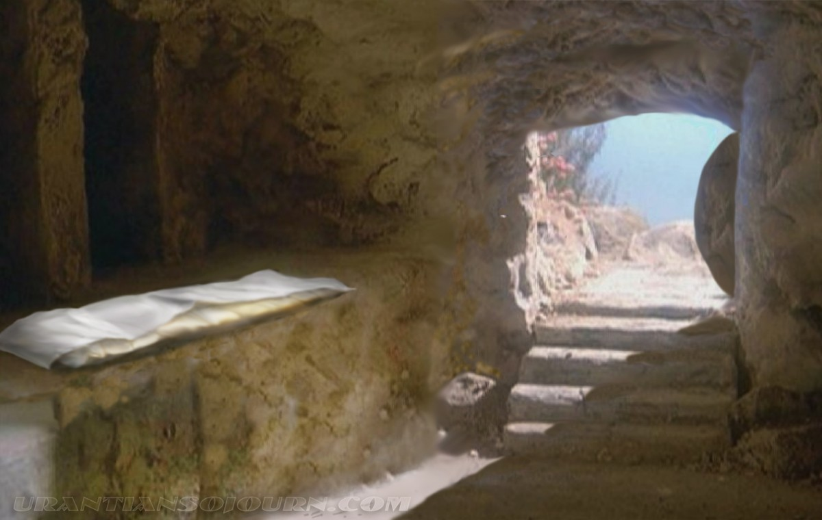
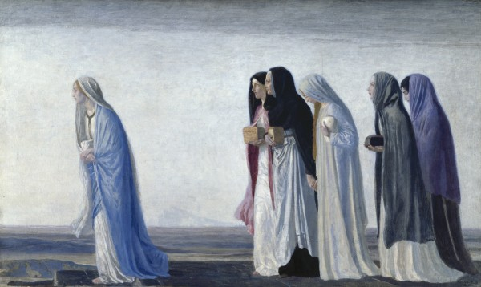
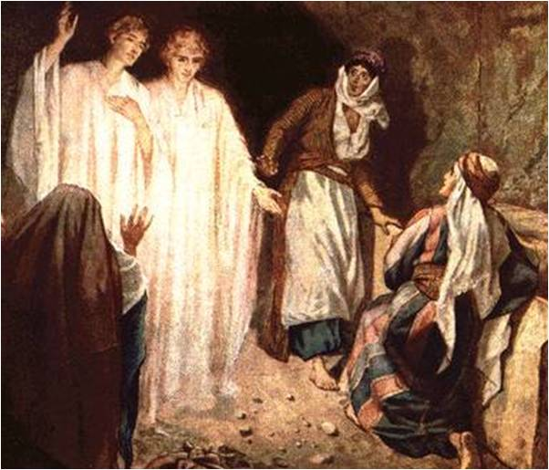
“He is Not Here”
After the day of the Sabbath when Mary Magdalene and other women came to the Savior’s tomb on Sunday morning, they found the body of Jesus gone.
Two heavenly messengers reminded them that Jesus had spoken to them about his death and Resurrection while they were in Galilee. At that time He had testified,
“The Son of man must be delivered into the hands of sinful men, and be crucified, and the third day rise again”
Luke 24:1-7; Matthew 17:22-23
(1)

Slide 3
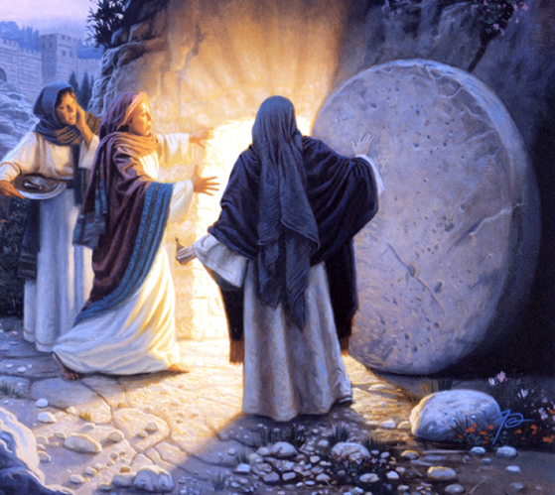
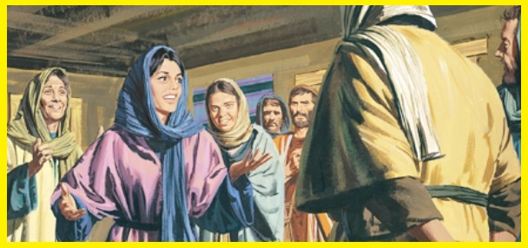
“Go Quickly”
“…tell his disciples that he is risen from the dead; and, behold, he goeth before you into Galilee; there shall ye see him; lo, I have told you.
Matthew 28:7
Mary Magdalene, and Joanna, and Mary the mother of James, and other women that were with them, and told the things to the disciples
Luke 24:9-10
(1)

Slide 4
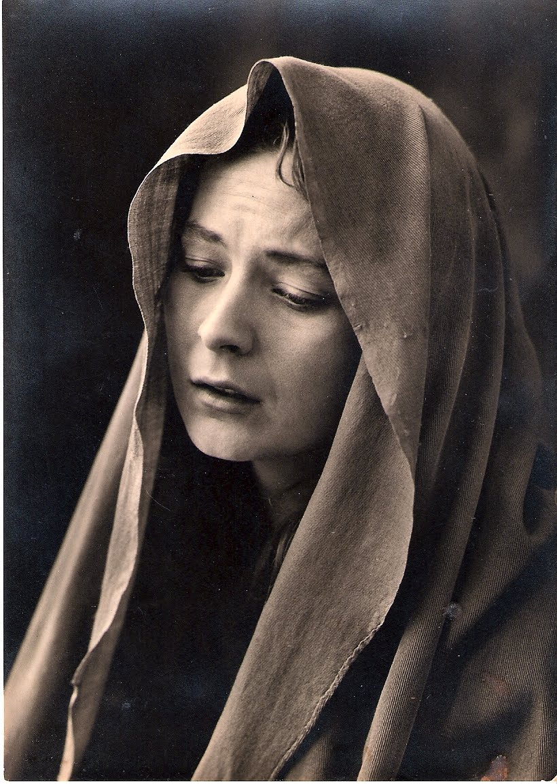
Mary Magdalene
Mary Magdalene seems to have served in a leadership capacity and had a prominent role in serving the Savior and a close association with Him.
She is mentioned first in several listings of female followers .
She was near the cross when Jesus died.
She was the first to speak and see the resurrected Lord.
Luke 24:9-10; Matthew 27:56; John 20:1-18
(1)

Slide 5
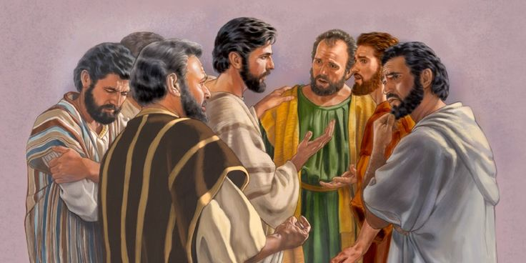
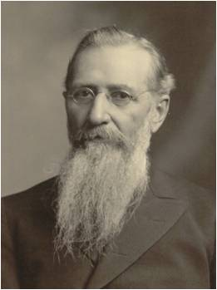
Forgetful
Even though Jesus had foretold His death and Resurrection on several occasions the Apostles found it difficult to believe the news of the Lord’s Resurrection when they heard it.
“Why were they thus forgetful and seemingly ignorant of all they had been taught by the Savior respecting the objects of his mission to the earth?
Because they lacked one important qualification, they had not yet been ‘endowed with power from on high.’
They had not yet obtained the gift of the Holy Ghost.”(2)
Luke 24:11, 49
(1)

Slide 6
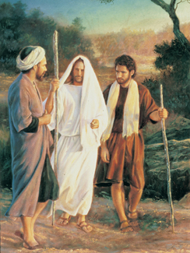
Road to Emmaus
Two of His disciples were walking toward Emmaus, a distance of “threescore furlongs” from Jerusalem (about seven miles or eleven kilometers)
Like Peter, these disciples had hoped that Jesus would be the political and military leader desired by the Jews. Thus, after the Savior began walking with them without them knowing His identity, they sadly spoke of the Savior’s death and said,
“We trusted that it had been he which should have redeemed Israel”
Will we recognize Christ when He returns?
Have we been taught that He will return?
As we study the scriptures, we invite the Holy Ghost to teach us of Jesus Christ
Greg Olsen
Luke 24:13-35
(1)

Slide 7
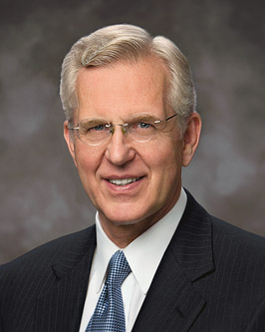
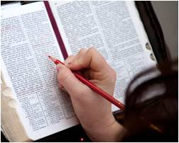
“Believe in the Son of God, that he will come to redeem his people, and that he shall suffer and die to atone for their sins; and that he shall rise again from the dead, which shall bring to pass the resurrection, that all men shall stand before him, to be judged at the last and judgment day”
(Alma 33:22).
“The central purpose of all scripture is to fill our souls with faith in God the Father and in His Son, Jesus Christ. …
“… Faith comes by the witness of the Holy Spirit to our souls, Spirit to spirit, as we hear or read the word of God.
And faith matures as we continue to feast upon the word. …
“… Study the scriptures carefully, deliberately. Ponder and pray over them.
Scriptures are revelation, and they will bring added revelation.”
(3)

Slide 8
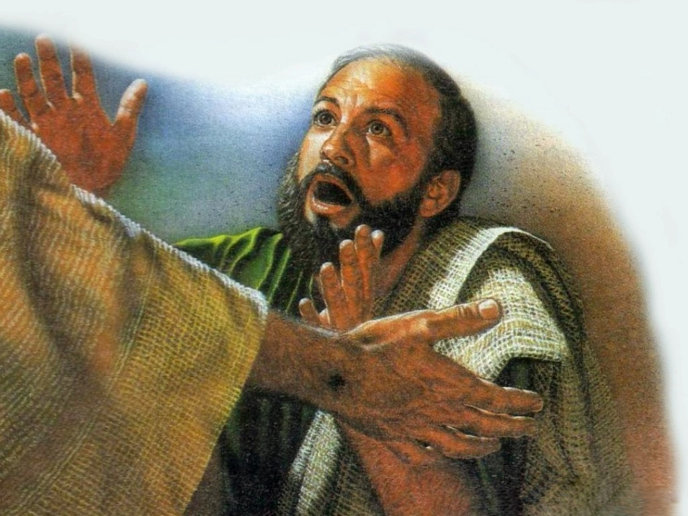
Jesus Meets With Simon Peter
And they rose up the same hour, and returned to Jerusalem, and found the eleven gathered together, and them that were with them,
Saying, The Lord is risen indeed, and hath appeared to Simon.
On the day of the Savior’s Resurrection, a sacred meeting occurred between the Lord and Peter, His chief Apostle. This meeting is mentioned only in Luke 24:34 and in 1 Corinthians 15:5, but these references give no details about what took place.
Luke 24:33-53
(1)

Slide 9
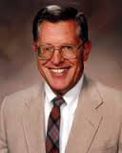
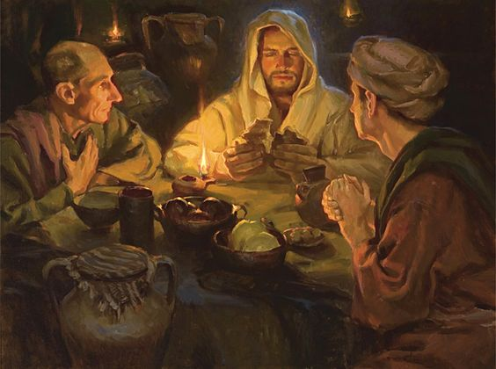
"...while he was teaching them they had no realization, of the greatness of the experience that was theirs.
It was only at their journey's end, when they sat to eat and Christ broke bread and blessed it, that their 'eyes were opened, and they knew him.' Only then did the one turn to the other and say, 'Did not our heart burn within us, while he talked with us by the way, and while he opened to us the scriptures?’
"As is so often the case, the spiritual hindsight of these two disciples was appreciably better than their immediate spiritual insight.“
Luke 24:31-32
(4)

Slide 10
Doctrinal Mastery
And as they thus spake, Jesus himself stood in the midst of them, and saith unto them, Peace be unto you.
But they were terrified and affrighted, and supposed that they had seen a spirit.
And he said unto them, Why are ye troubled? and why do thoughts arise in your hearts?
Behold my hands and my feet, that it is I myself: handle me, and see; for a spirit hath not flesh and bones, as ye see me have.
Luke 24:36-39

Slide 11
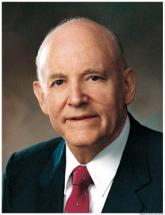
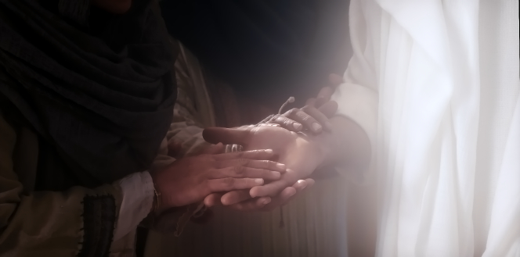
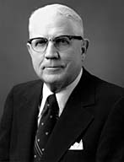
Resurrection
"We...believe in the literal resurrection of the body, reunited with the spirit, becoming the spiritual body or the soul as defined by scripture. If we should eliminate from our religious beliefs the doctrine of the atonement and resurrection of Jesus Christ and the resurrection of mankind, there would be nothing left but a code of ethics.” (5)
"Jesus did not lose his body after his resurrection. In some mysterious way it did not evaporate, neither did it expand to fill the immensity of space. Jesus had his body as he ascended to his Father from the Mount of Olives, and the record is perfectly clear that he will still have that same body when he comes in glory to judge the world." (6)
Luke 24:38-39

Slide 12
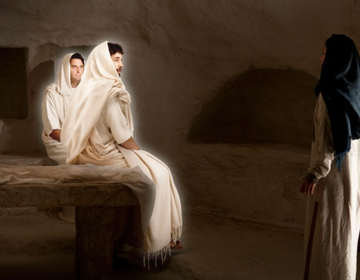
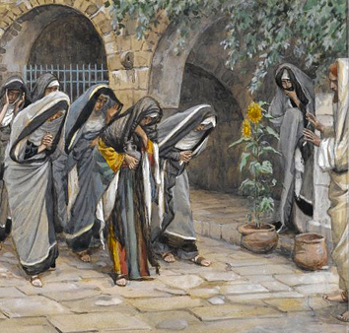
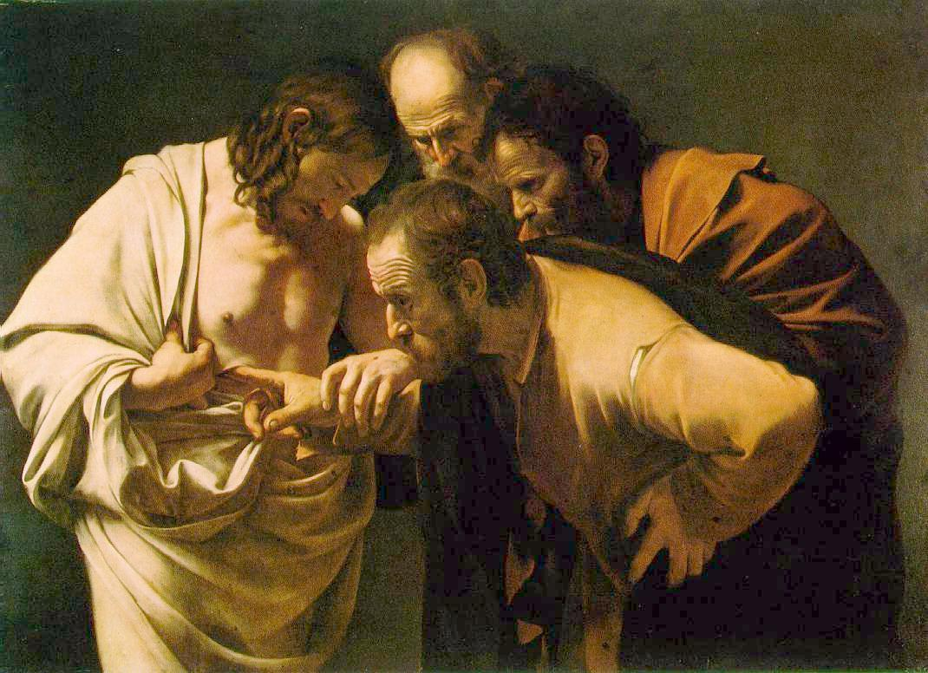
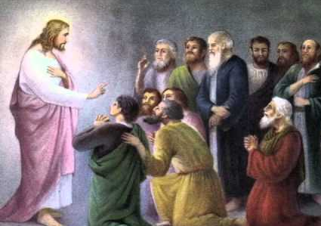
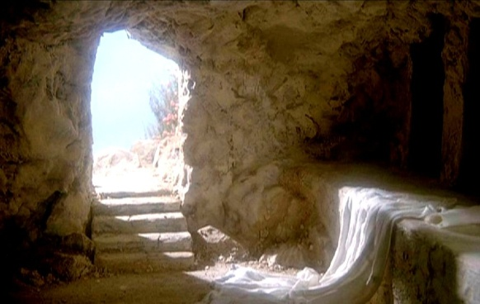
Proofs—Hearing, Seeing, Touched, Breathed Upon, and Witnessing
"That Jesus literally rose from the grave in the most real physical sense, with the same body of flesh and bones he had on earth, is demonstrated in many ways.
The Angels said He had risen.
The Apostles felt his resurrected body with their own hands and saw the nail holes and the hole from the spear.
After he shoed them his hands and feet, he breathed on them.
(John 20:22)
The women and then the brethren noted that the body was no longer in the tomb.
The women held Jesus by the feet
(Matthew 28:9)
Jesus ate real food.
Such evidences attest not only to Jesus' having a body but also that it was the same body he possessed at death-the body which was nailed to the cross. The evidence that he was resurrected and alive must of necessity be as clear and definite as the evidence that he had died." (7)
Luke 24:40

Slide 13
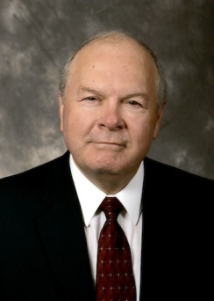
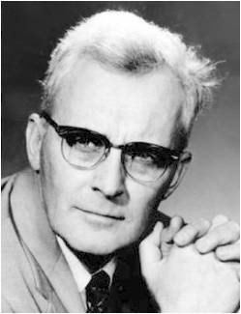
All Things Must Be Fulfilled
“…Christ's reference to the canon of scripture in the meridian of time... Jesus here made reference to the threefold division of the Hebrew Bible-the Law, the Prophets, and the Writings (although he called the Writings 'the psalms' here, probably because the book of Psalms is the first and longest book in the third section)." (8)
"The fact that the Lord himself reads to men out of the ancient books, 'for . . . they are they which testify of me', even though he is personally present among them as the risen Savior addressing them with his own lips, gives awesome testimony to the authority of the written word.” (9)
Luke 24:44; John 5:39

Slide 14
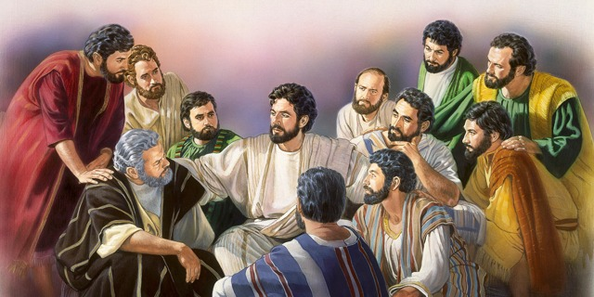
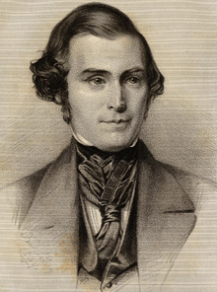
The Holy Spirit
Apostles must receive the Gift of the Holy Ghost prior to preaching the gospel
"He would not suffer them to commence this mission until the promise of the Father-the Holy Ghost-was given to them. They already had power to work mighty miracles, but had not the power to build up the kingdom of God.
This power they were to tarry for in Jerusalem, and when they should receive it, they were then to commence the duties of their mission, first, in the city of Jerusalem, and afterwards extend their labors to all nations.
The power to work miracles is entirely a different thing from the power to build up the kingdom of God: the latter power, however, always includes the former, but the former power does not always include the latter." (10)
Luke 24:47-49

Slide 15
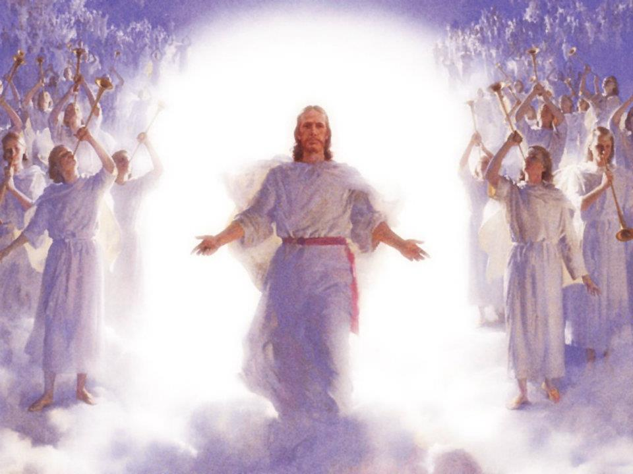
Carried Up Into Heaven
“Christ’s Ascension is literal in the fullest and most complete sense of the word. He was a resurrected man, a personage of tabernacle who, though immortal, walked and talked and ate with his earthly friends. …
The resurrected Lord ascended from the earth and went to the place where his Father is. As our latter-day revelation expresses it:
Wherefore, the Almighty God gave his Only Begotten Son, as it is written in those scriptures which have been given of him.
He suffered temptations but gave no heed unto them.
He was crucified, died, and rose again the third day;
And ascended into heaven, to sit down on the right hand of the Father, to reign with almighty power according to the will of the Father;
D&C 20:21-24
Luke 24:47-49

Slide 16
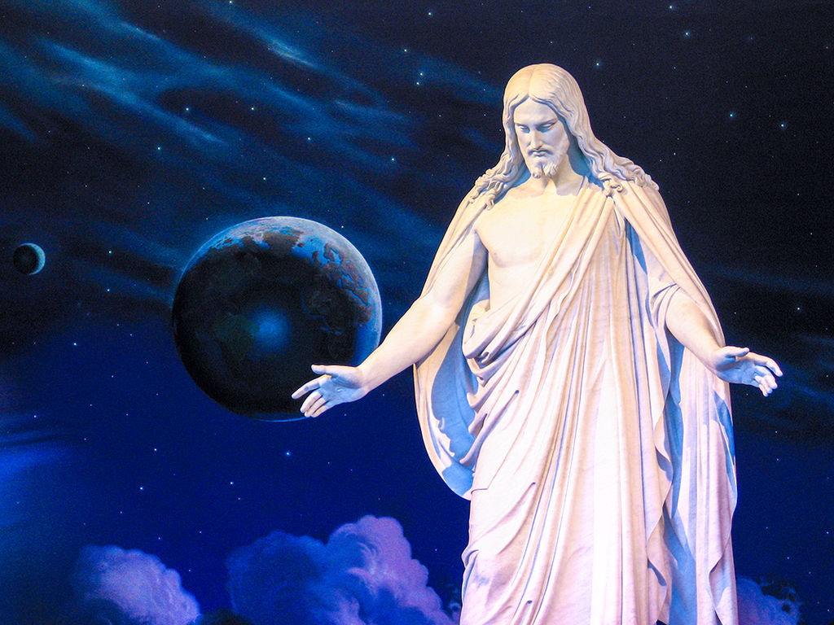
“Through the Atonement of Jesus Christ, all people will be resurrected—saved from physical death. Resurrection is the reuniting of the spirit with the body in a perfect, immortal state, no longer subject to disease or death. …
“An understanding and testimony of the resurrection can give you hope and perspective as you experience the challenges, trials, and triumphs of life.
You can find comfort in the assurance that the Savior lives and that through His Atonement, ‘he breaketh the bands of death, that the grave shall have no victory, and that the sting of death should be swallowed up in the hopes of glory.’ ”
1 Corinthians 15:22; Alma 11:42:45; Alma 22:14
(11)

Slide 17
Sources:
Suggested Hymn: #165 Abide With Me
Videos:
“Jesus Is Laid in a Tomb” (2:27)
“Christ Appears on the Road to Emmaus” (3:32)
Reflecting God's Love—What Scriptures Mean to Me (3:28)
Sunday Will Come (2:32)
New Testament Institute Student Manual Chapter 20
Joseph F. Smith (Gospel Doctrine, 5th ed. [1939], 20).
D. Todd Christofferson,“ The Blessing of Scripture,” Ensign or Liahona, May 2010, 34, 35
Joseph Fielding McConkie, Seeking the Spirit [Salt Lake City: Deseret Book Co., 1978], 7.
President Howard W. Hunter (Conference Report, April 1969, Afternoon Session 138.)
Sterling W. Sill (Conference Report, April 1963, Second Day-Morning Meeting 42 - 43.)
Excerpts from (Robert J. Matthews, Behold the Messiah [Salt Lake City: Bookcraft, 1994], 278.)
Robert L. Millet, Selected Writings of Robert L. Millet: Gospel Scholars Series [Salt Lake City: Deseret Book Co., 2000], 7.)
Hugh Nibley (Enoch the Prophet, 133 - 134.)
Orson Pratt's Works [Salt Lake City: Deseret News Press, 1945], 41 - 42
True to the Faith: A Gospel Reference[2004], 139, 140).
Elder Bruce R. McConkie (Doctrinal New Testament Commentary,1:872).
Presentation by ©http://fashionsbylynda.com/blog/

Slide 18
Event | Matthew | Mark | Luke | John
Women Find the Tomb Opened | 28:1 | 16:2-4 | 24:1, 2 | 20:1
Women Enter Tomb and See Angels Who Proclaim, “He is Not Here; for He is Risen” | 28:5-7 | 16:5-7 | 24:3-8
Women Hurry to Tell the Apostles | 28:8 | 16:8 | 24:9-11
Peter and John Witness the Empty tomb |  |  | 24:12 | 20:3-10
Jesus Appears to Two Followers At Emmaus |  | 16:12, 13 | 24:13-33, 35
Apostles Discussing Jesus’ Appearance to Simon Peter |  |  | 24:34
Jesus Appears to 10 Apostles and Those with Them |  | 16:14 | 24:36-48 | 20:19-23
The Ascension |  | 16:19, 20 | 24:49-53

Slide 19
Did Not Believe Luke 24:11:
"Perhaps the apostles should not be unduly criticized for not believing that Jesus, having been crucified and buried in a tomb, had come back to earth as a glorified being. In all human experience, this had never happened before. This was completely unprecedented. This was a different experience from the raising of Jairus's daughter (Mark 5:22-24, 35-43), the young man of Nain (Luke 7:11-15), or Lazarus (John 11:1-44). They all died again. Jesus, however, became a resurrected being. He would never die again. So it was that to the apostles the story of Mary Magdalene and the other women who witnessed the resurrection 'seemed to them as idle tales, and they believed them not.' ("Luke 24:11.)
"Like the apostles of old, this knowledge and belief should transform all of us to be confident, settled, unafraid, and at peace in our lives as followers of the divine Christ. It should help us carry all burdens, bear any sorrows, and fully savor all joys and happiness that can be found in this life." James E. Faust Reach Up for the Light [Salt Lake City: Deseret Book Co., 1990], 136
Flesh and Bones Luke 24:39:
"Although a resurrected body has 'flesh and bones,' it does not have 'blood.' Joseph Smith taught that resurrected beings have 'spirit in their bodies, and not blood.' President John Taylor also taught this principle: 'When the resurrection . . . of man shall be consummated, . . . he [will] still be in the same image, . . . without variation or change in any of his parts or faculties, except the substitution of spirit for blood.'" (Daniel H. Ludlow, Selected Writings of Daniel H. Ludlow: Gospel Scholars Series [Salt Lake City: Deseret Book Co., 2000], 87.)
"Paul...says 'Flesh and blood cannot inherit the kingdom of God.' (1 Cor. 15:50) Blood is corruptible; the blood-quickened body is subject to the law of death. But Christ's body when it was raised from the dead was 'quickened by the spirit.' There was a great deal of difference, not only in this respect but in others. When the disciples were shut up in that room Christ was able to enter it without opening the door, which could not be done by mortals. He had power to manifest himself to his disciples, and he had power to cover himself from their gaze. He had power to overcome the laws of gravity, and on a certain occasion, after he had visited his disciples, had appeared to 500 brethren at once, had given instructions to his apostles to build up his church, as he spoke to them 'a cloud received him out of their sight.' He was able to lift himself up from the earth and depart from this sphere to another; his body was no longer a mortal body, no longer governed by the same laws as those by which we are governed." Charles W. Penrose (Journal of Discourses, 26 vols. [London: Latter-day Saints' Book Depot, 1854-1886], 21: 229.)
Teaching By the Scriptures Luke 24:27,32:
The Gospels record that initially the followers of Jesus did not fully recognize how Old Testament prophecies were fulfilled in the life of Jesus Christ. This lack of understanding contrasts with their later vivid understanding of His saving mission and the ways it fulfilled prophecy. For example, in Peter’s first public teaching after the Resurrection, he quoted Psalm 16:8–11 and Psalm 110:1 and explained how these prophecies were fulfilled by Jesus (see Acts 2:22–36). In Peter’s next recorded public teaching, he explained how the prophecies in Deuteronomy 18:15 and Genesis 22:18 were fulfilled by Jesus, and he taught that “all the prophets” had “foretold of these days” (see Acts 3:22–26). Later, Peter, Paul, and other disciples consistently referred to ways the scriptures of the Old Testament testified of Jesus and His work. (1)
Teaching from the Scriptures:
“If the Savior were among us in the flesh today, He would teach us from the scriptures as He taught when He walked upon the earth. In the synagogue at Nazareth, ‘there was delivered unto him the book of the prophet Esaias. … And he began to say unto them, This day is this scripture fulfilled in your ears’ [Luke 4:17, 21]. Later when the Sadducees and Pharisees posed a difficult question, ‘Jesus answered and said unto them, Ye do err, not knowing the scriptures, nor the power of God’ [Matthew 22:29]. And after His Resurrection, on the road to Emmaus, His disciples ‘said one to another, Did not our heart burn within us, while he talked with us by the way, and while he opened to us the scriptures?’ [Luke 24:32]. To His disciples then and now, His words ring out: ‘Search the scriptures; for … they are they which testify of me’ [John 5:39]—a testimony borne by the Holy Ghost, for ‘by the power of the Holy Ghost ye may know the truth of all things’ [Moroni 10:5]” Elder Robert D. Hales “Holy Scriptures: The Power of God unto Our Salvation,” Ensign or Liahona, Nov. 2006, 26).
Witness of Jesus Christ Through the Holy Ghost Luke 24:47-49:
"'Ye shall be witnesses unto me both in Jerusalem, and in all Judaea, and in Samaria, and unto the uttermost part of the earth.' (Acts 1:8; see also Acts 10:42-43.) However, he cautioned them that their witnessing would be after they had received the Holy Ghost. (See Acts 1:8; see also Luke 24:49.)
"An eyewitness was not enough. Even the witness and testimony of the original Apostles had to be rooted in the testimony of the Holy Ghost. A prophet has told us that the witness of the Holy Ghost makes an impression on our soul that is more significant than 'a visitation of an angel.' (Joseph Fielding Smith, Doctrines of Salvation, 1:44.) And the Bible shows that when we testify on the basis of this witness, the Holy Ghost testifies to those who hear our words. (See Acts 2; Acts 10:44-47.)" Dallin H. Oaks ("Witnesses of Christ,“ Ensign, Nov. 1990, 30)

