Slide 2
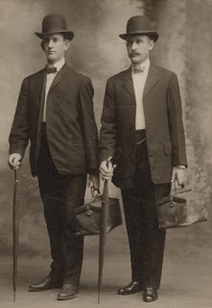
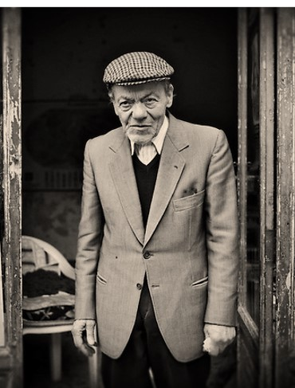
“Two [missionaries] called at the home of Mr. Elmer Pollard. … They presented their message and asked if he would join in prayer. He agreed, on the provision that he could offer the prayer.
“The prayer he offered astonished the missionaries. He said, ‘Heavenly Father, bless these two unfortunate, misguided missionaries, that they may return to their homes and not waste their time telling the people of Canada about a message which is so fantastic and about which they know so little.’
If you were one of those missionaries, what would you have said to Mr. Pollard?
How can someone know for themselves that Joseph Smith was a prophet of God?
President Thomas S. Monson

Slide 3
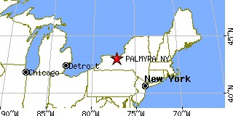
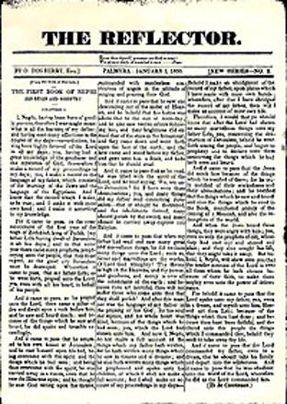
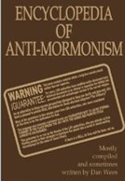
Why Joseph Writes About His Vision
Many false reports which were meant to turn people against the Church
Joseph Smith wanted provide the public with a reliable and accurate account of the events of the First Vision and the Restoration
Still today there are many who continue to spread false or misleading information about the Church with the intent to undermine faith.
Joseph Smith--History 1:1-2

Slide 4
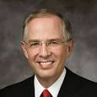
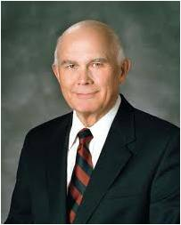
“There have always been a few who want to discredit the Church and to destroy faith. Today they use the Internet.
“Some of the information about the Church, no matter how convincing, is just not true”
Elder Neil L. Andersen
“Latter-day Saint readers should … be … sophisticated in their evaluation of what they read. …
“Our individual, personal testimonies are based on the witness of the Spirit, not on any combination or accumulation of historical facts. If we are so grounded, no alteration of historical facts can shake our testimonies.
Our Heavenly Father gave us powers of reason, and we are expected to use them to the fullest. But he also gave us the Comforter, who he said would lead us into truth and by whose power we may know the truth of all things. That is the ultimate guide for Latter-day Saints who are worthy and willing to rely on it”
Elder Dallin H. Oaks
Those who sincerely want the truth should diligently seek out credible sources of information about the Church and its history rather than simply accept any information they hear, including whatever comes up as a result of an Internet search
Joseph Smith--History 1:1-2

Slide 5
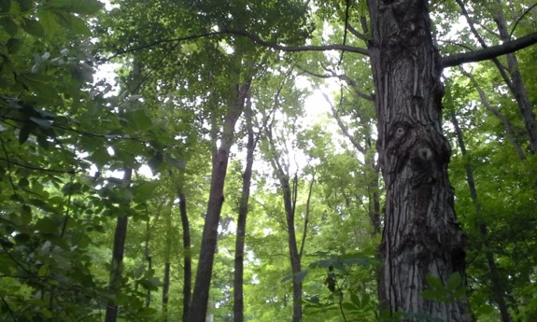
Accounts of the First Vision
Joseph Smith wrote this account of the First Vision in 1838 as part of an official history of the Church to be published to the world.
4 written or dictated by Joseph Smith and
5 written by others retelling his experience.
2. The 1835 Account
On 9 November 1835 Joseph related his early vision to a visiting Jewish minister named Robert Matthews, alias Robert Matthias, who said his priestly name was Joshua.
1. The 1832 Account
The earliest known written account of the First Vision was included in an autobiography Joseph wrote in 1832.
3. The 1838 Account
The third known account of the First Vision recorded by the Prophet was included in his “History of the Church.” Although Joseph Smith commenced dictating this history in 1838, the earliest known manuscript of this work is in the handwriting of James Mulholland, who was serving as scribe for the Prophet in 1839, thus indicating that the manuscript was probably copied by Mulholland in that year.
4. The 1842 Account
The last known account of the First Vision written by Joseph Smith was included in what is known as the Wentworth Letter.
Milton V. Backman Jr

Slide 6
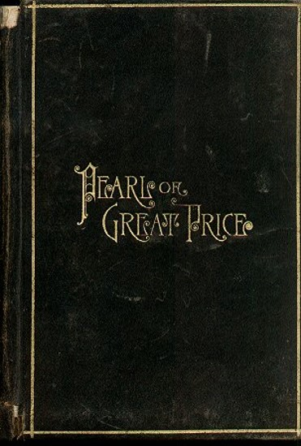
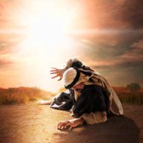
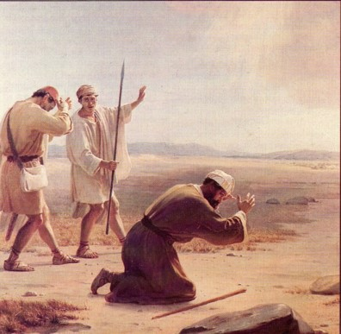
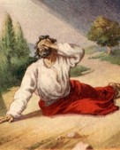
Different Accounts for Different Audiences
In these accounts, Joseph Smith emphasized different aspects of his experience of the First Vision, but the accounts all agree in the essential truth that Joseph Smith did indeed have the heavens opened to him and see divine messengers, including God the Father and the Lord Jesus Christ.
Because the 1838 account was part of Joseph Smith’s official history and testimony to the world, it was included in the Pearl of Great Price as scripture.
Paul’s Records 3 Accounts of his vision of the Lord
Acts 9:1–9
Acts 22:5–11
Acts 26:12–20

Slide 7
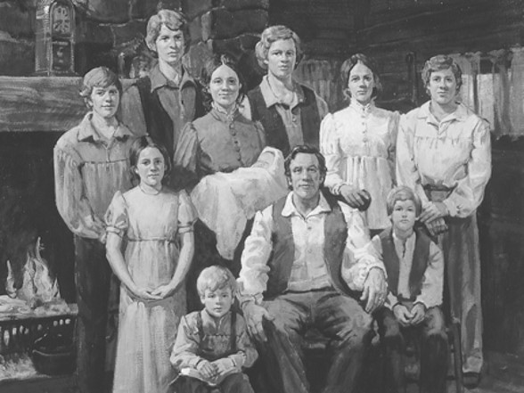
History
1805
December 23—Joseph Smith Jun. is born to Joseph Smith Sen. and Lucy Mack Smith
1815
The Smith’s move from Vermont to New York, Palmyra
1819
The Smith family move into Manchester south of Palmyra
Alvin, Hyrum, Joseph Jun., Ephraim (living only 11 days)Samuel Harrison, William, Don Carlos,
Sophronia, Catherine, and Lucy
1823
Alvin Smith died in the 26th year of age
1820
Joseph is concerned about religion that prevailed in western New York…Joseph Smith reads a passage in James 1:5
Joseph Smith—History 1:3-5

Slide 8
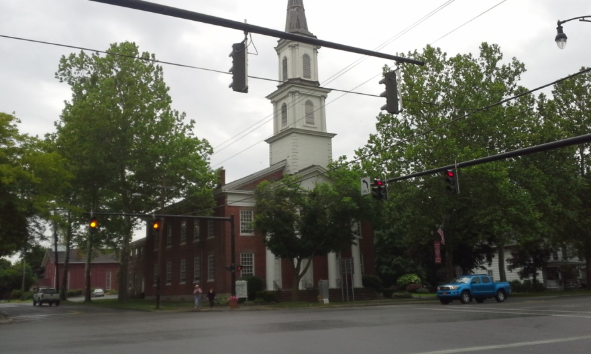
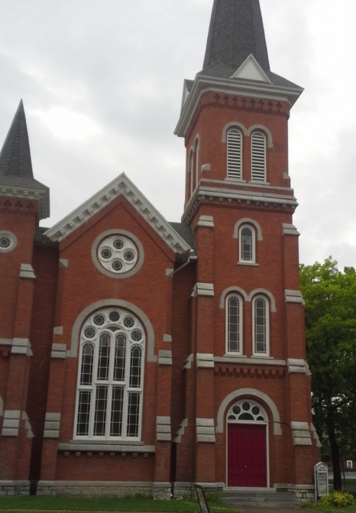
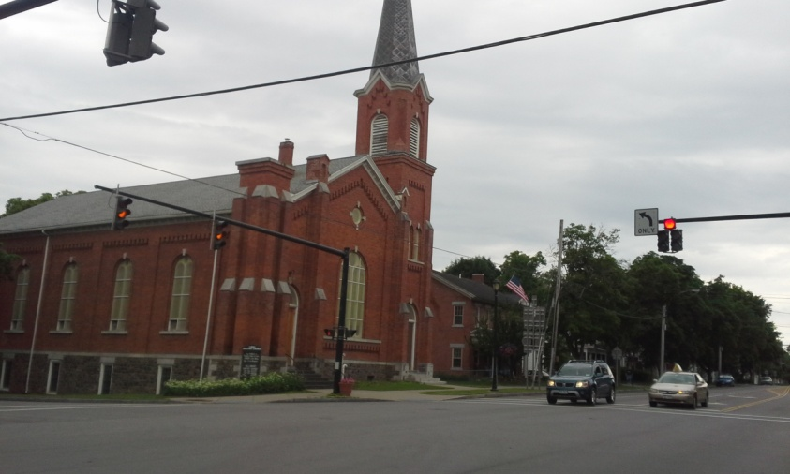
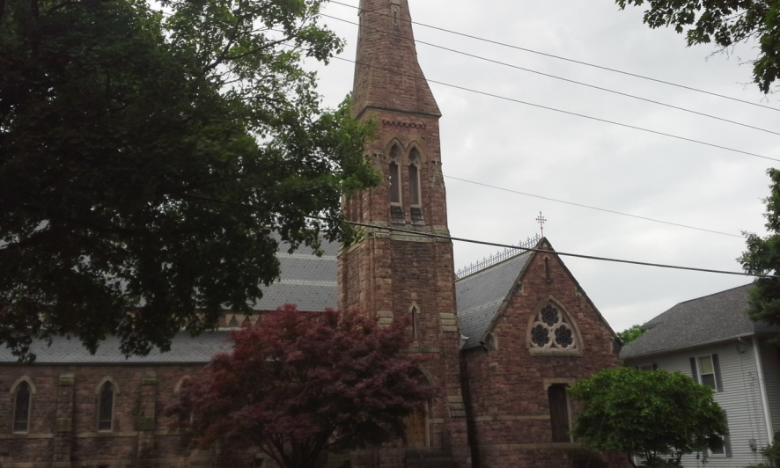
Religious Turmoil
Presbyterian Church
First United Methodist Church
Baptist Church
Zion’s Episcopal Church
Joseph Smith—History 1:5-13

Slide 9
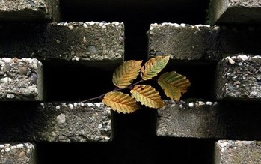
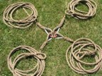
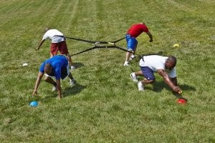
Religious Contention
Everyone had the choice in which church to attend
“in order to have everybody converted”
“it was seen that the seemingly good feelings of both the priests and the converts were more pretended than real;”
“a scene of great confusion and bad feeling ensued—priest contending against priest,
and convert against convert;
so that all their good feelings one for another, if they ever had any, were entirely lost in a strife of words and a contest about opinions.”
Joseph Smith—History 1:6

Slide 10
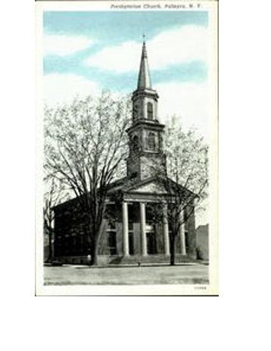
1820
Joseph Smith was 15 years old and 4 members of his family attended the Presbyterian faith:
Lucy—his mother
Hyrum
Samuel Harrison
Sophronia
‘…but though my feelings were deep and often poignant, still I kept myself aloof from all these parties, though I attended their several meetings as often as occasion would permit”
“In process of time my mind became somewhat partial to the Methodist sect”
Joseph Smith—History 1:7-8

Slide 11
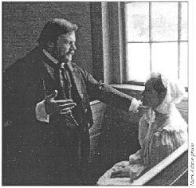
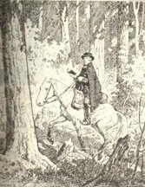
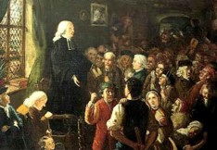
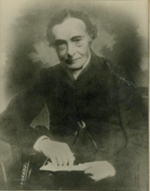
Church Against Church
“The Presbyterians were most decided against the Baptists and Methodists, and used all the powers of both reason and sophistry to prove their errors, or, at least, to make the people think they were in error.
“On the other hand, the Baptists and Methodists in their turn were equally zealous in endeavoring to establish their own tenets and disprove all others.”
Joseph Smith—History 1:9

Slide 12
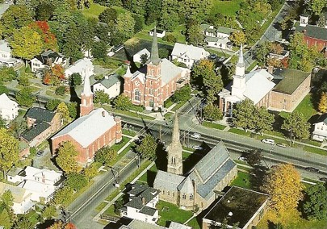
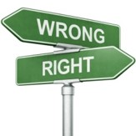
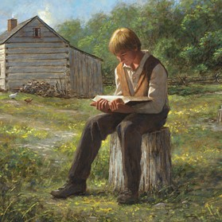
The Power of Scripture
“What is to be done? Who of all these parties are right; or, are they all wrong together? If any one of them be right, which is it, and how shall I know it?”
“Epistle of James, first chapter and fifth verse, which reads: If any of you lack wisdom, let him ask of God, that giveth to all men liberally, and upbraideth not; and it shall be given him.”
Joseph Smith—History 1:10-11

Slide 13
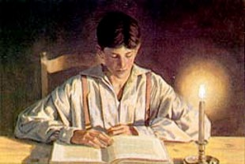
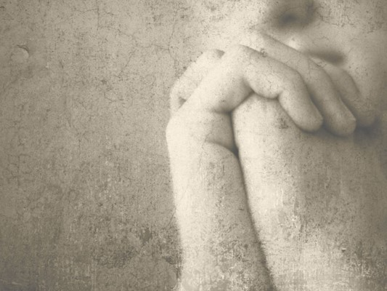
The Passage—The Determination
”for the teachers of religion of the different sects understood the same passages of scripture so differently as to destroy all confidence in settling the question by an appeal to the Bible.”
“At length I came to the conclusion that I must either remain in darkness and confusion, or else I must do as James directs, that is, ask of God.
I at length came to the determination to “ask of God,” concluding that if he gave wisdom to them that lacked wisdom, and would give liberally, and not upbraid, I might venture.
Joseph Smith—History 1:12-13

Slide 14
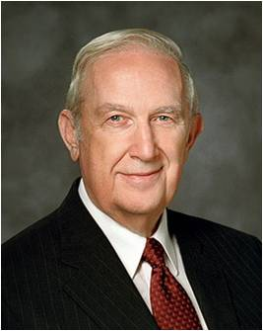
The Passage—The Determination
“Often when we pray for help with a significant matter, Heavenly Father will give us gentle promptings that require us to think, exercise faith, work, at times struggle, then act. It is a step-by-step process that enables us to discern inspired answers.
He will always hear your prayers and will invariably answer them. However, His answers will seldom come while you are on your knees praying, even when you may plead for an immediate response.
Rather, He will prompt you in quiet moments when the Spirit can most effectively touch your mind and heart. Hence, you should find periods of quiet time to recognize when you are being instructed and strengthened. His pattern causes you to grow.
Richard G. Scott
If we ask God in faith, He will answer our prayers
Joseph Smith—History 1:12-13

Slide 15
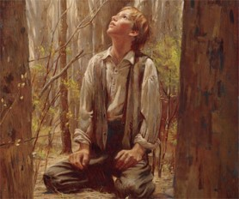
Into The Woods—a Sincere Prayer
1820
It was the first time in my life that I had made such an attempt, for amidst all my anxieties I had never as yet made the attempt to pray vocally.
“Obviously, secret prayer is necessary in many cases where it is awkward or infeasible to pray vocally. So, if we are in a social or a business setting and need comfort or direction, a resort to secret prayer is often our only alternative.”
Frances M. Gibbons
However:
“And again, I command thee that thou shalt pray vocally as well as in thy heart; yea, before the world as well as in secret, in public as well as in private.”
D&C 19:28
Joseph Smith—History 1:15

Slide 16
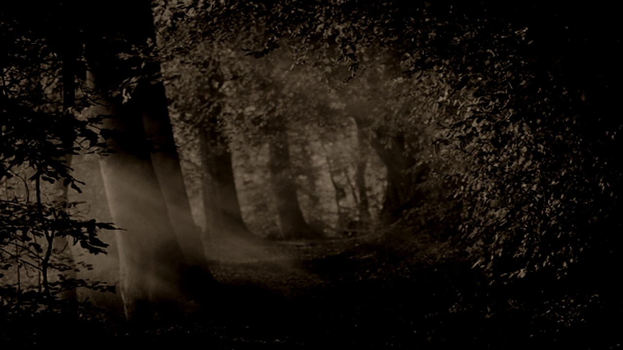
Power of Darkness
“…immediately I was seized upon by some power which entirely overcame me, and had such an astonishing influence over me as to bind my tongue so that I could not speak. Thick darkness gathered around me, and it seemed to me for a time as if I were doomed to sudden destruction.
Why do you think Satan tried to stop Joseph Smith from praying?
Exerting all his powers
Calling upon God to deliver him from his enemy
Just when he was about to sink into despair…
Joseph saw a pillar of light over his head “above the brightness of the sun, which descended gradually until it fell upon me.”
Joseph Smith—History 1:15-16

Slide 17
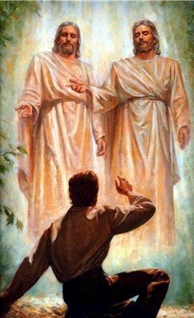
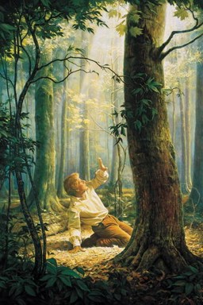
This is My Beloved Son. Hear Him!
It no sooner appeared than I found myself delivered from the enemy which held me bound. When the light rested upon me I saw two Personages, whose brightness and glory defy all description, standing above me in the air. One of them spake unto me, calling me by name and said, pointing to the other—This is My Beloved Son. Hear Him!”
Joseph Smith—History 1:17

Slide 18
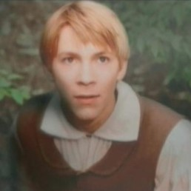
Inquire of the Lord
Which Church to join
Which sect was right
None were right–
“for they were all wrong; and the Personage who addressed me said that all their creeds were an abomination in his sight; that those professors were all corrupt; that: “they draw near to me with their lips, but their hearts are far from me, they teach for doctrines the commandments of men, having a form of godliness, but they deny the power thereof.”
Joseph Smith—History 1:18-20

Slide 19
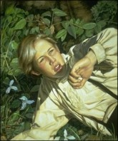
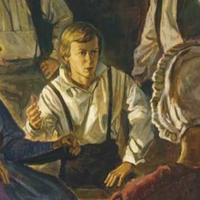
Having No Strength
I found myself lying on my back, looking up into heaven. When the light had departed, I had no strength; but soon recovering in some degree, I went home.
And as I leaned up to the fireplace, mother inquired what the matter was. I replied, “Never mind, all is well—I am well enough off.” I then said to my mother, “I have learned for myself that Presbyterianism is not true.” It seems as though the adversary was aware, at a very early period of my life, that I was destined to prove a disturber and an annoyer of his kingdom; else why should the powers of darkness combine against me?
Why the opposition and persecution that arose against me, almost in my infancy?
Joseph Smith—History 1:20

Slide 20
Doctrinal Mastery
In the First Vision, God called Joseph Smith to be a prophet
Joseph Smith History
1:15-20

Slide 21
The Rest of the Story
“The two returned to Mr. Pollard’s door. Mr. Pollard answered the knock and angrily said, ‘I thought I told you young men never to return!’
“The junior companion then said, with all the courage he could muster, ‘Mr. Pollard, when we left your door, you said that we didn’t really believe Joseph Smith was a prophet of God.
I want to testify to you, Mr. Pollard, that I know Joseph Smith was a prophet of God, that by inspiration he translated the sacred record known as the Book of Mormon, that he did see God the Father and Jesus the Son.’ The missionaries then departed the doorstep.
“[Mr. Pollard later testified:] ‘That evening, sleep would not come. I tossed and turned. Over and over in my mind I heard the words, “Joseph Smith was a prophet of God. I know it. … I know it. … I know it.” I could scarcely wait for morning to come. I telephoned the missionaries. … They returned, and this time my wife, my family, and I joined in the discussion as earnest seekers of truth. As a result, we have all embraced the gospel of Jesus Christ’”
Thomas S. Monson

Slide 22
Sources:
Related Videos:
Joseph Smith Was a Prophet Part 1 (1:04)
Origin (4:57)
Preparation of Joseph Smith: The First Vision (2:05)
Joseph Smith Was a Prophet Part 2 (2:03)
The Restoration (19:20)
President Thomas S. Monson (“The Prophet Joseph Smith: Teacher by Example,” Ensign or Liahona, Nov. 2005, 69).
(For more information about Joseph Smith’s four accounts of the First Vision, see Milton V. Backman Jr., “Joseph Smith’s Recitals of the First Vision,” Ensign, Jan. 1985, 8–17.)
Elder Neil L. Andersen (“Trial of Your Faith,” Ensign or Liahona, Nov. 2012, 41).
Elder Dallin H. Oaks (“Reading Church History” [address to CES religious educators, Aug. 16, 1985], 7, LDS.org ).
Milton V. Backman Jr., “Joseph Smith’s Recitals of the First Vision,” Ensign, Jan. 1985, 8–17.)
Richard G. Scott Using the Supernal Gift of Prayer April 2007 Gen. Conf.
Frances M. Gibbons The Dual Aspects of Prayer Oct. 1991 Gen Conf.

Slide 23
What was Joseph Smith’s early life like?
“[Joseph Smith’s] parents, Lucy Mack and Joseph Smith Sr., were married on 24 January 1796 and settled on a family farm in Tunbridge, Vermont. Joseph and Lucy rented a farm [in Sharon, Vermont] from Solomon Mack, Lucy’s father, in the summer of 1805 and Joseph also taught school in the winter. It was there that their fifth child, Joseph Smith Jr., was born on 23 December 1805. Lucy and Joseph taught their children religious precepts and Lucy especially encouraged the study of the Bible. Joseph Sr. was suspicious of traditional churches but always retained a strong belief in God” (The Pearl of Great Price Student Manual [Church Educational System manual, 2000], 54).
“Joseph Smith grew up on the family farm and was almost exclusively under his family’s influence. … During his formative years, Joseph Smith began to incorporate and manifest qualities that would help him fulfill his foreordained mission.
“… He developed strong family bonds, learned to work hard, to think for himself, to serve others, and to love liberty” (Church History in the Fulness of Times, 2nd ed. [Church Educational System manual, 2003], 15).
“During Joseph Smith’s earliest years, his family moved frequently, looking for fertile soil or some other way to earn a livelihood. … In 1811 the Smiths moved to the small community of West Lebanon, New Hampshire. … Typhoid fever came into West Lebanon. … One by one the Smith children fell ill. …
“Seven-year-old Joseph, Jr., recovered from [typhoid] fever after two weeks but suffered complications that eventually required four surgeries. The most serious complication involved a swelling and infection in the tibia of his left leg. … Joseph was in agony for over two weeks.” Joseph endured an operation to remove the infection from his leg “without being bound or drinking brandy wine to dull his senses” (Church History in the Fulness of Times, 22–23).
“In 1816, Joseph Sr. went to Palmyra, New York, to investigate the report of good land at low cost. Joseph Jr., at the time a boy of ten, remembered that even though he was not yet fully recovered from his leg operation, the teamster engaged to assist the Smiths in their journey made him walk through snow, forty miles per day for several days, during which time he suffered the most excruciating weariness and pain” (The Pearl of Great Price Student Manual, 54).
“Joseph Smith, Sr., the father of a family of ten—eleven by 1821—worked hard for a living. After two years in Palmyra, he accumulated enough money for a down payment on one hundred acres of wooded land in the nearby township of Farmington. During the first year he and his sons cleared thirty acres of heavy timber, prepared the ground for cultivation, and planted wheat. … Young Joseph later recalled that ‘it required the exertions of all that were able to render any assistance for the support of the Family.’ [“History of Joseph Smith By Himself,” 1832 (written in Kirtland, Ohio, between 20 July and 27 Nov. 1832), LDS Historical Department, Salt Lake City, p. 1.] …
“At this time Joseph’s opportunities for schooling were limited. He attributed this to the ‘indigent circumstances’ he was raised under. ‘We were deprived of the benefit of an education. Suffice it to say, I was merely instructed in reading, writing, and the ground rules of arithmetic which constituted my whole literary acquirements’ [“History of Joseph Smith By Himself,” pp. 1–2]” (Church History in the Fulness of Times, 29–30).

Slide 24
The Accounts of the First Vision:
In conclusion, an examination of the four accounts of the First Vision reveals several important concepts concerning the writing of Church history. Recognizing the importance of preserving that which had transpired, Joseph Smith devoted many hours during the 1830s and early 1840s to recording events which he had witnessed. While describing his sacred experience of 1820, he sometimes emphasized one theme and at other times concentrated on other major concepts. Although the precise wording of what he learned from the Savior is different in all the accounts, the same basic message was included in all except the 1835 recital—that God’s true church was not upon the earth in 1820. Of utmost importance was not the specific language in which the truths were unfolded but the truths themselves.
Since the 1838 recital was included in the Pearl of Great Price, an investigation of the publications of this history helps one better understand principles concerning the formation of scriptures. Joseph Smith was responsible for many changes in punctuation, spelling, and other similar revisions in his manuscript history. After a portion of this history was canonized in the Pearl of Great Price, additional textual refinements were made by editors acting under the authorization of Church leaders. These revisions were apparently made in the interests of grammatical quality, clarification, and consistency. Several short paragraphs were also added that had been included as notes in the manuscript history prior to the Prophet’s martyrdom. All these alterations were in harmony with precedents set by Joseph Smith in his textual revisions of latter-day scriptures. In no instance was there a change in the basic message recorded in the manuscript history concerning the historical setting of the First Vision or the truths unfolded during this remarkable experience. But changes were made in an effort to convey the truths unfolded by God in the latter-days in the best and clearest language that man could fashion.
Milton V. Backman, Jr., father of three, is a professor of Church History at Brigham Young University and serves as a regional welfare agent in the Provo Utah Edgemont Region.—see Milton V. Backman Jr.
Joseph Smith—History. When was Joseph Smith’s official history published?
In 1838 Joseph Smith began work on his official history, which was published in the newspaper Times and Seasons in 1842. This history later became part of the six-volume A Comprehensive History of the Church by B. H. Roberts in 1957. Joseph Smith—History, as it is found in the standard works, was extracted from Joseph Smith’s official history and published as part of a missionary tract called the Pearl of Great Price in 1851. The Pearl of Great Price was canonized as scripture in 1880.

Slide 25
Family of Joseph Smith Sr. and Lucy Mack Smith: The First Family of the Restoration Dec. 2005 Ensign
Joseph SMITH Sr. was born July 12, 1771, in Topsfield, Massachusetts. He married Lucy MACK on January 24, 1796, in Tunbridge, Vermont. Lucy was born July 8, 1775, in Gilsum, New Hampshire. They were the parents of 11 children, listed here in order of birth. Joseph Sr. died September 14, 1840, in Nauvoo, Illinois. Lucy died May 8, 1856, in Nauvoo, Illinois.
* Infant son SMITH was born and died in 1797, Tunbridge, Vermont.
Alvin SMITH was born February 11, 1798, in Tunbridge, Vermont, and died November 19, 1823, in Manchester Township, New York, at the age of 25.
Hyrum SMITH was born February 9, 1800, in Tunbridge, Vermont. He married Jerusha BARDEN on November 2, 1826, in Manchester Township, New York. They had six children. After Jerusha’s death, Hyrum married Mary FIELDING on December 24, 1837, in Kirtland, Ohio. They had two children. Hyrum was martyred June 27, 1844, in Carthage, Illinois. He has 13,583 known descendants. **
Sophronia SMITH was born May 17, 1803, in Tunbridge, Vermont. She married Calvin W. STODDARD on December 2, 1827, in Palmyra, New York. They had two children. After Calvin’s death, Sophronia marriedWilliam * McCLEARY on February 11, 1838, in Kirtland, Ohio. No children. She died October 28, 1876, in Colchester, Illinois. Sophronia has five known descendants. **
Joseph SMITH Jr. was born December 23, 1805, in Sharon, Vermont. He married Emma HALE on January 18, 1827, in South Bainbridge, New York. They had 11 children. The Prophet Joseph was martyred June 27, 1844, in Carthage, Illinois. He has 1,112 known descendants. **
Samuel Harrison SMITH was born March 13, 1808, in Tunbridge, Vermont. He married Mary BAILEY on August 13, 1834, in Kirtland, Ohio. They had six children. After Mary’s death, Samuel married Levira CLARKon April 29, 1841, in Nauvoo, Illinois. They had three children. Sometimes called the third martyr, Samuel died July 30, 1844, in Nauvoo, Illinois, of injuries sustained while riding from Nauvoo to Carthage to aid his brothers. He has 460 known descendants. **
Ephraim SMITH was born and died March 13, 1810, in Royalton, Vermont.
William B. SMITH was born March 13, 1811, in Royalton, Vermont. He married Caroline A. GRANT on February 14, 1833, in Kirtland, Ohio. They had two children. After Caroline’s death, he married Roxie R. GRANT on May 19, 1847, in Knox, Illinois. They had two children. After they divorced, William married Eliza E. SANBORN on November 12, 1857, in Kirtland, Ohio. They had three children. After Eliza’s death, William married Rosella GOYETTE on December 21, 1889, in Clinton, Iowa. No children. William died on November 13, 1893, in Osterdock, Iowa. He has 234 known descendants. **
* Katharine SMITH was born July 28, 1813, in Lebanon, New Hampshire. She married Wilkins J. SALISBURY on January 8, 1831, in Kirtland, Ohio. They had eight children. After his death, she married Joseph YOUNGERin Illinois. Soon afterward, they divorced. No children. She died February 1, 1900, in Fountain Green, Illinois. Katharine has 92 known descendants. **
Don Carlos SMITH was born March 25, 1816, in Norwich, Vermont. He married Agnes Moultin COOLBRITH on July 30, 1835, in Kirtland, Ohio. They had three children. He died August 7, 1841, in Nauvoo, Illinois. Don Carlos has six known descendants. **
Lucy SMITH was born July 18, 1821, in Manchester Township, New York. She married Arthur MILLIKIN on June 4, 1840, in Nauvoo, Illinois. They had nine children. She died December 9, 1882, in Colchester, Illinois. Lucy has 92 known descendants. **

Slide 26
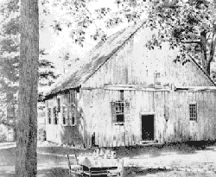
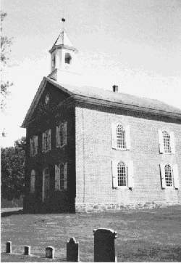
History of Palmyra
The land on which Palmyra now stands was originally inhabited by the Lenni Lenape Indians to whom the white man gave the name Delawares, who were members of the Algonquin family. This Indian tribe once enjoyed great dignity and power. Other Algonquin tribes settling in Pennsylvania were the Shawnees, the Nanticokes and Conoys. Tribes of the Iroquoian family of Indians living in Pennsylvania were the Susquehannocks, the Conestogas, and the Tuscaroras.
The first white men came into this area about 1650, or before, and were explorers or traders. The explorers were mainly concerned with scouting the new territory and gathering first-hand information for the future purchase of tracts of land. The traders were concerned mainly with trade with the Indians. They carried with them the usual stock of trading goods such as blankets, beads, kettles, iron axes, guns, etc. to trade for the pelts of fur bearing animals.
It has been said that a trading post with a stockade built by Indian traders was located several hundred yards north of the 300 block of West Main Street. Early citizens tell of a pond, and the outlines of a stockade could be seen years ago. A study of the cultural remains of the Indian campsites with their arrow points, axes and tools gives proof of the various tribes who used this valley as a hunting ground.
The only remaining thing to remind us of the Indian inhabitation of the area is the names they gave to the streams and mountains - Swatara Creek, the Indian name Swahadowry, corrupted from Schada-dawa, means in Susquehanna Indian "where we feed on eels" - Quitapahilla Creek, corrupted from Cuitpehelle, meaning "a spring that flows from the ground among pines" - Kittatiny hills, corrupted from Kittochtiny, a Delaware word meaning "the endless hills." There were several reasons why the early settlers were drawn to this area to build their homes and raise their families. The first was the traders who went back to the established settlements with glowing accounts of the good rich land and pure streams with fish and game in abundance. Another reason was the desire of William Penn to found a colony of small independent farmers. In his advertisements of his promise in the Eastern European countries, he stressed the opportunity for a poor man to own land. In addition, Penn's charter of civil rights and freedom of religion appealed to those people who desired these rights and were living in virtual serfdom.
OLD DERRY CHURCH BUILT A.D. 1720
BINDNAGLE CHURCH

Slide 27
In the beginning, a large portion of the land in Pennsylvania, perhaps most of it, was occupied by the settlers without legal rights, as squatters. Squatter rights were favored because of the abundance of good land, loose business methods of the proprietaries, long distance to the land office, overwhelming number of settlers, and slow method of settling the titles of the Indians. Most of the early settlers who settled in this area known as the "back country" during 1717-1740, especially the German and Scotch-Irish immigrants, did not take the trouble to acquire title by legal rights but simply squatted on unoccupied land. Because of this squatter method of settlement it is difficult and sometimes impossible to trace family migrations and/or land record titles, however, an investigation of early land records indicates clearly that Palmyra and the surrounding area was settled by two different European nationalities - namely, the Scotch-Irish and the German Palatinates.
The Scotch-Irish were Scotchmen who had migrated to Ireland under Elizabeth and James I, but as time passed they became dissatisfied with the rule of the English authorities and the native Irish. They came to America in large numbers because of political, religious, and economic reasons, although the economic reason was the most compelling. They were a hardy, self-reliant and courageous people who adapted to the wilderness and the frontier, and they preferred that way of life. They led the westward advance of settlements and therefore were the first line of defense against the Indians. Being of a restless nature, and not mixing well with the German element, they moved westward into Cumberland County. They were political minded and took an active interest in government once they were established. They were Presbyterians, and you can trace their movements from Philadelphia westward by the churches they built on the way, Donegal in Lancaster County, Paxtang near Harrisburg, Derry at Hershey, and Silver Spring near Carlisle.
Over the passing years most all of the Scotch-Irish have died away or moved to another part of the state. There are few indeed today in the Palmyra area who can trace their ancestry to the Scotch-Irish who settled here. Many of these early settlers are buried at Old Derry Church and on the "Old English" cemetery near Grantville.
The following were early settlers - David Mitchell, John Campbell, Henry Walker, George Aspey, James Caruthers, Thomas Ewing, Widow McCallen, William Sawyer, James Wilson, James Galbraith, John McCord, Robert McClure, and many others.
The Pennsylvania Germans, or German Palatinates, came from Germany, and have been commonly called the Pennsylvania Dutch. These Germans came to Pennsylvania for religious, Political, and economic reasons. Politically they were oppressed, they were economically poor, and they were severely persecuted for their religious beliefs. Like the ScotchIrish the Germans were clannish, and from the beginning tried to keep to themselves. Throughout Pennsylvania land the prevailing language was German, that, and the differences of religion kept the Germans from mixing either with the English or Scotch-Irish. Most of the German immigrants were farmers, and as a class they flourished best in rural sections. They were not politically minded and let the Quakers run the government. To them farming was a way of life, not merely a means of livelihood. The contributions of the Germans was the promotion of agriculture, in which they excelled all other groups. They were conservative, religious, frugal, and hard working people who lived close to the soil and added an element of strength to the state and nation.

Slide 28
Unlike the Scotch-Irish, the Pennsylvania Germans stayed on the land they loved, and it is not uncommon even today to find farms that have been handed down from father to son for several generations. It is also true that many of the present citizens of this area can claim these original German immigrants as their ancestors.
The following were early settlers - John Deininger, John Ober, John Bindnagle, John Early, Joseph Carmany, Michael Killinger, Johannes Bowman, Jacob Naftzger, Jacob Ricker, Joseph Forney, Anthony Hemperly, John Nye, Hans Kettering, John Gingerich, John Zimmerman, and many others.
From the time of Braddock's defeat at the hands of the French and Indians in 1755 - up until 1783, one of the hazards of the early pioneer farmer was fear o an Indian attack. Every rod of ground had to be cleared with an ax and held with the rifle. Fear of a Indian attack tried the stoutest hearts. Although the settlers in the foothills of the Blue Mountains marked the limit of actual settlement on the part of the white man, the early settlers of Palmyra were close to the mountains and had reason to fear an Indian attack.
These Indian raiding parties, of from 5 to 20 indians usually in the dead of night fell upon a homestead, scalped the older members of the family, took the children captive, and burned the buildings, retreating back into the mountains. Even men working in the fields in the daytime had armed guards to protect them while at work.
Rupp and Egle in their histories of Lebanon Count list many outrages in the area between Manada and Indiantown Gap along the mountain. It was necessary to build defenses for these Indian raids, and in 1756 the Provincial government built a chain of forts along the Blue Mountains from the Susquehanna at Harrisburg to the Delaware at Easton at distances of from 10-15 miles apart, especially at the gaps in the mountain. These forts usually consisted of a stockade of heavy planks enclosing several block houses which served as quarters for the troops and refuge for the settlers.
It was the duty of the garrison of these forts to patrol the distances between the forts; always on the alert for Indians. There was one such fort erected in what is now Lebanon County. The site is near Inwood named Fort Swatara. Captain Frederick Smith was given orders on January 16, 1756 to build a fort at this place, and any additional works as he might think necessary to make it strong and easy to defend.
The French and Indian War came to an end, and with it came an end to the Indian raids and the soldiers and settlers could return to the more peaceful pursuits of clearing more land and building larger houses and barns.
To Dr. John Palm (1713-1799) is given the credit for the founding of Palmyra. He has been called, and rightly so, Palmyra's First Citizen, because of his prominence as a frontier doctor, a soldier, and as a citizen of long standing in the early community.

Slide 29
The growth of any pioneer area or village was of necessity linked to the distance from a main road or navigable waterway. In the Palmyra area all travel was over "dirt roads" up to the 1800's, either by horseback or stagecoach. The only other transportation was by farm wagon or the large Conestoga wagon.
Most of the early settlers built along the Hill Road north of Palmyra, leading from Millerstown (now Annville) to Derry and on to Harris Ferry. The road from the Bindnagle area to the settlement at Campbelltown crossed this east to west road and then passed through Palmyra. Another of the main routes to and from Palmyra was the Downingtown, Ephrata, and Harrisburg Pike, now commonly known as the "Horseshoe Pike." Over this road the farmers took their grain and produce to Philadelphia and brought back merchandise for the shopkeepers.
A direct route through the valley from Reading to Harrisburg, known as the Berks and Dauphin Turnpike, was opened to traffic in 1817. The turnpike went over the only street of the village, now West Main Street. With the opening of this road came more traffic, the stagecoach carrying passengers and U.S. Mail. With the traffic came increased activity, livery stables and blacksmith shops to care for the horses, and taverns to provide food, drink and lodging for the travelers.
During this period Palmyra had five taverns; Casper Dasher Hostelry, Washington House, Lineweaver House, Rodearmel Inn, and the Philip Matter House' All these taverns were located on West Main Street between the 100 and 700 blocks. They were built b y or before the year 1800. Later, several other hotels were opened: the Railroad House on North Railroad Street near the Reading Railroad, the Eagle Hotel where Lee's 5 & 104 Store stood, and the Washington House and the American House, both on West Main Street.
With the passage of time came the demand for more speed and greater tonnage which resulted in the building of the Union Canal several miles north of the community. The Union Canal connected the Schuylkill River at Reading with the Susquehanna River at Middletown. It was completed in 1827 and store houses were built along its banks. An extensive traffic in lumber, grain, coal, iron ore, gypsum, and merchandise were carried, and in a peak year 267,307 tons were transported. The farmers and merchants in the Palmyra area benefited by the cheaper and faster service.
With the coming of the steam age came another change in travel and transportation. On November 30, 1857 a crowd of curious townspeople lined the railroad tracks as the great "Iron Horse" . . "with whistle tooting, bell ringing, and belch-clouds of black smoke" . . . thundered through Palmyra on the newly built Lebanon Valley Railroad. Two years later it merged with the Philadelphia and Reading Company and was later renamed the Reading Railroad.
The coming of the railroad sounded the death knell for the Union Canal and the Berks and Dauphin Turnpike as a toll road. The railroad brought cheaper and faster methods of transporting people and goods.

Slide 30
As the town grew, stores and small business establishments were opened. Joseph Horstick, son of Conrad, kept a store on what was known as the Witmer property on West Main Street. The building has since been torn down and dismantled. The account books of the store from 1813-1825 show the price and type of goods sold at a typical country store. The books are now in the Library of the Lebanon County Historical Society, through the courtesy of the Horstick family.
Other stores and business establishments were opened: Brunner Carriage Shop, John Henry Plow Factory, Stahle Wooden Farm Implements, Snoddy Wheelwright Shop, Forney-Troxell Furniture and Cabinet Shop (later known as Wm. A. Henry, Furnutre and Undertaking), saddle and harness shops, tailor shops, and the Hemperly Organ Factory.
It is quite evident that most of these small business establishments were necessary to the life of a small rural farming community. However, after the Civil War period, a change is noted in the types of business being established. A large grain warehouse was built on North Railroad Street (now Curry's Mill). The first newspaper was printed in 1878 by John M. Hoffa called "The Londonderry Gazette." A lumber and planing mill was opened to satisfy the need for new buildings. To take care of the financial affairs of the community, the Palmyra Bank opened its doors for business in 1887. A large abbatoir was built and it furnished meats to Palmyra and the surrounding area. In 1888 the first shoe factory, the Palmyra Boot & Shoe Co., was formed. Several years later the W. L. Kreider Sons, the J. Landis Shoe Co. and the A. S. Kreider Shoe Co., were also making shoes. There was a knitting mill, a paper box factory, the Annville & Palmyra Gas & Fuel Co., the Eagle Bakery, a bottling works, a dray line, flour and feed mill, and a Market House.
The first chore of the early settler, after the primary tasks of building a home, clearing the land, and insuring a food supply, was the building of a church. After the church was built, a school house followed. The Pennsylvania Germans, 'Iike the Scotch-Irish, respected and encouraged education, although they believed that education was related to the church, not the state.
http://www.palmyrapa.com/history/history-of-palmyra.html

