Slide 1
Lesson 60
Christ is the Word of God
John 1
Therefore, in the beginning the Word was, for he was the Word, even the messenger of salvation—
D&C 93:8

Slide 2
John
He was one of the original 12 Apostles and a special witness to the acts and teachings of Jesus.
He referred to himself as the “disciple whom Jesus loved”
His brother, James, and him were sons of Zebedee and a follower of John the Baptist
He was a fisherman.
He and James were two of the apostles Jesus appointed “To take the keys of Presidency.”
He was in the first presidency of the church in their day.
Was present at the raising of Jairus‘ daughter, at the Transfiguration, and in Gethsemane.
Some believe John wrote his Gospel at Ephesus (modern Turkey)some time after the destruction of Jerusalem and as early as 35-40 A.D.
About 92 percent of the material in the Gospel of John is not found in the other Gospel accounts.
The Book of Mormon affirms that John was foreordained to write the things recorded in the book of Revelation and it refers to John’s role as a revelator and restorer of the priesthood in the latter days revealed in the Doctrine and Covenants
John, the Beloved, did not die

Slide 3
Book
Of
John
Uniqueness of the Gospel:
Focuses on Jesus’ ministry around Judea.
Emphasizes Jesus as the Son of God.
Accents truths for Church members.
Emphasizes the spiritual message of events.
More often includes long discourses of Jesus.
In the Book of John :
*Begins testimony on the premortal
Christ as the “Word of God”.
*Summarizes many of the themes developed in the rest of the book.
*The book testifies of Jesus Christ’s divinity and His central role in our Heavenly Father’s plan.

Slide 4
Differences between John’s book and the other gospels
Focuses on Jesus’ ministry around Judea.
Emphasizes Jesus as the Son of God.
Accents truths for Church members.
Emphasizes the spiritual message of events.
More often includes long discourses of Jesus.
Focus on Jesus’ ministry around Galilee
Emphasize Jesus as the Son of David (the Messiah)
Accents the establishment of the Church and its priesthood.
Emphasize chronological events.
Jesus’ saying generally short

Slide 5
John’s Testimony:
Believe that Jesus Christ, the Son of God; and believe that ye might have life through his name. (John 20:31)

Slide 6
Understanding the Lord’s premortal greatness
John 1:1-3

Slide 7
Jesus created this earth
Jesus created worlds without number.
Jesus was the firstborn spirit of our Father in Heaven.
Jesus was a God before He was born on this earth.
5. Jesus was the one who established the covenant with Abraham.
True False
True False
True False
True False
True False

Slide 8
6. Jesus was the God of Abraham,
Isaac, and Jacob.
7. Jesus appeared to Moses in the burning bush.
8. Jesus helped the children of Israel escape from Egypt and parted the Red Sea.
9. Jesus gave the Ten Commandments
to Moses.
10. Jesus is Jehovah, the God of the
Old Testament.
True False
True False
True False
True False
True False

Slide 9
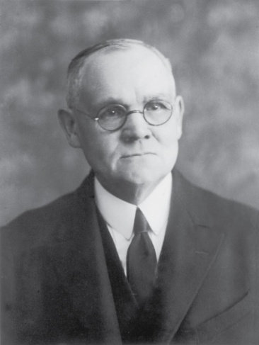
“We claim scriptural authority for the assertion that Jesus Christ was and is God the Creator, the God who reveled Himself to Adam, Enoch, and all the antediluvial patriarchs and prophets down to Noah; the God of Abraham, Isaac and Jacob; the God of Israel as a united people, and the God of Ephriam and Judah after the disruption of the Hebrew nation; the God who made Himself known to the prophets from Moses to Malachi; the God of the Old Testament record; and the God of the Nephites…
We affirm that Jesus Christ was and is Jehovah, the Eternal One.”
(2)

Slide 10
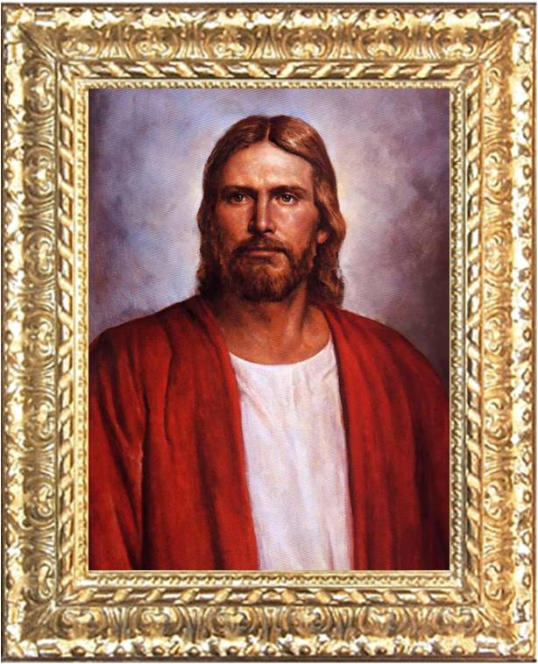
Jesus Was Chosen
John 1:1-18

Slide 11
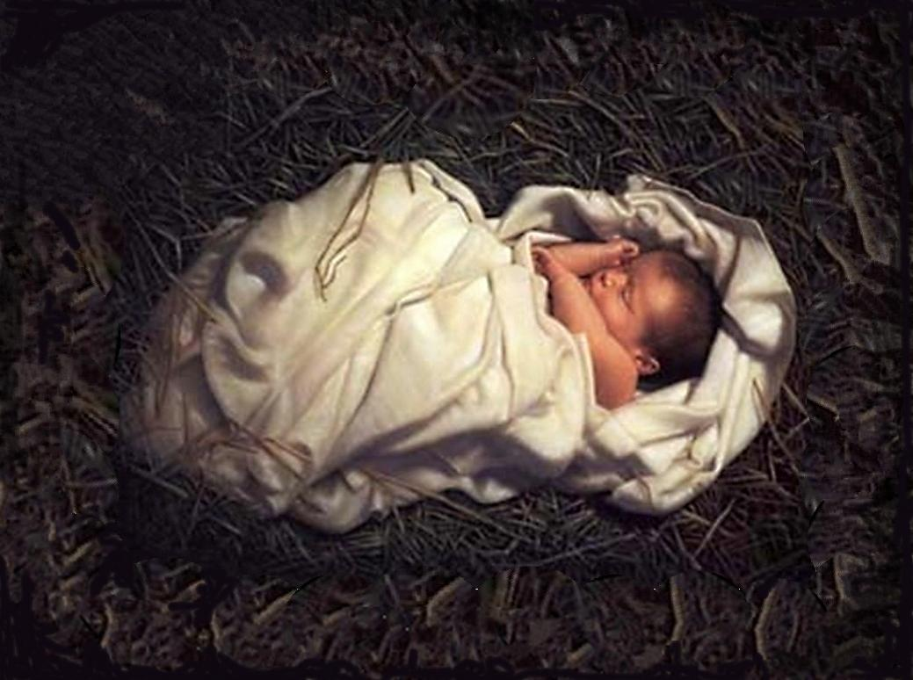
Divine Sonship
Jesus was the firstborn of the Father from the beginning:
“Among the spirit children of Elohim the firstborn was and is…Jesus Christ to whom all others are juniors. “
(9)

Slide 12
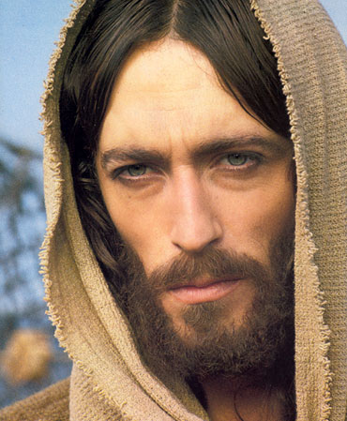
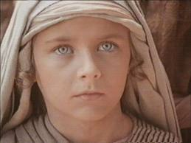
First Son--Birthright
Strict obedience through ages of premortality.
He advanced and progressed until “He stood as one “like unto God”
Abraham 3:24

Slide 13
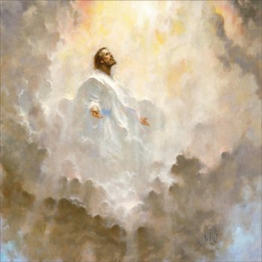
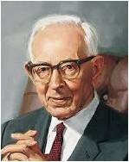
Jesus Christ Was with God in the Beginning
“Our Savior was a God before he was born into this world.”
“…and he brought with him the same status when he came here.”
(5)

Slide 14
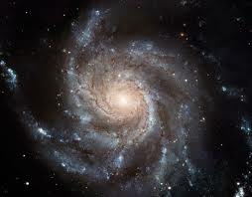
The Creation
“In the beginning was the Word…
Creation through the Son
“The word of my power”
John 1:1; Moses 1:32

Slide 15
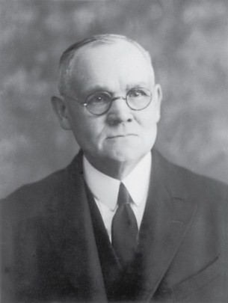
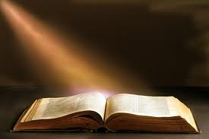
“…and the Word was with God…”
“The Word” is a title of Jesus Christ
Jesus was the executive
The will, commandment, or word of Father was put into effect.
John 1:1
(1,2)

Slide 16
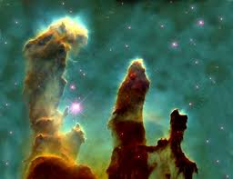
“…and the Word was God.”
“The great work of the Father is in creating worlds and peopling them.”
“…there is no end to my works, neither to my words” Moses 1:38
John 1:1
(5, 11)

Slide 17
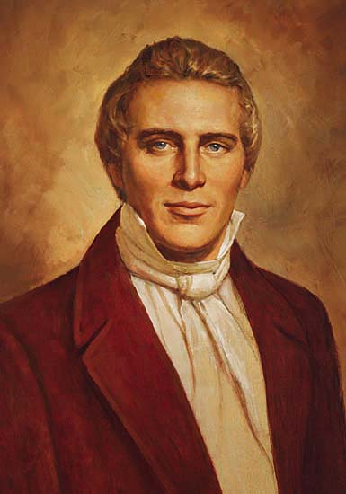
“In the beginning was the gospel preached through the Son. And the gospel was the word, and the word was with the Son, and the Son was with God, and the Son was of God.”
These words bear witness of the premortal existence of Jesus Christ, for He was “with God” in the beginning of all things. They affirm that His mission of salvation began in the premortal world, for He was “the Word,” even the messenger of salvation, who taught the gospel to us “in the beginning.”
Elsewhere in scripture we learn that in the premortal world, Jesus Christ was the great Jehovah
John 1:1 (JST); D&C 93:6-8
(1, 11)

Slide 18
Two Creative Events
That God the Father reserves for Himself.
“First, he is the Father of all spirits, Christ’s included.
… Second, he is the Creator of the physical body of man.”
John 1:1; Moses 2:27
(12)

Slide 19
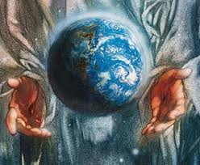
All things were made by Jesus Christ
In the premortal estate, Jesus was, under the Father, the Creator and Redeemer of the Father’s worlds.
All things were made by him; and without him was not anything made which was made.
And worlds without number have I created; and I also created them for mine own purpose; and by the Son I created them, which is mine Only Begotten.
John 1:3 (JST); Moses 1:33

Slide 20
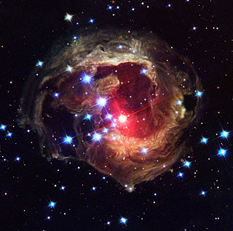
“The same was in the beginning with God.”
“I do the things I saw my Father do when worlds came rolling into existence. My Father worked out his kingdom with fear and trembling, and I must do the same, that is Christ must do the same.”
John 1:2
(4)

Slide 21
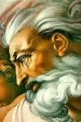
God himself was once as we are now. He is exalted.
If you were to see Him today, you would see Him like a man in form, like yourselves in all the person, image, and very form as a man.
(4)

Slide 22
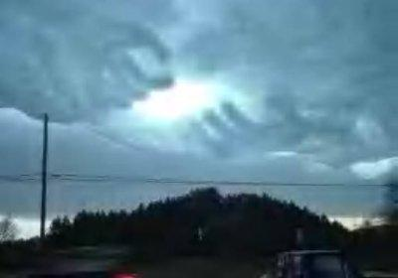
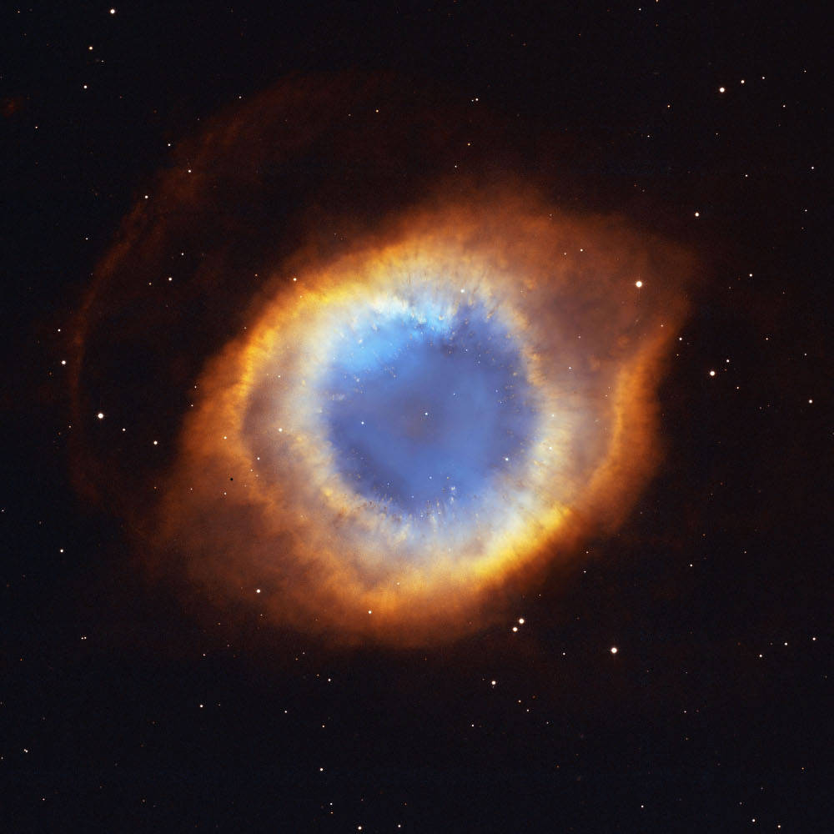
“Jesus treads in the tracks of His Father, and inherits what God did before…
…and God is thus glorified and exalted in salvation and exaltation of all his children”
(5)

Slide 23
“Adam was created in the very fashion, image and likeness of God…
…and received instruction from, and walked, talked, and conversed with him, as one man talk and communes with another.”
(4)

Slide 24
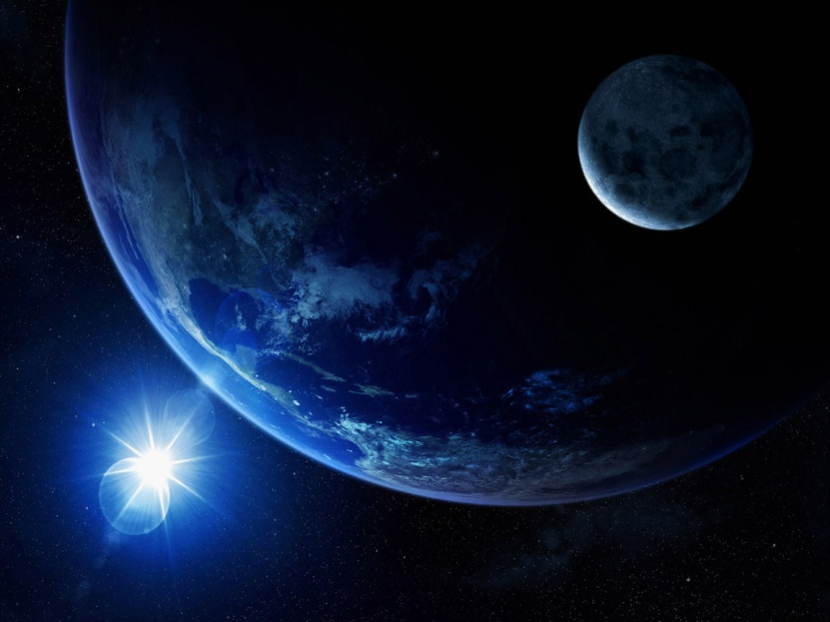
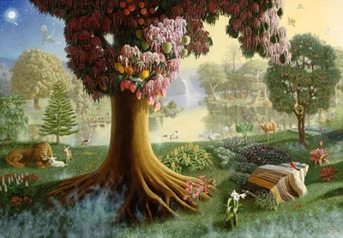
Bible word: Created
“All things were made by him; and with him was not any thing made that was made.”
To word create came from the Hebrew word baurau which does not mean create out of nothing…it means to organize
(4)

Slide 25
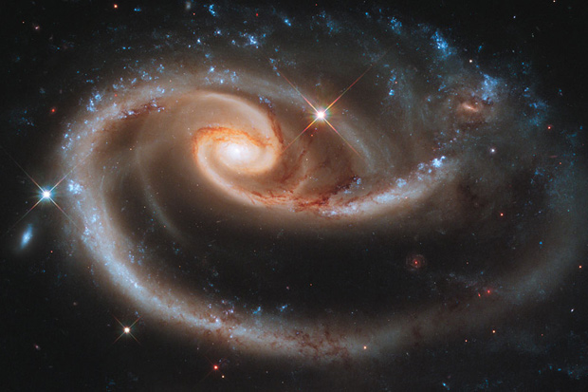
Elements Exists Eternally
God had materials, to organize the world out of chaos—chaotic matter, which is element, and in which dwells all the glory.
(4)

Slide 26
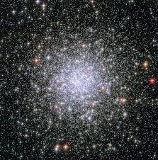
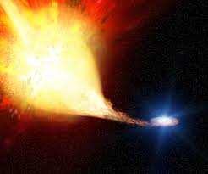
No Beginning and No End
The pure principle of element are principles which can never be destroyed: they may be organized and reorganized, but not destroyed.
(4)

Slide 27
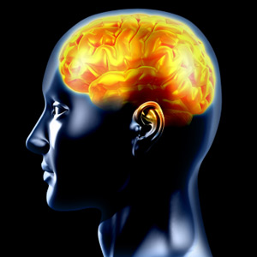
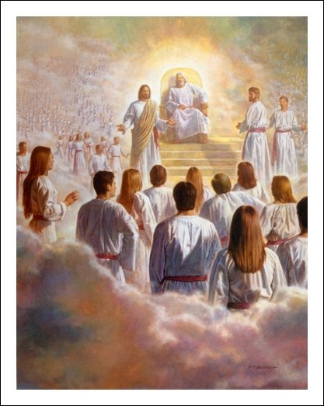
From Eternity to Eternity
“The intelligent part of man was never created but always existed.”
“…we are born sons and daughters of God in the spirit and are destined to exist forever.
(5)

Slide 28
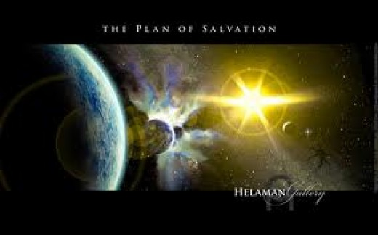
“In him was life; and the life was the light of men.”
Eternal Life
Manifestation from the Holy Ghost
John 1:3

Slide 29
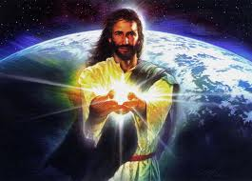
The great plan is to bring to pass the immortality and eternal Life
“All who have a true concept of Jesus Christ and who have received a witness by the spirit of his divinity are ever stirred by the records of his life.”
(6)

Slide 30
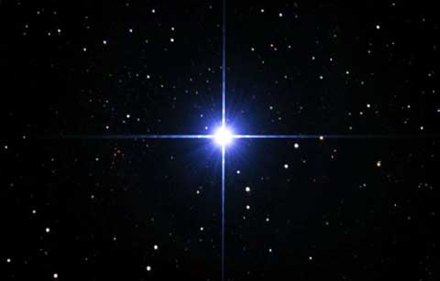
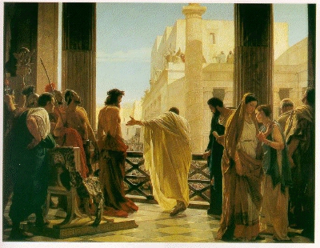
“And the light shineth in darkness: and the darkness comprehended it not.”
And the light shineth in the world, and the world perceiveth it not.
“…I am the same that came unto mine own, and mine own received me not…
John 1:5 (JST)

Slide 31
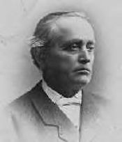
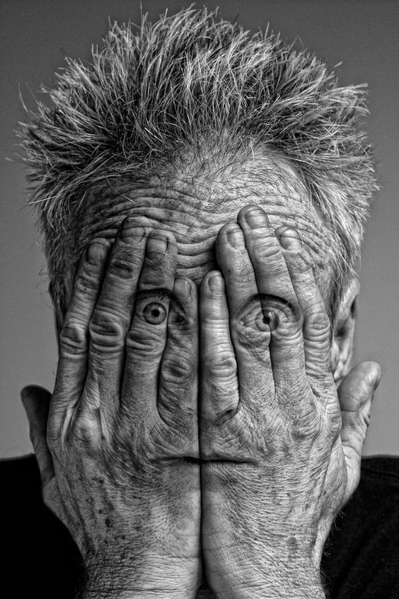
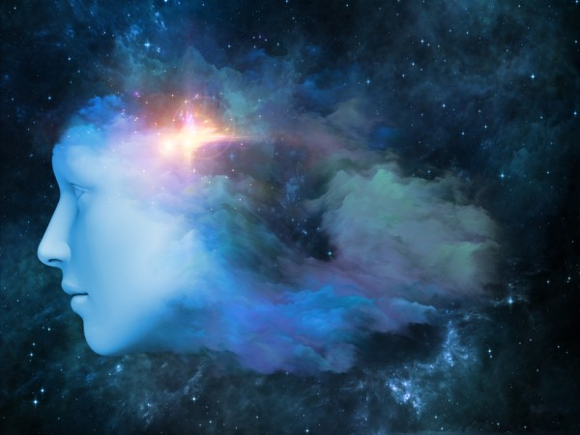
"The wicked comprehend not the things of God; they cannot know them, for they are spiritually discerned…
The unbelieving world cannot see as the Saints see; they walk in darkness, but the Saints are the children of light, even as many as keep sacred their covenants with God.
The wicked love darkness rather than light, because their deeds are evil…
We are called to be the children of light. Blessed are they who continue in the light, for the day of the Lord will not overtake them as a thief in the night;
but woe unto them that depart from, or reject that light that shines in the midst of the darkness, for the day cometh, and that speedily, when they will be overtaken as by a whirlwind.
The command of the Lord to the Saints is to watch, for we know not the day nor the hour when the Son of man shall come.”
John 1:5 (JST)
(14)

Slide 32
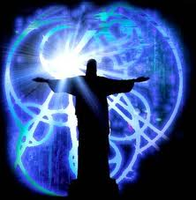
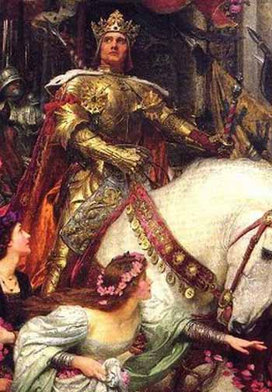
“I am the light which shineth in darkness, and the darkness comprehendeth it not.”
They were looking for a leader in political and social reform and they had little interest in spiritual things.
D&C 6:21

Slide 33
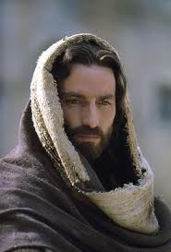
“The world was made by him, and the world knew him not”
There are those today who pass Him by without recognizing Him.
(3)

Slide 34
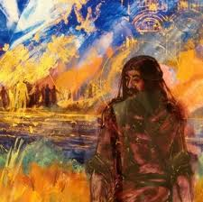
The Forerunner
“There was a man sent from God, whose name was John.”
John heard the Voice of the Lord. “Prepare ye the way of the Lord, make his paths straight.” (Mark 1:3)
John 1:6-7

Slide 35
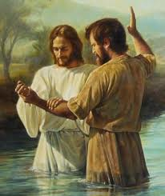
Spirit of Elias
“The same came for a witness, to bear witness of the Light, that all men through him might believe.”
Preparing the way for the greater…his mission was to preach repentance and baptize with water.
John 1:6-7
(4)

Slide 36
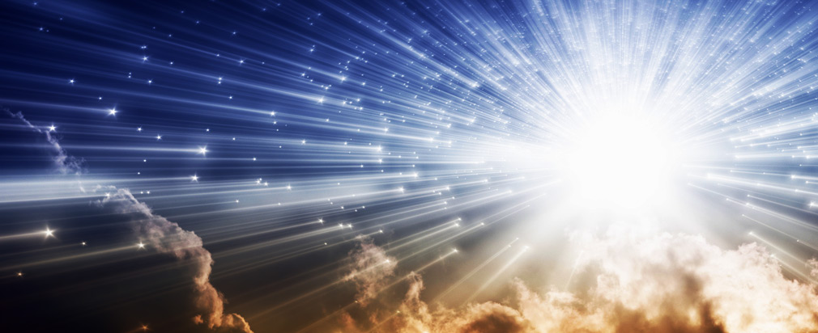
Jesus is the Light of the World
Which truth shineth. This is the light of Christ. As also he is in the sun, and the light of the sun, and the power thereof by which it was made.
Which light proceedeth forth from the presence of God to fill the immensity of space—
And the light which shineth, which giveth you light, is through him who enlighteneth your eyes, which is the same light that quickeneth your understandings;
The light which is in all things, which giveth life to all things, which is the law by which all things are governed, even the power of God who sitteth upon his throne, who is in the bosom of eternity, who is in the midst of all things.
"...the light of Christ is present in us mortals if we will respond to its illuminations (15)
John 1:9-10 D&C 88:7,11,12,13

Slide 37
The Witness
The Light
True Light
The World
Came to his own
Those who Received Him
He was born
The Word
The Glory
All men through him might believe.
For every one who comes into this world.
Made by Him
They didn’t know him
Is given power to become sons of God
Of God
Mortality of Jesus
Only Begotten of the Father full of grace and truth
John 1:7-14

Slide 39
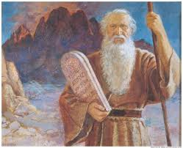
The Fulness
“For the law was given by Moses…
“…but grace and truth came by Jesus Christ.”
John 1:17

Slide 40
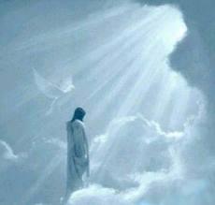
Grace and Truth
An enabling power that allows men and women to lay hold on eternal life and exaltation after they have expended their own best efforts.
The Spirit of Truth is for all who hearken to that Spirit, the gift of the Holy Ghost.
(10)

Slide 41
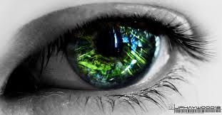
Declaration
“No man hath seen God at any time...
“…only the begotten Son, which is in the bosom of the Father, he hath declared him.”
John 1:18

Slide 42
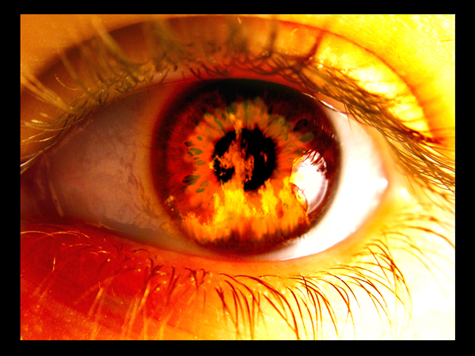
“And no man hath seen God at any time, except he hath borne record of the Son; for except it is through him no man can be saved.”
John 1:19 JST

Slide 43
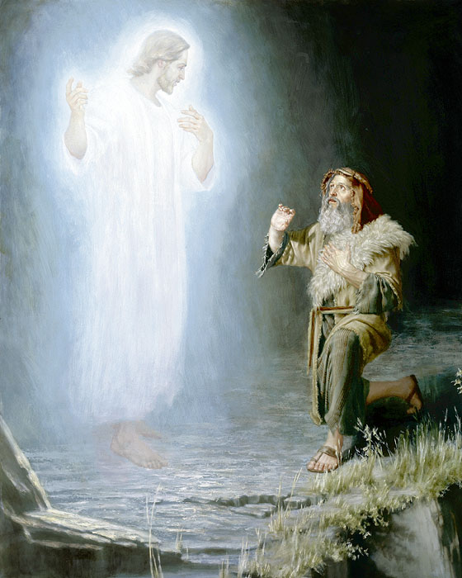
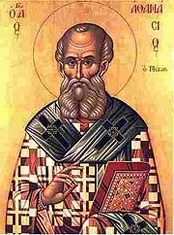
"It is to be hoped that you are aware that the Bible has come down to us through many translations and that it has been copied many times...
Therefore we find errors and contradictions in the Bible.
"There are too many passages which declare very definitely that God did appear, 'face to face,' with his ancient servants.
Therefore, passages which declare that no man has seen him, must be in error. For instance, the passage in John 1:18, to which you refer, is likely due to the fact that a translator in more recent years did not believe that God was a Personage and therefore could not be seen.
This notion has come down to us since the introduction of the Athanasian Creed in 325 A.D. The Prophet Joseph Smith has given us a correction of this passage as follows:
And no man hath seen God at any time, except he hath borne record of the Son, for except it is through him no man can be saved.
John 1:18(19-JST); See Also john 6:44-45
(5)

Slide 44
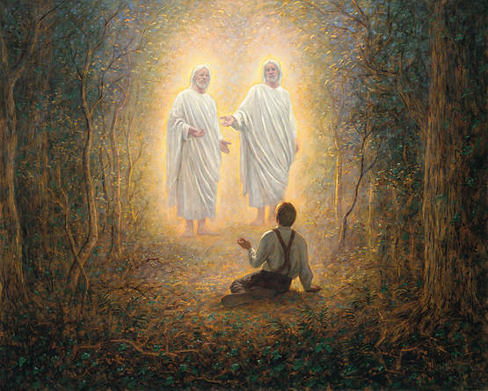
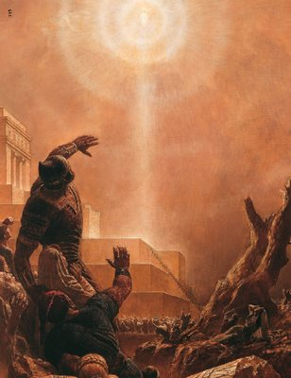
Can We See God?
Joseph Smith beheld the Father and the Son; therefore he could testify with personal knowledge that the scriptures were true.
“…Jesus showed himself unto this man in the spirit, …even as he showed himself unto the Nephites.”
Ether 3:17
(5)

Slide 45
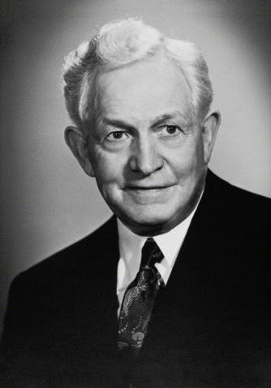
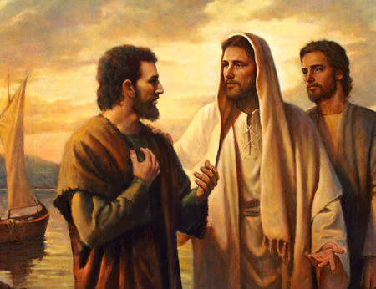
Learn of Him
John is the only New Testament writer to use “the Lamb” as a title for the Savior. (1)
From the Joseph Smith Translation Peter would be called “Cephas, which is, by interpretation, a seer, or a stone” indicating that Peter would become a seer in the Church.
"Accepting the invitation of Jesus to go with Him to the place where He stayed, these two men remained with Him, listening to His words all the rest of the day. When they left, they believed that Jesus was the King of Israel, the Savior of the world. Thus they became, in that day the first two, beside John the Baptist, to believe in Jesus.
"Whenever we have anything which is really good, we always desire to share it with one we love. It was so with these two brothers. They no sooner felt the divine influence that radiated from the Savior than they were filled with a desire to bring those whom they loved under that same influence.” (16)
As we accept the invitation to learn of and follow Jesus Christ, we will receive our own witness of Him
John 1:35-51 (JST 1:42)

Slide 46
"The import, glory, and grandeur of this Galilean meeting could not have been impressed more strongly upon [the disciples]. Nor can we doubt that the word went out-repetitiously-to all who were invited and that elaborate preparations were made.
This was to be no small and insignificant thing; many of them had already seen the Risen Lord, but all that had gone before was but a shadow and a foretaste of what was to be.”
John 1:51
(17)

Slide 47
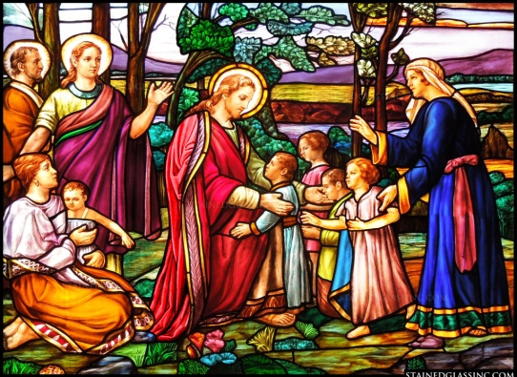
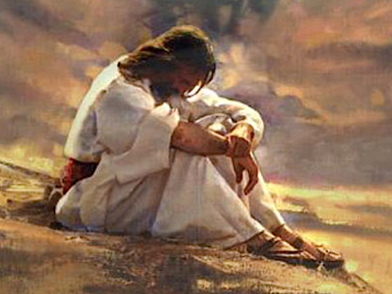
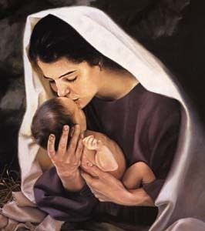
Titles for Jesus Christ
John 1:18, 34, 49
Deuteronomy 18:15
John 1:21
John 1:23
John 1:4-9
It was assumed He was ‘That Prophet’
The Lord
John 1:29, 36
The Light
The Lamb
The Son
John 3:29
John 1:38, 49
John 3:2
The Bridegroom
Teacher
The Master or Rabbi
John 1:41
The Messiah or Christ

Slide 48
Each title given teaches about the life and mission of the Savior
President Spencer W. Kimball says there are over 100 names given for our Savior

Slide 49
Sources:
Suggested Hymn: #66 Rejoice, the Lord is King
New Testament Institute Student Manual Chapter 21
Elder James E. Talmage…Jesus the Christ p. 32
President Howard W. Hunter
Discourses of the Prophet Joseph Smith p. 34,58,126
Doctrines of Salvation Joseph Fielding Smith p. 3,7 and Answers to Gospel Questions, 5 vols. [Salt Lake City: Deseret Book Co., 1957-1966], 2: 161-163.)
Infinite Atonement Tad R. Callister p. 87
Life and Teachings of Jesus and His Apostles course manual p. 15
Jesus the Christ James E. Talmage p. 33
First Presidency 1916: President Joseph F. Smith, Anthon H. Lund, Charles W. Penrose
Bible Dictionary King James Version LDS edition 697
Photos: Space Hubble internet sight. Internet. LDS site.
12. Bible appendix
13. Bruce R. McConkie, A New Witness for the Articles of Faith [1985], 63).
14. Elder Erastus Snow (Journal of Discourses, 26 vols. [London: Latter-day Saints' Book Depot, 1854-1886], 20: 373 - 374.)
Elder Neal A. Maxwell Not My Will, But Thine [Salt Lake City: Bookcraft, 1998], 9-10
President David O. McKay (Ancient Apostles [Salt Lake City: Deseret Book Co., 1964], 13.)
Elder Bruce R. McConkie (The Mortal Messiah: From Bethlehem to Calvary, 4 vols. [Salt Lake City: Deseret Book Co., 1979-1981], 4: 294.)
Presentation by ©http://fashionsbylynda.com/blog/

Slide 50
Event | Matthew | Mark | Luke | John
In the Beginning |  |  | 13:1-9 | 1:1-9
John is a Witness |  |  |  | 1:10-18
John Testifies of Jesus |  |  |  | 1:19-34
First Call of Disciples |  |  |  | 1:35-51

Slide 51
The Word John 1:1:
“In the Greek language of the New Testament, that Word was Logos, or ‘expression.’ It was another name for the Master. That terminology may seem strange, but it is appropriate. We use words to convey our expression to others. So Jesus was the Word, or expression, of His Father to the world” Elder Russell M. Nelson(“Jesus the Christ: Our Master and More,” Ensign, Apr. 2000, 4).
No Man Hath Seen God Luke 1:18:
"The Prophet Joseph Smith's understanding of the true meaning of these scriptures was made plain in a revelation received by him from the Lord at Hiram, Ohio, in November 1831: 'For no man has seen God at any time in the flesh, except quickened by the Spirit of God.' (D&C 67:11.)
"This doctrine was further clarified in the visions of Moses as revealed to the Prophet Joseph Smith:
But now mine own eyes have beheld God; but not my natural, but my spiritual eyes, for my natural eyes could not have beheld; for I should have withered and died in his presence; but his glory was upon me; and I beheld his face, for I was transfigured before him. (Pearl of Great Price, Moses 1:11.)
"It is thus plain that man can only see God when 'quickened by the Spirit of God.' This is apparently what John had in mind in the following statement:
It is written in the prophets, And they shall be all taught of God. Every man therefore that hath heard, and hath learned of the Father, cometh unto me.
Not that any man hath seen the Father, save he which is of God, he hath seen the Father. (John 6:45-46.)“ LeGrand Richards (A Marvelous Work and a Wonder [Salt Lake City: Deseret Book Co., 1950], 20-21.)
Creation of the World John 1:1:
“The Father operated in the work of creation through the Son, who thus became the executive through whom the will, commandment, or word of the Father was put into effect. It is with incisive appropriateness therefore, that the Son, Jesus Christ, is designated by the apostle John as the Word; or as declared by the Father ‘the word of my power’ [John 1:1;Moses 1:32]” James E. Talmage (Jesus the Christ, 3rd ed. [1916], 33).
Creator John 1;3:
Jesus Christ, under the direction of His Father, was the organizer and builder of this world; that out of the elements that existed in space, He, the great Master, compounded, produced and materialized this substantial world upon which you and I live; that we are indebted to Him, and to our Father in heaven, for this life that we are enjoying, the bodies that we have, the beautiful world that we inhabit. We sometimes wonder where our heaven will be, that is, the people of the world wonder. We Latter-day Saints have no reason to doubt where our heaven will be, for the Lord has made known to us, that this splendid world that has been provided for us will ultimately be redeemed, having obeyed the laws of its being, and become celestialized, the home of celestial beings; so that if we shall ever come into heaven, or heavenly conditions, it will be, ultimately, upon this redeemed world. Jesus Christ has been the organizer and the builder of it, possessed with power to do all that." Melvin J. Ballard (Conference Report, April 1914, Overflow Meeting.)
Bethabara john 1;28-34
“The River Jordan was the site Jesus chose for His baptism by John. … Is it significant that this sacred ordinance was performed in virtually the lowest body of fresh water on the planet? Could He have selected a better place to symbolize the humble depths to which He went and from which He rose? By example, He taught us that He literally descended beneath all things to rise above all things. Surely, being baptized after the manner of His baptism signifies that through our obedience and effort we, too, can come from the depths to ascend to lofty heights of our own destiny.
“To us, the River Jordan is a sacred stream. The Jordan marked the termination of the wandering of the children of Israel. They had journeyed there from the banks of the Nile. Joshua had led some 600,000 Israelite warriors and their families across that roiling river during flood season, when the waters were suddenly stopped and heaped up to allow the faithful Israelites, carrying the ark of the covenant, to cross an empty river bed. (See Joshua 3.)
“… Bethabara in Hebrew means ‘house of the crossing.’ … Could it be that Christ chose this location for His baptism in the River Jordan as a silent commemoration of the crossing of those faithful Israelites under Joshua’s direction so many years before, as well as a symbol that baptism is a spiritual crossing into the kingdom of God?” Elder Russell M. Nelson (“Why This Holy Land?” Ensign, Dec. 1989, 15).
The name Joshua is Hebrew, and it is rendered as Iēsous in Greek, which later became Iesus (later Jesus) in Latin. Thus, Joshua’s crossing of the Jordan River can be viewed as a type or foreshadowing of the future baptism of Jesus Christ (1)
John the Baptist Purpose John 1:6-8:
“The immediate purpose of the mission of John the Baptist was to bear witness that Jesus was the true Light, the true teacher of the way of life eternal, and to invite men to believe in him for the remission of their sins and be baptized. John the Baptist was not the Messiah or the leader of a great movement; he was the herald and witness, bearing testimony to the nature and divine titles of Jesus, and the witness through whom God attested the divine sonship of Jesus” Howard W. Hunter (in Conference Report, Oct. 1968, 141).

Slide 52
Nathanial or Bartholomew Luke 1:47:
"The reasons for assuming that Bartholomew and Nathanael are the same person are these: Bartholomew is named in each of the three synoptic Gospels as an apostle, but Nathanael is not mentioned. Nathanael is named twice in John's Gospel, and Bartholomew not at all; Bartholomew and Philip, or Nathanael and Philip, are mentioned together." james E. Talmage (Jesus the Christ, 213)
What Seek Ye? John 1:51:
“It seems that the essence of our mortal journey and the answers to the most significant questions in life are distilled down to these two very brief elements in the opening scenes of the Savior’s earthly ministry. One element is the question put to every one of us on this earth: ‘What seek ye? What do you want?’ The second is His response to our answer, whatever that answer is. Whoever we are and whatever we reply, His response is always the same: ‘Come,’ He says lovingly. ‘Come, follow me.’ Wherever you are going, first come and see what I do, see where and how I spend my time. Learn of me, walk with me, talk with me, believe. Listen to me pray. In turn you will find answers to your own prayers. God will bring rest to your souls” Elder Jeffrey R. Holland (“He Hath Filled the Hungry with Good Things,” Ensign, Nov. 1997, 65).
Chosen Apostles Luke 1:47:
"Clearly, Jesus had chosen these witnesses, for he said, 'Ye have not chosen me, but I have chosen you, and ordained you.' (John 15:16.) These twelve were common men from various walks of life. The Savior selected them because he could see far beyond their earthly appearance and look into their hearts, recognizing their potential.
"...In latter-day scriptures, we read that the Lord called Edward Partridge to be bishop for the Church because of his pure heart, 'for he is like unto Nathanael of old, in whom there is no guile.' (D&C 41:11.) In another revelation the Lord said, 'My servant George Miller is without guile; he may be trusted because of the integrity of his heart; and for the love which he has to my testimony I, the Lord, love him.' (D&C 124:20.)
"These passages of scripture help me understand what the Lord could see in Nathanael, Edward Partridge, and George Miller, and give me some insight into what he expects of the Saints. I believe the Savior was seeking purity of soul in those he called to be his twelve apostles. When he spoke of being without guile, he referred to something far deeper than outward appearance. He was reaching into the soul, to the very heart of righteousness. He was touching the key to goodness and to the Christlike life.
"To be without guile is to be pure in heart, an essential virtue of those who would be counted among true followers of Christ. He taught in the Sermon on the Mount: 'Blessed are the pure in heart: for they shall see God.' (Matthew 5:8; see also 3 Nephi 12:8.) He revealed to the Prophet Joseph Smith that Zion is the pure in heart (see D&C 97:21), and that a house is to be built in Zion in which the pure in heart shall see God (see D&C 97:10-16).
"If we are without guile, we are honest, true, and righteous. These are all attributes of Deity and are required of the Saints. Those who are honest are fair and truthful in their speech, straightforward in their dealings, free of deceit, and above stealing, misrepresentation, or any other fraudulent action. Honesty is of God; dishonesty of the devil, who was a liar from the beginning. Righteousness means living a life that is in harmony with the laws, principles, and ordinances of the gospel." Joseph B. Wirthlin (Finding Peace in Our Lives [Salt Lake City: Deseret Book Co., 1995], 180-181.)
The Light of Christ:
“The light of Christ is just what the words imply: enlightenment, knowledge, and an uplifting, ennobling, persevering influence that comes upon mankind because of Jesus Christ. For instance, Christ is ‘the true light that lighteth every man that cometh into the world’ (D&C 93:2; see John 1:9). The light of Christ fills the ‘immensity of space’ and is the means by which Christ is able to be ‘in all things, and is through all things, and is round about all things.’ It ‘giveth life to all things’ and is ‘the law by which all things are governed.’ It is also ‘the light that quickeneth’ man’s understanding (see D&C 88:6–13, 41). In this manner, the light of Christ is related to man’s conscience and tells him right from wrong (Moro. 7:12–19).
“The light of Christ should not be confused with the personage of the Holy Ghost, for the light of Christ is not a personage at all. Its influence is preliminary to and preparatory to one’s receiving the Holy Ghost” (Bible Dictionary, “Light of Christ”). Bible Dictionary
Elder Richard G. Scott of the Quorum of the Twelve Apostles taught the following about the Light of Christ:
“The Light of Christ is that divine power or influence that emanates from God through Jesus Christ. It gives light and life to all things. It prompts all rational individuals throughout the earth to distinguish truth from error, right from wrong. It activates your conscience” (“Peace of Conscience and Peace of Mind,” Ensign or Liahona, Nov. 2004, 15).
“Can any good thing come out of Nazareth? President Thomas S. Monson
“From Nazareth came example.
“From Nazareth came sight.
“From Nazareth came strength.
“From Nazareth came life.
“From Nazareth came faith.
“From Nazareth came peace.
“From Nazareth came courage.
“From Nazareth came Christ” (“Can There Any Good Thing Come Out of Nazareth?” Ensign, Oct. 1988, 3, 5).

Slide 53
Names Of Jesus The Christ
English | Greek | Hebrew | Meaning
Joshua | Jesus | Yhoshua or Yeshua | Individual name of the Savior “Help of Jehovah”. It was a common name. His name was divinely prescribed (made known before His birth
 | Christ | Messiah or Messias | A sacred title and not a common name. Hebrew meaning signifying the Anointed One.
 |  | Immanuel or Emmauel | God with us. Given in Isaiah as a sign of God’s deliverance and also Matthew. Signifies that Christ as God will be born into mortality of a Virgin and will be among the people to save and redeem them Other titles include: Redeemer, Only Begotten Son, Lord, Son of God, Son of Man. All made known before His birth
LORD |  | Jehovah, Yahveh, or Jahveh | Signifying the Self-existent One, or The Eternal. LORD, printed in capitals in the Old Testament

Slide 54
English | Greek | Hebrew | Meaning
 |  | Ehyeh | Signifying “I Am” is related in meaning and through derivation with the term Yahveh or Jehovah. Using this name when the Lord reveled Himself to Moses. He also declares Himself to be “the God of Abraham, Isaac, and Jacob.”
 |  | God Almighty | Appeared to Abraham, Isaac, and Jacob by this name. Jehovah was not known to them.
 | Alpha and Omega |  | First letter of the Greek alphabet, and last letter. Meaning all encompassing nature of Christ, being the first and the last, the beginning and the end.
 |  | Adonai or Yahveh | Jews referred this to terms of Lord and God as in the Old Testament. The Lord who spoke through the voice of Isaiah, and with Jehovah who spoke through Zechariah.

Slide 55
English | Greek | Hebrew | Meaning
Christ | Christ | Messiah | Meaning anointed and equivalent of Messiah, which is from a Hebrew and Aramaic term meaning anointed. “Anointed One”
 |  | Heavenly Father names
Elohim |  | Elohim | Frequently found in Hebrew texts of the Old Testament. Not found in our English version. In form the word is a Hebrew plural noun. It is expressive of supreme or absolute exaltation and power. Used in the restored Church of Jesus Christ, is the name-title of God the Eternal Father, whose firstborn Son in the spirit is Jehovah- The Only Begotten in the flesh, Jesus Christ.
 |  | Abba | Aramaic for father, in Talmudic times was used as a title of honor. It was used in the language of Jesus and the apostles, and later by Greek-speaking Christians as an intimate name for the Father in Heaven

Slide 56
Names of Jesus Christ (200)
Advocate
Almighty
Almighty God
Alpha and Omega
Amen, The
Ancient of Days
Anointed
Anointed One
Author
Author of Eternal Salvation
Beginning
Beginning and the Ending
Begotten
Beloved
Beloved Son
Beloved Son of God
Blessed of God
Bread of Life
Bridegroom
Bright and Morning Star
Captain of Man's Salvation
Captain of Our Salvation
Carpenter
Carpenter’s Son
Chief Cornerstone
Chosen
Chosen of God
Christ
Christ Child
Christ of God
Christ the Lamb
Christ the Lamb
Comforter
Consolation of Israel
Cornerstone
Counsellor
Creator
Creator of All Things
Deliverer
Divine Son
Door of the Sheep
Emmanuel
End of the Law
Endless
Eternal
Eternal Father
Eternal God
Eternal Head
Eternal Judge
Eternal Judge of Quick and Dead
Everlasting Father
Example
Exemplar
Faithful and True
Father
Father of Heaven and Earth
Finisher
Finisher of faith
First and the Last
Firstborn
Firstfruits
Forerunner
God
God of Abraham
God of Isaac
God of Israel
God of Jacob
God of Thy Father
God of Whole Earth
God's Anointed
God's Holy Child Jesus
Good Shepherd
Governor
Great I AM
Great God
Great Shepherd
Head of Every Man
Head of the Body
Head of the Church
Healer
Heir of All Things
Holy
Holy Child
Holy Messiah
Holy One
Holy One of Israel
Holy One of Jacob
I AM
Image of God
Immanuel
Jehovah
Jesus
Jesus Christ
Jesus of Galilee
Jesus of Nazareth
Joseph's Son
Judge
Judge of Quick and Dead
Just One
Just, The
King
King of Israel
King of Kings
King of Zion/Sion
King of the Jews
Lamb
Lamb of God
Life, the
Light of the World
Light, the
Lion of the Tribe of Judah
Living Bread
Living Stone
Living Water
Lord
Lord from Heaven
Lord God
Lord God Almighty
Lord God of Hosts
Lord Jehovah
Lord Jesus
Lord of All
Lord of Dead
Lord of Glory
Lord of Hosts
Lord of Living
Lord of Lords
Lord of the Sabbath
Lord Omnipotent
Lord our Righteousness
Lord's Christ
Maker
Man of Counsel
Man of Holiness
Master
Mediator
Meek and Lowly
Messenger of the Covenant
Messiah
Messias
Mighty God
Mighty One
Mighty One of Israel
Mighty One of Jacob
Minister
Most High God
Nazarene
Offspring of David
One Body
Only Begotten
Only Begotten of the Father
Only Begotten Son
Our Passover
Physician
Power of God
Prince
Prince of Life
Prince of Peace
Prophet
1-158

Slide 57
Prophet of Nazareth
Propitiation for Sins of Whole World
Rabbi
Redeemer
Redeemer of Israel
Redeemer of the World
Resurrection and the Life
Revealer
Righteous Judge
Righteous ManRock, the
Rock of Heaven
Root of Jesse
Sacrifice, the
Savior
Savior of Israel
Savior of the World
Second Comforter
Seed of Abraham
Seed of David
Seed of the Woman
Servant of Jehovah
Servant of the Lord
Shepherd
Son
Son of Abraham
Son of David
Son of God
Son of Man
Son of Mary
Son of Righteousness
Son of the Blessed
Son of the Eternal Father
Son of the Everlasting God
Son of the Highest
Son of the Living God
Son of the Most High God
Spiritual Rock
Stem of Jesse
Teacher Come from God
True Vine
Truth, the
Unchangeable One
Way, the
Well Beloved
Wisdom of God
Wonderful
Word of Life
Word, the
Worthy
159-208
This list contains over 200 of the many names of Jesus Christ. Some are titles of the Savior and concepts of who Christ is. Many of the names of Jesus come from the Bible, LDS Scriptures, and Latter-day revelation to living prophets.
By Rachel Bruner Updated by Krista Cook

