Slide 1
Lesson 61
Water to Wine
John 2

Slide 2
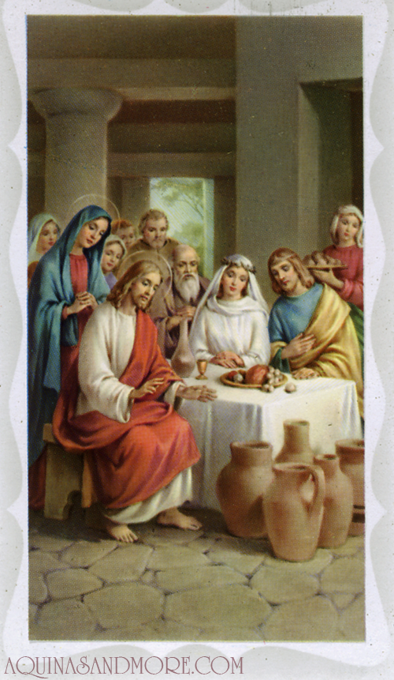
Water into Wine
The First Public Recorded Miracle of
Jesus Christ

Slide 3
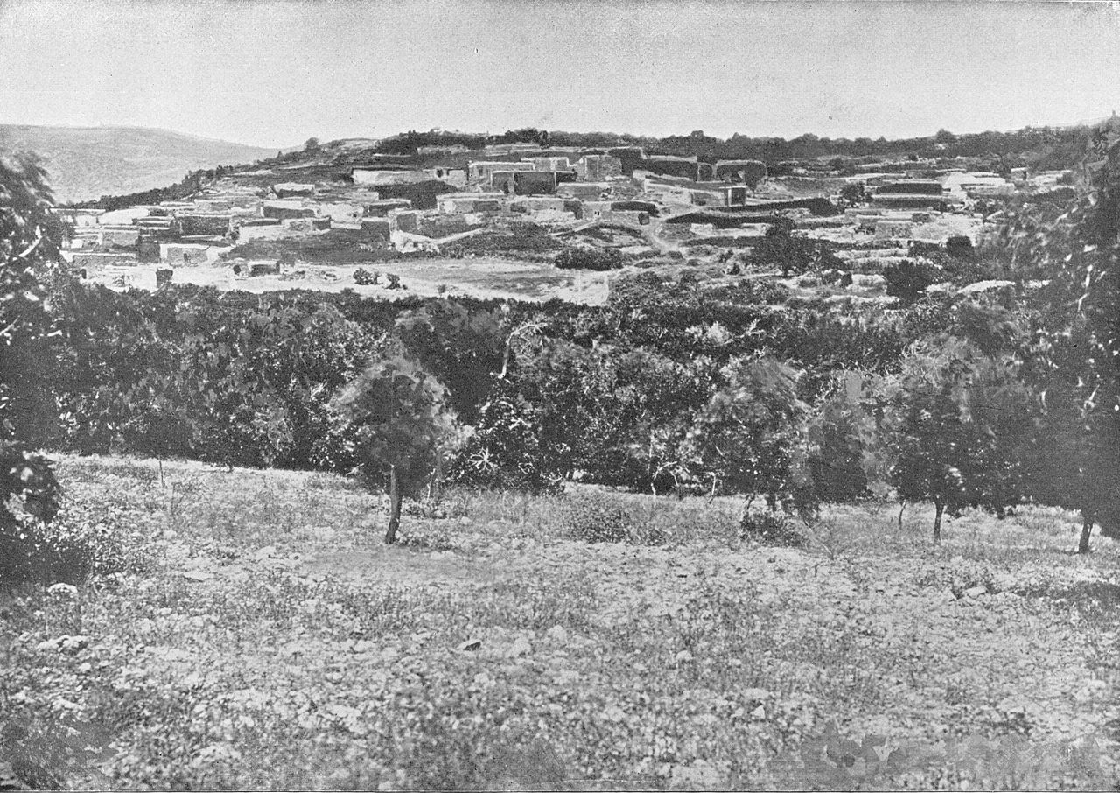
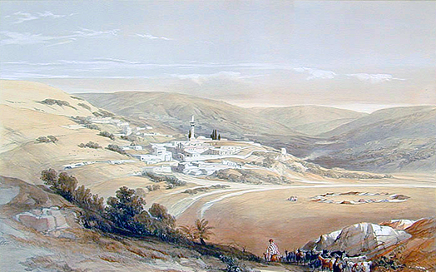
Cana
North of Nazareth - Galilean hills. Mary there as host. The wedding happened on the "third day of the week."
In ancient Jewish tradition, weddings were performed on Tuesdays, the third day of the week, because the word "good" was used twice in the creation account for the third day.
Important events were decided or celebrated on the third day because it would call for a "double" blessing from God. (2)
Daniel B. Shepp
Capernaum
Cana
Sea of Galilee
Nazareth
David Roberts
JST John 2:1

Slide 4
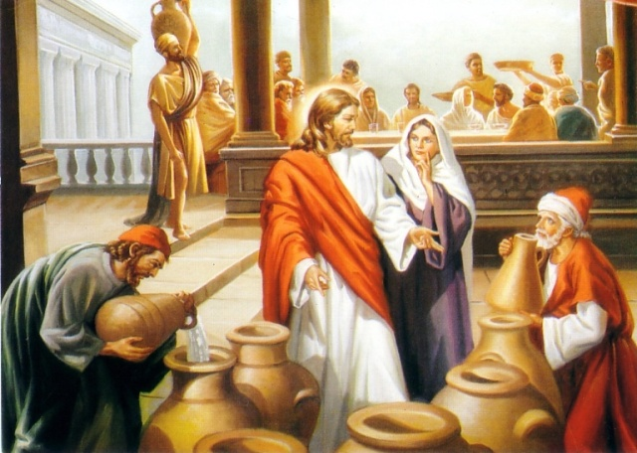
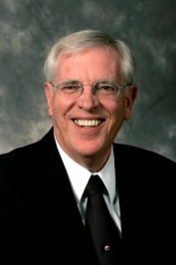
The Wedding Feast
Jesus Christ’s attendance at the wedding feast shows that He was not a social recluse; He participated in the normal social interactions of His day. His presence at a wedding demonstrates that He approved of marriage. (1)
A short time after Jesus was baptized, He and His disciples attended a wedding feast in Cana, a village near Jesus’s hometown of Nazareth.
Philip = Andrew’s friend
Nathanael = Phillip’s friend
They were not yet called to be apostles, but they believed that He was the Messiah. The miracle performed here was doubtless to increase their faith in the Messiahship of Jesus.
"Weddings were held at the home of the bride and were as elaborate as the budget of the house would allow, running from one day to a whole week.” (3)
COUSINS
John 2:2

Slide 5
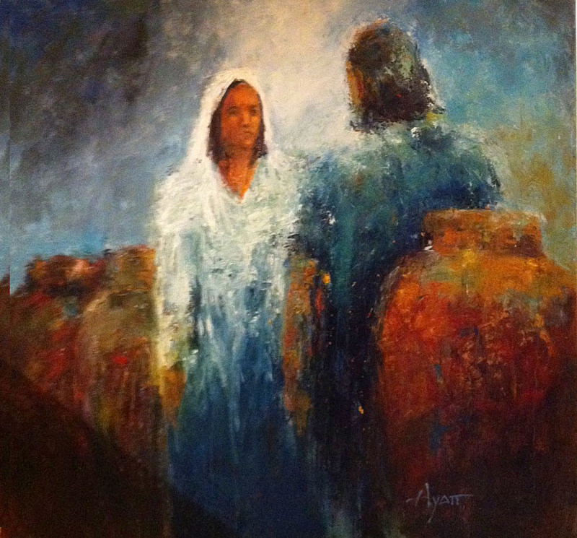
Mary Hosts the Wedding
with Jesus as the Birthright Son
“The hosts felt a strong obligation to provide lavish hospitality, and failing to do so would embarrass the family and mortify the newly wedded couple.
Mary may have been aware of this as she told her son that the wine had run out. We don't know Mary's function at the wedding, but the fact that she was concerned about the wine and was able to command the servants suggests that a close relative was being married." (3)

Slide 6
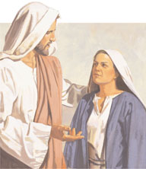
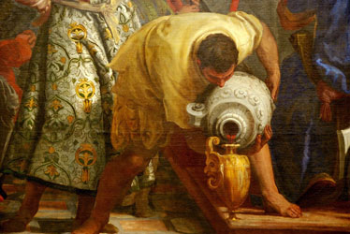
Woman,
what have I to do with thee?”
Mary knew he had great power, and she wanted him to use it. "We cannot avoid the conclusion that between Jesus' twelfth and thirtieth years there were many marvelous and miraculous things of which Mary knew." (4)
Mary tells the servants to do whatever her Son says because she already knows he will grant her request. She doesn't need to plead with him; she doesn't need to argue. She knows that the God of Israel will do what she wants because she is his mother-if for no other reason. And he does! (5)
John 2:3-4

Slide 7
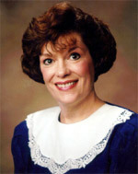
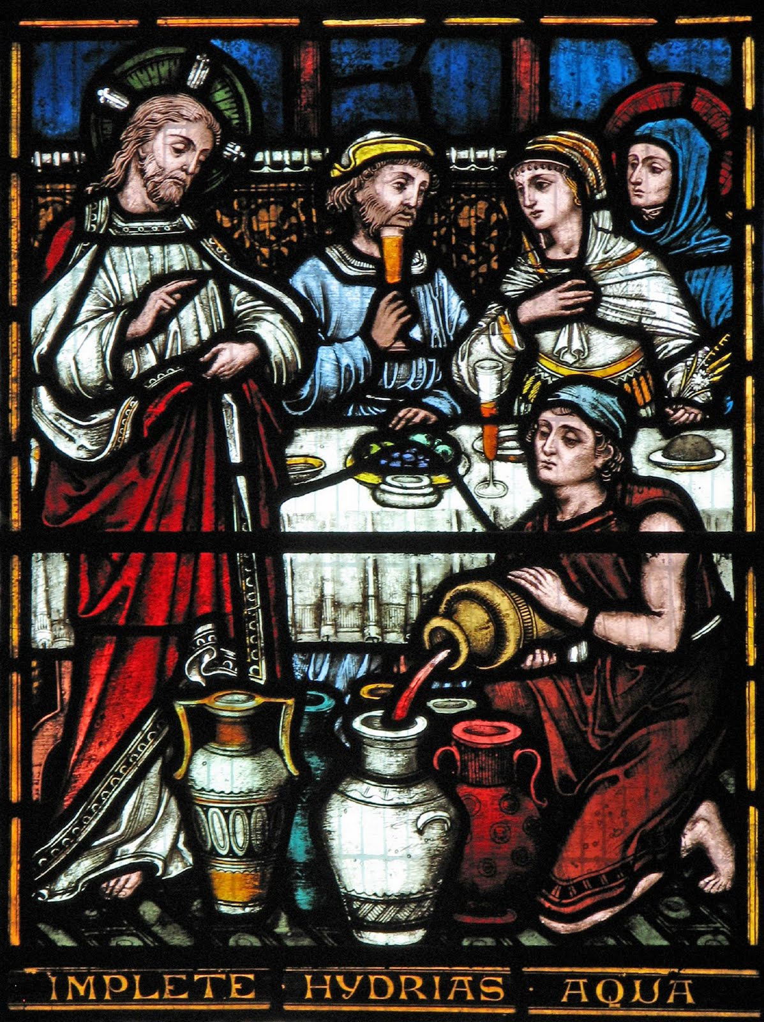
“Mine hour is not yet come.”
"Christ's mission to glorify his Heavenly Father and extend salvation to each of us did not prevent him from showing his profound love and respect for his mother.
Indeed, the scriptures make it clear that even during the agony of his crucifixion at Calvary, his mother's welfare was not far from his thoughts. John records that 'there stood by the cross of Jesus his mother.'
When Jesus saw his mother, standing by his disciple John, he said, 'Woman, behold thy son! Then saith he to the disciple, Behold thy mother! And from that hour that disciple took her unto his own home.’" (6)
John 2:5; John 19:25-27

Slide 8
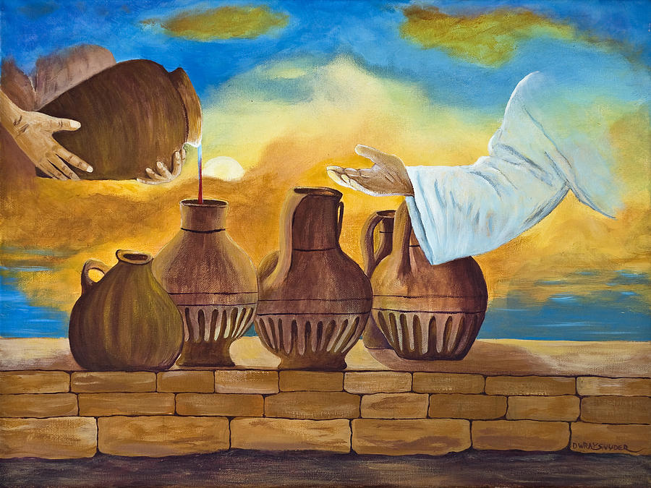
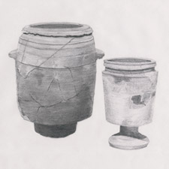
Six Water Pots
Wine was a customary drink at a wedding feast. Sometimes the wedding feast would continue for multiple days. To run out of wine would have been embarrassing for the hosts of the feast.
Life size Pots
1 Firkin = 9 gallons
2 Firkins = 18 gallons
3 Firkins = 27 gallons
100-160 gallons total
Limestone pots from the New Testament era in Israel
John 2:6
(4)

Slide 9
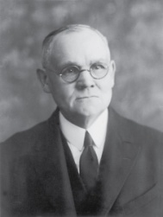
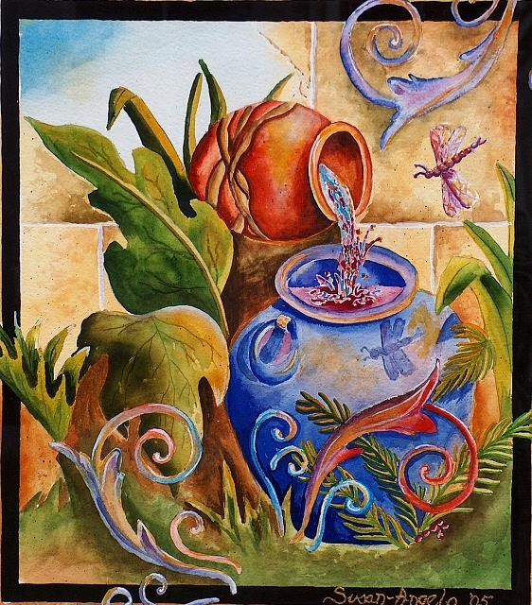
Water
for Religious Purposes
The Jews had a practice under the Pharisees to wash their hands for purification purposes before and after eating.
They also had rituals that required pure water that was dedicated to religious purposes.
The detailed regulations were set in the Talmud. Every home would have very large stone pots with this special dedicated water.
They would have been ceremonially cleansed (Kosher type cleansing today).
Stone vessels had special status because they could not become ritually impure. (8)
Used only for water
Dedicated for purification & rituals
Susan-Angelo DeBay
John 2:7

Slide 10
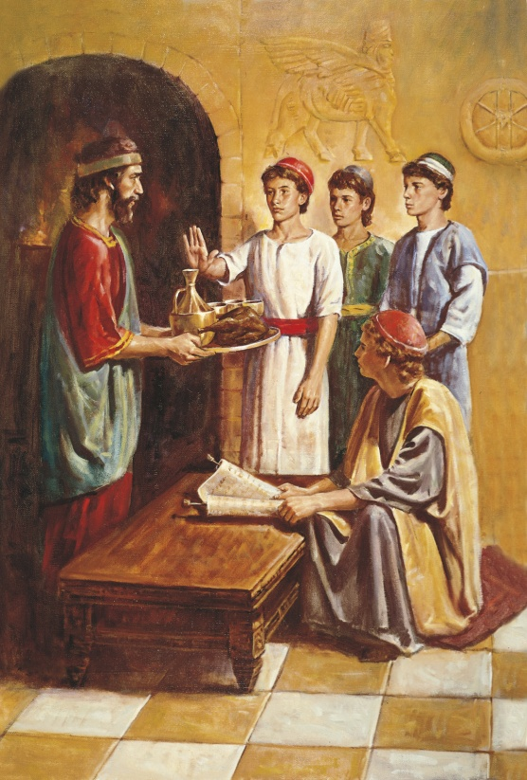
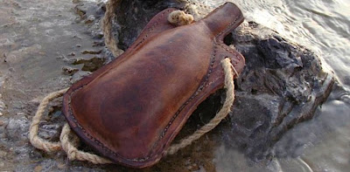
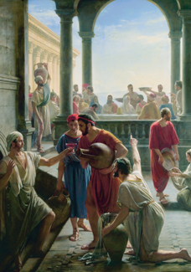
Good VS Bad Wine
There are many references in the Bible to the evils of drunkenness and strong drink.
These verses do not specifically forbid the use of alcohol, but they do condemn overindulgence and drunkenness.
In our day, the Lord has revealed the Word of Wisdom, which does forbid consumption of alcoholic beverages.
We should avoid judging the people of earlier dispensations by the commandments the Lord has given us in our day.
Carl H. Bloch
John 2:7; Proverbs 23:20–21; Isaiah 5:11–12; Ephesians 5:18; D&C 89:4-7

Slide 11
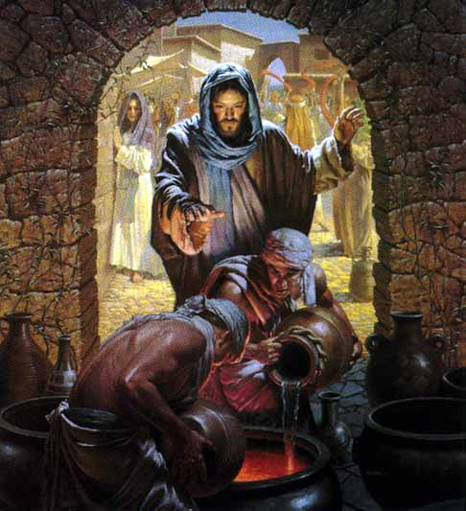
Water from a
Living Spring
Filled 1-2 gallons
at a time
to the brim
Christ who is the fountain
We don't go to him just once, but over and over until we are filled to the brim.
How do we go to Him?
By Prayer and Scriptures
John 2:7

Slide 12
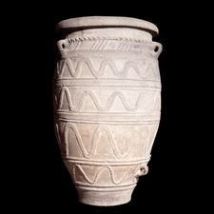
Water Pot Symbol
6= Imperfection
We are the Pot
Made from the elements of earth
Dedicated & cleansed to
hold living water

Slide 13
Water Symbolism
Living Water = Revelation
Source = God is the font
of living water
We are filled slowly…
…but to the brim
John 2:7

Slide 14
“Draw out now
& bare unto the Governor.”
Servants = Prophets
Vessels = US
Wine = Our character transformed through the Atonement
Governor = God the Father
John 2:8

Slide 15
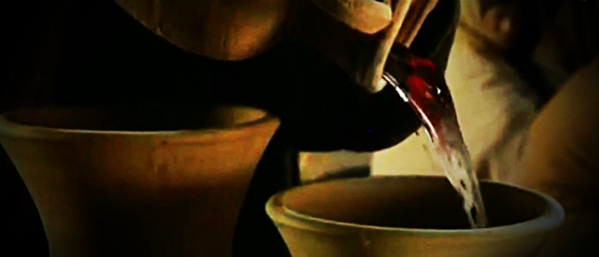
“Thou hast kept the good wine until now.”
The best wine was often used at the beginning of the feast and lesser-quality wine was used later into the feast
Jesus Christ has power over physical elements. The Savior knew He had a divine mission to fulfill. The Messiah manifested His divine power through miracles. The Son of God loved and respected His mother.
They were then instructed to draw out the water and take it to the "governor" (JST changes from ruler to governor) of the feast who tasted it.
He would have been the "Master of Ceremonies" for the wedding feast. He declared that what is normally done at weddings is that the host will bring forth the best wine, implying the more expensive, at the beginning of the 7 days of feasting to impress the guests and later, after the guests have been eating and drinking for a few days, to bring out the cheaper, lesser, or watered down wine, in the hopes that the guests don't notice. (7)
"[Christ], but a few days before had revolted at Satan's suggestion that He provide bread for His impoverished body --- now used His power to supply a luxury for others." (8)
John 2:9-10

Slide 16
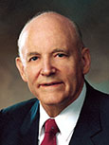
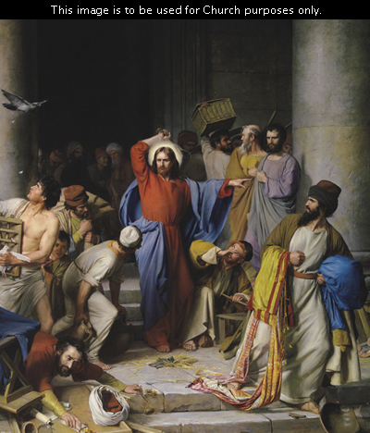
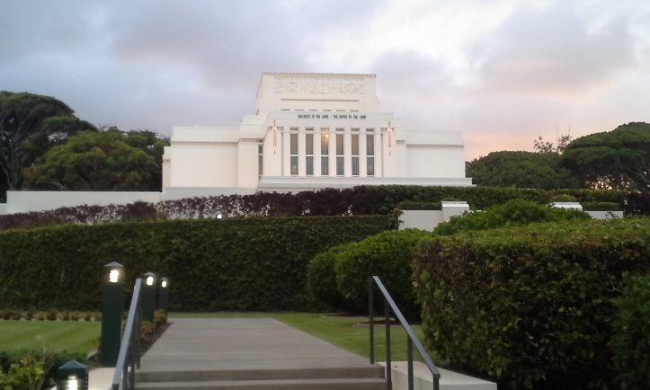
The Temple is a House of God
“Love of money had warped the hearts of many of Jesus’ countrymen. They cared more for gain than they did for God. Caring nothing for God, why should they care for his temple? They converted the temple courts into a marketplace and drowned out the prayers and psalms of the faithful with their greedy exchange of money and the bleating of innocent sheep. Never did Jesus show a greater tempest of emotion than in the cleansing of the temple. …
“The reason for the tempest lies in just three words: ‘My Father’s house.’ It was not an ordinary house; it was the house of God.
It was erected for God’s worship. It was a home for the reverent heart. It was intended to be a place of solace for men’s woes and troubles, the very gate of heaven. ‘Take these things hence;’ he said, ‘make not my Father’s house an house of merchandise.’
His devotion to the Most High kindled a fire in his soul and gave his words the force that pierced the offenders like a dagger.”
Carl Heinrich Bloch
John 2:12-25
(9)

Slide 17
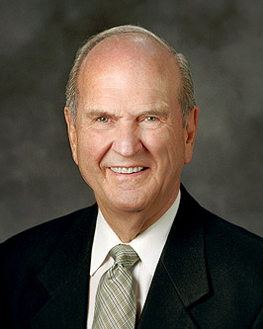
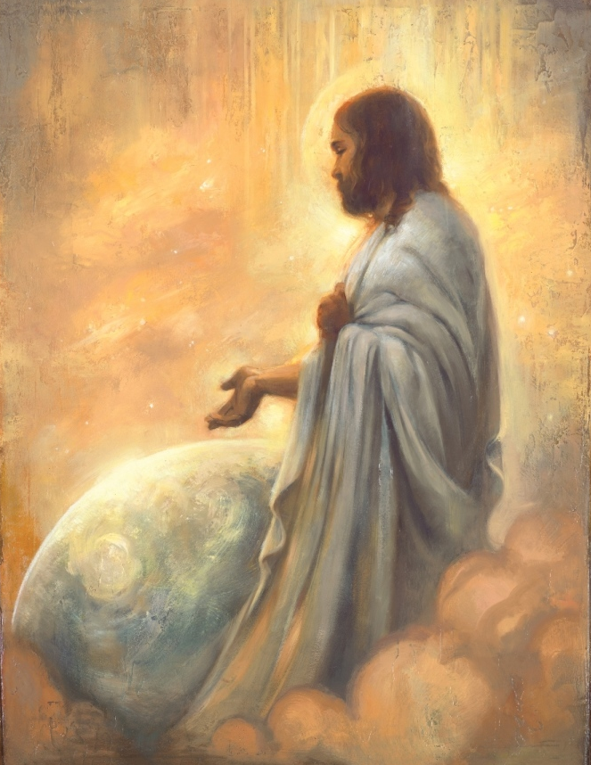
The Temple – His Body
“This great priesthood power of resurrection is vested in the Lord of this world. He taught that ‘all power is given unto me in heaven and in earth’
“‘Destroy this temple, and in three days I will raise it up. … But he spake of the temple of his body’
“The keys of the Resurrection repose securely with our Lord and Master.
Annie Hendri
“‘I am the resurrection, and the life: he that believeth in me, though he were dead, yet shall he live.’”
John 2:12-25; Matthew 28:18; John 11:25
(10)

Slide 18
Sources:
Suggested Hymn: #132 God is in His Holy Temple
Videos:
Jesus Turns Water into Wine (2:27)
Jesus Cleanses the Temple (1;35)
New Testament Institute Student Manual Chapter 22
(Ogden & Skinner, The Four Gospels, p. 107-108)
Richard D. Draper, "Home Life at the Time of Christ," Ensign, Sept. 1987, 58
Bruce R. McConkie, The Mortal Messiah: From Bethlehem to Calvary, 1: 451 Pot size: Doctrinal New Testament Commentary, 3 vols. [Salt Lake City: Bookcraft, 1965-1973], 1: 136.
Gospeldoctrine.com
Susan Easton Black, "Mary, His Mother," Ensign, Jan. 1991, 12
Becky Davies and Lesley Meacham Poway Institute
James E. Talmage, Jesus the Christ, p. 138
President Howard W. Hunter (“Hallowed Be Thy Name,” Ensign, Nov. 1977, 52–53).
Elder Russell M. Nelson (“Life after Life,” Ensign, May 1987, 10).
Presentation by ©http://fashionsbylynda.com/blog/

Slide 19
Event | Matthew | Mark | Luke | John
First Miracle: Water to Wine at Marriage in Cana |  |  |  | 2:1-11
Jesus Visits Capernaum |  |  |  | 2:12
Jesus Attends Passover and Cleanses Temple |  |  |  | 2:13-25
Who’s Wedding: John 1:2
"There is no way of knowing from the text whose wedding was being celebrated (there are numerous reasons why it could not have been Jesus' own wedding, as some have suggested), but it was apparently a grand affair lasting for many days. (C. Wilfred Griggs, Studies in Scripture, Vol. 5: The Gospels, ed. by Kent P. Jackson and Robert L. Millet, [Salt Lake City: Deseret Book Co., 1986], 126.)
"Weddings were held at the home of the bride and were as elaborate as the budget of the house would allow, running from one day to a whole week. The hosts felt a strong obligation to provide lavish hospitality, and failing to do so would embarrass the family and mortify the newly wedded couple. Mary may have been aware of this as she told her son that the wine had run out. We don't know Mary's function at the wedding, but the fact that she was concerned about the wine and was able to command the servants suggests that a close relative was being married." (Richard D. Draper, "Home Life at the Time of Christ," Ensign, Sept. 1987, 58)
Woman John 2:4:
This expression from the Savior has prompted some discussion. In English, it sounds like a harsh reproof. Accordingly, the Joseph Smith translation softens the phrase, but it also changes the meaning. To me, the expression is more meaningful as it stands-with the understanding that Jesus was not being rude to his mother, "for the word translated [for] mother is technically woman, but is more polite than the English word suggests." (Jackson and Millet, Studies in Scripture, Vol. 5: The Gospels, 126)
Water into Wine John 2:9:
"Every hour of every day somewhere on earth the Lord turns water into wine. By his power, pursuant to the laws he has ordained, men prepare the soil and plant the vine; from the good earth, from the rains that fall, and from the light of the sun, the vine takes nutrient, grows, and bears fruit; men dung it and dig about it and prune it, and the fruit matures and ripens: they harvest the crop and process it in the wine vat; and it comes out as wine on the lees well refined. It is a miracle...the Lord Jesus, turned water into wine, in an instant, suddenly as it were, by laws known to him but unknown to us. It was a miracle, the first of his public miracles." (The Mortal Messiah: From Bethlehem to Calvary, 4 vols. [Salt Lake City: Deseret Book Co., 1979-1981], 1: 450.)
Most likely the marriage was of one of Jesus' half-siblings. Jesus' attendance also puts a divine stamp of approval on marriage itself.
Jesus himself was 30 years of age and would probably have married as was customary for Jewish men to do in their late teens:
At five years old one is ready for the scripture, at ten years for the Mishnah, at thirteen for the commandments, at fifteen for Talmud, at eighteen for marriage, at twenty for pursuit of righteousness, at thirty for full strength." (Ogden/Skinner, The Four Gospels, p. 108)
Observation: Had Jesus not been married we probably would have read of accusation after accusation against him, because marriage was number one of the commandments God had given from the beginning. There are none. Poway Institute

Slide 20
Passover John 2:13:
"...it appears that Christ began his public ministry on the celebration day of the Passover feast. If so...it would have also been on his birthday. But which birthday? It would have been near his thirtieth because he was 'beginning to be about thirty' at his baptism shortly before (Luke 3:23). Let us also consider law of Moses symbolism to help answer this question.
"...The Savior cleansed the temple just before Passover both at the beginning of his ministry (see John 2:13-16) and at the end (see Matt. 21:12-3). In terms of our having a fuller understanding of Passover, note that the cleansing of the temple also fits the pattern of Passover. That is, part of the prescribed actions at Passover include searching the house for any leaven and putting it entirely outside the house. (See Ex. 12:15.) It would seem that leaven could symbolize false teachings (see Matt. 16:12), hypocrisy (see Luke 12:1), or wickedness (see 1 Cor. 5:7-8), which the Savior put out of his Father's house, the temple, by 'cleansing' it of those who defiled it." (John P. Pratt, "Passover-Was It Symbolic of His Coming?" Ensign, Jan. 1994, 42)
Something of Interest
Jesus’ cousins with James and John:
1. In the Gospel of Matthew, James and John are identified as the sons of Zebedee.
“And going on from thence, he saw other two brethren, James the son of Zebedee, and John his brother, in a ship with Zebedee their father” (Matthew 4:21).
2. Standing among the women near the cross with Jesus’ mother Mary was the mother of Zebedee’s children as identified by the Gospel of Matthew.
“Among which was Mary Magdalene, and Mary the mother of James and Joses, and the mother of Zebedee’s children (Matthew 27:56).
3. Standing among the women near the cross with Jesus’ mother Mary was Salome as identified by the Gospel of Mark.
“There were also women looking on afar off: among whom was Mary Magdalene, and Mary the mother of James the less and of Joses, and Salome“ (Mark 15:40).
4. Salome was Jesus’ mother’s sister as the apostle John himself states, about his own mother. Mark’s Gospel account refers to her by name. John’s Gospel account refers to her by her relationship to Mary.
“Now there stood by the cross of Jesus his mother, and his mother’s sister, Mary the wife of Cleophas, and Mary Magdalene” (John 19:25).
From Matthew’s account we know that James and John were the sons of Zebedee. By comparing Matthew and Mark we discover that Salome was the name of wife of the wife of Zebedee and the mother of James and John. From John we see that Salome was Mary’s sister.
I first thought that there could be other women in the account as well, but the order of the names and the similarity of the language in the accounts leads me to be almost certain that Jesus’ mother’s sister is Salome, the wife of Zebedee and the mother of James and John. Therefore, James and John were Jesus’ first cousins.
The implications of this are enormous when we consider how the various books of the New Testament were compiled and the roles that James and John, and also the “brothers of the Lord” James and Jude, had in writing and compiling the New Testament canon.
Forerunner.com by Jay Rogers Aug. 2007
Entering the Temple:
“Before entering the temple, you will be interviewed by your bishop and stake president for your temple recommend. Be honest and candid with them. That interview is not a test to be passed but an important step to confirm that you have the maturity and spirituality to receive the supernal ordinances and make and keep the edifying covenants offered in the house of the Lord. Personal worthiness is an essential requirement to enjoy the blessings of the temple. Anyone foolish enough to enter the temple unworthily will receive condemnation” Elder Richard G. Scott (“Receive the Temple Blessings,” Ensign, May 1999, 25).
Sacred Temple:
“The first sacred temple of Jerusalem was constructed on Mount Moriah. At that site, Jesus attended the remodeled second temple. Initially He called it 'my Father's house.' There He accomplished the first cleansing of the temple by driving out the money-changers.
"At the time of the second cleansing, He called it 'my house.' And He said unto them, 'It is written, My house shall be called the house of prayer; but ye have made it a den of thieves.' (Matt 21:13)
"Finally and sadly, He called it 'your house' when He said in desperation, 'Behold, your house is left unto you desolate,' (Matt. 23:38) and predicted the destruction of Jerusalem and the temple, of which one stone would not be left upon the other." Elder Russell M. Nelson (Perfection Pending, and Other Favorite Discourses [Salt Lake City: Deseret Book Co., 1998], 179.)

