Slide 1
Lesson 62
To Be Born Again
John 3
For the natural man is an enemy to God, and has been from the fall of Adam, and will be, forever and ever, unless he yields to the enticings of the Holy Spirit, and putteth off the natural man and becometh a saint through the atonement of Christ the Lord, and becometh as a child, submissive, meek, humble, patient, full of love, willing to submit to all things which the Lord seeth fit to inflict upon him, even as a child doth submit to his father.
Mosiah 3:19

Slide 2
Nicodemus
He was a Pharisee, a ruler of the Jews
He was a member of the Sanhedrin. The Sanhedrin was a governing council made up of Pharisees and Sadducees that directed many of the civil and religious affairs of the Jewish people
He came in secret to Jesus during the night hour to learn more of His teaching
Jesus taught him the fundamental doctrines of the gospel
He later defended the Savior to his Pharisee associates who were intent on destroying the Christian cause
He asked Pilate if he and Joseph of Arimathaea could have the body of Jesus and helped prepare Him for burial
(2)

Slide 3
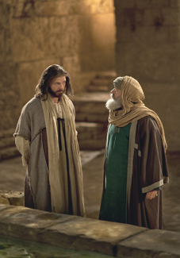
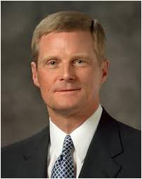
To Be Born Again
True or False?
As long as I am a good person, I can go to heaven.
“We begin the process of being born again through exercising faith in Christ, repenting of our sins, and being baptized by immersion for the remission of sins by one having priesthood authority. … Total immersion in and saturation with the Savior’s gospel are essential steps in the process of being born again.”
(3)

Slide 4
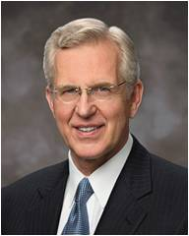
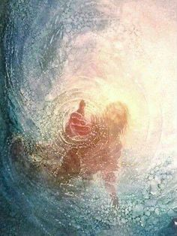
Our Own Effort
To be born again requires both our own effort and “divine power,” and for most of us, this happens over time rather than all at once.
“It was Jesus who stated that entry into the kingdom of God requires that one be born again—born of water and of the Spirit.
His teaching about a physical and a spiritual baptism helps us understand that both our own action and the intervention of divine power are needed for this transformative rebirth—for the change from natural man to saint…
John 3:3-5; Mosiah 3:19
(4)

Slide 5
Physical Birth
Our mortal life begins
We inherit physical and mental traits and material things from our parents.
In many cultures we receive our father’s name.
We can become like our parents.
Spiritual Birth
We begin a new life in Christ
Christ becomes our Father and we receive a spiritual inheritance from Him.
We receive the name of Christ.
We begin our progression towards becoming like our Father in Heaven.

Slide 6
Alma 5:14
“And now behold, I ask of you, my brethren of the church,
Have ye spiritually been born of God?
Have ye received his image in your countenances?
Have ye experienced this mighty change in your hearts?”

Slide 7
Doctrinal Mastery
John 3;5
Jesus answered, Verily, verily, I say unto thee, Except a man be born of water and of the Spirit, he cannot enter into the kingdom of God.
(4)

Slide 8
“Whosoever believeth in Him…”
John 3:14-21
During the time of Moses the Lord sent poisonous serpents in consequence of the Israelites sinning against God. The Israelites were poisoned when the serpents bit them.
The Lord directed Moses to raise up a brass serpent on a pole and promised that any Israelite who looked at the serpent on the pole would be healed.

Slide 9
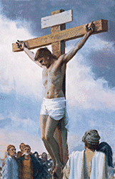
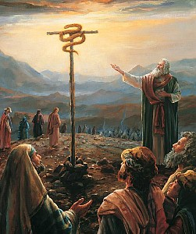
“And as Moses lifted up the serpent in the wilderness…
…even so must the Son of man be lifted up:”
John 3:14

Slide 10
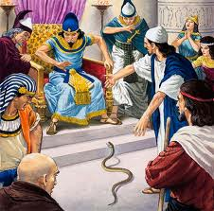
Aaron’s rod becomes a serpent
(Exodus 7:9-10)
Prove yourselves by performing a miracle.
Miracle---sign seeker

Slide 11
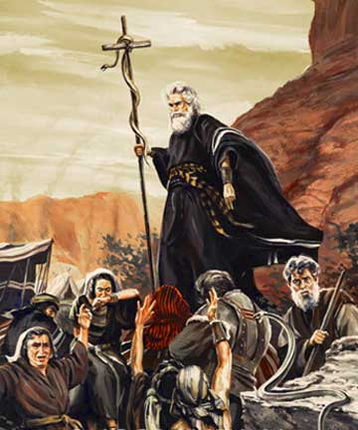
Moses tests Children of Israel in the wilderness
“…wherein were fiery serpents, and scorpions, and drought, where there was no water…”
(Deuteronomy 8:15)
John 3:14

Slide 12
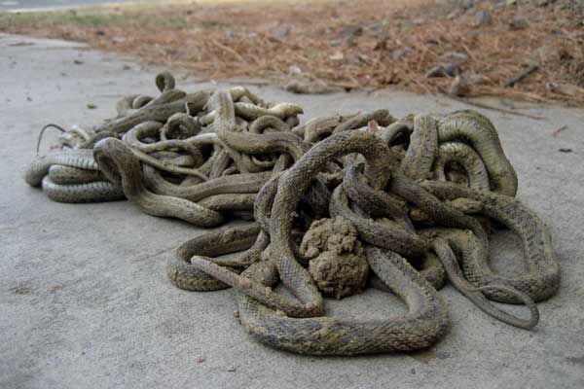
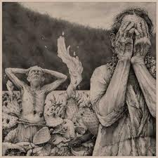
The Lord tests the Jaradites
“And there came forth poisonous serpents also upon the face of the land, and did poison many people…” (Ether 9:31-33)

Slide 13
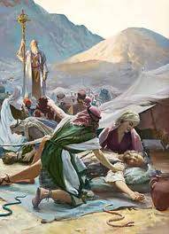
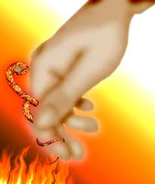
Children of Moses bitten by poisonous serpents
(Numbers 21:6)
Those who looked…were healed (Numbers 21:8)
John 3:14 ; 1 Nephi 17:41

Slide 14
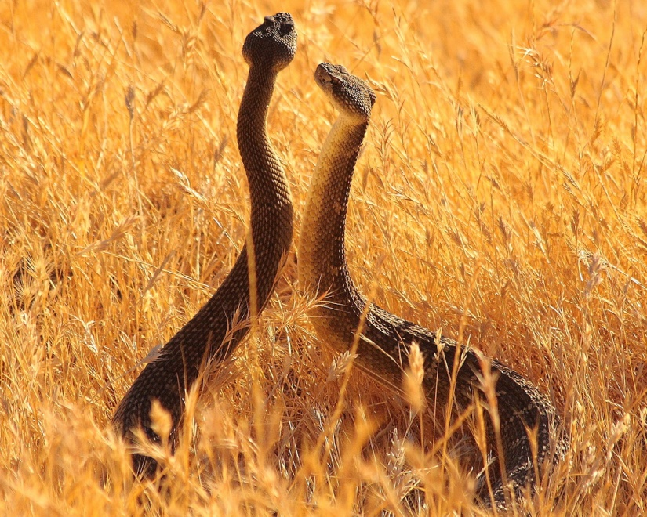
Fiery Serpents
Snakes marked with flamelike spots, or whose bite caused acute inflammation (Num. 21:6)
The Lord sent these upon the children of Israel to “straiten them,” and he prepared a way that those who were bitten might be healed by looking at the serpent of brass that Moses raised up before them, which was a symbol of the Redeemer being lifted upon the cross.
Bible Dictionary; (Num. 21:6, 8-9.)

Slide 15
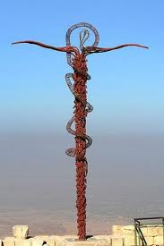
Symbolism of Jesus Christ
“…and behold a type was raised up in the wilderness…” (Alma 33:19)

Slide 16
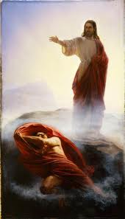
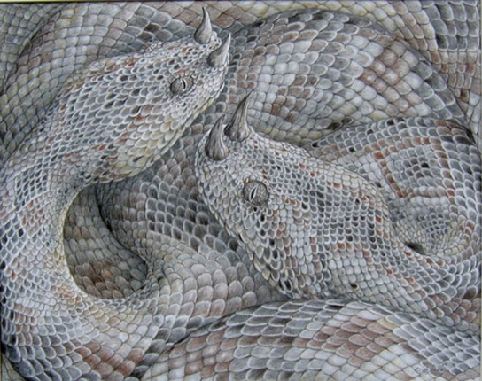
One lifted and One Cast Out
Referring to war in heaven
“And the great dragon was cast out, that old serpent, called the Devil, and Satan, which deceiveth the whole world; he was cast out into earth, and his angels were cast out with him.” (Revelations 12:9)
John 3:14

Slide 17
Eve’s Snake
“…The serpent beguiled me, and I did eat.”
Genesis 3:13

Slide 18
“…being who beguiled our first parents, who transformeth himself nigh unto an angel of light, and stirreth up the children of men…”
(2 Nephi 9:9)
J. Kirk Richards

Slide 19
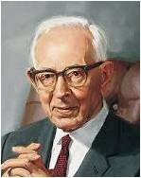
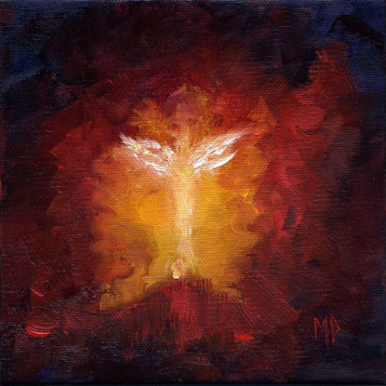
“Satan can and will appear as an angel of light. By revelation we have been given the keys by which the true and false messengers can be detected.”
And no marvel; for Satan himself is transformed into an angel of light.
2 Corinthians 11:14
Marina Petro
(5)

Slide 20
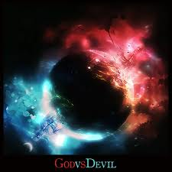
How Can you tell God from Satan?
Messengers of God:
Angel as a resurrected person
Just men made perfect who are not resurrected, a spirit
Messenger of Satan:
Can appear as angel of light
Has no body

Slide 21
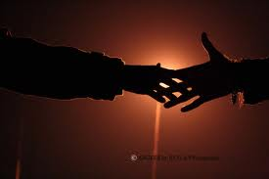
“If he be an angel he will do so, and you will feel his hand. If he be the spirit of a just man made perfect he will come in his glory; for that is the only way he can appear--
“Ask him to shake hands with you, but he will not move, because it is contrary to the order of heaven for a just man to deceive; but he will still deliver his message.
But If it be the devil as an angel of light, when you ask him to shake hands he will offer you his hand, and you will not feel anything; you may therefore detect him.”
D&C 129:5-8

Slide 22
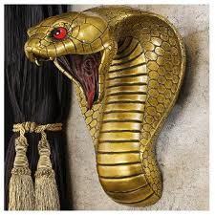
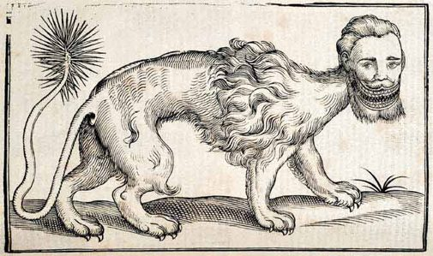
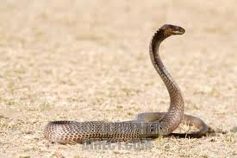
Egyptians:
fallen serpent—Sebau—Satan,
whose arms are “bound in chains”
or “hewn off” and whose legs are “hacked off” and whose joints are “cut asunder.”
(6)

Slide 23
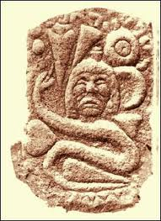
Muslims:
Their Gospel of Barnabas
When Satan was cast out of Paradise he was to have his “legs cut off by the angel Michael with the sword of God.”
(6)

Slide 24
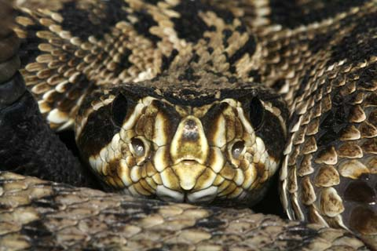
India according to Josephus:
The serpent once possessed the power of human speech, but had been deprived of it.
(6)

Slide 25
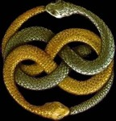
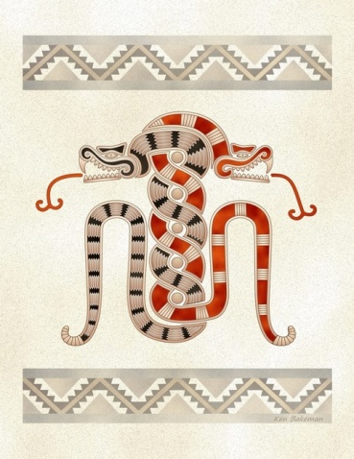
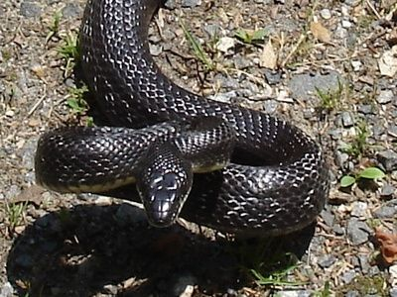
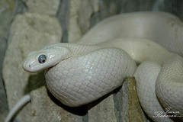
Two Serpent Motif
Mirrored twins
(6)

Slide 26
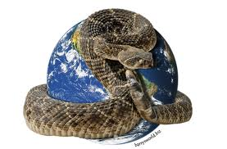
Snake—belly to the ground
Represents earthly or worldly things. A symbol of earth.
(6)

Slide 27
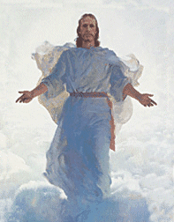
Healer of Nations
The Hippocratic Oath is an oath historically taken by physicians. It is one of the most widely known of Greek medical texts. In its original form, it requires a new physician to swear, by a number of healing gods, to uphold specific ethical standards.
Of historic and traditional value, the oath is considered a rite of passage for practitioners of medicine in many countries, although nowadays various modernized versions are often used.
The original Hippocratic Oath began with the invocation "I swear by Apollo the Physician and by Asclepius and by Hygieia and Panacea and by all the gods ..." The serpent and the staff appear to have been separate symbols that were combined at some point in the development of the Asclepian cult.
Represents a “type” of Christ who was lifted up and resurrected

Slide 28
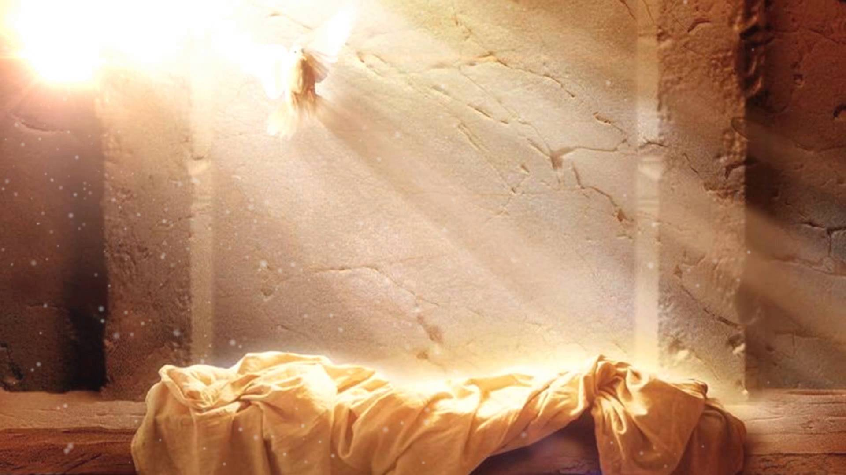
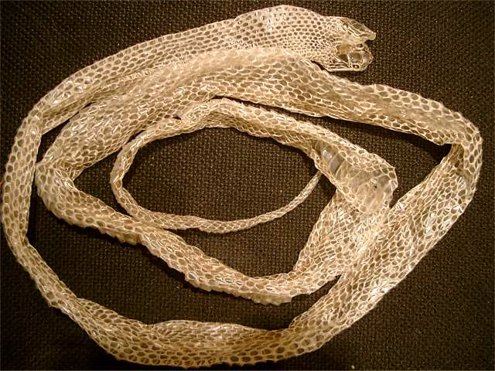
Symbols of Resurrection
A Snake will shed it’s skin and a new one will become the protector.
Jesus Christ’s Blood was shed for us; He is our protector

Slide 29
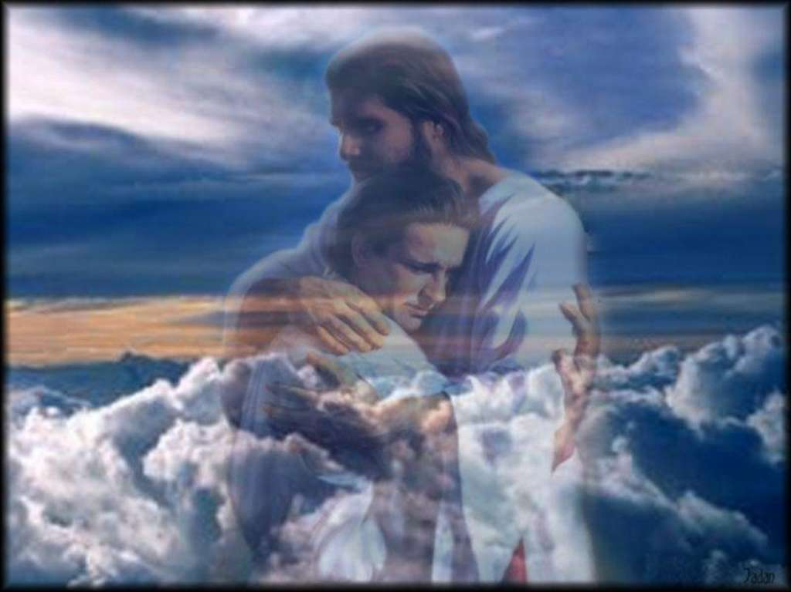
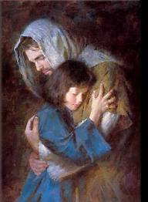
Our Protector
For God so loved the world, that he gave his only begotten Son, that whosoever believeth in him should not perish, but have everlasting life.
For God sent not his Son into the world to condemn the world; but that the world through him might be saved.
John 3:16-17

Slide 30
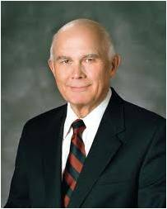
“There is no greater evidence of the infinite power and perfection of God’s love than is declared by the Apostle John…
Think how it must have grieved our Heavenly Father to send His Son to endure incomprehensible suffering for our sins. That is the greatest evidence of His love for each of us!”
(7)

Slide 31
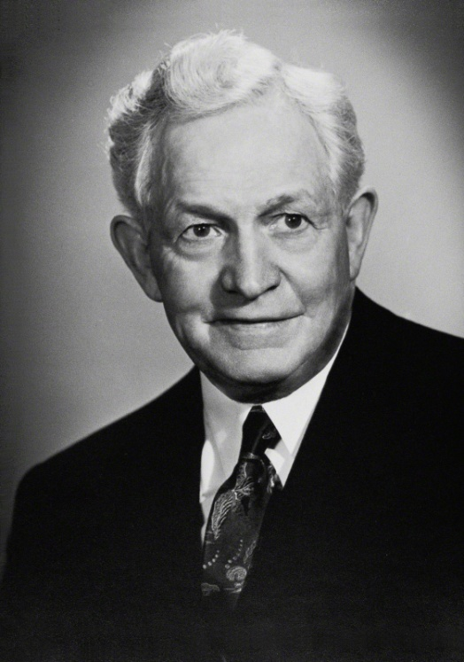
Jesus is the Christ
“Every person who lives in this world wields an influence, whether for good or for evil.
“The effect of our words and acts is tremendous in this world. Every moment of life you are changing to a degree the lives of the whole world.”
John 3:22-36
(8)

Slide 32
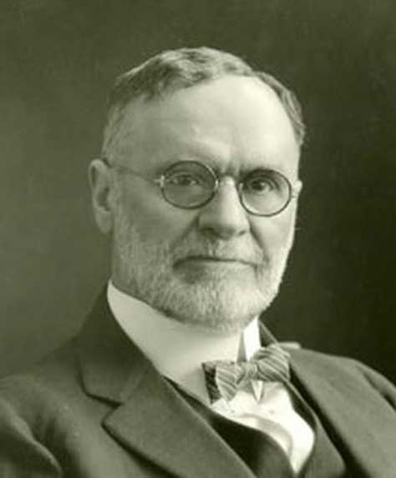
Baptized By Immersion
"'Born of water' means to come out of the water, and coming out of the water, presupposes going into the water.
This is why we are baptized by immersion, which means sinking, dipping, burying, plunging. Immersion is the only mode of baptism that symbolizes a birth. Jesus was baptized by immersion. He must have gone down into the water, for when he was baptized he 'went up straightway out of the water'.
When Philip baptized the Eunuch, 'they went down both into the water.' John baptized 'in Anon, near to Salim, because there was much water there,' a proof presumptive of baptism by immersion, that being the only mode requiring 'much water' for its performance.”
John 3:23; Matthew 3:16
(9)

Slide 33
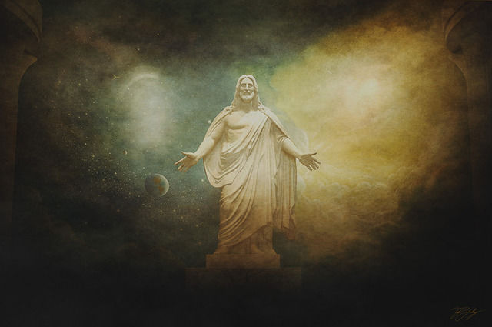
Given in Portions
God giveth not the Spirit by measure unto him. The Father...hath given all things into his hand
Even Apostles and Prophets are not given a full measure of the Spirit of God.
To all of us, the Spirit is given in portions depending on our stewardship and faithfulness.
In contrast to even the greatest prophets, Jesus received the Spirit in full measure for the Father had 'given all things into his hand,' in that 'he received all power, both in heaven and on earth‘…
And he received all power, both in heaven and on earth, and the glory of the Father was with him, for he dwelt in him.
D&C 93:17
John 3:34-35
(10)

Slide 34
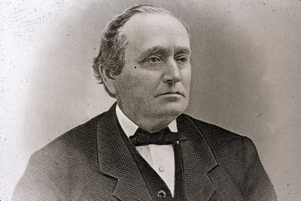
"[The Spirit] is measured out to you and me in the providence of the Lord; but for him there was a storehouse to draw upon, as it were, without measure.
He could continue to heal the sick and raise the dead and perform great and marvelous things, and yet the supply of vitality was not in the least abated.”
John 3:34-35
(10)

Slide 35
Sources:
Suggested Hymn: He Sent His Son Children’s Songbook page 34
Video: “Heavenly Things” (8:55)
Jesus Teaches of Being Born Again
For God So Loved the World
Something Different about Us: Example (2:51)
New Testament Institute Student Manual Chapter 22
Who’s Who in the New Testament by Richard J. Allen p. 128-129
Elder David A. Bednar (“Ye Must Be Born Again,” Ensign or Liahona, May 2007, 21).
Elder D. Todd Christofferson (“Born Again,” Ensign or Liahona, May 2008, 77–78).
Joseph Fielding Smith (Answers to Gospel Questions, 5 vols. [Salt Lake City: Deseret Book Co., 1957-1966], 1: 178.)
Becky Davies and Lesley Meacham Poway Institute
Elder Dallin H. Oaks (“Love and Law,” Ensign or Liahona, Nov. 2009, 26).
(Teachings of Presidents of the Church: David O. McKay [2003], 227
Orson F. Whitney(Gospel Themes, 58.)
Gospeldoctrine.com (John 3)
Elder Erastus Snow Rest (Journal of Discourses, 26 vols. [London: Latter-day Saints' Book Depot, 1854-1886], 21: 26.)
Presentation by ©http://fashionsbylynda.com/blog/

Slide 36
Event | Matthew | Mark | Luke | John
Nicodemus, a Pharisee and Ruler Taught by Jesus |  |  |  | 3:1-21
John Further Testifies of Jesus |  |  |  | 3:22-36
Born Again John 3:3-5:
“We were born again when we entered into a covenant relationship with our Savior by being born of water and of the Spirit and by taking upon us the name of Jesus Christ. …
“Latter-day Saints affirm that those who have been born again in this way are spiritually begotten sons and daughters of Jesus Christ (see Mosiah 5:7; 15:9–13;27:25). Nevertheless, in order to realize the intended blessings of this born-again status, we must still keep our covenants and endure to the end. In the meantime, through the grace of God, we have been born again as new creatures with new spiritual parentage and the prospects of a glorious inheritance” Dallin H. Oaks “Have You Been Saved?” Ensign, May 1998, 56).
“When we are baptized by immersion by one with the proper priesthood authority and choose to follow our Savior, we then are in His kingdom and of His kingdom. …
“At baptism we make a covenant with our Heavenly Father that we are willing to come into His kingdom and keep His commandments from that time forward, even though we still live in the world. …
“When we understand our baptismal covenant and the gift of the Holy Ghost, it will change our lives and will establish our total allegiance to the kingdom of God. When temptations come our way, if we will listen, the Holy Ghost will remind us that we have promised to remember our Savior and obey the commandments of God. …
“By choosing to be in His kingdom, we separate—not isolate—ourselves from the world. Our dress will be modest, our thoughts pure, our language clean. The movies and television we watch, the music we listen to, the books, magazines, and newspapers we read will be uplifting. We will choose friends who encourage our eternal goals, and we will treat others with kindness. We will shun the vices of immorality, gambling, tobacco, liquor, and illicit drugs. Our Sunday activities will reflect the commandment of God to remember the Sabbath day and keep it holy. We will follow the example of Jesus Christ in the way we treat others. We will live to be worthy to enter the house of the Lord” Elder Robert D. Hales(“The Covenant of Baptism: To Be in the Kingdom and of the Kingdom,” Ensign, Nov. 2000, 7–8).
Moses and the Serpent John 3;14:
"The whole episode points toward the need to look upon Jesus Christ as our Lord, likewise a simple but unwaivable requirement. How plain and precious in any age! Yet believing in Jesus is sometimes regarded as foolishness. One can imagine the scoffing comments of some in Moses' time concerning the illogicality and foolishness of looking upon a brass pole in order to be healed and saved." Elder Neal A. Maxwell (Plain and Precious Things [Salt Lake City: Deseret Book Co., 1983], 21.)
John 3:16:
Elder Bruce R. McConkie (1915–85) of the Quorum of the Twelve Apostles taught that John 3:16 “summarizes the whole plan of salvation, tying together the Father, the Son, his atoning sacrifice, that belief in him which presupposes righteous works, and ultimate eternal exaltation for the faithful” (Doctrinal New Testament Commentary, 1:144).
All Men Come to Him John 3:26:
"John's supporters were concerned at the success of One whom they regarded in some measure as a rival to their beloved teacher...John's reply to his ardent followers constitutes a sublime instance of self-abnegation....In such a reply, under the existent conditions, is to be found the spirit of true greatness, and of a humility that could rest only on a conviction of divine assurance to the Baptist as to himself and the Christ. In more than one sense was John great among all who are born of women. He had entered upon his work when sent of God so to do; he realized that his work had been in a measure superseded, and he patiently awaited his release, in the meantime continuing in the ministry, directing souls to his Master. The beginning of the end was near. He was soon seized and thrown into a dungeon; where, as shall be shown, he was beheaded to sate the vengeance of a corrupt woman whose sins he had boldly denounced." Elder James E. Talmage (Jesus the Christ, 164-165)

Slide 37
Baptism John 3:22 Did Jesus Perform Baptisms?:
"In the King James Version John 3:22 we read that Jesus came with his disciples into the land of Judea, 'and there he tarried with them, and baptized.' The passage seems to say that Jesus himself performed some of the baptisms. However, a little later we find: 'When therefore the Lord knew how the Pharisees had heard that Jesus made and baptized more disciples than John, (though Jesus himself baptized not, but his disciples,) he left Judea, and departed again into Galilee' (John 4:1-3).
"This passage denies that Jesus performed baptisms himself, contradicting the passage in John 3. The matter is resolved by the Prophet's translation, which brings into harmony the various statements about Jesus performing baptisms: 'When therefore the Pharisees had heard that Jesus made and baptized more disciples than John, they sought more diligently some means that they might put him to death; for many received John as a prophet, but they believed not on Jesus. Now the Lord knew this, though he himself baptized not so many as his disciples; for he suffered them for an example, preferring one another. And he left Judea, and departed again into Galilee.' ([Joseph Smith Translation of the Bible]. The Holy Scriptures: Inspired Version. Independence, Mo.: Herald Publishing House, 1970 John 4:1-5.)
"Not only does the Joseph Smith Translation clearly state that Jesus performed baptisms (see also [Joseph Smith Translation of the Bible]. The Holy Scriptures: Inspired Version. Independence, Mo.: Herald Publishing House, 1970 Mark 1:6 and John 1:28) but it also explains why Jesus left the area. The King James Version leaves us dangling because it mentions the Pharisees but doesn't say what they have to do with the story. The Joseph Smith Translation explains that they wanted to kill Jesus because of his popularity, and therefore he left Judea and went into Galilee." (Robert J. Matthews, Behold the Messiah [Salt Lake City: Bookcraft, 1994], 191-192.)

