Slide 1
Lesson 63
The Living Water
John 4
Therefore, O my son, whosoever will come may come and partake of the waters of life freely; and whosoever will not come the same is not compelled to come; but in the last day it shall be restored unto him according to his deeds.
Alma 42:27
Presentation by ©http://fashionsbylynda.com/blog/

Slide 2
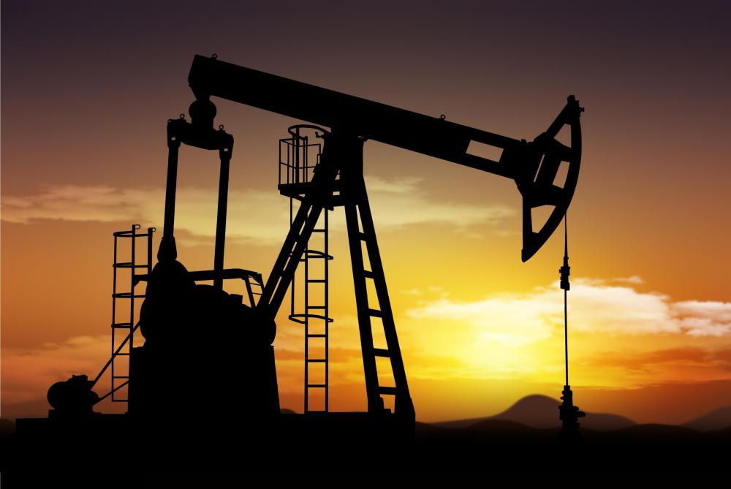
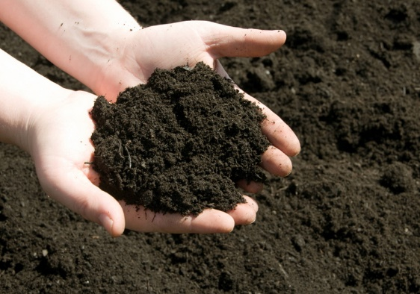
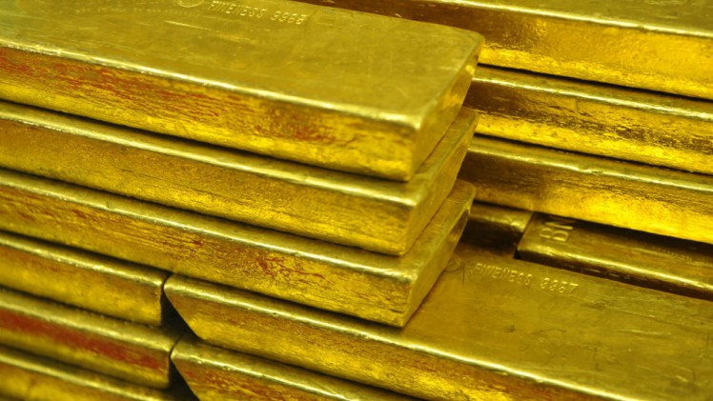
What is the most valuable natural resource on the earth?

Slide 3
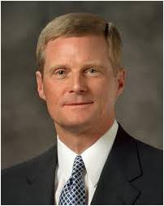
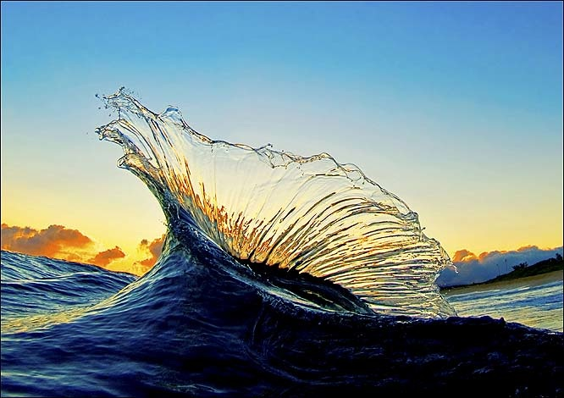
“We might initially think that gold, oil, or diamonds have the greatest worth. But of all the minerals, metals, gems, and solvents found on and in the earth, the most valuable is water.”
(2)

Slide 4
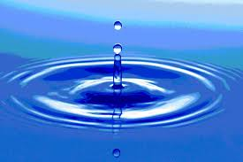
The Living Water
John 4:1-30
For my people have committed two evils; they have forsaken me the fountain of living waters, and hewed them out cisterns, broken cisterns, that can hold no water.
Jeremiah 2:13
And it shall be in that day, that living waters shall go out from Jerusalem; half of them toward the former sea, and half of them toward the hinder sea: in summer and in winter shall it be.
Zechariah 14:8
And he said unto me, It is done. I am Alpha and Omega, the beginning and the end. I will give unto him that is athirst of the fountain of the water of life freely.
Revelation 21:6
But unto him that keepeth my commandments I will give the mysteries of my kingdom, and the same shall be in him a well of living water, springing up unto everlasting life.
D&C 63:23

Slide 5
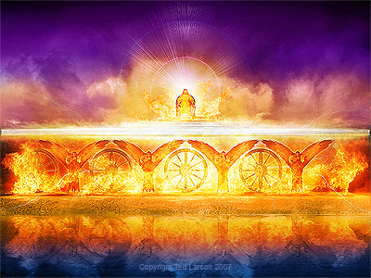
Ezekiel sees in a vision a “spring of pure water” forming a river and flowing through the dry wilderness of Judaea
Ezekiel 47:1

Slide 6
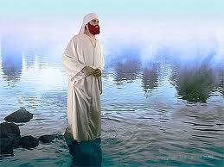
Ezekiel saw that wherever the river flowed life came to the barren desert

Slide 7
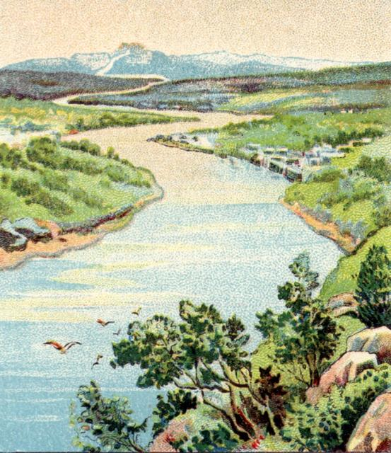
“Water from the river does two things:
It gives life and it heals.
The life it produces will not “fade”, and that which it heals will live forever. “
Ezekiel 47:9
Excerpt from Michael Wilcox “House of Glory”

Slide 8
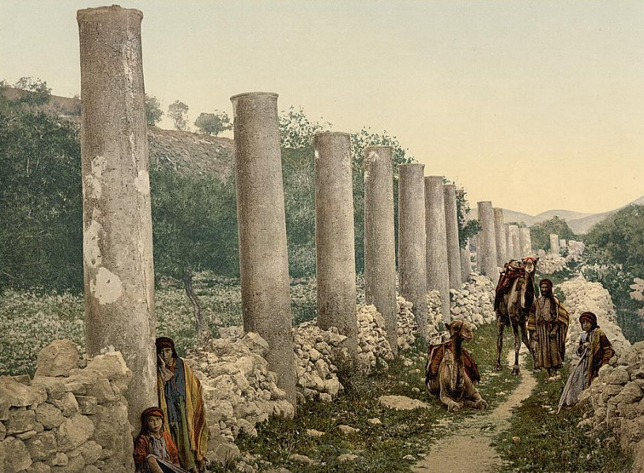
Jesus leaves Judaea for Galilee and goes through Samaria
John 4:3-4

Slide 9
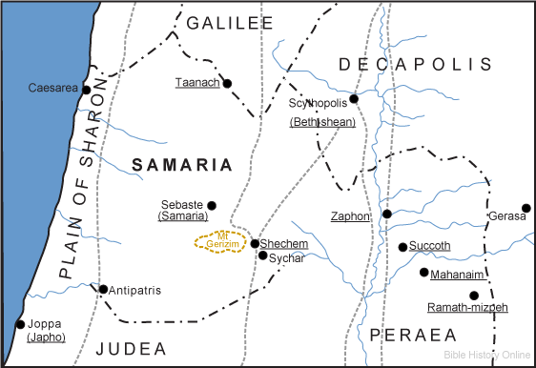
Samaritan Territory
Because of increased persecution in Jerusalem from the chief priests and Pharisees, Jesus left Judea for Galilee, traveling through Samaria to a city called Sychar. Being tired and thirsty, he sat down on Jacob’s well at “about the sixth hour.” (1)
John 4:6

Slide 10
Samaritan Woman
The Samaritan woman who went to the well and spoke with Jesus may have come at this unusual time to avoid the women of the village, who may have shunned her as a sinner.
Jews customarily had no contact with Samaritans and rabbis did not ordinarily talk to single women.
John 4:6
(1)

Slide 11
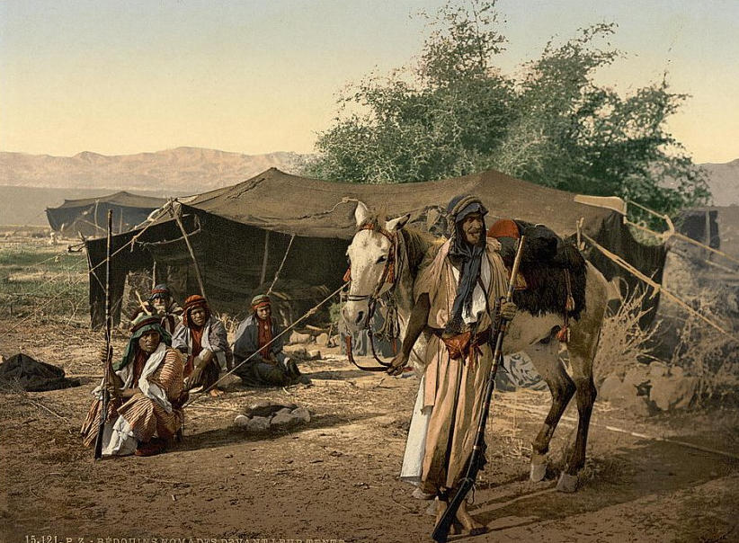
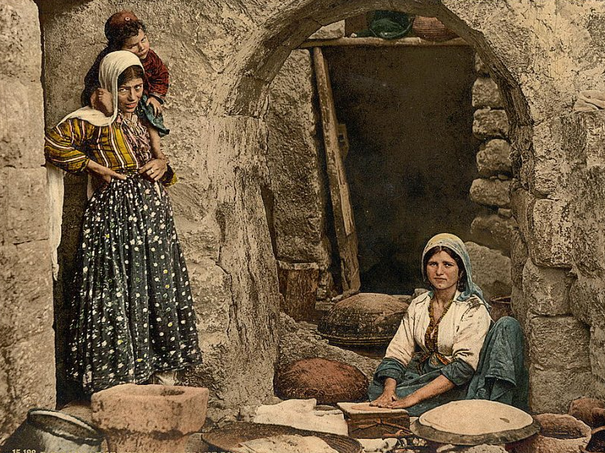
Near the city Sychar in Samaria Jesus and his disciples stop for the night. The disciples leave to find food in the nearby city.
John 4:8

Slide 12
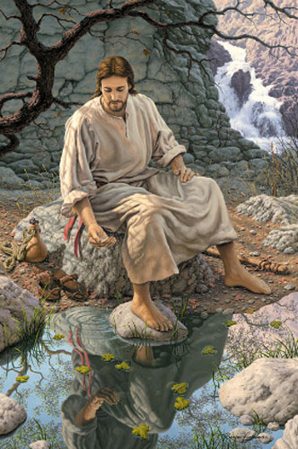
Being weary, Jesus sits at Jacob’s Well near the parcel of ground that Jacob gave to his son Joseph
John 4:5-6

Slide 13
A woman of Samaria comes to draw water from the well.
John 4:7

Slide 14
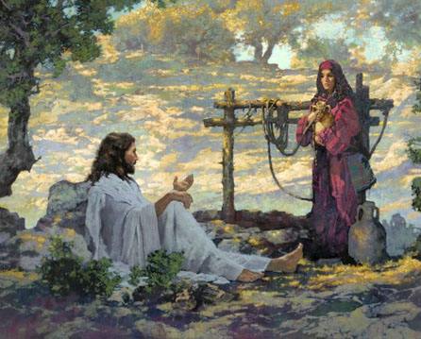
Jesus asks for a drink
John 4:7

Slide 15
The woman wonders why he would accept a drink from a Samaritan
John 4:9

Slide 16
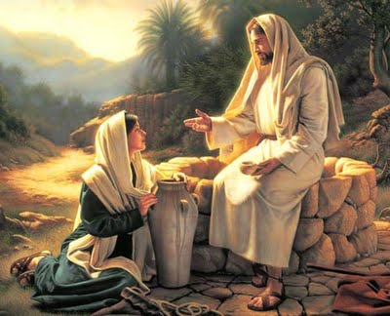
“…if thou knewest the gift of God, and who it is that saith to thee, Give me to drink; thou wouldest have asked of him, and he would have given thee living water.”
John 4:9

Slide 17
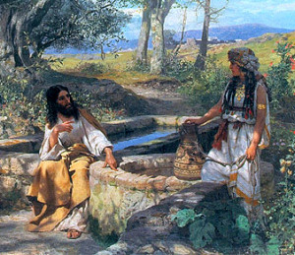
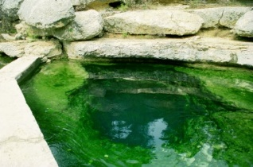
The woman does not understand about the living water
John 4:11

Slide 18
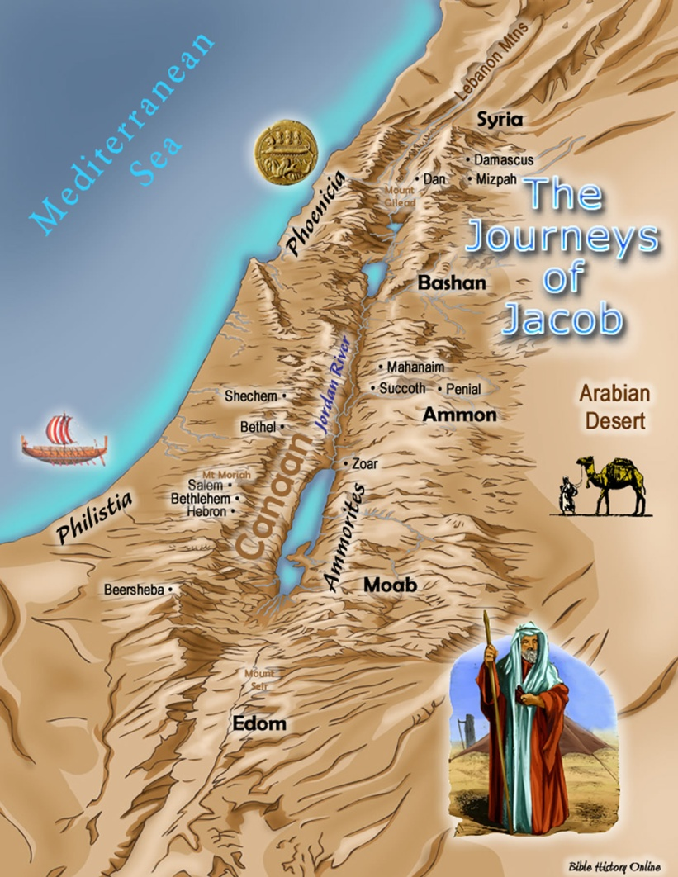
She understands that Jacob and his family used the well.
John 4:12

Slide 19
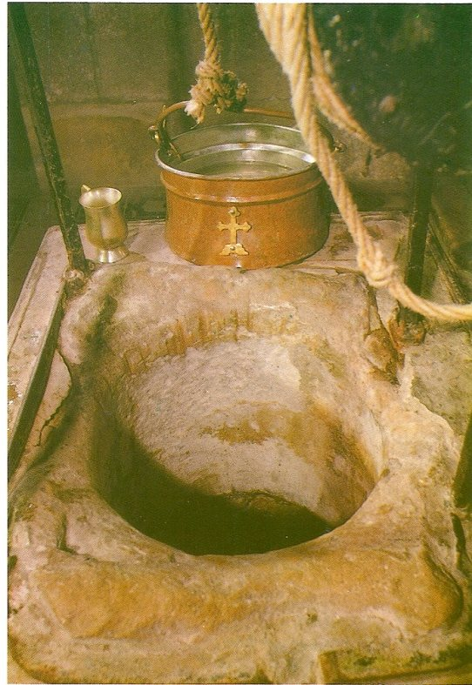
Jacob’s well
“Therefore with joy shall ye draw water out of the wells of salvation”
Isaiah 12:3
Jacob’s well was on the land that Jacob, the father of the twelve tribes of Israel, had settled after he returned from working for Laban in Padan-aram in Mesopotamia. Jacob bequeathed this land to his son Joseph. (1)
Genesis 33:18

Slide 20
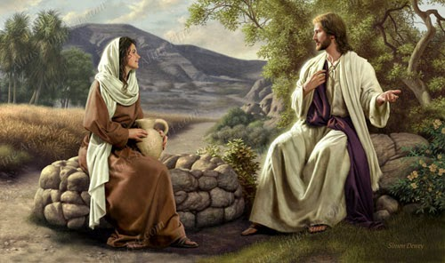
“…Whosoever drinketh of this water shall thirst again:
…but whosoever drinketh of the water that I shall give him shall never thirst…”
John 4:13-14

Slide 21
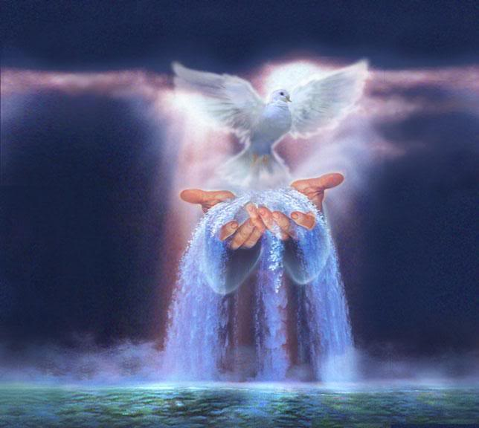
…but the water that I shall give him shall be in him a well of water springing up into everlasting life.”
John 4:14

Slide 22
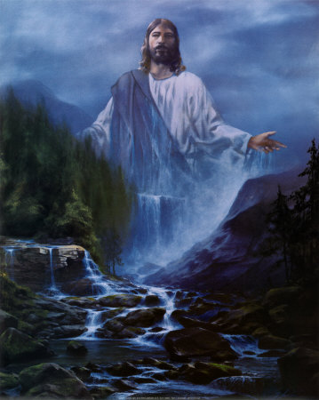
The Living water is the gospel of Jesus Christ; its communicator is the Holy Ghost.
The living water also nourishes. He gives us rest. He sustains us when we are weary.
Matthew 11:28

Slide 23
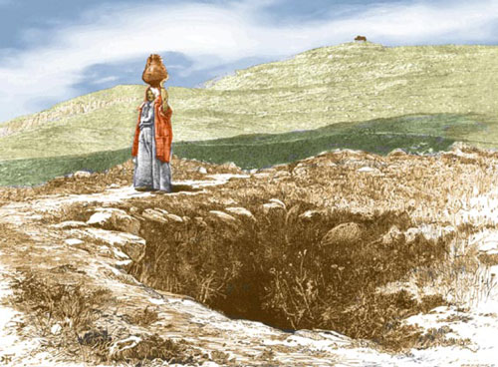
The Living waters can bring peace and joy even when the wellspring within us seems to have dried.

Slide 24
“The living water referred to in this episode is a representation of the Lord Jesus Christ and His gospel.
And as water is necessary to sustain physical life, so the Savior and His doctrines, principles, and ordinances are essential for eternal life.
You and I need His living water daily and in ample supply to sustain our ongoing spiritual growth and development.”
If we come unto Jesus Christ and earnestly partake of His gospel, then we will receive eternal life.
(2)

Slide 25
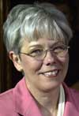
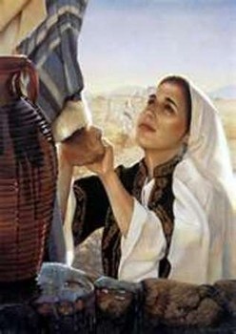
The Samaritan woman, once she recognized Him, listened to His words. Then she was able to be humble enough to drink of the water and be healed.
John 4:24-26
(4)

Slide 26
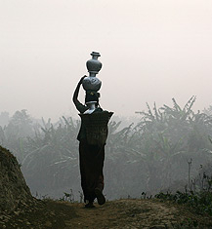
Believing, the woman took her pot and went to tell her people about the “Messias” who had come.
John 4:24-28

Slide 27
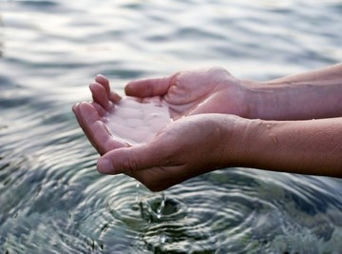
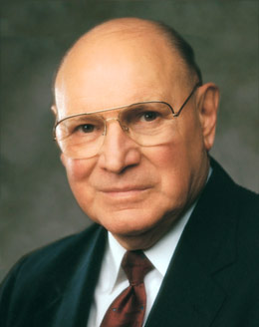
Everlasting Life
“…the gospel of Jesus Christ heals broken hearts, infuses meaning into lives, binds loved ones together with ties that transcend mortality, and bring to life a sublime joy. “
(3)

Slide 28
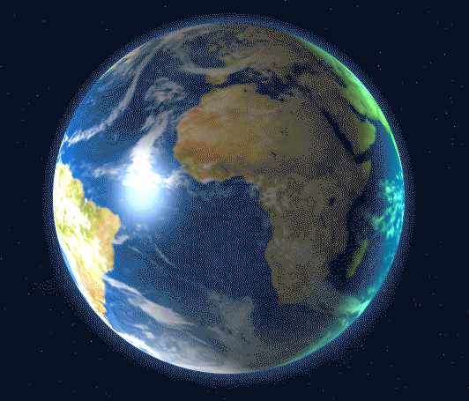
Faith Of Our Father
“The faith of our Father in Heaven has been consistent since the beginning of time, even from before the foundation of this world. John the Revelator described a great war in heaven.
The issue was moral agency, as it is today.
All who have ever lived on this earth were among those who fought against Satan and stood with the Son and the Father.
Therefore, do we not owe our allegiance to God, our Heavenly Father? …
God desires that all of His children receive it, irrespective of their background, culture, or tradition.
True religion should not originate from what pleases men or the traditions of ancestors, but rather from what pleases God, our Eternal Father” (5)
Revelation 12:7-9

Slide 29
Is God a Spirit?
The Greek phrase can also be understood to mean “God is spirit,” or “God is spiritual.” …
From latter-day revelation, we know that “the Father has a body of flesh and bones as tangible as man’s; the Son also; but the Holy Ghost has not a body of flesh and bones, but is a personage of Spirit”
John 4:24; D&C 130:22

Slide 30
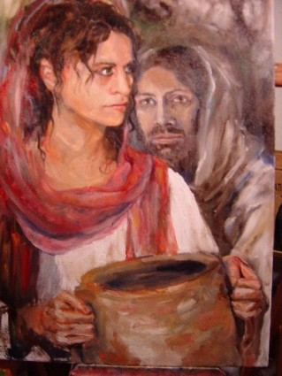
I Am
“I that speak unto thee am he,”
Jesus was declaring that He is Jehovah.
John 4:25-26

Slide 31
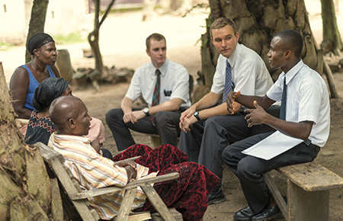
A Desire to Share
As we gain a testimony of Jesus Christ, we are filled with a desire to share it with others
“When the crowd of curious Samaritans arrived to see and hear the man who had proclaimed himself to be the Messiah, … their initial curiosity matured into testimony.
They declared, ‘We have heard him ourselves, and know that this is indeed the Christ, the Saviour of the world.’” (3)
John 4:28-42

Slide 32
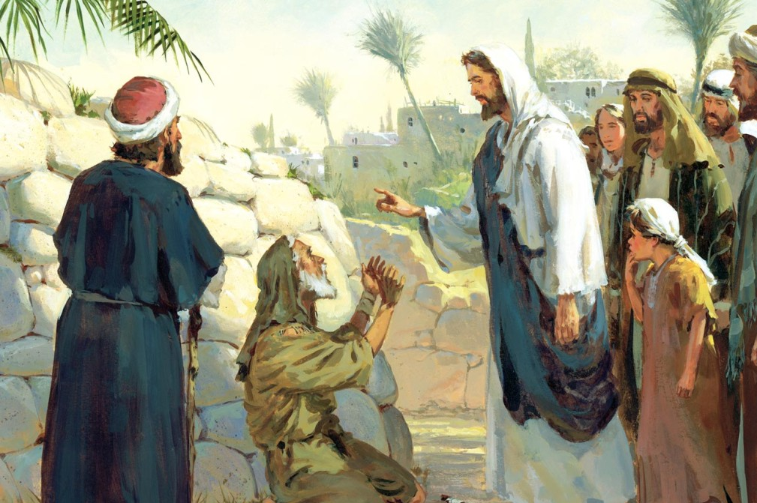
A Nobleman’s Son
The nobleman manifested significant faith in the Savior in at least two ways.
First, although his home, Capernaum, was about 20 miles (32 kilometers) away from Cana, he made the journey to implore the Savior for His help.
Second, when the Savior assured him that his son would live, the nobleman “went his way,” trusting the Savior’s word. (1)
As we believe in Jesus Christ without needing signs, the Lord will confirm our belief
John 4:46-54

Slide 33
Sources:
Suggested Hymn: #236 Lord, Accept into Thy Kingdom
Video: The Woman at the Well (7:30)
New Testament Institute Student Manual Chapter 22
Elder David A. Bednar (“A Reservoir of Living Water” [Church Educational System fireside for young adults, Feb. 4, 2007], 1,lds.org/broadcasts).
Elder Joseph B. Wirthlin The Abundant Life 2006 April Gen. Conf. and “Living Water to Quench Spiritual Thirst,” Ensign, May 1995, 18–19).
Kathleen H. Hughes “Blessed by Living Water 2003 April General Conference
President Dieter F. Uchtdorf (“Faith of Our Father,” Ensign orLiahona, May 2008, 75).
Presentation by ©http://fashionsbylynda.com/blog/

Slide 34
Event | Matthew | Mark | Luke | John
Jesus Leaves Judea for Galilee | 4:12 | 1:14 | 4:14 | 4:1-3
Samarian Woman at Jacob’s Well |  |  |  | 4:4-42
Jesus Enters Galilee |  |  | 4:15 | 4:43-45
Jesus Heals a Nobleman’s son |  |  |  | 4:46-54
Living Water John 4:1-30:
“Fully understood and embraced, the gospel of Jesus Christ heals broken hearts, infuses meaning into lives, binds loved ones together with ties that transcend mortality, and brings to life a sublime joy. …
“The abundant life is a spiritual life. Too many sit at the banquet table of the gospel of Jesus Christ and merely nibble at the feast placed before them. They go through the motions—attending their meetings perhaps, glancing at scriptures, repeating familiar prayers—but their hearts are far away. If they are honest, they would admit to being more interested in the latest neighborhood rumors, stock market trends, and their favorite TV show than they are in the supernal wonders and sweet ministerings of the Holy Spirit.
“Do you wish to partake of this living water and experience that divine well springing up within you to everlasting life?
“Then be not afraid. Believe with all your hearts. Develop an unshakable faith in the Son of God. Let your hearts reach out in earnest prayer. Fill your minds with knowledge of Him. Forsake your weaknesses. Walk in holiness and harmony with the commandments” Elder Joseph B. Wirthlin(“The Abundant Life,” Ensign or Liahona, May 2006, 100).
Samaritan History: John 4:19-24:
Toward the end of the sixth century B.C., the Jews rejected the Samaritans’ offer to help rebuild the temple in Jerusalem (see Ezra 4:1–10). Shortly thereafter, Manasseh, a priest from Jerusalem who had married the daughter of Sanballat, the Gentile governor of Samaria, was expelled from the priesthood. He then built a rival temple on Mount Gerizim in Samaria. This was the mountain referred to by the woman at the well (see Bible Dictionary, “Gerizim and Ebal”). During the Hasmonean (Jewish) revolt against the Seleucids in the late second century B.C., the Samaritans refused to aid the Jewish cause. Perhaps as retaliation for this lack of solidarity, John Hyrcanus, a leader of the Hasmonean Jews, destroyed the Samaritan temple on Mount Gerizim, and it was never rebuilt. The destruction of this temple added to the animosity that already existed between the Samaritans and Jews.
When the Samaritan woman came to understand that Jesus was indeed a prophet, she desired to know how she could worship. The Samaritan temple had been destroyed, Samaritans were not welcome in the temple in Jerusalem, and she did not know where she could worship (1)
Worshipping John 4:24:
“There is no salvation in worshiping a false god. It does not matter one particle how sincerely someone may believe that God is a golden calf, or that he is an immaterial, uncreated power that is in all things; the worship of such a being or concept has no saving power. Men may believe with all their souls that images or powers or laws are God, but no amount of devotion to these concepts will ever give the power that leads toimmortality and eternal life. …
“But if he worships the true and living God, in spirit and in truth, then God Almighty will pour out his Spirit upon him, and he will have power to raise the dead, move mountains, entertain angels, and walk in celestial streets” Elder Bruce R. McConkie (“How to Worship,” Ensign, Dec. 1971, 129).
Nobleman’s son John 4:50:
“Though he was in Cana, Jesus gave the command and the nobleman’s son, some twenty miles away in Capernaum, was healed. By the power of faith the sick are healed regardless of their geographical location. God is God of the universe; his power is everywhere manifest” Elder Bruce R. McConkie (Doctrinal New Testament Commentary, 1:159).

