Slide 1
Lesson 64
To Be Made Whole
John 5
Verily, verily, I say unto you, The Son can do nothing of himself, but what he seeth the Father do: for what things soever he doeth, these also doeth the Son likewise.
John 5:19
In all He does, Jesus Christ represents Heavenly Father and seeks to obey His will
And hath given him authority to execute judgment also, because he is the Son of man. John 5:27

Slide 2
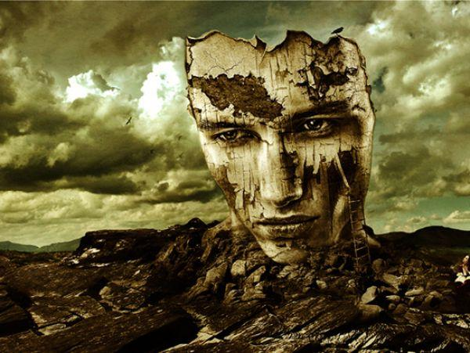
Have you ever broken something important or valuable.
As children of Heavenly Father we are important and have great worth.
Because of our choices or the challenges we face, at times we may feel broken or like we have little value.

Slide 3
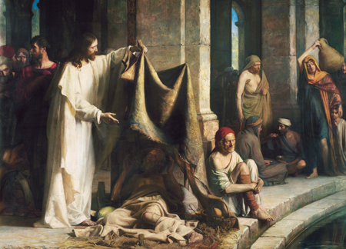
Feast
While in Jerusalem, He went to a pool near the temple.
Carl H. Bloch
John 5:1

Slide 4
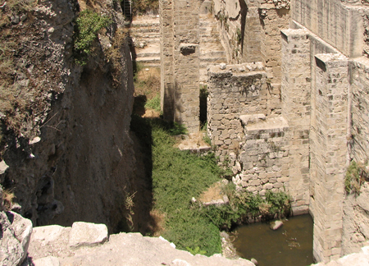
Bethesda
Bethesda can be translated as “house of mercy” or “house of grace”
Pool of Bethesda Today
Archaeological excavations have identified the site for the pool of Bethesda as being just outside a north gate of the ancient temple precinct in Jerusalem, possibly a gate through which sacrificial sheep were led into the temple grounds.
(1)
John 5:1

Slide 5
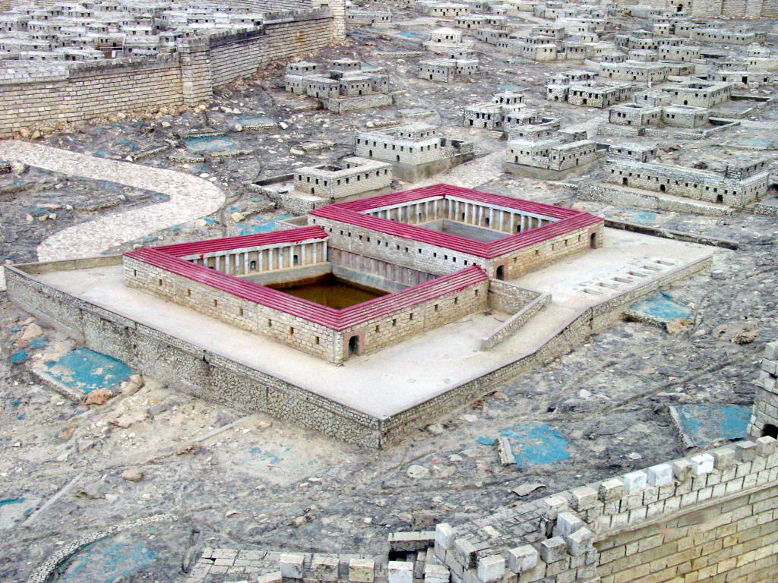
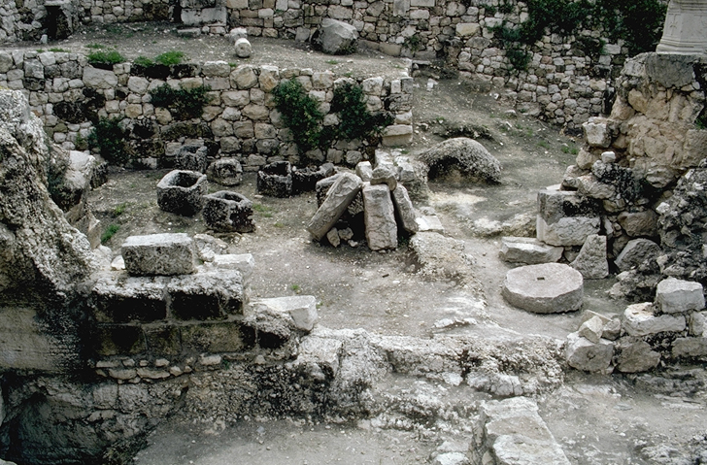
In Jerusalem by the sheep market is a pool
Impotent, blind, halt, and withered describe people who were sick, feeble, or disabled in some way…
John 5:2-3

Slide 6
Waiting to Be Healed
People of all kinds of inflictions gather at this pool…
…and wait for the moving water.
John 5:3

Slide 7
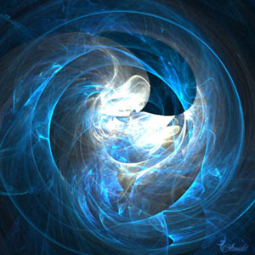
Tradition :The angels stirred the water, moving it, during a certain season, and those who able to wash in it were healed.
“No doubt the pool of Bethesda was a mineral spring whose waters had some curative virtue.
“Any notion that an angel came down and troubled the waters, so that the first person thereafter entering them would be healed, was pure superstition.
Healing miracles are not wrought in any such manner.” (2)
John 5:4

Slide 8
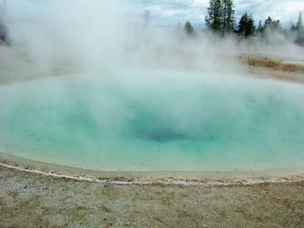
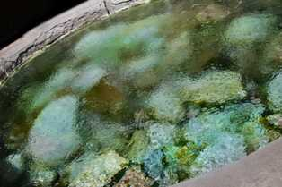
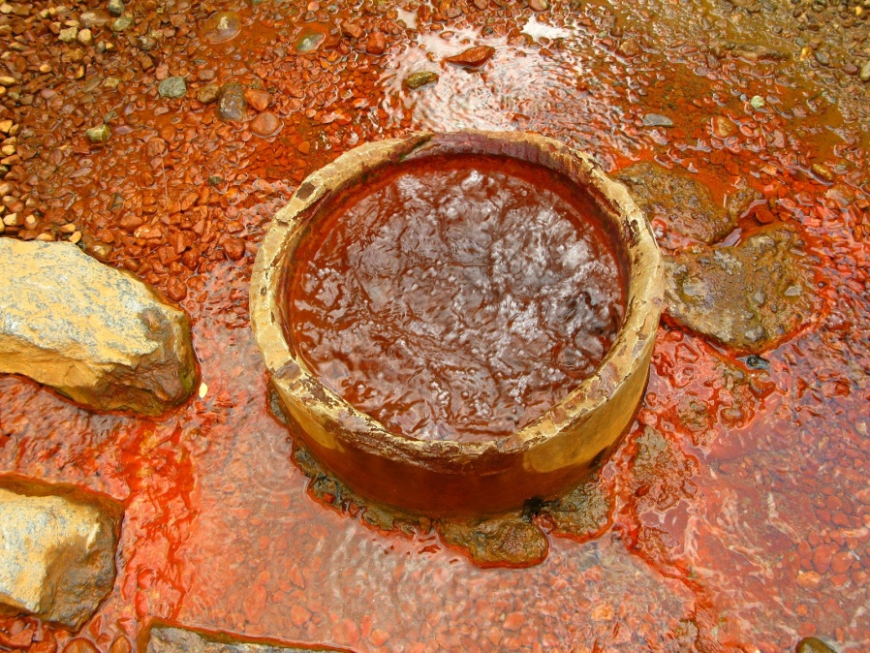
Mineral Spring
At intervals the spring rose with bubbling disturbance. Then receded to normal level

Slide 9
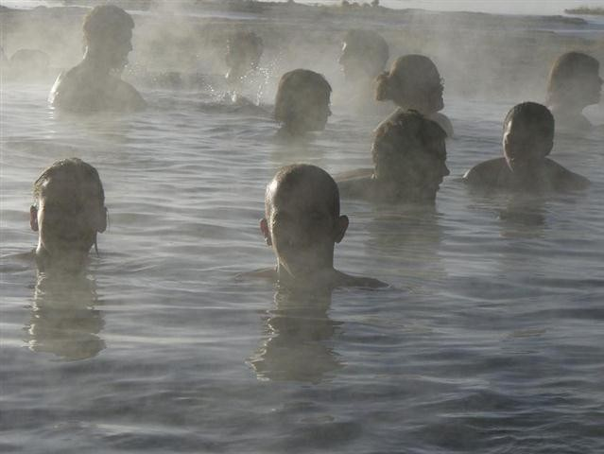
Some believed that the upwelling of the Bethesda waters was the result of supernatural agency and that if they stepped into the water during this time they would be healed.

Slide 10
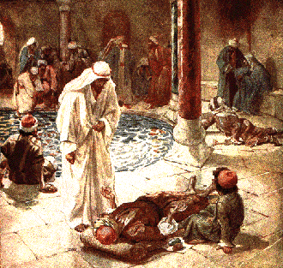
“And a certain man was there, which had an infirmity thirty and eight years.”
John 5:5

Slide 11
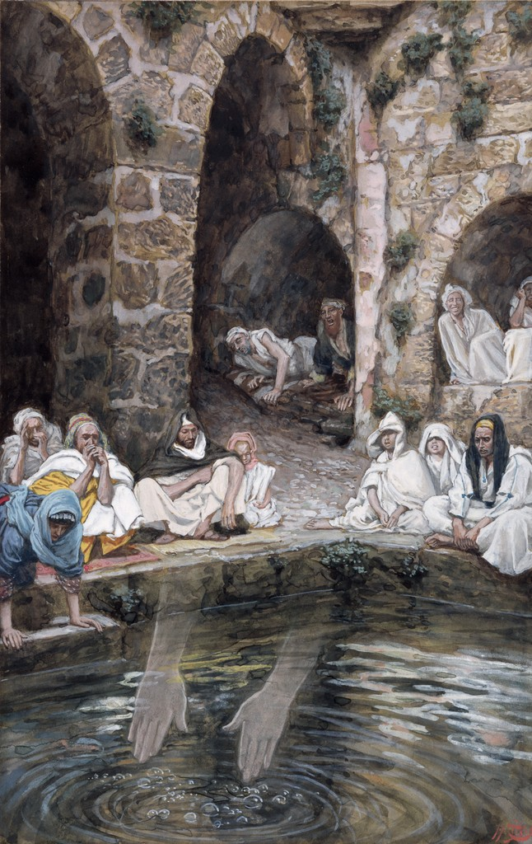
Others, less crippled, crowded him away, and according to legend only the first to enter the pool after the agitation of the water might expect to be healed.
John 5:5

Slide 12
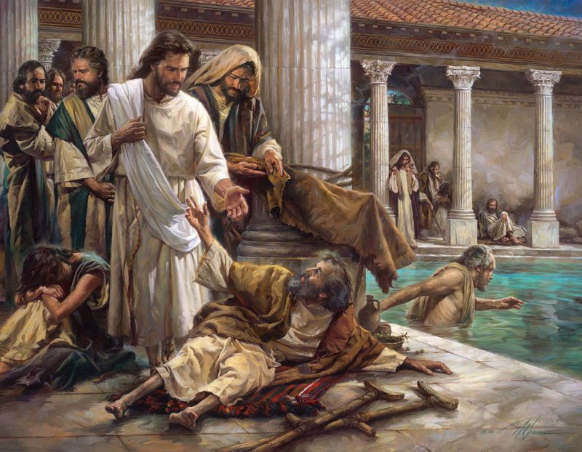
When Jesus saw him and recognized that he would be fit for a blessing, He asked,
“Wilt thou be made whole?”
John 5:6

Slide 13
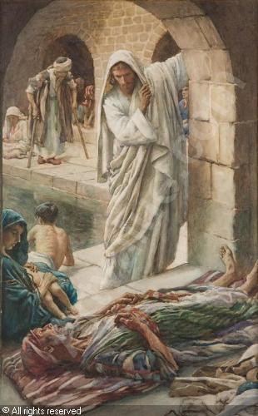
Troubled, the man said,
“Sir, I have no man, when the water is troubled, to put me into the pool…”
John 5:7

Slide 14
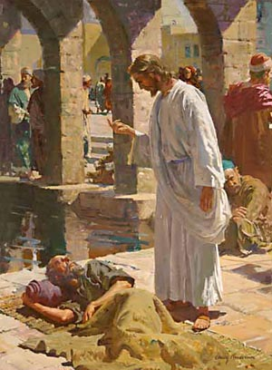
Through the power and mercy of Jesus Christ, we can be made whole
“Rise, take up thy bed, and walk”
John 5:8

Slide 15
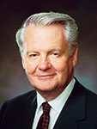
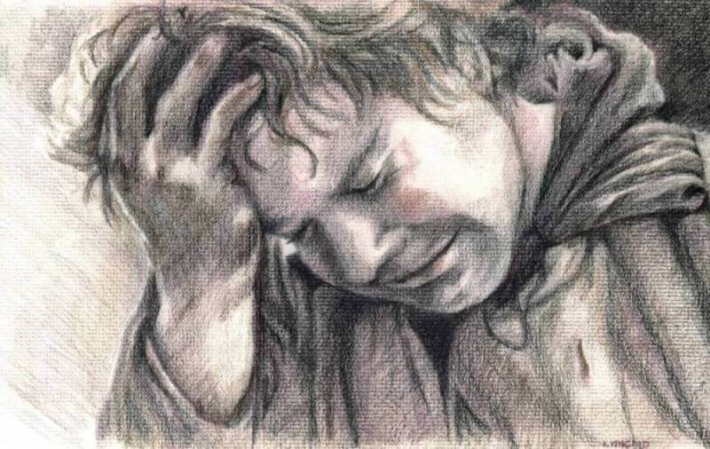
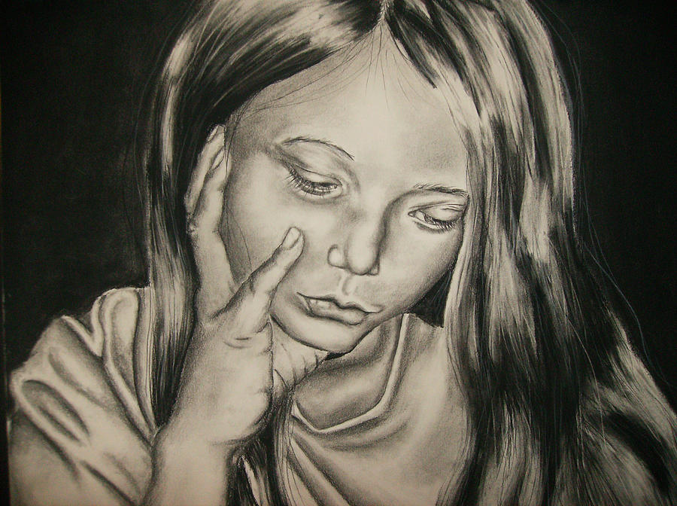
“Just as the lame man at the Pool of Bethesda needed someone stronger than himself to be healed, so we are dependent on the miracles of Christ’s atonement if our souls are to be made whole from grief, sorrow, and sin. …
Through Christ, broken hearts are mended and peace replaces anxiety and sorrow.”
John 5:9
(3)

Slide 16
The man was made whole. And walked away
The Pharisees question him about breaking the Sabbath Law
John 5:9-13

Slide 17
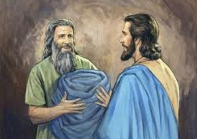
Jesus finds him later in the temple. Perhaps the man went looking for the one who healed him.
“Behold, thou art made whole: sin no more…”
John 5:14

Slide 18
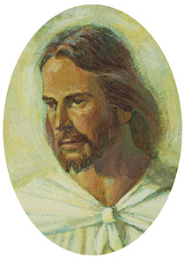
Jesus is willing to help those in need. It is up to us whether we want to be made whole

Slide 19
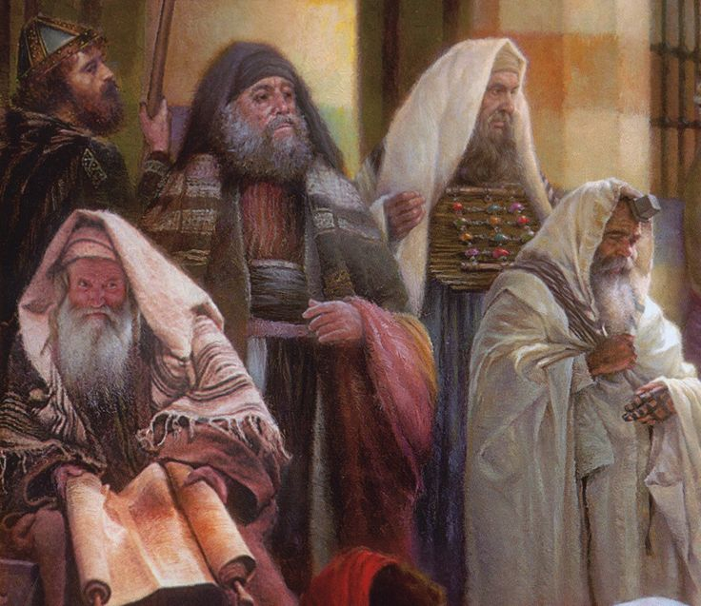
Healing on the Sabbath
When the Jewish leaders learned that the man had been healed by Jesus on the Sabbath, they persecuted and tried to kill the Savior.
The Jews persecuted the Savior not only because He healed a man on the Sabbath, but because He said that God was His Father. (1)
John 5:10-16

Slide 20
“‘Equal with God!’—awful blasphemy or awesome truth!—one or the other. There is no middle ground, no room for compromise; there are no principles to compose: either Jesus is divine or he is blaspheming!
“‘Equal with God!’—not, as yet, in the infinite and eternal sense, but in the sense of being one with him, of being his natural heir, destined to receive, inherit, and possess all that the Father hath.
“‘Equal with God!’—not that he was then reigning in glory and exaltation over all the works which their hands had made, but in the sense that he was God’s Son, upon whom the Father had placed his own name and to whom he had given glory and honor and power.”
In all He does, Jesus Christ represents Heavenly Father and seeks to obey His will
John 5:10-16
(2)

Slide 21
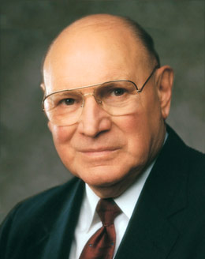
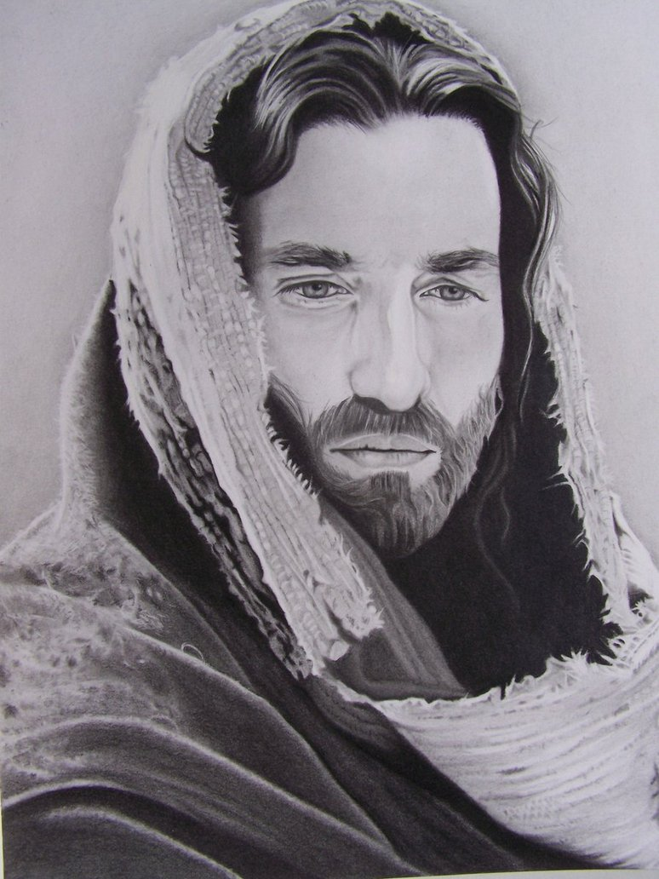
Jesus Christ Our Final Judge
He stands as the head of The Church of Jesus Christ of Latter-day Saints.
“Knowing that Jesus Christ is the firstborn Son of God in the spirit and the Only Begotten Son in the flesh gives a far more noble and majestic view of him than if he were just a great teacher or philosopher. He is our Lord, the Redeemer of all mankind, our Mediator with the Father. Because of his love for us, he has atoned for the sins of the world and has provided a way for the faithful to return to our Heavenly Father’s presence.”
“He will come again in power and glory to dwell on the earth, and will stand as Judge of all mankind at the last day.”
John 5:22, 27, 30
fabichaco
(5)

Slide 22
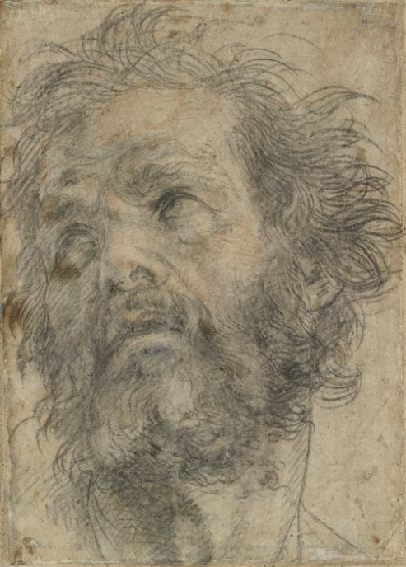
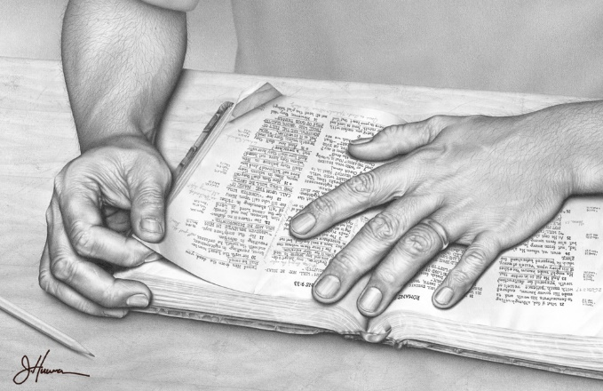
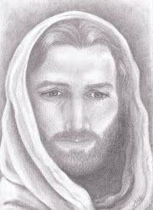
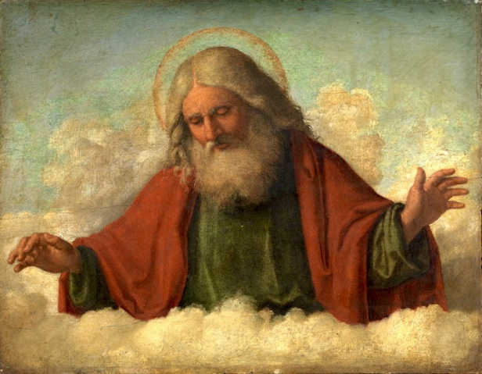
Jesus’s Divinity
John 5:33-35
John the Baptist
“…and he bare witness unto the truth.”
John 5:37
The Scriptures
“… for in them ye think ye have eternal life: and they are they which testify of me.”
John 5:36
His Works
“…the same works that I do, bear witness of me, that the Father hath sent me.”
John 5:37
His Father
“…the Father himself, which hath sent me, hath borne witness of me.”
Andrea del Sarto
John 5:33-37
(5)
J.D.
Cima da Conegliano

Slide 23
Qualifying for Eternal Life
Many Jews in Jesus’s day believed that merely studying the scriptures would allow them to receive eternal life.
They failed to understand that the purpose of the scriptures was to point them to Jesus Christ.
He said, in essence, “You think you have eternal life, but search the scriptures, for they testify of me.”
PICK ME
PICK ME
Only by coming unto Jesus Christ can we receive eternal life
John 5:39-40
(5)

Slide 24
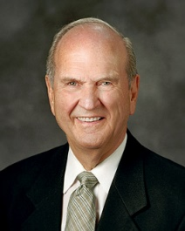
How To Achieve Eternal Life Through Scriptures
Once we understand why we need guidance and where we obtain it, we then ask, how can we achieve it?
Scriptural guidance helps you to recognize error and make the necessary correction.
Guidance can come when grappling with a serious challenge in life.
To feast means to savor. We savor the scriptures by studying them in a spirit of delightful discovery and faithful obedience.
You cultivate such revelatory experiences by living according to the light already given you and by searching the scriptures with pure motives.
We all need guidance through life. We obtain it best from the standard works and teachings of the prophets of God.
With diligent effort, we can achieve that guidance and thus qualify for all of the blessings that God has in store for His faithful children.
John 5:39-40
(6)

Slide 25
Sources:
Suggested Hymn: #141 Jesus, the Very Thought of Thee
Video:
Broken Things to Mend (2:35)
Life after War and Overcoming Post-Traumatic Stress (6:02)
Jesus Christ Will Be Our Final Judge (1:17)
New Testament Institute Student Manual Chapter 23
Elder Bruce R. McConkie (Doctrinal New Testament Commentary, 3 vols. [1965–73], 1:188). “Equal with God” (The Mortal Messiah: From Bethlehem to Calvary, 4 vols. [1979–81], 2:71).
Elder Merrill J. Bateman(“The Power to Heal from Within,” Ensign, May 1995, 13).
Elder Joseph B. Wirthlin Fruits of the Restored Gospel of Jesus Christ 1991 Oct. Gen. Conf.
Excerpts from: Elder Russell M. Nelson Living by Scriptural Guidance 2000 Oct. Gen Conf.
Presentation by ©http://fashionsbylynda.com/blog/

Slide 26
Event | Matthew | Mark | Luke | John
Jesus Attends a Feast at Jerusalem |  |  |  | 5:1
Jesus Heals a Man on the Sabbath |  |  |  | 5:2-16
Jesus to Do the Work of His Father |  |  |  | 5:17-47
Needing to Be Healed:
“Just as the lame man at the Pool of Bethesda needed someone stronger than himself to be healed (see John 5:1–9), so we are dependent on the miracles of Christ’s atonement if our souls are to be made whole from grief, sorrow, and sin. … Through Christ, broken hearts are mended and peace replaces anxiety and sorrow. … As Isaiah stated concerning the Savior: ‘Surely he hath borne our griefs, and carried our sorrows. … And with his stripes we are healed’ (Isa. 53:4–5).
“The Savior’s atonement in the garden and on the cross is intimate as well as infinite. Infinite in that it spans the eternities. Intimate in that the Savior felt each person’s pains, sufferings, and sicknesses. Consequently, he knows how to carry our sorrows and relieve our burdens that we might be healed from within, made whole persons, and receive everlasting joy in his kingdom. May our faith in the Father and the Son help each of us to become whole” Bishop Merrill J. Bateman (“The Power to Heal from Within,” Ensign, May 1995, 13–14).
So Focused on Moses John 5:46:
"It is ironic that many in Jesus' time refused to listen to Him because they were so fixed on Moses. To those who persecuted Him because He had healed an invalid on the Sabbath, he said: 'Had ye believed Moses, ye would have believed me: for he wrote of me. But if ye believe not his writings, how shall ye believe my words?' (John 5:46-47. See also Mormon 7:9.) Yet Jesus had personally called, instructed, and tutored Moses!
He told the Nephites, 'Behold, . . . the law is fulfilled that was given unto Moses. Behold, I am he that gave the law, and I am he who covenanted with my people Israel; therefore, the law in me is fulfilled, for I have come to fulfill the law; therefore it hath an end.' (3 Nephi 15:4-5.)" Elder Neal A. Maxwell (Meek and Lowly [Salt Lake City: Deseret Book Co., 1987], 77.)
Scripture Searching John 5:39-40:
“In the end, the central purpose of all scripture is to fill our souls with faith in God the Father and in His Son, Jesus Christ—faith that They exist; faith in the Father’s plan for our immortality and eternal life; faith in the Atonement and Resurrection of Jesus Christ, which animates this plan of happiness; faith to make the gospel of Jesus Christ our way of life; and faith to come to know ‘the only true God, and Jesus Christ, whom [He has] sent’ (John 17:3)” (“The Blessing of Scripture,” Ensign or Liahona, May 2010, 34).
Equal John 5:19:
To come to earth with such a responsibility, to stand in place of Elohim—speaking as He would speak, judging and serving, loving and warning, forbearing and forgiving as He would do—this is a duty of such staggering proportions that you and I cannot comprehend such a thing. But in the loyalty and determination that would be characteristic of a divine child, Jesus could comprehend it and He did it. Then, when the praise and honor began to come, He humbly directed all adulation to the Father [see John 5:19; 14:10]” Elder Jeffrey R. Holland (“The Grandeur of God,” Ensign or Liahona, Nov. 2003, 70–71).

