Slide 1
Lesson 65
Jesus is the Way
John 6
Including:
Parallels of Moses and Jesus
The Bread of Life
A firm testimony of Jesus Christ will help us remain faithful during times when it may be difficult to follow the Savior or live His teachings.

Slide 2
Parallels of the
Exodus of Israel From Egypt
and A New Exodus
John 6

Slide 3
God led the children of Israel through the wilderness by the Red Sea
Exodus 13:18
Moses “Came to the mountain of God”
Exodus 3:1, 12
Exodus 19:1-3
Jehovah multiplied signs and wonders
Exodus 7:3
Exodus 7-11
A multitude followed Jesus across the Sea of Galilee
John 6:1-2
Jesus went into a mountain
John 6:3,15
Many people followed Jesus because of signs
John 6:2, 26, 30

Slide 4
The Lord instituted the Feast of the Passover
Exodus 12
God gave Israel manna or “bread from heaven
Exodus 18:4, 3-35
Deuteronomy 8:3
The Lord told the people to gather only what they needed each day so nothing was wasted
Exodus 16:16-30
It was the time of the Passover
John 6:4
Jesus fed the multitude with five loaves and two fishes. He said, “I am the bread which came down from heaven”
John 6:5-14
John 6:41, 31-58
Jesus told the disciples to gather the fragments so that nothing was lost
John 6:12

Slide 5
The Lord promised to raise up a Prophet like Moses
Deuteronomy 18:15-18
The Lord saved the Israelites by parting the Red Sea; they walked through on dry ground.
Exodus 14
The account emphasizes darkness and wind
Exodus 14:20-21
The multitude recognized that Jesus was “that prophet”
John 6:14
Jesus walked across the Sea of Galilee and saved the disciples from the storm
John 6:16-21
This account also emphasizes darkness and wind
John 6:17-18

Slide 6
Israel murmured against the Lord
Exodus 15:24, 16:8, 17:3
Numbers 11:4-6
Prophets testified concerning the significance of the Exodus
Exodus 14:31
Number 20:12
Deuteronomy 4:33, 35
Isaiah 51:9-16, 52:1-6
1 Nephi 17
2 Nephi 25:20
D&C 136:22
The multitude murmured against the Lord
John 6:43, 61-66
Peter testified that Jesus has the “words of eternal life”
John 6:68, 66-69

Slide 7
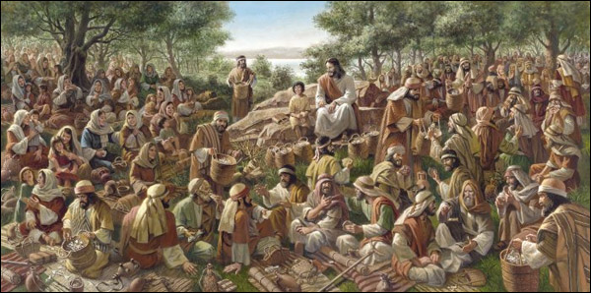
Feeding the 5,000
After the Savior testified of His divinity at Jerusalem , He returned to Galilee, where He and His Apostles taught the gospel and healed many people Jesus then crossed the Sea of Galilee with His disciples and miraculously fed a multitude of more than 5,000 people
John 5; Matthew 5-13; John 6:3-14

Slide 8
Trying to Make Jesus King
Following the feeding of the five thousand, the Savior was perhaps at the height of His public popularity.
John recorded that some sought to “take him by force, to make him a king”
What did Jesus do rather than allow the people to crown Him as their king?
John 6:15

Slide 9
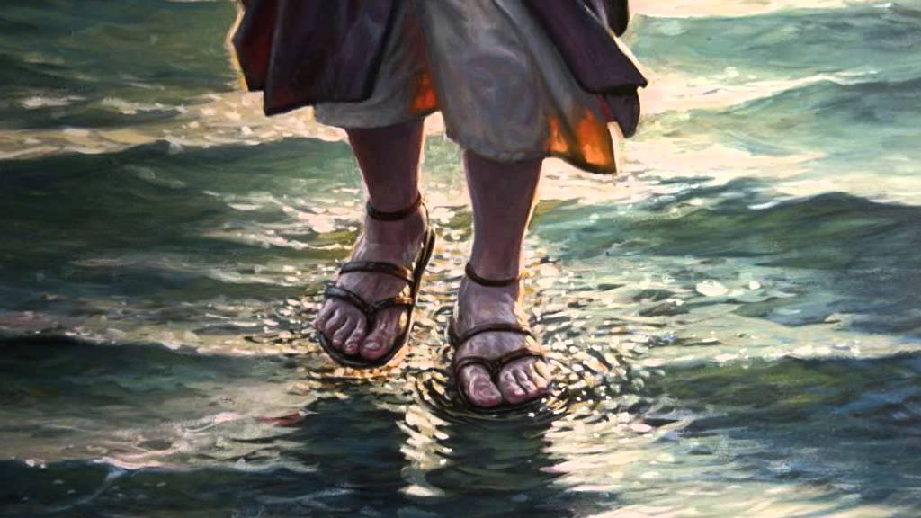
Jesus Walks Upon the Water
The Savior sent his disciples across the Sea of Galilee, and then late in the night as the disciples struggled to row against the waves and wind, Jesus walked across the sea to join them
As we willingly receive the Savior and His teachings, He can help guide us safely through the struggles of mortality
John’s account of this event emphasizes that when the disciples “willingly” received Jesus into their ship, they “immediately” landed safely at their destination.
John 6:16-21

Slide 10
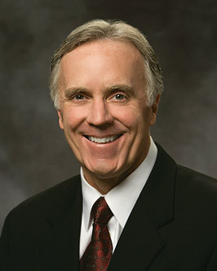
The Savior of the World, the Truth, and the Way
John 1,4,6,8,11
(2)

Slide 11
John testifies of Christ
“In the beginning was the Word, and the Word was with God, and the Word was God.”
John 1:1
(2)

Slide 12
Jesus Christ is the Way:
He is The Beginning and the End
(2)

Slide 13
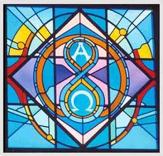
To Joseph Smith
“I am Alpha and Omega, Christ the Lord; yea, even I am he, the beginning and the end, the Redeemer of the world”
D&C 19:1
(2)

Slide 14
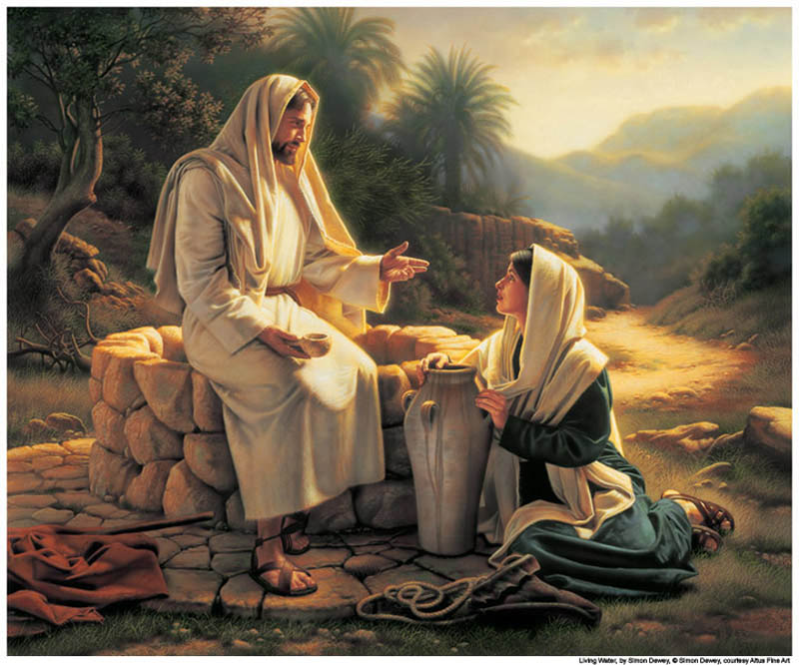
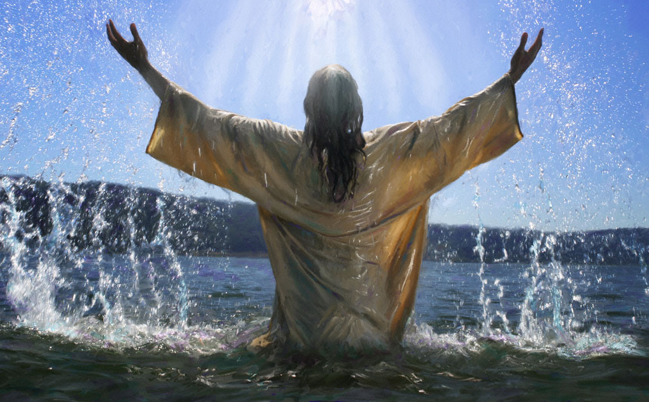
To the woman at the well
“But whosoever drinketh of the water that I shall give him shall never thirst…”
John 4:14
(2)

Slide 15
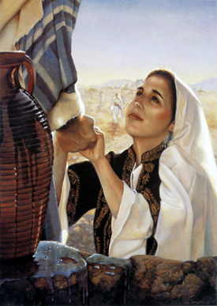
Jesus offers:
a well of living water…
either we drink and never thirst more, or we don’t and foolishly remain thirsty still.
(2)

Slide 16
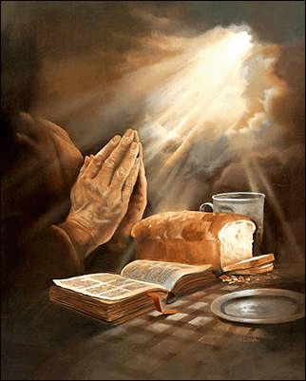
Jesus Christ is the Way:
He is the Bread and Water
Meat = food
The living manna sent from God
What did the Savior tell them they should be seeking?
Why did the people seek Him?
John 6:22-59

Slide 17
Manna was “bread from heaven” that God provided for the children of Israel as they wandered in the wilderness
John 6:31

Slide 18
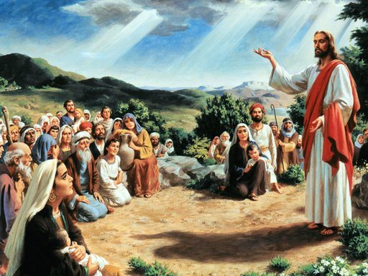
To the Jews in Capernaum
“…My father giveth you the true bread from heaven.”
John 6:32
(2)

Slide 19
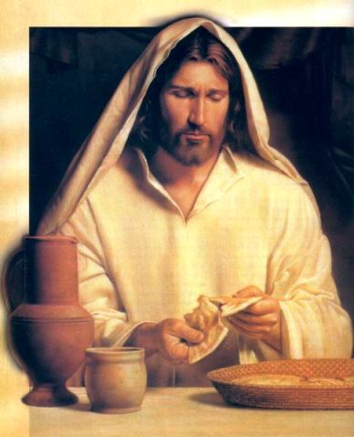
“..I am the bread of life; he that cometh to me shall never hunger; and he that believeth on me shall never thirst.”
John 6:35
(2)

Slide 20
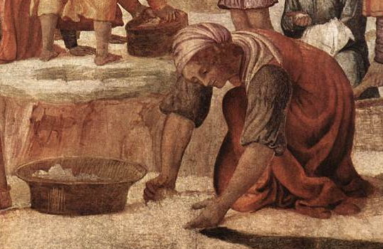
“For the bread of God is he which cometh down from heaven, and giveth life unto the world.”
John 6:33
(2)

Slide 21
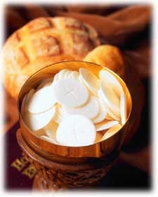
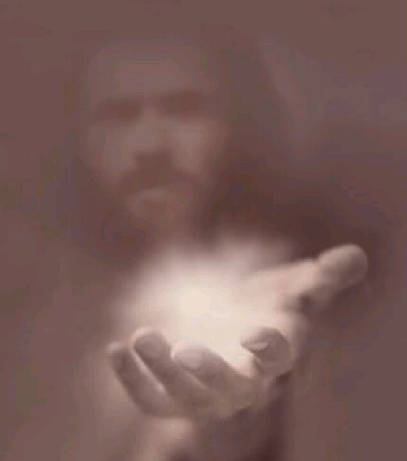
Jesus offers:
The Bread of Life…
either we eat and hunger no more, or we don’t and foolishly remain weak and hungry still
Unlike the bread that can satisfy us only for a short time, Jesus Christ offers us blessings that will last forever
(2)

Slide 22
Jesus Christ is the Way:
He is Light and Life
“In him was life; and the life was the light of men.”
John 1:4
(2)

Slide 23
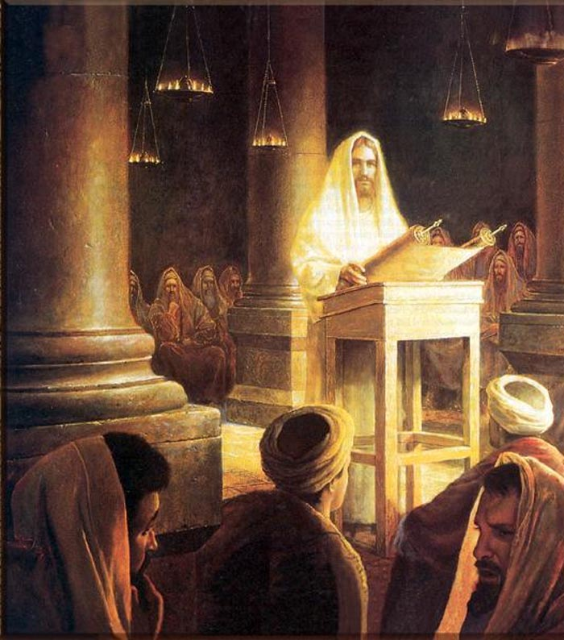
To the Pharisees
“…I am the light of the world; he that followeth me shall not walk in darkness, but shall have the light of life”
John 8:12
(2)

Slide 24
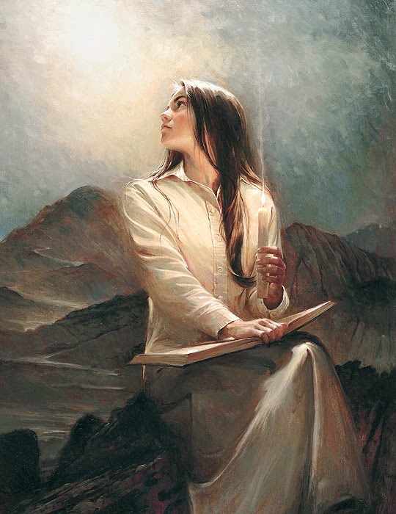
Jesus offers:
The Light of the world…
either we follow Him and see clearly, or we don’t and foolishly remain blind and in darkness still
(2)

Slide 25
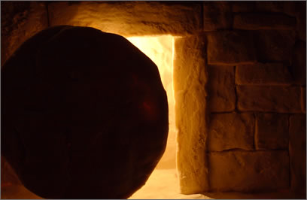
Jesus Christ is the Way:
He is The Resurrection and the Life
(2)

Slide 26
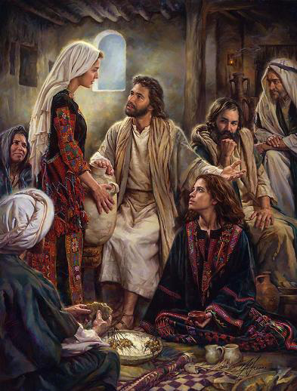
To Martha:
“I am the resurrection, and the life; he that believeth in me, though he were dead, yet shall he live…And whosoever liveth and believeth in me shall never die.”
John 11:25-26
(2)

Slide 27
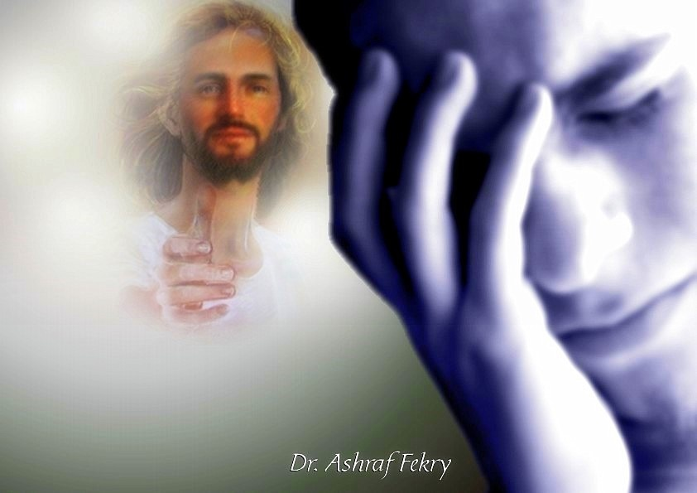
Jesus offers:
Resurrection and Life.
“The words that I speak unto you, they are spirit, and they are life.”
either we learn of Him and have life more abundantly, or we don’t and foolishly remain dead still.
(2)

Slide 28
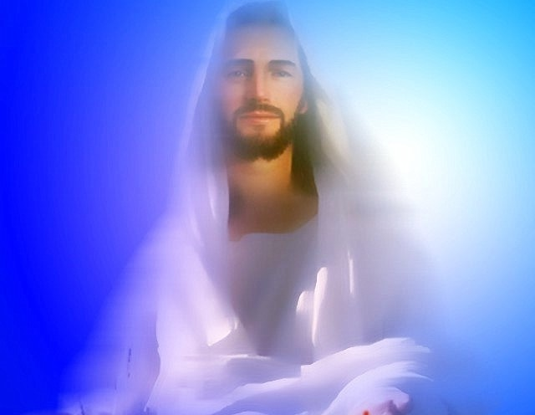
Jesus Christ is the Way:
He is The truth, and the Way
(2)

Slide 29
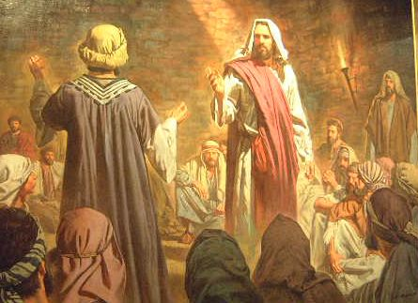
To the Jews who believed Him
“…If ye continue in my word, then are ye my disciples indeed…And ye shall know the truth, and the truth shall make you free.”
John 8:31-32
(2)

Slide 30
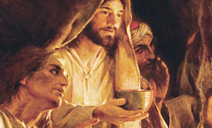
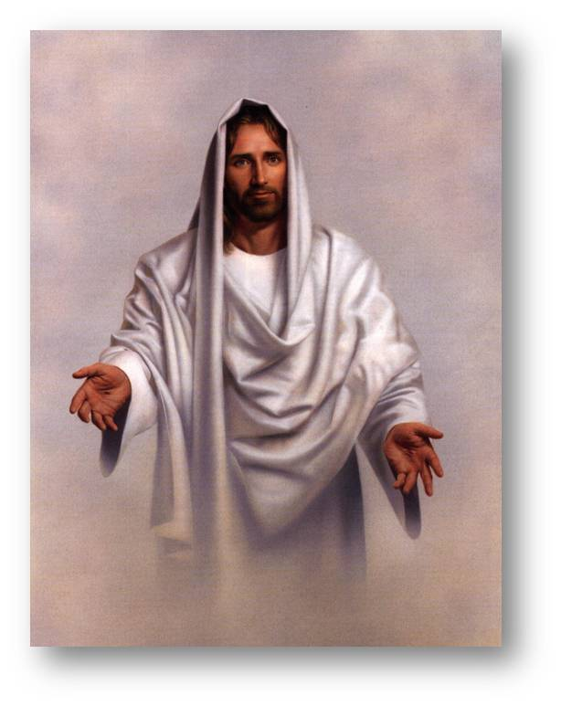
To Thomas and the other apostles
“I am the way, the truth, and the life; no man cometh unto the Father, but by me.”
John 14:6
(2)

Slide 31
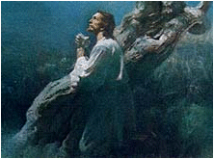
Jesus offers:
Himself as the Savior of the world…
either we accept the blessings of His Atonement and are made clean and pure, worthy to have His Spirit, or we don’t and foolishly remain alone and filthy still.
(2)

Slide 32
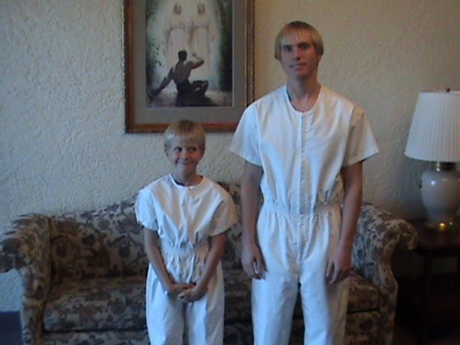
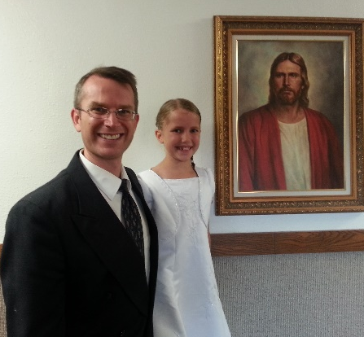
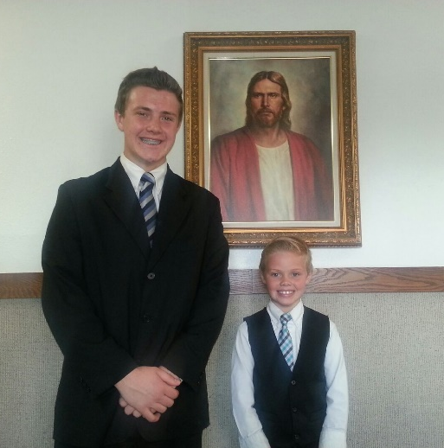
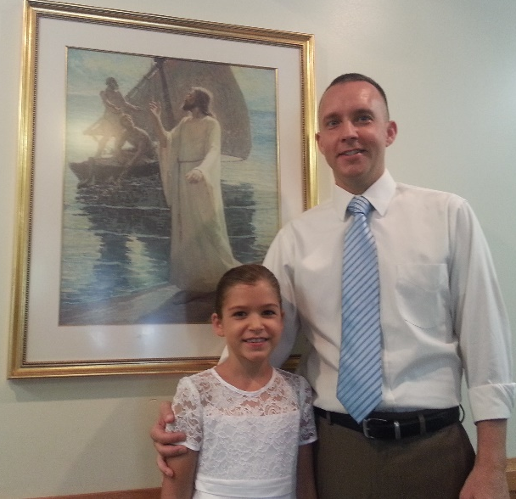
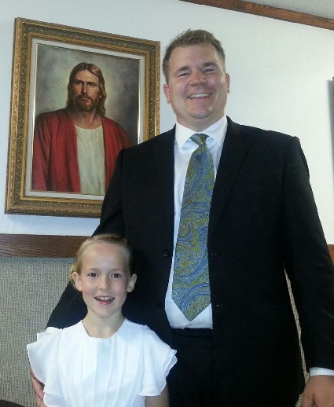
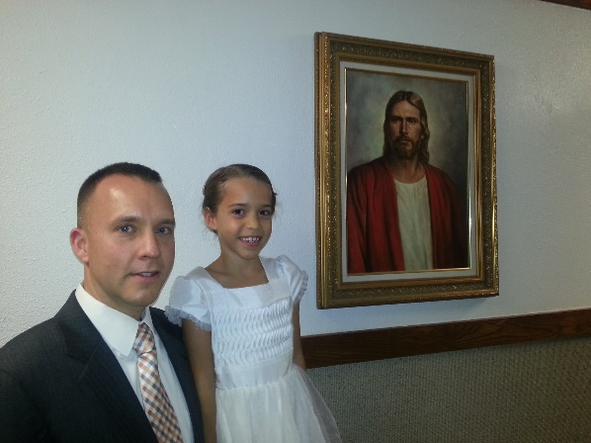
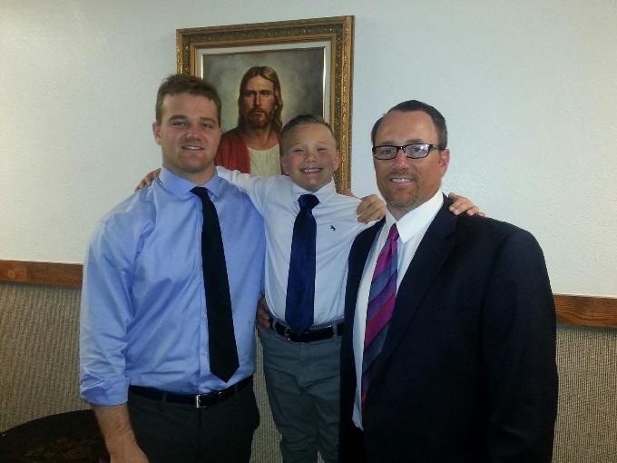
What then shall I do?
We can take upon us the name of the Son, and always remember him and keep his commandments which he has given us, that we may always have his Spirit to be with us.
D&C 20:77
(2)

Slide 33
We are saved by eating the flesh and drinking the blood of the Son of God
Exaltation in the highest heaven of the celestial world
To accept him as a Son of God
Eating his flesh and drinking his blood brings eternal life
Jesus is the Way
Men must eat his flesh and He will give it for the life of the world
Keeping commandments and enduring in obedience
The eternal atoning sacrifice
To eat the flesh and drink the Blood of the Son of God
(3)

Slide 34
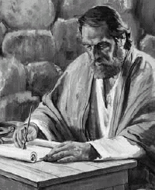
Paul says,
“They ‘did all eat the same spiritual meat; And did all drink the same spiritual drink; for they drank of that spiritual Rock that followed them: and that Rock was Christ.”
1 Corinthians 10:3-4

Slide 35
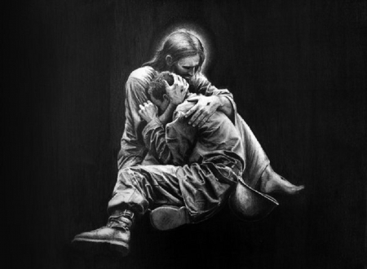
Come to His Son
In His discourse to the Jewish leaders, the Savior highlighted ways God helps people come to His Son.
The Father will “draw” us to the Savior—to “draw” is to attract or to pull gently, as with “the enticings of the Holy Spirit”).
Also, we cannot come to the Savior unless it is “given” unto us by the Father.
To have faith or repentance “given” to us means receiving divine help to believe and follow Jesus Christ. (1)
John 6:44; Mosiah 3:19

Slide 36
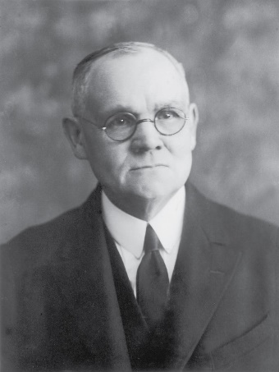
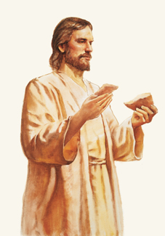
Eat of the Flesh and Drink of the Blood
“To eat the flesh and drink the blood of Christ was and is to believe in and accept Him as the literal Son of God and Savior of the world, and to obey His commandments. By these means only may the Spirit of God become an abiding part of man’s individual being, even as the substance of the food he eats is assimilated with the tissues of his body.
“… The figure used by Jesus—that of eating His flesh and drinking His blood as typical of unqualified and absolute acceptance of Himself as the Savior of men—is of superlative import; for thereby are affirmed the divinity of His Person, and the fact of His preexistent and eternal Godship.
The sacrament of the Lord’s supper, established by the Savior on the night of His betrayal, perpetuates the symbolism of eating His flesh and drinking His blood, by the partaking of bread and wine in remembrance of Him. Acceptance of Jesus as the Christ implies obedience to the laws and ordinances of His gospel.”
John 6:51-58
Del Parson
(4)

Slide 37
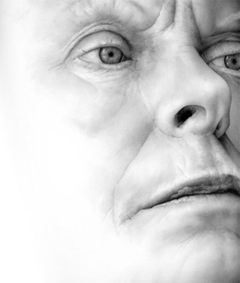
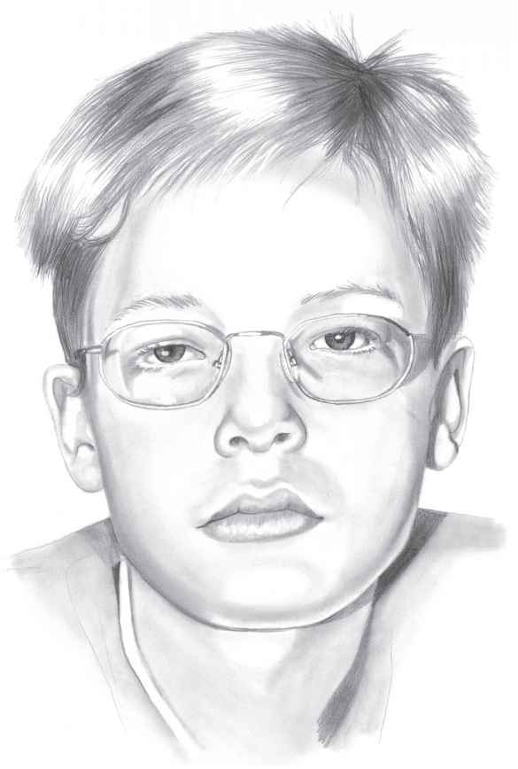
Hard Sayings
Why people abandoned Jesus and why we must be willing to accept the hard doctrines of the gospel, even when they are unpopular with the world…
“…many of those who followed Him ‘went back, and walked no more with him.’
Once His doctrines really began to make demands of people, it was too much for many.
“There are equivalent ‘hard sayings’ about our secular societies that one hesitates to utter but which need to be heard. They are not popular. … A truth may touch us, bore us, or merely make us uncomfortable. But those are reactions to truth, and reactions do not alter the reality of truth itself. … Hard sayings … when pondered, may make it easier to let go of the world. …
Complexity is scarcely the cause, for the gospel is so plain and simple. Rather, the failure to comprehend seems to be rooted in a resolute refusal to let go of the world long enough to ponder the precious truths in the message of the Master.”
Cath Riley
Dirk Dzimirsky
John 6:60-69
(5)

Slide 38
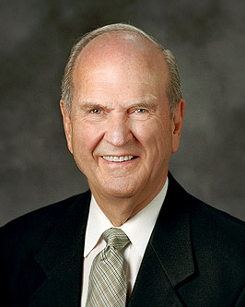
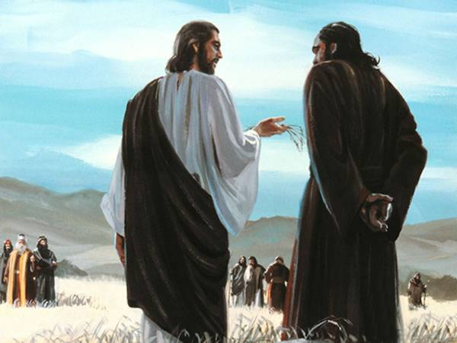
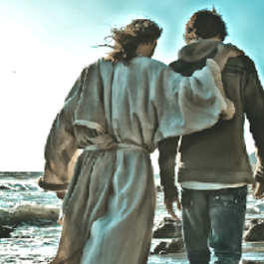
Power To Endure
…to whom shall we go? thou hast the words of eternal life.
And we believe and are sure that thou art that Christ, the Son of the living God.
"Peter's answer defines the real core of commitment.
When we know without a doubt that Jesus is the Christ, we will want to stay with Him. When we are surely converted, the power to endure is ours."
John 6:68-69
(6)

Slide 39
Sources:
Suggested Hymn: #175 O God, the Eternal Father verses 1 and 4
Video: I am the Bread of Life (6:42)
Daily Bread: Change (3:00)
New Testament Institute Student Manual Chapter 23
Elder Lawrence E. Corbridge Notes From: The Way October 2008 Gen. Conf.
Elder Bruce R. McConkie Mortal Messiah p. 2:377-379
Elder James E. Talmage (Jesus the Christ, 342–43).
Elder Neal A. Maxwell (Wherefore, Ye Must Press Forward [1977], 6–7, 22).
Elder Russell M. Nelson (Perfection Pending, and Other Favorite Discourses [Salt Lake City: Deseret Book Co., 1998], 129.)
Presentation by ©http://fashionsbylynda.com/blog/

Slide 40
Event | Matthew | Mark | Luke | John
The Twelve Apostles Return and Depart—Jesus is to Rest | 14:13 | 6:30-33 | 9:10 | 6:1, 2
Jesus Feeds 5,000 | 14:14-21 | 6:34-44 | 9:11-17 | 6:3-14
Jesus Departs to the Mountain to Avoid Being Made King | 14:22, 23 | 6:45, 46 |  | 6:15
Jesus Walks on Water | 14:24-33 | 6:47-52 |  | 6:16-21
Jesus is the Bread of Life |  |  |  | 6:22-59
Many Reject Jesus |  |  |  | 6:60-71
Similarities between Moses and the Savior: (I AM):
Perhaps one of the most striking similarities between the ministries of Moses and the Savior is the use of “I Am” statements. When Moses asked the Lord what to say when the children of Israel asked for His name, the Lord responded, “I AM THAT I AM” (Exodus 3:13–14).
“I Am”—one of the names by which the Savior is known in the Old Testament—is recorded repeatedly by John, and Moses was told to use this name so the Israelites would know that Jehovah had spoken. John recorded that the Savior declared, “I am the bread of life” (John 6:35, 48, 51; italics added). He made other similar “I am” statements during His ministry (see John 8:12; 10:9, 11;11:25; 14:6; 15:1). (1)
Bread:
As a common food staple in many cultures, bread serves as an ideal metaphor for the fundamental role the Savior and His teachings should have in our lives. As Jesus taught people about “the bread of life,” He drew upon the background of His listeners. He used their religious history as a teaching tool—the feeding of the five thousand and the Bread of Life discourse took place as the Jews were preparing for the Passover, during which the children of Israel ate unleavened bread in memory of their deliverance from Egypt and the manna that God had provided for them in the wilderness. He drew upon the people’s personal experience—many of those who listened to the Master on this occasion had also been among the five thousand who had eaten the bread He miraculously provided just the day before.
The Savior also drew upon his listeners’ geographical location—they were now hearing Him teach in Capernaum, a region that appears to have been associated with bread making; more remnants of grinding mills have been discovered at Capernaum than at any other place in Israel. When the crowd referred to the manna provided for Israel in the days of Moses, the Savior reminded them that the same God who had provided that “bread from heaven” now offered to them the “true bread from heaven” (John 6:32). Jesus had demonstrated that He could indeed provide for them temporally, but He was also “that bread of life” (John 6:48) who could give eternal life to those who would partake of the spiritual nourishment He now offered (see John 6:51).(1)
Tradition that the Messiah would come and feed: John 5:15:
“There was a tradition, taught by the Rabbis and firmly entrenched in the public mind, that when Messiah came, he would feed them with bread from heaven. … It had even become a fixed belief that the Messiah, when He came, would signalize His advent by a repetition of this stupendous miracle. ‘As the first Saviour—the deliverer from Egyptian bondage,’ said the Rabbis, ‘caused manna to fall for Israel from heaven, so the second Saviour—the Messiah—will also cause manna to descend for them once more’ [Cunningham Geikie, The Life and Words of Christ (1886), 516–17].
“Thus, when Jesus multiplied the five barley loaves and the two small fishes, it was as though the traditional sign had been given. The peak of his popular appeal had come. In their eyes he stood on the summit. He was the Messiah, they reasoned, and must reign as their king” (Mortal Messiah, 2:367–68).

