Slide 1
Lesson 68
F
R
E
D
O
M
E
F
R
S
O
M
I
N
Jesus said unto them, Verily, verily, I say unto you, Before Abraham was, I am.
John 8:58
John 8:31-59
Hagar
Sarah
Abraham
Keturah
Ishmael
Rebekah
Isaac
Midian
Ishmaelites
Jacob
Midianites
Israelites

Slide 2
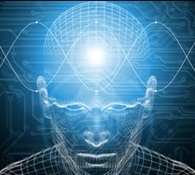
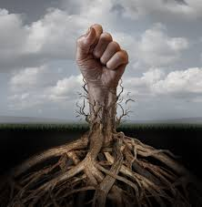
Freedom From Sin
Continue in Truth
Become Christ’s Disciples
Know the Truth
Freedom
T
R
T
U
H
Truth
If we continue in Jesus Christ’s word, then we will be His disciples and know the truth, which will make us free
John 8:31-32

Slide 3
The Truth Shall Make You Free
Free from power of false doctrine
Free from the bondage of appetite and lust
Free from the shackles of sin
Free from every evil and corrupt influence
Free from every restraining and curtailing power
Free to go on to the unlimited freedom enjoyed it its fulness only by exalted beings
John 8:30-32
(3)

Slide 4
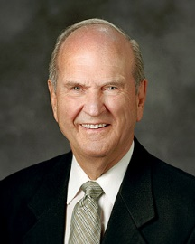
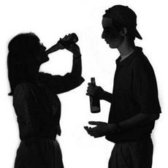
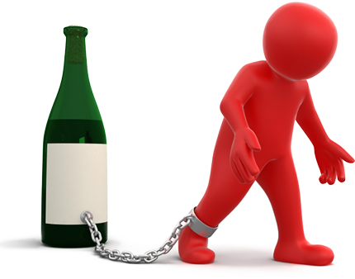
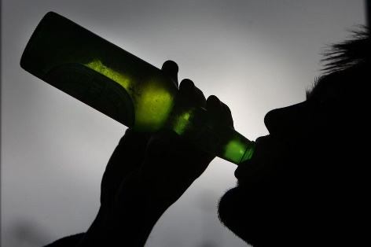
G
S
A Servant of
D
O
N
I
The Greek verb translated as “committeth” implies continuing in sin rather than a single occurrence of sin.
Addiction
Enslavement
Experiment
Habit
Dependence
“Agency, or the power to choose, was ours as spirit children of our Creator before the world was.
It is a gift from God, nearly as precious as life itself.
“Often, however, agency is misunderstood. While we are free to choose, once we have made those choices, we are tied to the consequences of those choices.”
Enslaving shackles of habit are too small to be sensed until they are too strong to be broken. …
John 8:34
(2)

Slide 5
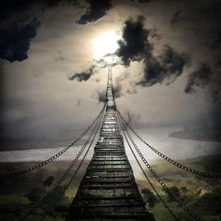
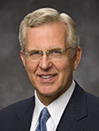
“Yielding to [Satan’s] temptations leads to a narrower and narrower range of choices until none remains and to addictions that leave us powerless to resist. …
“… Does anyone doubt that, as a consequence of possessing all light and truth, God possesses ultimate freedom to be and to do?
“Likewise, as our understanding of gospel doctrine and principles grows, our agency expands.
First, we have more choices and can achieve more and receive greater blessings because we have more laws that we can obey.
… Second, with added understanding we can make more intelligent choices because we see more clearly not only the alternatives but also their potential outcomes.”
John 8:34
(4)

Slide 6
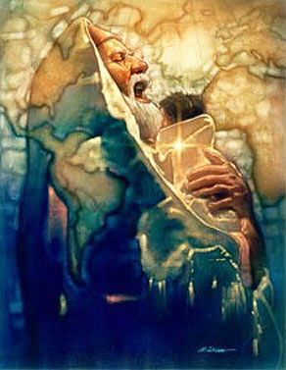
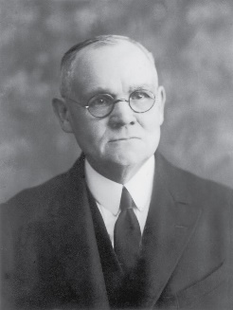
Entitlement
The Jews mistakenly believed that simply being descendants of Abraham and heirs to the Abrahamic covenant entitled them to spiritual freedom.
The book of Genesis records some of Abraham’s works that stand in contrast to the behavior of the Jewish leaders.
Abraham converted others to the gospel.
He avoided strife.
He was obedient to God.
He welcomed heavenly messengers.
He exercised tremendous faith.
"Judaism held that the posterity of Abraham had an assured place in the kingdom of the expected
Messiah, and that no
proselyte from among the
Gentiles could possibly
attain the rank and
distinction of which the 'children' were sure." (3)
Ron DiCianni
John 8:37; Abraham---Genesis 12:1-9; 13:7-9; 15:1-6; 18:1-8; 22:1-19
(1)

Slide 7
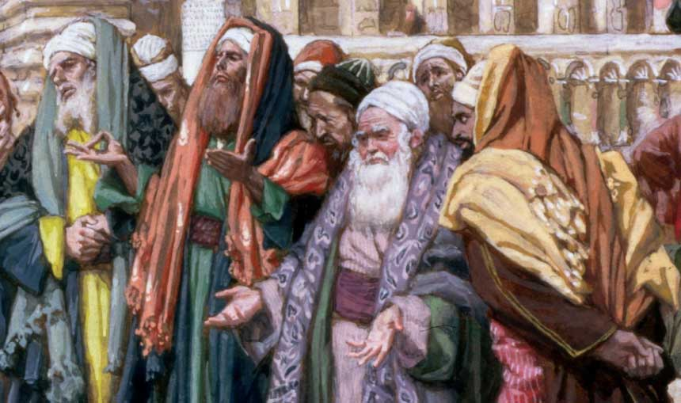
Deeds of Their Fathers
Jesus was clearly implying that the Jews were serving someone other than God.
In apparent retaliation, bristling at the suggestion that they were “sons” or followers of the devil, the Jewish leaders said, “We be not born of fornication”, which was an insult about what was thought to be Jesus’s illegitimate birth because Mary and Joseph were not legally married at the time of Mary’s conception.
This insult helps us understand the kind of treatment Jesus may have endured throughout His life. In many ways, He knew what it was like to have people revile Him, persecute Him, and say all manner of evil against Him falsely.
John 8:41
(1)

Slide 8
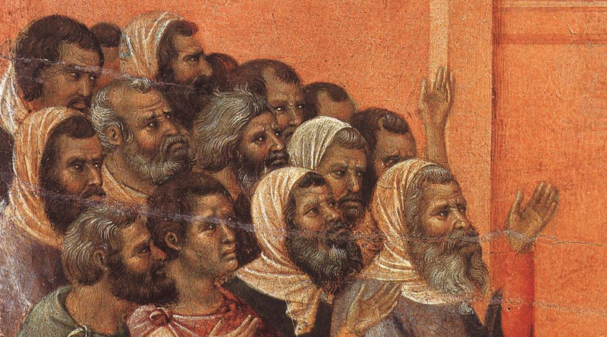
Receiving God’s Word
“He that is of God receiveth God’s words; ye therefore receive them not, because ye are not of God”
John 8:47
The response of the Jewish leaders was to call Jesus a Samaritan—the lowest of all people and not of Jewish descent—and state that He was possessed of a devil.
These leaders had hardened their hearts, refusing to believe that Jesus was the Son of God—even though their father Abraham, all other ancient prophets, and their scriptures taught clearly of Him.
John 8:42-52
(1)

Slide 9
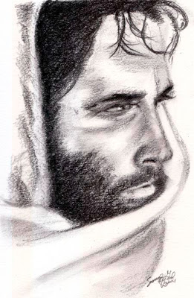
I Am
Jesus said unto them, Verily, verily, I say unto you, Before Abraham was, I am.
The term identifies Jehovah, the God of Abraham, Isaac, and Jacob; …
Jehovah is derived from the Hebrew word hayah, which means ‘to be’ or ‘to exist.’ A form of the word hayah in the Hebrew text of the Old Testament was translated as I AM
And God said unto Moses, I AM THAT I AM: and he said, Thus shalt thou say unto the children of Israel, I AM hath sent me unto you.
Exodus 3:14
Jehovah had thus revealed to Moses this very name that He had meekly and modestly chosen for His own premortal identification: ‘I AM’” (2)
Yongsung Kim
John 8:58
(1)

Slide 10
Sources:
Suggested Hymn: #240 Know This, That Every Soul Is Free
Video:
Addictions Surrender Our Freedoms of Choice (0:53)
New Testament Institute Student Manual Chapter 24
Elder Russell M. Nelson (“Addiction or Freedom,” Ensign, Nov. 1988, 6–7). I AM--(“Jesus the Christ: Our Master and More,” Ensign, Apr. 2000, 6–7).
Elder James E. Talmage (Jesus the Christ, 115)
4. Elder D. Todd Christofferson (“Moral Agency,” Ensign, June 2009, 49, 50–51).
Presentation by ©http://fashionsbylynda.com/blog/

Slide 11
Event | Matthew | Mark | Luke | John
The Truth Shall Make You Free |  |  |  | 8:30-32
Who is Abraham’s Seed? |  |  |  | 8:31-59
True Freedom John 8:30-32:
“Obedience leads to true freedom. The more we obey revealed truth, the more we become liberated. …
“Freedom and liberty are precious gifts that come to us when we are obedient to the laws of God and the whisperings of the Spirit. … Obedience to [principles of revealed truth] makes us truly free to reach the potential and the glory which our Heavenly Father has in store for us.” President James E. Faust (“Obedience: The Path to Freedom,” Ensign, May 1999, 45, 47).
Abraham is Our Father John 8:39:
"...according to the common notion of the time, the vials of wrath were to be poured out only on the Gentiles, while they, as Abraham's children, were sure of escape-in the words of the Talmud, that 'the night' (Isa. 21:12) was 'only to the nations of the world, but the morning to Israel'? (Jer. Taan. 64a).
"For, no principle was more fully established in the popular conviction, than that all Israel had part in the world to come (Sanh. 10.1), and this, specifically, because of their connection with Abraham...'The merits of the Fathers,' is one of the commonest phrases in the mouth of the Rabbis. Abraham was represented as sitting at the gate of Gehenna (hell), to deliver any Israelite who otherwise might have been consigned to its terrors. In fact, by their descent from Abraham, all the children of Israel were nobles, infinitely higher than any proselytes. 'What,' exclaims the Talmud, 'shall the born Israelite stand upon the earth, and the proselyte be in heaven?' (Jer. Chag. 76a)." (Edersheim, The Life and Times of Jesus the Messiah, p. 187-88)
Addition or Freedom John 8:31-32:
From an initial experiment thought to be trivial, a vicious cycle may follow. From trial comes a habit. From habit comes dependence. From dependence comes addiction. Its grasp is so gradual. Enslaving shackles of habit are too small to be sensed until they are too strong to be broken. …
“Agency, or the power to choose, was ours as spirit children of our Creator before the world was. (See Alma 13:3; Moses 4:4.) It is a gift from God, nearly as precious as life itself.
“Often, however, agency is misunderstood. While we are free to choose, once we have made those choices, we are tied to the consequences of those choices” Elder Russell M. Nelson (“Addiction or Freedom,” Ensign, Nov. 1988, 6–7).
Bible Dictionary: Abraham, Covenant of:
“Abraham first received the gospel by baptism (which is the covenant of salvation). Then he had conferred upon him the higher priesthood, and he entered into celestial marriage (which is the covenant of exaltation), gaining assurance thereby that he would have eternal increase. Finally he received a promise that all of these blessings would be offered to all of his mortal posterity (D&C 132:29–50; Abr. 2:6–11). … Abraham’s posterity would receive certain lands as an eternal inheritance (Gen. 17;22:15–18; Gal. 3; Abr. 2).
These promises taken together are called the Abrahamic covenant. …
“The portions of the covenant that pertain to personal salvation and eternal increase are renewed with each individual who receives the ordinance of celestial marriage (see D&C 132:29–33). Those of non-Israelite lineage, commonly known as gentiles, are adopted into the house of Israel, and become heirs of the covenant and the seed of Abraham, through the ordinances of the gospel (Gal. 3:26–29).
“Being an heir to the Abrahamic covenant does not make one a ‘chosen person’ per se but does signify that such are chosen to responsibly carry the gospel to all the peoples of the earth. Abraham’s seed have carried out the missionary activity in all the nations since Abraham’s day. (Matt. 3:9; Abr. 2:9–11)”
Boosting of Heritage John 8:39:
When the Jewish leaders boasted that they were Abraham’s seed, implying they held special privileges in the sight of God, the Savior reproved them for failing to do the works of their highly esteemed ancestral father. They were not acting like the covenant children of Abraham; rather, they were trying to kill the God of Abraham, who was standing before them and telling them the truth. (1)

Slide 12
“I AM” Statements
REFERENCE IN JOHN | “I AM” STATEMENT | FULFILLMENT
6:35, 48, 51 | “I am the bread of life.” | Jesus Christ gave Himself for us in the Atonement. He feeds us spiritually.
8:12; 9:5 | “I am the light of the world.” | Jesus Christ is the source of all truth. If we follow His words and example, we will not stumble or walk in spiritual darkness.
8:58 | “Before Abraham was, I am.” | Jesus Christ is Jehovah of the Old Testament.
10:7, 9 | “I am the door of the sheep.” | Jesus Christ protects us like a shepherd at the door of a sheep enclosure. No one can enter His kingdom except through Him.
10:11, 14 | “I am the good shepherd.” | Jesus Christ leads us. He gave His life for us. He knows each of us individually.
10:36 | “I am the Son of God.” | Jesus Christ is the Firstborn of the Father’s spirit children (see D&C 93:21) and His Only Begotten in the flesh (see John 1:14).
11:25 | “I am the resurrection, and the life.” | Through the Atonement of Jesus Christ we can overcome physical and spiritual death. Jesus Christ gave us the gift of resurrection.
14:6 | “I am the way, the truth, and the life.” | Jesus Christ is the only way to the Father, and He is the source of all truth. Because of His Atonement, we will all be resurrected and through our faithfulness may inherit eternal life.
15:1, 5 | “I am the true vine.” | We depend on Jesus Christ for life. Only by abiding by His teachings will we be able to bear the fruit of righteousness.
New Testament Seminary Teacher Manual

