Slide 1
Lesson 69
Spiritual Blindness VS
Physical Blindness
John 9
And in that day shall the deaf hear the words of the book, and the eyes of the blind shall see out of obscurity, and out of darkness. Isaiah 29:18

Slide 2
Isaiah’s Prophecy
Then the eyes of the blind shall be opened, and the ears of the deaf shall be unstopped.
Isaiah 35:5
I the Lord have called thee in righteousness, and will hold thine hand, and will keep thee, and give thee for a covenant of the people, for a light of the Gentiles;
To open the blind eyes, to bring out the prisoners from the prison, and them that sit in darkness out of the prison house.
Isaiah 42:6-7
And in that day shall the deaf hear the words of the book, and the eyes of the blind shall see out of obscurity, and out of darkness. Isaiah 29:18

Slide 3
Who Did Sin?
“Master, who did sin, this man, or his parents, that he was born blind?”
The disciples observed:
that suffering was the result of iniquity and
that there was a premortal existence of some kind.
“Neither hath this man sinned, nor his parents: but that the works of God should be made manifest in him”
This question teaches that a person suffering from a mortal adversity, such as a disability, is not necessarily guilty of sin. (1)
John 9:2-3

Slide 4
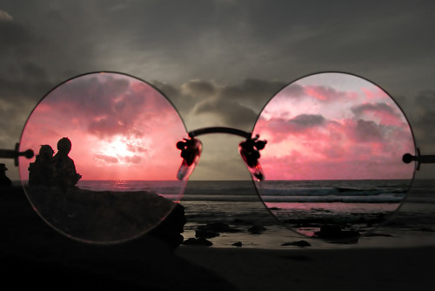
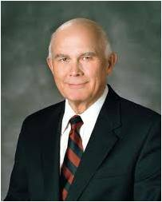
“We are sent here to be tested.
There must be opposition in all things. We are meant to learn and grow through that opposition, through meeting our challenges, and through teaching others to do the same. …
The Lord will not only consecrate our afflictions for our gain, but He will use them to bless the lives of countless others.
“Jesus taught this lesson when He and His disciples met a man who was born blind.
“If we see life through the lens of spirituality, we can see many examples of the works of God being furthered through the adversities of His children. …
“When we understand this principle, that God offers us opportunities for blessings and blesses us through our own adversities and the adversities of others, we can understand why He has commanded us again and again to ‘thank the Lord thy God in all things’ (D&C 59:7)”
John 9:2-3
(2)

Slide 5
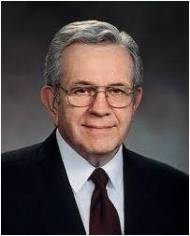
“It is natural for parents with handicapped children to ask themselves, ‘What did we do wrong?’
The idea that all suffering is somehow the direct result of sin has been taught since ancient times.
It is false doctrine.
That notion was even accepted by some of the early disciples until the Lord corrected them.
“There is little room for feelings of guilt in connection with handicaps. Some handicaps may result from carelessness or abuse, and some through addiction of parents. But most of them do not.
Afflictions come to the innocent”
(3)

Slide 6
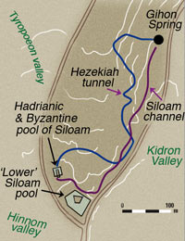
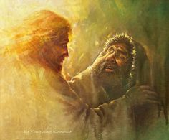
Pool of Siloam
When the Savior saw the man who had been blind from birth, He anointed the man’s eyes with clay and told him to wash in the pool of Siloam.
Yongsung Kim
He is instantly healed.
John 9:5-7

Slide 7
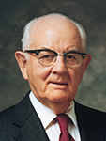
Spittle
"Strange-we provide pure, sterile tissue for spittle and forbid expectorating even on sidewalks.
"We bathe with soap, scrub with disinfectants, and scald dishes, pots, and pans with boiling water to kill the germs from the filth of clay.
"We use for culinary purposes and especially in hospitals and sickrooms only water purified by chemical processes.
"But here the Master disregarded all our rules of sanitation and prescribed spittle, germ-ridden clay, and impure water...
The miracle was conceived in the womb of faith and born and matured in the act of obedience.
"Had the command involved oil instead of spittle, herbs instead of clay, and waters of a pure bubbling spring instead of filthy Siloam, the result would have been the same. But some would have said that oil and herbs and pure water had healed the eyes, but even the untrained must know that these could not cure one.
The unparalleled miracle was positively the result of faith obedience.
"Though there is no compulsion, the spiritual laws of today must also be obeyed if blessings are to be realized.“
John 9:5-7
(5)

Slide 8
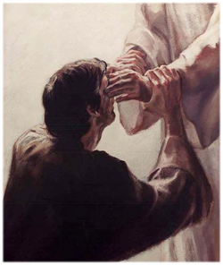
“A Man Called Jesus”
With commitment and resolve, the man believed and accepted Jesus as “the Son of God”
“Conversion is a process that seldom occurs in an instant suddenly. Gospel grace dawns gradually upon most believers.” (4)
John 9:11, 35-38

Slide 9
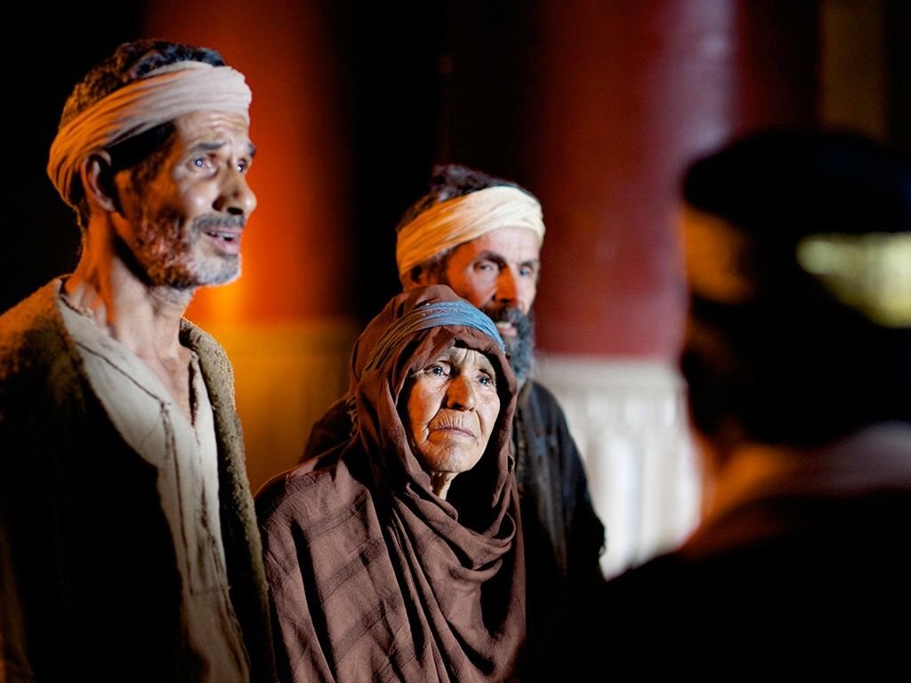
“Put Out of the Synagogues”
“Synagogues served as the religious and social center for many Jewish communities.
Synagogues offered access to spiritual instruction and worship, as well as educational and social opportunities.
Because the synagogue was so integral to Jewish society, to be cast out of the synagogue … meant more than being excommunicated and losing fellowship with the religious community.
This meant banishment from cultural and social affairs as well. This threat was apparently severe enough to keep the parents of the man born blind from getting too involved in the investigation of [their son’s healing]”
John 9:22, 34-35
(1)

Slide 10
OR
Is it more important to be spiritually clean?
Is it more important to be physically clean?
John 9:35-38

Slide 11
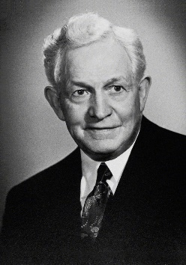
Evil
Thoughts
Speaking the Lord’s name in vain
Unrighteous
Actions
False
accusations
“I implore you to think clean thoughts. Every action is preceded by a thought. If we want to control our action, we must control our thinking.” (7)
What kinds of things make people spiritually unclean?
Gossiping
Vulgarity
King Solomon states twice:
“A lying tongue and a false witness that speaketh lies” are an abomination unto Him
(Proverbs 6:16-19)
Lying

Slide 12
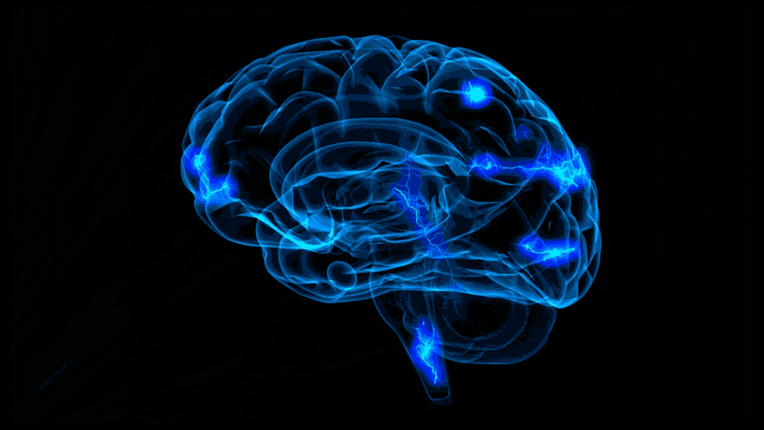
“The brain won’t vomit back filth.
Once recorded, it will always remain subject to recall, flashing its perverted images across your mind and drawing you away from the wholesome things in life”
(2)

Slide 13
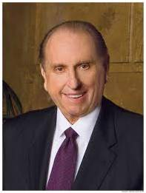
Unhealthy
Foods
“The body has defenses to rid itself of unwholesome food.” (2)
However…
“Drugs impair our ability to think, to reason, and to make prudent and wise choices.”
(8)
What kinds of things make people physically unclean?
Harmful drugs

Slide 14
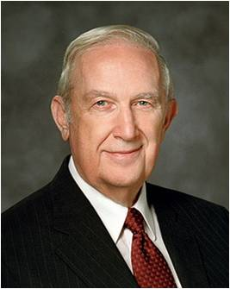
Exercise Faith
“I solemnly testify that Jesus Christ guides this, His church. He knows and loves you personally. As you walk in faithful obedience, He will bless you, inspire you, and lead you to greater knowledge and capacity. “
(9)
What kinds of things make people spiritually clean?
Obedience

Slide 15
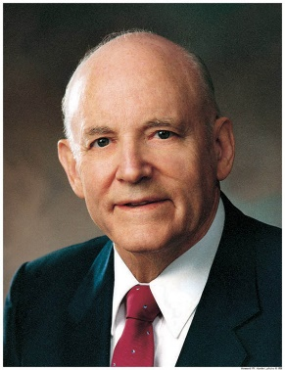
“Sight For the Spiritual”
“Now sight had been given twice—once to remedy a congenital defect and once to behold the King of Kings before He would ascend to His eternal throne. Jesus had quickened both temporal and spiritual vision.” (6)
How might the man’s healing from physical blindness represent his healing from spiritual blindness?
Why do you think exercising faith is necessary in order to see and understand spiritual truth more clearly?
As we exercise faith in Jesus Christ, our spiritual vision and understanding become clearer
John 9:36-38

Slide 16
“Blind Also”
After the Savior healed the man born blind, some Pharisees asked Jesus whether they were “blind also.” In reply, the Savior used a metaphor, teaching that individuals who were “blind”—those who did not know who He was—“should have no sin”.
On the other hand, individuals who could “see”—those who had received enough witnesses concerning the Savior and His divine mission that they should have known who He was—would be accountable for their actions.
The Pharisees were among those who could “see,” and thus their “sin remaineth.” Spiritually speaking, they chose to be blind because they refused to recognize Jesus as the Son of God, despite the many witnesses they had received.
John 9:39-41
(1)

Slide 17
“Choosing to Be Blind”
The Pharisees were among those who could ‘see,’ and thus their ‘sin remaineth.’ Spiritually speaking, they chose to be blind because they refused to recognize Jesus as the Son of God, despite the many witnesses they had received”
Do You Choose To Be Blind Also?
John 9:39-41
(1)

Slide 18
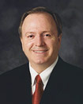
Sources:
Suggested Hymn: #89 The Lord is My Light
Video:
Man Heals a Man Born Blind (3:37)
New Testament Institute Student Manual Chapter 24
Elder Dallin H. Oaks (“Give Thanks in All Things,” Ensign or Liahona,May 2003, 97–98). Things They’re Saying New Era Feb. 1974
Elder Boyd K. Packer (“The Moving of the Water,” Ensign, May 1991, 7–8).
Elder Bruce R. McConkie The Mortal Messiah: From Bethlehem to Calvary, 4 vols. [1979–81], 2:188).
President Spencer W. Kimball (Conference Report, October 1954, Afternoon Meeting 55.)
President Howard W. Hunter (“The God That Doest Wonders,” Ensign, May 1989, 16–17).
Quote from: President David O. McKay President Thomas S. Monson That We May Touch Heaven Nov. 1990 Gen. Conf.
President Thomas S. Monson Peace Be Still 2002 Oct. Gen. Conf.
Elder Richard G. Scott (“Acquiring Spiritual Knowledge,” Ensign, Nov. 1993, 88).
Good Reading:
Elder Lynn G. Robbins The Eyes of the Blind Shall See Ensign June 2016
Presentation by ©http://fashionsbylynda.com/blog/

Slide 19
Event | Matthew | Mark | Luke | John
Jesus Heals a Man Born Blind |  |  |  | 9:1-41
Pre-existence John 9:2:
"Apparently the Jews had some understanding of the doctrine of pre-existence. Among their righteous forbears it had been taught plainly as a basic gospel truth. (Moses 3:4-9; 4:1-4; 6:51; Abraham 3:22-28.) Such scriptures as were then available to them however, contained only passing allusions to it. (Num. 16:22; Isa. 14:12-20; Jer. 1:5.) But it was a doctrine implicit in the whole plan of salvation... Jesus' disciples-probably as a direct result of his teachings-knew and believed that men were the spirit children of God in pre-existence and that in such prior estate they were subject to law and endowed with agency. Otherwise they never would have asked nor would there have been any sense or reason to a question which is predicated upon the assumption that men can sin before they are born into mortality." Elder Bruce R. McConkie (Doctrinal New Testament Commentary, 3 vols. [Salt Lake City: Bookcraft, 1965-1973], 1: 480.)
Healing by the Power of the Priesthood John 9:6-7:
Priesthood administrations are always performed by the laying on of hands. The Savior, however, frequently performed many miracles using other means. While the pattern has been taught by the Brethren and established for our generation, Christ's manner of healings teach us that it is the faith that heals not the oil nor the ordinance. Elder Bruce R. McConkie noted, "Healing miracles are performed by the power of faith and in the authority of the priesthood. By doing these physical acts, however, the Master's apparent purpose was to strengthen the faith of the blind or deaf person, persons who were denied the ability to gain increased assurance and resultant faith by seeing his countenance or hearing his words." (Doctrinal Commentary on the New Testament 1:320.)
In the case of the blind man, he has never seen nor heard Jesus before. How could he have had any faith in Jesus? Remarkably, the Savior didn't ask whether he believed or not. He just responded with a kind word and a healing touch-bolstering the man's faith in the goodness of Jesus. This blind man knew that no man born blind from birth had ever been healed (v. 32), but he did not quarrel with Christ's instructions. His response was remarkably obedient. Gospeldoctrine.com
Having a handicapped Child John 9:1-3:
“It is natural for parents with handicapped children to ask themselves, ‘What did we do wrong?’ The idea thatall suffering is somehow the direct result of sin has been taught since ancient times. It is false doctrine. That notion was even accepted by some of the early disciples until the Lord corrected them.
“‘As Jesus passed by, he saw a man which was blind from his birth.
“‘And his disciples asked him, saying, Master, who did sin, this man, or his parents, that he was born blind?
“‘Jesus answered, Neither hath this man sinned, nor his parents: but that the works of God should be made manifest in him.’ (John 9:1–3.)
“There is little room for feelings of guilt in connection with handicaps. Some handicaps may result from carelessness or abuse, and some through addiction of parents. But most of them do not. Afflictions come to the innocent” Elder Boyd K. Packer (“The Moving of the Water,” Ensign, May 1991, 7–8).
Pool of Siloam:
The water from the Gihon Springs and Hezekiah’s Tunnel that came through the Pool of Siloam. It continues to flow today. It was discovered when a New City Sewer System was being built. From here it flows out and across the street into a drain. Soil still cover the unexcited part of the pool.

Slide 20
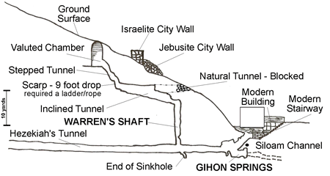
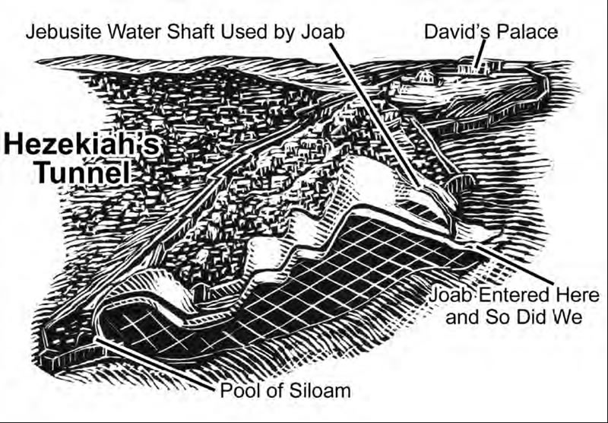
David took the city by telling his army that the only way to enter the fortified city was through the water shaft the Jebusites had cut.
The Jebusites had made an underground passage way for the public to descend in. This public tunnel led to a shaft that served as a well to lower buckets in to draw water up from the Gihon Springs.
1 Chronicles 11:6 says that Joab led David's men into the Gihon Springs, shimmied up the shaft to reach the underground public tunnel. From there they stormed the city.
Hezekiah's Tunnel (the blue stream running underground) was a tunnel chipped out by Hezekiah's men around the year 701 BC. Large groups of Israelites had fled the northern kingdom because of the Assyrians. They moved to Jerusalem. The tunnel was cut by Hezekiah to provide water to these people on the other side of the ridge of the city and to ensure the city had water when the Assyrians invaded Judah and Jerusalem.
"It was Hezekiah who blocked the upper outlet of the Gihon spring and channeled the water down to the west side of the City of David."
Second Chronicles 32:2-4 says that Hezekiah had blocked off the Gihon's springs flow to pools and streams outside the city so that when the Assyrians came they would not find any water around the outside of the city. This water was then diverted into Hezekiah's tunnel that ran under the city into the new pool called the Pool of Siloam. The Bible reads: "When Hezekiah saw that Sennacherib had come and that he intended to make war on Jerusalem, he consulted with his officials and military staff about blocking off the water from the springs outside the city, and they helped him. A large force of men assembled, and they blocked all the springs and the stream that flowed through the land.
'Why should the kings of Assyria come and find plenty of water?' they asked."
"The tunneling was completed. . . While the hewers wielded the ax, each man toward his fellow. . . there was heard a man's voice calling to his fellow. . . the hewers hacked each toward the other, ax against ax, and the water flowed from the spring to the pool, a distance of 1,200 cubits.“
Galyn is the water at the end of Hezekiah's tunnel. This channel of water was formerly thought to be the Pool of Siloam.
In 2004 large stone steps further down the water flow were found. By 2005 the new site for the original Pool of Siloam had clearly been discovered
http://www.generationword.com/Israel/jerusalem_sites/hezekiah_tunnel.html

Slide 21
Set of 6—see instructions in Teachers Manual

