Slide 1
Lesson 7
John the Baptist
Matthew 3
Now this is the commandment: Repent, all ye ends of the earth, and come unto me and be baptized in my name, that ye may be sanctified by the reception of the Holy Ghost, that ye may stand spotless before me at the last day.
3 Nephi 27:20

Slide 2
John the Baptist
His forthcoming birth and the nature of his ministry were announced to John’s father by the angel Gabriel. He was an “Elias”
He was the son of Zacharias and Elisabeth. He was born 6 months before Jesus and he was ordained at the age of 8 days old (D&C 84:28)
He was the child of promise, with prophecies of his mission given by Isaiah and Malachi
He grew up in the desert until the time arrived for his ministry. He preached in Judaea
He was the embodiment of the law of Moses, designed to prepare the way for the Messiah and make ready for the people to receive Him
The sign of the dove was an emblem for the Holy Ghost and a signal which John recognized that he had baptized the Son of God. John also saw and heard the voice of the Father
He preached and baptized several months before he baptized Jesus
John, the Beloved, and his brother Andrew were baptized by John before they met Jesus
He was the forerunner in two gospel dispensations
He criticized Herod’s marriage and was shut in prison, then later he was beheaded by the hand of Herodias, Herod’s wife
(1)

Slide 3
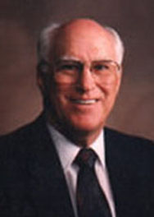
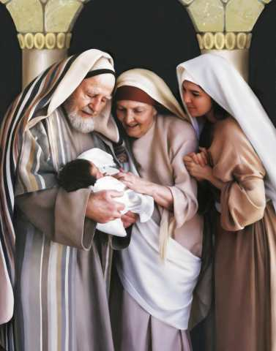
The Aaronic Priesthood
“For he [John] was baptized while he was yet in his childhood, and was ordained by the angel of God at the time he was eight days old unto this power, to overthrow the kingdom of the Jews, and to make straight the way of the Lord before the face of his people, to prepare them for the coming of the Lord, in whose hand is given all power.”
D&C 84:28
The identity of the angel mentioned in the foregoing statement is not revealed. Although John’s father, Zacharias, had the Aaronic Priesthood, he may not have held the proper keys of authority to ordain his son to this particular calling.
Therefore this special authority had to be conferred by this heavenly messenger, who was duly authorized and sent to confer it. John’s ordination was not merely the bestowal of the Aaronic Priesthood, which his father held, but also the conferring of certain essential powers peculiar to the time among which was the authority to overthrow the kingdom of the Jews and ‘to make straight the way of the Lord.’ ”
“The reason Zacharias could not ordain John is because of the fact that John received certain keys of authority which his father Zacharias did not possess.
(2)

Slide 4
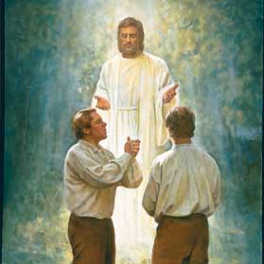
The Aaronic Priesthood Restored
Upon you my fellow servants, in the name of Messiah I confer the Priesthood of Aaron, which holds the keys of the ministering of angels, and of the gospel of repentance, and of baptism by immersion for the remission of sins; and this shall never be taken again from the earth, until the sons of Levi do offer again an offering unto the Lord in righteousness. D&C 13:1
The messenger who visited us on this occasion and conferred this Priesthood upon us, said that his name was John, the same that is called John the Baptist in the New Testament, and that he acted under the direction of Peter, James and John, who held the keys of the Priesthood of Melchizedek, which Priesthood, he said, would in due time be conferred on us, and that I should be called the first Elder of the Church, and he (Oliver Cowdery) the second. It was on the fifteenth day of May, 1829, that we were ordained under the hand of this messenger, and baptized. (JS—H 1:72)

Slide 5
The Forerunner
Written about 700 Years Before: Isaiah
“The voice of him that crieth in the wilderness, Prepare ye the way of the Lord, make straight in the desert a highway for our God.”
Isa. 40:3
Written about 400 Years Before: Malachi
Behold, I will send my messenger, and he shall prepare the way before me: and the Lord, whom ye seek, shall suddenly come to his temple, even the messenger of the covenant, whom ye delight in: behold, he shall come, saith the Lord of hosts.
Malachi 3:1
Written about 600-595 BC: Nephi
And he spake also concerning a prophet who should come before the Messiah, to prepare the way of the Lord
1 Nephi 10:7
Written about 559-545 BC: Nephi
And the Lamb of God went forth and was baptized of him; and after he was baptized, I beheld the heavens open, and the Holy Ghost come down out of heaven and abide upon him in the form of a dove.
1 Nephi 11:27
Wherefore, I would that ye should remember that I have spoken unto you concerning that prophet which the Lord showed unto me, that should baptize the Lamb of God, which should take away the sins of the world.
2 Nephi 31:4
Matthew 11:10; John 7:27
(1)

Slide 6
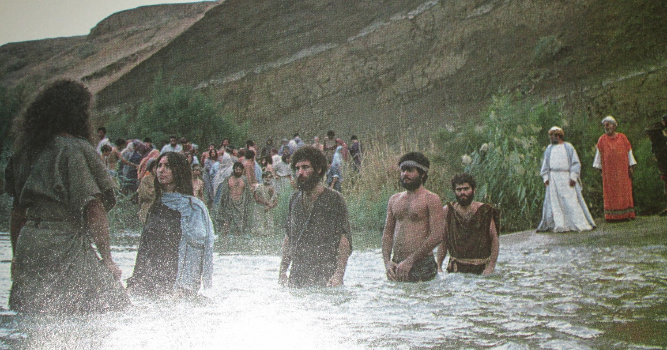
John Preaches
The people whom John taught were willing to confess their sins and be baptized
Being willing to confess one’s sins to Heavenly Father and, when necessary, to designated priesthood leaders is essential to repentance
Matthew 3:5-6

Slide 7
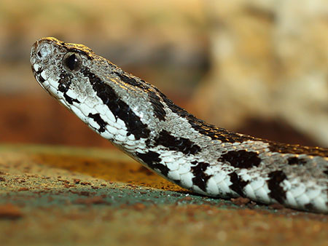
Pharisees VS Sadducees
Generation of Vipers
The Pharisees were a religious group of Jews whose name suggests being separate or apart. They took pride in strictly observing the law of Moses and believed that man-made additions to it, known as the oral law, were as important as the law of Moses itself.
The Sadducees were a small but politically powerful group of Jews who believed in obeying the letter of the law of Moses. They did not believe in the doctrine of resurrection or eternal life
Palestinian Viper
Matthew 3:7
(1)

Slide 8
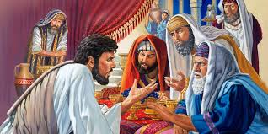
Threatened
The Pharisees and Sadducees felt threatened by John, as he drew many people away from their evil influence and false teachings
Generation of Vipers
34 Why is it that ye receive not the preaching of him whom God hath sent? If ye receive not this in your hearts, ye receive not me; and if ye receive not me, ye receive not him of whom I am sent to bear record; and for your sins ye have no cloak.
35 Repent, therefore, and bring forth fruits meet for repentance;
36 And think not to say within yourselves, We are the children of Abraham, and we only have power to bring seed unto our father Abraham; for I say unto you that God is able of these stones to raise up children into Abraham.
JST Matthew 3:34-36
If the Pharisees and Sadducees rejected John’s word, they would also rejected Jesus
Matthew 3:7
(1)

Slide 9
Bring Forth Fruits
Meet = worthy of—truly repentant
In the scriptures people are sometimes symbolized by trees that produce either good fruit or bad fruit
Matthew 3:7-8 footnote b

Slide 10
We demonstrate true repentance to the Lord as we change our desires and actions to follow His teachings
#!@%*
How might someone think or act if they had repented of these sins?
Matthew 3:8
(1)

Slide 11
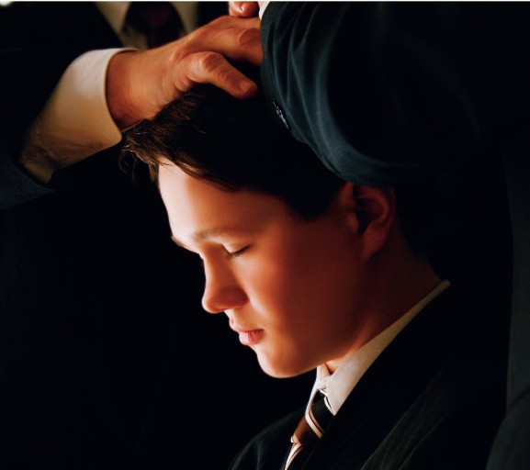
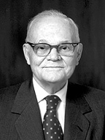
Baptism by Fire
Baptism of fire by the Holy Ghost ‘converts [us] from carnality to spirituality. It cleanses, heals, and purifies the soul. …
Faith in the Lord Jesus Christ, repentance, and water baptism are all preliminary and prerequisite to it, but [the baptism of fire] is the consummation.
To receive [this baptism of fire] is to have one’s garments washed in the atoning blood of Jesus Christ’ (3)
John was referring to receiving the gift of the Holy Ghost, the second half of the covenant and ordinance of baptism.
The Holy Ghost sanctifies and refines our souls as if by fire
Matthew 3:11

Slide 12
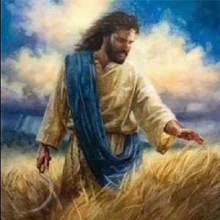
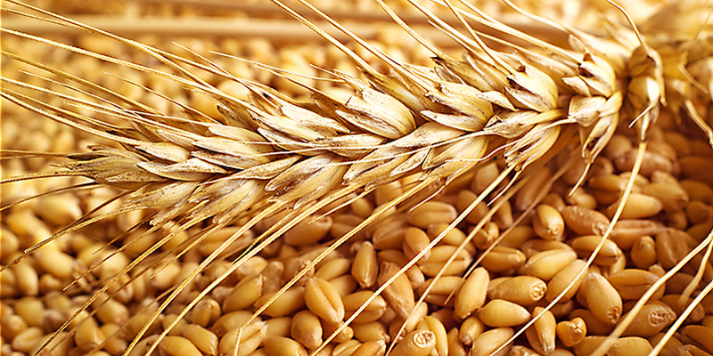
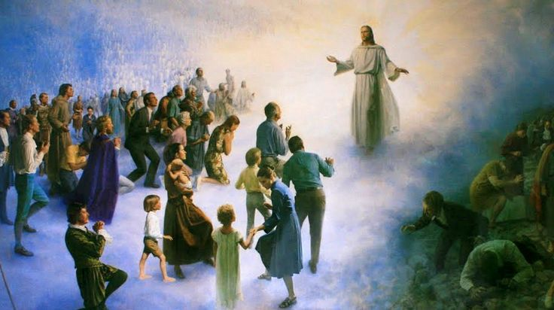
Separating Believers from Non-believers
“fan” = is a winnowing fan that was used to toss wheat into the air
Garner = storehouse
The righteous who accept Jesus Christ (the wheat) and to the wicked who reject Him (the chaff).
Matthew 3:12

Slide 13
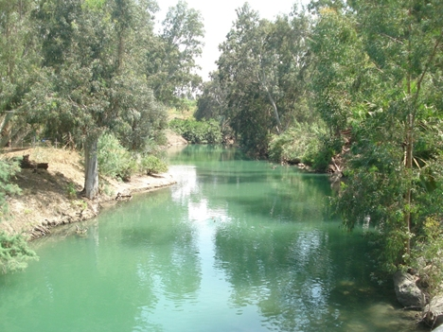
Baptism of Jesus
By Whom?
How?
Why?
John the Baptist
“out of the water” =
By Immersion
“To fulfil all righteousness”
Receiving the ordinances of salvation is a requirement to return to live with Heavenly Father again. By being baptized Jesus set an example by demonstrating humility and obeying the commandments of His Father, and receiving the ordinance necessary to attain eternal life
By Proper Authority
He was covered completely by the water.
Matthew 3:13-17

Slide 14
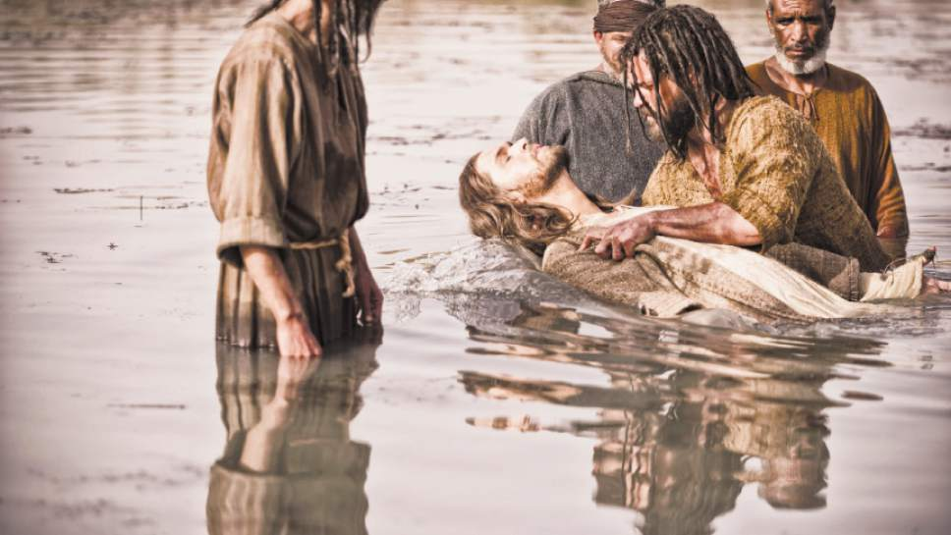
Mightier Than I
Baptism by immersion by one holding authority is essential for salvation.
Cast into fire
Unrepentant individuals lose the influence of the Spirit of God and eventually forfeit the blessings of the celestial kingdom.
The person who is called of God and has authority from Jesus Christ to baptize, shall go down into the water with the person who has presented himself or herself for baptism, and shall say, calling him or her by name: Having been commissioned of Jesus Christ, I baptize you in the name of the Father, and of the Son, and of the Holy Ghost. Amen.
Then shall he immerse him or her in the water, and come forth again out of the water.
D&C 20:73-74
Matthew 3:11
Matthew 3:16

Slide 15
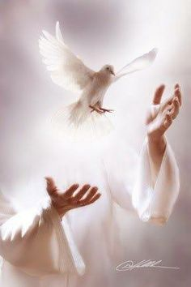
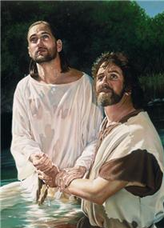
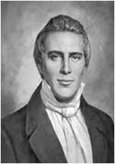
Descending Like a Dove
This is my beloved Son, in whom I am well pleased.
“The sign of the dove was instituted before the creation of the world, a witness for the Holy Ghost, and the devil cannot come in the sign of a dove.
The Holy Ghost is a personage, and is in the form of a personage.
It does not confine itself to the form of the dove, but in sign of the dove.
The Holy Ghost cannot be transformed into a dove; but the sign of a dove was given to John to signify the truth of the deed, as the dove is an emblem or token of truth and innocence” (4)
Liz Lemon Swindle
Matthew 3:16-17

Slide 16
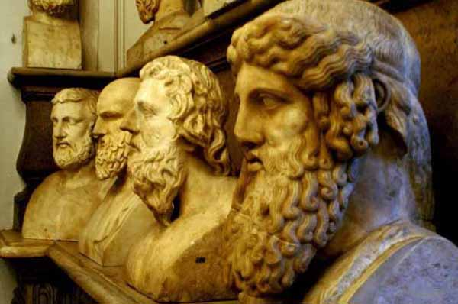
Three distinct and Separate Persons
We believe in God, the Eternal Father, and in His Son, Jesus Christ, and in the Holy Ghost
“We believe these three divine persons constituting a single Godhead are united in purpose, in manner, in testimony, in mission. … I think it is accurate to say we believe They are one in every significant and eternal aspect imaginable except believing Them to be three persons combined in one substance, a Trinitarian notion never set forth in the scriptures because it is not true.”
One of the reasons for confusion about the nature of the Godhead is that during the Great Apostasy, “churchmen, philosophers, and ecclesiastical dignitaries” debated the nature of the Godhead and ultimately decided that God was unknowable and incomprehensible
Matthew 3:17
(5)

Slide 17
Sources:
Suggested Song: Baptism pg. 100 Children’s Songbook
Video: “The Baptism of Jesus”
Bible Dictionary
Robert J. Matthews John the Baptist: A Burning and a Shining Light September 1972 Ensign
Marion G. Romney Learning for the Eternities, comp. George J. Romney [1977], 133
Prophet Joseph Smith (Teachings of Presidents of the Church: Joseph Smith [2007], 81).
Elder Jeffrey R. Holland (“The Only True God and Jesus Christ Whom He Hath Sent,” Ensign or Liahona, Nov. 2007, 40)
“The Only True God and Jesus Christ Whom He Hath Sent,” 40–41
Presentation by ©http://fashionsbylynda.com/blog/

Slide 18
John’s Ordination:
“The reason Zacharias could not ordain John is because of the fact that John received certain keys of authority which his father Zacharias did not possess. Therefore this special authority had to be conferred by this heavenly messenger, who was duly authorized and sent to confer it. John’s ordination was not merely the bestowal of the Aaronic Priesthood, which his father held, but also the conferring of certain essential powers peculiar to the time among which was the authority to overthrow the kingdom of the Jews and ‘to make straight the way of the Lord.’ Moreover, it was to prepare the Jews and other Israelites for the coming of the Son of God. This great authority required a special ordination beyond the delegated power that had been given to Zacharias or any other priest who went before him, so the angel of the Lord was sent to John in his childhood to confer it.” Joseph Fielding Smith Answers to Gospel Questions, vol. 5, p. 2.
Matthew 3:7 Viper::
It is the most common poisonous snake in Israel. Vipers are active at night and typically hunt by hiding and then sneaking up on their prey. When they feel threatened, vipers will coil their body, hiss, and strike at their opponents..
Matthew 3:12 Fan::
“The ‘fan’ is a winnowing fan that was used to toss wheat into the air. This allowed the wheat to be separated from the chaff. Wheat kernels would fall back to the ground while the wind blew the lighter chaff away. The wheat was then gathered into a garner, or storehouse, and the chaff was burned with fire. John the Baptist taught that the Savior, who would come after him, would separate believers from nonbelievers in the same way that wheat was separated from chaff (New Testament Student Manual [Church Educational System manual, 2014], 17).

Slide 19
Opening Events in Jesus’ Ministry
Event | Matthew | Mark | Luke | John
Time and Background of John’s Ministry |  |  | 3:1, 2
John and His Message | 3:1-12 | 1:2-8 | 3:3-18
Jesus is Baptized by John | 3:13-17 | 1:9-11 | 3:21-23
Fast and Temptation of Jesus | 4:1-11 | 1:12, 13 | 4:1-13
John Testifies of Jesus |  |  |  | 1:19-34
First Call of Disciples |  |  |  | 1:35-51
First Miracle: Water to Wine at Marriage in Cana |  |  |  | 2:1-11
Jesus Visits Capernaum |  |  |  | 2:12
Source: Horizontal Harmony of the Four Gospels by Thomas M. Mumford

