Slide 2
Describe the Taste

Slide 3
Physical Needs VS Spiritual Needs
What are our responsibilities in feeding ourselves physically?
What are our responsibilities in feeding ourselves spiritually?
Doctrine and Covenants
Book of Mormon
Holy Bible
Some people think the responsibility for gospel learning lies primarily with a teacher. However, much like the example of the food or drink, one person cannot internalize spiritual truths for another. Each of us must learn and apply gospel truths for ourselves in order to receive spiritual strength and growth.

Slide 4
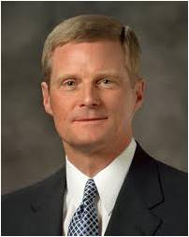
Spiritual learning requires effort on our part.
Spiritual learning requires us to exercise faith and act.
“Learning by faith requires spiritual, mental, and physical exertion and not just passive reception. …
“… A student must exercise faith and act in order to obtain the knowledge for himself or herself”
David A. Bednar

Slide 5
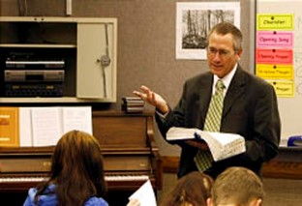
Holy Ghost
To teach the truth.
A teacher, missionary, or leader in the Church has the responsibility to preach the gospel by the Spirit,…
…it is the Holy Ghost who reveals, enlightens, and carries the truth of the gospel into our hearts.
Wherefore, I the Lord ask you this question—unto what were ye ordained?
To preach my gospel by the Spirit, even the Comforter which was sent forth to teach the truth.
D&C 50:13-14
Teacher
Student
To preach the gospel by the Spirit
To receive the word of truth by the Spirit.

Slide 6
Responsibility of the Receiver
And again, he that receiveth the word of truth, doth he receive it by the Spirit of truth or some other way?
If it be some other way it is not of God.
Therefore, why is it that ye cannot understand and know, that he that receiveth the word by the Spirit of truth receiveth it as it is preached by the Spirit of truth?
D&C 50:19-21

Slide 7
Receiving the Spirit
To receive a ball, a person must prepare to catch it. Likewise, we must prepare our hearts and minds to receive truth by the Spirit
How can we prepare Spiritually to receive the Truth?

Slide 8
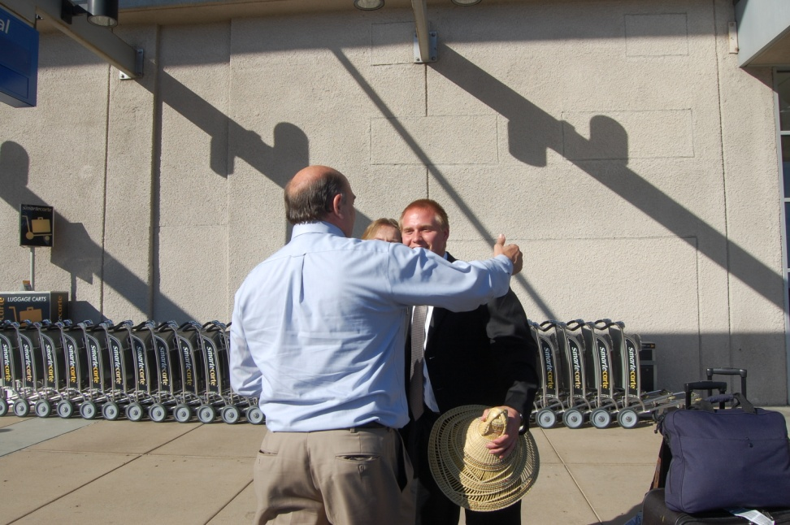
Catching the Spirit
Wherefore, he that preacheth and he that receiveth, understand one another, and both are edified and rejoice together.
D&C 50:22

Slide 9
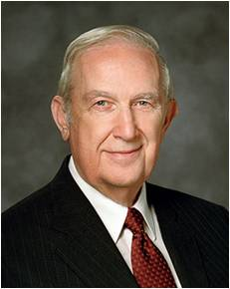
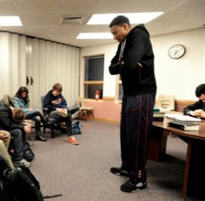
As we exercise our agency to participate in the learning process, we invite the Spirit to teach and testify of truth
“[A learner’s] decision to participate is an exercise in agency that permits the Holy Ghost to communicate a personalized message suited to [his or her] individual needs. Creating an atmosphere of participation enhances the probability that the Spirit will teach more important lessons than [the teacher] can communicate”
Richard G. Scott

Slide 10
“I Have Learned For Myself”
Joseph Smith’s example of learning the truth for himself through scripture reading and sincere desire and prayer
If we diligently study God’s word and act on it in faith, then we can come to know the truths of the gospel for ourselves.

Slide 11
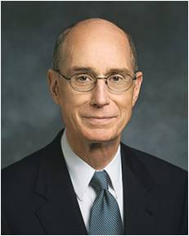
If we become casual in our study of the scriptures, we will become casual in our prayers.
“We may not cease to pray, but our prayers will become more repetitive, more mechanical, lacking real intent. Our hearts cannot be drawn out to a God we do not know, and the scriptures and the words of living prophets help us know Him.”

Slide 12
How Can I Receive the Spirit?
What actions will you take this year to invite the Spirit to teach you and to carry the truths of the gospel into your heart?

Slide 13
Sources:
Video:
Making Seminary a Spiritual Experience (1:47)
The Spirit of Revelation (1:51)
David A. Bednar (“Seek Learning by Faith” [address to CES religious educators, Feb. 3, 2006], 3, lds.org
Richard G. Scott (“To Learn and to Teach More Effectively” [BYU Campus Education Week devotional, Aug. 21, 2007], 4–5, speeches.byu.edu ).
President Henry B. Eyring (“Prayer,” Ensign, Nov. 2001, 17).

Slide 14
Inviting the Holy Ghost
Elder David A. Bednar testified of the connection between learners fulfilling their role and the Spirit’s opportunity to teach and testify:
“A learner exercising agency by acting in accordance with correct principles opens his or her heart to the Holy Ghost—and invites His teaching, testifying power, and confirming witness. … It is in the sincerity and consistency of our faith-inspired action that we indicate to our Heavenly Father and His Son, Jesus Christ, our willingness to learn and receive instruction from the Holy Ghost” (“Seek Learning by Faith” [address to CES religious educators, Feb. 3, 2006], 3, lds.org)
Importance of daily scripture study:
True to the Faith states the following about the importance of daily scripture study:
“Latter-day prophets counsel us to study the scriptures every day, both individually and with our families. They encourage us, as Nephi encouraged his brethren, to liken the scriptures to ourselves, finding ways that the sacred accounts of old apply in our lives today (see 1 Nephi 19:23–24). They exhort us to ‘search the scriptures’ (John 5:39) and ‘feast upon the words of Christ’ (2 Nephi 32:3).
“You will benefit greatly by following this counsel. Daily, meaningful scripture study helps you be receptive to the whisperings of the Holy Ghost. It builds your faith, fortifies you against temptation, and helps you draw near to your Heavenly Father and His Beloved Son.
“Develop a plan for your personal study of the scriptures. Consider setting aside a certain amount of time each day to study the scriptures. During that time, read carefully, being attentive to the promptings of the Spirit. Ask your Heavenly Father to help you know what He would have you learn and do.
“Continue reading the scriptures, particularly the Book of Mormon, throughout your life. You will rediscover the treasures of the scriptures again and again, finding new meaning and application in them as you study them at different stages of life” (True to the Faith: A Gospel Reference [2004], 156).
Importance of Prayer
President Henry B. Eyring of the First Presidency said:
“If we become casual in our study of the scriptures, we will become casual in our prayers.
“We may not cease to pray, but our prayers will become more repetitive, more mechanical, lacking real intent. Our hearts cannot be drawn out to a God we do not know, and the scriptures and the words of living prophets help us know Him” (“Prayer,” Ensign, Nov. 2001, 17).
Other quotes

