Slide 1
Lesson 71
“…Thy Brother Shall Live.”
A Power Over Death
John 11
Yea, and are willing to mourn with those that mourn; yea, and comfort those that stand in need of comfort, and to stand as witnesses of God at all times and in all things, and in all places that ye may be in, even until death, that ye may be redeemed of God, and be numbered with those of the first resurrection, that ye may have eternal life. Mosiah 18:9
Presentation by ©http://fashionsbylynda.com/blog/

Slide 2
What are some ways people’s faith in Jesus Christ may be affected as they experience trials?

Slide 3
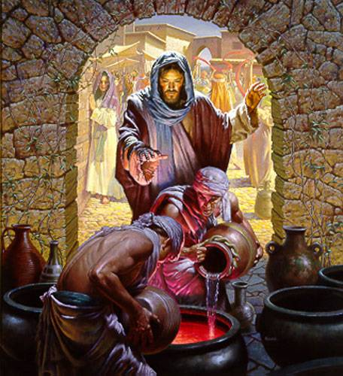
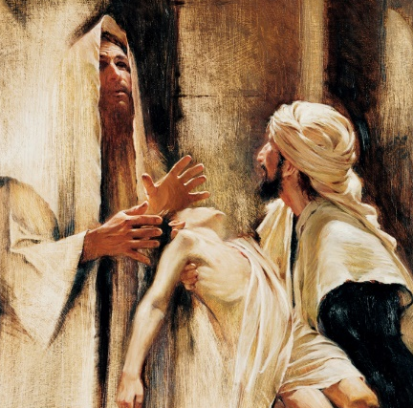
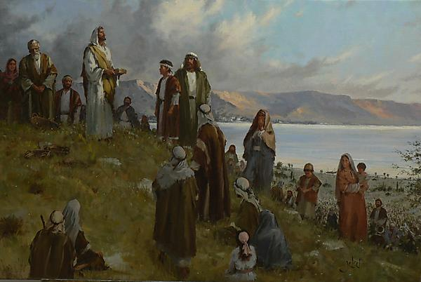
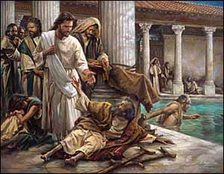
7 Miracles in John
Turning water to wine
(John 2:1–11)
Healing a nobleman’s son (John 4:46–54)
Healing of an invalid at the pool of Bethesda
(John 5:1–15)
Feeding the five thousand
(John 6:1–14)
Walter Rane
Power to create or to change something from one condition to another
Power to restore us to health
Brian Jekel
Nathan Greene
Power to create in order to satisfy physical hunger
Power to heal us both physically and spiritually

Slide 4
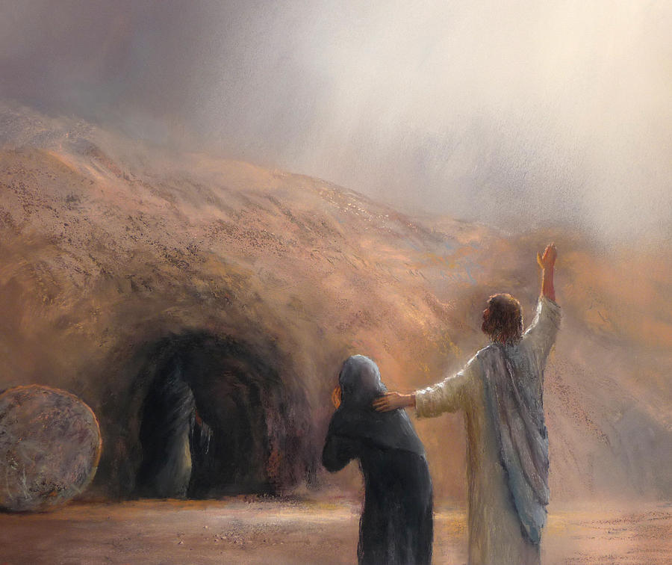
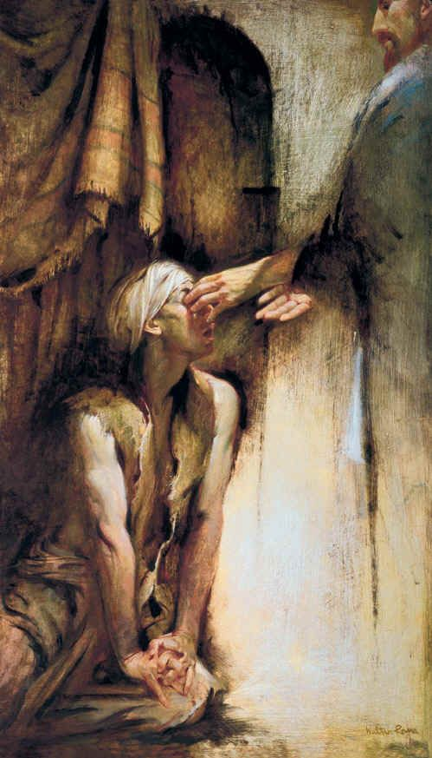
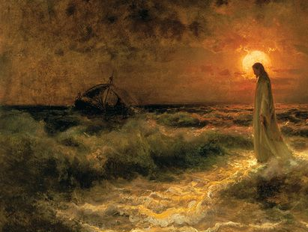
7 Miracles in John
Healing a man born blind
(John 9:1–7)
Raising Lazarus from the dead
(John 11:1–45)
Walking on water
(John 6:16–21)
JOHANN VON KLEVER
Power over nature
James R C Martin
Walter Rane
Power over physical death
Power over physical sight

Slide 5
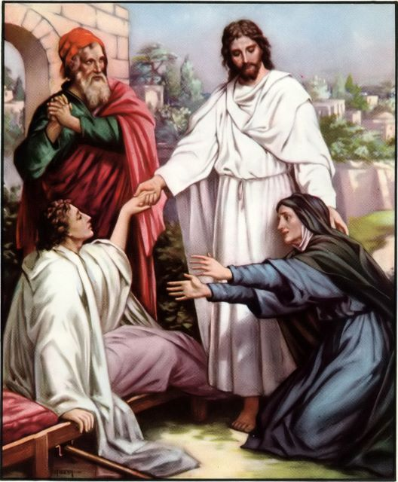
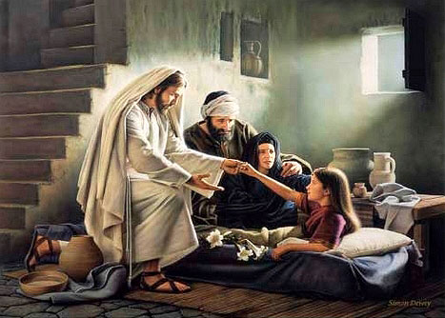
Previously…
The Savior had brought two individuals back to life:
The daughter of Jairus
And the son of the widow of Nain.
Luke 8:41–42, 49–56; Luke 7:11-17

Slide 6
Lazarus, brother of Mary and Martha
John 11:1

Slide 7
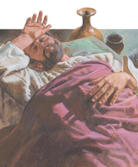
“…behold, he whom thou lovest is sick.”
A message was sent by Mary and Martha to Jesus
Bethabara
Bethany
Jesus was in Bethabara of Perea, which was approximately a day’s journey from Bethany.
It would have taken at least one day for a person to bring this message to Jesus and another day for Jesus to travel to Bethany.
John 11:3; John 1:28; 10:40

Slide 8
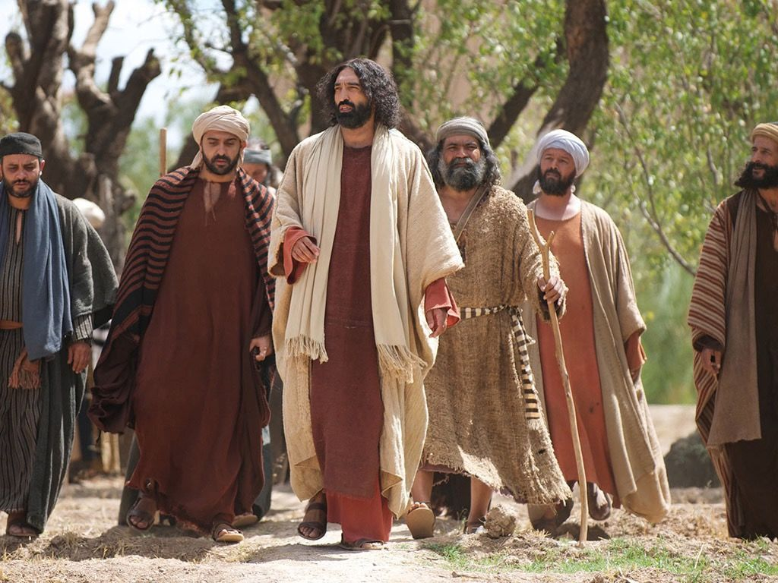
An Expectation?
Was Jesus willing to immediately travel to Bethany and heal Lazarus;
or perhaps speak and heal him from a distance, as Jesus had done for a nobleman’s son
“…this sickness is not unto death, but for the glory of God, that the Son of God might be glorified thereby.”
The Savior decided to stay where He was for two days before departing to visit the ailing Lazarus.
John 11:4

Slide 9
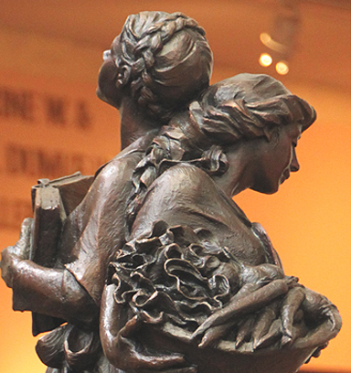
This statement Jesus said was probably the word sent back to the sisters.

Slide 10
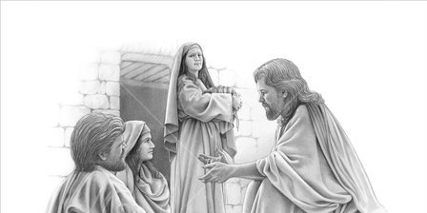
“Now Jesus loved Martha, and her sister, and Lazarus.”
John 11:5

Slide 11
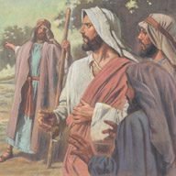
“When he had heard therefore that he was sick, he abode two days still in the same place where he was.”
Jesus with full knowledge of Lazarus' sickness, did nothing to prevent his death; [and] allowed his body to be prepared for burial; (2)
Was this a test of faith for Mary and Martha?
John 11:6

Slide 12
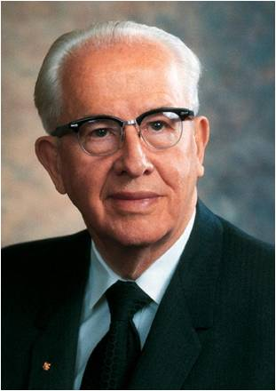
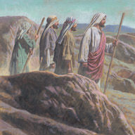
“…let us go to Judaea”
"The custom among the Jews was to bury their deceased on the same day of death; they held a superstition that the spirit lingered around the body for three days and then departed on the fourth day.
Jesus was very familiar with their beliefs, and He therefore delayed His arrival in Bethany until Lazarus had been in the grave for four days.
In that way there would be no question about the miracle He was to perform." (3)
John 11:7

Slide 13
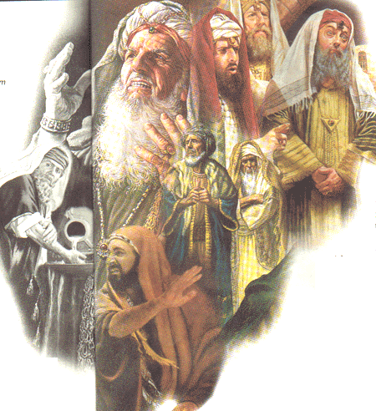
“…the Jews of late sought to stone thee…”
“Certainly Jesus would go to Judea in spite of the threats of death that faced him there.
‘Though it be the eleventh hour of my life, yet there are twelve hours in the day, and during that designated period, I shall do the work appointed me without stumbling or faltering.” (2)
John 11:8

Slide 14
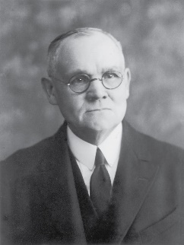
“…If any man walk in the day, he stumbleth not, because he seeth the light of this world.”
"Jesus made clear to them that He was not to be deterred from duty in the time thereof, nor should others be; for as He illustrated, the working day is twelve hours long; and during that period a man may walk without stumbling, for he walks in the light, but if he let the hours pass and then try to walk or work in darkness, he stumbles.
It was then His day to work, and He was making no mistake in returning to Judea." (4)
John 11:9

Slide 15
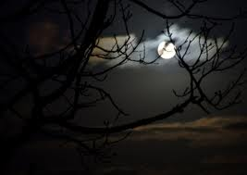
“But if a man walk in the night, he stumbleth, because there is no light in him.”
“This is the time given me to do my work. I cannot wait for the night when perchance the opposition will die down.
He that shirks his responsibilities and puts off his labors until the night shall stumble in the darkness and fail in his work.’” (2)
John 11:10

Slide 16
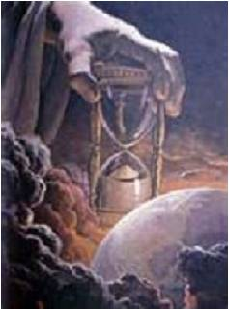
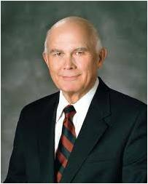
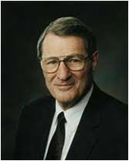
The Lord’s Time Table
“The first principle of the gospel is faith in the Lord Jesus Christ. Faith means trust—trust in God’s will, trust in His way of doing things, and trust in His timetable. We should not try to impose our timetable on His. ”
“‘The issue for us is trusting God enough to trust also His timing. If we can truly believe He has our welfare at heart, may we not let His plans unfold as He thinks best? …’ “Indeed, we cannot have true faith in the Lord without also having complete trust in the Lord’s will and in the Lord’s timing.”
John 11:10
(5)

Slide 17
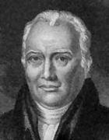
“Our friend Lazarus sleepeth; but I go, that I may awake him out of sleep.”
It was very common among the Jews to express death by sleep…falling asleep—sleeping with their fathers…
The Hebrews probably used this form of speech to signify their belief in the immortality of the soul, and the resurrection of the body.
It is certain that our Lord received no intimation of Lazarus's death from any person, and that he knew it through that power by which he knows all things.
Then they also which are fallen asleep in Christ are perished. 1 Corinthians 15:18
(6)
John 11:11

Slide 18
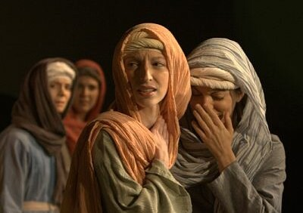
“Lazarus is dead”
4 days
“Decomposition was well under way; death had long since been established as an absolute certainty. …
To the Jews the term of four days had special significance; it was the popular belief among them that by the fourth day the spirit had finally and irrevocably departed from the vicinity of the corpse.” (2)
John 11:12-15

Slide 19
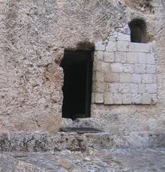
In ancient times depicted in the bible, people buried their dead in various ways.
Sometimes bodies were buried in the dirt, but most often, bodies were buried in caves that were naturally occurring or chiseled out of rock.
The way people sealed the tomb depended on the type of tomb, and also upon who they buried inside.

Slide 20
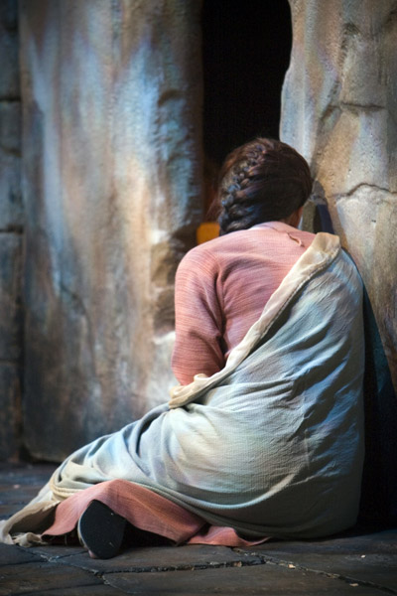
A burial took place, if possible, on the same day. The body was laid without coffin on a bier, and carried out beyond the town walls to the place of burial.
The tomb was visited by family and friends for at least the first three days.
Tombs were carefully marked and generally kept whitewashed in order that people might not be defiled by walking over them unawares.
Matt. 23:27; Luke 11:44
(7)

Slide 21
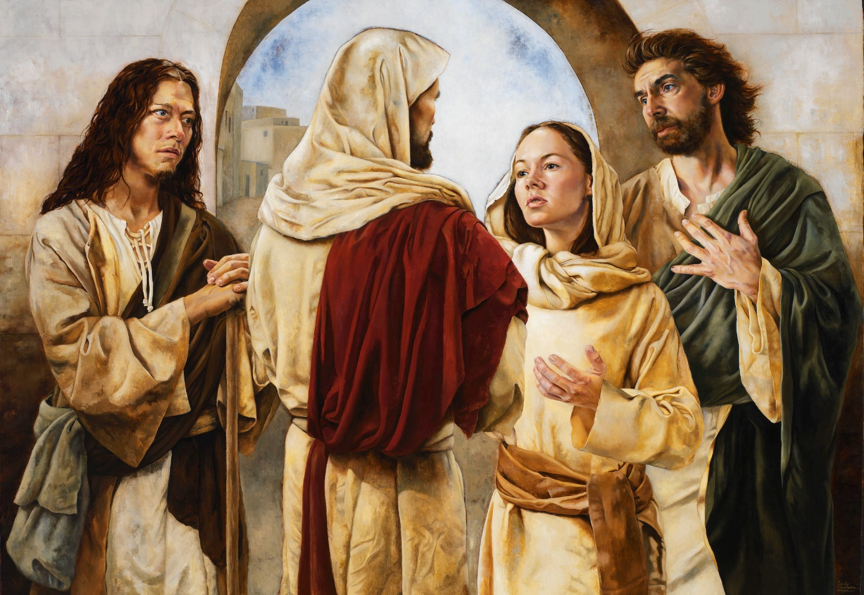
“…Thy Brother Shall Rise”
John 11:24

Slide 22
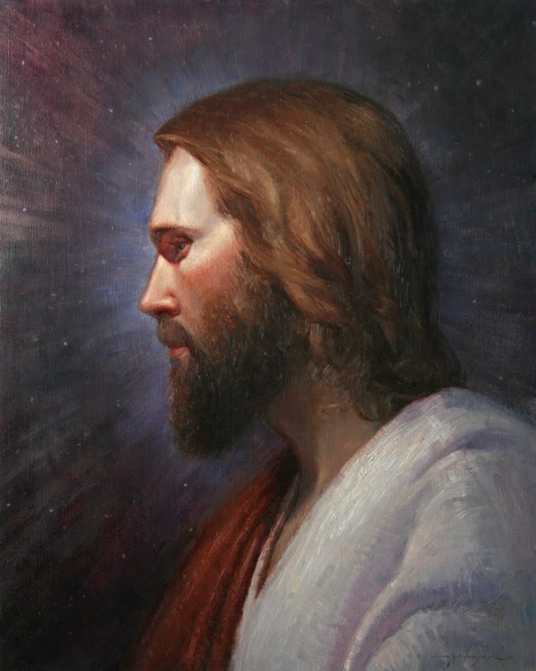
“…I am the resurrection, and the life; he that believeth in me, though here dead, yet shall he live…”
John 11:25

Slide 23
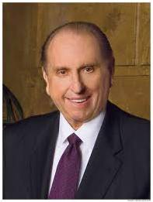
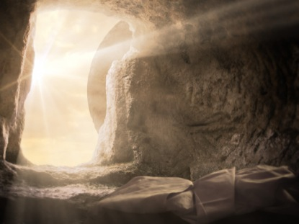
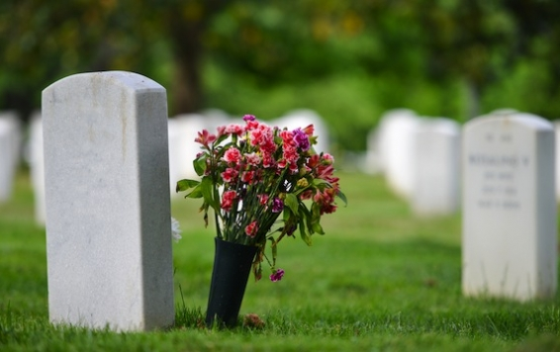
“Frequently death comes as an intruder. It is an enemy that suddenly appears in the midst of life’s feast, putting out its lights and gaiety. Death lays its heavy hand upon those dear to us and at times leaves us baffled and wondering.
In certain situations, as in great suffering and illness, death comes as an angel of mercy. But for the most part, we think of it as the enemy of human happiness.
“The darkness of death can ever be dispelled by the light of revealed truth.”
“This reassurance—yes, even holy confirmation—of life beyond the grave could well provide the peace promised by the Savior when He assured His disciples: ‘Peace I leave with you, my peace I give unto you: not as the world giveth, give I unto you. Let not your heart be troubled, neither let it be afraid.’” (John 14:27)
John 11:25-27
(8)

Slide 24
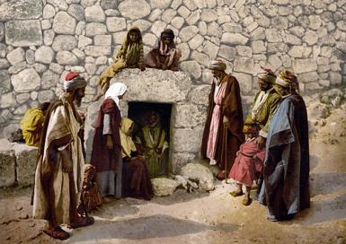
“And whosoever liveth and believeth in me shall never die. Believest thou this?
"This raising of Lazarus from the dead is thus a witness, for all the world and through all the eternities, that the Man who did it is the resurrection and the life; that immortality and eternal life come by him; that he is the Son of the Living God." (2)
John 11:26

Slide 25
Faith of the Sisters
“…Yea, Lord; I believe that thou art the Christ, the Son of God, which should come into the world.”
“…Lord, if thou hadst been here, my brother had not died.”
Martha testified that she knew her brother, Lazarus, would rise again in the Resurrection.
Her knowledge was expressed in her testimony to the Savior on this occasion.
Mary also knew that if He would have been there her brother would have been saved.
John11:27, 32

Slide 26
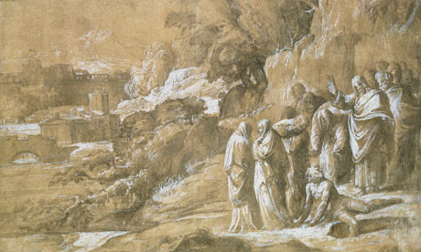
“…Jesus was not yet come into town…”
As the Jewish burying places were without their cities and villages, it appears that the place where our Savior was, when Martha met him, was not far from the place where Lazarus was buried. (6)
John 11:30

Slide 27
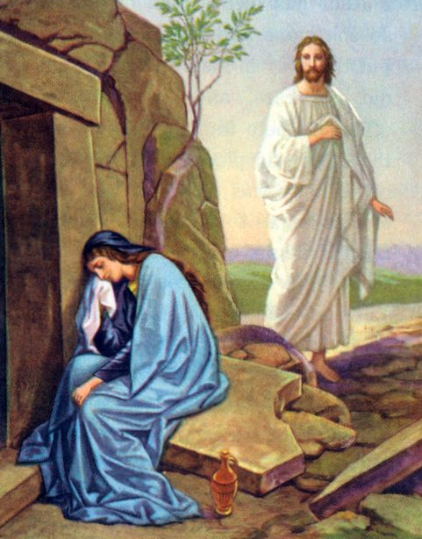
“…When Jesus saw her weeping, and the Jews also weeping which came with her, he groaned in the spirit, and was troubled.”
Jesus shows himself to be truly man; and a man, too, who, notwithstanding his amazing dignity and excellence, did not feel it beneath him to sympathize with the distressed, and weep with those who wept. (6)
Read Mosiah 18:9
John 11:33

Slide 28
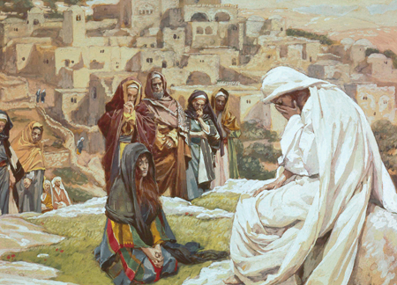
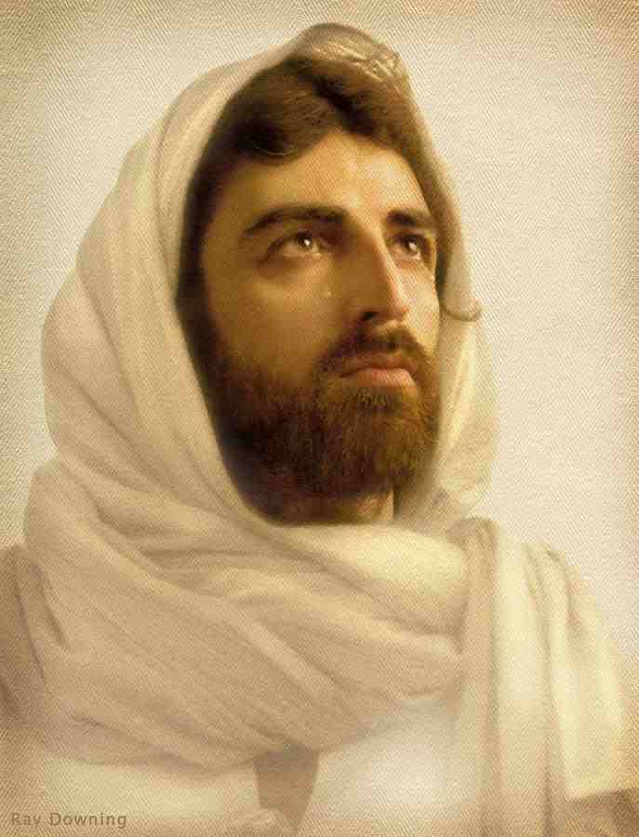
“Jesus wept.”
The Jews presumed that Jesus wept because he was sad that Lazarus was dead. Such was not the case, for he knew that Lazarus would be raised from the dead in only five minutes.
Others have presumed that Christ wept because of his love and tender feelings for Mary and Martha. Certainly, he "mourned with those that mourned, and comforted those that stood in need of comfort," (Mosiah 18:9) but Christ knew that this mourning would shortly be turned into joy.
Although Jesus Christ knew that He would raise Lazarus from death, His tears on this occasion show His compassion for all those who suffer and mourn.
John 11:36
(9)

Slide 29
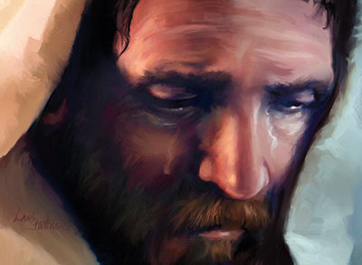
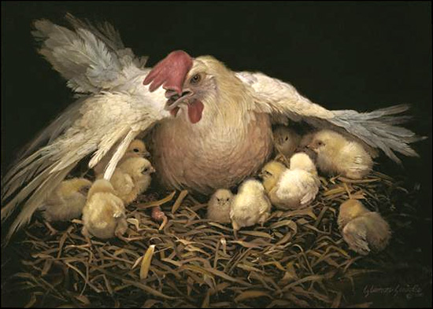
Those Who Still Don’t Believe
The greatest tragedy of the story of Lazarus is that some of the Jews who would witness this miracle would still not believe. Jesus knows that the leaders of the Jews will hate him even more for performing this miracle.
Jesus wept at the wickedness of those who could witness the raising of Lazarus and yet would not repent. He wept over the wickedness of Jerusalem (Lu. 19:41)
and lamented that they would not be gathered together, 'even as a hen gathereth her chickens under he wings'
O Jerusalem, Jerusalem, thou that killest the prophets, and stonest them which are sent unto thee, how oftenwould I have gathered thy children together, even as a hen gathereth her chickens under her wings, and ye would not! Matthew 23:27
John 11:36-37
(9)

Slide 30
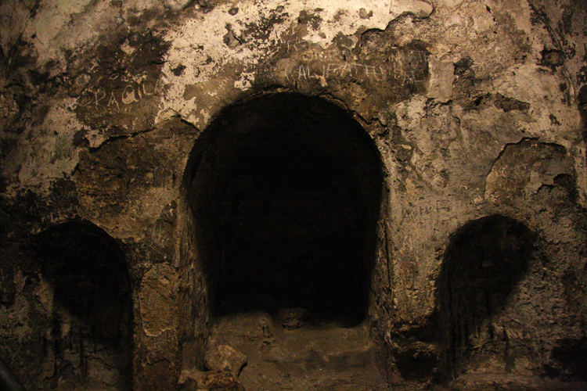
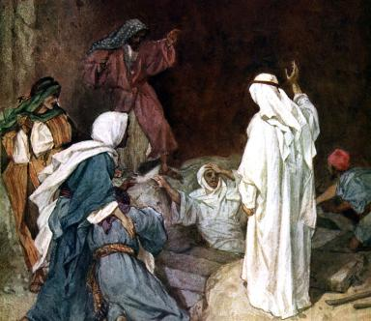
“…Take ye away the stone…”
Why didn’t Jesus remove the stone, why didn’t he unwrap the corpse?
In raising Lazarus from the dead after four days, Jesus showed that He has power over death in a way that Jews could not deny or misinterpret.
John 11:38-39

Slide 31
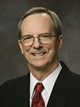
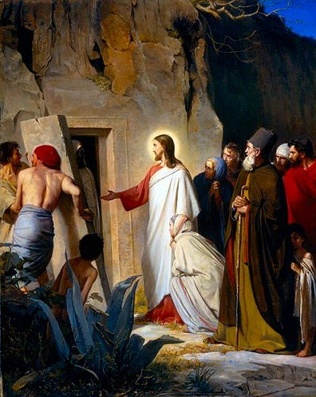
A man must do all he can and when he has reached his limits, when he has asserted all his mental, moral, and spiritual energies, then will the powers of heaven intervene.
Man could remove the stone and unwrap the body, so he must do it; but only the power of God could call the dead to life.”
John 11:38-39
(10)

Slide 32
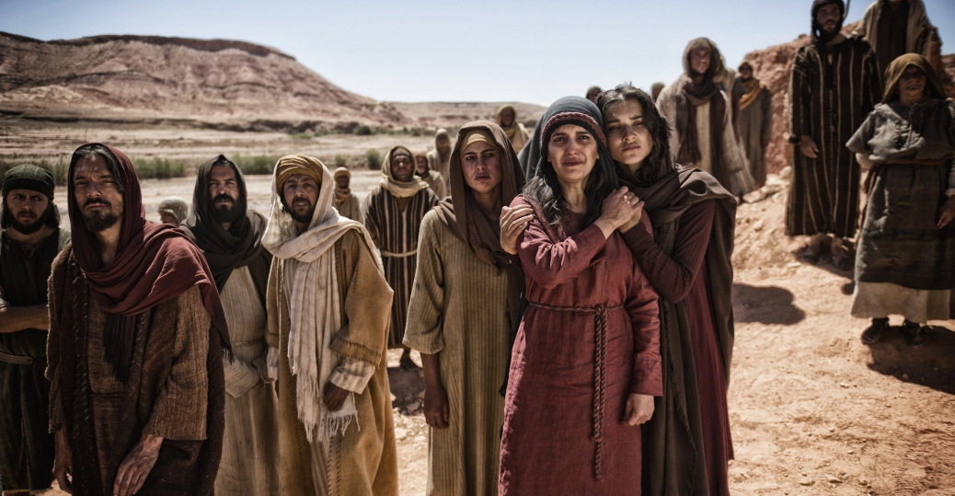
“…said I not unto thee, that, if thou wouldest believe, thou shouldest see the glory of God?”
John 11:40

Slide 33
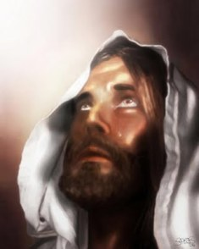
“…they took away the stone from the place where the dead was laid. And Jesus lifted up his eyes, and said, Father, I thank thee that thou hast heard me.”
John 11:41-42

Slide 34
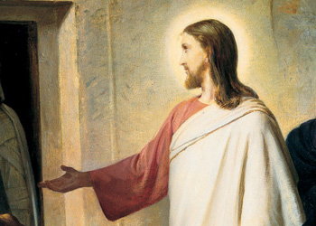
“…Lazarus, come forth.”
"The passage of time has not altered the capacity of the Redeemer to change men's lives. As He said to the dead Lazarus, so He says to you and me:
'Come forth.‘…
A Message to Us:
…Come forth from the despair of doubt. Come forth from the sorrow of sin. Come forth from the death of disbelief. Come forth to a newness of life. Come forth."
John 11:43
(8)

Slide 35
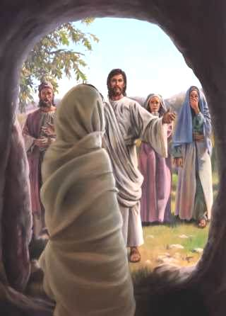
“And he that was dead came forth, bound hand and foot with graveclothes…”
John 11:44

Slide 36
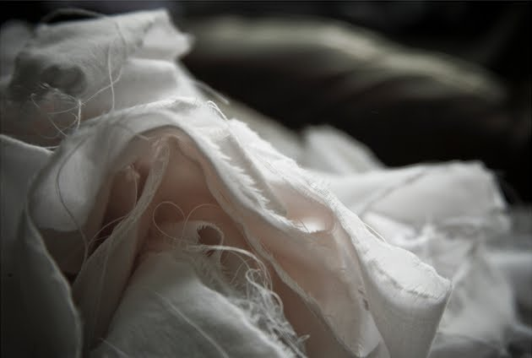
Graveclothes
Jewish Custom
After death the body was washed, covered with spices, and wound round and round with long cloths of linen or other material.
(7)

Slide 37
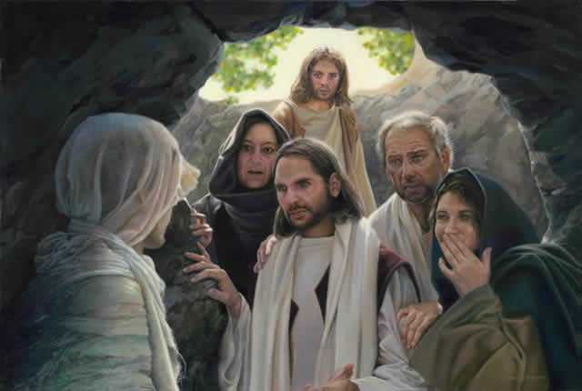
“…Loose him, and let him go.”
John 11:44

Slide 38
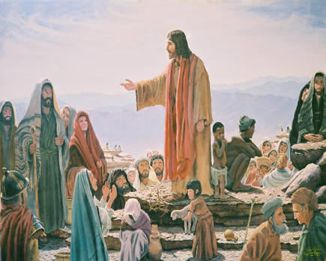
“…many of the Jews which came to Mary, and had seen the things which Jesus did, believed on him.”
If we choose to exercise faith in Jesus Christ during our trials, then our faith in Him will be confirmed and deepened
“But some of them went their ways to the Pharisees, and told them what things Jesus had done.”
John 11:45-46

Slide 39
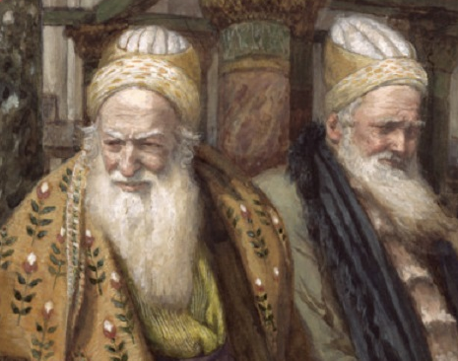
Caiaphas, the high priest, advocated that Jesus should be killed to prevent their nation’s destruction by the Romans.
He also unwittingly prophesied of the effects the death of Jesus would have on God’s children.
The Jewish leaders determined to put Jesus to death and commanded that those knowing of His whereabouts should notify them so He could be taken.
James Tissot
But because of priestcrafts and iniquities, they at Jerusalem will stiffen their necks against him, that he be crucified. 2 Nephi 10:5
John 11:49-57

Slide 40
Sources:
Suggested Hymn: #68 A Mighty Fortress Is Our God
Video:
Lazarus Is Raised from the Dead
New Testament Institute Student Manual Chapter 25 and 1999 Teacher Resource Manual (New Testament)
Bruce R. McConkie (Doctrinal New Testament Commentary, 3 vols. [Salt Lake City: Bookcraft, 1965-1973], 1: 530-533.) and ("Drink from the Fountain," Ensign, Apr. 1975, 71)
Ezra Taft Benson (Come unto Christ [Salt Lake City: Deseret Book Co., 1983], 5.)
James E. Talmage (Jesus the Christ, 491)
Elder Dallin H. Oaks and Neal A. Maxwell (“Timing” [Brigham Young University devotional, Jan. 29, 2002], 2; speeches.byu.edu).
Adam Clarke New Testament Commentary
Bible Dictionary
President Thomas S. Monson (“Now Is the Time,” Ensign, Nov. 2001, 59). And ("The Paths Jesus Walked," Ensign, Sept. 1992, 6)
Gospeldoctrine.com
Tad R. Callister page 188 “Inevitable Apostasy”
Presentation by ©http://fashionsbylynda.com/blog/

Slide 41
Event | Matthew | Mark | Luke | John
Jesus Raises Lazarus from the Dead |  |  |  | 11:1-46
Chief Priest and Pharisees Counsel to Kill Jesus |  |  |  | 11:47-53
Jesus Seeks Refuge in Ephraim |  |  |  | 11:54
7 Miracles in the Gospel of John
MIRACLE | POWER DEMONSTRATED | ASSOCIATED TEACHINGS
Turning water to wine (John 2:1–11) | Power to create or to change something from one condition to another | This “beginning of miracles” may be considered an introduction to the Savior’s teachings to Nicodemus and to the woman at the well in Samaria (see John 3–4). Both individuals experienced a change in their spiritual condition.
Healing a nobleman’s son (John 4:46–54) | Power to restore us to health | This “second miracle”—restoring the nobleman’s son from sickness to health—may be considered a conclusion to the Savior’s teachings recorded in John 3–4, which resulted in both Nicodemus and the Samaritan woman being spiritually healed.
Healing of an invalid at the pool of Bethesda (John 5:1–15) | Power to heal us both physically and spiritually | Jesus Christ will bring to pass the Resurrection of all mankind—the time when all physical problems will be healed—and be the Final Judge of all (see John 5:21–29).
Feeding the five thousand (John 6:1–14) | Power to create in order to satisfy physical hunger | In the Bread of Life discourse, Jesus Christ taught that He is divine and we must believe in Him to have everlasting life (see John 6:25–59). Just as Jesus satisfied physical hunger, He can satisfy spiritual hunger as well.
Walking on water (John 6:16–21) | Power over nature | The Savior can overcome natural elements, and we can have faith that He will help us overcome the natural man; we can walk with Him even when His sayings are hard (see John 6:60–69).
Healing a man born blind (John 9:1–7) | Power over physical sight | Just as the Savior can restore physical sight, He can give spiritual sight to those who believe in Him (see John 9:8–41).
Raising Lazarus from the dead (John 11:1–45) | Power over physical death | Jesus Christ is “the resurrection, and the life” (see John 11:20–32). Through Him, all mankind will live again and can receive eternal life.
New Testament Institute Manual Chapter 25

Slide 42
Difference Between Raising Daughter of Jairus and Son of Widow:
“With ‘our friend Lazarus’ it was different. … Two reasons in particular stand out.
(1) As our Lord neared the climax of his mortal ministry, he was again bearing testimony, in a way that could not be refuted, of his Messiahship, of his divine Sonship, of the fact that he was in very deed the literal Son of God; and
(2) He was setting the stage, so as to dramatize for all time, one of his greatest teachings: That he was the resurrection and the life, that immortality and eternal life came by him, and that those who believed and obeyed his words should never die spiritually.”
Bruce R. McConkie (Doctrinal New Testament Commentary, 3 vols. [1965–73], 1:531).
“I Am the Resurrection” John 11:25-26:
"The whole purpose of the plan of salvation is to provide immortality for all men and to make eternal life available for those who overcome the world and qualify for such a high exaltation. 'For behold, this is my work and my glory,' saith God, 'to bring to pass the immortality and eternal life of man.' (Moses 1:39.) This is accomplished through the redemption of Christ, by virtue of which all men are 'raised in immortality,' thus being redeemed from the temporal fall, and by virtue of which the saints are 'raised [also] unto eternal life,' thus being 'redeemed from their spiritual fall.' (D&C 29:43-44.)
"Immortality/Salvation is in Christ. Immortality comes through him; his resurrection brings to pass the resurrection of all men. Eternal life is his gift to those whose sins he has borne. 'I am the resurrection, and the life,' he said. 'Both immortality and eternal life come because of my atoning sacrifice.' 'He that believeth in me, though he were dead, yet shall he live.' Temporal death and spiritual death are both swallowed up in Christ. 'And whosoever liveth and believeth in me shall never die.' (John 11:25-26.)" Elder Bruce R. McConkie (A New Witness for the Articles of Faith [Salt Lake City: Deseret Book Co., 1985], 153.)
The Light: John 11:9:
Life is the time to fulfill the will of God, and to prepare for glory. Jesus is the light of the world; he that walks in his Spirit, and by his direction, cannot stumble - cannot fall into sin, nor be surprised by an unexpected death. But he who walks in the night, in the darkness of his own heart, and according to the maxims of this dark world, he stumbles - falls into sin, and at last falls into hell. Reader! do not dream of walking to heaven in the night of thy death. God has given thee the warning: receive it, and begin to live to him, and for eternity.) (6)
Graveclothes: John 11:44
These were long slips of linen a few inches in breadth, with which the body and limbs of the dead were swathed, and especially those who were embalmed, that the aromatics might be kept in contact with the flesh. But as it is evident that Lazarus had not been embalmed, it is probable that his limbs were not swathed together, as is the constant case with those who are embalmed, but separately, so that he could come out of the tomb at the command of Christ, though he could not walk freely till the rollers were taken away. But some will have it that he was swathed exactly like a mummy, and that his coming out in that state was another miracle. But there is no need of multiplying miracles in this case: there was one wrought which was a most sovereign proof of the unlimited power and goodness of God. Several of the primitive fathers have adduced this resurrection of Lazarus as the model, type, proof, and pledge of the general resurrection of the dead.
Mourning John 11:19
Mourning, among the Jews, lasted about thirty days: the three first days were termed days of weeping: then followed seven of lamentation. During the three days, the mourner did no servile work; and, if any one saluted him, he did not return the salutation. During the seven days, he did no servile work, except in private - lay with his bed on the floor - did not put on his sandals - did not wash nor anoint himself - had his head covered - and neither read in the law, the Mishnah, nor the Talmud. All the thirty days he continued unshaven, wore no white or new clothes, and did not sew up the rents which he had made in his garments. (6)
Weeping at the Grave John 11:31:
It appears that it was the custom for the nearest relatives of the deceased to go at times, during the three days of weeping, accompanied by their friends and neighbors, to mourn near the graves of the deceased. They supposed that the spirit hovered about the place where the body was laid for three days, to see whether it might be again permitted to enter, but, when it saw the face change, it knew that all hope was now past. It was on this ground that the seven days of lamentation succeeded the three days of weeping, because all hope was now taken away. They had traditions that, in the course of three days, persons who had died were raised again to life. See Lightfoot. (6)

Slide 43
The Messiahship of Jesus John 11:47:
“[The miracle of raising Lazarus] was such irrefutable proof of the Messiahship of Jesus that the Sanhedrin determined Jesus must die because, they said, He ‘doeth many miracles’ which will cause the people to believe (see John 11:47). Sadly, however, John also recorded, ‘But though he had done so many miracles before them, yet [the people] believed not on him’
“Today there are unbelievers among us who would spread seeds of heresy that Jesus could not cast out evil spirits, did not walk on the water or heal the sick or miraculously feed 5,000 or calm storms or raise the dead. They would have you believe that such claims are fantastic or that there is a natural explanation for each alleged miracle. Some have gone so far as to publish psychological explanations for His reported miracles. … But I say, Jesus’ entire ministry was a mark of His divinity. He spoke as God, He acted as God, and performed works which only God Himself can do. His works bear testimony of His divinity” President Ezra Taft Benson(“Five Marks of the Divinity of Jesus Christ,” Ensign, Dec. 2001, 11).
Caiaphas’ Prophecy:
The great miracle of restoring Lazarus to life caused many Jews who witnessed it to believe in Jesus Christ. When word of this reached the Pharisees, they met in council to deal with the threat to their power and influence with the people. Rather than exercising righteous leadership, they employed priestcraft, fulfilling the prophecy of Jacob uttered centuries earlier: “Because of priestcrafts and iniquities, they at Jerusalem will stiffen their necks against him [Jesus Christ], that he be crucified”

