Slide 1
Lesson 72
Miracles – Believe It Or Not
John 12
Not Believe
Believe
For this people’s heart is waxed gross, and their ears are dull of hearing, and their eyes they have closed; lest at any time they should see with their eyes, and hear with their ears, and should understand with their heart, and should be converted, and I should heal them.
Matthew 13:15

Slide 2
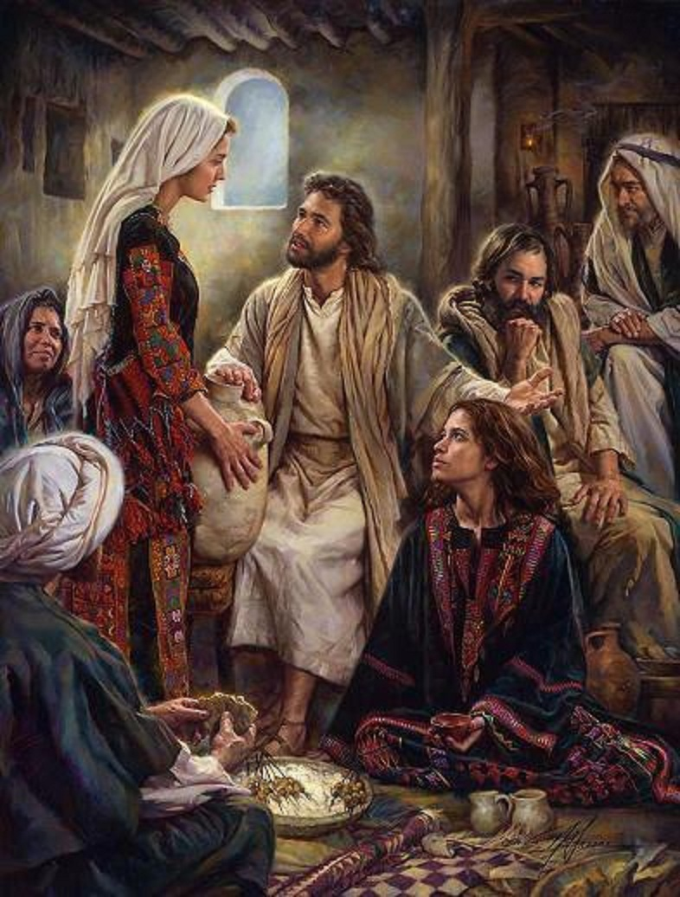
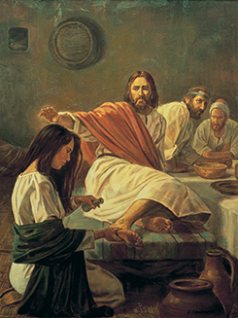
Mary, Martha, and Lazarus
Six days before the Passover, Jesus ate supper with some friends in Bethany.
Mary, the sister of Martha and Lazarus, anointed Jesus’s feet with expensive ointment.
Many people heard that Jesus was in Bethany and came to see Him and Lazarus, whom Jesus had previously raised from the dead.
Robert T. Barrett

Slide 3
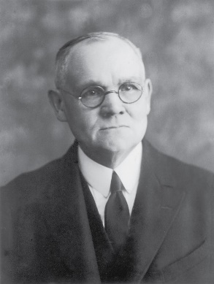
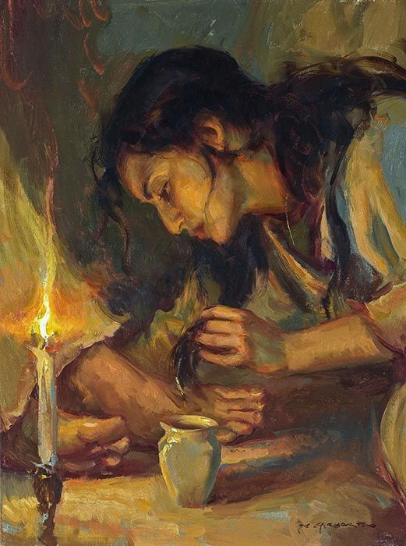
"To anoint the head of a guest with ordinary oil was to do him honor; to anoint his feet also was to show unusual and signal regard; but the anointing of head and feet with spikenard, and in such abundance, was an act of reverential homage rarely rendered even to kings.
Mary's act was an expression of adoration; it was the fragrant outwelling of a heart overflowing with worship and affection."
Daniel F. Gerhartz
(4)

Slide 4
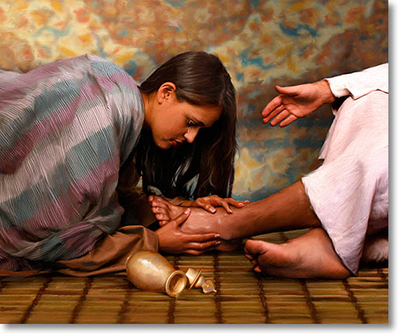
“Here sat the Lord of Heaven, in the house of his friends, as the hour of his greatest trials approached, with those who loved him knowing he was soon to face betrayal and crucifixion.
What act of love, of devotion, of adoration, of worship, could a mere mortal perform for him who is eternal?
Could a loved one do more than David had said the Good Shepherd himself would do in conferring honor and blessing upon another, that is: ‘Thou anointest my head with oil’?
(Psalm 23:5.)”
John 12:3
(3)

Slide 5
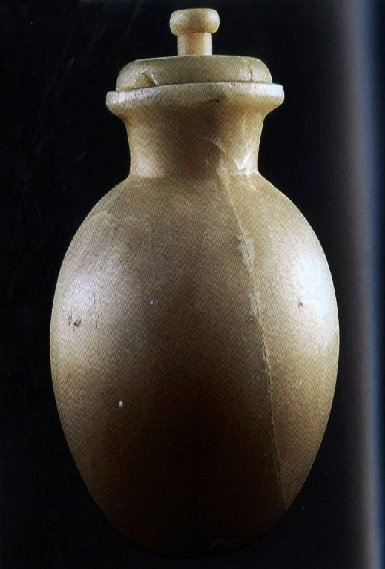
Spikenard
The oil was known in ancient times and was part of the Ayurvedic herbal tradition of India.
It was obtained as a luxury in ancient Egypt, the Near East.
In Rome, it was the main ingredient of the perfume, which was part of the Ketoret used when referring to the consecrated incense described in the Hebrew Bible and Talmud.
It was offered on the specialized incense altar in the time when the Tabernacle was located in the First and Second Jerusalem Temples.
Spikenard, also called nard, nardin, and muskroot, is a class of aromatic amber-colored essential oil derived from Nardostachys jatamansi, a flowering plant of the Valerian family which grows in the Himalayas of Nepal, China, and India. The oil has, since ancient times, been used as a perfume, as a medicine and in religious contexts, across a wide territory from India to Europe.
Pope Francis has included the spikenard in his coat of arms.
(2)

Slide 6
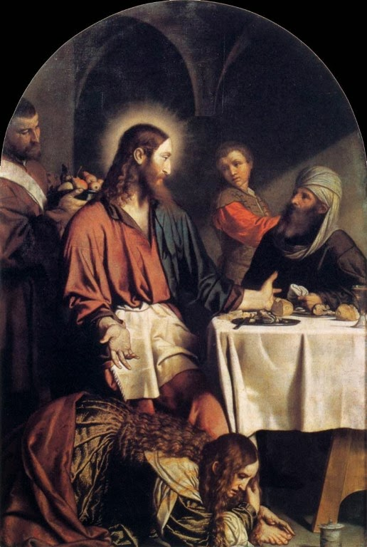
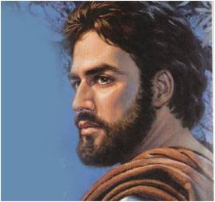
“Let Her Alone”
Mary anointed the feet of Jesus with costly ointment (300 pence was most of an average year’s wages) and then wiped His feet with her hair, underscoring the gratitude she felt for Him.
Judas Iscariot, who would soon sell his soul to Lucifer, protested but only to try to cover up his own thievery.
…for she hath preserved this ointment until now, that she might anoint me in token of my burial”
John 12:7 JST

Slide 7
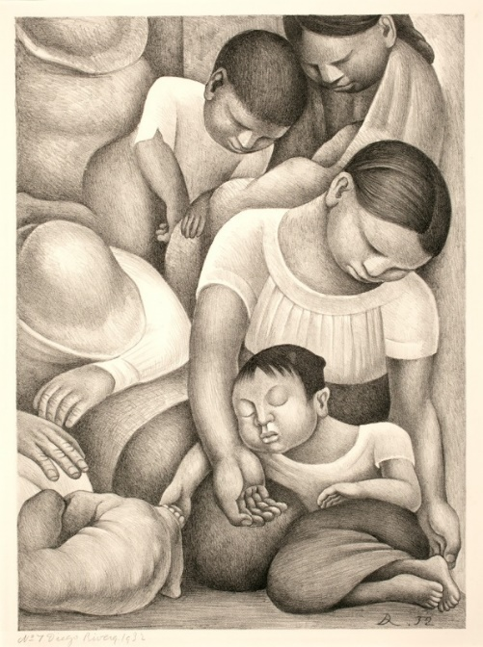
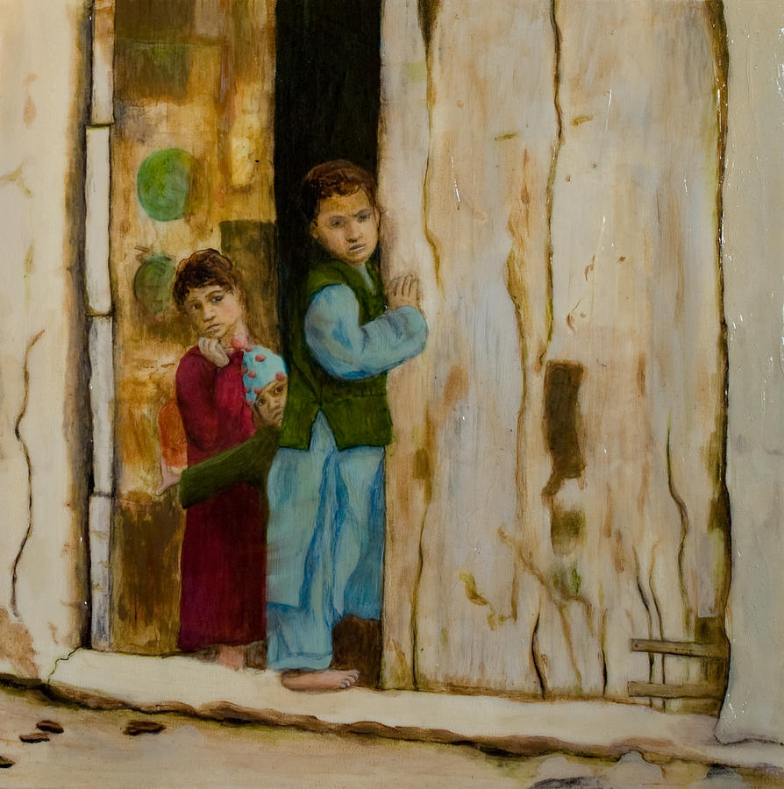
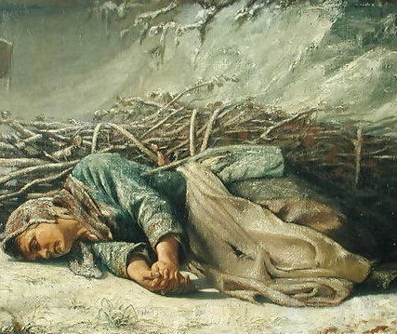
“There Will Be Poor Always”
Take Care of the Poor
We must have the facilities to do so…It is part of the Lord’s plan
Can we say:
“Oh, the Church will take care of that”….
For ye have the poor with you always, and whensoever ye will ye may do them good: but me ye have not always.
Mark 14:7
We need to think as individual, reach down and extend a helping hand without notice, without thanks, without expectation of anything in return, to give of that which the Lord has so generously blessed us.
Diego Rivera
John 12:8
Julia Collard
(5)
Alexandre Antigna

Slide 8
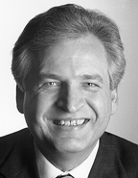
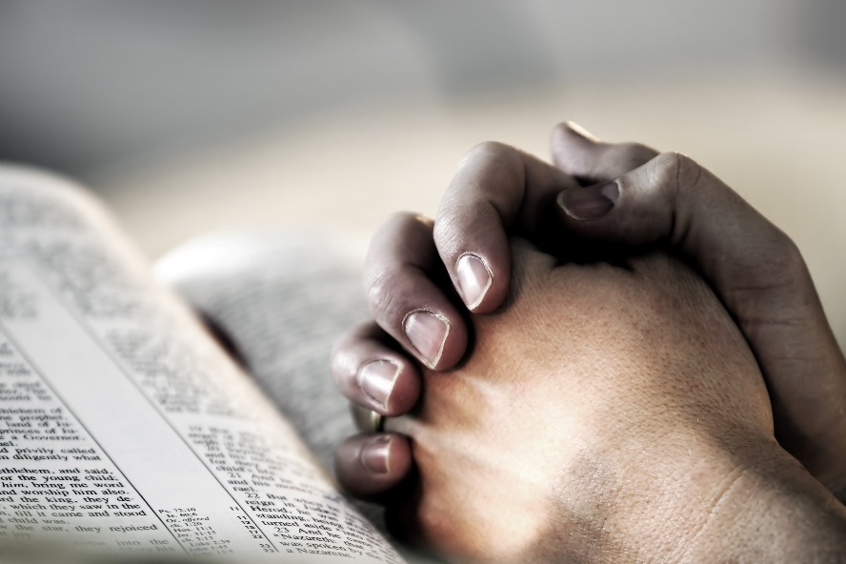
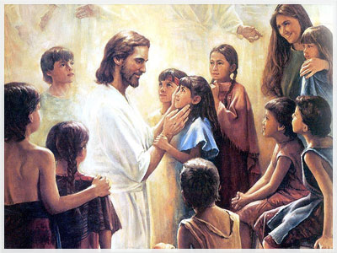
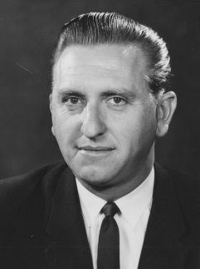
Will We See Jesus?
"Sooner or later, every person who has ever lived on earth will be given a knowledge about the divinity of Jesus Christ...
But knowledge about him is not enough. The knowledge that saves comes from our personal efforts to develop a close companionship with the Lord through prayer and meditation. (6)
The little children have another way of expressing the same wish. Most often they say: 'Tell me the stories of Jesus I love to hear; things I would ask him to tell me if he were here.' (7)
"They seek after Jesus, and so it has ever been. No search is so universal. No undertaking so richly rewarding. No effort so ennobling. No purpose so divine." (8)
John 12:20-21

Slide 9
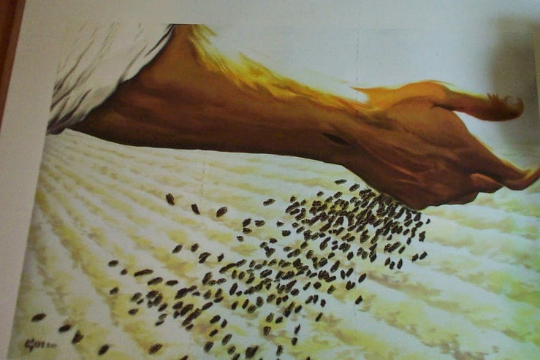
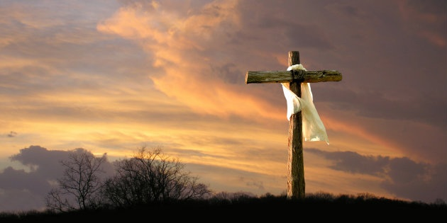
“Corn is the Seed”
Christ died a physical death in order to bring life to all the world
Symbolically, Christ is the seed of the harvest.
He is likened unto a grain of wheat which must die in order to produce its fruit.
Just as a seed is of no value unless it is planted, so Christ's earthly mission would have been almost meaningless without his death and atoning sacrifice.
Anyone who would “lose” his life by serving and following Him would receive eternal life from the Father.
The blessings of the gospel are for all men…the message of salvation would eventually be taken to all the nations of the earth (1)
John 12:24-25
(9)

Slide 10
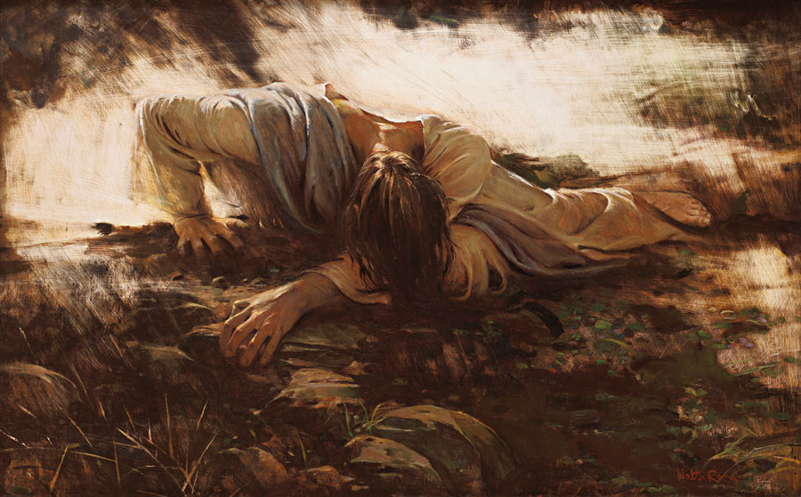
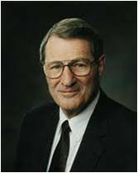
Troubled Soul
And he taketh with him Peter and James and John, and began to be sore amazed, and to be very heavy;
And saith unto them,
My soul is exceeding sorrowful unto death: tarry ye here, and watch.
Mark 14:33-34
Walter Rane
"Imagine, Jehovah, the Creator of this and other worlds, 'astonished'! Jesus knew cognitively what He must do, but not experientially. He had never personally known the exquisite and exacting process of an atonement before. Thus, when the agony came in its fulness, it was so much, much worse than even He with his unique intellect had ever imagined!"
“I … will glorify it again” =
Heavenly Father’s full confidence in His Son that He will complete the Atonement.
John 12:27-28
(10)

Slide 11
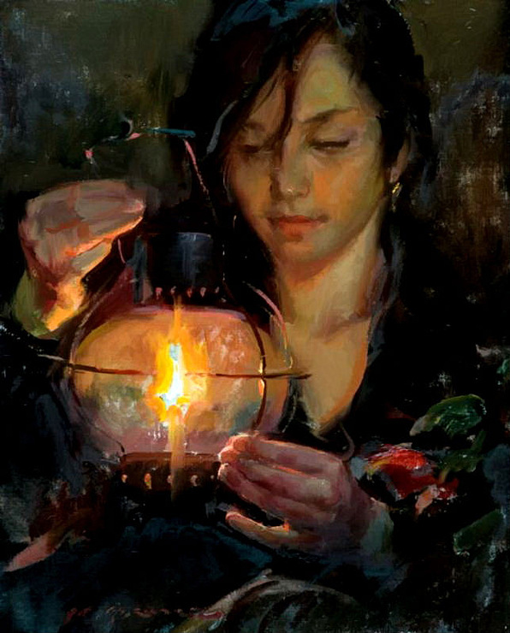
Children of Light
Darkness is absent of Light
We become spiritually begotten of Jesus Christ through accepting the gospel, and in this sense we become his children, or 'children of light.'
Walk while ye have the light
Believe in the light
Daniel Gerhartz
'The coming of the Lord draweth nigh, and it overtaketh the world as a thief in the night-therefore, gird up your loins, that you may be the children of light, and that day shall not overtake you as a thief.' (D&C 106:4-5.)"
John 12:35-36
(11)

Slide 12
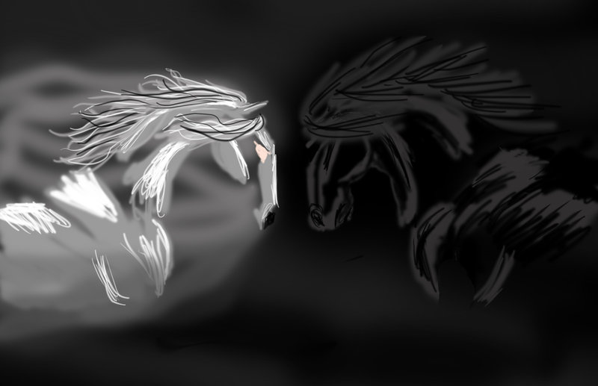
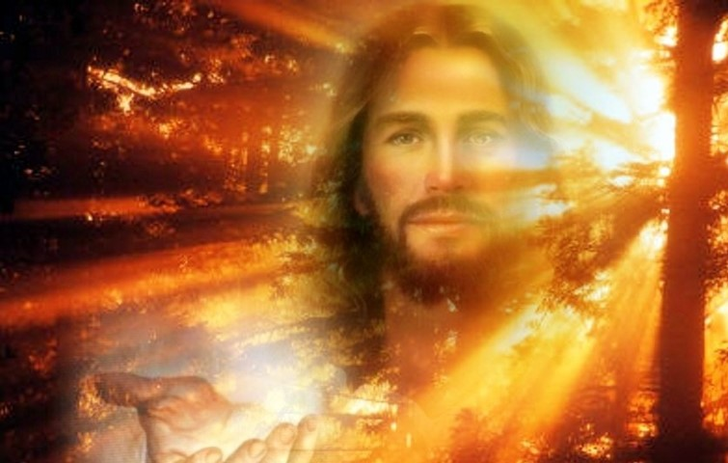
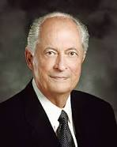
“We are engaged in a battle between the forces of light and darkness.
If it were not for the Light of Jesus Christ and His gospel, we would be doomed to the destruction of darkness.
But the Savior said, ‘I am come a light into the world’. ‘He that followeth me shall not walk in darkness, but shall have the light of life’.
“The Lord is our light and, literally, our salvation. Like the sacred fire that encircled the children in 3 Nephi His light will form a protective shield between you and the darkness of the adversary as you live worthy of it.
You need that light. We need that light”
John 12:46; Psalm 27:1; John 8:12; 3 Nephi 17:24
(13)

Slide 13
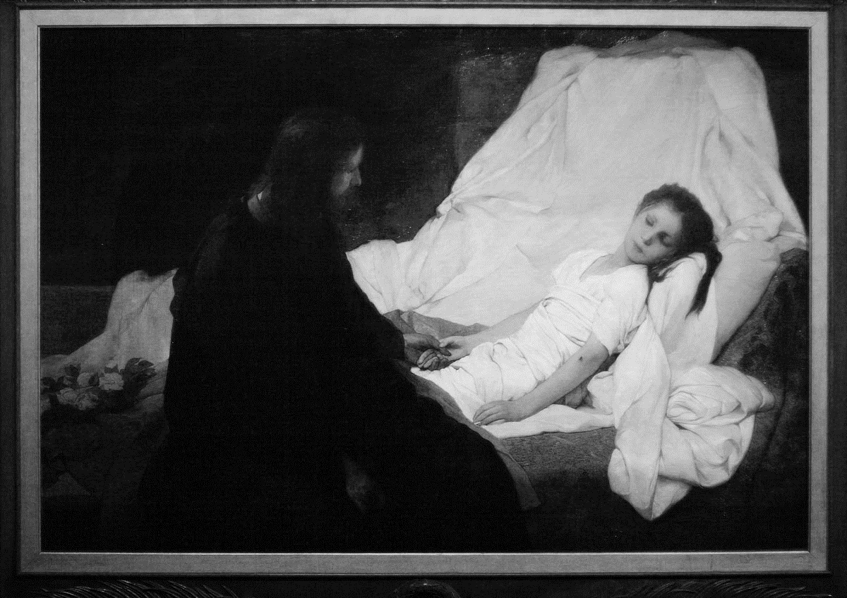
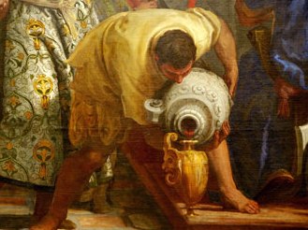
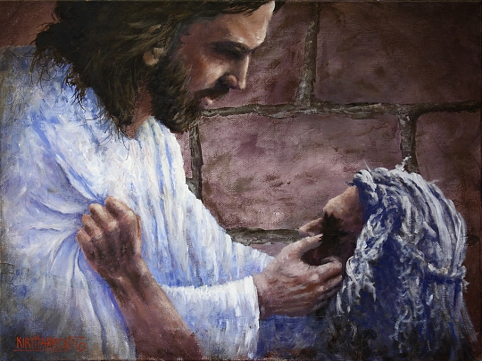
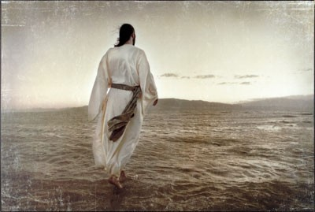
Believe Or Not
And he said, Go, and tell this people, Hear ye indeed, but understand not; and see ye indeed, but perceive not.
Make the heart of this people fat, and make their ears heavy, and shut their eyes; lest they see with their eyes, and hear with their ears, and understand with their heart, and convert, and be healed. Isaiah 6:9-10
Miracles alone do not cause us to believe in Jesus Christ
John 12:38-41

Slide 14
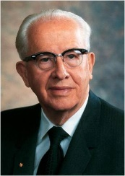
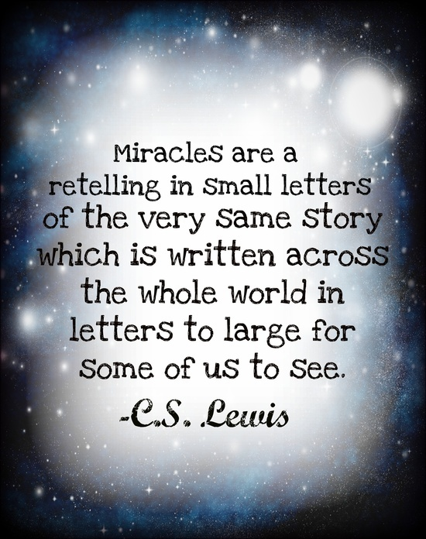
"Today some unbelievers among us spread seeds of heresy, claiming that Jesus could not cast out evil spirits and did not walk on water nor heal the sick nor miraculously feed five thousand nor calm storms nor raise the dead.
These would have us believe that such claims are fantastic and that there is a natural explanation for each alleged miracle.
Some have gone so far as to publish psychological explanations for His reported miracles. But Jesus' entire ministry was a mark of His divinity.
He spoke as God, He acted as God, and He performed works that only God Himself can do. His works bear testimony to His divinity.“
(12)
John 12:38-41

Slide 15
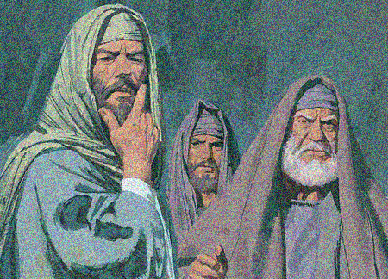
Can You Not Believe?
Why did some chief rulers not openly acknowledge their belief in Jesus?
“The fear of man bringeth a snare: but whoso putteth his trust in the Lord shall be safe” Proverbs 29:25
John 12:42-43
Paul Mann
(11)

Slide 16
Danger
There is danger in making decisions based on what others think about us
“Every time we make choices in our lives, we should weigh the ultimate effect our decisions will have on our goal of attaining eternal life. …
“We make poor and irrational decisions if we are motivated by fear: fear of man, fear of not being popular, fear of failure, fear of public opinion.”
Caring more about pleasing others than pleasing God can prevent us from openly acknowledging our belief in Jesus Christ and His gospel.
John 12:42-43
(13)

Slide 17
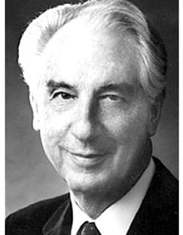
Spiritual Light
Spiritual Darkness
What dangers can come from living in spiritual darkness?
The Lord is my light and my salvation; whom shall I fear? the Lord is the strength of my life; of whom shall I be afraid?
Psalm 27:1
Satan is most anxious to capture our hearts and place us in bondage to him to draw us into spiritual darkness. (14)
He . . . is the author of all sin. And behold, he doth carry on his works of darkness . . . from generation to generation according as he can get hold upon the hearts of the children of men. [Helaman 6:30]
If we believe in Jesus Christ, we do not have to live in spiritual darkness
If ye will turn to the Lord with full purpose of heart, and put your trust in him, and serve him with all diligence of mind, if ye do this, he will, according to his own will and pleasure, deliver you out of bondage. [Mosiah 7:33]
John 12:44-46
(13)

Slide 18
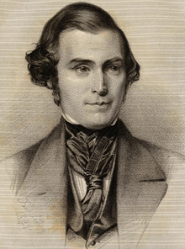
The Word of God
For I have not spoken of myself; but the Father which sent me, he gave me a commandment, what I should say, and what I should speak.
"Jesus Himself, though He was sent by His Father, and came forth from God, did not presume to teach of Himself, or perform anything pertaining to the work of the ministry, without first obtaining a revelation from the Father to direct Him.”
John 12:47-50
(14)

Slide 19
Sources:
Suggested Hymn: #134 I Believe in Christ
Video: The Hope of God's Light (6:46)
New Testament Institute Student Manual Chapter 25
Wikipedia
Elder Bruce R. McConkie (Doctrinal New Testament Commentary, 1:700).
James E. Talmage (Jesus the Christ, p. 512.)
President Gordon B. Hinckley (General Authority Training Meeting, April 2, 1996.)" (Teachings of Gordon B. Hinckley [Salt Lake City: Deseret Book Co., 1997], 459.)
David A. Whetten, "Sir, We Would See Jesus,"Ensign, Oct. 1978, 5-7)
(W. H. Parker, The Children Sing, No. 65.)
Elder Thomas S. Monson (Conference Report, October 1965, Afternoon Meeting 141.)
Gosepldoctrine.com
Elder Neal A. Maxwell ("Willing to Submit,“ Ensign, May 1985, 72-73)
Excerpts from Jo Ann H. Seely, Studies in Scripture, Vol. 6: Acts to Revelation, ed. by Jackson and Millet, 163.
President Ezra Taft Benson (Come unto Christ[Salt Lake City: Deseret Book Co., 1983], 6.)
Elder Robert D. Hales (“Out of Darkness into His Marvelous Light,” Ensign, May 2002, 70). And(“Making Righteous Choices at the Crossroads of Life,” Ensign, Nov. 1988, 10–11).
J. Thomas Fyans BYU Speeches Cycle of Life April 10, 1988
(Orson Pratt's Works [Salt Lake City: Deseret News Press, 1945], 145 - 146.)

Slide 20
Event | Matthew | Mark | Luke | John
Mary Anoints Jesus at the Home of Simon the Leper | 26:6-13 | 14:3-9 |  | 12:1-8
Many See Lazarus at Bethany and Believe |  |  |  | 12:9-11
Triumphal Entry into Jerusalem and Return to Bethany | 21:1-11 | 11:1-11 | 19:29-44 | 12:12-19
Jesus Testifies of His Death |  |  |  | 12:20-36
Jesus Relationship to His Father |  |  |  | 12:44-50
Jesus Departs from Crowds at the Temple |  |  |  | 12:36
Reaction of People to Jesus’ Teachings |  |  |  | 12:37-43
Robert T. Barrett

Slide 21
Spikenard: John 12:3
Your plants are an orchard of pomegranates With pleasant fruits, Fragrant henna with spikenard, spikenard and saffron, calamus and cinnamon, with every kind of incense tree, with myrrh and aloes, and all the finest spices.
Song of Solomon 4:13-14
Full Article of Pres. Gordon B. Hinckley’s Statement:
"We must take care of the poor. Said the Lord, 'The poor ye have with you always.' (Mark 14:7;John 12:8.) There have always been poor and I guess there always will be poor until the Millennium. We must take care of them and we must have the facilities to do so. But we must be very careful not to over institutionalize that care. We must not shift the burden that we ought to carry in our own hearts of spreading kindness and love and help to others, to the institution, which at best, is impersonal.
"I do not want you to get any idea that I am saying we should not have the welfare program. We must have it. It is a part of the Lord's plan and the good it does is vast and incalculable. But I think there is a tendency among us to say, 'Oh, the Church will take care of that. I pay my fast offering. Let the Church take care of that.' We need as individuals, I think, to reach down and extend a helping hand without notice, without thanks, without expectation of anything in return, to give of that with which the Lord has so generously blessed us. (General Authority Training Meeting, April 2, 1996.)" (Teachings of Gordon B. Hinckley [Salt Lake City: Deseret Book Co., 1997], 459.)
Judas, the Hypocrite: John 12:6
"The dishonest man brings only misery into the world. Look what Judas brought upon himself by not being true! He associated with his Lord and heard the divine truths from his Master's lips. It may be that once he felt in his heart the truth, but he let outside influences come upon him. He let his appetite for greed lead him into dishonesty.
"Following that prompting, he opposed the work of the Master, found fault with conditions around him. Six days before the Passover, Mary, out of the great love in her heart, anointed Jesus with costly oils. Who was it that found fault? Not the honest man in whose heart was the truth; but Judas. And even in his faultfinding, you detect the lie: 'Why was not this ointment sold for three hundred pence, and given to the poor?' (John 12:5.)
"What a dissembler! What a hypocrite! He did not want the money for the poor, 'but,' says one of his companions, 'because he was a thief, and had the bag. . . .' (John 12:6.) He sat at meat with his Lord, near his Master's side, there in the presence of the Divine Man, pretending to be one with him-not only in friendship, but in discipleship; not only that, but a disciple in whom had been placed trust. There at the table eating bread by the side of the Master, he was still untrue and had already bargained to betray his Lord into the hands of his enemies.“ President David O. McKay (Man May Know for Himself: Teachings of President David O. McKay, compiled by Clare Middlemiss [Salt Lake City: Deseret Book Co., 1967], 272.)
Corn as Seed John 12:24:
The Law also required the firstfruits of the field. We might wonder how the firstfruits of the field are symbolic of Christ's life and mission. This passage from John helps to understand the meaning. The Lord tells us that he is likened unto a grain of wheat which must die in order to produce its fruit. Just as a seed is of no value unless it is planted, so Christ's earthly mission would have been almost meaningless without his death and atoning sacrifice. The Law states, 'ye shall bring a sheaf of the firstfuits of your harvest unto the priest: And he shall wave the sheaf before the Lord, to be accepted for you' (Lev. 23:10-11). Symbolically, Christ is the seed of the harvest. Before Elohim is waved the sheaf of Jesus' sacrifice, which will be accepted for us, lest we be punished for our many sins (see DC 19:5-20; 45:3-5).
The latter-day application is that we must follow the Lord's example. Just as Christ died a physical death in order to bring life to all the world, so we must die as to the carnal things of the world so that we can bring forth spiritual fruit
Submitting ourselves John 12:25:
"The submission of one's will is placing on God's altar the only uniquely personal thing one has to place there. The many other things we 'give' are actually the things He has already given or loaned to us. However, when we finally submit ourselves by letting our individual wills be swallowed up in God's will, we will really be giving something to Him! It is the only possession which is truly ours to give. Consecration thus constitutes the only unconditional surrender which is also a total victory." Elder Neal A. Maxwell (If Thou Endure It Well [Salt Lake City: Bookcraft, 1996], 54.)
Mary probably understood that Jesus would be sacrificed. It is doubtful that she understood that exactly one week from her anointing, Jesus body would be taken from the cross and anointed again. Mary anointed Jesus' living head and feet with ointment one Friday evening, and Nicodemus anointed Jesus' dead body with myrrh and aloes the next (Jn. 19:38-39). Mary's privilege was greater, for she anointed the living Christ. She had earned the privilege with faith and devotion which had stood the test of time. Tragically, Nicodemus, one who had feared being put out of the synagogue, was only able to declare his allegiance when the Master was already gone. Gospeldoctrine.com
Glorify John 12:29:
"There has always been to me a great lesson in that incident. We do not always understand the Savior. We do not always understand the messages from heaven. We are not in tune. When the Savior was introduced upon this continent, the Father spoke from heaven. The people heard the noise but did not understand. He spoke again, but they did not understand. Finally, the third time they heard and knew what he said: 'Behold my Beloved Son.' (3 Ne. 11:3-7)." Rueben J. Clark (Conference Report, October 1950, Afternoon Meeting 101 - 102.)

Slide 22
Satan is the Prince of the World John 12:31:
The 'prince of this world' is Satan (see Jn. 14:30; 16:11; DC 127:11). Jesus says 'now' he will be cast out in the sense that Christ's atonement will deny the prince of all his power over death. In another sense, the prince of this world will be literally cast from the earth at the beginning of the Millenium (Rev. 20:1-3). (9)
Corn as Seed John 12:24:
The Law also required the firstfruits of the field. We might wonder how the firstfruits of the field are symbolic of Christ's life and mission. This passage from John helps to understand the meaning. The Lord tells us that he is likened unto a grain of wheat which must die in order to produce its fruit. Just as a seed is of no value unless it is planted, so Christ's earthly mission would have been almost meaningless without his death and atoning sacrifice. The Law states, 'ye shall bring a sheaf of the firstfuits of your harvest unto the priest: And he shall wave the sheaf before the Lord, to be accepted for you' (Lev. 23:10-11). Symbolically, Christ is the seed of the harvest. Before Elohim is waved the sheaf of Jesus' sacrifice, which will be accepted for us, lest we be punished for our many sins (see DC 19:5-20; 45:3-5).
The latter-day application is that we must follow the Lord's example. Just as Christ died a physical death in order to bring life to all the world, so we must die as to the carnal things of the world so that we can bring forth spiritual fruit. (9)
Did Jesus Have to Die? John 12:34:
"Most of Jesus' contemporaries...did not expect that the Messiah would suffer and die. When Jesus taught the crowds in Jerusalem about his impending crucifixion, 'the people answered him, We have heard out of the law that [Messiah] abideth for ever: and how sayest thou, The Son of man must be lifted up?' (John 12:34.)
"Even the Apostles were confused about the sacrificial role of the Messiah. After Peter declared that Jesus was the Messiah, the Son of the living God, Peter presumed to rebuke the Lord for saying that the Messiah 'must go unto Jerusalem, and suffer many things of the elders and chief priests and scribes, and be killed, and be raised again the third day.' (Matt. 16:16, 21-22.)" (Keith Meservy, "This Day Is This Scripture Fulfilled," Ensign, Apr. 1987, 7)
Fears John 12:43-44:
“To not take counsel from our fears simply means that we do not permit fear and uncertainty to determine our course in life. … To not take counsel from our fears means that faith in the Lord Jesus Christ overrules our fears and that we press forward with a steadfastness in Him” Elder David A. Bednar (“Fear Not, I Am with Thee,” BYU–Hawaii commencement address, Dec. 15, 2012; byuh.edu).
Believe Not the Miracles? John 37:
"The viewing of signs or miracles is not a secure foundation for conversion. Scriptural history attests that people converted by signs and wonders soon forget them and again become susceptible to the lies and distortions of Satan and his servants. (Hel. 16:23; 3 Ne. 1:22,12:1) 'How long will this people provoke me?' the Lord said to Moses, 'and how long will it be ere they believe me, for all the signs that I have shewed among them?' (Num. 14:11.)
"Jesus made a triumphal entry into Jerusalem, but John records in sadness, 'Though he had done so many miracles before them, yet they believed not on him.' (John 12:37.)
"In contrast to the witness of the Spirit, which can be renewed from time to time as needed by a worthy recipient, the viewing of a sign or the experiencing of a miracle is a one-time event that will fade in the memory of its witness and can dim in its impact upon him or her. For example, as President Kimball observed, 'Oliver Cowdery saw many signs. He handled the sacred plates; saw John the Baptist; received the higher priesthood from Peter, James, and John, and was the recipient of many great miracles, and yet they could not hold him to the faith.‘ Elder Dallin H. Oaks The Lord's Way [Salt Lake City: Deseret Book Co., 1991], 87.)
To Save the World John 12:47:
"The time of Christ and the apostles was not to be the time of judgment, but of testing; without the opportunity of freely accepting or rejecting, there could be no judgment: 'If I had not done among them the works which none other man did, they had not had sin: but now they have both seen and hated both me and my Father' (John 15:24; italics added). That was the purpose of his preaching to them-to give them the chance, not to convert them no matter what-'That the saying of Esaias the prophet might be fulfilled, which he spake, Lord, who hath believed our report? . . .
"'Therefore they could not believe' (John 12:38-41); 'their ears are dull of hearing, and their eyes they have closed; lest at any time they should see with their eyes, and hear with their ears, and should understand with their heart, and should be converted' (Matthew 13:15).
The world is not going to be converted, but it is going to be judged. The first act of the drama is all a preparation, not for the second act, but for the last one-the second coming and the judgment; on that time and event all the apostles fix their gaze as the reward and vindication of all they are doing. In between lies the dark and dismal interlude of the second act about which the Lord and the apostles have a great deal to say." Hugh Nibley (Mormonism and Early Christianity, 270.)

Slide 23
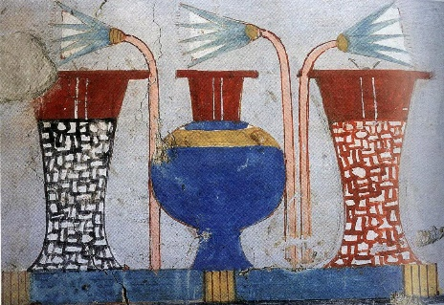
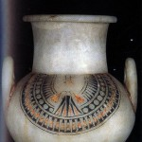
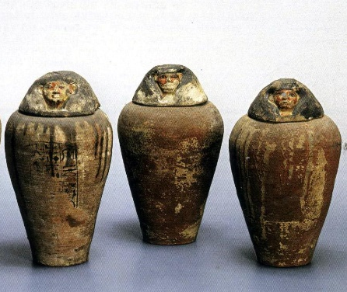
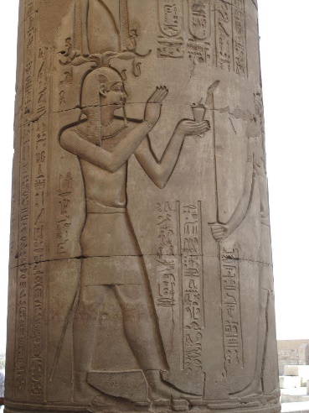
Something of Interest Aromatherapy:
It is believed that ancient Egyptians were the first in the world to invent extraction of flower essences, and they are credited as some of the first perfumers in history. Egyptians were the first civilization to incorporate perfume into their culture.
The roots of aromatherapy lie in ancient civilizations, particularly that of Egypt. The goal of aromatherapy is to provide holistic therapy in such a manner that the body cannot be separated from the mind, soul, or spirit.
Ancient Egyptians were masters of the holistic and believed that beauty, magic, and medicine were inseparable. They recognized body care and beauty to start with cleanliness. Unpleasant smells were associated with impurity, and good smells indicated the presence of the sacred.
In no other country or culture was the concern with body care and beautification so extensive, and it even transcended economic status. Body care was a prerequisite for all Egyptians. It was a common practice for both, men and women, of all classes, to oil their bodies daily as a form of moisturization and protection from the hot arid conditions. Records show that body oil for daily use was one of the basic supplies issued in the form of wages even to the lowest class of workers. Body care and cosmetics were a common daily concern cutting all societal divisions, just as they are today.
Egypt is recognized as the origin for significant development in aromatherapy, and the first distillation of essential oils (dating back to 3500 B.C.) was done in Egypt.
During the 3rd Dynasty (2650-2575 BC) in Egypt, the process of embalming and mummification was developed by the Egyptians in their search for immortality. Frankincense, myrrh, galbanum, cinnamon, cedarwood, juniper berry and spikenard are all known to have been used at some stage to preserve the bodies of their royalty in preparation of the afterlife. Extensive knowledge of Egyptian beauty regime can be credited to the burial customs and arid climate which preserves artifacts well.
One of the first extractions was done with the lotus flower. The lotus flower was growing everywhere along the River Nile and became the symbol of Upper Egypt. Many aromatic substances were necessary for the afterlife, and in ancient Egyptian mythology, the lotus flower essence was believed to help in the resurrection.
During the period between the 18th and the 25th Dynasty (1539-657 BC), the Egyptians continued to refine their use of aromatics in incense, medicine, cosmetics, and finally perfumes. Until just a few hundred years before the birth of Christ, the Egyptian perfumery industry was celebrated as the finest in the whole of the Middle East and beyond.
Evidence of this has been found in the tomb of King Tutankhamon, where the funeral furniture displays the pharaoh’s wife wrapping his body with the lotus oil. It is believed that jars in the tomb contained lotus flower essence (the tomb was robbed during the Late period).
Early graves contained cosmetic implements and later tombs contained sealed, airtight jars. The perfume industry of ancient Egypt was justifiably famous, as the aromas of these jars lingered even after being opened thousands of years later. Many of these jars were made from alabaster, which was known as the finest material for storing scent.
Ancient cosmetic papyrus is filled with mentions of myrrh, marjoram, olibanum, jasmine, rose, cardamom, cinnamon, lemongrass, almond, and other botanical oils. In addition, it is documented that Egyptians had access and used 21 different types of vegetable oils for cosmetic purposes—many of which are still used today in natural products.
There is a great deal of historical evidence that ancient Egyptians used essential oils for medicinal, spiritual, and cosmetic applications to establish the foundation of what we know, today, as modern aromatherapy.
http://areejaromatherapy.com/aromatherapy-in-egypt/

