Slide 1
Lesson 73
Love One Another
John 13
But ye will teach them to walk in the ways of truth and soberness; ye will teach them to love one another, and to serve one another.
Mosiah 4:15
And he commanded them that there should be no contention one with another, but that they should look forward with one eye, having one faith and one baptism, having their hearts knit together in unity and in love one towards another.
Mosiah 18:21
Presentation by ©http://fashionsbylynda.com/blog/

Slide 2
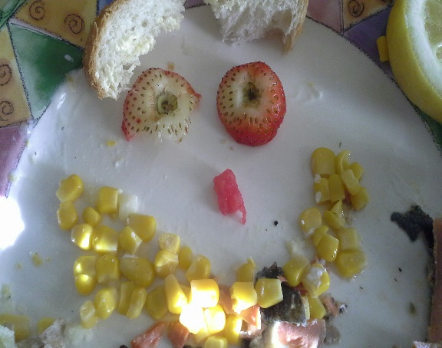
How Happy Are You?
Unhappy
Truly Happy
Where would you place yourself on this continuum?
Would you like to be happier than you currently are?
Can you think of someone whom you would like to help become happier?

Slide 3
The Last Supper
Jesus celebrated the Passover feast with His Apostles.
John 13:1-3

Slide 4
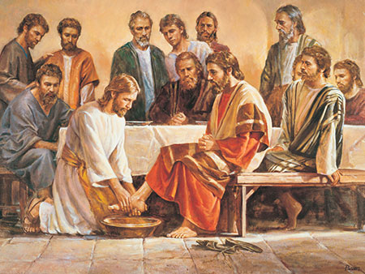
Washing Feet of Apostles
“laid aside his garments” = Jesus took off an outer garment, similar to someone removing a jacket in our day.
“In New Testament times, people wore open sandals, walked on mostly dirt roads that accumulated the filth of beasts, and had only irregular access to bathing water. Their feet became very dirty, and washing another person’s feet could have been a distasteful task. …
This custom of hospitality was usually performed by the lowest level of servants.
Del Parson
“Christ quietly arose, girded himself as a slave or servant would, and knelt to wash the Apostles’ feet” (2)
John 13:4-5

Slide 5
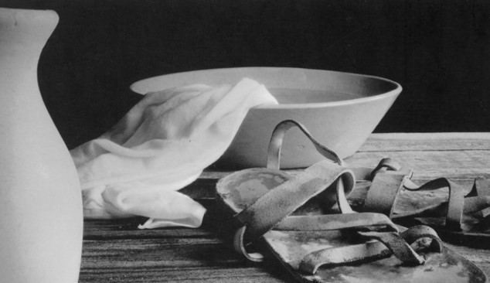
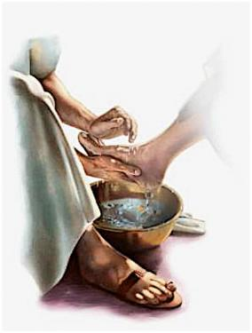
“Washing of feet is a gospel ordinance; it is a holy and sacred rite, one performed by the saints in the seclusion of their temple sanctuaries.
It is not done before the world or for worldly people. For his day and dispensation Jesus instituted it in the upper room at the time of the Last Supper.
“Our Lord did two things in the performance of this ordinance:
1. He fulfilled the old law given to Moses; and
2. He instituted a sacred ordinance which should be performed by legal administrators among his true disciples from that day forward.
“As part of the restoration of all things, the ordinance of washing of feet has been restored in the dispensation of the fulness of times.”
John 13:4-5
(3)

Slide 6
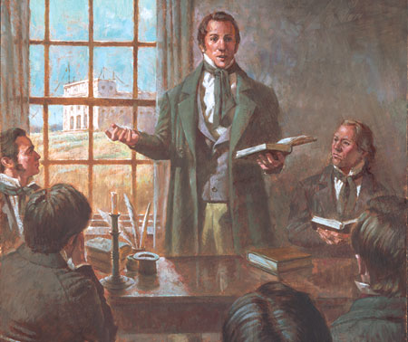
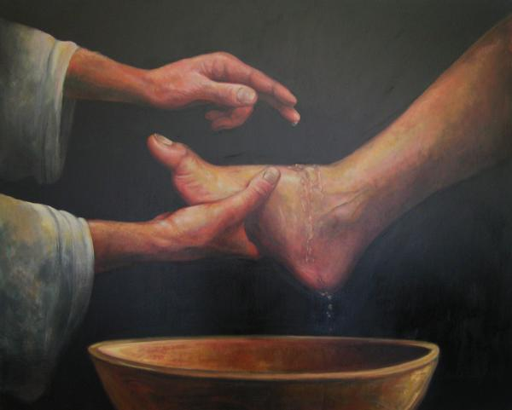
On December 27, 1832, the Prophet Joseph Smith received a revelation that declared:
“Sanctify yourselves; yea, purify your hearts, and cleanse your hands and your feet before me, that I may make you clean” (D&C 88:74).
In that same revelation the Lord commanded the Prophet to organize the School of the Prophets, saying that those who were part of the school.
“And he shall be received by the ordinance of the washing of feet” (D&C 88:139)
“In the case of [the School of the Prophets] the ordinance [of washing of feet] is to be performed by the President of the Church.
In compliance with this revelation the Prophet on January 23, 1833, washed the feet of the members of the school of the prophets.”
John 13:4-5
(4)

Slide 7
“On March 29 and 30, 1836, [in the newly dedicated Kirtland Temple] the leading brethren, including the First Presidency, Council of the Twelve, bishoprics, and presidents of quorums, participated in the ordinance of washing of feet.”
“Thus the knowledge relative to the washing of feet has been revealed step by step in this day until a full knowledge is now incorporated in the revealed ordinances of the Lord’s house.”
John 13:4-5
(3,4)

Slide 8
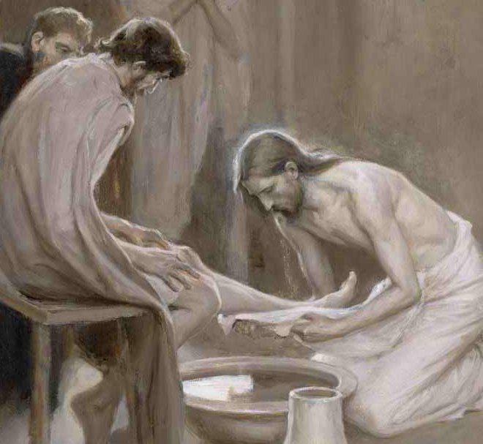
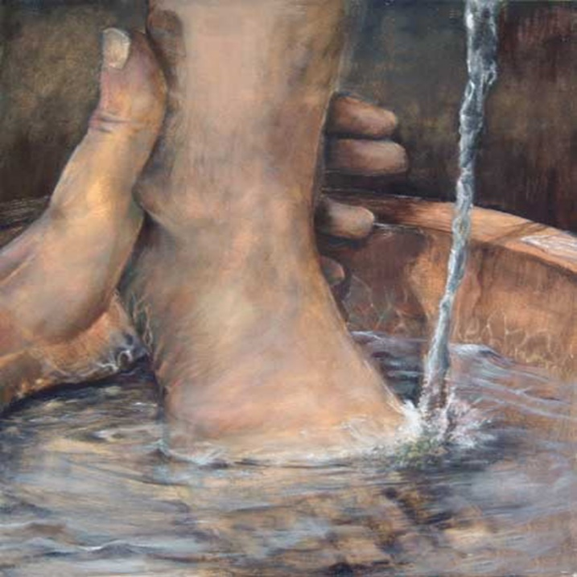
Peter Objects
Lord, dost thou wash my feet?
Peter’s initial rejection of the Master’s offer to wash his feet can be understood in light of the fact that this custom of hospitality was usually performed by the lowest level of servants.
However, when the Savior explained to Peter that having his feet washed was essential to fellowship with Him, Peter then asked for a more complete washing, which the Savior explained was not necessary. Peter’s request illustrates the respect he had for the Lord and his earnest desire to follow Him completely.
John 13:6-10
(4)

Slide 9
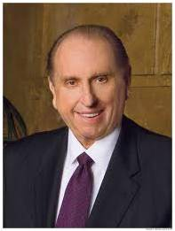
Happy Are Ye If Ye Do Them
Happiness was contingent upon their service to others.
Unhappy
“To find real happiness, we must seek for it in a focus outside ourselves. No one has learned the meaning of living until he has surrendered his ego to the service of his fellow man. Service to others is akin to duty—the fulfillment of which brings true joy.”
Truly Happy
(5)

Slide 10
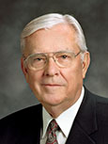
“In your morning prayer each new day, ask Heavenly Father to guide you to recognize an opportunity to serve one of His precious children.
Then go throughout the day with your heart full of faith and love, looking for someone to help.
If you do this, your spiritual sensitivities will be enlarged and you will discover opportunities to serve that you never before realized were possible.”
(6)

Slide 11
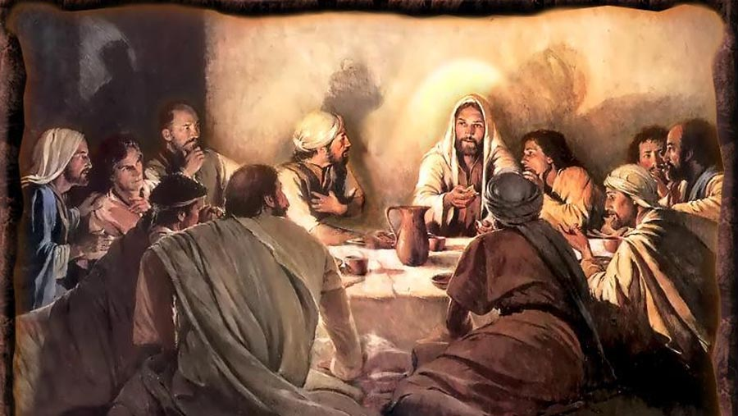
The Betrayer Amongst Them
When Jesus had thus said, he was troubled in spirit, and testified, and said, Verily, verily, I say unto you, that one of you shall betray me.
Leaning on the bosom =
In New Testament times, those dining at formal meals often reclined on low couches placed around tables, leaning on their left arms with their heads toward the table and their feet pointed away from the table.
Therefore, the guest seated to the right of the host would have leaned toward the host. This appears to have been where the Apostle John sat, “leaning on Jesus’ bosom,” or reclining toward Jesus, during the meal.
This position would have allowed John, the disciple “whom Jesus loved,” to have private conversations with the Savior that would not have been heard by everyone at the meal, such as the one concerning Judas’s betrayal.
Walter Rane
John 13:18-30; Luke 16:22
(1)

Slide 12
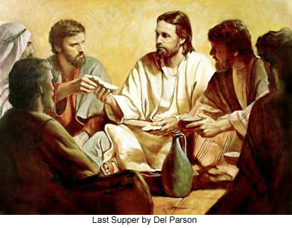
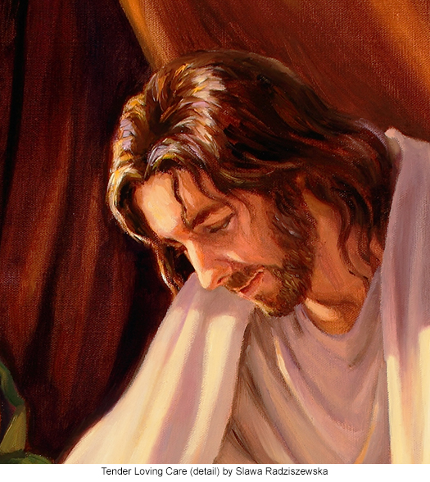
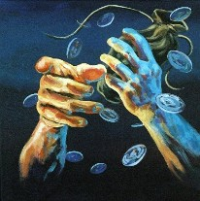
Sop
A small piece of bread that those dining would use to scoop broth and meat from a bowl.
Since it was a gesture of kindness and respect for a host to dip a sop and give it to a dinner guest, the Savior by this act presented Judas with an offer of friendship, perhaps one final opportunity for him to abandon his planned betrayal.
Del Parson
“That thou doest, do quickly”
The Savior gave a sop to Judas, after which “Satan entered into him”
He already knew what Judas had determined to do and that the time had come for him to act upon his final decision.
Slawa Radziszewska
(1)
John 13:26-27

Slide 13
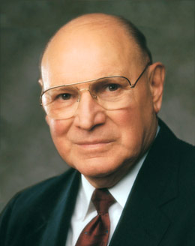
Love One Another
Thou shalt not avenge, nor bear any grudge against the children of thy people, but thou shalt love thy neighbour as thyself: I am the Lord.
Leviticus 19:18
After the Savior dismissed Judas, the setting was prepared for the Savior to give important teachings to the rest of the Apostles.
The Savior commands us to love one another as He loves us
“Love is the beginning, the middle, and the end of the pathway of discipleship. It comforts, counsels, cures, and consoles. It leads us through valleys of darkness and through the veil of death. In the end love leads us to the glory and grandeur of eternal life. …
(1)
John 13:34-35

Slide 14
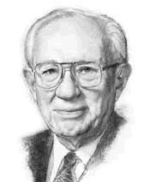
"Love is the only force that can erase the differences between people, that can bridge chasms of bitterness…
"If the world is to be improved, the process of love must make a change in the hearts of mankind. It can do so when we look beyond self to give our love to God and others, and do so with all our heart, with all our soul, and with all our mind.
Hate drew a circle that shut me out- Heretic, rebel, a thing to flout.
But Love and I had the wit to win:
We drew a circle that took him in.
“Love is the defining characteristic of a disciple of Christ” (9)
Edwin Markham
(7)

Slide 15
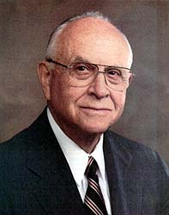
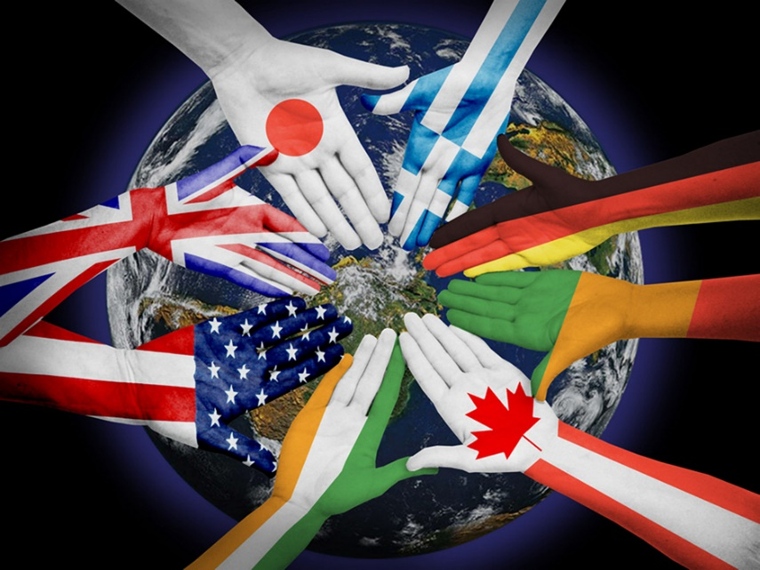
By This Shall Men Know
"Besides loving God, we are commanded to follow what to many is a more difficult commandment: to love all, even enemies, and to go beyond the barriers of race or class or family relationships.
It is easy, of course, to be kind to those who are kind to us-the usual standard of friendly reciprocity. But we are commanded to cultivate genuine fellowship and even a kinship with every human being on earth.
Whom should we bar from our circle?
We might deny ourselves a nearness to our Savior because of our prejudices of neighborhood or possession or race-attitudes that Christ would surely condemn. Love has no boundary, no limitation of good will."
(8)
John 13:34-35

Slide 16
Sources:
Suggested Hymn: #308 As I Have Loved You
Video:
Unselfish Service (2:26)
He Truly Loves Us (1:45)
New Testament Institute Student Manual Chapter 25
Jeffrey R. Holland, “He Loved Them unto the End,” Ensign, Nov. 1989, 25
Elder Bruce R. McConkie (Doctrinal New Testament Commentary, 1:708-710).
History of the Church, 1:323; 2:430–31]
President Thomas S. Monson (“Guideposts for Life’s Journey” [Brigham Young University devotional, Nov. 13, 2007], 4;speeches.byu.edu).
Elder M. Russell Ballard (“Be Anxiously Engaged,” Ensign or Liahona, Nov. 2012, 31).
Gordon B. Hinckley (Faith: The Essence of True Religion [Salt Lake City: Deseret Book Co., 1989], 48-49.)
Elder David B. Haight (A Light unto the World [Salt Lake City: Deseret Book Co., 1997], 124.)
President Dieter F. Uchtdorf “The Love of God,” Ensign or Liahona, Nov. 2009, 22).
Presentation by ©http://fashionsbylynda.com/blog/

Slide 17
Event | Matthew | Mark | Luke | John
Jesus Washes Apostles Feet |  |  |  | 13:1-17, 20
Jesus Announces His Betrayal | 26:21-25 | 14:18-21 | 22:21-23 | 13:18-22
Judas, Alone, Leaves the Upper Room |  |  |  | 13:23-30
Commandment to Love One Another |  |  |  | 13:31-35
Peter’s Denial Prophesied and Profess Loyalty | 26:34, 35 | 14:30, 31 | 22:33-38 | 13:36-38
Loving His Disciples to the End John 13:1:
This small circle of believers in this scarcely founded kingdom were about to pass through their severest trial, so he would set aside his own increasing anguish in order that he might yet once more serve and strengthen them. It does not matter that no one washed his feet. In transcendent humility he would continue to teach and to cleanse them. He would to the final hour—and beyond—be their sustaining servant. As John wrote, who was there and watched the wonder of it all, ‘Having loved his own which were in the world, he loved them unto the end.’ (John 13:1.)
“So it had been, and so it was to be—through the night, and through the pain, and forever. He would always be their strength, and no anguish in his own soul would ever keep him from that sustaining role” Elder Jeffrey R. Holland (“He Loved Them unto the End,” Ensign, Nov. 1989, 25).
Love is the Great Commandment John 34-35:
“Love is the beginning, the middle, and the end of the pathway of discipleship. It comforts, counsels, cures, and consoles. It leads us through valleys of darkness and through the veil of death. In the end love leads us to the glory and grandeur of eternal life. …
Continued
“Brethren and sisters, as you prayerfully consider what you can do to increase harmony, spirituality, and build up the kingdom of God, consider your sacred duty to teach others to love the Lord and their fellowman. This is the central object of our existence. Without charity—or the pure love of Christ—whatever else we accomplish matters little. With it, all else becomes vibrant and alive.
“When we inspire and teach others to fill their hearts with love, obedience flows from the inside out in voluntary acts of self-sacrifice and service. …
“When Jesus gave His disciples a new commandment to ‘love one another; as I have loved you’ [John 13:34], He gave to them the grand key to happiness in this life and glory in the next.
“Love is the greatest of all the commandments—all others hang upon it. It is our focus as followers of the living Christ” Elder Joseph B. Wirthlin (“The Great Commandment,” Ensign orLiahona, Nov. 2007, 28–31).
The Great Example John 13:13-15:
“When the Savior was about to leave his Apostles, he gave them a great example of service. You remember he girded himself with a towel and washed his disciples’ feet [see John 13:3–17]. …
“What an example of service to those great servants, followers of the Christ! He that is greatest among you, let him be least. So we sense the obligation to be of greater service to the membership of the Church, to devote our lives to the advancement of the kingdom of God on earth” President David O. McKay (in Conference Report, Apr. 1951, 158–59).

Slide 18
Love One Another John 34-35:
"How often have we read the words 'a new commandment I give unto you'? The Ten Commandments had sounded down through the millennia since Moses' time, and now an additional commandment came from the Master: 'That ye love one another; as I have loved you, that ye also love one another.' (John 13:34.)
"Only those who are true possessors of charity can measure up to the full stature of this new commandment. This is the commandment that lifts us to the more noble and virtuous life. We cannot nor ever will love one another as He has loved us until we exercise in our own lives the full dimensions of charity. Those who practice charity may not always receive the promised benefits and ultimate successes. Ours is a different time schedule, but by and by we will all learn and know that 'charity never faileth.' (Corinthians 13:8.) The pure love of Christ will eventually triumph over all the evils, including power, pride, boasting, worldly acclaim, cruelty, wars, perversion, sadness, and heartache. The Lord through His servants has promised that charity will never fail. One day charity, the pure love of Christ, will triumph over all the world. Those who are possessors of charity will triumph over all evil and will dwell with the author of this 'new commandment' forever and forever.“Vaughn J. Featherstone (The Incomparable Christ: Our Master and Model [Salt Lake City: Deseret Book Co., 1995], 78-79.)
By This Shall Men Know John 13:34-35:
"In building the kingdom of God, every positive act, every friendly greeting, every warm smile, every thoughtful, kind note contributes to the strength of the whole. It is my prayer that we may be open and outgoing, friendly, and helpful to all who come among us. But let us give special care and concern for the new converts to the Church. When we detect a halting step or a stumble as they begin their journey on the gospel path, let us be there to lift and support with words of kindness and concern; let us be available to give gentle, loving counsel that will strengthen and sustain. Let us conscientiously look for occasions to show that love which the Savior admonished us to have when He said, 'A new commandment I give unto you, That ye love one another' (John 13:34)." Elder Carl B. Pratt ("Care for New Converts," Ensign, Nov. 1997, 12)
The Love of the Savior “The love the Savior described is an active love. It is not manifested through large and heroic deeds but rather through simple acts of kindness and service” Elder M. Russell Ballard (“Finding Joy through Loving Service,” Ensign or Liahona, May 2011, 47).

