Slide 1
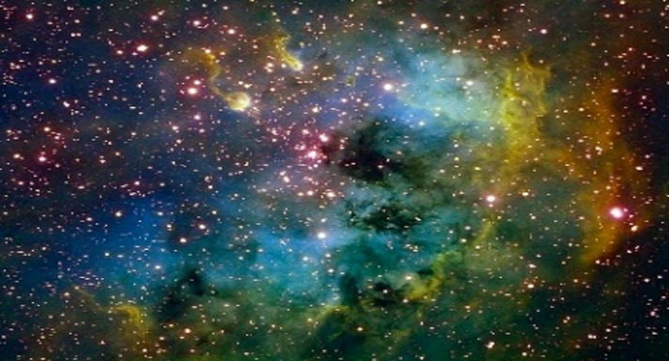
Lesson 74
Many Kingdoms
John 14
Wherefore, as it is written, they are gods, even the sons of God—
Wherefore, all things are theirs, whether life or death, or things present, or things to come, all are theirs and they are Christ’s, and Christ is God’s.
These shall dwell in the presence of God and his Christ forever and ever.
D&C 76:58-59, 62

Slide 2
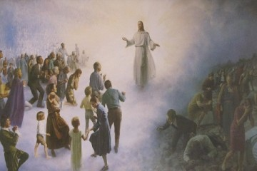
Celestial Kingdom
Through the Atonement of Jesus Christ, all people will be resurrected.
After we are resurrected, we will stand before the Lord to be judged according to our desires and actions.
Each of us will accordingly receive an eternal dwelling place in a specific kingdom of glory.
“Some of the mysteries of his kingdom, some of the deep and hidden doctrines, some things that can be understood only by the power of the Spirit” (2)
John 14:2
(3)

Slide 3
Kingdoms of Glory
The celestial kingdom is the highest of the three kingdoms of glory.
Those in this kingdom will dwell forever in the presence of God the Father and His Son Jesus Christ.
To inherit celestial glory and to help others receive that great blessing as well. Such a goal is not achieved in one attempt; it is the result of a lifetime of righteousness and constancy of purpose.
The celestial kingdom is the place prepared for those who have “received the testimony of Jesus” and been “made perfect through Jesus the mediator of the new covenant, who wrought out this perfect atonement through the shedding of his own blood.”
To inherit this gift, we must receive the ordinances of salvation, keep the commandments, and repent of our sins.
John 14:2
(3)

Slide 4
“Some of the mysteries of his kingdom, some of the deep and hidden doctrines, some things that can be understood only by the power of the Spirit”
The Savior’s teachings about what the Holy Ghost can do for us are among the clearest instructions on the Holy Ghost in all scripture.
(1,2)

Slide 5
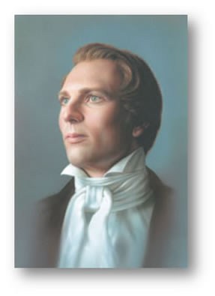
“[The statement] ‘In my Father’s house are many mansions’ … should be—‘In my Father’s kingdom are many kingdoms,’ in order that ye may be heirs of God and joint-heirs with me. …
There are mansions for those who obey a celestial law, and there are other mansions for those who come short of the law, every man in his own order.”
John 14:2
(4)

Slide 6
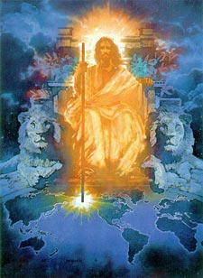
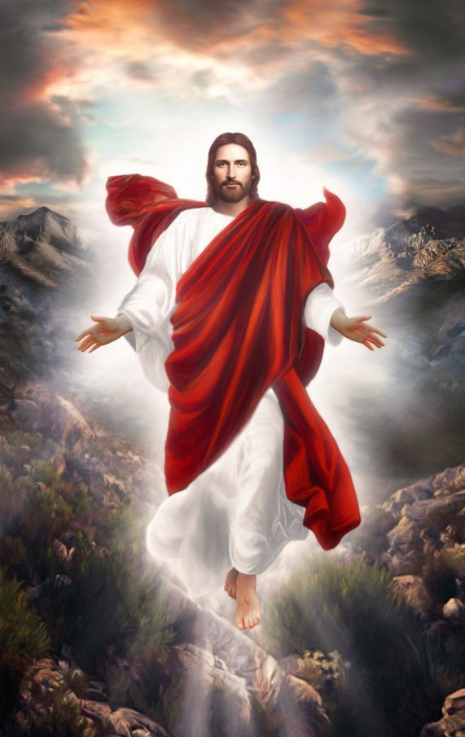
Jesus Will Return Again
And if I go and prepare a place for you, I will come again, and receive you unto myself; that where I am, there ye may be also.
John 14:3
“And when I go, I will prepare a place for you, and come again, and receive you unto myself; that where I am, ye may be also”
Joseph Smith Translation, John 14:3
(4)

Slide 7
I Am the Way
A “way” (Greek hodos) was a road or highway for traveling from one place to another…
…it could also refer to one’s course of behavior or “way of life.”
He did not say that He knew the way, but that He was the way, the truth, and the life.
Coming to the Father means we must do more than learn about Jesus Christ—we must follow Him and try to be like Him
No other way, no other road, no other system, no other name will bring salvation. (5)
John 14:6
(1)

Slide 8
Doctrinal Mastery
John 14:6
Jesus saith unto him, I am the way, the truth, and the life: no man cometh unto the Father, but by me.
(4)

Slide 9
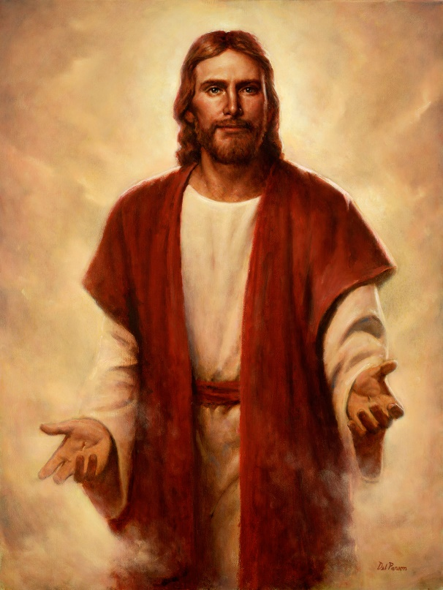
In that it is in and through Him that salvation comes; ‘no man cometh unto the Father, but by me,’ He said.
He is the Way
He is the embodiment and personification of that holy attribute. (Alma 5:48.)
He is the Truth
Del Parson
In Him the light of life centers; except for Him and His power there would be no existence; should He withdraw the light of life, death would gain an immediate victory; and without Him there would be neither immortal life, nor eternal life, which is life in unending glory.”
He is the Life
(2)

Slide 10
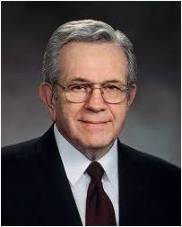
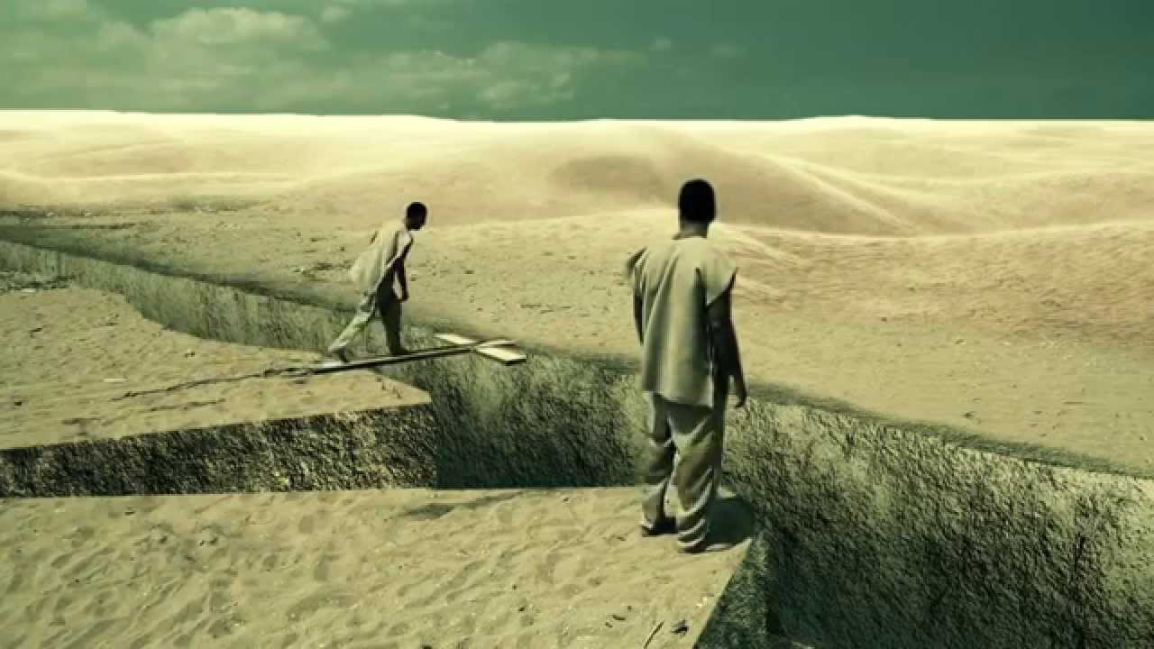
"When the Lord was upon the earth He made it very clear that there was one way, and one way only, by which man may be saved.
[The idea] was clear in the minds of His Apostles also, and their preaching provided for one way, and one way only, for people to be saved.“
(6)

Slide 11
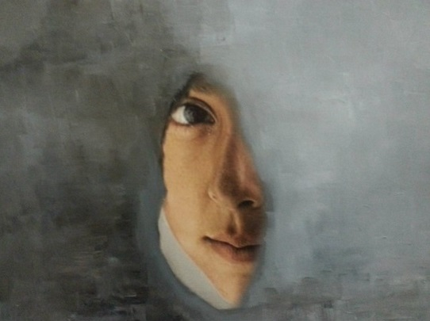
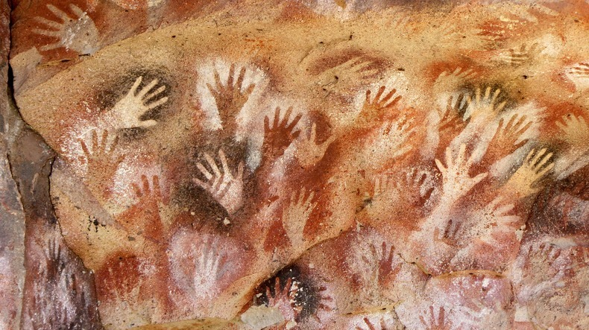
“Shew Us the Father”
“In all that Jesus came to say and do, including and especially in His atoning suffering and sacrifice, He was showing us who and what God our Eternal Father is like, how completely devoted He is to His children in every age and nation. …
Donya Hafezi Haghani,
“…God in His ultimate effort to have us know Him, sent to earth His Only Begotten and perfect Son, created in His very likeness and image, to live and serve among mortals in the everyday rigors of life. …
John 14:8-11
(7)

Slide 12
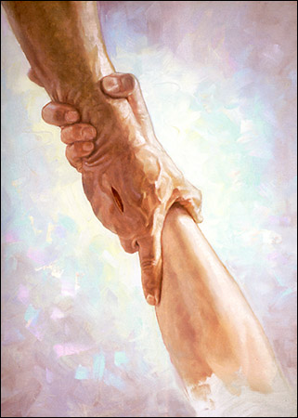
How Can We Show Love To Him?
“…So feeding the hungry, healing the sick, rebuking hypocrisy, pleading for faith—this was Christ showing us the way of the Father, He who is ‘merciful and gracious, slow to anger, long-suffering and full of goodness’.
In His life and especially in His death, Christ was declaring, ‘This is God’s compassion I am showing you, as well as that of my own.’”
Chris Hopkins
John 14:8-11; Lectures on Faith. P. 42 (1985)
(7)

Slide 13
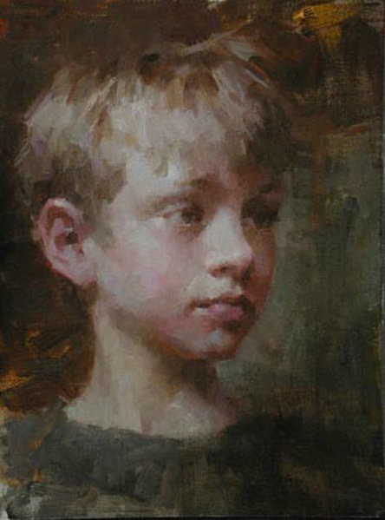
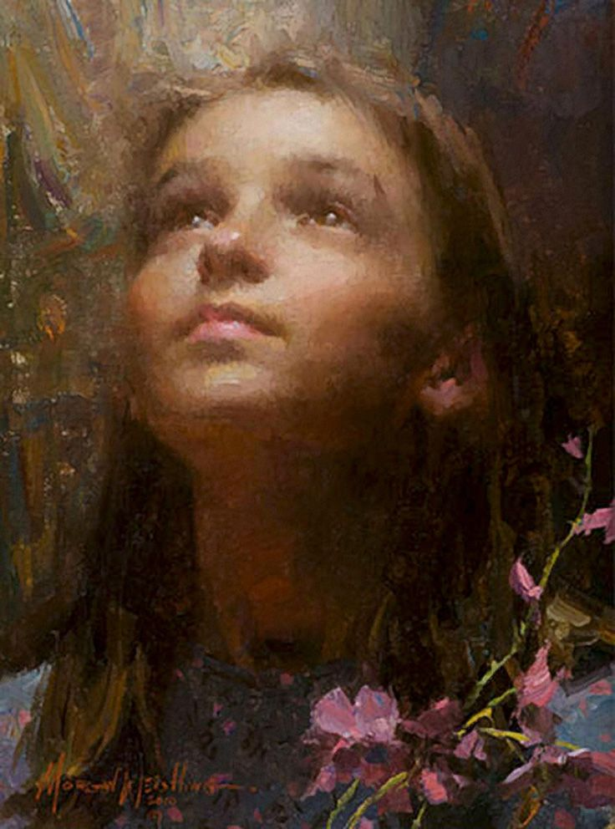
If Ye Love Me
Keep the Commandments
“When we love the Lord, obedience ceases to be a burden. Obedience becomes a delight.”
Morgan Weistling
Morgan Weistling
John 14:15
(8)

Slide 14
Doctrinal Mastery
John 14:15
If ye love me, keep my commandments.
(4)

Slide 15
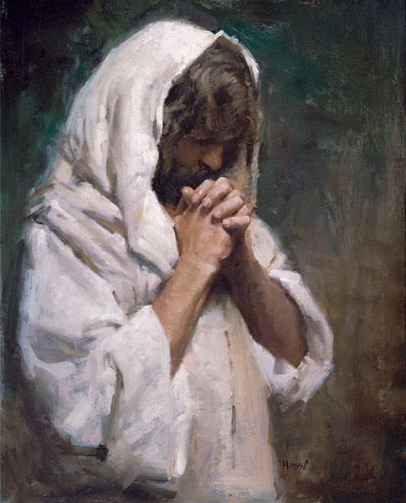
The Comforter
“Comforter” in the King James Version, appears only in the writings of John.
One who is summoned
Because the Savior had been a comforter to His Apostles during His mortal ministry, He called the Holy Ghost another Comforter.
The Holy Ghost can comfort us, teach us all things, and bring all things to our remembrance
Morgan Weistling
John 14:16-17
(1)

Slide 16
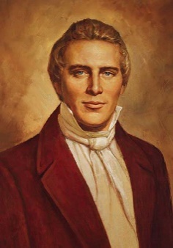
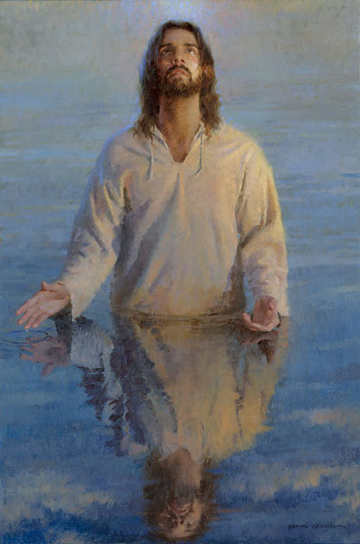
“There are two Comforters spoken of.
One is the Holy Ghost, the same as given on the day of Pentecost, and that all Saints receive after faith, repentance, and baptism. This first Comforter [is the] Holy Ghost. …
Morgan Weistling
“The other Comforter spoken of is a subject of great interest, and perhaps understood by few of this generation.
After a person has faith in Christ, repents of his sins, and is baptized for the remission of his sins and receives the Holy Ghost, (by the laying on of hands), which is the first Comforter, then let him continue to humble himself before God, hungering and thirsting after righteousness, and living by every word of God...
John 14:16-17
(4)

Slide 17
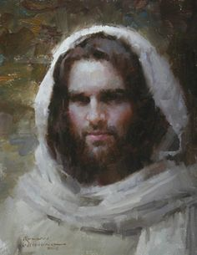
“When the Lord has thoroughly proved him, and finds that the man is determined to serve Him at all hazards, then the man will find his calling and his election made sure, then it will be his privilege to receive the other Comforter, which the Lord hath promised the Saints.”
“What is this other Comforter?
It is no more nor less than the Lord Jesus Christ Himself; and this is the sum and substance of the whole matter; that when any man obtains this last Comforter, he will have the personage of Jesus Christ to attend him, or appear unto him from time to time, and even He will manifest the Father unto him, and they will take up their abode with him, and the visions of the heavens will be opened unto him, and the Lord will teach him face to face, and he may have a perfect knowledge of the mysteries of the Kingdom of God.”
Morgan Weistling
John 14:16-17
(4)

Slide 18
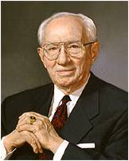
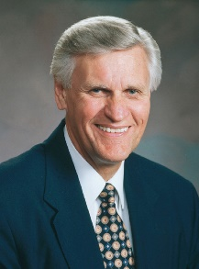
Testify of Truth
“The Holy Ghost is the Testifier of Truth, who can teach men things they cannot teach one another. ..”
And when ye shall receive these things, I would exhort you that ye would ask God, the Eternal Father, in the name of Christ, if these things are not true; and if ye shall ask with a sincere heart, with real intent, having faith in Christ, he will manifest the truth of it unto you, by the power of the Holy Ghost.
And by the power of the Holy Ghost ye may know the truth of all things.
“Sometimes the feeling [of a spiritual witness] is like a memory. We first learned the gospel in our heavenly home. We have come to this earth with a veil of forgetfulness. And yet lingering in each of our spirits are those dormant memories. The Holy Ghost can part the veil and bring those things out of their dormancy.”
John 14:26
(9, 10)

Slide 19
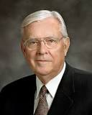
The Promise of Peace
“Was He promising His beloved associates the kind of peace the world recognizes—safety, security, with the absence of contention or tribulation?
Those original Apostles knew much of trial and persecution throughout the remainder of their lives:
‘Not as the world giveth, give I unto you. Let not your heart be troubled, neither let it be afraid’.
“‘These things I have spoken unto you, that in me ye might have peace,’
‘In the world ye shall have tribulation: but be of good cheer; I have overcome the world’ .
“Peace—real peace, whole-souled to the very core of your being—comes only in and through faith in the Lord Jesus Christ.”
John 14:27
(11)

Slide 20
Sources:
Suggested Song: #133 Father in Heaven
Video:
Comfort in Trials (3:46)
New Testament Institute Student Manual Chapter 26
Elder Bruce R. McConkie (The Mortal Messiah: From Bethlehem to Calvary, 4 vols. [1979–81], 4:73). Mormon Doctrine, 2nd ed. [1966], 832).
LDS Topics
Prophet Joseph Smith (Teachings of Presidents of the Church: Joseph Smith[2007], 219). History of the Church, 3:380–81
Robert E. Wells (The Mount and the Master [Salt Lake City: Deseret Book Co., 1991], 189)
President Boyd K. Packer (Let Not Your Heart Be Troubled [Salt Lake City: Bookcraft, 1991], 44.)
Excerpts from Elder Jeffrey R. Holland (“The Grandeur of God,” Ensign or Liahona, Nov. 2003, 70–72).
Elder Joseph B. Wirthlin(“The Great Commandment,” Ensign or Liahona, Nov. 2007, 30).
President Gordon B. Hinckley (“The Father, Son, and Holy Ghost,” Ensign, Mar. 1998, 7).
Elder Glenn L. Pace (“Do You Know?” Ensign or Liahona, May 2007, 79).
Elder M. Russell Ballard (“The Peaceable Things of the Kingdom,” Ensign, May 2002, 88).
Presentation by ©http://fashionsbylynda.com/blog/

Slide 21
Event | Matthew | Mark | Luke | John
Discourse on Peace Through Knowing God |  |  |  | 14:1-31
Many Mansions John 14:2:
“At the time Joseph Smith received revelations and organized the Church, the vast majority of [Christian] churches taught that the Savior’s Atonement would notbring about the salvation of most of mankind. The common precept was that a few would be saved and the overwhelming majority would be doomed to endless tortures of the most awful and unspeakable intensity. The marvelous doctrine revealed to the Prophet Joseph unveiled to us a plan of salvation that is applicable to all mankind, including those who do not hear of Christ in this life, children who die before the age of accountability, and those who have no understanding.
“… Because of the Atonement of Jesus Christ, all spirits blessed by birth will ultimately be resurrected, spirit and body reunited, and inherit kingdoms of glory that are superior to our existence here on earth [see D&C 76:89]. The exceptions are confined to those who, like Satan and his angels, willfully rebel against God [see Isaiah 14:12–15; Luke 10:18; Revelation 12:7–9; D&C 76:32–37]” Elder Quentin L. Cook (“Our Father’s Plan—Big Enough for All His Children,” Ensign or Liahona, May 2009, 36–37).
“He that hath seen me hath seen the Father” John 14:9:
: “Jesus Christ, the Son of God, is ‘the express image’ of His Father’s person (Hebrews 1:3). He walked the earth as a human being, as a perfect man, and said, in answer to a question put to Him: ‘He that hath seen me hath seen the Father’ (John 14:9). This alone ought to solve the problem to the satisfaction of every thoughtful, reverent mind. The conclusion is irresistible, that if the Son of God be the express image (that is, likeness) of His Father’s person, then His Father is in the form of man; for that was the form of the Son of God, not only during His mortal life, but before His mortal birth, and after His resurrection. It was in this form that the Father and the Son, as two personages, appeared to Joseph Smith, when, as a boy of fourteen years, he received his first vision” (Teachings of Presidents of the Church: Joseph F. Smith [1998], 334).
The Comforter John 14:16-17:
In the New Testament, the Greek word paraklētos,translated “Comforter” in the King James Version, appears only in the writings of John. The word is composed of para, meaning “beside,” and klētos,meaning “one who is summoned.” A paraklētos is one who is summoned to another’s side as a helper, intercessor, or advocate. In John’s writings, the titleparaklētos is applied to two individuals: the Holy Ghost and Jesus Christ. The Savior promised His disciples that after He departed, they would not be left alone but would have the companionship of the Holy Ghost to help them (see John 14:16, 26; 15:26; 16:7). The Savior’s promise that He would give His disciples the Holy Ghost as “another Comforter” (John 14:16; italics added) meant that He Himself was also a Comforter. Elder Jeffrey R. Holland
He is the Way John 4:6:
“There is only one way to happiness and fulfillment. He is the Way. Every other way, any other way, whatever other way, is foolishness. …
“… We can either follow the Lord and be endowed with His power and have peace, light, strength, knowledge, confidence, love, and joy, or we can go some other way, any other way, whatever other way, and go it alone—without His support, without His power, without guidance, in darkness, turmoil, doubt, grief, and despair. And I ask, which way is easier? …
“There is only one way to happiness and fulfillment. Jesus Christ is the Way.” Elder Lawrence E. Corbridge (“The Way,” Ensign or Liahona,Nov. 2008, 34, 36).

Slide 22
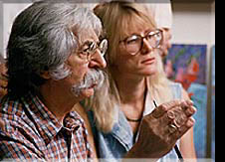
Morgan Weistling Artist:
Morgan studied art at an early age with his father, a former art student. His parents both met at art school. His father, Howard, a POW in Germany, entertained his fellow American prisoners in Stalag 1 with a daily comic strip that he created and drew to keep morale up. Drawn on scraps of paper found on the prison grounds, he crafted a humorous world of characters that managed to bring a smile to imprisoned soldiers. In the last days of the war and feeling the Russians would be coming, his talents with painting saved his life. Using some paints supplied by the Geneva Convention, he painted a American Flag on the shoulder of his prisoner uniform so that the Russians invading Germany would identify him and not shoot him. It worked.
Weistling's father came back from the war with dreams of being an artist. With the G.I. Bill, he took classes at Woodbury Art College in Los Angeles where he met Morgan's mom. After marrying and starting a family, Morgan's father had to abandon his artistic dreams and support his new family by becoming a gardener. But, he saved all his art books.....
Morgan, much younger than his brother and sister, began his artistic training as early as 19 months old. His father would sit with him on his lap at night and teach him how to draw and use his imagination. " My dad and I bonded together with drawing and spoke to each other with pictures". Weistling's father had a real talent for telling a story in comic strip form and so it began in Morgan, a natural sense of the narrative."It was here that art became a language for me".
That led to his studying the art books his father had acquired years earlier. Authors such as Andrew Loomis, Vanderpole, and Bridgeman. The most important books, though, were the volume set from the Famous Artist School.
At the age of 12, Weistling was determined to go through the entire course on his own since the school was no longer in existence. By the age of 15, his study of anatomy, drawing, and painting needed a mentor's direction.
That direction came through a retired illustrator named Fred Fixler. Fred's school, then called the Brandes Art Institute, was dedicated to one thing: learning how to draw from life. "The minute I saw his life drawings I knew this was the guy to study with, there was no doubt," says Morgan. Working part-time as a janitor for the school to pay his tuition, Weistling studied there for 3 years.
While still a student and working at an art store, one day a prominent illustrator came in for supplies. Weistling showed him his student work. The next day he found himself employed at one of the top movie poster agencies in Hollywood. "At that time, all I wanted to be was an illustrator," Weistling says, "but that was amazingly fast." For the next 14 years he illustrated for every movie studio in Hollywood as well as many other fields of illustration.
After being art-directed for years, Morgan needed to paint something for himself. He took time out to produce a painting of two children and brought it to Scottsdale Arizona on the advice of long time friend, Julio Pro .
The first gallery he walked into signed him on the spot, Trailside Galleries. Co-owner Maryvonne Leshe was quick to spot new talent. She was soon proven right. "He would send his paintings to us un-framed and before we could get them hung, they would be sold," quips Maryvonne. Soon a "draw" system for Weistling's paintings became necessary. His first one-man show had 26 paintings and all were sold opening night. Since then, Morgan has had five more one-man shows and they sold -out opening night as well.
Also interested in depicting his Christian faith, Morgan has portrayed the life of Christ in many of his paintings. Those images can be found in the best selling book, The Image of Christ, with paintings and text by Morgan.
Morgan and his wife, JoAnn, have been married since 1990 and also met in art school. JoAnn is represented by Trailside Galleries and paints under the name "J. Peralta" in honor of her grandmother. She also exhibits in the Master's show at the Autry Museum. They have two daughters, Brittany and Sienna. Both girls model for paintings frequently. Brittany's work can seen on the main page of this site.

Slide 23
Those Who Will Live in the Celestial Kingdom
And again we bear record—for we saw and heard, and this is the testimony of the gospel of Christ concerning them who shall come forth in the resurrection of the just— D&C 76:50
D&C 76:51 | Those who received a testimony of Jesus | D&C 76:58 | They are Gods, even the Sons of Gods
D&C 76:51 | Those who are baptized by water in His name | D&C 76:59-60 | All things are theirs in life and death and overcome all things
D&C 76:52 | Those who keep the commandments | D&C 76:62 | They will dwell in the presence of God and His Son forever
D&C 76:52 | Those who are washed clean through repentance | D&C 76:63 | They will come with Jesus Christ when He will reign upon the earth
D&C 76:52 | Those who receive the Holy Ghost by proper authority--ordained | D&C 76:64-65 | They will have a part in the first resurrection and of the just
D&C 76:53 | Those who are just and true | D&C 76:66-67 | They will come to Mount Zion and be accompanied by angels
D&C 76:54 | They are they who are the church of the Firstborn. | D&C 76:68 | There names will be written in Heaven
D&C 76:55 | Those who have been given all things by Heavenly Father | D&C 76:69 | They are just men who are made perfect through Jesus Christ, the mediator
D&C 76:56 | Those who are priests and kings who have received His fullness and glory | D&C 76:70 | Their bodies are celestial, the highest of all, whose glory is the sun
D&C 76:57 | Those who are priests after the order of Melchizedek, Enoch, and the Son of God

