Slide 1


Lesson 75
There is a law, irrevocably decreed in heaven before the foundations of this world, upon which all blessings are predicated—
And when we obtain any blessing from God, it is by obedience to that law upon which it is predicated.
D&C 130:20-21

Slide 2

productive
dead
unsuccessful
fruitful
abundant
unproductive
Which of these words would you like to describe your life?
unhappy
worthwhile

Slide 3
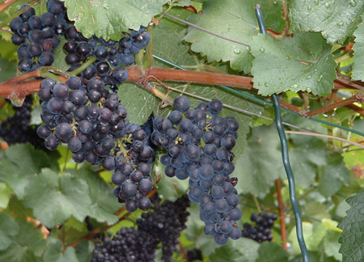
Metaphors
Israel’s prophets commonly used grapevines and vineyards as metaphors
Yet I had planted thee a noble vine, wholly a right seed: how then art thou turned into the degenerate plant of a strange vine unto me? Jeremiah 2:21
For the vineyard of the Lord of hosts is the house of Israel, and the men of Judah his pleasant plant: and he looked for judgment, but behold oppression; for righteousness, but behold a cry.
Isaiah 5:1
And it came to pass that the master of the vineyard went forth, and he saw that his olive tree began to decay; and he said: I will prune it, and dig about it, and nourish it, that perhaps it may shoot forth young and tender branches, and it perish not.
Jacob 5:4
Israel is an empty vine, he bringeth forth fruit unto himself: according to the multitude of his fruit he hath increased the altars; according to the goodness of his land they have made goodly images.
Hosea 10:1
John 15:4

Slide 4
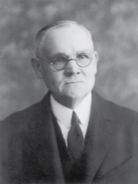
“Those ordained servants of the Lord were as helpless and useless without Him as is a bough severed from the tree.
As the branch is made fruitful only by virtue of the nourishing sap it receives from the rooted trunk, and if cut away or broken off withers, dries, and becomes utterly worthless except as fuel for the burning, so those men, though ordained to the Holy Apostleship, would find themselves strong and fruitful in good works, only as they remained in steadfast communion with the Lord.
Without Christ what were they, but unschooled Galileans, some of them fishermen, one a publican, the rest of undistinguished attainments, and all of them weak mortals?”
(2)

Slide 5
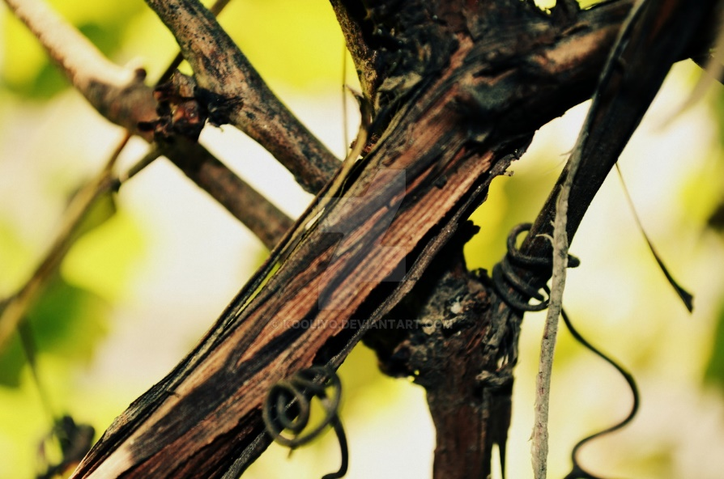
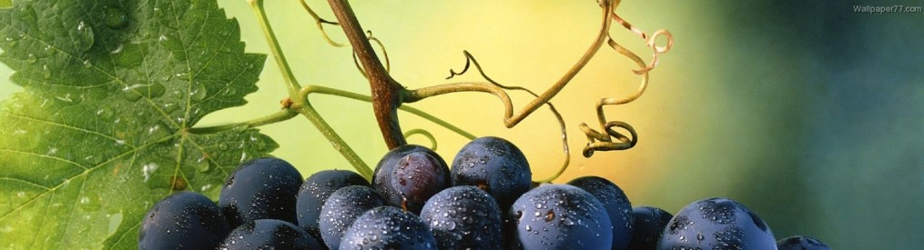
Vines, Branches, and Fruit
What does the vine represent?
What do the branches represent?
If Jesus Christ is the vine and we are the branches, what does the fruit represent?
Jesus Christ
Disciples of Jesus Christ
Righteous Works
John 15:4
(2)

Slide 6
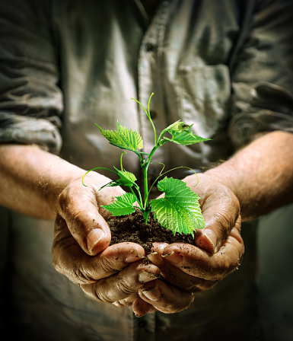
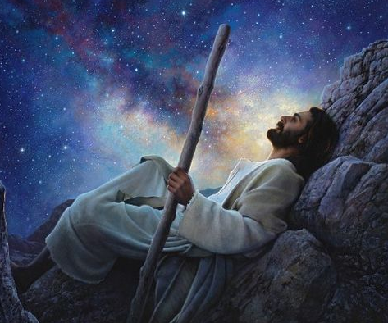
Husbandman
I am the true vine, and my Father is the husbandman.
Someone who cares for a vineyard.
God the Father planted the true vine [Jesus Christ] from which all others would take nourishment.
Greg Olsen
John 15:1

Slide 7
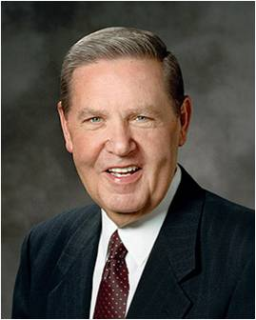
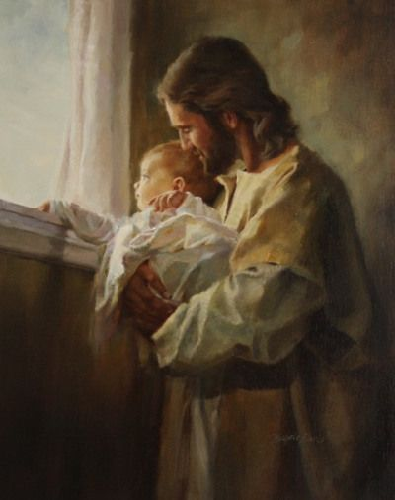
Abide In Me
“The branch cannot bear fruit of itself, except it abide in the vine; no more can ye, except ye abide in me”
“In Spanish that familiar phrase is rendered ‘permaneced en mi.’ Like the English verb ‘abide,’ permanecer means ‘to remain, to stay,’ but even [English speakers] like me can hear the root cognate there of ‘permanence.’
The sense of this then is ‘stay—but stay forever.’
That is the call of the gospel message to [everyone] in the world. Come, but come to remain.
Come with conviction and endurance. Come permanently, for your sake and the sake of all the generations who must follow you. …”
Harry Anderson
John 15:5
(3)

Slide 8
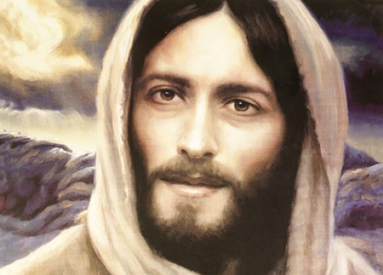
If Ye Love Me…
Keep My Commandments
“It is … through the grace of the Lord that individuals, through faith in the Atonement of Jesus Christ and repentance of their sins, receive strength and assistance to do good works that they otherwise would not be able to maintain if left to their own means.
This grace is an enabling power that allows men and women to lay hold on eternal life and exaltation after they have expended their own best efforts.”
Keeping Their commandments allows us to receive a fulness of the blessings They lovingly desire to give us
John 15:9-11
(3)

Slide 9
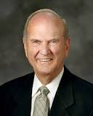
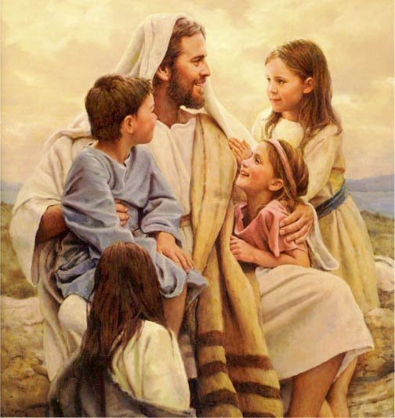
Love One Another
“Surely the best evidence of our adoration of Jesus is our emulation of Him”
Adoration =
great love and respect
Emulation =
to imitate or copy.
This is my commandment, That ye love one another, as I have loved you.
John 15:12
(5)

Slide 10
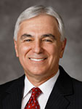
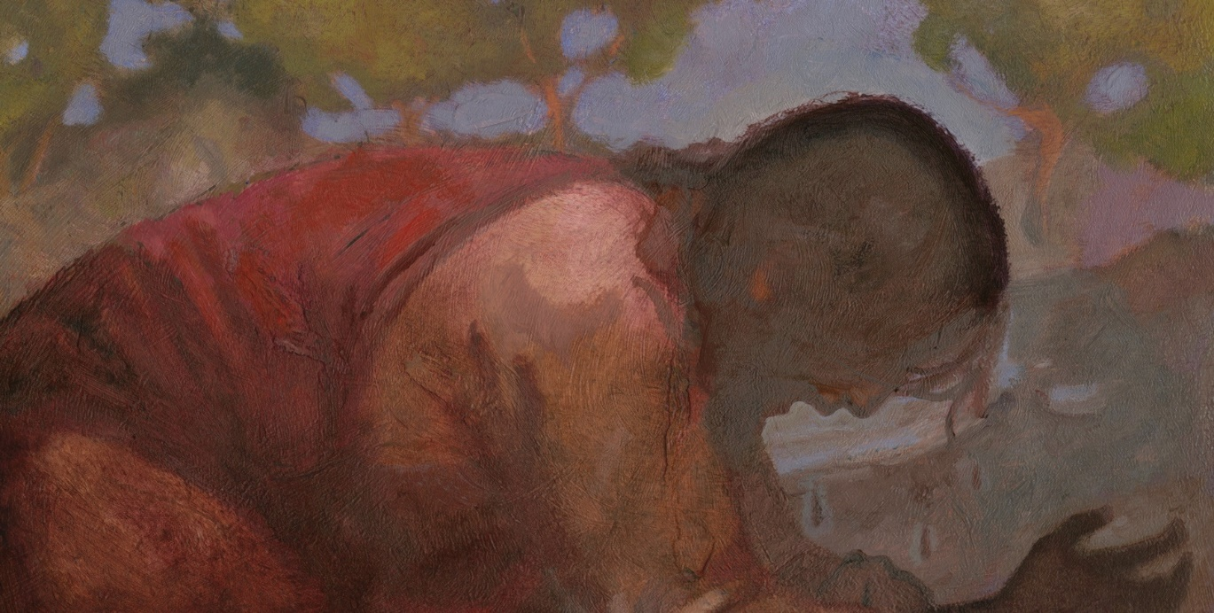
“[Jesus Christ] gave us the supreme example of love when He declared, ‘Greater love hath no man than this, that a man lay down his life for his friends’.
He later atoned for all our sins and finally gave His life for all of us.
“We can lay down our lives for those we love not by physically dying for them but rather by living for them—giving of our time; always being present in their lives; serving them; being courteous, affectionate, and showing true love for those of our family and to all men—as the Savior taught”
J. Kirk Richards
(6)
John 15:13

Slide 11
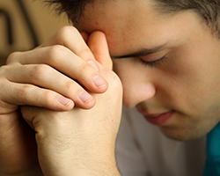
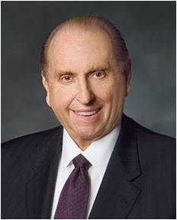
Do We Have to Die to Defend Our Faith?
For I am not ashamed of the gospel of Christ: for it is the power of God unto salvation to every one that believeth; to the Jew first, and also to the Greek.
Romans 1:16
One of the things we agree to do as part of the baptismal covenant is “to stand as witnesses of God at all times and in all things, and in all places that [we] may be in” (Mosiah 18:9).
In the April 2014 general conference, several speakers reminded us that there will be times when standing as a witness of God will mean having to face opposition, criticism, and ridicule.
So what should you do when you’re required to take the uncomfortable, uncool, or unpopular step of defending your beliefs?
“We will all face fear, experience ridicule, and meet opposition.
Let us—all of us—have the courage to defy the consensus, the courage to stand for principle. Courage, not compromise, brings the smile of God’s approval.” (8)
John 15:13
(7)

Slide 12
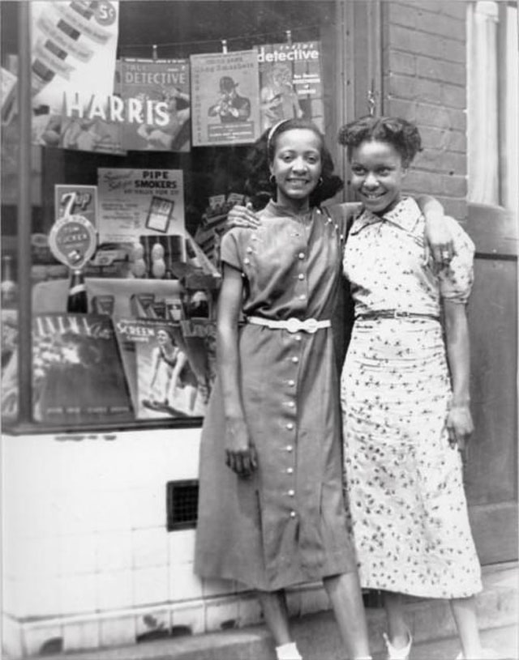
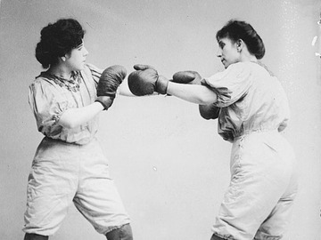
Our Beliefs Are Tested
The World = those who oppose the message of Jesus Christ
“One of mortality’s great tests comes when our beliefs are questioned or criticized. In such moments, we may want to respond aggressively—to ‘put up our dukes.’
But these are important opportunities to step back, pray, and follow the Savior’s example.
Remember that Jesus Himself was despised and rejected by the world. …
When we respond to our accusers as the Savior did, we not only become more Christlike, we invite others to feel His love and follow Him as well.
John 15:15-18
(5)

Slide 13
Doctrinal Mastery
John 15:16
Ye have not chosen me, but I have chosen you, and ordained you, that ye should go and bring forth fruit, and that your fruit should remain: that whatsoever ye shall ask of the Father in my name, he may give it you.

Slide 14
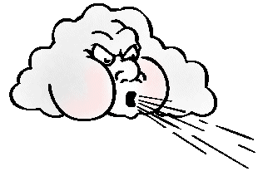
Opposition
When the winds of adversity come, remember one thing ---
Kites fly the very highest against the wind.
Kites don’t fly in spite of Opposition, kites fly high because of opposition. In fact, they couldn't fly without opposition.
John Bytheway
John 15:15-18
(5)

Slide 15
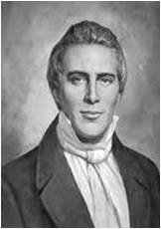
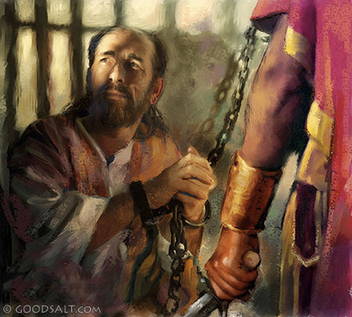
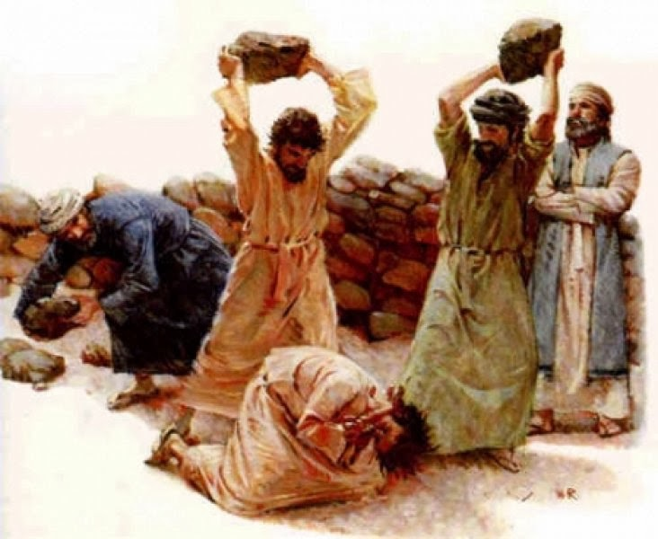
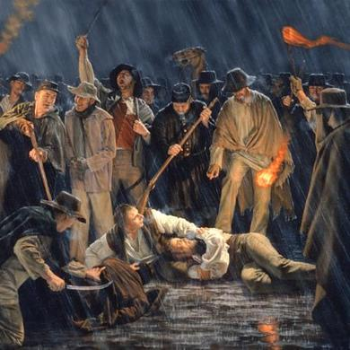
The Disciples Will Testify of Him
"The trials [the Saints] have had to pass through shall work together for their good and prepare them for the society of those who have come up out of great tribulation, washed their robes, and made them white in the blood of the Lamb.
Marvel not then if you are persecuted, but remember the words of the Savior, 'The servant is not above his Lord; if they have persecuted me, they will persecute you also,' and that all the afflictions through which the Saints have to pass are in fulfillment of the words of the prophets which have spoken since the world began. . . .
Afflictions, persecutions, imprisonments, and deaths we must expect according to the scriptures.”
John 15:21-25
(9)

Slide 16
Sources:
Suggested Hymn: #113 Our Savior’s Love
Video: Abide in Me (1:57)
I Was a Stranger: Love One Another (3:28)
New Testament Institute Student Manual Chapter 26
Elder James E. Talmage (Jesus the Christ, 3rd ed. [1916], 604–5).
Elder Jeffrey R. Holland “Abide in Me,” Ensign or Liahona, May 2004, 32
Bible Dictionary, “Grace”.
President Russell M. Nelson “The Mission and Ministry of Jesus Christ,” Ensign, Apr. 2013, 38.)
Elder Claudio R. M. Costa(“Don’t Leave for Tomorrow What You Can Do Today,” Ensign or Liahona, Nov. 2007, 74).
Faith Youth Article Magazine The Do’s and Don’ts of Defending Your Faith by David A. Edwards
President Thomas S. Monson “Be Strong and of a Good Courage,” Ensign or Liahona, May 2014, 69).
(Kent P. Jackson, comp. and ed., Joseph Smith's Commentary on the Bible [Salt Lake City: Deseret Book Co., 1994], 139.)
Presentation by ©http://fashionsbylynda.com/blog/

Slide 17
Event | Matthew | Mark | Luke | John
Jesus is the True Vine |  |  |  | 15:1-11
Love One Another |  |  |  | 15:12-17
The World Will Hate the Apostle |  |  |  | 15:18; 16:3
Branches and Vines John 15:2
"How many of us belong to that branch which beareth good fruit? How many of us are in danger of being cut off because of our inactivity, because of our failure to take advantage of every opportunity that comes to us for service in this great work?
"May we be numbered among the branches that bear fruit; may God purge us that we may bring forth more fruit; may we always abide in him and may his words abide in us, that we may eventually be glorified with that glory which he has promised to those who are faithful in all things. May God help us to see the way; may we be guided by his Spirit that we may go forward and accomplish that which is required of us, doing it in faith and humility." Elder David A. Smith (Conference Report, April 1926, Third Day-Morning Session 130.)
Keep Commandments, Abide in His love John 15:10
“God’s love is so perfect that He lovingly requires us to obey His commandments because He knows that only through obedience to His laws can we become perfect, as He is. …
“God’s choicest blessings are clearly contingent upon obedience to God’s laws and commandments. The key teaching is from modern revelation:
“‘There is a law, irrevocably decreed in heaven before the foundations of this world, upon which all blessings are predicated—
“‘And when we obtain any blessing from God, it is by obedience to that law upon which it is predicated’ (D&C 130:20–21). …
“If a person understands the teachings of Jesus, he or she cannot reasonably conclude that our loving Heavenly Father or His divine Son believes that Their love supersedes Their commandments” Elder Dallin H. Oaks (“Love and Law,” Ensign or Liahona, Nov. 2009, 27–28).
Abide in Him John 15:5
To abide in Christ is to trust in him, rely on him, be patient with him and his plan for us, yield ourselves to his mercies, surrender to him, and thereby draw upon his life and his strength.
"Though the vine and the branch are related, they are not the same. The uniting factor is the sap that flows through the branches. That is like the Holy Spirit in our lives: we appropriate Christ's strength through the power of the Holy Ghost. When that Spirit dwells in us, we begin to bear the 'fruit of the Spirit.' Paul contrasts the 'works of the flesh'-such things as adultery, fornication, idolatry, witchcraft, hatred, strife, and so forth, which are behaviors and attitudes characterizing the natural man-with the fruit of the Spirit, the works and dispositions that characterize the man or woman who has been born again. 'But the fruit of the Spirit is love, joy, peace, longsuffering, gentleness, goodness, faith, meekness, temperance. . . . And they that are Christ's have crucified the flesh with the affections and lusts.' Paul then offers this wonderful plea to the household of faith: 'If we live in the Spirit, let us also walk in the Spirit' (Galatians 5:19-25).
"In other words, if we claim membership in the Church of Jesus Christ, let us act like it. If we profess discipleship, people ought to be able to see that discipleship without difficulty. The fruit of the Spirit is the characteristics and attributes that flow from a changed heart-the ways that truly Christlike people feel and act." (Robert L. Millet, Alive in Christ: The Miracle of Spiritual Rebirth [Salt Lake City: Deseret Book Co., 1997], 59)
Love One Another John 15:12
"How critical it is that all who serve together in God's kingdom do so from a foundation of love: love for the Lord, love for the work, and love for each other. No matter how intense our effort or how carefully we follow the handbooks and guidelines, if we don't truly love each other we can't possibly hope to convey the full power of the gospel of love. And I can't help but believe that members are more likely to seek counsel from leaders from whom they feel sincere love emanating. Miracles seem to follow after Church leaders who are motivated by a keen feeling of loving devotion to those over whom they preside." M. Russell Ballard (Counseling with Our Councils: Learning to Minister Together in the Church and in the Family [Salt Lake City: Deseret Book Co., 1997], 35.)

Slide 18
Die for your faith John 15:13:
"Some men are willing to die for their faith but will not fully live for it. Christ both lived and died for us. . . .
"That man is greatest and most blessed and joyful whose life most closely fits the pattern of the Christ. This has nothing to do with earthly wealth, power, or prestige. The only true test of greatness, blessedness, joyfulness is how close a life can come to being like the Master, Jesus Christ." Ezra Taft Benson (I Know That My Redeemer Lives: Latter-day Prophets Testify of the Savior [Salt Lake City: Deseret Book Co., 1990], 216.)
The Price of Discipleship John 15:18-21:
“One of mortality’s great tests comes when our beliefs are questioned or criticized. In such moments, we may want to respond aggressively—to ‘put up our dukes.’ But these are important opportunities to step back, pray, and follow the Savior’s example. Remember that Jesus Himself was despised and rejected by the world. … When we respond to our accusers as the Savior did, we not only become more Christlike, we invite others to feel His love and follow Him as well.
“To respond in a Christlike way cannot be scripted or based on a formula. The Savior responded differently in every situation. When He was confronted by wicked King Herod, He remained silent. When He stood before Pilate, He bore a simple and powerful testimony of His divinity and purpose. Facing the moneychangers who were defiling the temple, He exercised His divine responsibility to preserve and protect that which was sacred. Lifted up upon a cross, He uttered the incomparable Christian response: ‘Father, forgive them; for they know not what they do’ (Luke 23:34). …
“The Prophet Joseph Smith demonstrated [Christian] courage throughout his life. … He did not retaliate or give in to hatred. Like all true disciples of Christ, he stood with the Savior by loving others in a tolerant and compassionate way. That is Christian courage.
“When we do not retaliate—when we turn the other cheek and resist feelings of anger—we too stand with the Savior. We show forth His love, which is the only power that can subdue the adversary and answer our accusers without accusing them in return. That is not weakness. That is Christian courage” Elder Robert D. Hales (“Christian Courage: The Price of Discipleship,” Ensign or Liahona, Nov. 2008, 72).

