Slide 1
Lesson 76
Joy VS Sorrow
John 16
"For the faithful, there is short-term tribulation but long-term joy."
–Neal A. Maxwell

Slide 2
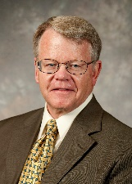
One By One
"One by one the Apostles chosen by Christ were killed, as he had predicted.
James, the brother of John, was the first member of the Quorum of the Twelve that we know of to be executed, sometime around A.D. 44.
Others followed. James the Just, the brother of the Lord, may have been martyred in A.D. 62.
And then during the Neronian persecutions of Christianity in Rome (A.D. 64-67), 'the Church suffered the greatest loss it had yet sustained in the death of the apostles Peter and Paul.'
Thus, as scholars point out, no tradition about the early Church is more firmly held than that 'all the Apostles except John were martyrs.' The Apostolic Age came to an end, and the keys of the kingdom were gone."
John 16:1-4: Acts 12:1-2
(2)

Slide 3
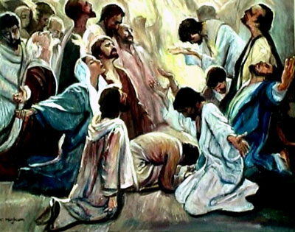
The Gift of the Holy Ghost
During Christ's ministry the gift of the Holy Ghost was not given to the disciples.
The influence of the Holy Ghost was operative during his ministry but there was no need for the disciples to have two members of the Godhead testifying to them at the same time.
There was no need for this sort of divine redundancy.
Therefore, in order for them to benefit from the constant companionship of the Holy Ghost, they had to first lose the privilege of the constant companionship of Jesus. The Holy Ghost was poured out upon them, as promised, on the day of Pentecost.
John 16:7; Acts 2
(3)

Slide 4
To Be Alone
“The Holy Ghost did not operate in the fulness among the Jews during the years of Jesus’ mortal sojourn.” (4)
Whom did Jesus promise would come after He departed?
Jesus would send the Comforter, or the Holy Ghost
John 16:7
John 16:7; Acts 2
(3)

Slide 5
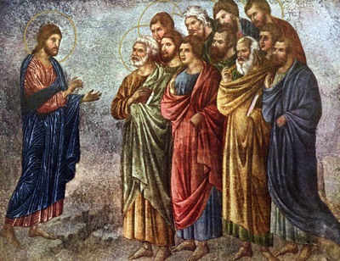
“As long as Jesus was with the disciples in person, there was not the full need for them to have the constant companionship of the Spirit that there would be after Jesus left.”
John 16:7
(5)

Slide 6
The Role of the Holy Ghost
To reprove the world of sin = often kindly intent to correct a fault
“’And he shall remind the world of sin, and of righteousness, and of judgment.‘
This comforter reminds of these things through the servants of the Lord.”
The Holy Ghost will guide you in Spirit to know the truth
John 16:8-11
John 16:7; Acts 2
(6)

Slide 7
Mission of the Holy Ghost
The mission, then, of the Holy Ghost is to remind the world of sin-one of the greatest of which is unbelief in Jesus Christ.
The Holy Ghost is to remind the world of the righteousness of Jesus Christ who was indeed the Son of God as evidenced by his return to his Father.
And the Holy Ghost is to remind the world of a final judgment, 'to teach them of a judgment which is to come' (DC 84:87) upon the prince of this world (Satan) and all of his followers. (3)
The Holy Ghost guides the Savior’s true Church in every dispensation and also guides individuals in their efforts to find truth and live their lives in accordance with God’s will.
Behold, I send you out to reprove the world of all their unrighteous deeds, and to teach them of a judgment which is to come. D&C 84:87
John 16:8-11
John 16:7; Acts 2
(1)

Slide 8
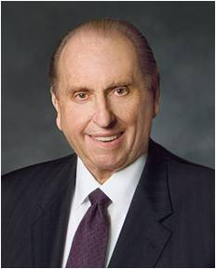
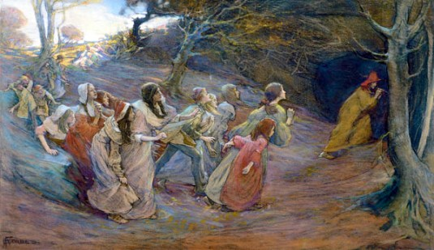
The Pied Piper VS The Holy Ghost
“We are surrounded—even at times bombarded—by the messages of the adversary. … Lucifer, that clever pied piper, plays his lilting melody and attracts the unsuspecting away from the safety of their chosen pathway … .
He seeks not just the so-called refuse of humanity; he seeks all of us, including the very elect of God. … Lucifer’s methods are cunning; his victims, numerous. …
I plead with you to make a determination right here, right now, not to deviate from the path which will lead to our goal: eternal life with our Father in Heaven. …
No temptation, no pressure, no enticing can overcome us unless we allow such.”
John 16:8-11
John 16:7; Acts 2
(7)

Slide 9
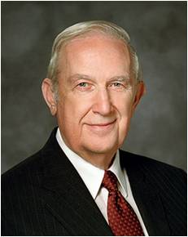
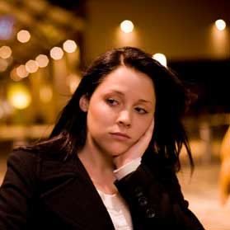
To Bear Witness
The Holy Ghost, whose role is to bear witness of the Father and the Son, will
“not speak of himself; but whatsoever he shall hear, that shall he speak.”
“Father in Heaven knew that you would face challenges and be required to make some decisions that would be beyond your own ability to decide correctly.
In His plan of happiness, He included a provision for you to receive help with such challenges and decisions during your mortal life.
That assistance will come to you through the Holy Ghost as spiritual guidance.”
The Holy Ghost reveals truths and instruction that come from Heavenly Father and Jesus Christ
John 16:13
John 16:7; Acts 2
(8)

Slide 10
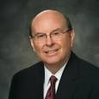
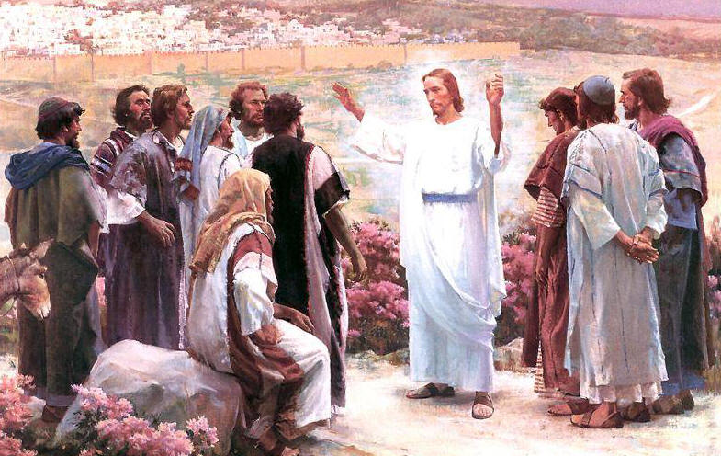
The Source of Joy
“The source of the kind of joy which causes us to rejoice is an understanding of the plan of salvation.
The Savior in the Gospel of John was approaching the closing hours of His mortal life when He would take upon Himself the sins of the world.
As He prepared His disciples for what He knew was to come, He told them, ‘A little while, and ye shall not see me: and again, a little while, and ye shall see me’.
“They were not yet ready to comprehend the Resurrection.
Instead the Savior explained in gentle terms that He would leave and return and told them what they would feel: sorrow at His leaving, ‘but I will see you again, and your heart shall rejoice, and your joy no man taketh from you’”.
John 16:16, 22
(9)

Slide 11
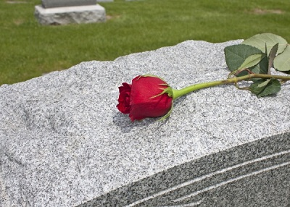
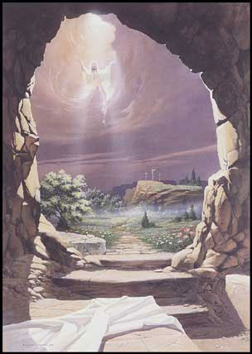
“Just as the Savior’s death brought sorrow, the vicissitudes of life, like death, disease, poverty, and injury, can and often will bring unhappiness.
Separation from those we love invariably brings sorrow and mourning. Life is not easy, and it would be improper to diminish in any way the trials and tribulations that most experience.
“That having been said, the Resurrection and Atonement wrought by the Savior and the promise of eternal life with our loved ones are of such overwhelming significance that to not rejoice would demonstrate a lack of understanding of the Savior’s gift.”
“Joy comes when we have the Spirit in our lives”
John 16:16, 22
(9)

Slide 12
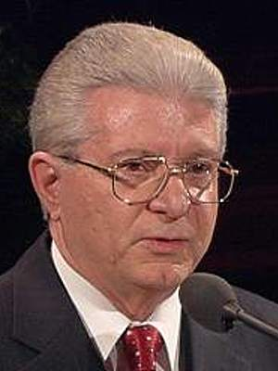
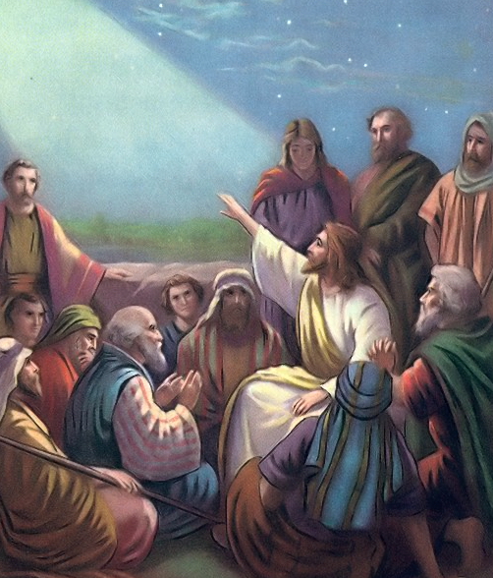
Be of Good Cheer
Jesus taught His disciples to pray directly to Heavenly Father in His (Christ’s) name and assured them of the Father’s love for them and Him.
Can we have happiness amidst sorrow?
“As part of our mortal probation, we pass through affliction, pain, and disappointment. Only in Jesus Christ can we find peace. He can help us to be of good cheer and to overcome all the challenges of this life.
It means having hope, not getting discouraged, not losing faith, and living life joyfully. ‘Men are, that they might have joy’ [2 Nephi 2:25]. It means facing life with confidence.
“The gospel of Jesus Christ gives us the strength and the eternal perspective to face what is coming with good cheer.”
John 16:33
(10)

Slide 13
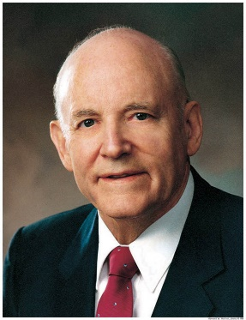
"Peace can come to an individual only by an unconditional surrender to him who is the Prince of peace and who has the power to confer peace.
"One may live in beautiful and peaceful surroundings, yet, because of inner dissension and discord, be in a state of constant turmoil.
On the other hand, one may be in the midst of utter destruction and the bloodshed of war, yet have the serenity of unspeakable peace.
If we look to the ways of the world, we will find turmoil and confusion.
If we will but turn to God, we will find peace for the restless soul.
'Peace I leave with you, my peace I give unto you: not as the world giveth.' (John 14:27.)
John 16:33
(11)

Slide 14
Finding Peace
"We can find such peace in a world of conflict if we will but accept his great gift and his further invitation:
'Come unto me, all ye that labour and are heavy laden, and I will give you rest. Take my yoke upon you, and learn of me; for I am meek and lowly in heart: and ye shall find rest unto your souls.' (Matt. 11:28-29.)
"This peace shelters us from the worldly turmoil. The knowledge that God lives, that we are his children, and that he loves us soothes the troubled heart. The answer to the quest lies in faith in God and in his Son, Jesus Christ. This will bring peace to us now and in the eternity to follow."
John 16:33
(10)

Slide 15
Sources:
Suggested Hymn: #122 Though Deepening Trials or #129 Where Can I Turn for Peace?
Video:
Be of Good Cheer (9:09)
New Testament Institute Student Manual Chapter 26
Andrew C. Skinner, "Apostasy, Restoration, and Lessons in Faith," Ensign, Dec. 1995, 29
Gospeldoctrine.com
Bible Dictionary
Elder Bruce R. McConkie (Doctrinal New Testament Commentary, 3 vols. [1965–73], 753).
Kent P. Jackson, Joseph Smith's Commentary on the Bible, p. 139, italics added
President Thomas S. Monson, “The Three Rs of Choice,” Ensign, Nov. 2010, 67–69.
Elder Richard G. Scott (“To Acquire Spiritual Guidance,” Ensign or Liahona, Nov. 2009, 6).
Elder Quentin L. Cook (“Rejoice!” Ensign, Nov. 1996, 28).
Elder Adhemar Damiani (“Be of Good Cheer and Faithful in Adversity,” Ensign or Liahona, May 2005, 94).
President Howard W. Hunter (That We Might Have Joy [Salt Lake City: Deseret Book Co., 1994], 30.)
Picture of Jesus in frame 13 by Jared Barnes
Neal A. Maxwell quote (Frame 1): (Even As I Am [Salt Lake City: Deseret Book Co., 1982], 91.)

Slide 16
Event | Matthew | Mark | Luke | John
Jesus Further Explains His Death |  |  |  | 16:4-33
Receiving the Gift of the Holy Ghost John 16:7:
"...in the New Testament, the full powers and gifts of the Holy Ghost were not given in the Old World meridian Church until the day of Pentecost...While the Bridegroom was present with his disciples in the flesh, he was their Comforter, their Revelator, their Testator. He was their Life and Light, their source of power and might. 'Hence, as long as Jesus was with the disciples in person, there was not the full need for them to have the constant companionship of the Spirit that there would be after Jesus left.' But because of the vital role that Spirit would play thereafter in the growth, development, and expansion of the early Christian Church, Jesus said: 'It is expedient for you that I go away: for if I go not away, the Comforter will not come unto you; but if I depart, I will send him unto you' (John 16:7)." (Selected Writings of Robert L. Millet: Gospel Scholars Series [Salt Lake City: Deseret Book Co., 2000], 194.)
Peace Comes by Obedience John 16:33:
"Peace does not come to the transgressor of law, Peace comes by obedience to law, and it is that message which Jesus would have us establish among men-peace to the individual that he may be at peace with his God; perfect harmony existing between his Creator and himself, perfect harmony existing between himself and law, the righteous laws to which he is subject and from which he never can escape peace in the home, families living at peace with each other and with their neighbors." (Conference Report, October 1965, First Day-Morning Meeting 10.)
The Future is Bright: John 16:33:
“I testify to you that our promised blessings are beyond measure. Though the storm clouds may gather, though the rains may pour down upon us, our knowledge of the gospel and our love of our Heavenly Father and of our Savior will comfort and sustain us and bring joy to our hearts as we walk uprightly and keep the commandments. There will be nothing in this world that can defeat us.
“My beloved brothers and sisters, fear not. Be of good cheer. The future is as bright as your faith” President Thomas S. Monson (“Be of Good Cheer,” Ensign or Liahona, May 2009, 91–92).
The Holy Ghost As Our Guide John 16:12-13:
“How do we take the Holy Spirit for our guide? We must repent of our sins each week and renew our covenants by partaking of the sacrament with clean hands and a pure heart, as we are commanded to do (see D&C 59:8–9, 12). Only in this way can we have the divine promise that we will ‘always have his Spirit to be with [us]’ (D&C 20:77). That Spirit is the Holy Ghost, whose mission is to teach us, to lead us to truth, and to testify of the Father and the Son (see John 14:26; John 15:26; John 16:13; 3 Nephi 11:32, 36)” Elder Dallin H. Oaks (“Be Not Deceived,” Ensign or Liahona, Nov. 2004, 46).
Be of Good Cheer John 16:33:
“Your level of spirituality is also directly related to how well you fill the Lord’s commandments to ‘Be of good cheer’ and ‘Lift up your heart and rejoice’ (D&C 31:3). How many times in the scriptures did the Lord command us to be of good cheer? He didn’t say, ‘Be of good cheer if everything is going well, if you have enough money to pay all your bills, if [you are feeling well],’ or whatever. No. For us to be of good cheer is a commandment and not merely a suggestion” Elder Joe J. Christensen (“Ten Ideas to Increase Your Spirituality,” Ensign, Mar. 1999, 59).

Slide 17
The Pied Piper:
The town of Hamlyn was once full of rats. They ate all the food, troubled sleeping babies, and made a lot of noise. The people had grown tired of the rats but were unable to do anything. Even the cats were not able to kill the rats.
One day, a queer fellow with piercing eyes, came to town. He was called the Pied Piper. He went to the Mayor and asked him, “What will you pay me if I free your town of every single rat?” The mayor offered fifty pounds to the Pied Piper.
Happy with the offer, the Pied Piper started playing his pipe. Hearing the shrill, keen note, every rat came out from its hole and started following him. The Pied Piper kept on playing his pipe and the rats followed hirn. The piper walked up to the harbour with millions of rats behind him and led them into the water and waited till every rat had drowned.
Now the town was free of the little devils and the people were very happy.
After all the rats were dead, the Pied Piper returned and asked the Mayor for his money. The Mayor said that he could only give him twenty pounds for such an easy job. Now that the rats were dead, the Mayor thought that there was nothing to worry about. But the Pied Piper wanted to teach him a lesson. This time he played a different tune. Hearing his music, the children came out of their houses. They started following the piper, dancing and shouting. The elders watched in disbelief as the Pied Piper led the children far, far away. The Mayor sent his men to look for the piper and bring the children back but none could find the lost children.
http://shortstoriesshort.com/story/the-pied-piper/

