Slide 1
Lesson 77
The Intercessory Prayer
John 17
This is eternal lives—to know the only wise and true God, and Jesus Christ, whom he hath sent. I am he. Receive ye, therefore, my law.
D&C 132:24

Slide 2
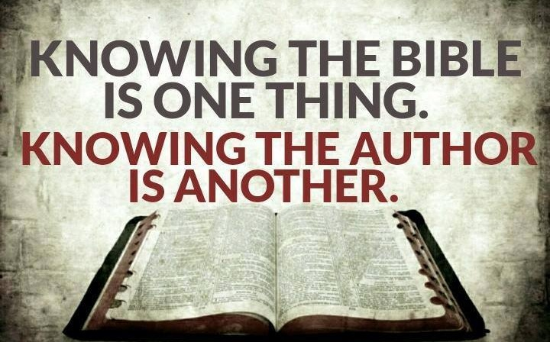
What is the difference between knowing about someone and actually knowing that person?
What does it take to really know someone?
Who are some individuals whom you feel would be important for you to get to know better?

Slide 3
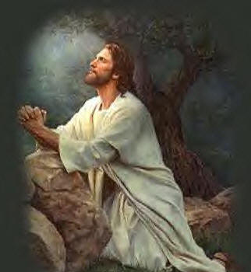
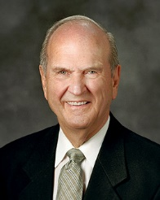
Intercede
“[The Intercessory Prayer is] so named because the Lord prayerfully interceded with His Father for the benefit of His disciples.
Jesus Christ spoke to Heavenly Father in behalf of His disciples, pleading that they might receive eternal life.
To speak to someone in behalf of another person.
‘These words spake Jesus, and lifted up his eyes to heaven, and said, Father, … glorify thy Son, that thy Son also may glorify thee. …
“‘I have finished the work which thou gavest me to do. …
“From this prayer of the Lord we learn how keenly He feels His responsibility as our Mediator and Advocate with the Father.”
John 17:1-3
(2)

Slide 4
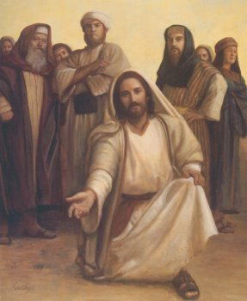
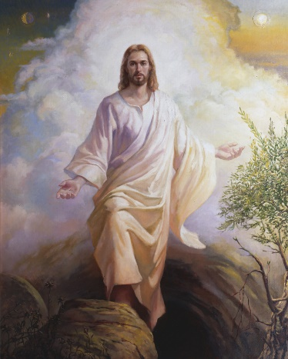
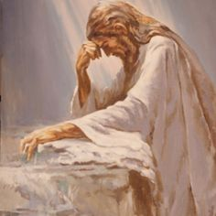
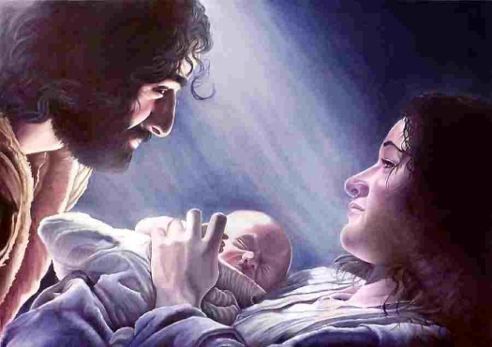
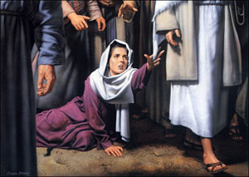
Receiving Eternal Life
“It is one thing to know about God and another to know him. We know about him when we learn that he is a personal being in whose image man is created; when we learn that the Son is in the express image of his Father’s person; when we learn that both the Father and the Son possess certain specified attributes and powers…
To receive eternal life, we must come to know Heavenly Father and His Son, Jesus Christ.
…To know God is to think what he thinks, to feel what he feels, to have the power he possesses, to comprehend the truths he understands, and to do what he does.
Those who know God become like him, and have his kind of life, which is eternal life.”
John 17:1-3
(3)

Slide 5
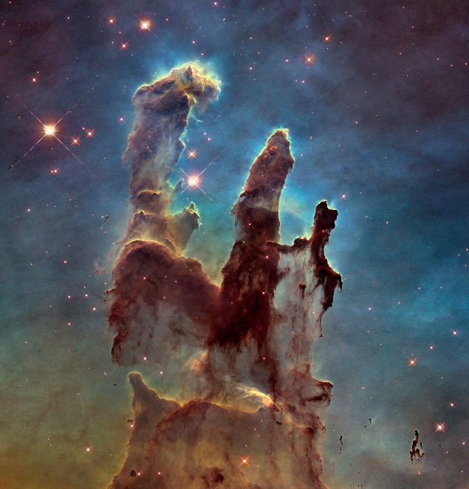
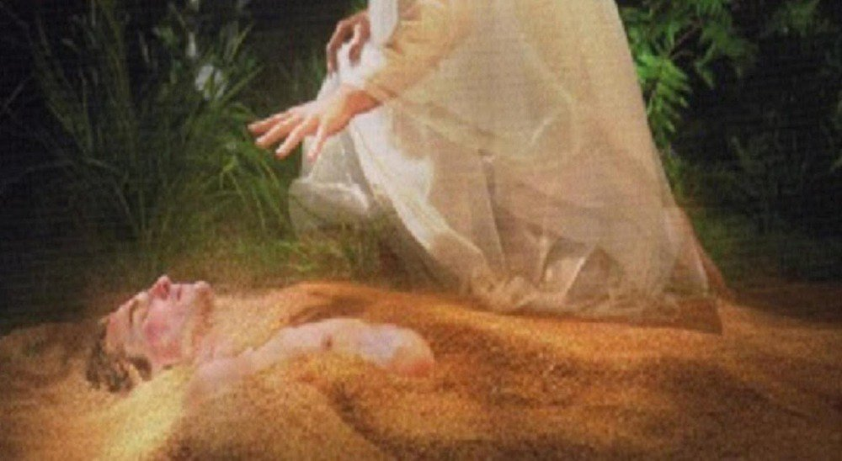
Receiving Eternal Life
No Christ, No peace
Know Christ,
Know Peace
Hubble Picture-Pillars of Creation
“We are created as much from the dust of eternity as we are from the dust of the earth.
To believe in God is to know that all the rules will be fair and that there will be wonderful surprises.
You have the Savior of the world on your side if you seek his help and follow his direction.”
John 17:1-3

Slide 6
Doctrinal Mastery
John 17:3
And this is life eternal, that they might know thee the only true God, and Jesus Christ, whom thou hast sent.

Slide 7
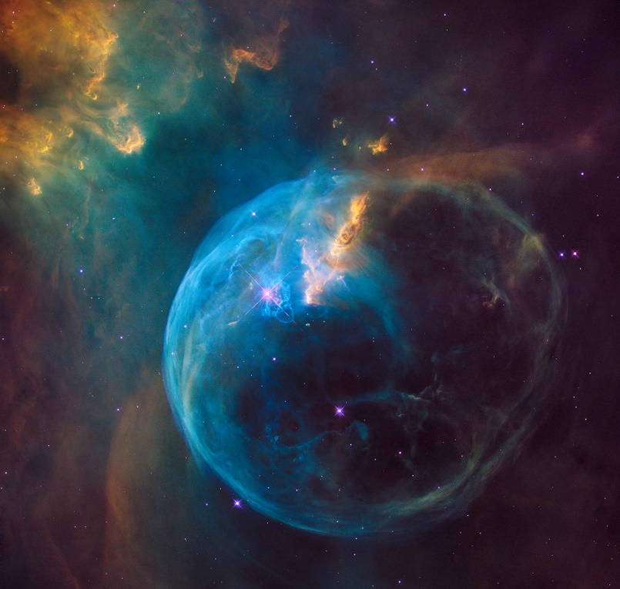
The Completion of His Mission
“Jesus ‘was like unto God’ before the world was; he had glory and dominion then; and he then became, under the direction of the Father, the Creator of this earth and of worlds without number.
And there stood one among them that was like unto God, and he said unto those who were with him: We will go down, for there is space there, and we will take of these materials, and we will make an earth whereon these may dwell; Abraham 3:24
“Jesus is certifying to the Father that the Son has done the appointed work, and asks that as a consequence he be given again the state of dignity and honor he once held.”
John 17:4-8
(3)

Slide 8
Purify
Father, I thank thee that thou hast purified those whom I have chosen, because of their faith, and I pray for them, and also for them who shall believe on their words, that they may be purified in me, through faith on their words, even as they are purified in me.
3 Nephi 29:28
Father, behold the sufferings and death of him who did no sin, in whom thou wast well pleased; behold the blood of thy Son which was shed, the blood of him whom thou gavest that thyself might be glorified;
Wherefore, Father, spare these my brethren that believe on my name, that they may come unto me and have everlasting life.
D&C 45:4-5
If we remain faithful, there will come a day when we will hear him intercede on our behalf as well. The Mediator and Advocate with the Father will plead our cause…
When we hear these words said on our behalf we will feel as the apostles did and will be filled with joy indescribable.
John 17:9-10
(4)

Slide 9
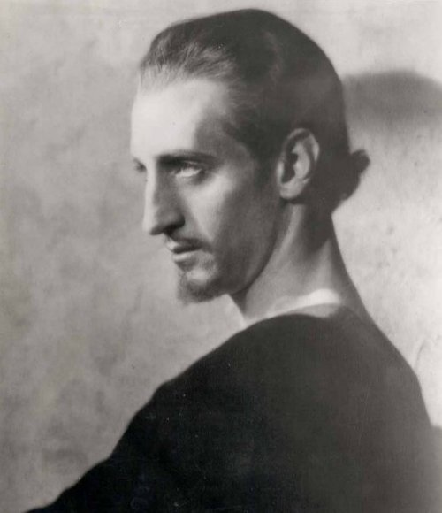
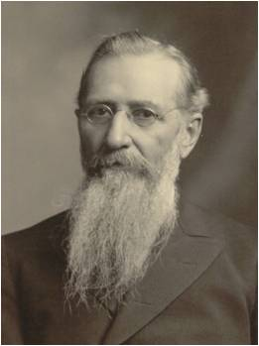
Who is a Son of Perdition?
The Greek word from which “perdition” is translated (apōleia) = a condition of being lost or destroyed.
Elsewhere in the New Testament, apōleia is translated as “destruction” (1)
Sons of perdition are those who receive “no forgiveness in this world nor in the world to come—having denied the Holy Spirit after having received it, and having denied the Only Begotten Son of the Father, having crucified him unto themselves and put him to an open shame.” (10)
“We know the divine plan required Jesus to be crucified, but it is wrenching to think that one of His special witnesses who sat at His feet, heard Him pray, watched Him heal, and felt His touch could betray Him and all that He was for 30 pieces of silver.
We are not the ones to judge Judas’s fate, but Jesus said of His betrayer, ‘Good [were it] for that man if he had not been born.”
*See Commentary by Joseph F. Smith
John 17:12
(6)

Slide 10
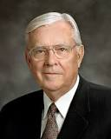
In the World—Not Of the World
First, ‘Be in the world.’ Be involved; be informed. Try to be understanding and tolerant and to appreciate diversity. Make meaningful contributions to society through service and involvement.
Second, ‘Be not of the world.’ Do not follow wrong paths or bend to accommodate or accept what is not right. …
“Members of the Church need to influence more than we are influenced. We should work to stem the tide of sin and evil instead of passively being swept along by it. We each need to help solve the problem rather than avoid or ignore it.”
John 17:14-16
(5)

Slide 11
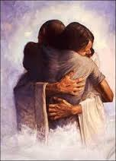
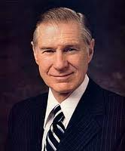
Being One—In Purpose
“The literal meaning of the English word Atonement is self-evident: at-one-ment, the bringing together of things that have been separated or estranged.” (6)
As we come unto Jesus Christ and receive the blessings of His Atonement, we can become one with the Father and the Son
“We should earnestly seek not just to know about the Master, but to strive, as He invited, to be one with Him …
“… The days ahead will be filled with affliction and difficulty. But with the assuring comfort of a personal relationship with God, we will be given a
calming courage.” (7)
John 17:20-23

Slide 12
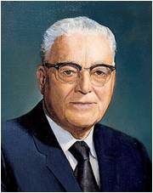
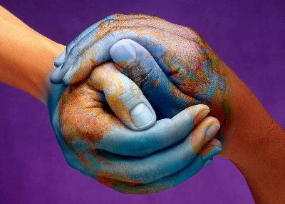
Behold, this I have given unto you … I say unto you, be one; and if ye are not one ye are not mine.
D&C 38:27
If we are not united, we are not His. Here unity is the test of divine ownership as thus expressed.
If we would be united in love and fellowship and harmony, this church would convert the world, who would see in us the shining example of these qualities which evidence that divine ownership."
John 17:20-23
(8)

Slide 13
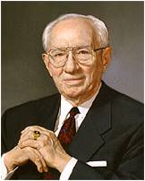
The Father and The Son
“They are distinct beings, but they are one in purpose and effort. They are united as one in bringing to pass the grand, divine plan for the salvation and exaltation of the children of God. …
“It is that perfect unity between the Father, the Son, and the Holy Ghost that binds these three into the oneness of the divine Godhead.”
John 17:20-23
(9)

Slide 14
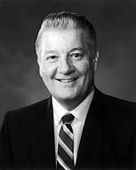
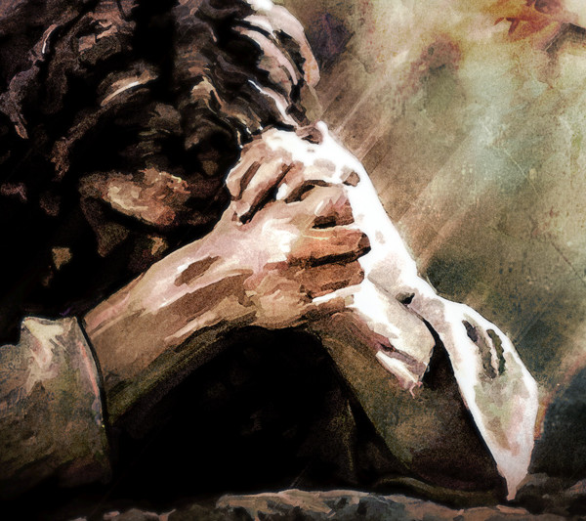
The Love of God
“When filled with God’s love, we can do and see and understand things that we could not otherwise do or see or understand. Filled with His love, we can endure pain, quell fear, forgive freely, avoid contention, renew strength, and bless and help others in ways surprising even to us.
“Jesus Christ was filled with unfathomable love as He endured incomprehensible pain, cruelty, and injustice for us.
Through His love for us, He rose above otherwise insurmountable barriers. His love knows no barriers. He invites us to follow Him and partake of His unlimited love so we too may rise above the pain and cruelty and injustice of this world and help and forgive and bless.”
Chad Winks
John 17:26
(11)

Slide 15
Sources:
Suggested Hymn: #145 Prayer Is the Soul's Sincere Desire
New Testament Institute Student Manual Chapter 27
Elder Russell M. Nelson (“Lessons from the Lord’s Prayers,” Ensign or Liahona, May 2009, 47).
Elder Bruce R. McConkie (Doctrinal New Testament Commentary, 3 vols. [1965–73], 1:762). (Doctrinal New Testament Commentary, 1:762).
Gospeldoctrine.com
Elder M. Russell Ballard “The Effects of Television,” Ensign, May 1989, 80.
Elder Jeffrey R. Holland (“The Atonement of Jesus Christ,” Ensign, Mar. 2008, 34–35). (“None Were with Him,” Ensign or Liahona, May 2009, 86).
President James E. Faust (“That We Might Know Thee,” Ensign, Jan. 1999, 2, 5).
President Harold B. Lee (The Teachings of Harold B. Lee, edited by Clyde J. Williams [Salt Lake City: Bookcraft, 1996], 388.)
President Gordon B. Hinckley (“The Father, Son, and Holy Ghost,” Ensign, Nov. 1986, 51).
Gospel Topics: Sons of Perdition
Elder John H. Groberg (“The Power of God’s Love,” Ensign or Liahona, Nov. 2004, 11).
Presentation by ©http://fashionsbylynda.com/blog/

Slide 16
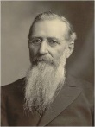
Event | Matthew | Mark | Luke | John
Jesus Prays For His Disciples |  |  |  | 17:1-26
Knowing God John 17:1-3:
Knowing God means more than believing that He exists or having an intellectual understanding about Him; it means becoming acquainted with Him through personal experience and living His teachings. (1)
One in Purpose John 17:20-23:
How glorious it is to contemplate that we have been invited into that perfect unity that exists with the Father and the Son. How can this happen? …
“Jesus achieved perfect unity with the Father by submitting Himself, both flesh and spirit, to the will of the Father. … Referring to His Father, Jesus said, ‘I do always those things that please him’ (John 8:29). …
“Surely we will not be one with God and Christ until we make Their will and interest our greatest desire. Such submissiveness is not reached in a day, but through the Holy Spirit, the Lord will tutor us if we are willing until, in process of time, it may accurately be said that He is in us as the Father is in Him. At times I tremble to consider what may be required, but I know that it is only in this perfect union that a fulness of joy can be found. I am grateful beyond expression that I am invited to be one with those holy beings I revere and worship as my Heavenly Father and Redeemer.” Elder D. Todd Christofferson (“That They May Be One in Us,” Ensign, Nov. 2002, 71–73).
The Creator:
Christ is the Creator and Redeemer of worlds so numerous that they cannot be numbered by man. As to his infinite and eternal creative and redemptive enterprises the divine word attests: “And worlds without number have I created,” saith the Father, “and I also created them for mine own purpose; and by the Son I created them, which is mine Only Begotten. … But only an account of this earth, and the inhabitants thereof, give I unto you.” As to all of the other worlds of the Lord’s creating we know only that it is his work and his glory “to bring to pass”—through the Redeemer—“the immortality and eternal life” of all their inhabitants. (Moses 1:33, 35, 39.) Christ and the Creation June 1982 Ensign By Elder Bruce R. McConkie
At One John 17:11
"The Saviour sought continually to impress upon the minds of his disciples that a perfect oneness reigned among all celestial beings-that the Father and the Son and their minister, the Holy Ghost, were one in their administration in heaven and among the people pertaining to this earth. Between them and all the heavenly hosts there can be no disunion, no discord, no wavering on a suggestion, on a thought or reflection, on a feeling or manifestation; for such a principle would differ widely from the character of Him who dictates them, who makes his throne the habitation of justice, mercy, equity, and truth. If the heavenly hosts were not one, they would be entirely unfit to dwell in eternal burnings with the Father and Ruler of the universe.
"A perfect oneness will save a people, because intelligent beings cannot become perfectly one only by acting upon principles that pertain to eternal life. Wicked men may be partially united in evil; but, in the very nature of things, such a union is of short duration. The very principle upon which they are partially united will itself breed contention and disunion to destroy the temporary compact. Only the line of truth and righteousness can secure to any kingdom or people, either of earthly or heavenly existence, an eternal continuation of perfect union; for only truth and those who are sanctified by it can dwell in celestial glory." President Brigham Young (Journal of Discourses,7: 277-8.)
*Was Judas a Son of Perdition? John 17:12
President Joseph F. Smith (1838–1918) wrote about whether or not Judas is a son of perdition, after first referring to Doctrine and Covenants 76:31–37, 43, which describes the knowledge that must be understood and then rejected by those who become sons of perdition: “That Judas did partake of all this knowledge—that these great truths had been revealed to him—that he had received the Holy Spirit by the gift of God, and was therefore qualified to commit the unpardonable sin, is not at all clear to me. To my mind it strongly appears that not one of the disciples possessed sufficient light, knowledge nor wisdom, at the time of the crucifixion, for either exaltation or condemnation; for it was afterward that their minds were opened to understand the scriptures, and that they were endowed with power from on high; without which they were only children in knowledge, in comparison to what they afterwards became under the influence of the Spirit.” (Gospel Doctrine, 5th ed. [1939], 433).

Slide 17
HOW THE FATHER AND THE SON ARE ONE
_____ 1. John 17:1, 5, 22 _____ 2. John 17:2 _____ 3. John 17:6–8, 17 _____ 4.John 17:3, 18 _____ 5. John 17:24–26 | a. One in purpose b. One in word and truth c. One in love d. One in power e. One in glory
HOW THE FATHER AND THE SON ARE ONE
_____ 1. John 17:1, 5, 22 _____ 2. John 17:2 _____ 3. John 17:6–8, 17 _____ 4.John 17:3, 18 _____ 5. John 17:24–26 | a. One in purpose b. One in word and truth c. One in love d. One in power e. One in glory
HOW THE FATHER AND THE SON ARE ONE
_____ 1. John 17:1, 5, 22 _____ 2. John 17:2 _____ 3. John 17:6–8, 17 _____ 4.John 17:3, 18 _____ 5. John 17:24–26 | a. One in purpose b. One in word and truth c. One in love d. One in power e. One in glory
HOW THE FATHER AND THE SON ARE ONE
_____ 1. John 17:1, 5, 22 _____ 2. John 17:2 _____ 3. John 17:6–8, 17 _____ 4.John 17:3, 18 _____ 5. John 17:24–26 | a. One in purpose b. One in word and truth c. One in love d. One in power e. One in glory
HOW THE FATHER AND THE SON ARE ONE
_____ 1. John 17:1, 5, 22 _____ 2. John 17:2 _____ 3. John 17:6–8, 17 _____ 4.John 17:3, 18 _____ 5. John 17:24–26 | a. One in purpose b. One in word and truth c. One in love d. One in power e. One in glory
HOW THE FATHER AND THE SON ARE ONE
_____ 1. John 17:1, 5, 22 _____ 2. John 17:2 _____ 3. John 17:6–8, 17 _____ 4.John 17:3, 18 _____ 5. John 17:24–26 | a. One in purpose b. One in word and truth c. One in love d. One in power e. One in glory

