Slide 1
Lesson 79
Christ is Risen
John 20
Matthew 28:1-8
Mark 16:2-11
Luke 24:1-12
But now is Christ risen from the dead, and become the firstfruits of them that slept.
For since by man came death, by man came also the resurrection of the dead.
For as in Adam all die, even so in Christ shall all be made alive.
1 Corinthians 15:20-22
John 20:1-18
Presentation by ©http://fashionsbylynda.com/blog/

Slide 3
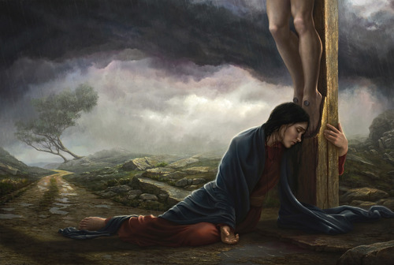
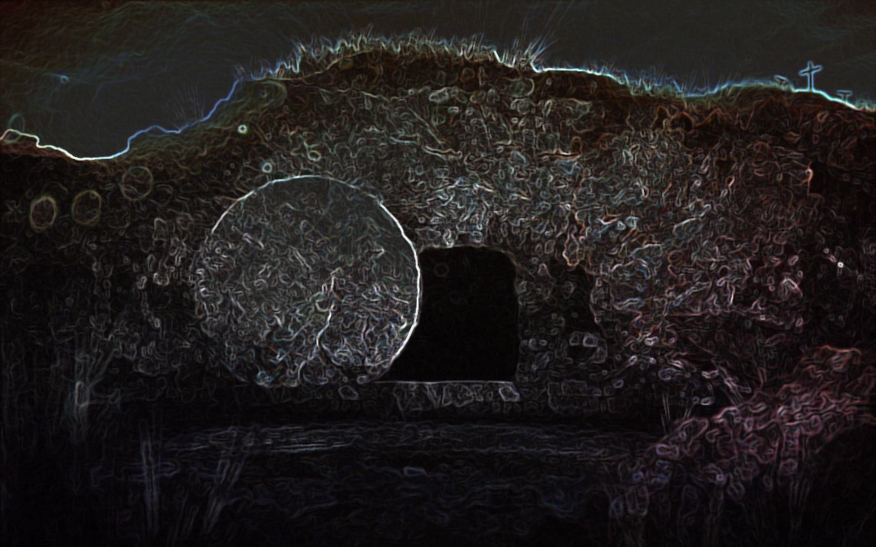
Previously…
The Lord’s covenant people observed the Sabbath from sundown on Friday to sundown on Saturday.
Joseph Brickey
After Jesus died at about 3:00 p.m. on Friday, His body was placed in a tomb late that afternoon and a large stone was set to seal the entrance of the tomb. The Sabbath then began at sunset.
John 19:41-42

Slide 4
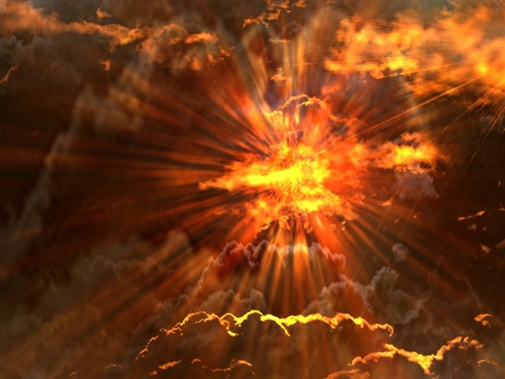
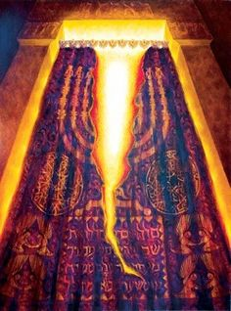
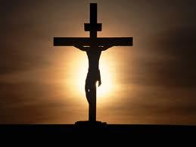
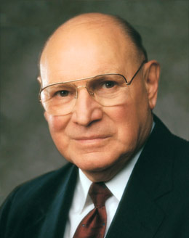
“I think of how dark that Friday was when Christ was lifted up on the cross.
On that terrible Friday the earth shook and grew dark. Frightful storms lashed at the earth.
Those evil men who sought His life rejoiced.
Now that Jesus was no more, surely those who followed Him would disperse. On that day they stood triumphant.
On that day the veil of the temple was rent in twain.
Mary Magdalene and Mary, the mother of Jesus, were both overcome with grief and despair. The superb man they had loved and honored hung lifeless upon the cross.”
(3)

Slide 5
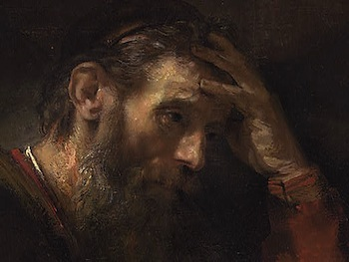
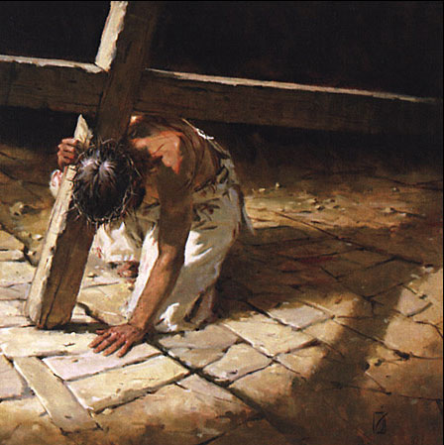
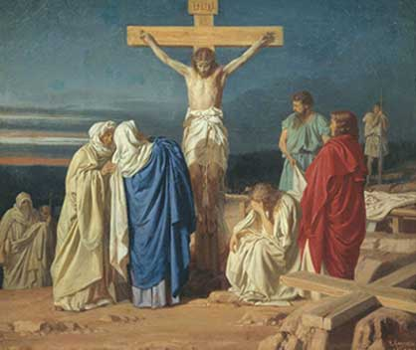
“On that Friday the Apostles were devastated.
Jesus, their Savior—the man who had walked on water and raised the dead—was Himself at the mercy of wicked men.
They watched helplessly as He was overcome by His enemies.
On that Friday the Savior of mankind was humiliated and bruised, abused and reviled.
It was a Friday filled with devastating, consuming sorrow that gnawed at the souls of those who loved and honored the Son of God.
I think that of all the days since the beginning of this world’s history, that Friday was the darkest.”
(3)

Slide 6
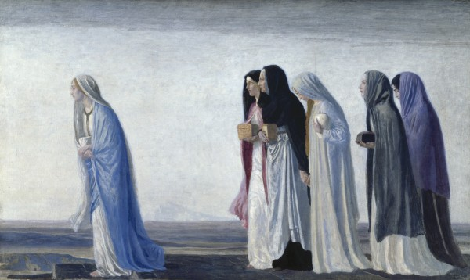
Anoint--Embalm
To preserve (a corpse) from decay, originally with spices and now usually by arterial injection of a preservative.
This was the time they left their own houses, and by the rising of the sun they got to the tomb.
As the preceding day was the Sabbath, they could not, consistently with the observances of that day, approach the tomb.
Mark 16:1-2
(2)

Slide 7
The Earthquake
There was a great earthquake and an angel rolled back the stone of the tomb and sat upon it.
The guards were afraid and became as dead men.
God can, by one and the same means, comfort his servants, and terrify his enemies. (2)
Matthew 28:1-4

Slide 8
Sepulchre
“The first day of the week cometh Mary Magdalene early, when it was yet dark, unto the sepulchre.”
“…the first day of the week, came Mary Magdalene and the other Mary to see the sepulchre.”
John 20:1; Matthew 28:1

Slide 9
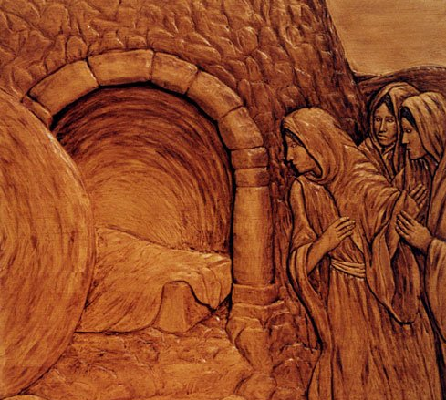
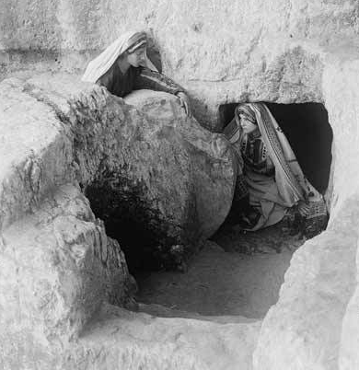
The Stone
“…and seeth the stone taken away from the sepulchre.”
John 20:1-2

Slide 10
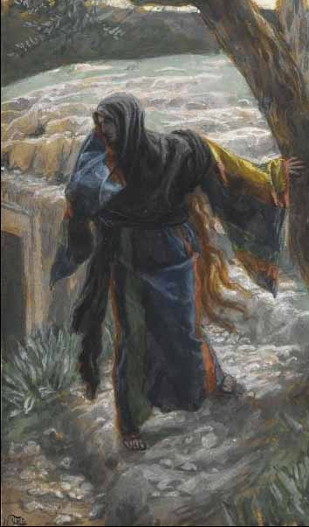
“He is Not Here”
The women are favored by angelic visitation and assurance
Tissot
Then Mary ran to tell Simon, Peter and the other disciple (John)
Matthew 28:5-7; Luke 24:10

Slide 11
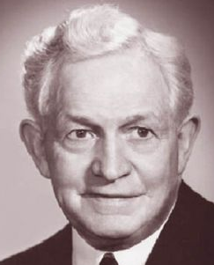
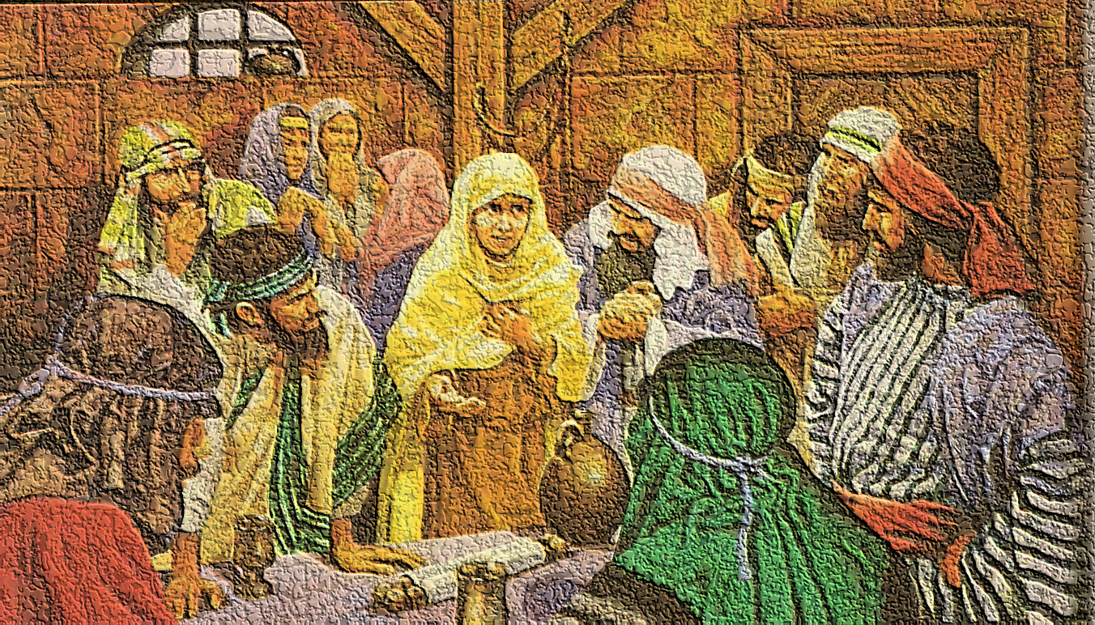
Idle Tales
…they have taken away the Lord out of the sepulchre, and we know not where they have laid him.”
"Like the apostles of old, this knowledge and belief should transform all of us to be confident, settled, unafraid, and at peace in our lives as followers of the divine Christ.
It should help us carry all burdens, bear any sorrows, and fully savor all joys and happiness that can be found in this life.“ (5)
“And their words seemed to them as idle tales, and they believed them not.”
John 20:2; Luke 24:11

Slide 12
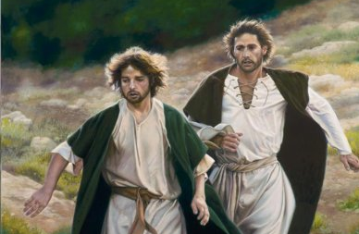
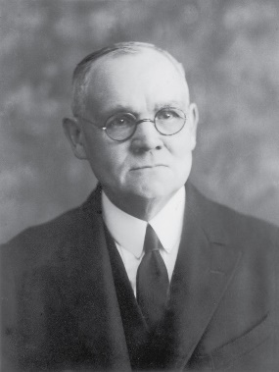
Peter and That Other Disciple
It was probably John the Beloved that ran with Peter to the sepulchre.
“Peter, and “that other disciple” who, doubtless, was John, set forth in haste, running together toward the sepulchre. John outran his companion, and on reaching the tomb stooped to look in, and so caught a glimpse of the linen cerements lying on the floor; [but it was Peter who entered first].” (4)
John 20:3

Slide 13
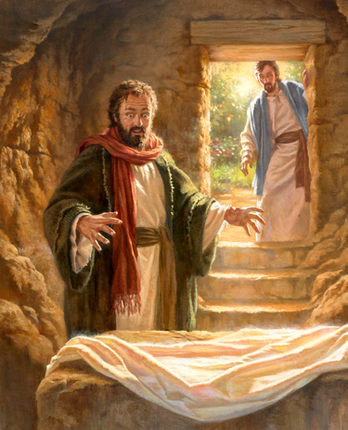
“And he (John) stooping down, and looking in, saw the linen clothes lying; yet went he not in.”
“Then cometh Simon Peter following him, and went into the sepulchre, and seeth the linen clothes lie.”
John 20:5-6; Luke 24:12

Slide 14
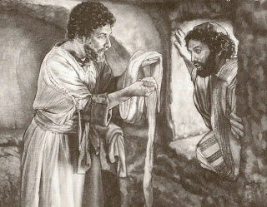
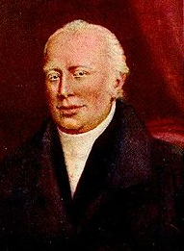
“Then went in also that other disciple, which came first to the sepulchre and he saw, and believed.”
Peter seeth the linen clothes lie, and the napkin that was about his head not lying with the linen clothes, but wrapped together in a place by itself. All these circumstances prove that the thing was done leisurely; order and regularity being observed through the whole. Hurry and confusion necessarily mark every act of robbery. (2)
“And the napkin, that was about his head, not lying with the linen clothes, but wrapped together in a place by itself.”
It must have been John, the Beloved as “that other disciple”.
The other authors do not mention the napkin.
John had an eye for detail.
“Then the disciples went away again unto their own home.”
John 20:7-8, 10

Slide 15
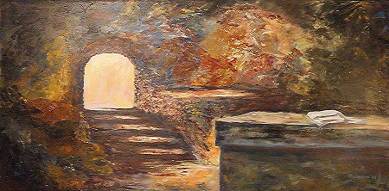
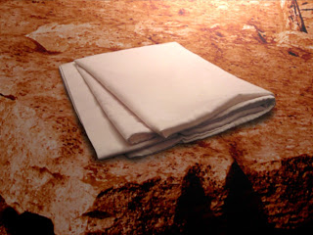
Neatly Folded Napkin
The head covering over the body of Jesus Christ in the grave was a neatly “folded napkin.”
It goes on to say that among Jews of the time a master would let his servants know whether he was finished eating or coming back to the table by the way he left his napkin.
If he tossed it aside, he was finished.
If he folded it, he was not finished and would return.
The hidden message in the story is that by laying his “napkin” aside and neatly folded Jesus was saying he was coming back.
See notes*
John 20:7

Slide 16
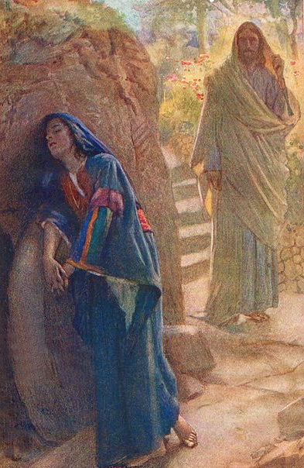
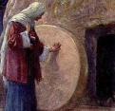
Jesus Appears to Mary
Mary followed Peter and John to the tomb, stayed and wept.
She is the only person mentioned in each of the four Gospels as a witness to the Crucifixion, burial, and empty tomb.(1)
Mary Magdalene, or Mary of Magdala, likely came from a town called Magdala on the western shore of the Sea of Galilee.
According to Mark 16:9 and Luke 8:2, the Savior cleansed her of “seven devils.”
She was a disciple of Jesus Christ and “became one of the closest friends Christ had among women.” (4)
John 20:10-11
Harold Copping

Slide 17
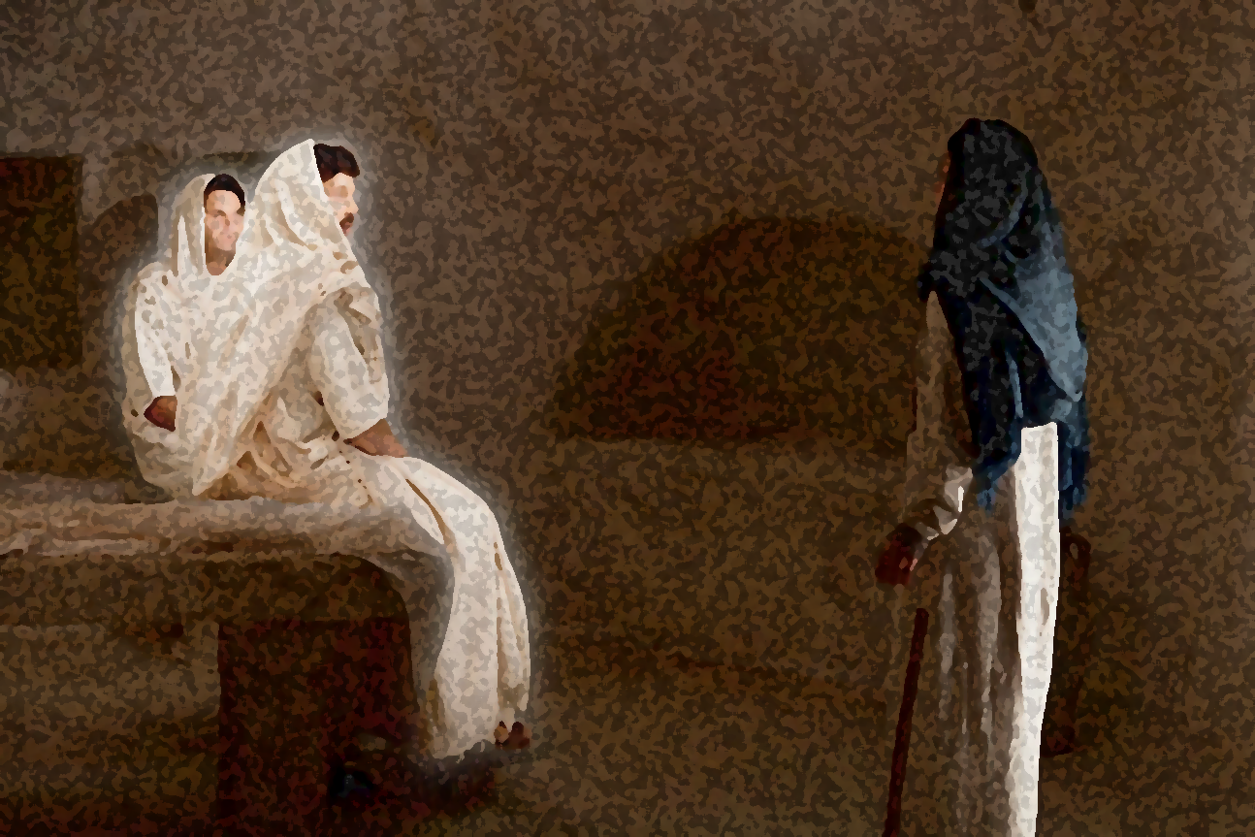
“Why Seek Ye Among the Living?”
And shall deliver him to the Gentiles to mock, and to scourge, and to crucify him: and the third day he shall rise again.
Matthew 20:19
And they shall scourge him, and put him to death: and the third day he shall rise again.
Luke 18:33
And they shall mock him, and shall scourge him, and shall spit upon him, and shall kill him: and the third day he shall rise again.
Mark 10:34
Remember What He Has Taught?
The Son of man must be delivered into the hands of sinful men, and be crucified, and the third day rise again.
Luke 24:5-8; John 20:12

Slide 18
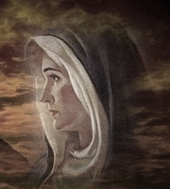
“Why Weepest Thou?”
…Because they have taken away my Lord, and I know not where they have laid him.”
John 20:13
John 20:13

Slide 19
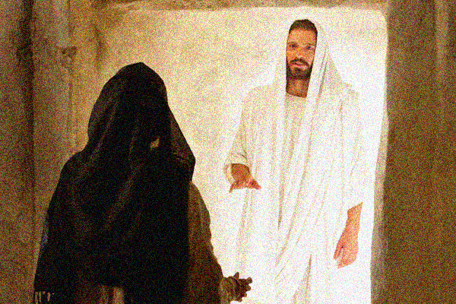
Turn Around
“And when she had thus said, she turned herself back, and saw Jesus standing, and knew not that it was Jesus.”
“Now when Jesus was risen early the first day of the week, he appeared first to Mary Magdalene…”
John 20:14; Mark 16:9

Slide 20
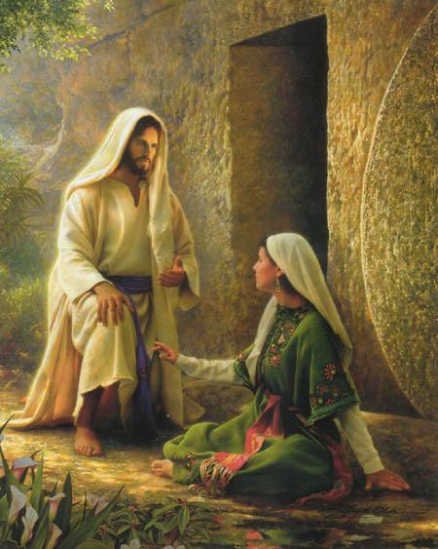
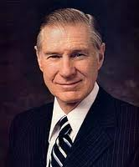
The Gardener
“Jesus saith unto her, Woman, why weepest thou?...
…Sir, if thou have borne him hence, tell me where thou hast laid him, and I will take him away.”
"The Savior was speaking not just to the sorrowing Mary. He was also speaking to us-men, women, and children and all of mankind ever born or yet to be born, for the tears of sorrow, pain, or remorse are the common lot of mankind.
Some have so much, while others struggle with so very little...Jesus said, 'Be not faithless, but believing' .
Through faith and righteousness all of the inequities, injuries, and pains of this life can be fully compensated for and made right. Blessings denied in this life will be fully recompensed in the eternities.“ (6)
Greg Olsen
John 20:15

Slide 21
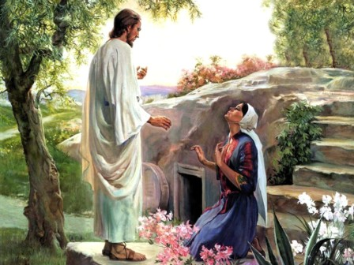
Rabboni
“Jesus saith unto her, Mary…
The Aramaic word Rabboni, used by Mary to address the resurrected Savior, is used only twice in the New Testament.
The King James translators retained the Aramaic word and John’s translation for his readers, which is “Master.”
In Mark 10:51, the word is translated as “Lord.”
The title Rabbi was used for respected teachers among first-century Jews.
Rabboni, a more lofty form of the title Rabbi, was a title that was rarely used and was usually reserved for highly esteemed teachers who had both divine knowledge and authority to teach others.
John 20:16
(1)

Slide 22
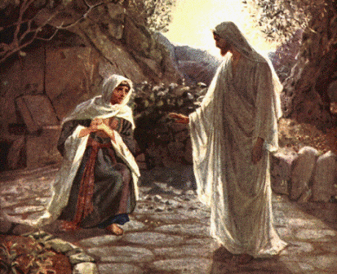
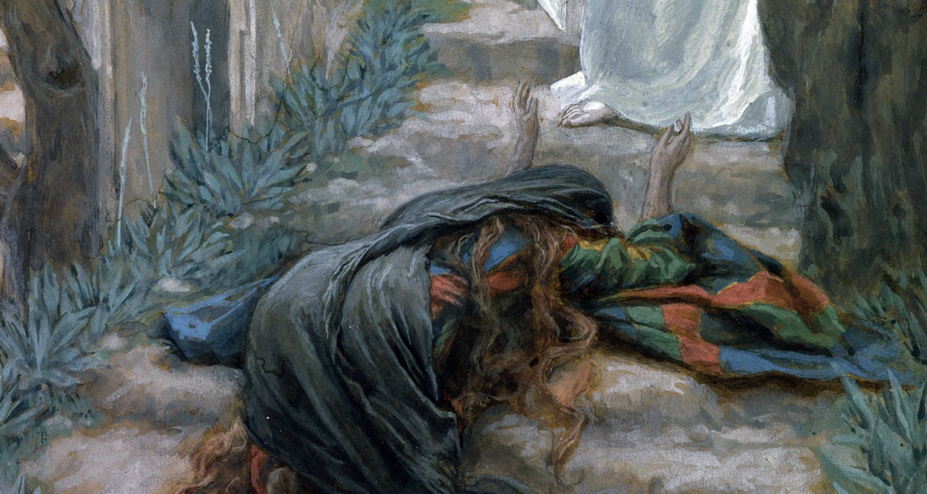
“Touch Me Not”
“…touch me not; for I am not yet ascended to my Father…
Some give the meaning as ‘Do not cling to me any longer,’ or ‘Do not hold me any longer.’
Some speak of ceasing to hold him or cling to him, leaving the inference that Mary was already holding him.
There is valid reason for supposing that the thought conveyed to Mary by the Risen Lord was to this effect: ‘You cannot hold me here, for I am going to ascend to my Father.’”
Tissot
The King James Version = ‘Touch me not.’
The Joseph Smith Translation = ‘Hold me not.’
Greek Variations = ‘Do not cling to me’ or ‘Do not hold me.’
John 20:17
(7)

Slide 23
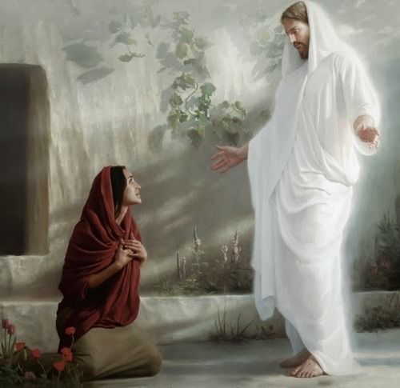
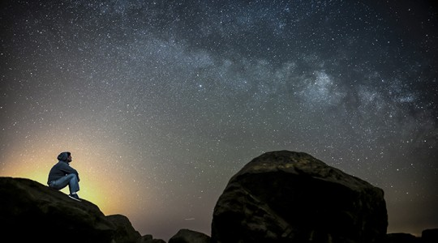
After Resurrection
Jesus Christ’s appearance to Mary Magdalene makes clear that after His Resurrection, there would be a respectful separation between the mortal disciples and the immortal Christ.
Joseph Brickey
Jesus’s appearance also clarifies that He did not go directly into the presence of God the Father after His death.
In the same way, after we die, our spirits will go to the world of spirits and await the time when they will be reunited with our physical bodies.
John 20:17
(1)

Slide 24
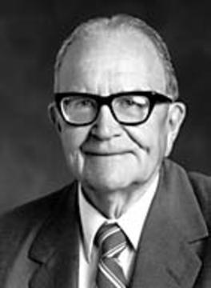
Between Death and Resurrection
Behold, it has been made known unto me, by an angel, that the spirits of all men, as soon as they are departed from this mortal body; yea, the spirits of all men, whether they be good or evil, are taken home to that God who gave them life. And then shall it come to pass that the spirits of those who are righteous, are received into a state of happiness, which is called paradise; a state of rest; a state of peace, where they shall rest from all their troubles and from all care, and sorrow.
Alma 40:11-12
While divested of His body Christ ministered among the departed, both in paradise and in the prison realm where dwelt in a state of durance the spirits of the disobedient. (4)
Tissot
Tissot
"During that period between death and resurrection, Jesus went into the spirit world, as he had promised the thieves on the cross. There he organized the preaching of the gospel to the spirits in prison.“ (8)
Mark 16:1-2

Slide 25
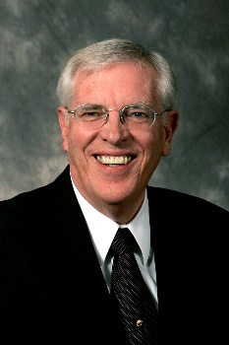
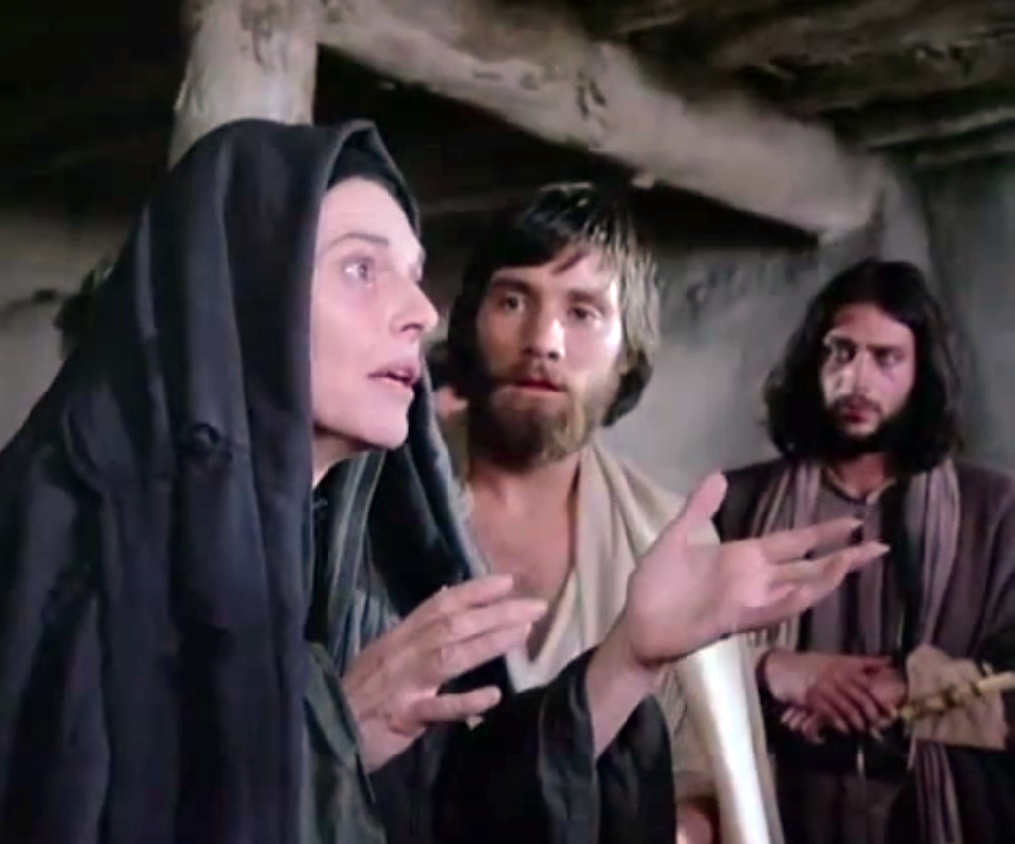
Mary’s Witness
"On that Sunday, the disciples were downhearted, frightened men. It seems it would have been easier for them to believe that Jesus had died and stayed dead. Yet their conversion to the reality of Christ's resurrection strengthens their witness for those who otherwise might disbelieve that vital truth.
Each Gospel writer makes it clear that the disciples were not swept into belief because they wanted to be.
Rather, they believed in spite of their own inclinations to the contrary.
The evidence of the truth eventually became overwhelming when the Lord appeared to them in person."
Jesus Christ overcame death through His Resurrection
John 20:18; Mark 16:11
(9)

Slide 26
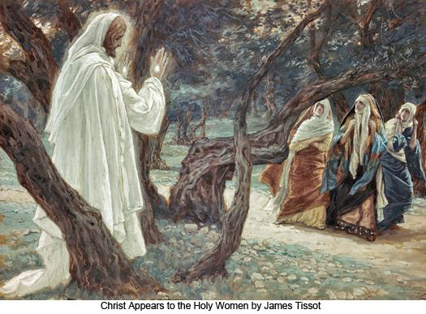
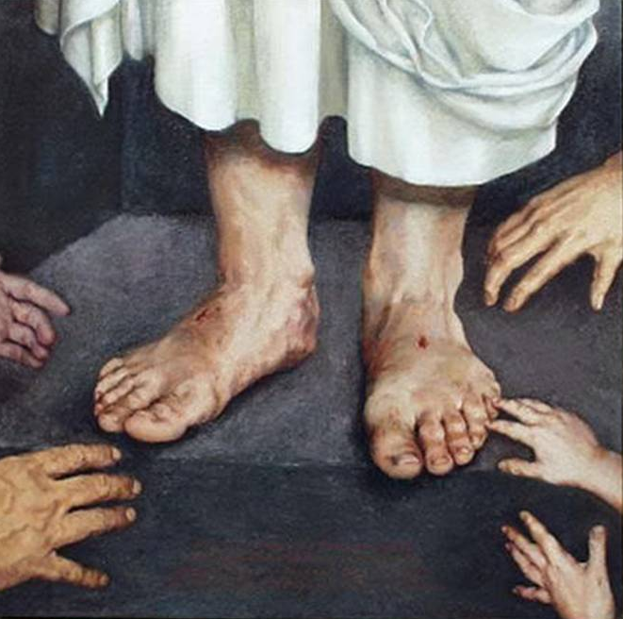
Other Women Witnesses The Savior
“… Jesus chose to appear to and be handled by a group of other women-all before he came even to Peter and the rest of the Twelve... We know that women in general are more spiritual than men, and certainly their instincts and desires to render compassionate service exceed those of their male counterparts.”(7) See Notes*
Tissot
It appears reasonable and probable that between Mary's impulsive attempt to touch the Lord, and the action of the other women who held Him by the feet as they bowed in worshipful reverence, Christ did ascend to the Father, and that later He returned to earth to continue His ministry in the resurrected state." (4)
Matthew 26:9-10

Slide 27
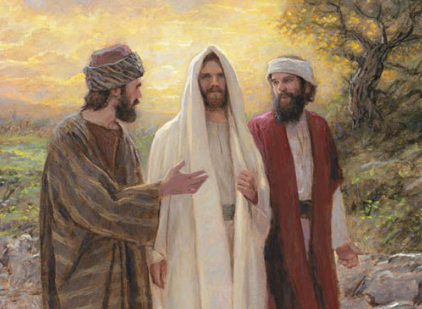
Two Witnesses On the Road to Emmaus
Christ appeared "in another form."
In what form did he appear?
The scriptures don't tell us exactly how it was that these two faithful disciples didn't immediately recognize Jesus as the resurrected Lord. Luke's version says their "eyes were holden" at least until their "eyes were opened... and he vanished out of their sight.”
Mark insinuates it was because he appeared to them "in another form," which gives the impression that His appearance was altered. Perhaps this was how their "eyes were holden."
Jon McNaughton
Mark 16:12; Luke 24:13
(10)

Slide 28
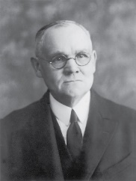
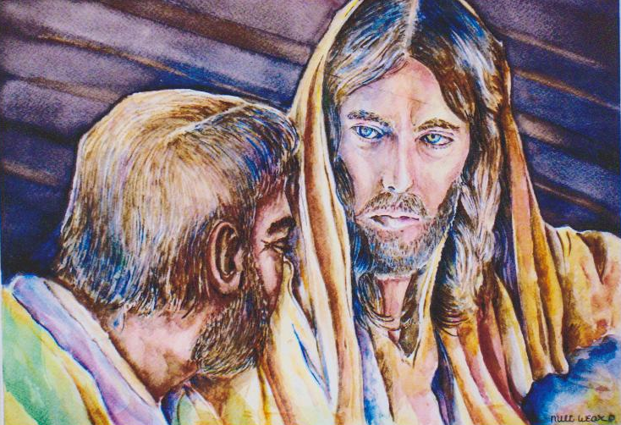
Peter Sees the Lord
"This is the sole mention made by the Gospel-writers of Christ's personal appearance to Simon Peter on that day.
The interview between the Lord and His once recreant but now repentant apostle must have been affecting in the extreme.
Peter's remorseful penitence over his denial of Christ in the palace of the high priest was deep and pitiful; he may have doubted that ever again would the Master call him His servant; but hope must have been engendered through the message from the tomb brought by the women...
To the repentant Peter came the Lord, doubtless with forgiveness and loving assurance."
Luke 24:34; 1 Corinthians 15:5
(4)

Slide 29
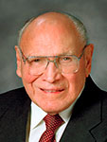
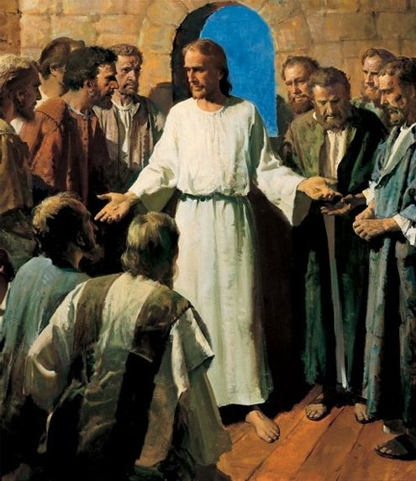
The 10 Apostles See the Lord
“In an instant the eyes that had been filled with ever-flowing tears dried. The lips that had whispered prayers of distress and grief now filled the air with wondrous praise, for Jesus the Christ, the Son of the living God, stood before them as the firstfruits of the Resurrection, the proof that death is merely the beginning of a new and wondrous existence” (3)
Which Apostle was not present when the other disciples saw the resurrected Lord?
John 20:19-20
(3)

Slide 30
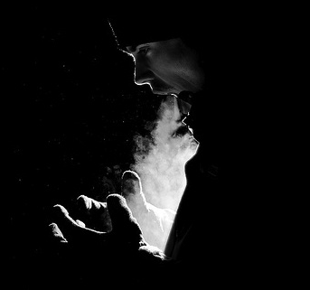
“Receive Ye the Holy Ghost”
Interestingly, the Savior doesn't always follow protocol. Instead of giving the Gift of the Holy Ghost by the laying on of hands, he breathes upon the apostles and says, 'Receive ye the Holy Ghost.'
Many times he performed miracles without the laying on of hands.
We are instructed to administer ordinances by the laying on of hands, 'now I give unto thee a commandment, that thou shalt baptize by water, and they shall receive the Holy Ghost by the laying on of the hands, even as the apostles of old'.
Similarly, though the Master administered to the sick in a variety of ways, we are commanded to attend to this by the laying on of hands, 'whosoever among you are sick...the elders of the church, two or more, shall be called, and shall pray for and lay their hands upon them in my name'.”
John 20:22; D&C 35:6; D&C 42:43-44 (laying on of the hands)
(10)

Slide 31
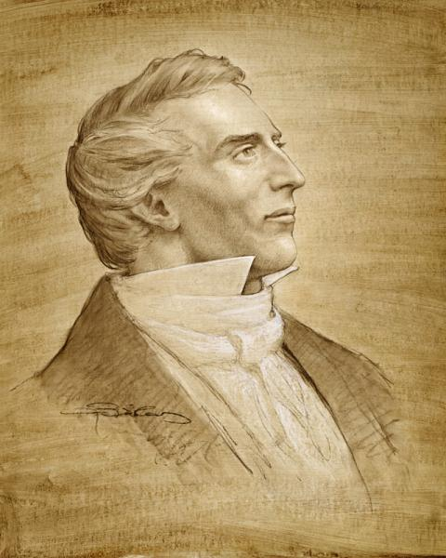
Given the Authority to Remit Sins
The “keys of the kingdom of heaven” that the Savior had earlier bestowed on the Apostles gave them the power to bind or loose on earth and in heaven.
The Savior used similar language as He instructed the Apostles about their authority to remit or retain sins.
This same apostolic power is always found in the true Church.
The Lord said to Joseph Smith: “I have conferred upon you the keys and power of the priesthood … ; and whosesoever sins you remit on earth shall be remitted eternally in the heavens; and whosesoever sins you retain on earth shall be retained in heaven”
Joseph Brickey
John 20:23; Matthew 16:19; Matthew 18:18; D&C 132:45-46
(1)

Slide 32
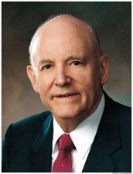
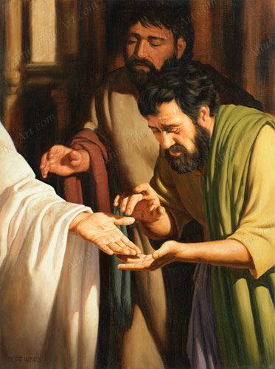
The 11 Apostles See the Lord
“We think of Thomas as one who had traveled and talked with the Master, and who had been chosen by him. Inwardly we wish that Thomas could have turned toward the future with confidence in the things which were not then visible, instead of saying in effect, ‘To see is to believe.’ …
“A week later, the disciples were again together in the same house in Jerusalem. This time Thomas was with them. The door was closed, but Jesus came and stood in the midst of them and said, ‘… Peace be unto you.
“‘Then saith he to Thomas, Reach hither thy finger, and behold my hands; and reach hither thy hand, and thrust it into my side: and be not faithless, but believing.’”
We will be blessed if we choose to believe in Jesus Christ even when we cannot see Him
Jeff Ward
Thomas Was Devoted to Jesus:
Then said Thomas, which is called Didymus, unto his fellow disciples, Let us also go, that we may die with him.
John 11:16
John 20:26-27
(12)

Slide 33
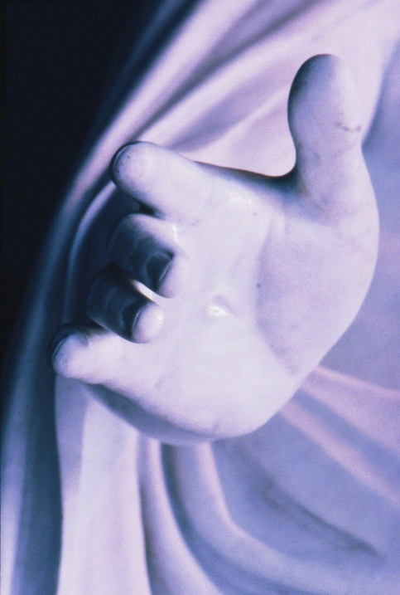
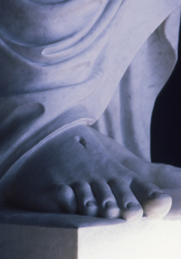
Retaining His Wounds
Several possible reasons why Jesus Christ has retained the wounds of the Crucifixion in His hands, feet, and side:
To substantiate His literal, physical Resurrection
To testify that He is the Messiah of whom the prophets wrote
To identify Himself as the Messiah to the Jews in the last days and to assure the faithful of His power to save and bless
John 20:27; 3 Nephi 11:11-17; Zechariah 12:9-10; D&C 45:51-52; D&C 6:34-37
(1)

Slide 34
“Even though the power of the Resurrection could have—and undoubtedly one day will have—completely restored and made new the wounds from the crucifixion, nevertheless Christ chose to retain those wounds for a purpose, including for his appearance in the last days when he will show those marks and reveal that he was wounded ‘in the house of [his] friends’.
“The wounds in his hands, feet, and side are signs that in mortality painful things happen even to the pure and the perfect, signs that tribulation is not evidence that God does not love us. It is a significant and hopeful fact that it is the wounded Christ who comes to our rescue. He who bears the scars of sacrifice, the lesions of love, the emblems of humility and forgiveness is the Captain of our Soul.
That evidence of pain in mortality is undoubtedly intended to give courage to others who are also hurt and wounded by life, perhaps even in the house of their friends.”
(12)

Slide 35
Sources;
Suggested Hymn: #200 Christ the Lord is Risen Today
Videos:
Jesus is Resurrected
He is Risen
The Risen Lord Appears to the Apostles
Blessed Are They Who Have Not Seen, and Yet Have Believed (2:29)
General Conference Montage(1:58)
https://www.youtube.com/watch?v=JTBOp2cNygU
New Testament Institute Student Manual Chapter 28
Adam Clarke Commentary
Elder Joseph B. Wirthlin (“Sunday Will Come,” Ensign or Liahona, Nov. 2006, 29–30).
Elder James E. Talmage Jesus the Christ p. 264, 638, 672, 682
President David O. McKay (Reach Up for the Light [Salt Lake City: Deseret Book Co., 1990], 136.)
President James E. ("Woman, Why Weepest Thou?" Ensign, Nov. 1996, 52)
Bruce R. McConkie (The Mortal Messiah, 4 vols. [1979–81], 4:264) and (The Mortal Messiah: From Bethlehem to Calvary, 4 vols. [Salt Lake City: Deseret Book Co., 1979-1981], 4: 265
Elder Theodore M. Burton ("Neither Cryptic Nor Hidden," Ensign, May 1977, 28)
Richard D. Draper, "The Reality of the Resurrection," Ensign, Apr. 1994, 39
Gospeldoctrine.com
Pres. Howard W. Hunter (in Conference Report, Oct. 1962, 22–23).
Elder Jeffrey R. Holland (Christ and the New Covenant[1997], 258–59).
Presentation by ©http://fashionsbylynda.com/blog/

Slide 36
Event | Matthew | Mark | Luke | John
Women Find the Tomb Opened | 28:1 | 16:2-4 | 24:1, 2 | 20:1
Mary Magdalene Runs Immediately to Tell the Apostles |  |  |  | 20:2
Peter and John Witness the Empty tomb |  |  | 24:12 | 20:3-10
Jesus Appears to Mary Magdalene |  | 16:9-11 |  | 20:11-18
Jesus Appears to 10 Apostles and Those with Them |  | 16:14 | 24:36-48 | 20:19-23
Jesus Again Appears to Apostles including Thomas |  |  |  | 20:24-29
The Size of the Stone John 20:1:
The entrance of a Jewish tomb was quite small, so the stone needed to cover the opening would only be 4-6’ in diameter, and approximately 1’ thick. How much would such a stone weigh? Depending on the type of stone used, it could weigh between 1-2 tons (2000-4000 pounds). This is quite heavy, but two men could move it into place (Mt 27:60; John 19:38-42). The more difficult task was removing the stone.
Generally speaking, the rolling stone was set inside a groove in front of the entrance, and secured from falling over by a stone wall that stood in front of tomb opening (the rolling stone was sandwiched between the tomb entrance and stone wall as the pictures below illustrate). Often, the groove was not level, but slightly sloped. To close the tomb, the stone would be rolled down the groove at a decline and come to rest in front of the entrance. To open the tomb, the stone would have to be rolled up the groove at an incline.
Given the structure of such tombs, it would not have been possible for Jesus to simply push the stone over from the inside of the tomb. He would have to roll the 2000+ pound stone back up the groove without having anything to grip. Such a feat would not be possible for one healthy man, yet alone a man who had just been beaten (and hung on a cross) by the Romans.
The Size of the Stone Covering Jesus’ Tomb
Posted by Theosophical Ruminator
The Herodian family tomb west of the Old City provides an idea of what Joseph of Arimathea's tomb would have looked like

Slide 37
Idle Tales Luke 24:11:
"Perhaps the apostles should not be unduly criticized for not believing that Jesus, having been crucified and buried in a tomb, had come back to earth as a glorified being. In all human experience, this had never happened before. This was completely unprecedented. This was a different experience from the raising of Jairus's daughter (Mark 5:22-24, 35-43), the young man of Nain (Luke 7:11-15), or Lazarus (John 11:1-44). They all died again. Jesus, however, became a resurrected being. He would never die again. So it was that to the apostles the story of Mary Magdalene and the other women who witnessed the resurrection 'seemed to them as idle tales, and they believed them not.' ("Luke 24:11Luke 24:11.)
Mary: John 20:11:
“No woman should question how the Savior values womanhood. The grieving Mary Magdalene was the first to visit the sepulchre after the Crucifixion, and when she saw that the stone had been rolled away and that the tomb was empty, she ran to tell Peter and John. The two Apostles came to see and then went away sorrowing. But Mary stayed. She had stood near the cross [see Matthew 27:56; Mark 15:40; John 19:25]. She had been at the burial [see Matthew 27:61; Mark 15:47]. And now she stood weeping by the empty sepulchre [see John 20:11]. There she was honored to be the first mortal to see the risen Lord.” President James E. Faust (“Woman, Why Weepest Thou?” Ensign, Nov. 1996, 54).
Jesus Spoke to Mary Calling Her by Her Name John 20:16:
"Jesus then spoke to her but one word-and the tenderness with which the word was uttered revealed to her his identity...But only one word was spoken to the woman and she no longer supposed him to be the gardener. 'Jesus saith unto her, Mary.'
"The burden of a saddened heart was lifted when she heard her name thus spoken. Many times before she had thus been addressed by her Lord, but never before had her name been spoken by immortal lips. It was a woman's name, not the name of a disciple, that the resurrected Son of God first uttered. To him Mary was the most favored of names. It was not only the name of the first woman to whom Christ spoke as the risen Lord. It was the name of the sainted mother who had given him birth; it was the name of the sister of Lazarus who had seen him restore life to her brother; it was the name of the mother of James and John; and many others whom he loved no doubt bore the name which he had spoken to the woman in the garden near the place of his burial." Matthew Cowley (Matthew Cowley Speaks [Salt Lake City: Deseret Book Co., 1954], 323.)
*Neatly Folded Napkin John 20:7
The head covering over the body of Jesus Christ in the grave was a neatly “folded napkin.” It goes on to say that among Jews of the time a master would let his servants know whether he was finished eating or coming back to the table by the way he left his napkin. If he tossed it aside, he was finished. If he folded it, he was not finished and would return. The hidden message in the story is that by laying his “napkin” aside and neatly folded Jesus was saying he was coming back.
https://www.truthorfiction.com/folded-napkin/
The folded napkin had to do with the Master and Servant, and every Jewish boy knew this tradition.
When the servant set the dinner table for the master, he made sure that it was exactly the way the master wanted it. The table was furnished perfectly, and then the servant would wait, just out of sight, until the master had finished eating, and the servant would not dare touch that table, until the master was finished. Now if the master was done eating, he would rise from the table, wipe his fingers, his mouth, and clean his beard, and would wad up that napkin and toss it onto the table. The servant would then know to clear the table. For in those days, the wadded napkin meant, 'I'm done'. But if the master got up from the table, and folded his napkin, and laid it beside his plate, the servant would not dare touch the table, because..........
The folded napkin meant, 'I'm coming back!‘
http://www.propheticrevelation.net/misc/the_folded_napkin.htm
Touch Me Not John 20:17:
"One may wonder why Jesus had forbidden Mary Magdalene to touch Him, and then, so soon after, had permitted other women to hold Him by the feet as they bowed in reverence. We may assume that Mary's emotional approach had been prompted more by a feeling of personal yet holy affection than by an impulse of devotional worship such as the other women evinced. Though the resurrected Christ manifested the same friendly and intimate regard as He had shown in the mortal state toward those with whom He had been closely associated, He was no longer one of them in the literal sense. There was about Him a divine dignity that forbade close personal familiarity. To Mary Magdalene Christ had said: 'Touch me not; for I am not yet ascended to my Father.' If the second clause was spoken in explanation of the first, we have to infer that no human hand was to be permitted to touch the Lord's resurrected and immortalized body until after He had presented Himself to the Father. It appears reasonable and probable that between Mary's impulsive attempt to touch the Lord, and the action of the other women who held Him by the feet as they bowed in worshipful reverence, Christ did ascend to the Father, and that later He returned to earth to continue His ministry in the resurrected state.” Elder James E. Talmage (Jesus the Christ, p. 682.)

Slide 38
I Am Not Yet Ascended to My Father John 20:17:
"...we as members of the Church also stand in jeopardy if we do not do our temple work. Much of our time is taken up with the mundane details of everyday living, which must be done, of course; but those who are members of His kingdom at this critical time should endeavor to give much time and effort to this important work.
"These things of eternity pertaining to the spirit world and the hereafter were on the mind of the Savior when he was crucified. This is reflected in his statement to the repentant thief, which has puzzled many people: '...To day shalt thou be with me in paradise.'
"You will remember also that when the woman came to the tomb of the buried Savior, the Savior was not in his tomb. When he met her in the garden, he said, 'Touch me not; for I am not yet ascended to my Father [in heaven]: but ... I ascend unto my Father, and your Father; and to my God, and your God.' (John 20:17.) He had still not been to see his Heavenly Father, so he hadn't gone directly to the heaven we think of. He had gone some other place." ("The Things of Eternity-Stand We in Jeopardy?" President Spencer W. Kimball Ensign, Jan. 1977, 5)
Thomas John 20:28-29:
“The record does not indicate that Thomas accepted this invitation—this loving rebuke by the Lord. Thomas could see the print of the nails and the wound of the spear. He only answered: ‘… My Lord and my God’ [John 20:28]. Now he believed, but Thomas had missed the highest form of faith.
“‘Jesus saith unto him, Thomas, because thou hast seen me, thou hast believed: blessed are they that have not seen, and yet have believed’ [John 20:29].
“This occurrence stands as one of the great lessons of all times. Thomas had said, ‘To see is to believe,’ but Christ answered: ‘To believe is to see’” Pres. Howard W. Hunter (in Conference Report, Oct. 1962, 22–23).
“Have you not heard others speak as Thomas spoke? ‘Give us,’ they say, ‘the empirical evidence. Prove before our very eyes, and our ears, and our hands, else we will not believe.’ This is the language of the time in which we live. Thomas the Doubter has become the example of men in all ages who refuse to accept other than that which they can physically prove and explain—as if they could prove love, or faith, or even such physical phenomena as electricity.”
President Hinckley then quoted John 20:26–29 and continued: “To all within the sound of my voice who may have doubts, I repeat the words given Thomas as he felt the wounded hands of the Lord: ‘Be not faithless, but believing.’ Believe in Jesus Christ, the Son of God, the greatest figure of time and eternity” President Spencer W. Kimball (“Be Not Faithless,” Ensign, May 1978, 59).
Jesus Appears to Other Women Matthew 28:9-10:
"Does the Lord respect women? Do women matter to the Lord? The answer is yes-a resounding yes!...Of this you may be certain: The Lord especially loves righteous women-women who are not only faithful but filled with faith, women who are optimistic and cheerful because they know who they are and where they are going, women who are striving to live and serve as women of God." Elder M. Russell Ballard ("Women of Righteousness", Ensign, Apr. 2002, 66)
No Doubt John 20:29-31:
“Can anyone doubt the veracity of that account? No event of history has been more certainly confirmed. There is the testimony of all who saw and felt and spoke with the risen Lord. He appeared on two continents in two hemispheres and taught the people before His final ascension. Two sacred volumes, two testaments speak of this most glorious of all events in all of human history. But these are only accounts, the faithless critic says. To which we reply that beyond these is the witness and the testimony, borne by the power of the Holy Ghost, of the truth and validity of this most remarkable event. Through the centuries untold numbers have paid with the sacrifice of their comforts, their fortunes, their very lives for the convictions they carried in their hearts of the reality of the risen, living Lord.
“And then comes the ringing testimony of the Prophet of this dispensation that in a wondrous theophany he saw and was spoken to by the Almighty Father and the Risen Son. That vision, glorious beyond description, became the wellspring of this The Church of Jesus Christ of Latter-day Saints” President Gordon B. Hinckley (“This Glorious Easter Morn,” Ensign, May 1996, 67).
Receiving the Holy Ghost John 20:22:
“They thus received, but did not at that moment actually enjoy, the gift of the Holy Ghost. … The gift of the Holy Ghost is the right, based on faithfulness, to receive the constant companionship of this member of the Godhead; and this gift is conferred by the laying on of hands following baptism. This gift offers certain blessings provided there is full compliance with the law involved; everyone upon whom the gift is bestowed does not in fact enjoy or possess the offered gift. In the case of the apostles the actual enjoyment of the gift was delayed until the day of Pentecost. (Acts 2.)” Elder Bruce R. McConkie (Doctrinal New Testament Commentary, 1:857).

Slide 39
Order of Appearances of the Resurrected Savior | Scripture
To Mary Magdalene, near the sepulchre | Mark 16:9, 10 John 20:14
To other women, somewhere between the sepulchre and Jerusalem | Matthew 28:9
To two disciples on the road to Emmaus | Mark 16:12 Luke 24:13
To Peter, in or near Jerusalem | Luke 24:34 1 Corinthians 15:5
To ten of the apostles and others at Jerusalem | Luke 24:36 John 20:19
To the eleven apostles at Jerusalem --Thomas | Mark 16:14 John 20:26
To the apostles at the Sea of Tiberias, Galilee | John 21
To the eleven apostles on a mountain in Galilee | Matthew 28:16
To five hundred brethren at once | 1 Corinthians 15:6
To James (note: no record of this manifestation is made by the Gospel-writers) | 1 Corinthians 15:7
To the eleven apostles at the time of the ascension, Mount of Olives, near Bethany | Mark 16:19 Luke 24:50-51
To the Nephites in the Americas | 3 Nephi 10-28

Slide 40
*Something of Interest
Women VS Men: Women are more soulful than men. While men may excel in physical prowess, women are far ahead when it comes to spiritual strength. Women are more sensitive to matters of the soul, more receptive to ideas of faith, more drawn to the divine than men. The feminine soul has an openness to the abstract and a grasp of the intangible that a male soul can only yearn for. This is why G‑d told Abraham, the first Jewish man, "Whatever Sarah your wife tells you, listen to her voice." She was the greater prophet, her soul more intuitive than his.
The Torah gives men more physical mitzvahs to tame the body and give the soul extra power. Women don't need this help, because although men can jump higher in the air, women can reach higher into the heavens.
http://www.chabad.org/library/article_cdo/aid/2576222/jewish/The-Gender-Gap.htm
"A mountain of Gallup survey data attests to the idea that women are more religious than men, hold their beliefs more firmly, practice their faith more consistently, and work more vigorously for the congregation," Gallup wrote.
Among the reasons women tend to be more religious, he says:
Mothers have tended to spend more time raising children, which often means overseeing their involvement in church activities.
Though two-income households are more common today, in the past women often had more flexible daily schedules, permitting more church involvement during the week.
Women tend to be more open about sharing personal problems and are more relational than men. Other Gallup research shows a higher proportion of women than men say they have a "best friend" in their congregation, he wrote.
Lastly, Gallup argued, "More so than men, women lean toward an empirical [depending on experience or observation] rather than a rational basis for faith.“
http://www.livescience.com/7689-women-religious-men.html
…countless studies have shown that women are more likely to be religious than men. Now, that doesn’t mean that every study shows such a difference, or that the difference is always significant. Nor does it mean that the difference is discernable on every measure of religiosity/secularity -- for example, orthodox Jewish men are more likely to regularly attend synagogue than orthodox Jewish women.
Consider, for example, that according to the American Religious Identification Survey, men currently make up 58% of Americans who claim “no religion,” 70% of Americans who self-identify as atheist, and 75% of those who self identify as agnostic. Or consider the Pew Forum’s Religious Landscape national survey, which found that 86% of American women claim to be religious affiliated, but only 79% of American men claim as much; 77% of women believe in God with absolute certainly, but only 65% of men do; 66% of women pray daily, but only 49% of men do; 63% of women say that religion is very important in their lives, but only 49% of men say as much; 44% of women attend religious services on a weekly basis, but only 34% of men do. The differences may or may not be significant – social science gets fuzzy here -- but they are consistent.
In short, on just about whatever measures one uses to assess religiosity – frequency of prayer, belief in God, church attendance, or self-identification – women are more likely than men in the United States to be religious.
…are these averages and percentages universal? Do we find similar differences in other countries around the world?
Yes.
To see the article further: https://www.psychologytoday.com/blog/the-secular-life/201409/why-are-women-more-religious-men
BYU Religious Study Center Gender and Religious Devotion
The Religiosity of Mormon Men and Women through the Life Cycle
Small Excerpt:
Mormon men and women are quite different in the way they evaluate their own religious devotion. In the United States and many other societies, women are typically more religious than men. A recent Gallup poll (1993, pp. 43, 55) found that 46 percent of American women attended religious services weekly, while only 39 percent of men did so. In addition, 66 percent of women and only 48 percent of men said that religion was very important in their lives.
Are LDS people different? Religious devotion among LDS people generally followed the same pattern of other Americans, with some interesting variations, as the data in table 10.1 demonstrate. Mormon women were typically slightly more religious than Mormon men.
For Further Information:
https://rsc.byu.edu/archived/latter-day-saint-social-life-social-research-lds-church-and-its-members/10-religiosity

Slide 41
Monsieur James Tissot
5 October 1836 – 8 August 1902
A French painter
Monsieur James Tissot is now a man of sixty-two, yet his vigor of mind and body is remarkable. One might al­most speak of his vigor of soul, for the spiritual quality in this distinguished artist is one of his most striking characteristics. Not only is he deeply religious in his daily life, but he is something beyond that: he is a mystic and seer of visions.
But the Tissot of today, the man of soli­tude and meditation, the reverent worshiper, the almost ecstatic believer in divine mys­teries, is a very different Tissot from the one who left Paris twelve years ago to undertake a great work in Palestine. Up to that time Tissot had been known as an artist of unusual power and versatility, but an artist who was also much of a worldling. He was a traveler and a cosmopolitan; he was at home in many cities. Ten years of his life were spent in London, where he earned some millions of francs from his paintings and where his house was famous among grand establishments for the beautiful things within and without it. This was the house that later passed into the hands of Tissot's friend Alma-Tadema.
The cause of this sudden change in a man of mature years was sought for eagerly by Tissot's friends. There was much gossip about him in Paris and London. It was rumored that he had entered a monastery. There was no doubt that he went to prayer frequently, that he shunned the busy and frivolous paths once trodden by him with pleasure. People who had known him well saw little of him now. But why this change had come on, or just what it meant, remained in the realm of conjecture. It is sufficient for us to know that the death of a very dear friend about this time had much to do with turning M. Tissot's thoughts in a new direction. He saw life more sadly and more seriously. He felt himself alone in the world, for he had never married, and with ebbing fires of the body, the soul fires began to burn more brightly. The worship of God was no longer a subject of speculation, but a real thing that had come into his heart. And now in the East a star of guidance shone out clear, a sign in the heavens beckoning this man, calling him to Jerusalem, and he heard the call and answered it. Tissot the artist became Tissot the pilgrim.
Ten years to do 500 paintings: so stands the record. And although these paintings, measured by inches, are not so very large, yet they present such variety of scene and incident, such knowledge of antiquity, such faithfulness in smallest details, such understanding of Oriental character, such convincingness in the setting forth of Christ's 'life, and withal such power of the imagina­tion and spiritual insight, that one would think twenty years all too short for the task. What other artist ever painted one picture a week with merit in it and kept up that aver­age for 500 weeks? Nor does this take ac­count of hundreds of sketches done in prep­aration, nor of hundreds of initial letters and chapter endings and delicate bits of page decoration (two or three hours for each), done by this indefatigable man for the great French edition of his work just pub­lished. There was needed strength of soul as well as ar­tistic power for this business!
“To do my work best I must be able to think and feel quite alone, I must have solitude. So, for weeks at a time, I would withdraw from Paris to a wonderful lonely valley, shaped like a vast amphitheater, where the wind blows always and a little river runs. This is one of nature’s worship spots, where reverence is in the air. Hun­dreds of years ago godly men chose this place for a monastery, and on the ruins of their building I have made my home for con­templation. Ah, the days that I have spent there listening to the wind sigh and watching the river flow!“
Originally published in McClure’s Magazine in March of 1899.
For further read: http://www.digitalhistoryproject.com/2012/05/artist-james-j-tissot-his-paintings-of.html
Jacques Tissot was born in the port town of Nantes, France and spent his early childhood there. His father, Marcel Théodore Tissot, was a successful drapery merchant. His mother, Marie Durand, assisted her husband in the family business and designed hats. A devout Catholic, Tissot's mother instilled pious devotion in the future artist from a very young age. Tissot's youth spent in Nantes likely contributed to his frequent depiction of shipping vessels and boats in his later works. The involvement of his parents in the fashion industry is believed to have been an influence on his painting style, as he depicted women's clothing in fine detail. By the time Tissot was 17, he knew he wanted to pursue painting as a career. His father opposed this, preferring his son to follow a business profession, but the young Tissot gained his mother's support for his chosen vocation. Around this time, he began using the given name of James. By 1854 he was commonly known as James Tissot; he may have adopted it because of his increasing interest in everything English. Wikipedia

